Slide 1


gradle.build

Slide 2
Concepts Used
> High Quality Solutions For Optimisation problems
> Solutions
> Dijkstra's Algorithm
> Genetic Algorithms
> Travel Sales Man
> Microbial Genetic Algorithm
> Match Phrase
> Double DQN

Slide 3
Innovations
> Initialisation of parameters
> Computing those parameters using Deep Learning
> Get the desired Results

Slide 4
Road to Market
> Use cases
Let machine do all the hard-work
Build something more complex than just using Rest API
> Feasibility and Scalability
Nothing is paid, as we build our own algorithms.
Can be easily computed and deployed in TomCat, Apache Servers.

Slide 5
Tech Stack
> Language- Python
> Libraries – tensorflow, numpy, pandas, matplotlib

Slide 6
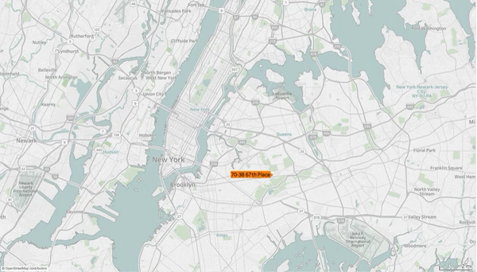
Demo

Slide 7
THANK YOU

