Slide 1

ALIGHT SOLUTIONS | GLOBAL OPERATIONS ENABLEMENT
Mastering VLOOKUP & HLOOKUP in Excel
A Step-by-Step, Visual Operational Guide for Backend Processing Teams
PRESENTER
SUBHRA SINGH
Quality Analyst | Alight Solutions
WHAT YOU WILL LEARN TODAY
✔ The 4 simple ingredients in every lookup formula
✔ VLOOKUP: Scanning vertical participant rosters
✔ HLOOKUP: Scanning horizontal rating matrices
✔ The #1 Golden Rule (Leftmost column requirement)
✔ Troubleshooting #N/A, #REF!, and range lock fixes
Alight Solutions • Internal Training Material • Confidential
1 / 10

Slide 2

ALIGHT SOLUTIONS | BACKEND OPERATIONS TRAINING
Why Lookups Matter: Eliminating Manual Matching in Backend Ops
THE MANUAL WAY (SLOW & RISKY)
✖ Ctrl + F Searching:
Manually searching ID-by-ID across 5,000 participant rows takes hours.
✖ Copy-Paste Fatigue:
Repetitive copy-pasting causes accidental misalignment of employee plans.
✖ High Error Rate:
One misplaced row can lead to incorrect benefit deductions or missed SLAs.
✖ No Scalability:
Cannot easily re-run or refresh when new monthly files arrive from clients.
THE LOOKUP WAY (INSTANT & 100% ACCURATE)
✔ Instant Execution:
Excel matches thousands of rows in under 2 seconds automatically.
✔ Zero Typing Mistakes:
Exact match ensures the correct participant plan is pulled every single time.
✔ Audit-Ready & Repeatable:
Formulas update instantly when source data is refreshed or audited.
✔ Two Core Flavors:
VLOOKUP for vertical columns | HLOOKUP for horizontal matrices.
THE GOLDEN DIRECTION RULE:
• VLOOKUP = Vertical Lookup -> Scans DOWN Columns (95%+ of backend spreadsheets).
• HLOOKUP = Horizontal Lookup -> Scans ACROSS Rows (used for bonus tiers, tax brackets, and rate cards).
Alight Solutions • Internal Training Material • Confidential
2 / 10

Slide 3
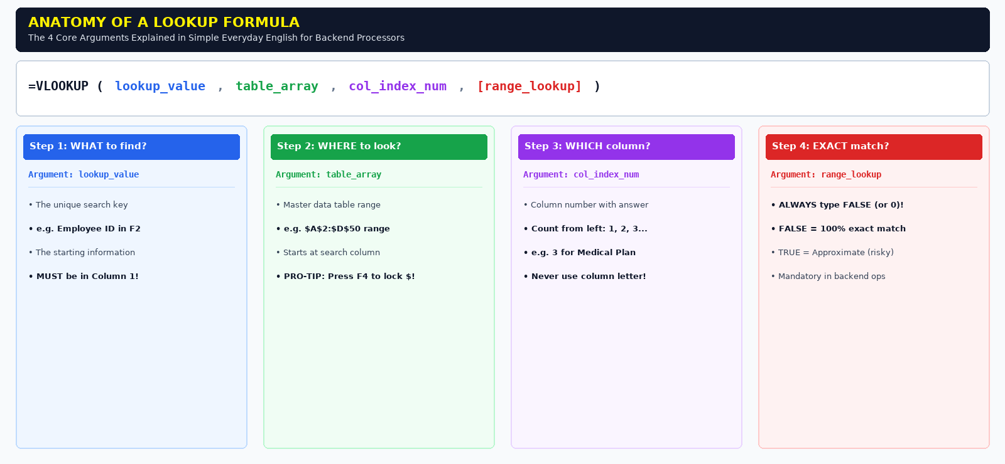
ALIGHT SOLUTIONS | BACKEND OPERATIONS TRAINING
Anatomy of the Formula: The 4 Core Ingredients Explained
Alight Solutions • Internal Training Material • Confidential
3 / 10

Slide 4
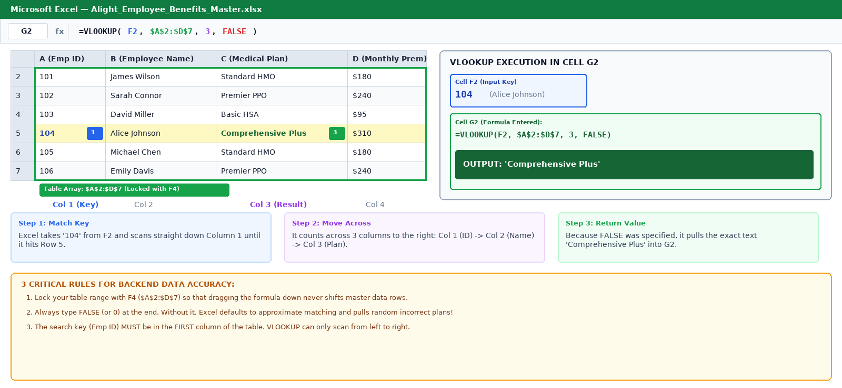
ALIGHT SOLUTIONS | BACKEND OPERATIONS TRAINING
Step-by-Step Guide: Using VLOOKUP on Employee Rosters
Alight Solutions • Internal Training Material • Confidential
4 / 10

Slide 5
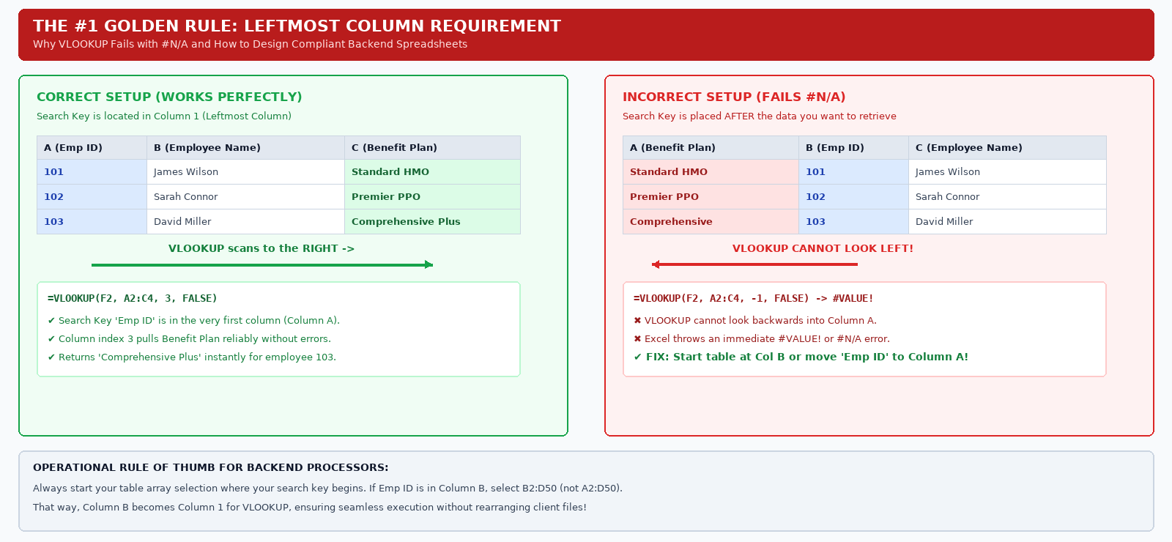
ALIGHT SOLUTIONS | BACKEND OPERATIONS TRAINING
The #1 Golden Rule of VLOOKUP: The Leftmost Column Constraint
Alight Solutions • Internal Training Material • Confidential
5 / 10

Slide 6
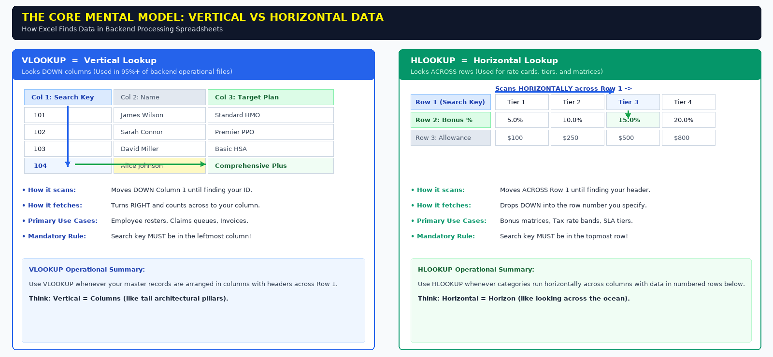
ALIGHT SOLUTIONS | BACKEND OPERATIONS TRAINING
Understanding HLOOKUP: When Data Runs Horizontally in Rows
Alight Solutions • Internal Training Material • Confidential
6 / 10

Slide 7
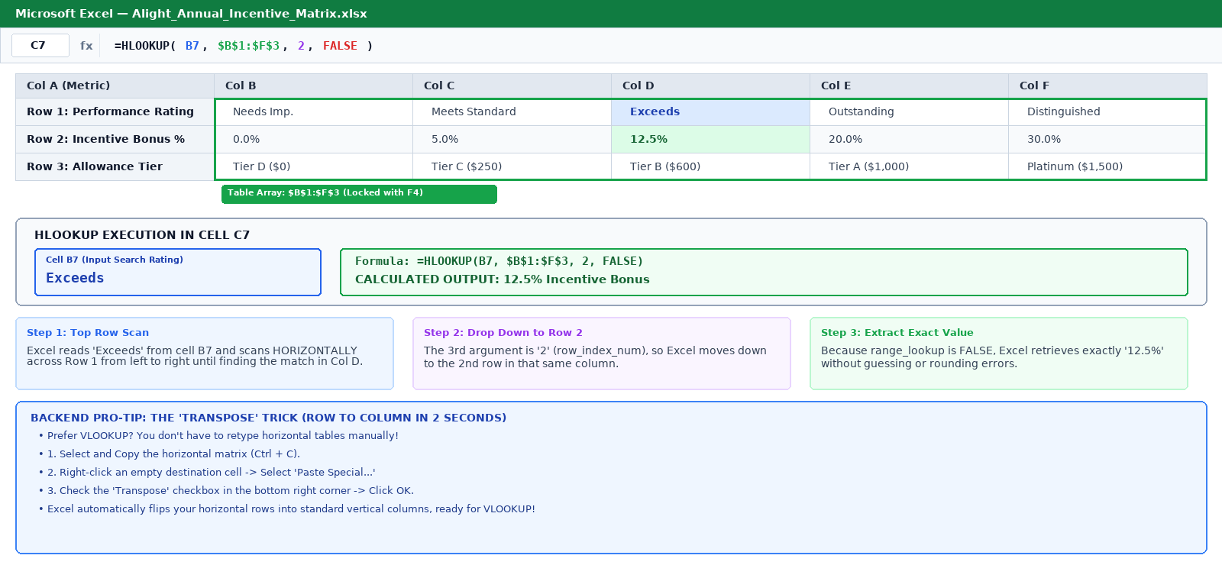
ALIGHT SOLUTIONS | BACKEND OPERATIONS TRAINING
Step-by-Step Guide: Using HLOOKUP on Rating & Bonus Matrices
Alight Solutions • Internal Training Material • Confidential
7 / 10

Slide 8
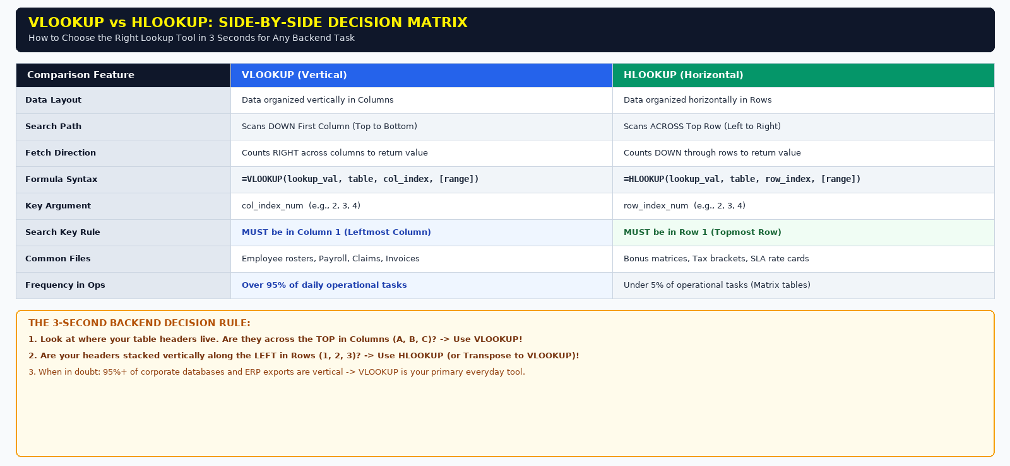
ALIGHT SOLUTIONS | BACKEND OPERATIONS TRAINING
VLOOKUP vs HLOOKUP: Side-by-Side Quick Decision Guide
Alight Solutions • Internal Training Material • Confidential
8 / 10

Slide 9
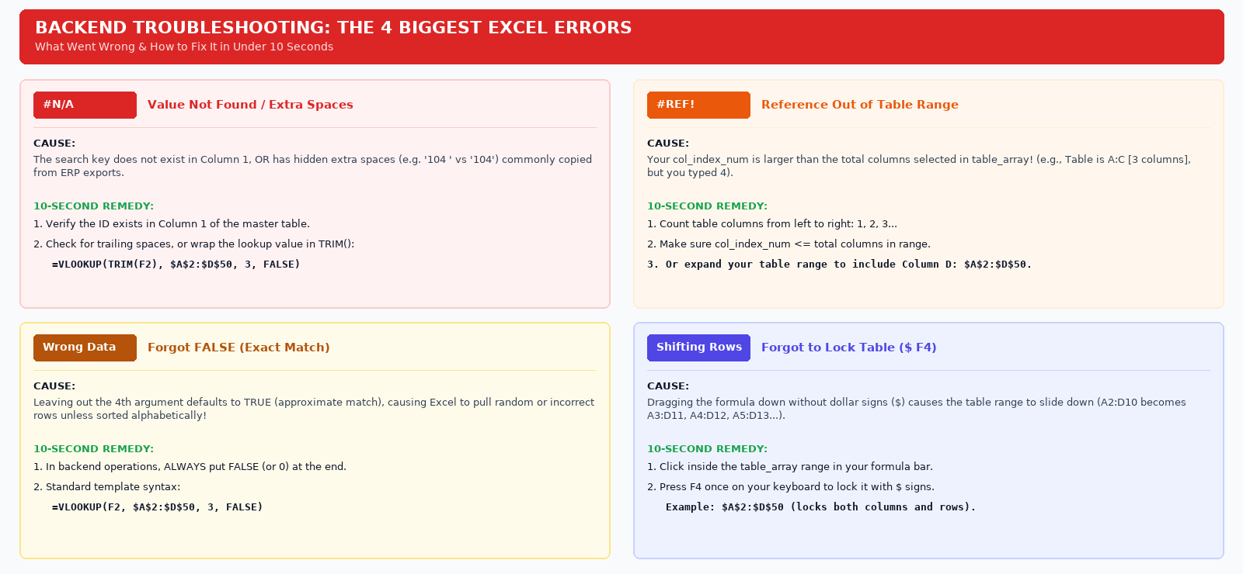
ALIGHT SOLUTIONS | BACKEND OPERATIONS TRAINING
Backend Troubleshooting: The 4 Biggest Excel Errors & Fixes
Alight Solutions • Internal Training Material • Confidential
9 / 10

Slide 10
ALIGHT SOLUTIONS | BACKEND OPERATIONS TRAINING
Quality Checklist & Operational Best Practices Summary
THE 5-POINT BACKEND PROCESSOR CHECKLIST
✔ 1. Lock Master Tables with F4 ($ signs)
Always verify your table array is locked ($A$2:$D$50). Dragging unlocked formulas shifts rows and causes valid records to throw #N/A errors.
✔ 2. Confirm Search Key is in Column 1
For VLOOKUP, your search key must sit in the first column of the selection. If key is in Column B, start your selection at B2:D50.
✔ 3. Always Finish with FALSE (or 0)
Never omit the 4th argument. In backend operations, approximate match defaults to TRUE and pulls incorrect participant records!
✔ 4. Clean Trailing Spaces with TRIM()
If an ID clearly exists but returns #N/A, hidden ERP spaces are usually to blame. Wrap the key in TRIM(F2) to sanitize it automatically.
✔ 5. Check for Duplicate Search Keys
VLOOKUP always returns the first matching occurrence it finds. Ensure your search key is truly unique across the dataset.
TRAINING & OPERATIONAL SUPPORT
Subhra Singh
Quality Analyst | Alight Solutions
─────────────────────────────────
ADDITIONAL RESOURCES:
• Video Reference: Kevin Stratvert (Ex-Microsoft)
• Weekly 1-on-1 Office Hours for Team Members
Alight Solutions • Internal Training Material • Confidential
10 / 10

