Slide 1

MICROSOFT EXCEL · LOOKUP FUNCTIONS
VLOOKUP & HLOOKUP
Find a value in your data, and bring back what belongs with it. Two Excel functions, explained step by step with annotated screenshots.
Prepared for
Backend Processing Team
Presenter
SUBHRA SINGH
September 2026
Source tutorial: “VLOOKUP vs HLOOKUP Excel Functions, Simplified in 5 mins!”
Notes:
Welcome. Today we cover the two Excel lookup functions the team asks about most: VLOOKUP and HLOOKUP. By the end you will be able to build both from scratch, know which one to reach for, and fix the #N/A error when it appears. No prior formula experience needed.

Slide 2

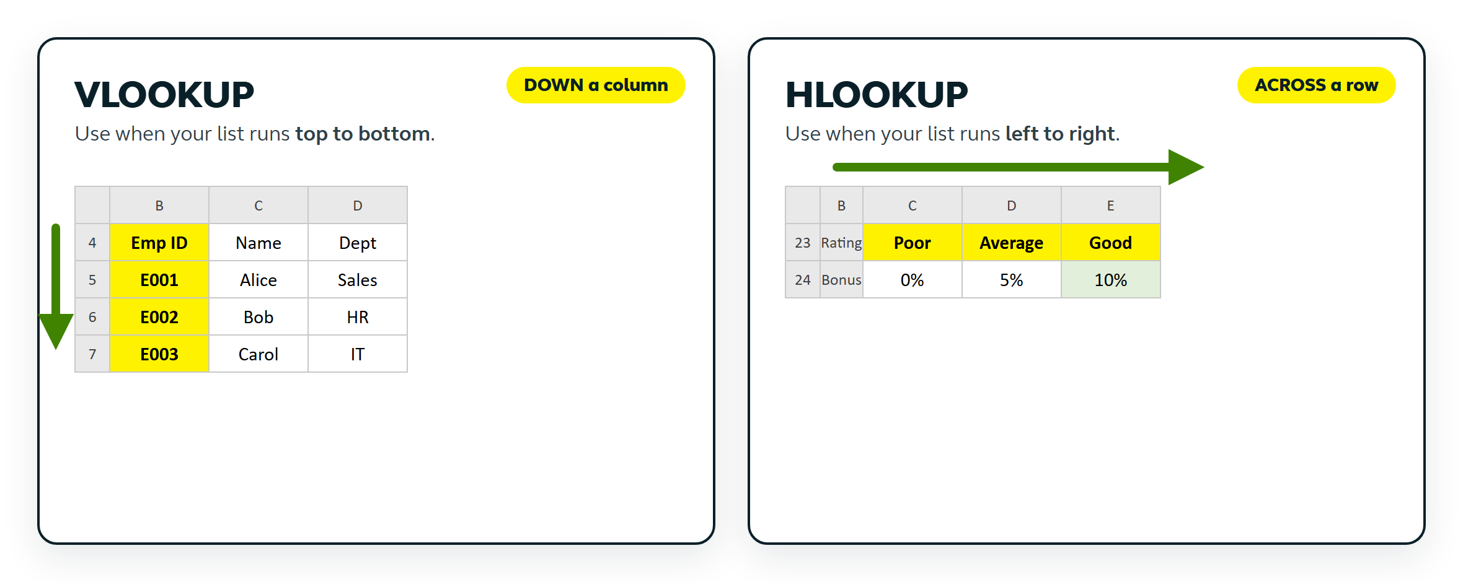
THE BIG IDEA
Same question, two directions
A lookup answers one thing: “find this value, and bring back what belongs to it.” The only real difference between the two functions is the direction Excel travels.
VLOOKUP & HLOOKUP | Backend Processing Team | Alight
2
Notes:
Frame the whole session with this one picture. VLOOKUP reads DOWN a column; HLOOKUP reads ACROSS a row. Same idea, rotated 90 degrees. If they remember nothing else, they should remember which way each one looks.

Slide 3
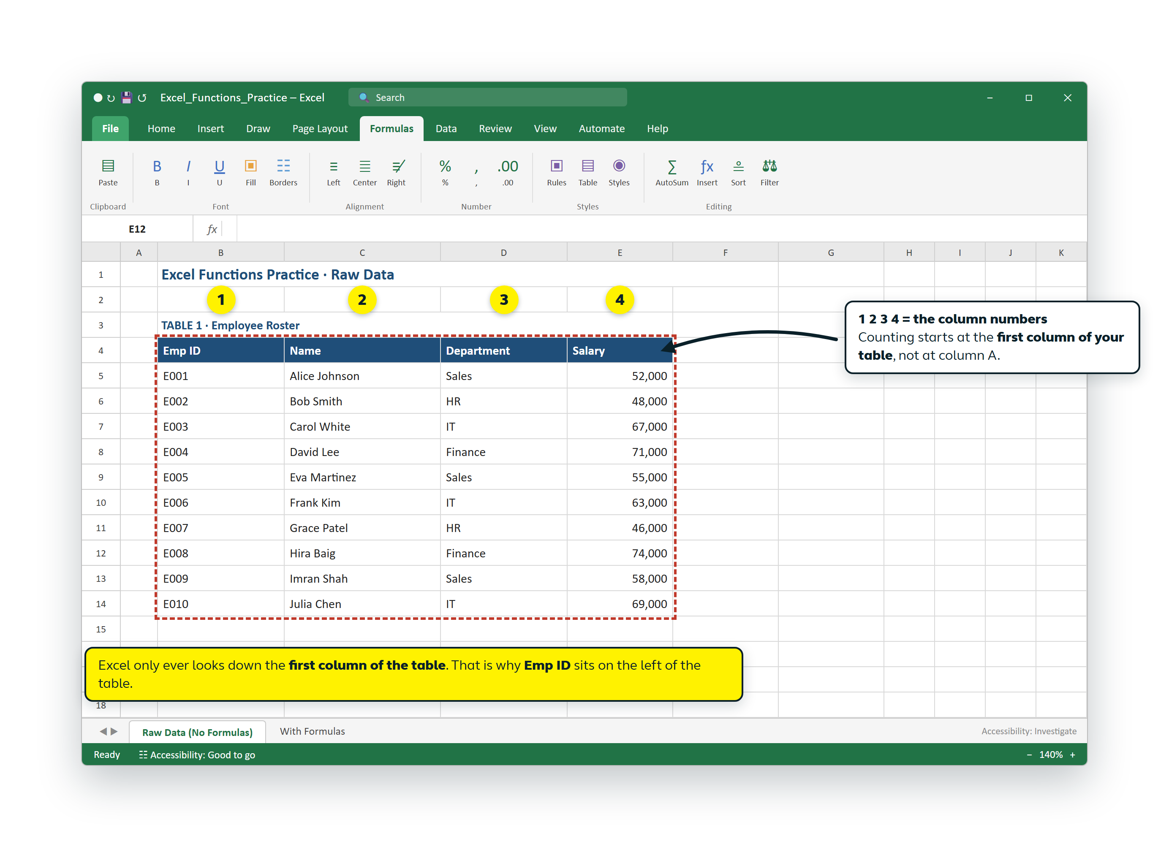
0
STEP 0 · BEFORE YOU START
Get the table right first
Excel can only look things up if your data is laid out the way it expects.
1
A matching column on the left
This is the piece of information you already know (here: Emp ID). Excel only ever searches this first column.
2
The answer columns to its right
Name, Department, Salary. These are what the formula brings back.
3
One header row
Clear headers make the formula easy to read and easy to re-use.
The column numbers in the formula (1 2 3 4) are counted from the FIRST column of the table, not from column A.
VLOOKUP & HLOOKUP | Backend Processing Team | Alight
3
Notes:
Spend a moment here. This is the step people skip. Two requirements: the matching column must be on the LEFT of the table, and the values you want must be to its RIGHT. Point at the yellow 1 2 3 4 badges: the column numbers count from the first column of the table, so Emp ID is 1, Name is 2, Department is 3, Salary is 4.

Slide 4
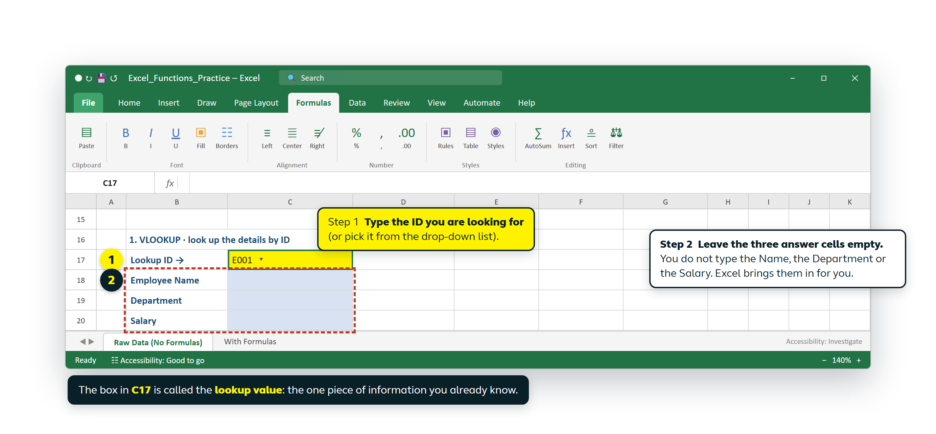
1
VLOOKUP · PART 1
Tell Excel what you are looking for
① Type the ID you already know
② Leave the answer cells empty
③ Or pick it from a drop-down
VLOOKUP & HLOOKUP | Backend Processing Team | Alight
4
Notes:
Step 1 is just typing what you already know: the employee ID, E001. Look at the green dashed box. The three answer cells stay completely empty. This is the part that surprises people. You never type the name, the department or the salary; the formula fetches them. The yellow box in C17 is called the lookup value.

Slide 5
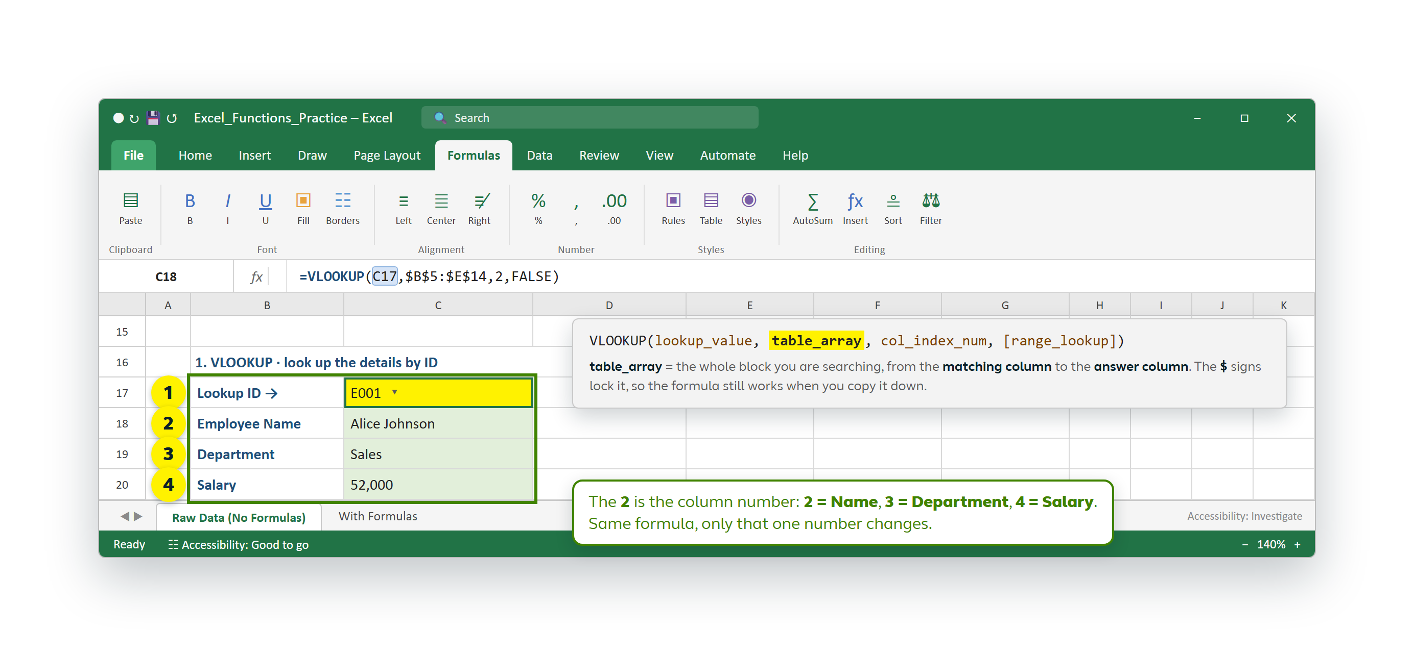
2
VLOOKUP · PART 2
Build the formula, one comma at a time
=VLOOKUP( C17 , $B$5:$E$14 , 2 , FALSE )
1 = what to find · 2 = where to look · 3 = which column · 4 = exact match
VLOOKUP & HLOOKUP | Backend Processing Team | Alight
5
Notes:
Walk them through the four arguments in order. C17 is what we are looking for. $B$5:$E$14 is the whole table, from the matching column to the last answer column. The dollar signs lock it so it still works when copied down. The 2 is the column number: change it to 3 for Department and 4 for Salary. FALSE means exact match, so always use FALSE.

Slide 6
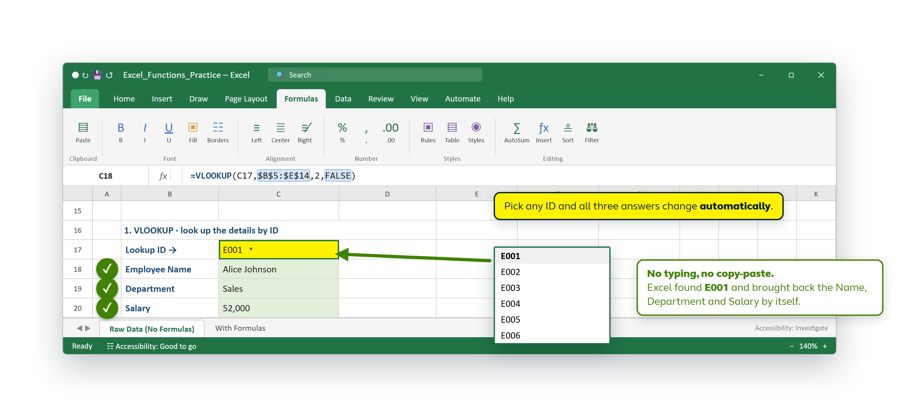
3
VLOOKUP · PART 3
Excel fills in the answers by itself
✓ No typing, no copy-paste
✓ Answers update instantly
✓ Works on thousands of rows
VLOOKUP & HLOOKUP | Backend Processing Team | Alight
6
Notes:
Here is the payoff. E001 is typed once and Excel returns Alice Johnson, Sales and 52,000. The drop-down list is optional but very handy: select the ID column, Data ribbon, Data Validation, Allow: List, then pick the ID column as the source. After that anyone can pick an ID from a list and every answer refreshes on its own.

Slide 7
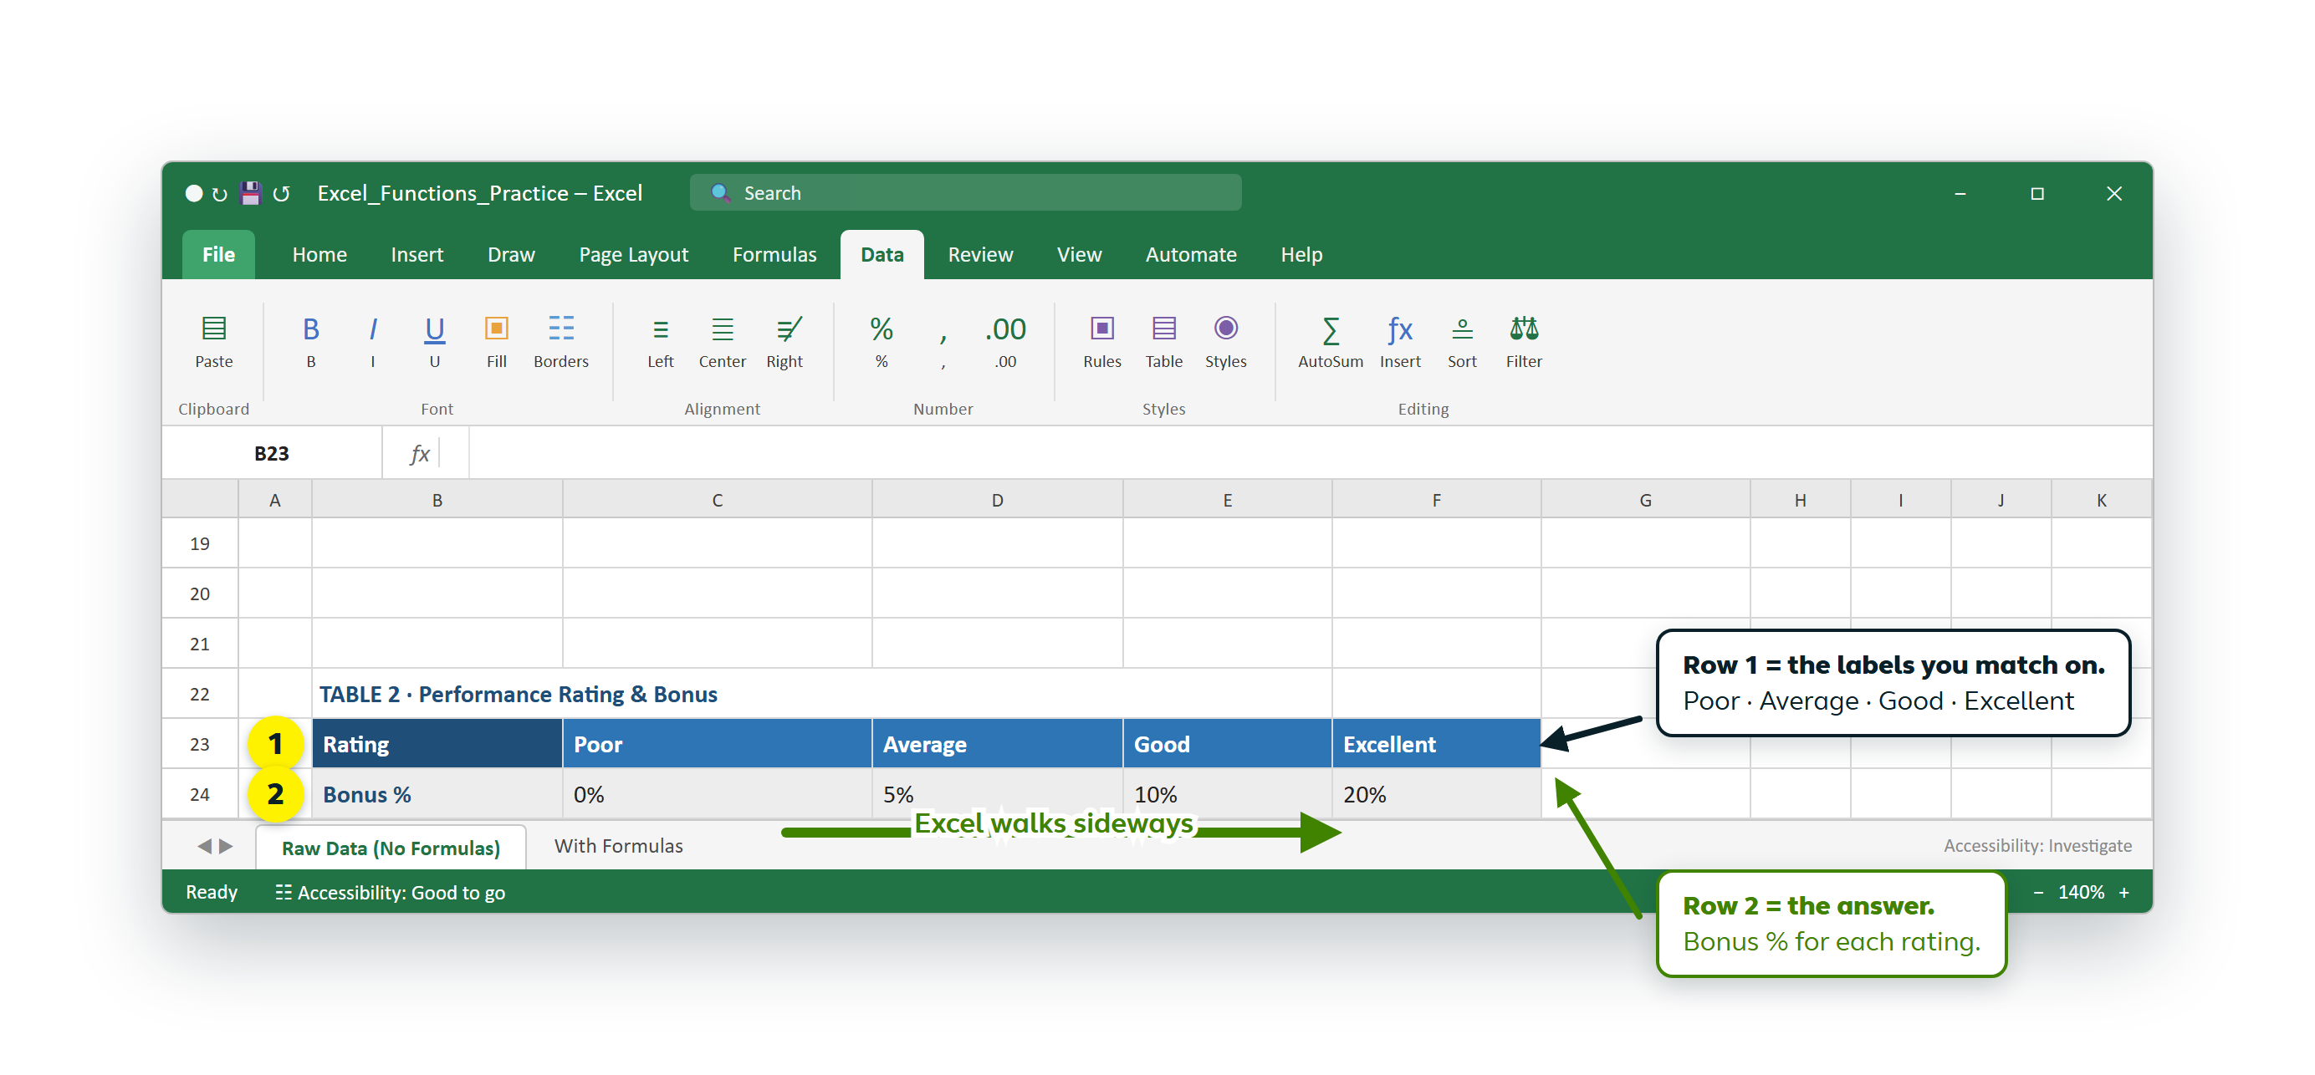
4
HLOOKUP
When the table runs sideways
Row 1 → the labels you match
Row 2 → the answer you want
Excel walks across, then drops down
VLOOKUP & HLOOKUP | Backend Processing Team | Alight
7
Notes:
HLOOKUP is the same idea rotated. Here the ratings sit side by side along row 1 and the bonus percentages along row 2. Excel walks sideways to find the rating, then steps down to read the value underneath it. If your table reads left to right, this is your function.

Slide 8
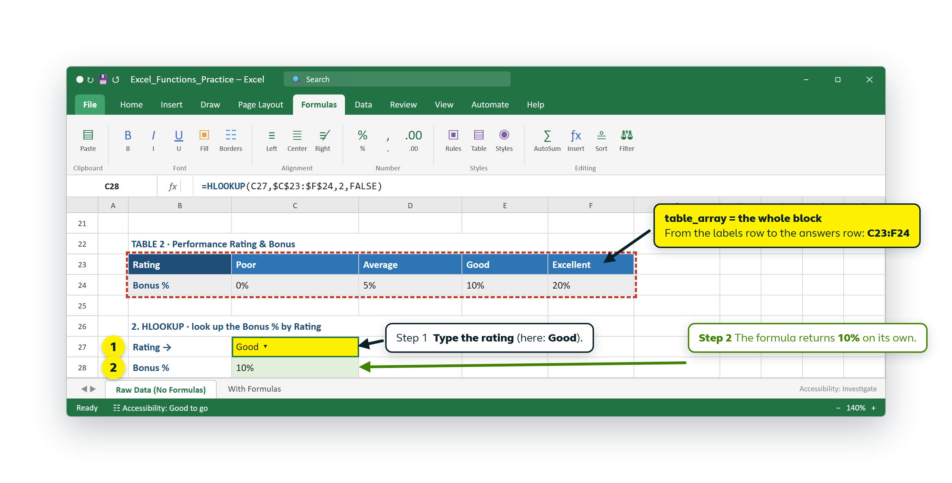
5
HLOOKUP · STEP BY STEP
Type the rating, get the bonus
=HLOOKUP( C27 , $C$23:$F$24 , 2 , FALSE )
1 = the rating · 2 = the whole block · 3 = row 2 holds the answer · 4 = exact match
VLOOKUP & HLOOKUP | Backend Processing Team | Alight
8
Notes:
Only two differences from VLOOKUP. The table range now runs across the columns, and instead of a column number we give a ROW number. Row 1 holds the ratings, so row 2 holds the bonus, hence the 2. Add a drop-down list of the four ratings and the whole lookup becomes a single click.

Slide 9
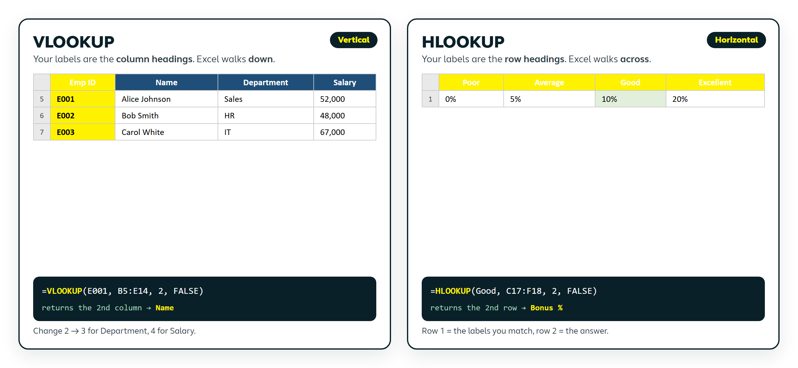
WHICH ONE DO I USE?
Pick by direction, not by difficulty
If your labels run down a column, use VLOOKUP. If they run across a row, use HLOOKUP. The formula is the same shape either way.
VLOOKUP & HLOOKUP | Backend Processing Team | Alight
9
Notes:
Give them this as a one-line rule: look at how the labels are arranged. Column of labels = VLOOKUP, column number. Row of labels = HLOOKUP, row number. Everything else, including the lookup value, the range and the FALSE, stays exactly the same.

Slide 10
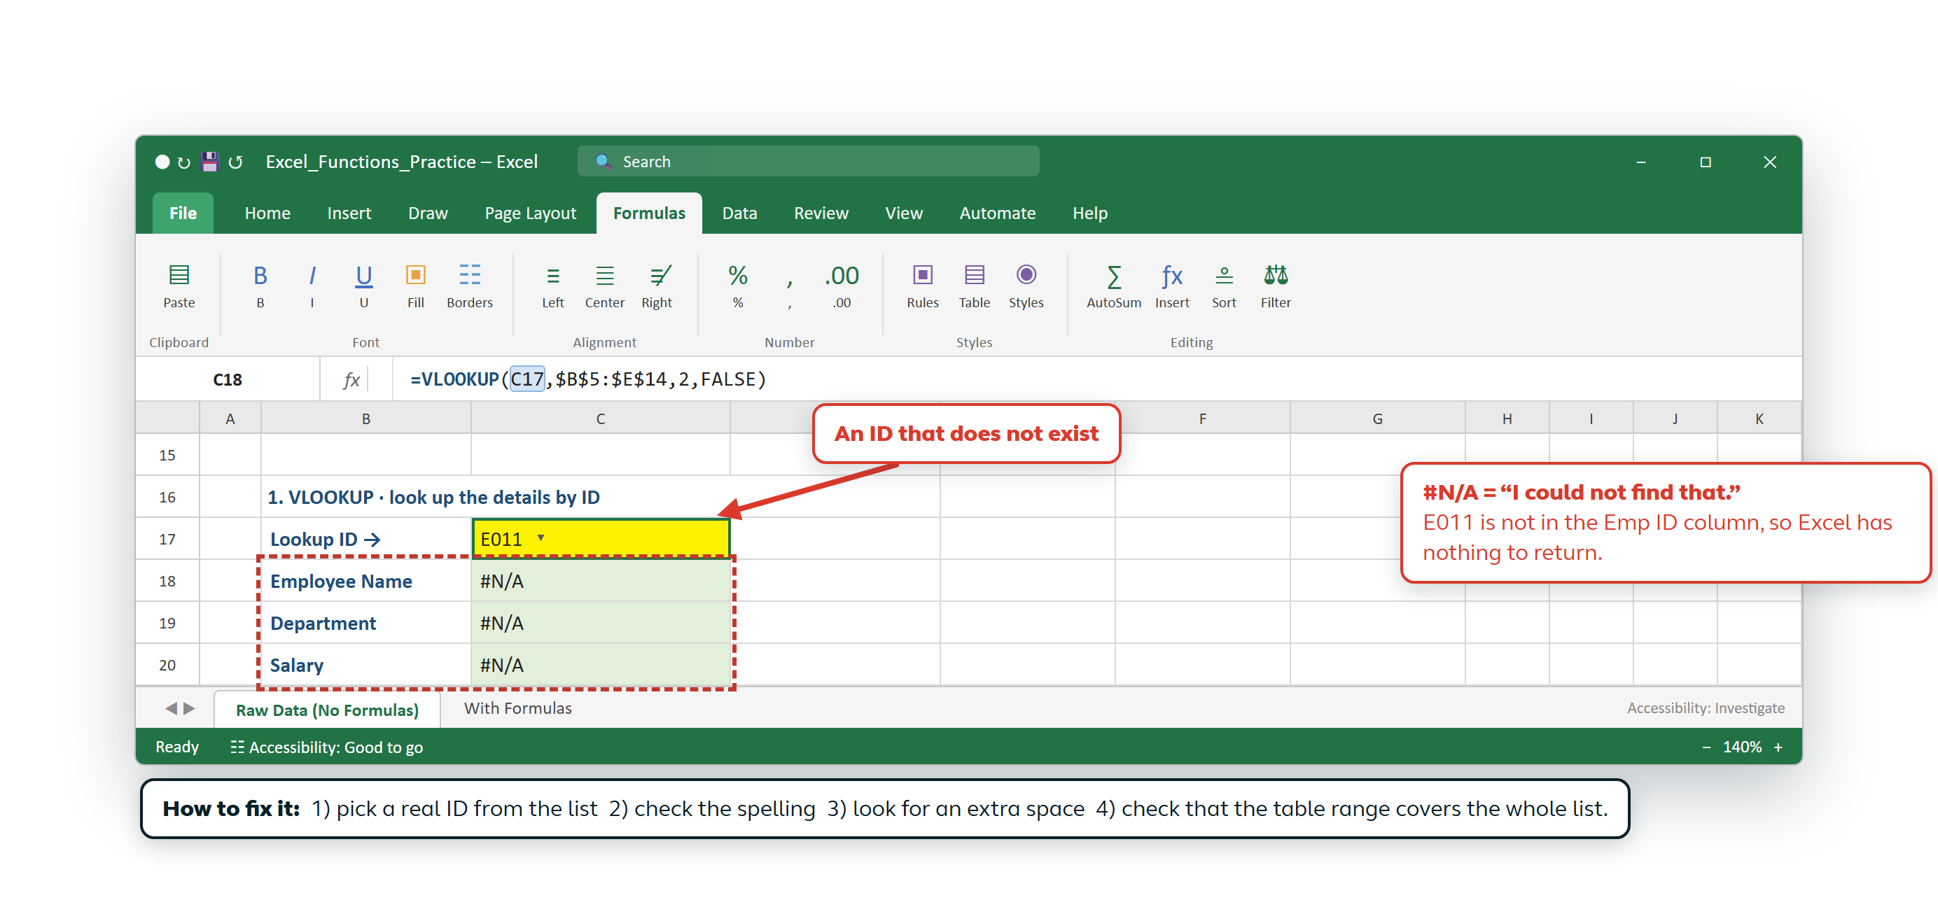
TROUBLESHOOTING & RECAP
#N/A is not a disaster
It only means Excel could not find your value in the table.
FOUR RULES TO REMEMBER
1
The matching column must be on the LEFT of the table.
2
Column numbers count from the first column of the table.
3
Always end the formula with FALSE for an exact match.
4
Lock the table range with $ signs before you copy the formula.
An ID that is not in the list · a spelling mistake · a hidden extra space · a table range that misses rows
Thank you. Questions? I am happy to walk through your own sheet with you.
Subhra Singh · Quality Team
Notes:
Close with the four rules. They prevent almost every lookup problem we see. Then the recap: VLOOKUP searches down a column, HLOOKUP searches across a row, both use the same four-part formula, and both end in FALSE. Offer to sit with anyone who wants to build their first one on real work data.

