Slide 1

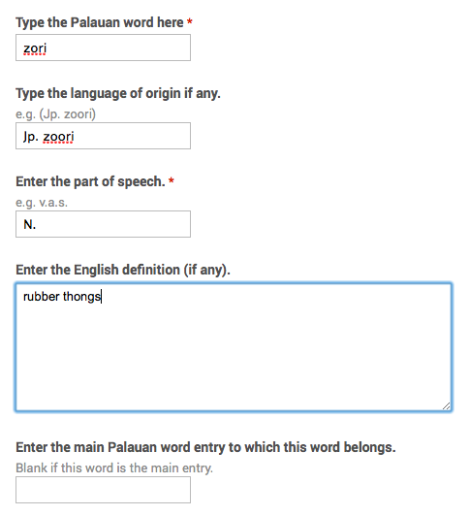
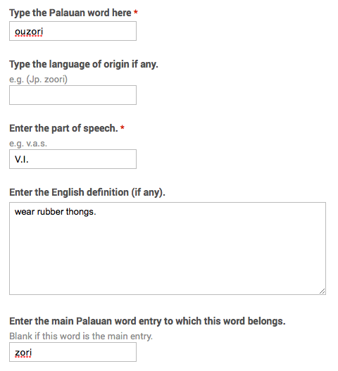
This dictionary entry is expanded into two google form entries.

Slide 2
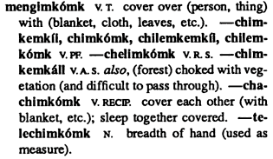
This dictionary entry is expanded into six google form entries.
mengimkomk is a V.T. entry with an english definition, and a blank value for main Palauan word entry since it is the main Palauan word entry itself.
chimkemkii, chimkomk, chillemkmekii, chilemkomk is a V.PF entry with no english definition that has mengimkomk as the main Palauan word entry.
chelimkomk is a V.R.S. entry with no english definition that has mengimkomk as the main Palauan word entry.
chimkemkall is a V.A.S. entry with an english definition that has mengimkomk as the main Palauan word entry.
chachimkomk is a V.RECIP. entry with an english definition that has mengimkomk as the main Palauan word entry.
telechimkomk is a N. entry with an english definition that has mengimkomk as the main Palauan word entry.

