Slide 1
Country Level Indicators of Suicide Risk: Data Analysis and Decision Making Support for Policy Makers
Team 25: ISyE 6414 Spring 2020

Slide 2



Team Members: Team 25
Background Information on Team (add a picture)
Little bit of get to know you
Osman Ghandour
BS in ISyE
From Columbia, SC
Hobbies: Fitness & Podcasts
Sam Garcia
MS in Statistics
(Part-time - ISyE)
From San Juan, PR
Hobbies: Software Development and Linux
Michael Szostak
MS in Aerospace
Aerospace Systems Design Lab
From Austin, TX
Hobbies: Running & Mtn Biking
Peter Williams
MS in Statistics
(Part-time - School of Math)
From Atlanta, GA
Hobbies: Running & Board Games

Slide 3
Research Motivation – Why We Chose This Topic
Suicide is a national problem, deaths are tragic, also preventable
The possibility of prevention and the scale of the problem highlight the need for policy makers, at the national level, to understand the factors that contribute to suicide not only in their respective countries but also in neighboring countries
Quick Overview of Data Sources (no need to spend a lot of time here)

Slide 4
Highlight Trends: Trends Worldwide
Highlight increases over time? Some kind of compelling visual

Slide 5
Where is This a Problem?
Can we provide a world heatmap here highlight hotspots of this problem worldwide

Slide 6
Anecdotal Evidence From the News About Highlight Countries
“Russian levels of alcohol consumption and suicide are among the highest in the world.” – Pridemore, WA. Heavy drinking and Suicide in Russia.
“…heavy alcohol consumption was promoted as a way to eliminate dissent, while other observers claim that alcohol was — and remains for many — the only escape from the drabness of everyday life.” – Chelala, C. Vodka is Putin’s worst enemy, The Moscow Times
“Russian drinkers die a variety of deaths. Alcohol poisoning. Cirrhosis. Accidents. Suicide…The result? Russians live some of the shortest lives in any large economy.” – Phillips, M. Russia is quite literally drinking itself to death, Quartz

Slide 7
Considered Data Sources

Slide 8
Initially considered data sources
Input | Description, Hypothesis of suicide relationship | Source
#X1 = Current_health_expenditure_percentage_of_GDP | Money spent per country on Health care. Good health care may represent healthier and longer life for citizens. Assumption is healthy life would decrease suicide | WHO [1]
#X2 = female_male_labor_participation | qqPeter
#X3 = gdp/capita ppp | qqPeter
#X4 = litres_alcohol_per_capita | Alcohol per capita consumption per year in liters of pure alcohol. Countries with higher rates of alcohol consumption tend to have higher suicide rates. By reducing the amount of alcohol consumed, suicides will be reduced.
#X5 = Suicide_prevention_strategy | qqPeter
#X6 = Psychiatrists working in mental health sector (per 100 000 population) | # of Practitioners of psychiatry per capita, as they are Mental health care personnel and can help identify mental health disorders which are linked to suicide | WHO [6]
#X7 = Mental hospitals (per 100 000 population) | qqPeter
Notes:
[x1] https://www.who.int/health_financing/topics/resource-tracking/ghed-update/en/
[x6] https://www.who.int/gho/mental_health/human_resources/psychiatrists_nurses/en/

Slide 9

Chosen Model
qqOsman
$\frac{Y_{1}^{.4}−1}{.4}= X_{3}+X_{4}$+ $X_{5}$
Very brief
Show data transformations
Which Inputs were dropped
Model Explanation in later sections

Slide 10

Remaining Inputs: Health Expenditure
Current Health Expenditure as % of GDP
Data retrieved from the WHO gathered from Civil Registration records [1]
CHE is based on expenditures “including healthcare goods and services consumed during each year. This indicator does not include capital health expenditures such as buildings, machinery, IT and stocks of vaccines for emergency or outbreaks.” [2].
In 2015 CHE was 10% globally [3], and is typically higher for devolved countries
Studies in the past have seen a negative correlation between CHE and suicide rates [4]
Notes:
[1] https://www.who.int/health_financing/topics/resource-tracking/ghed-update/en/
[2] https://datacatalog.worldbank.org/current-health-expenditure-gdp
[3] https://www.who.int/gho/health_financing/health_expenditure/en/
[4] https://journals.sagepub.com/doi/pdf/10.1177/070674371005500406

Slide 11
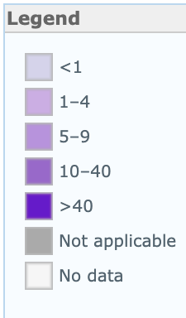
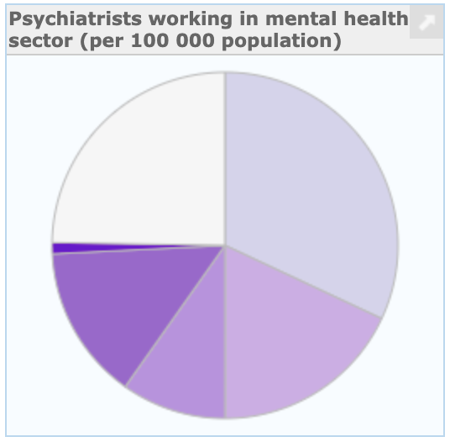
Remaining Inputs: Psychiatrists
Psychiatrists Working in Mental Health Sector (per 1000000 population)
A Psychiatrist is a practitioner of psychiatry, the branch of medicine devoted to the diagnosis, prevention, study, and treatment of mental disorders [1].
Low-income countries have 0.1 psychiatrists and the rate of psychiatrists in high income countries is 120 times greater [1]

Slide 12
Remaining Input: Alcohol Consumption
Liters of Pure Alcohol Consumed per Capita per Year
Data gathered from World Health Organization’s (WHO) Substance Abuse Country Profiles (Is this correct?)
Harmful use of alcohol is among the major risk factors for suicide
The harmful use of alcohol is defined as “…drinking that causes detrimental health and social consequences for the drinker, the people around the drinker and society at large…”
Risk of suicidal ideation, suicidal attempts and completed suicide are each increased by 2–3 times among those with Alcohol Use Disorders (AUD) in comparison with the general population
People have approximately seven times increased risk for a suicide attempt soon after drinking alcohol, and this risk further increases to 37 times after heavy use of alcohol

Slide 13
Remaining Input: Alcohol Consumption
Countries that have higher rates of alcohol use generally also have higher rates of suicide, and we were able to draw similar conclusions from our findings
A study published in The Lancet found that global alcohol consumption saw an increase of about 70% from 1990 to 2017

Slide 14
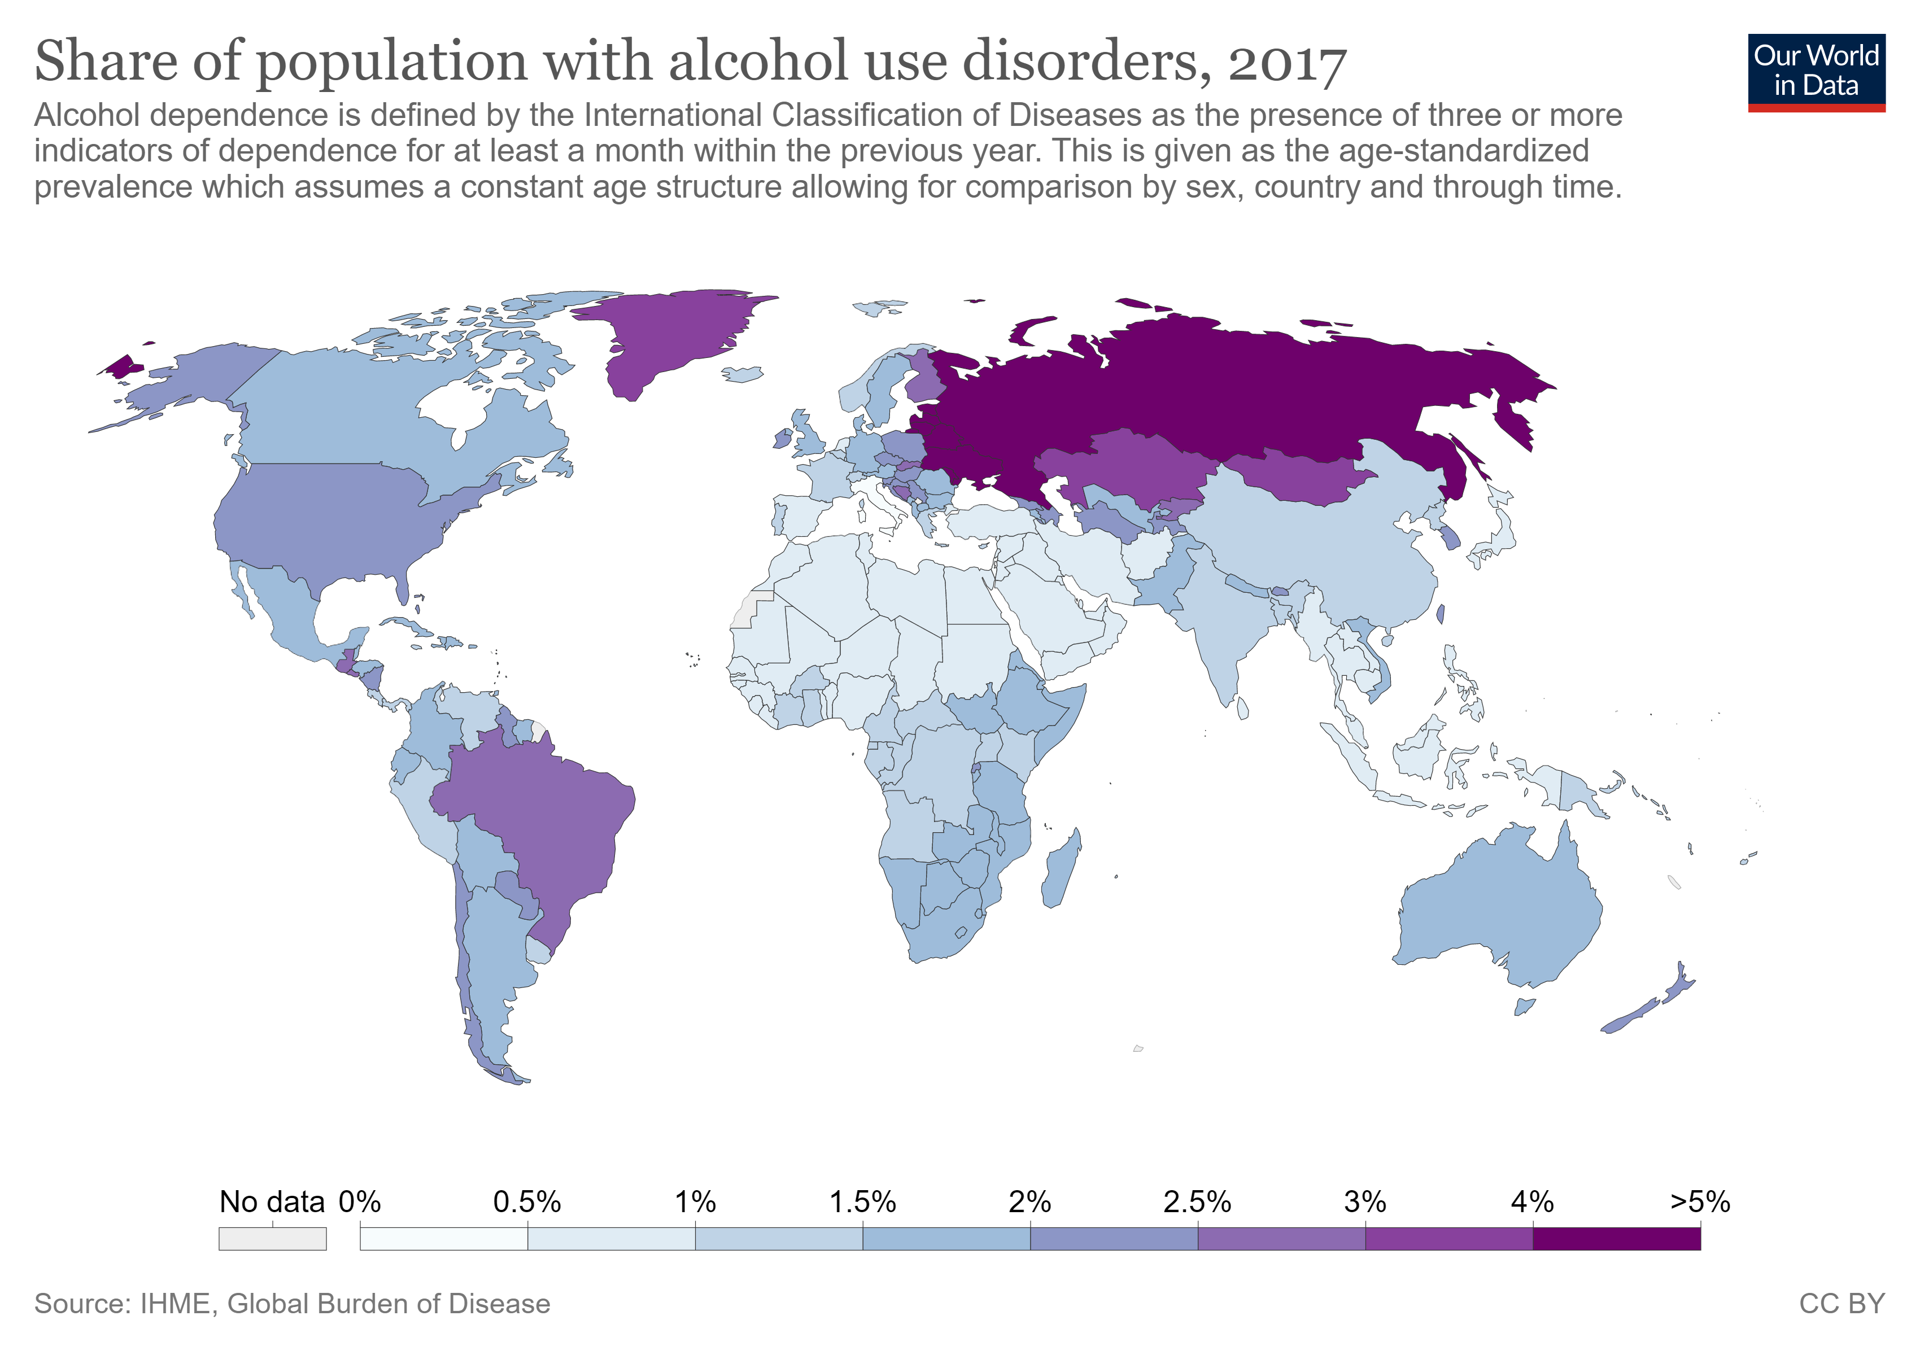
Alcohol Consumption: continued

Slide 15
Regression Model

Slide 16
Model Creation
qqOsman

Slide 17
Model Refinement
qqOsman

Slide 18
Model Limitations
qqOsman

Slide 19
Model Outcomes
qqOsman

Slide 20
Research & Data Analysis

Slide 21
What Does the Data Tell Us?
Sections:
Impact of Economic Indicators (GDP)
Impact of Substance Abuse Indications (Alcohol Abuse)
Impact of Mental Health Resources

Slide 22
Impact of Wealth, Country Level Economic Indicators
Exploratory Analysis - Visual
Testing (Hypothesis etc.)
Elasiticity/impact on our outcome
What policy makers should know

Slide 23
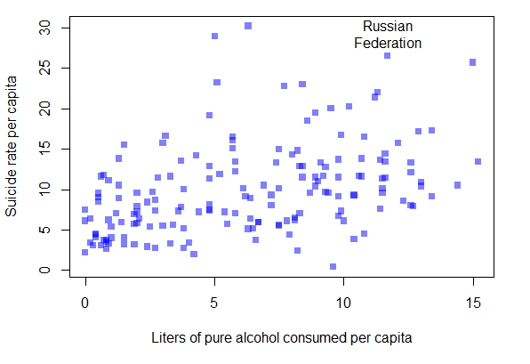
Impact Alcohol Abuse
Exploratory Analysis – Visual
An association exists between alcohol consumption and the rate of suicide. This association is particularly noticeable with Russia.
Testing (Hypothesis etc.)
Countries with higher rates of alcohol consumption tend to have higher suicide rates. By reducing the amount of alcohol consumed, suicides will be reduced.

Slide 24
Impact Alcohol Abuse
Elasiticity/impact on our outcome
Each X-unit increase/decrease in liters of alcohol consumed per capita resulted in Y-unit increase/decrease in the rate of suicide per capita.
What policy makers should know and do
Suicide is a complex societal problem with no singular cause. However, harmful use of alcohol is among the major risk factors for suicide.
Policy makers should consider implementing measures designed to mitigate the harmful use of alcohol as a means of reducing the rate of suicide.
According to the WHO, these policy interventions have proven effective at reducing the harmful use of alcohol:
Increase the price of alcohol via taxation
Enact and enforce restrictions on alcohol advertising (across multiple types of media)
Enact and enforce restrictions on the physical availability of retailed alcohol (via reduced hours of sale)

Slide 25
Impact of Availability of Mental Health Resources
Exploratory Analysis - Visual
Testing (Hypothesis etc.)
Elasiticity/impact on our outcome
What policy makers should know

Slide 26
Impact of Availability of Mental Health Resources
Exploratory Analysis - Visual
Testing (Hypothesis etc.)
Elasiticity/impact on our outcome
What policy makers should know

Slide 27
Recommendations & Decision Making Support for Policy Makers (Prescriptive)

Slide 28
What kind of Country Level Decision Making Support This Analysis Provides
Justify investment and potential impact of decision making
Bringing up statistics that would motivate decision makers
Outlining a high-level strategy a country could take
Highlighting where policy makers could invest in additional research to better understand the problem

Slide 29
Supporting Future Researchers on This Topic

Slide 30
Conclusions & Appendix

