Slide 1
Country Level Indicators of Suicide Risk: Data Analysis and Decision Making Support for Policy Makers
Team 25: ISyE 6414 Spring 2020

Slide 2



Team Members: Team 25
Background Information on Team (add a picture)
Little bit of get to know you
Osman Ghandour
MS in __
Aerospace Systems Design Lab
From Austin, TX
Hobbies: Running & Mtn Biking
Sam LASTNAME
MS in Statistics
(Part-time - School of Math)
From Atlanta, GA
Hobbies: Running & Board Games
Michael Szostak
MS in Aerospace
Aerospace Systems Design Lab
From Austin, TX
Hobbies: Running & Mtn Biking
Peter Williams
MS in Statistics
(Part-time - School of Math)
From Atlanta, GA
Hobbies: Running & Board Games

Slide 3
Research Motivation – Why We Chose This Topic
Suicide is a national problem, deaths are tragic, also preventable
The possibility of prevention and the scale of the problem highlight the need for policy makers, at the national level, to understand the factors that contribute to suicide not only in their
Quick Overview of Data Sources (no need to spend a lot of time here)

Slide 4
Highlight Trends: Trends Worldwide
Highlight increases over time? Some kind of compelling visual

Slide 5
Where is This a Problem?
Can we provide a world heatmap here highlight hotspots of this problem worldwide

Slide 6
Anecdotal Evidence From the News About Highlight Countries
Pick some countries from the world heatmap and highlight specific news stories, or descriptions of the problem
Point: Motivate the contribution of the factors we are going to study further:
Economic impact: GDP (poor economic conditions – create stress)
Substance Abuse: Alcohol abuse
Mental Health Resource available (counts of professional or facilities)

Slide 7
Considered Data Sources

Slide 8
Initially considered data sources
Input | Description, Hypothesis of suicide relationship | Source
#X1 = Current_health_expenditure_percentage_of_GDP | Money spent per country on Health care. Good health care may represent healthier and longer life for citizens. Assumption is healthy life would decrease suicide | WHO [1]
#X2 = female_male_labor_participation | qqPeter
#X3 = gdp/capita ppp | qqPeter
#X4 = litres_alcohol_per_capita | qqSam
#X5 = Suicide_prevention_strategy | qqPeter
#X6 = Psychiatrists working in mental health sector (per 100 000 population) | # of Practitioners of psychiatry per capita, as they are Mental health care personnel and can help identify mental health disorders which are linked to suicide | WHO [6]
#X7 = Mental hospitals (per 100 000 population) | qqPeter
Notes:
[x1] https://www.who.int/health_financing/topics/resource-tracking/ghed-update/en/
[x6] https://www.who.int/gho/mental_health/human_resources/psychiatrists_nurses/en/

Slide 9
Chosen Model
qqOsman
Show the model
Very brief
Show data transformations
Which Inputs were dropped
Model Explanation in later sections

Slide 10

Remaining Inputs: Health Expenditure
Current Health Expenditure as % of GDP
Data retrieved from the WHO gathered from Civil Registration records [1]
CHE is based on expenditures “including healthcare goods and services consumed during each year. This indicator does not include capital health expenditures such as buildings, machinery, IT and stocks of vaccines for emergency or outbreaks.” [2].
In 2015 CHE was 10% globally [3], and is typically higher for devolved countries
Studies in the past have seen a negative correlation between CHE and suicide rates [4]
Notes:
[1] https://www.who.int/health_financing/topics/resource-tracking/ghed-update/en/
[2] https://datacatalog.worldbank.org/current-health-expenditure-gdp
[3] https://www.who.int/gho/health_financing/health_expenditure/en/
[4] https://journals.sagepub.com/doi/pdf/10.1177/070674371005500406

Slide 11
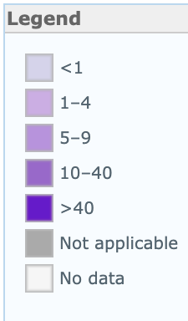
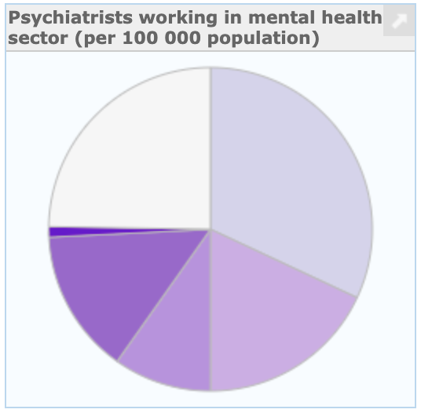
Remaining Inputs: Psychiatrists
Psychiatrists Working in Mental Health Sector (per 1000000 population)
A Psychiatrist is a practitioner of psychiatry, the branch of medicine devoted to the diagnosis, prevention, study, and treatment of mental disorders [1].
Low-income countries have 0.1 psychiatrists and the rate of psychiatrists in high income countries is 120 times greater [1]

Slide 12
Remaining Input: Alcohol Consumption
Liters Alcohol per Capita
qqSam

Slide 13
Regression Model

Slide 14
Model Creation
qqOsman

Slide 15
Model Refinement
qqOsman

Slide 16
Model Limitations
qqOsman

Slide 17
Model Outcomes
qqOsman

Slide 18
Research & Data Analysis

Slide 19
What Does the Data Tell Us?
Sections:
Impact of Economic Indicators (GDP)
Impact of Substance Abuse Indications (Alcohol Abuse)
Impact of Mental Health Resources

Slide 20
Impact of Wealth, Country Level Economic Indicators
Exploratory Analysis - Visual
Testing (Hypothesis etc.)
Elasiticity/impact on our outcome
What policy makers should know

Slide 21
Impact Alcohol Abuse
Exploratory Analysis - Visual
Testing (Hypothesis etc.)
Elasiticity/impact on our outcome
What policy makers should know and do

Slide 22
Impact of Availability of Mental Health Resources
Exploratory Analysis - Visual
Testing (Hypothesis etc.)
Elasiticity/impact on our outcome
What policy makers should know

Slide 23
Impact of Availability of Mental Health Resources
Exploratory Analysis - Visual
Testing (Hypothesis etc.)
Elasiticity/impact on our outcome
What policy makers should know

Slide 24
Recommendations & Decision Making Support for Policy Makers (Prescriptive)

Slide 25
What kind of Country Level Decision Making Support This Analysis Provides
Justify investment and potential impact of decision making
Bringing up statistics that would motivate decision makers
Outlining a high-level strategy a country could take
Highlighting where policy makers could invest in additional research to better understand the problem

Slide 26
Supporting Future Researchers on This Topic

Slide 27
Conclusions & Appendix

