Slide 1
Country Level Indicators of Suicide Risk: Data Analysis and Decision Making Support for Policy Makers
Team 25: ISyE 6414 Spring 2020

Slide 2



Team Members: Team 25
Background Information on Team (add a picture)
Little bit of get to know you
Osman Ghandour
BS in ISyE
From Columbia, SC
Hobbies: Fitness & Podcasts
Sam Garcia
MS in Statistics
(Part-time - ISyE)
From San Juan, PR
Hobbies: Software Development and Linux
Michael Szostak
MS in Aerospace
Aerospace Systems Design Lab
From Austin, TX
Hobbies: Running & Mtn Biking
Peter Williams
MS in Statistics
(Part-time - School of Math)
From Atlanta, GA
Hobbies: Running & Board Games

Slide 3
Table of Contents
Research Motivation (MS)
Align to the Proposal
Why this is important
What we as researchers can do
Descriptive Analysis (working title) (SG)
Why is this problem complex?
Where is this a problem
Economics - Zimbabwe
Alcohol - Russia
Considered Data Sources (OG)
Sources – Where and Why
Inputs
X1, X3…
Analysis (OG)
Inferential vs Predictive
Model
Modeling Assumptions and/or Methodology
Which variables were used and why
Impact (PW)
Each variable/country
Visuals:
Alcohol
Gdp as proxy for economic stability
Suicide prevention strategy
Female-to-Male labor ratio: something we controlled for
Recommendations (SG)
Suicide Prevention Strategy
Reduce Alcohol Consumption
GDP: ensure income security
Limitations and Future Research (MS)
Our assumption: GDP is a proxy for individual income
Policy recommendation re: GDP not as strong
Use Median Income data instead of GDP as a proxy
Categorize: issues with the data collected
What didn’t we consider?
Modeling Methodology
Can’t make country-specific inferences, this is global
Next Steps
Recommendations for Further Research
Appendix (PW)
Model Specs
Model Summary
References

Slide 4
Research Motivation

Slide 5
Research Motivation – Why We Chose This Topic
Suicide is a national problem, deaths are tragic, also preventable
The possibility of prevention and the scale of the problem highlight the need for policy makers, at the national level, to understand the factors that contribute to suicide not only in their respective countries but also in neighboring countries
Quick Overview of Data Sources (no need to spend a lot of time here)

Slide 6
Highlight Trends: Trends Worldwide
Highlight increases over time? Some kind of compelling visual

Slide 7
Where is This a Problem?
Can we provide a world heatmap here highlight hotspots of this problem worldwide

Slide 8
Anecdotal Evidence From the News About Highlight Countries
Pick some countries from the world heatmap and highlight specific news stories, or descriptions of the problem
Point: Motivate the contribution of the factors we are going to study further:
Economic impact: GDP (poor economic conditions – create stress)
Substance Abuse: Alcohol abuse
Mental Health Resource available (counts of professional or facilities)

Slide 9
Considered Data Sources

Slide 10
Initially considered data sources
Input | Description, Hypothesis of suicide relationship | Source
#X1 = Current_health_expenditure_percentage_of_GDP | Money spent per country on Health care. Good health care may represent healthier and longer life for citizens. Assumption is healthy life would decrease suicide | WHO [1]
#X2 = female_male_labor_participation | qqPeter
#X3 = gdp/capita ppp | qqPeter
#X4 = litres_alcohol_per_capita | Alcohol per capita consumption per year in liters of pure alcohol. Countries with higher rates of alcohol consumption tend to have higher suicide rates. By reducing the amount of alcohol consumed, suicides will be reduced.
#X5 = Suicide_prevention_strategy | Countries which have a “stand-alone” national suicide prevention strategy (NSPSs) are included as 1s, else 0. These NSPSs have implemented policies which combat suicide.
#X6 = Psychiatrists working in mental health sector (per 100 000 population) | # of Practitioners of psychiatry per capita, as they are Mental health care personnel and can help identify mental health disorders which are linked to suicide | WHO [6]
#X7 = Mental hospitals (per 100 000 population) | qqPeter
Notes:
[x1] https://www.who.int/health_financing/topics/resource-tracking/ghed-update/en/
[x6] https://www.who.int/gho/mental_health/human_resources/psychiatrists_nurses/en/

Slide 11
Chosen Model
qqOsman
Very brief
Show data transformations
Which Inputs were dropped
Model Explanation in later sections

Slide 12

Remaining Inputs: Health Expenditure
Current Health Expenditure as % of GDP
Data retrieved from the WHO gathered from Civil Registration records [1]
CHE is based on expenditures “including healthcare goods and services consumed during each year. This indicator does not include capital health expenditures such as buildings, machinery, IT and stocks of vaccines for emergency or outbreaks.” [2].
In 2015 CHE was 10% globally [3], and is typically higher for devolved countries
Studies in the past have seen a negative correlation between CHE and suicide rates [4]
Notes:
[1] https://www.who.int/health_financing/topics/resource-tracking/ghed-update/en/
[2] https://datacatalog.worldbank.org/current-health-expenditure-gdp
[3] https://www.who.int/gho/health_financing/health_expenditure/en/
[4] https://journals.sagepub.com/doi/pdf/10.1177/070674371005500406

Slide 13

Remaining Inputs: NSPS
Countries which have a National Suicide Prevention Strategy (NSPS)
Data retrieved from the UN report gathered from participating countries [1]
An implementation of a NSPS in Scotland called “Choose Live” decreased suicide rates by 20% over 10 years. [1].
Since a WHO report on suicide prevention, the WHO has tracked a growing number of technical requests from countries on how to implement NSPSs. [1]
While government implementation of NSPSs may lead to a reduction in suicide, it may also be the cultural recognition of the issue by government, in addition to specific policy actions which decrease overall suicide.
Notes:
[1] https://apps.who.int/iris/rest/bitstreams/1174021/retrieve

Slide 14
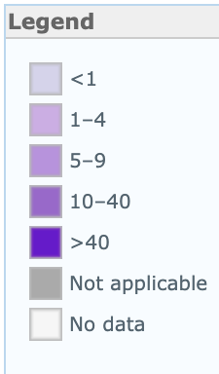
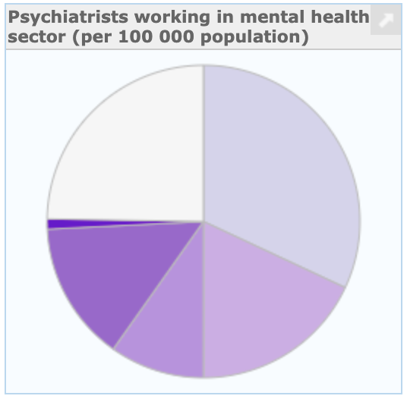
Remaining Inputs: Psychiatrists
Psychiatrists Working in Mental Health Sector (per 1000000 population)
A Psychiatrist is a practitioner of psychiatry, the branch of medicine devoted to the diagnosis, prevention, study, and treatment of mental disorders [1].
Low-income countries have 0.1 psychiatrists and the rate of psychiatrists in high income countries is 120 times greater [1]

Slide 15
Remaining Input: Alcohol Consumption
Liters of Pure Alcohol Consumed per Capita per Year
Data gathered from World Health Organization’s (WHO) Substance Abuse Country Profiles
Harmful use of alcohol is among the major risk factors for suicide
Risk of suicidal ideation, suicidal attempts and completed suicide are each increased by 2–3 times among those with Alcohol Use Disorders (AUD)
A study published in The Lancet found that global alcohol consumption saw an increase of about 70% from 1990 to 2017, going from about 21 billion liters of pure alcohol to 35.7 billion liters of pure alcohol

Slide 16
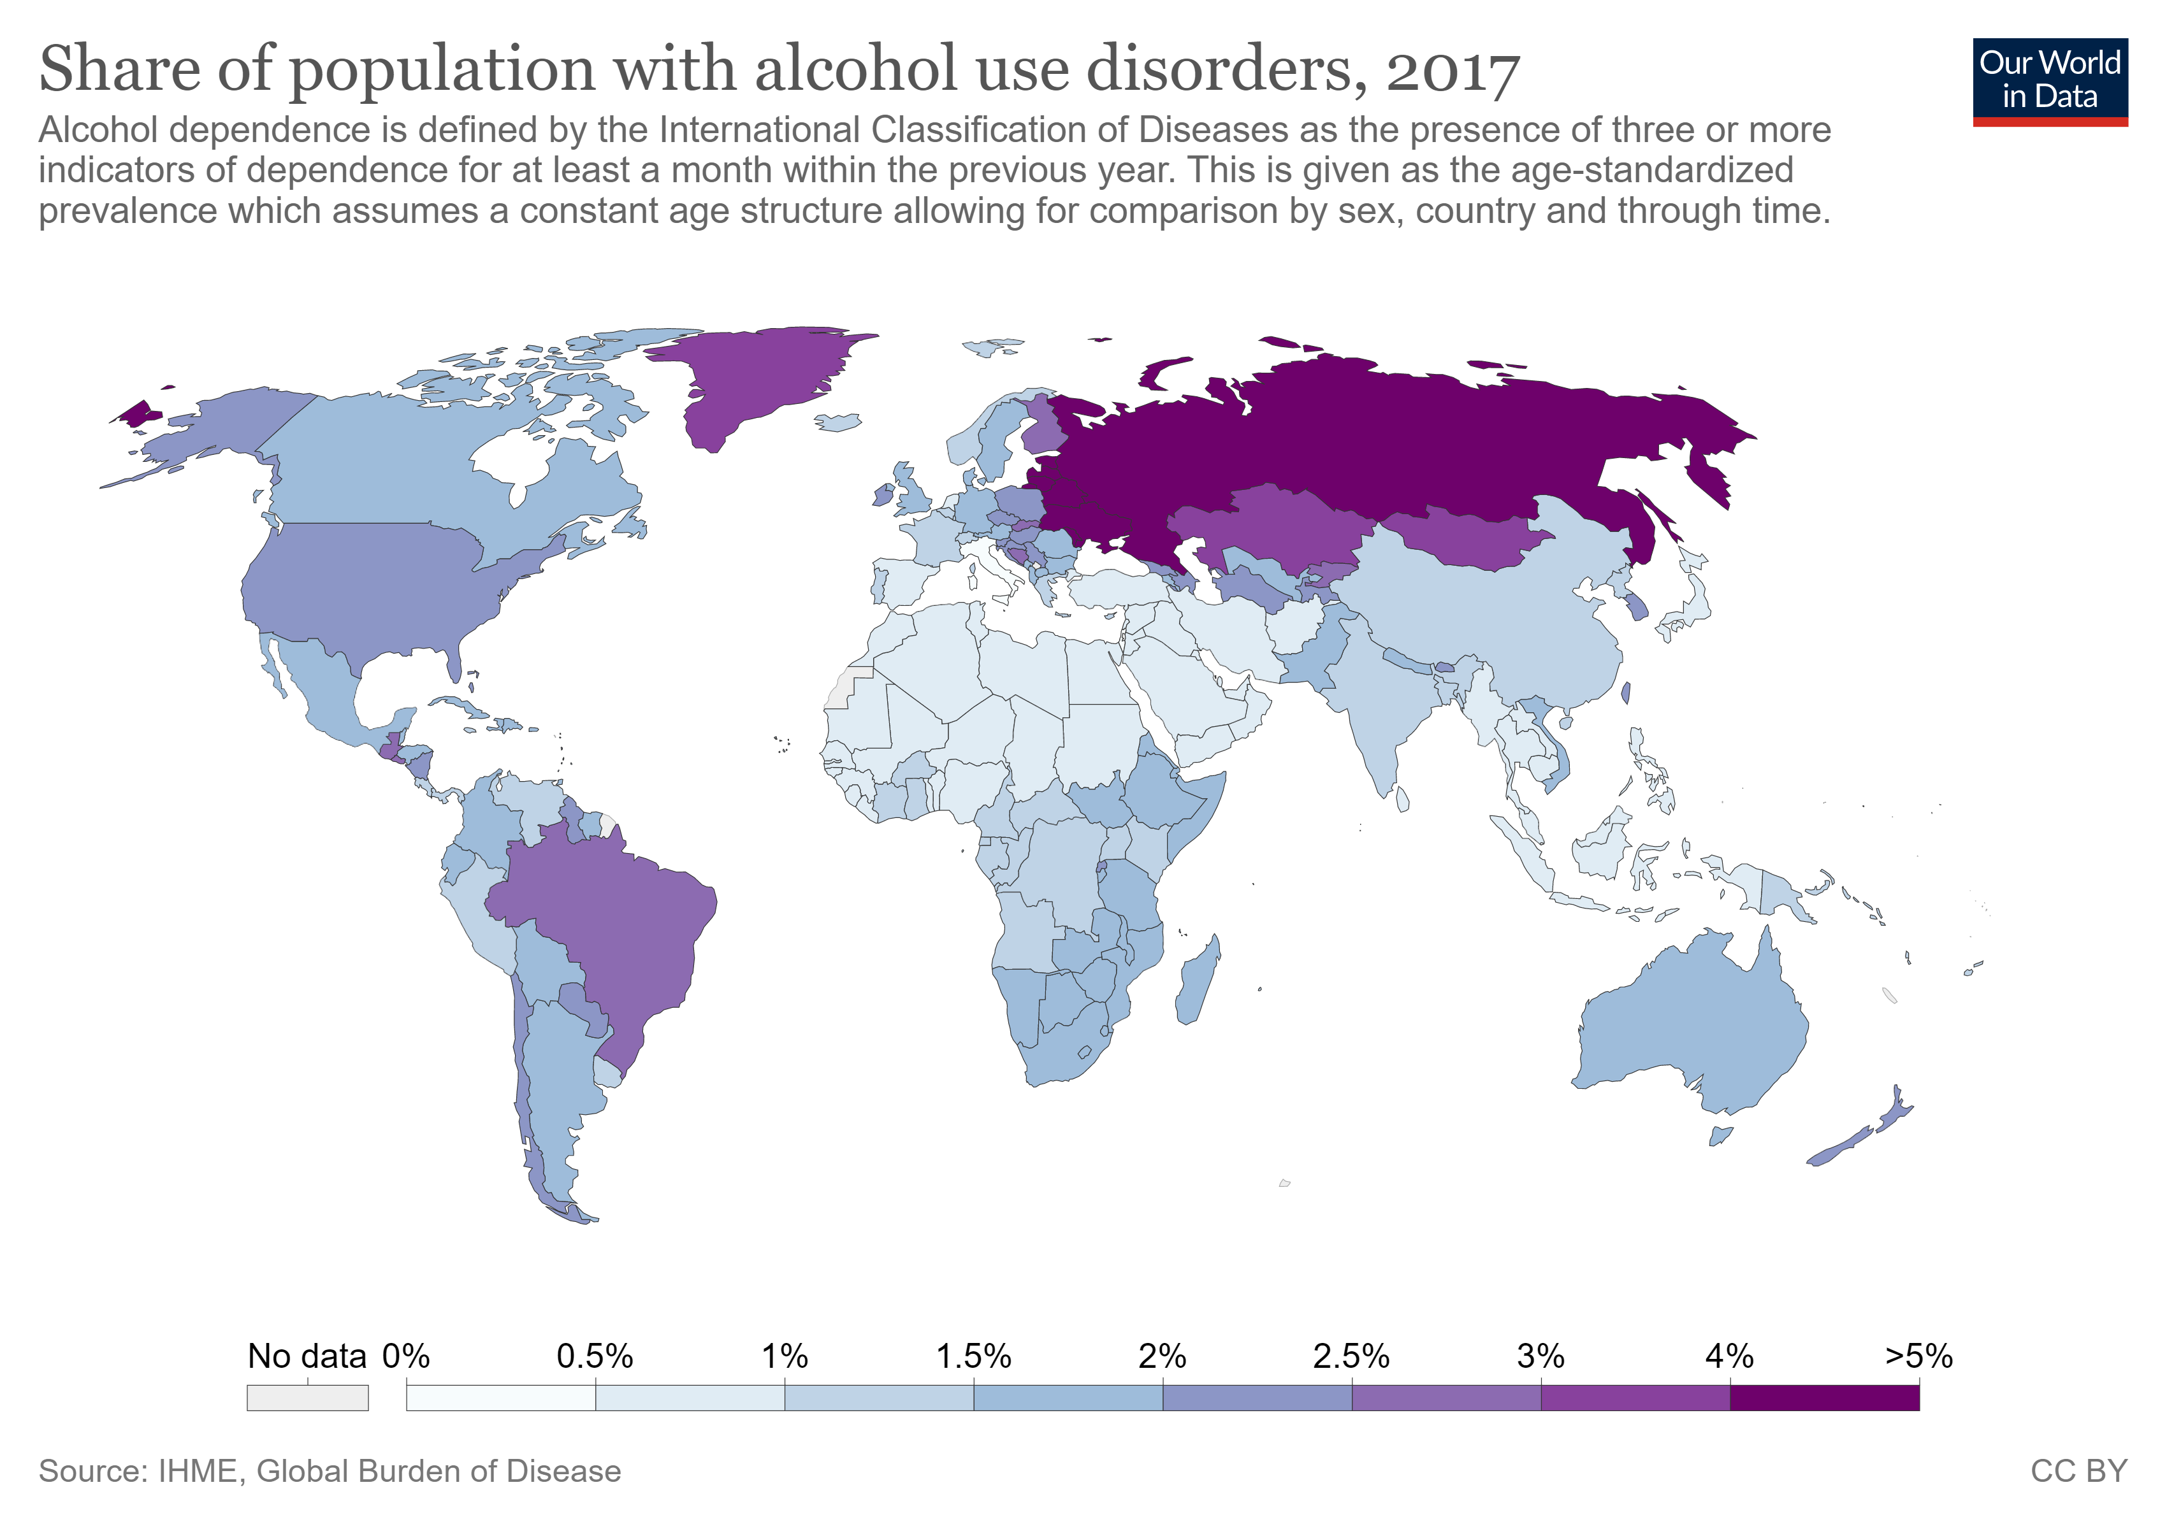
Alcohol Consumption: continued

Slide 17
Regression Model

Slide 18
Model Creation
qqOsman

Slide 19
Model Refinement
qqOsman

Slide 20
Model Limitations
qqOsman

Slide 21
Model Outcomes
qqOsman

Slide 22
Research & Data Analysis

Slide 23
What Does the Data Tell Us?
Sections:
Impact of Current Health Expenditure as % GDP
Impact of Substance Abuse Indications (Alcohol Abuse)
Impact of Mental Health Resources (Psychiatrists working in mental health sector (per 100000 population) )
Impact of National Suicide Prevention Strategies (NSPS)

Slide 24
Impact of Current Health Expenditure as % GDP
qqMichael
Exploratory Analysis - Visual
Testing (Hypothesis etc.)
Elasiticity/impact on our outcome
What policy makers should know

Slide 25
Impact Alcohol Abuse
Exploratory Analysis – Visual
An association exists between alcohol consumption and the rate of suicide.
Testing (Hypothesis etc.)
Countries with higher rates of alcohol consumption tend to have higher suicide rates. By reducing the amount of alcohol consumed, suicides will be reduced.
Elasiticity/impact on our outcome
Each X-unit increase/decrease in liters of alcohol consumed per capita resulted in Y-unit increase/decrease in the rate of suicide per capita.
What policy makers should know and do
Policy makers should consider implementing measures designed to mitigate the harmful use of alcohol as a means of reducing the rate of suicide.

Slide 26
Impact of Psychiatrists working in mental health sector (per 100000 population)
qqMichael
Exploratory Analysis - Visual
Testing (Hypothesis etc.)
Elasiticity/impact on our outcome
What policy makers should know

Slide 27
Impact of NSPS
qqMichael
Exploratory Analysis - Visual
Testing (Hypothesis etc.)
Elasiticity/impact on our outcome
What policy makers should know

Slide 28
Recommendations & Decision Making Support for Policy Makers (Prescriptive)

Slide 29
What kind of Country Level Decision Making Support This Analysis Provides
Justify investment and potential impact of decision making
Bringing up statistics that would motivate decision makers
Outlining a high-level strategy a country could take
Highlighting where policy makers could invest in additional research to better understand the problem

Slide 30
Supporting Future Researchers on This Topic

Slide 31
Conclusions

Slide 32
Appendix

Slide 33
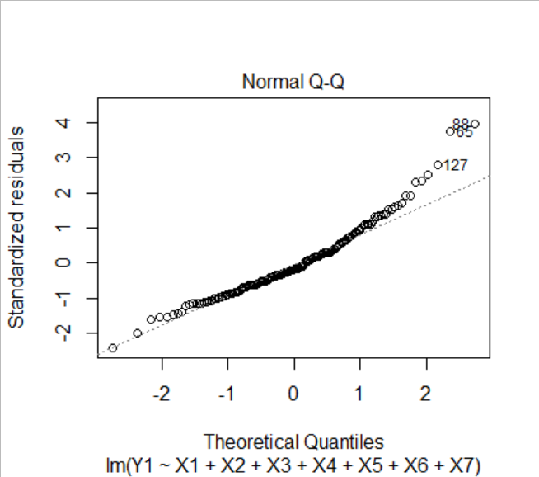
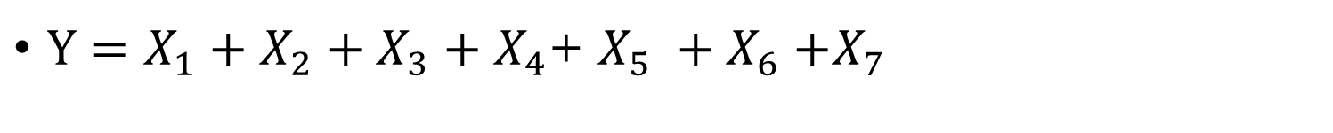
Model Development Initial Model: Multiple Linear Regression
$Y=X_{1}+X_{2}+X_{3}+X_{4}$+ $X_{5} {+ X}_{6}+X_{7}$
Normal Q-Q plot shows that the points deviate from the reference line at the higher quintiles. In order to correct for this, our next step was to try a Box Cox transformation on Y.

Slide 34
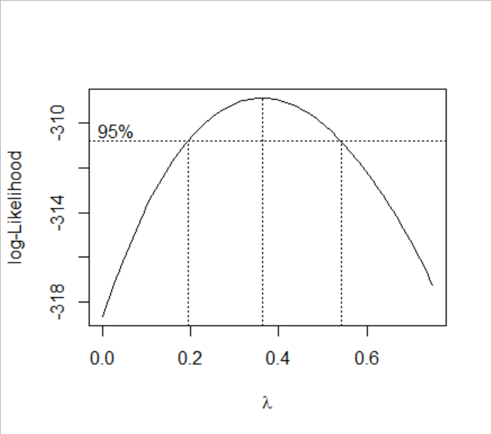
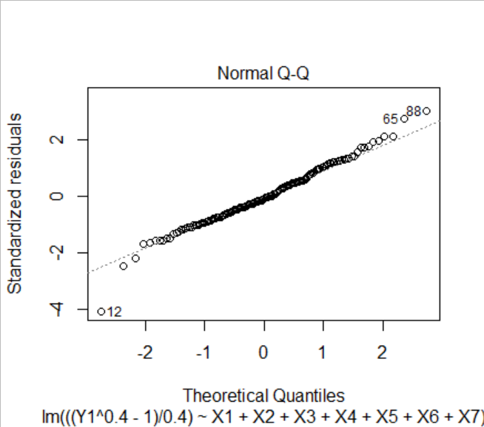
Model Development – Box Cox Transformation
$\frac{Y^{.4}−1}{.4} =X_{1}+X_{2}+X_{3}+X_{4}$+ $X_{5} {+ X}_{6}+X_{7}$
Box Cox transformation on λ = 0.4 seems to be appropriate
After transformation, the points in the Normal Q-Q plot are much closer to the reference line

Slide 35
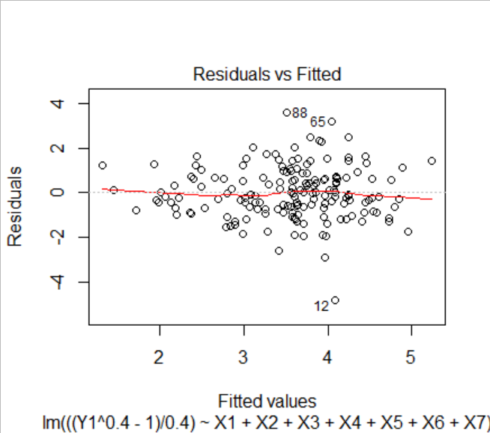
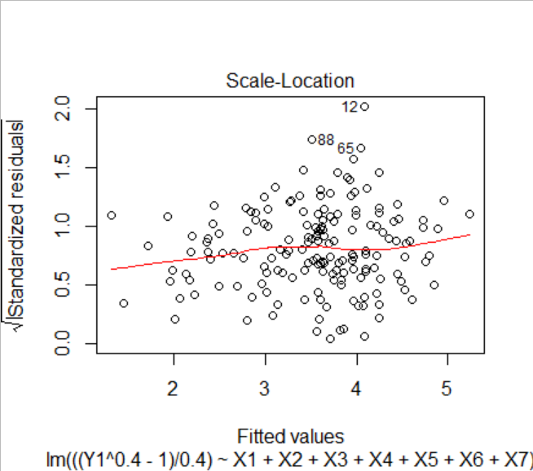
Model Development – Remove Outliers
Points 12, 65, and 88 were identified as outliers on the Residuals vs Fitted, Scale-Location, and Normal Q-Q plots (refer to previous slide)

Slide 36
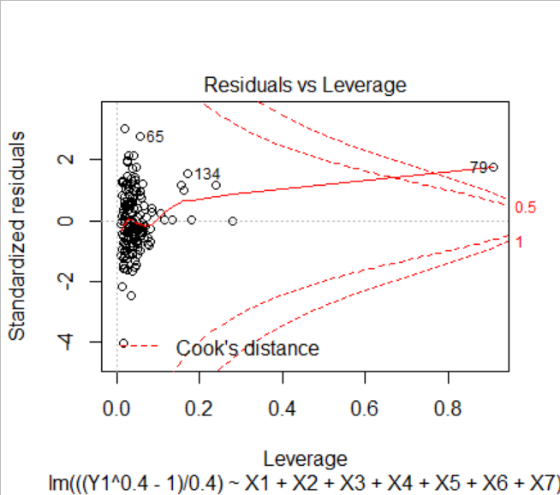
Model Development – Remove Outliers
In addition, point 79 was identified as an outlier that should be removed, as it had very high leverage in the model

Slide 37
Model Development – Remove Outliers
Points 12, 65, 79, and 88 also had country specific reasons for being removed from the data set
12 – Barbados:
Caribbean's leading tourism island, transitioned from agricultural to service based economy very successfully
“very high human development‟ status in terms of the UNDP’s human development index
Extremely low suicide rate
65 – Guyana:
Extremely poor island country largely made up of agricultural villages.
Very high alcohol and suicide statistics
Ministry of health identified poverty, pervasive stigma about mental illness, access to lethal chemicals, alcohol misuse, interpersonal violence, family dysfunction and insufficient mental health resources as key factors causing one of the highest suicide rates in the world.
79 – Japan:
Notoriously overworked and over stressed population, although the country is very wealthy
Long cultural history of considering certain types of suicides honorable, relatively high cultural tolerance for suicide
Very high suicide rate when compared to other rich nations
88 – Lesotho:
Small, landlocked, mountainous country in Africa
Highest suicide rate in Africa
High levels of child labor
Very poor general health outcomes, ex. second highest instances of tuberculosis and HIV/AIDS in the world

Slide 38
Model Development – Variable Reduction
qqOsman, Removed Vars is wrong
Next step was to remove the variables that were redundant or unnecessary in our model. We used the step function which removes variables based on AIC.
Removed Variables:
X1 – Health Expenditure as a percentage of GDP
X6 – Psychiatrists working in mental health sector (per 100 000 population)
X7 – Mental hospitals (per 100 000 population)
Model After Variable Reduction: $\frac{Y^{.4}−1}{.4} =X_{2}+X_{3}+X_{4}$+ $X_{5}$

Slide 39
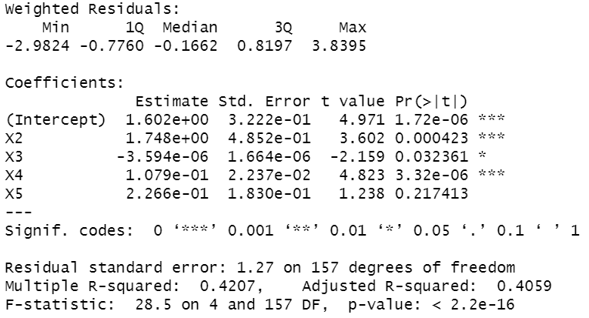
Model Development – IWLS and Final Model
Final step was to implement iteratively weighted least squares
Performed 10 iterations
To the right is the summary of the final model after IWLS

Slide 40
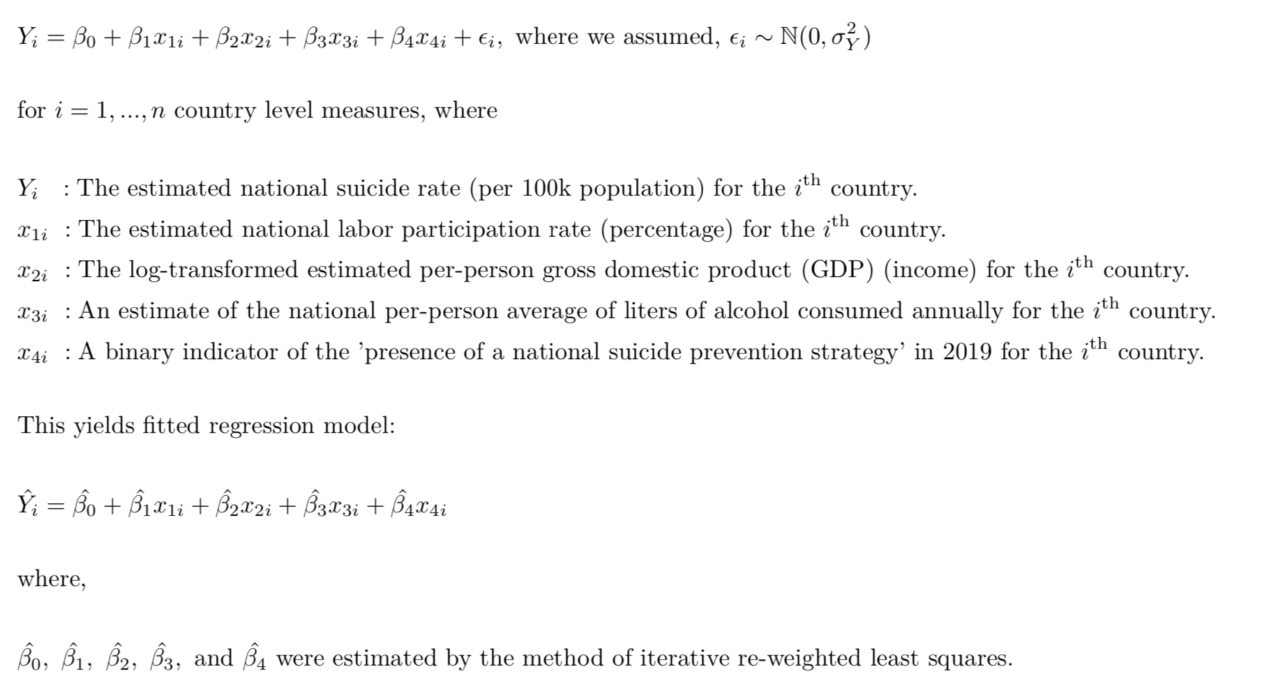
Model Specification

