Slide 1
Country Level Indicators of Suicide Risk: Data Analysis and Decision Making Support for Policy Makers
Team 25: ISyE 6414 Spring 2020

Slide 2



Team Members: Team 25
Background Information on Team (add a picture)
Little bit of get to know you
Osman Ghandour
BS in ISyE
From Columbia, SC
Hobbies: Fitness & Podcasts
Sam Garcia
MS in Statistics
(Part-time - ISyE)
From San Juan, PR
Hobbies: Software Development and Linux
Michael Szostak
MS in Aerospace
Aerospace Systems Design Lab
From Austin, TX
Hobbies: Running & Mtn Biking
Peter Williams
MS in Statistics
(Part-time - School of Math)
From Atlanta, GA
Hobbies: Running & Board Games

Slide 3
Table of Contents
Research Motivation (MS)
Align to the Proposal
Why this is important
What we as researchers can do
Descriptive Analysis (working title) (SG)
Why is this problem complex?
Where is this a problem
Economics - Zimbabwe
Alcohol - Russia
Considered Data Sources (OG)
Sources – Where and Why
Inputs
X1, X3…
Analysis (OG)
Inferential vs Predictive
Model
Modeling Assumptions and/or Methodology
Which variables were used and why
Impact (PW)
Each variable/country
Visuals:
Alcohol
Gdp as proxy for economic stability
Suicide prevention strategy
Female-to-Male labor ratio: something we controlled for
Recommendations (SG)
Suicide Prevention Strategy
Reduce Alcohol Consumption
GDP: ensure income security
Limitations and Future Research (MS)
Our assumption: GDP is a proxy for individual income
Policy recommendation re: GDP not as strong
Use Median Income data instead of GDP as a proxy
Categorize: issues with the data collected
What didn’t we consider?
Modeling Methodology
Can’t make country-specific inferences, this is global
Next Steps
Recommendations for Further Research
Appendix (PW)
Model Specs
Model Summary
References

Slide 4
Research Motivation – Why We Chose This Topic
Suicide is a national problem, deaths are tragic, also preventable
The possibility of prevention and the scale of the problem highlight the need for policy makers, at the national level, to understand the factors that contribute to suicide not only in their respective countries but also in neighboring countries
Quick Overview of Data Sources (no need to spend a lot of time here)

Slide 5
Descriptive Analysis – Why is suicide a complex problem?
Suicide has no singular cause. It is a complex societal problem with many psychological, social, biological, cultural, and environmental factors.
Though it might seem intuitive to categorize suicidal ideation, attempted suicide, and completed suicide as strictly a psychiatric or medical issue or a mental illness, not all who commit suicide are mentally ill. “Mental illness is often not clearly distinguishable from normal distress” [1].
Due to the sheer number of potential factors associated with suicide and the complex nature of the relationships between them, we chose to limit our study to a small set of factors that could be controlled for and acted upon via policy interventions.
By using the model as a tool for inferential analysis, we were able to identify associations between, and provide policy recommendations for, the individual factors.
To the layperson, some of the interventions may seem unrelated to the issue of suicide. However, a lawmaker should understand that a complex relationship exists between the factors represented in the model. To the them, it should be apparent that enacting the recommendations not only address the, seemingly disparate, factors identified in the model, but also will reduce the suicide rate.
Notes:
[1] “Does suicide always indicate a mental illness?”, Sanati, A 2009,
https://www.ncbi.nlm.nih.gov/pmc/articles/PMC4222167/. Accessed 12 Apr. 2020.

Slide 6
Descriptive Analysis – Where is suicide a problem?
Economics - Zimbabwe
Political crisis coupled with failed economic policy led to the decline of Zimbabwe’s economic output. Over the past few decades, Zimbabwe’s economic decline has resulted in hyperinflation and an unemployment rate of over 90% [1]. Of the 166 countries in our study, Zimbabwe ranks 13th in the world for suicides per capita.
Alcohol – Russia
Alcohol use disorder (AUD), defined in the WHO’s International Classification of Diseases, is a chronic disease characterized by compulsive alcohol consumption, loss of control over of alcohol intake, and negative emotional state when not consuming alcohol. In Russia, the prevalence of AUD is about 4.7%, meaning that almost 1-in-20 suffer from alcohol dependence [2]. Alcoholism has been a problem because drinking is not only pervasive, but also a socially acceptable behavior in Russian society. Of the 166 countries in our study, Russia ranks 3rd in the world for suicides per capita.
Notes:
[1] “The Economic Decline of Zimbabwe”, Munangagwa, C.L. 2009
https://cupola.gettysburg.edu/cgi/viewcontent.cgi?article=1021&context=ger. Accessed 12 Apr. 2020
[2] Hannah Ritchie and Max Roser (2020) - "Alcohol Consumption". Published online at OurWorldInData.org.
https://ourworldindata.org/alcohol-consumption [Online Resource]. Accessed 6 Apr. 2020.

Slide 7
Highlight Trends: Trends Worldwide
Highlight increases over time? Some kind of compelling visual

Slide 8
Where is This a Problem?
Can we provide a world heatmap here highlight hotspots of this problem worldwide

Slide 9
Anecdotal Evidence From the News About Highlight Countries
“Russian levels of alcohol consumption and suicide are among the highest in the world.” [1] – Pridemore, WA. Heavy drinking and Suicide in Russia.
“…heavy alcohol consumption was promoted as a way to eliminate dissent, while other observers claim that alcohol was — and remains for many — the only escape from the drabness of everyday life.” [2] – Chelala, C. Vodka is Putin’s worst enemy, The Moscow Times
“Russian drinkers die a variety of deaths. Alcohol poisoning. Cirrhosis. Accidents. Suicide…The result? Russians live some of the shortest lives in any large economy.” [3] – Phillips, M. Russia is quite literally drinking itself to death, Quartz
Notes:
[1] Pridemore WA. “Heavy drinking and Suicide in Russia”. Soc Forces. 2006;85:413–30.
https://www.ncbi.nlm.nih.gov/pmc/articles/PMC1642767/. Accessed 11 Apr. 2020.
[2] Chelala C. “Vodka is Putin’s worst enemy” 10 Nov. 2014,
https://www.themoscowtimes.com/2014/11/10/vodka-is-putins-worst-enemy-a41180. Accessed 11 Apr. 2020
[3] Phillips, M. “Russia is quite literally drinking itself to death” 13 May. 2015,
https://qz.com/403307/russia-is-quite-literally-drinking-itself-to-death/. Accessed 11 Apr. 2020

Slide 10
Considered Data Sources

Slide 11
Initially considered data sources
Input | Description, Hypothesis of suicide relationship | Source
#X1 = Current_health_expenditure_percentage_of_GDP | Money spent per country on Health care. Good health care may represent healthier and longer life for citizens. Assumption is healthy life would decrease suicide | WHO [1]
#X2 = female_male_labor_participation | qqPeter
#X3 = gdp/capita ppp | qqPeter
#X4 = litres_alcohol_per_capita | Alcohol per capita consumption per year in liters of pure alcohol. Countries with higher rates of alcohol consumption tend to have higher suicide rates. By reducing the amount of alcohol consumed, suicides will be reduced.
#X5 = Suicide_prevention_strategy | qqPeter
#X6 = Psychiatrists working in mental health sector (per 100 000 population) | # of Practitioners of psychiatry per capita, as they are Mental health care personnel and can help identify mental health disorders which are linked to suicide | WHO [6]
#X7 = Mental hospitals (per 100 000 population) | qqPeter
Notes:
[x1] https://www.who.int/health_financing/topics/resource-tracking/ghed-update/en/
[x6] https://www.who.int/gho/mental_health/human_resources/psychiatrists_nurses/en/

Slide 12

Chosen Model
qqOsman
$\frac{Y_{1}^{.4}−1}{.4}= X_{3}+X_{4}$+ $X_{5}$
Very brief
Show data transformations
Which Inputs were dropped
Model Explanation in later sections

Slide 13

Remaining Inputs: Health Expenditure
Current Health Expenditure as % of GDP
Data retrieved from the WHO gathered from Civil Registration records [1]
CHE is based on expenditures “including healthcare goods and services consumed during each year. This indicator does not include capital health expenditures such as buildings, machinery, IT and stocks of vaccines for emergency or outbreaks.” [2].
In 2015 CHE was 10% globally [3], and is typically higher for devolved countries
Studies in the past have seen a negative correlation between CHE and suicide rates [4]
Notes:
[1] https://www.who.int/health_financing/topics/resource-tracking/ghed-update/en/
[2] https://datacatalog.worldbank.org/current-health-expenditure-gdp
[3] https://www.who.int/gho/health_financing/health_expenditure/en/
[4] https://journals.sagepub.com/doi/pdf/10.1177/070674371005500406

Slide 14
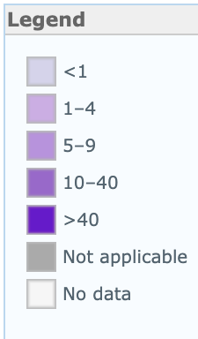
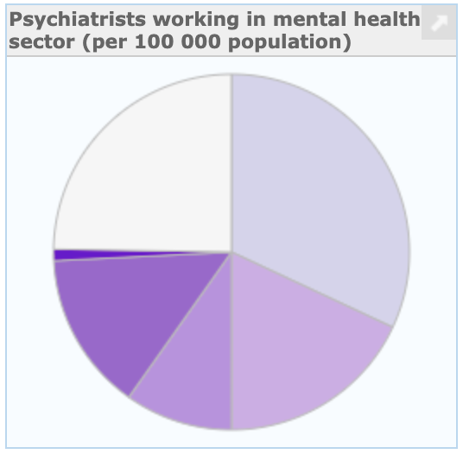
Remaining Inputs: Psychiatrists
Psychiatrists Working in Mental Health Sector (per 1000000 population)
A Psychiatrist is a practitioner of psychiatry, the branch of medicine devoted to the diagnosis, prevention, study, and treatment of mental disorders [1].
Low-income countries have 0.1 psychiatrists and the rate of psychiatrists in high income countries is 120 times greater [1]

Slide 15
Remaining Input: Alcohol Consumption
Liters of Pure Alcohol Consumed per Capita per Year
Data gathered from World Health Organization’s (WHO) Substance Abuse Country Profiles (Is this correct?)
Harmful use of alcohol is among the major risk factors for suicide
The harmful use of alcohol is defined as “…drinking that causes detrimental health and social consequences for the drinker, the people around the drinker and society at large…” [1]
Risk of suicidal ideation, suicidal attempts and completed suicide are each increased by 2–3 times among those with Alcohol Use Disorders (AUD) in comparison with the general population [2]
People have approximately seven times increased risk for a suicide attempt soon after drinking alcohol, and this risk further increases to 37 times after heavy use of alcohol [3]
Notes:
[1] "WHO | Global status report on alcohol and health 2018 - World ...." 21 Sep. 2018,
https://www.who.int/substance_abuse/publications/global_alcohol_report/en/. Accessed 5 Apr. 2020.
[2] "Alcohol-Related Risk of Suicidal Ideation, Suicide Attempt ...." 20 May. 2015,
https://www.ncbi.nlm.nih.gov/pmc/articles/PMC4439031/. Accessed 5 Apr. 2020.
[3] "A meta-analysis of acute use of alcohol and the risk of suicide ...." 8 Dec. 2016,
https://www.ncbi.nlm.nih.gov/pmc/articles/PMC5340592/. Accessed 5 Apr. 2020.

Slide 16
Remaining Input: Alcohol Consumption
Countries that have higher rates of alcohol use generally also have higher rates of suicide, and we were able to draw similar conclusions from our findings
A study published in The Lancet found that global alcohol consumption saw an increase of about 70% from 1990 to 2017 [1]
Notes:
[1] “Where Global Alcohol Consumption Is Rising and Falling”,
https://www.forbes.com/sites/niallmccarthy/2019/05/09/where-global-alcohol-consumption-is-rising-falling-infographic. Accessed 6 Apr. 2020.

Slide 17
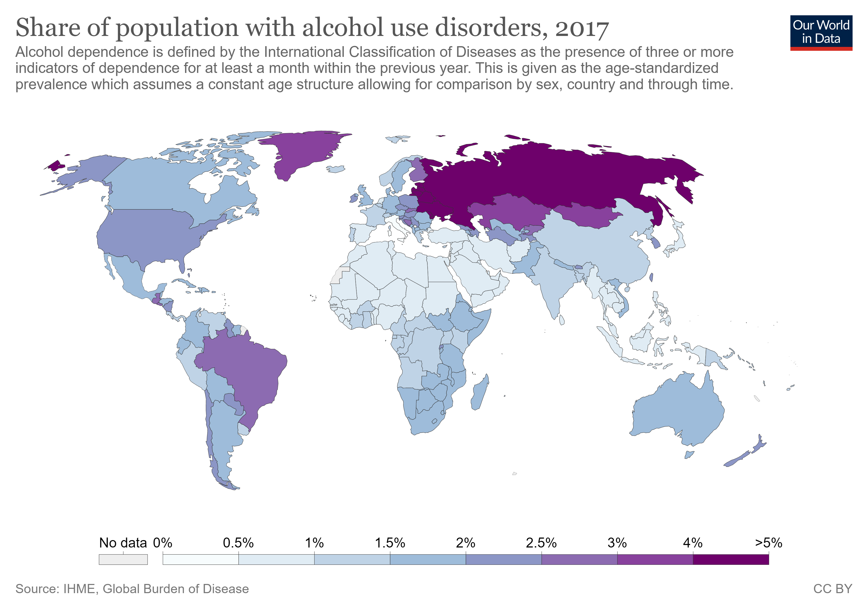
Alcohol Consumption: continued
Notes:
[1] Hannah Ritchie and Max Roser (2020) - "Alcohol Consumption". Published online at OurWorldInData.org.
https://ourworldindata.org/alcohol-consumption [Online Resource]. Accessed 6 Apr. 2020.

Slide 18
Regression Model

Slide 19
Model Creation
qqOsman

Slide 20
Model Refinement
qqOsman

Slide 21
Model Limitations
qqOsman

Slide 22
Model Outcomes
qqOsman

Slide 23
Research & Data Analysis

Slide 24
What Does the Data Tell Us?
Sections:
Impact of Economic Indicators (GDP)
Impact of Substance Abuse Indications (Alcohol Abuse)
Impact of Mental Health Resources

Slide 25
Impact of Wealth, Country Level Economic Indicators
Exploratory Analysis - Visual
Testing (Hypothesis etc.)
Elasiticity/impact on our outcome
What policy makers should know

Slide 26
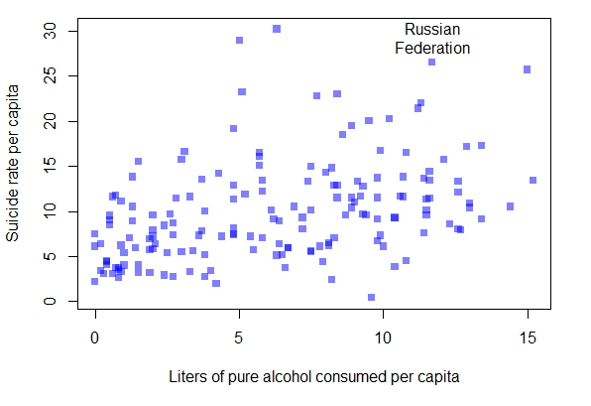
Impact Alcohol Abuse
Exploratory Analysis – Visual
An association exists between alcohol consumption and the rate of suicide. This association is particularly noticeable with Russia.
Testing (Hypothesis etc.)
Countries with higher rates of alcohol consumption tend to have higher suicide rates. By reducing the amount of alcohol consumed, suicides will be reduced.

Slide 27
Impact Alcohol Abuse
Elasiticity/impact on our outcome
Each X-unit increase/decrease in liters of alcohol consumed per capita resulted in Y-unit increase/decrease in the rate of suicide per capita.
What policy makers should know and do
Suicide is a complex societal problem with no singular cause. However, harmful use of alcohol is among the major risk factors for suicide.
Policy makers should consider implementing measures designed to mitigate the harmful use of alcohol as a means of reducing the rate of suicide.
According to the WHO, these policy interventions have proven effective at reducing the harmful use of alcohol:
Increase the price of alcohol via taxation
Enact and enforce restrictions on alcohol advertising (across multiple types of media)
Enact and enforce restrictions on the physical availability of retailed alcohol (via reduced hours of sale)

Slide 28
Impact of Availability of Mental Health Resources
Exploratory Analysis - Visual
Testing (Hypothesis etc.)
Elasiticity/impact on our outcome
What policy makers should know

Slide 29
Impact of Availability of Mental Health Resources
Exploratory Analysis - Visual
Testing (Hypothesis etc.)
Elasiticity/impact on our outcome
What policy makers should know

Slide 30
Recommendations & Decision-Making Support for Policy Makers (Prescriptive)

Slide 31
Recommendation: Suicide Prevention Strategy
Consider establishing an authoritative agency, tasked with the continued investigating, formulating, and implementing policy aimed at reducing suicide. Due to the complexity of the suicide problem, this agency must draw on knowledge from many disciplines, including mental health, medical sciences, and economics, to identify affirmative actions and best practices in suicide prevention.
Consider implementing a national strategy for suicide prevention, which should not be intended to replace existing strategies or frameworks already in place in local municipalities, territories, provinces, states, etc. This strategy can include, but is not limited to, the establishing of a national suicide crisis line as well as suicide prevention and care services.
Promote public awareness campaigns highlighting the prevalence of suicide. By changing public perceptions and reducing the stigmas associated with seeking help, the rate of suicide can be reduced.

Slide 32
Recommendation: Reduce Alcohol Consumption
Suicide is a complex societal problem with no singular cause. However, harmful use of alcohol is among the major risk factors for suicide.
Policy makers should consider implementing measures designed to mitigate the harmful use of alcohol as a means of reducing the rate of suicide.
According to the WHO, these policy interventions have proven effective at reducing the harmful use of alcohol:
Increase the price of alcohol via taxation
Enact and enforce restrictions on alcohol advertising (across multiple types of media)
Enact and enforce restrictions on the physical availability of retailed alcohol (via reduced hours of sale)

Slide 33
Recommendation: GDP (ensure income security? or reduce poverty?)
Pursue measures aimed at improving the nation’s financial standing, attractiveness for investment, and rate of business startup as a means for improving the overall economic climate. By enacting policy aimed at improving economic conditions, poverty is reduced thereby reducing the rate of suicide.
Remove unnecessary or unclear laws that could be preventing the startup of business and industry. Ensure that policy is clear and unambiguous so that businesses know if, and when, they are in violation of the law.
By improving the economic output of the country and the percentage of GDP per capita, the impact of economic factors, as a cause of suicide, will be reduced. Thus reducing the rate of suicide.

Slide 34
What kind of Country Level Decision Making Support This Analysis Provides
Justify investment and potential impact of decision making
Bringing up statistics that would motivate decision makers
Outlining a high-level strategy a country could take
Highlighting where policy makers could invest in additional research to better understand the problem

Slide 35
Supporting Future Researchers on This Topic

Slide 36
Conclusions & Appendix

