Slide 1
CREDIT RISK ANALYSIS
Presented by: Mohamed islem Beggari

Slide 2
INTRODUCTION:
What is Credit Analysis?
Credit analysis is the systematic process of evaluating the creditworthiness of individuals, businesses, or entities seeking to borrow funds from financial institutions or lenders
Recommendation & decision
Gathering information
Financial Statement Analysis
Assessing Creditworthiness
Industry and Economic Analysis
Management and Business Analysis
Risk Evaluation
The process of credit analysis involves

Slide 3
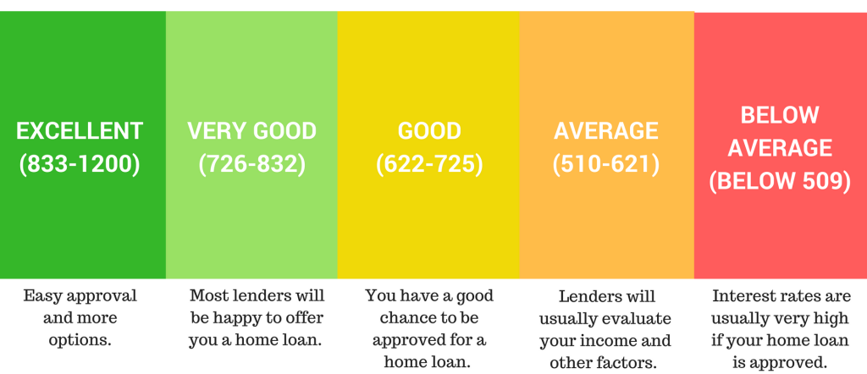
What is credit risk analysis ?
Credit risk analysis is the process of evaluating the potential risk of a borrower defaulting on their financial obligations. It involves assessing various factors, including the borrower's financial history, creditworthiness, income, collateral, and economic conditions,
Scoring Technics ?
A credit score is a 3-digit number that reflects the likelihood that a consumer will repay his debts.
This score is a numerical representation of the borrower's creditworthiness and risk profile.
Notes:
. Some scoring technics like FICO SCORE use the borrower's credit history, payment behavior, and other relevant data to calculate a credit score. While credit scoring helps paint an important picture of a customer’s creditworthiness based
on their financial history, it does not tell us much about their probability of default. Those
with low credit scores may be at a higher risk for non-payment, based on their history of
default or other financial issues, but a good credit score does not necessarily mean a customer
is a low risk.

Slide 4
32,581 entities
DATA OVERVIEW
12 columns
3 columns of FLOAT
5 columns of INT
4 columns of OBJECT.

Slide 5
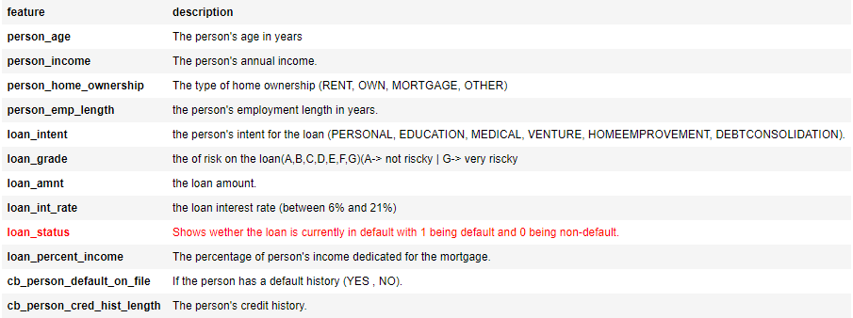
DATASET

Slide 6
DATA CLEANING PLAN
01
02
03
Checking / removing duplicates
Feature Selection
Checking/dealing with Missing Data
Detecting / Removing outliers
04

Slide 7
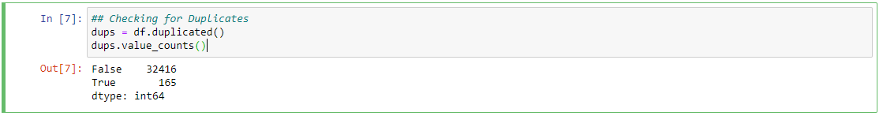
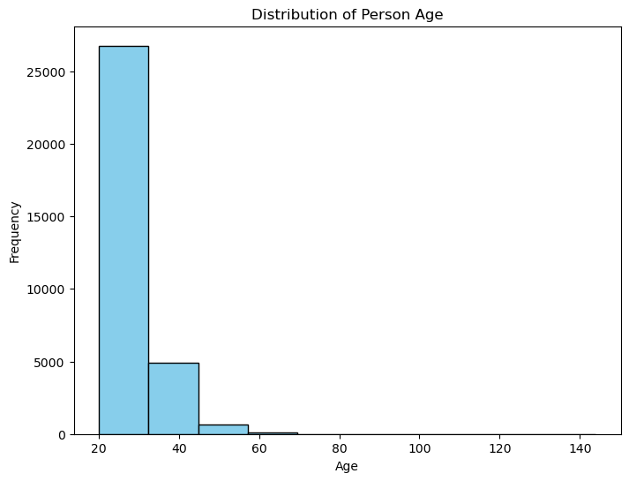
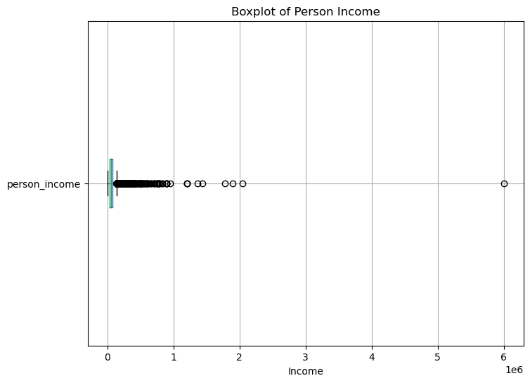
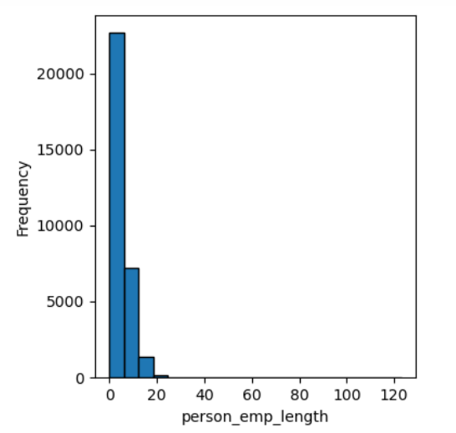
Checking / Removing duplicates
Feature Selection
Detecting / Removing Outliers:

Slide 8
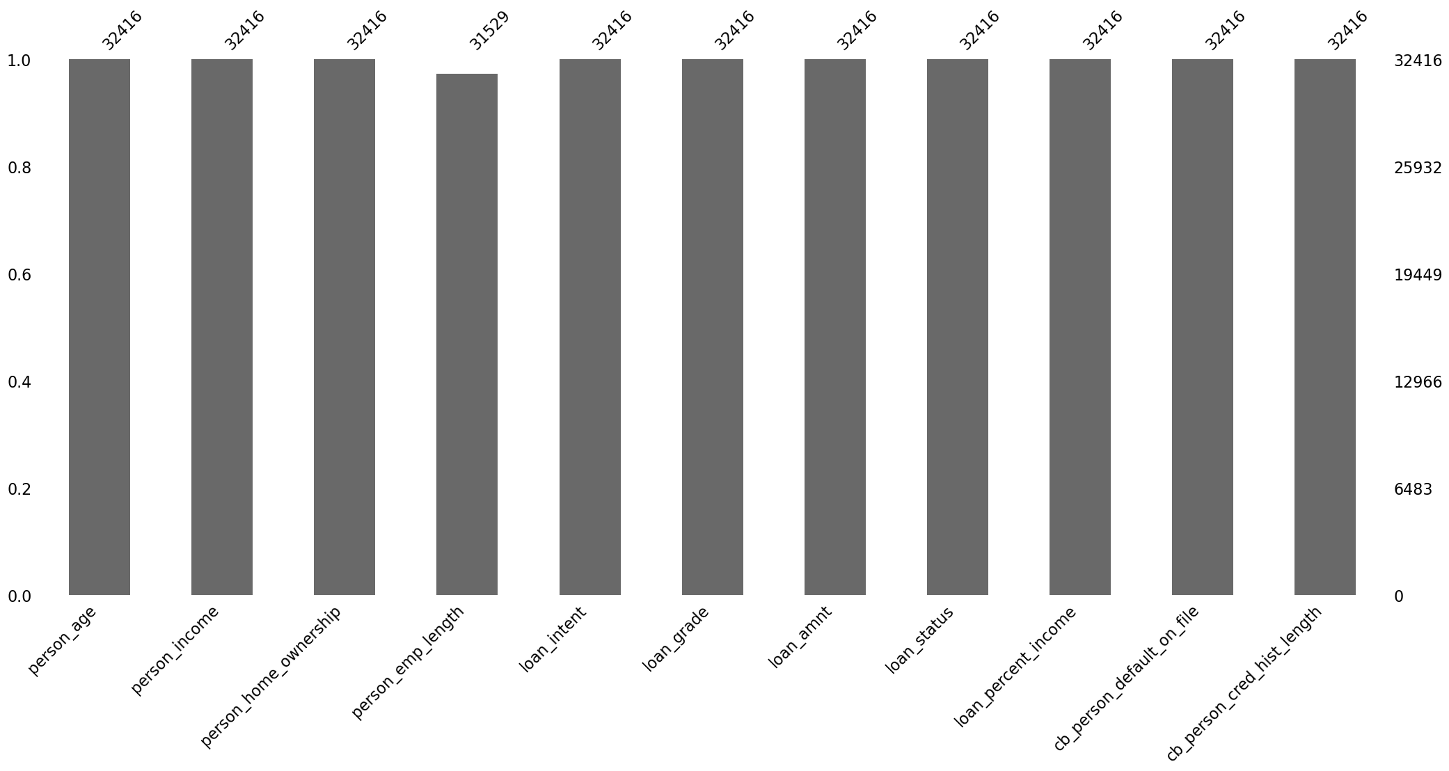
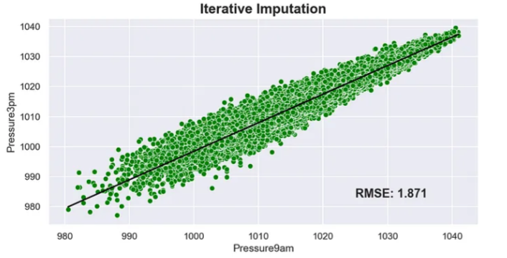
Checking for Missing DATA:
MSNO Library :
Dealing with Missing DATA:
Iterative Imputer :

Slide 9
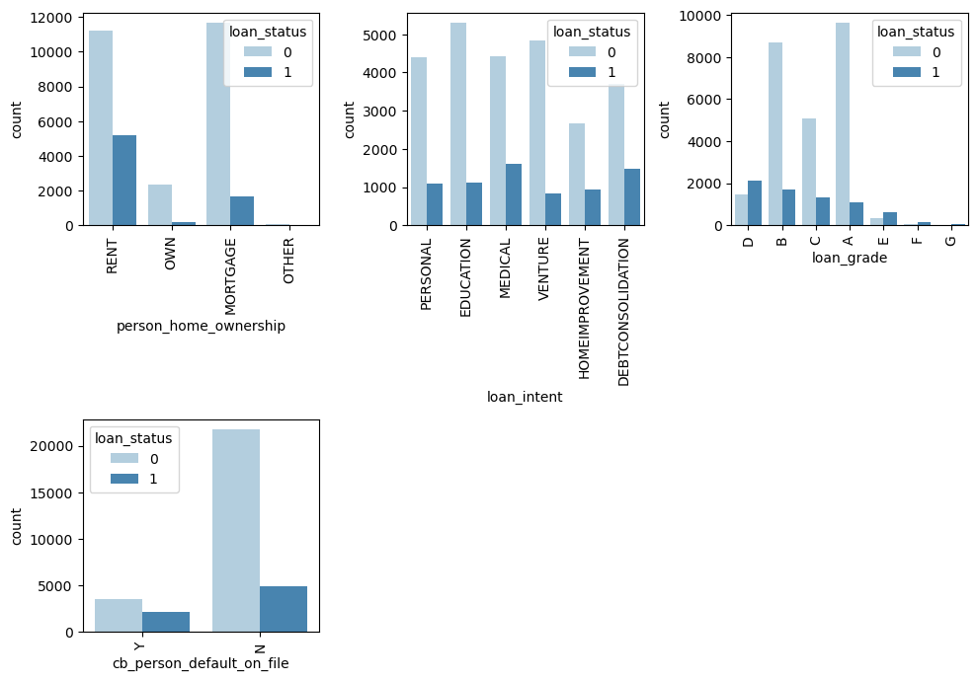
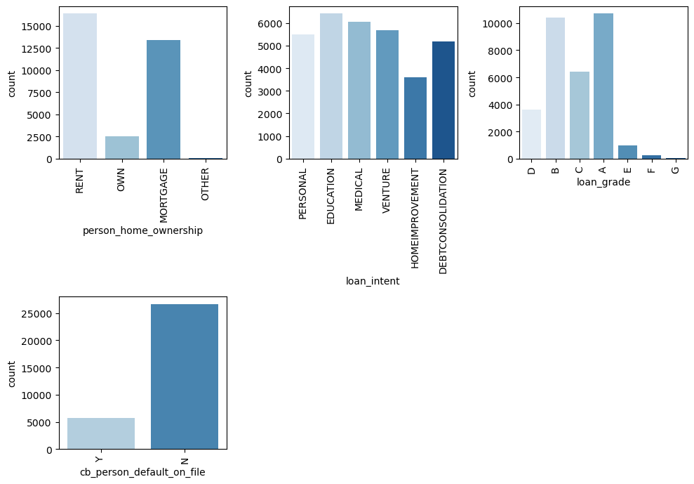
DATA VISUALIZATION & EXPLORATION
Categorical features

Slide 10
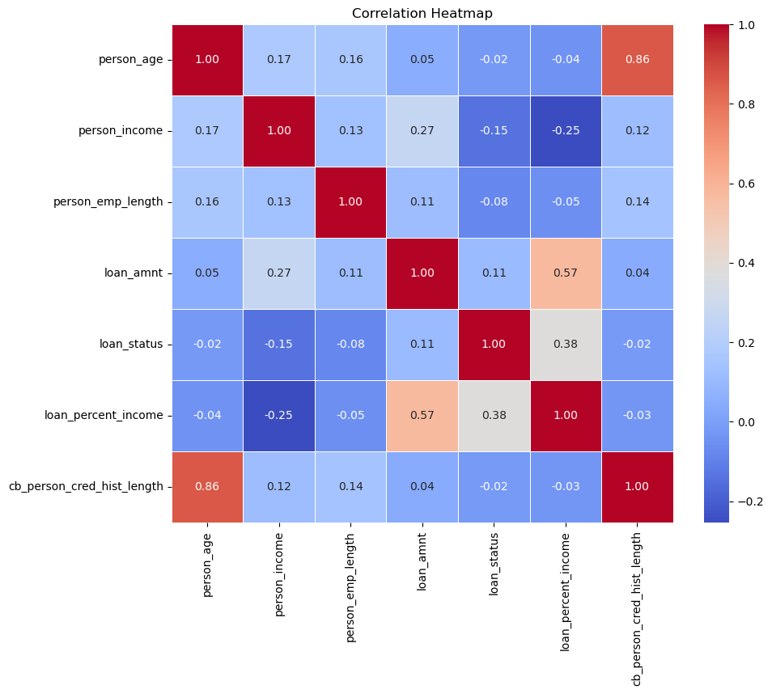
Numerical features

Slide 11
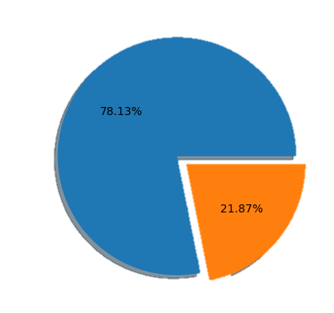
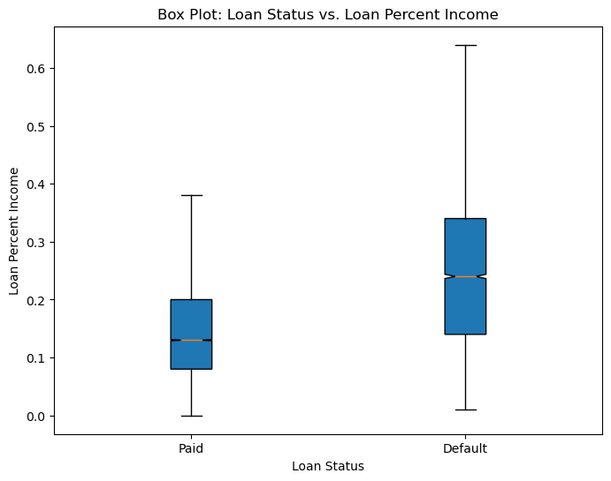
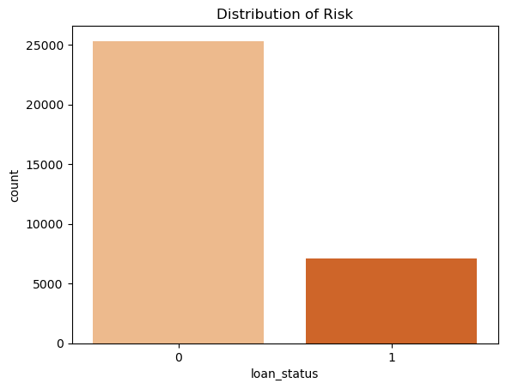
Target feature

Slide 12
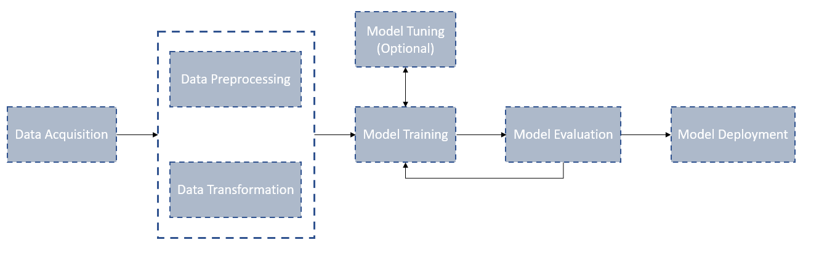
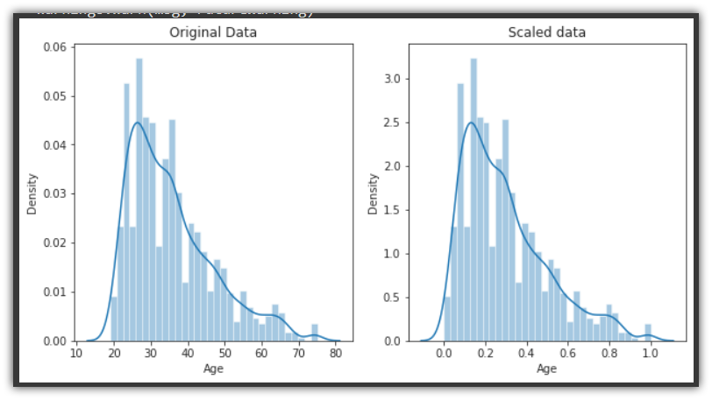
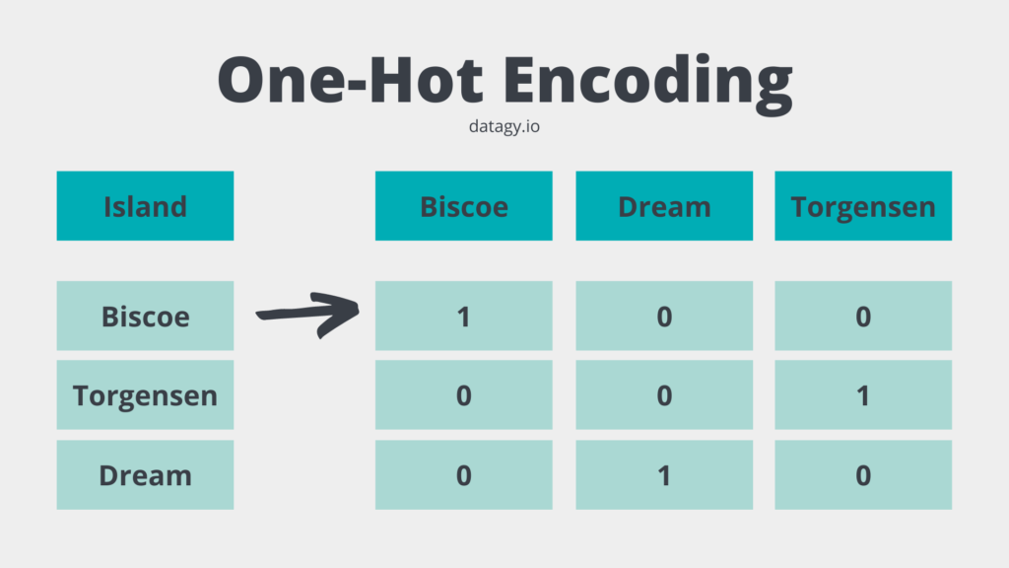
DATA PREPROCESSING :
Pipeline:
Preprocessing techniques
Iterative Imputer
Scaling
One-Hot Encoder

Slide 13
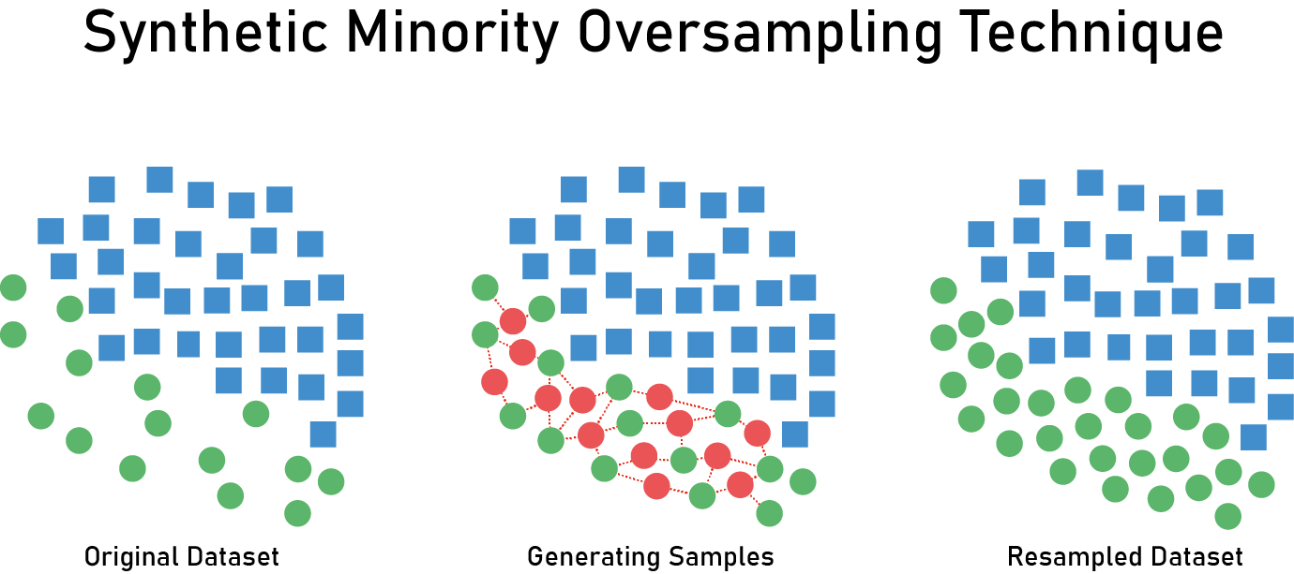
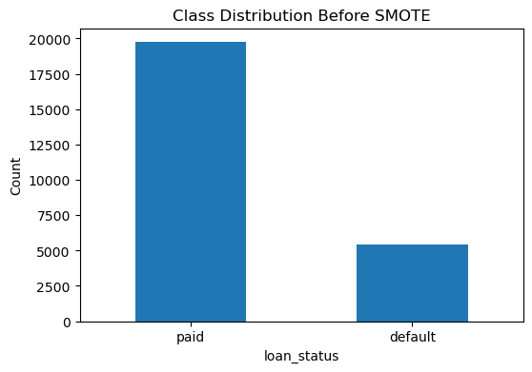
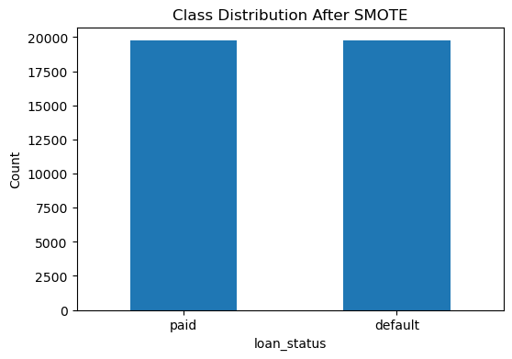
Handling Data Imbalance :
SMOTE is an oversampling technique designed to address the issues caused by data imbalance. It generates synthetic samples for the minority class by creating new instances that are similar to existing minority class instances.
SMOTE
SMOTE

Slide 14
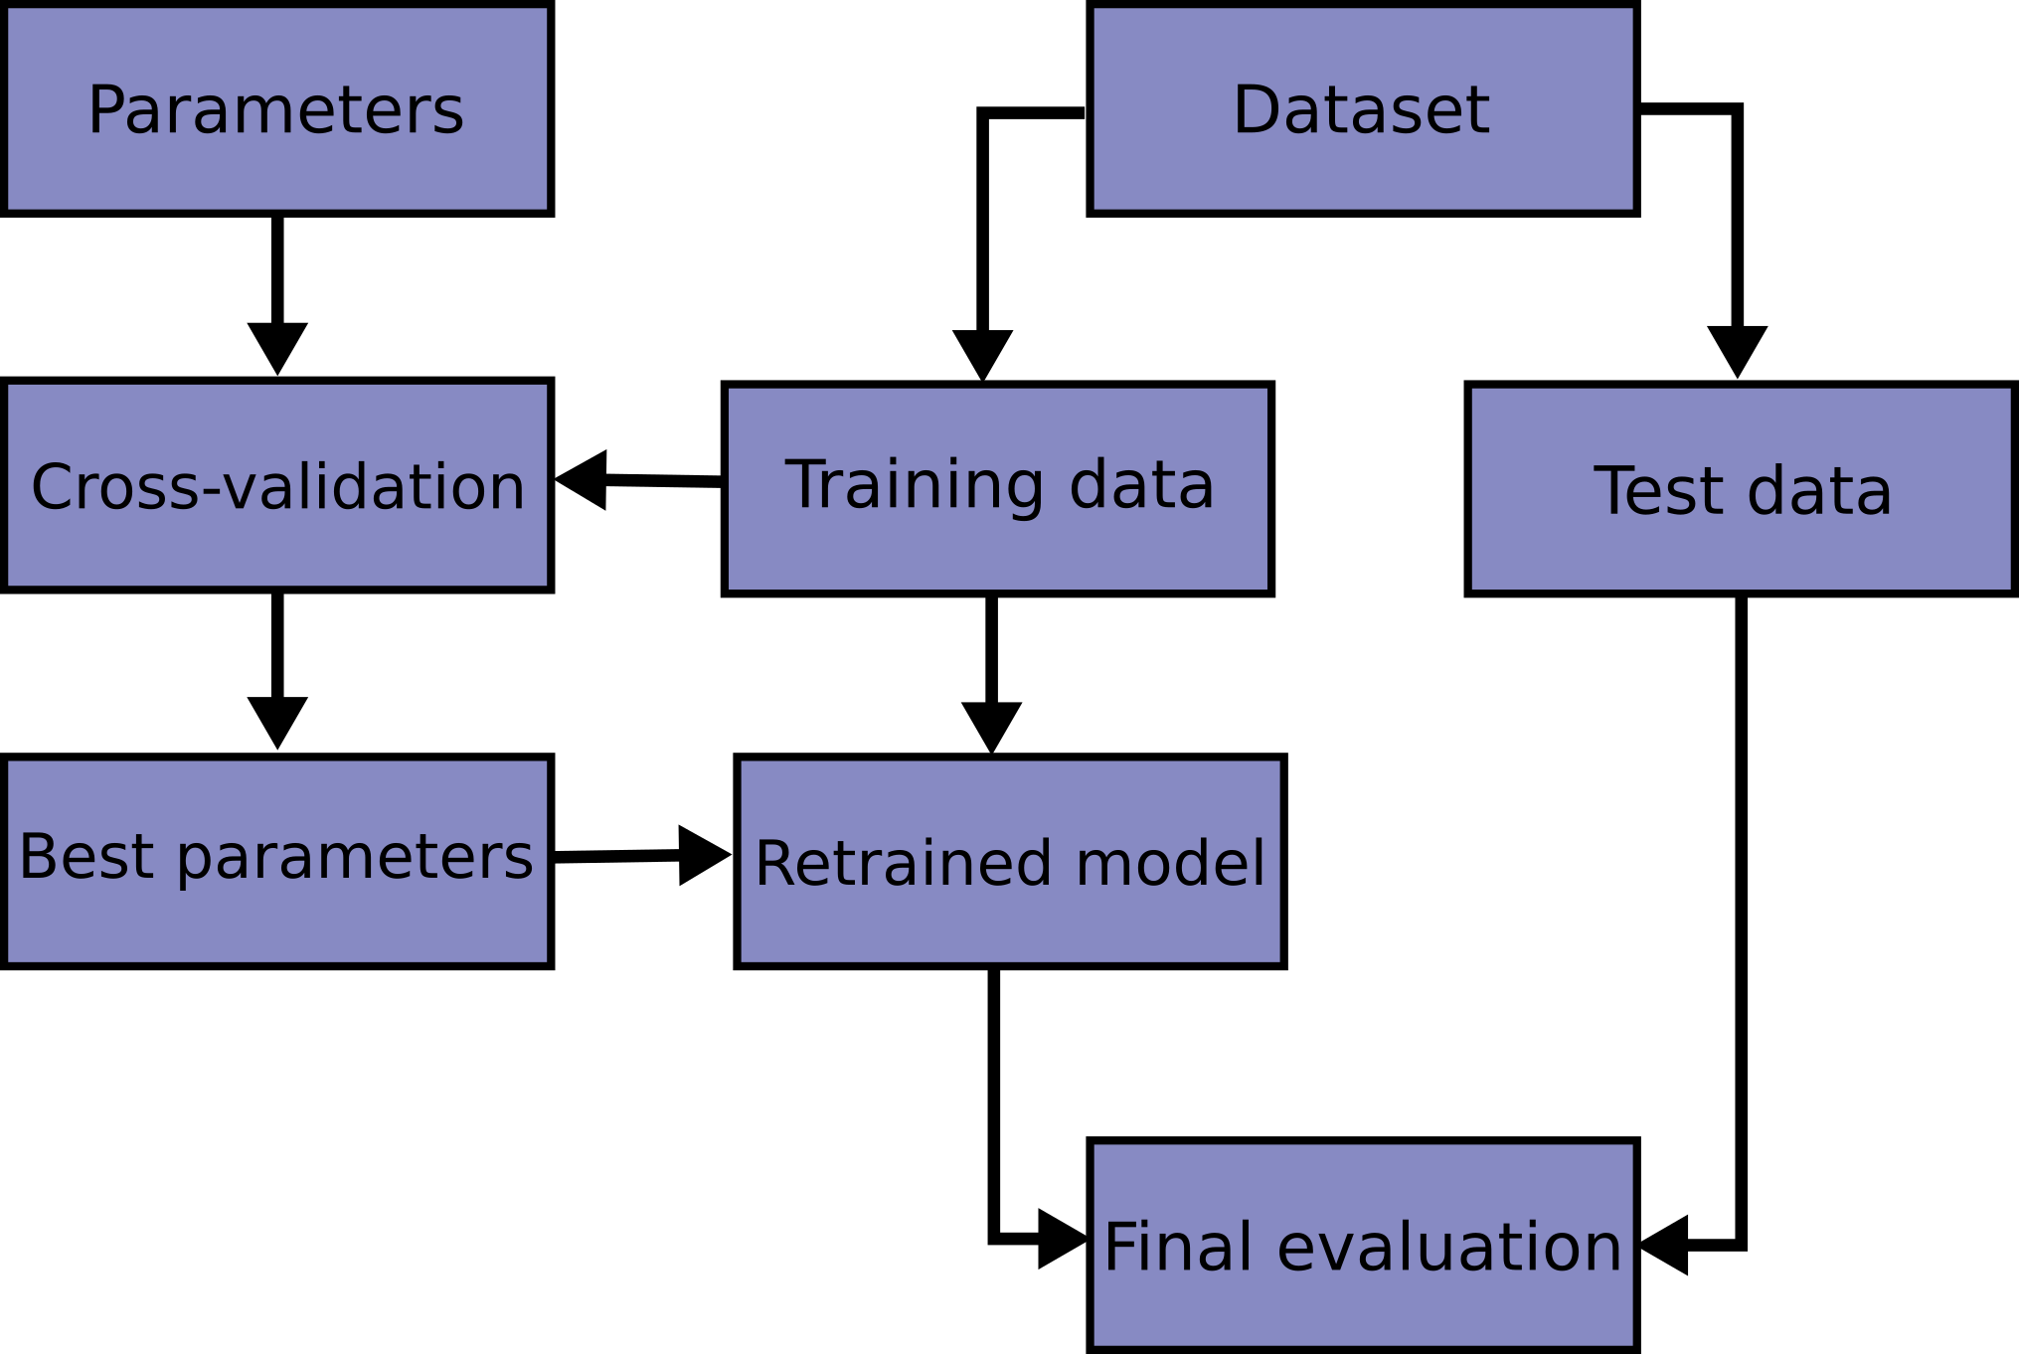
Model Selection and Hyper-parameter Tuning:
Logistic Regression
Cross-Validation
Random Forests
Gradient Boosting Algorithms
Support Vector Machines
Neural Networks

Slide 15
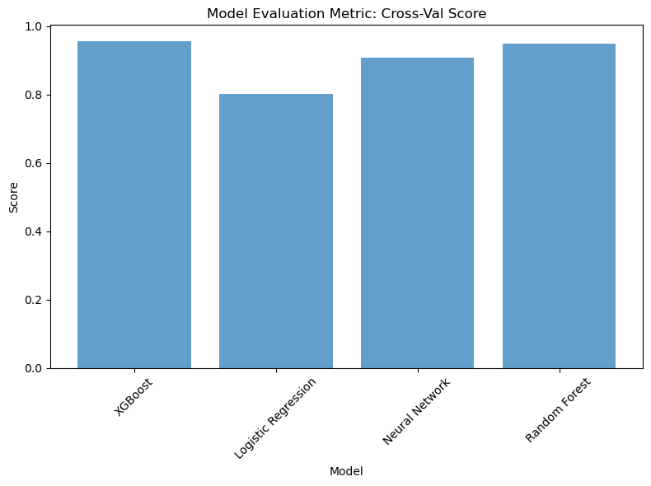
Model Evaluation
Cross-Validation Score :

Slide 16
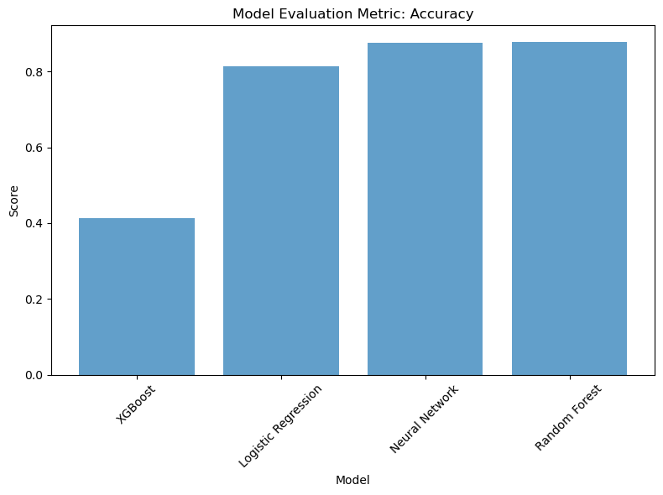
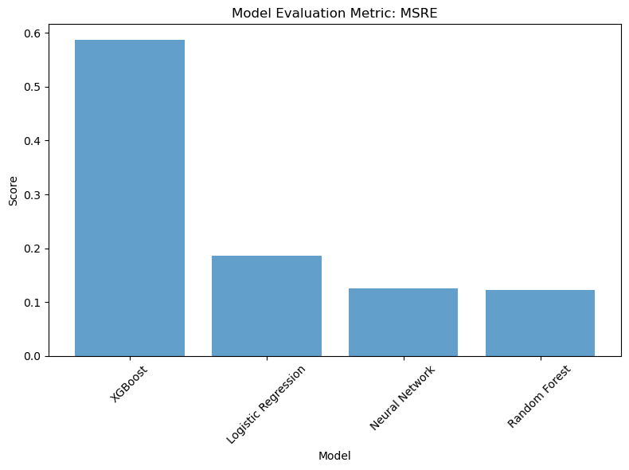
Accuracy
MSRE

Slide 17
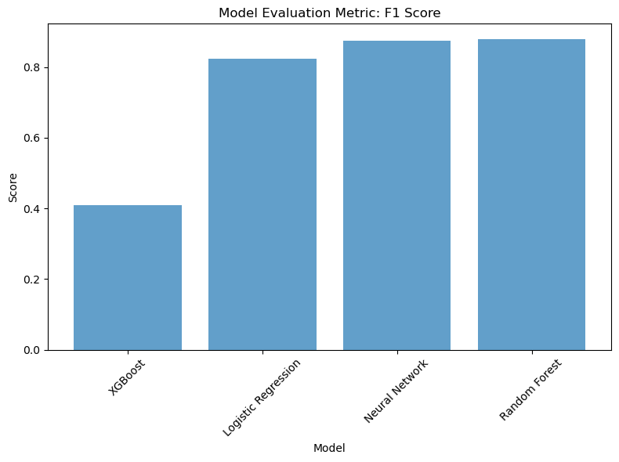
F1-SCORE

Slide 18
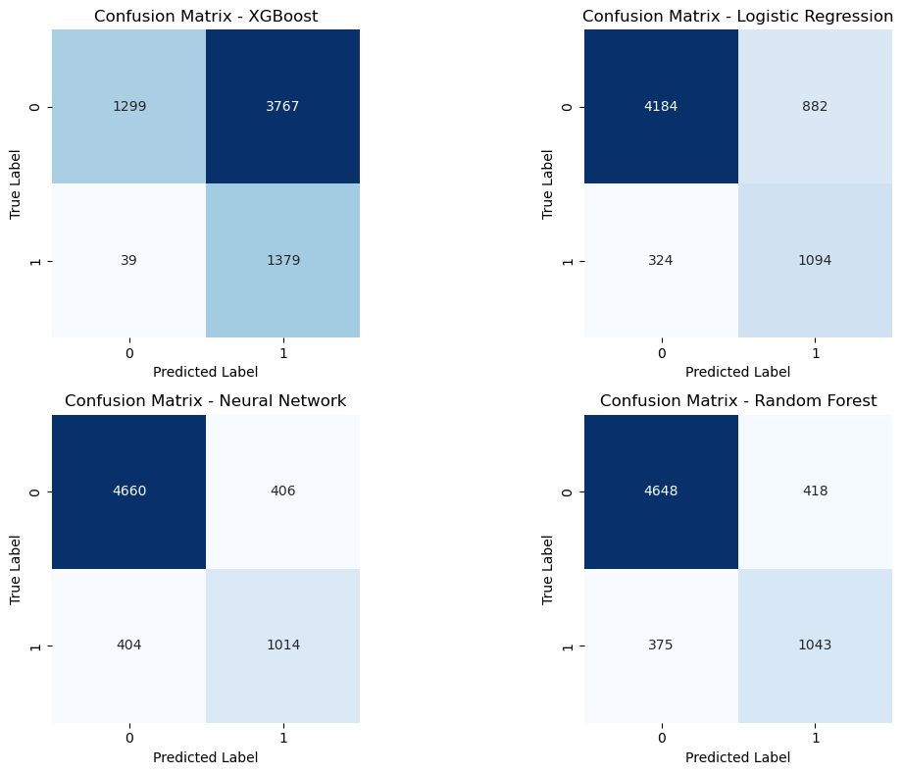
The confusion matrix
True Positive (TP): The model correctly predicted a positive class instance as positive.
False Positive (FP): The model incorrectly predicted a negative class instance as positive.
True Negative (TN): The model correctly predicted a negative class instance as negative.
False Negative (FN): The model incorrectly predicted a positive class instance as negative.
 | Correct classifications | Wrong classifications
XGBoost | 2678 | 3806
Random forest | 5691 | 793
Logistic regression | 5278 | 1206
Neural Network | 5674 | 810

Slide 19
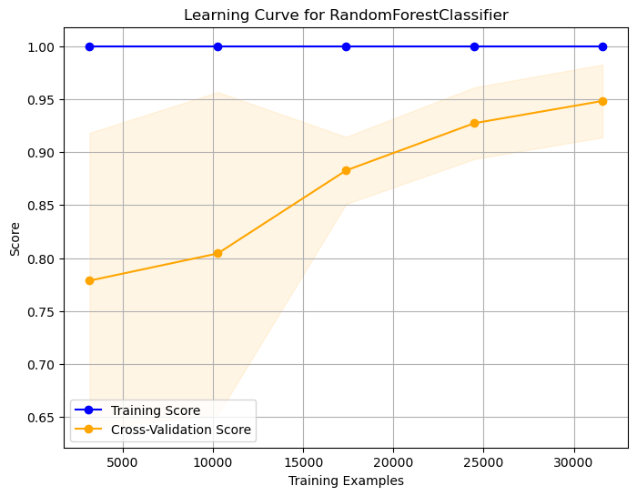
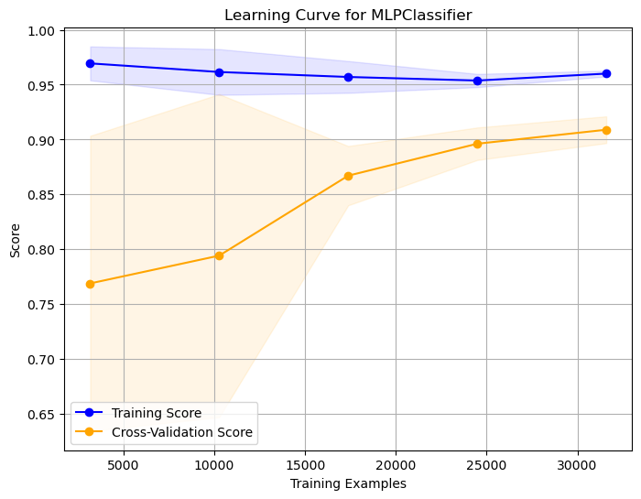
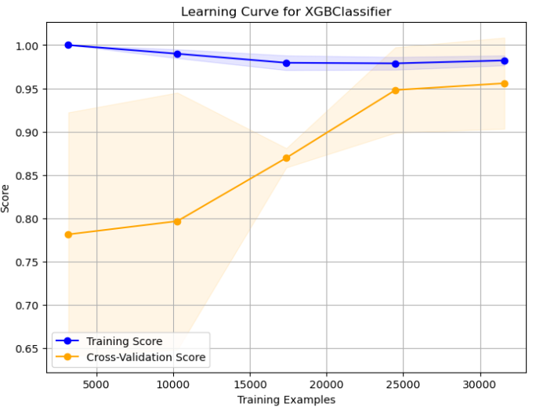
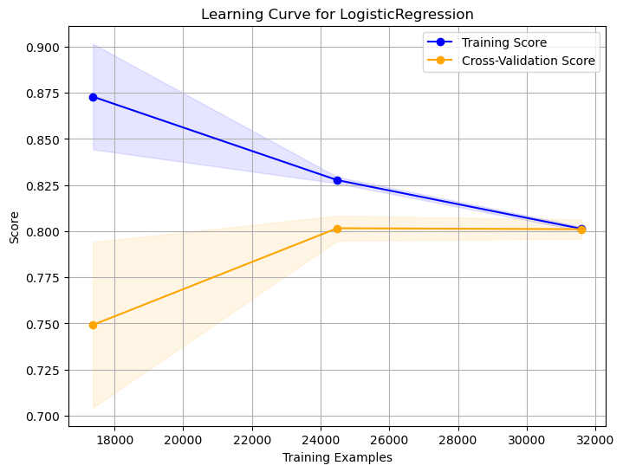
Learning Curve

Slide 20

DEMONSTRATION

Slide 21
CONCLUSION
In this research we discovered the world of credit risk analysis, presenting a long learning journey through various stages of data preprocessing, model development, and evaluation. By using a range of machine learning techniques and methods, this study has
demonstrated the potential of predictive models in assessing creditworthiness accurately.
In this project, we have been exposed to many concepts like:
--> Building a pipeline
--> Hyper-parameter tuning
--> Evaluating models
--> Building our first Streamlit application
--> Deploying it.

Slide 22


Any questions?
mohamed.islem.beggari@etu.univ-st-etienne.fr
THANK YOU FOR YOUR ATTENTION

