Slide 1

Introduction to Database
ISLEM BRAHAM © 2021

Slide 2
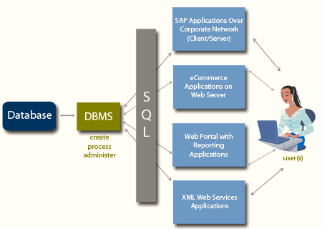
How Does The Database System Work ?
1

Slide 3
Database Management System (DBMS)
Definition & Features
Database Management System (DBMS) is a software application/tool used by end users to access the data stored in the database files. A DBMS is also used to perform administrative tasks on the database and objects contained within the database.
DBMS is a collection of applications that allow users and other programs to capture and analyze data by providing additional functionality like reporting services to help you create, deploy and manage reports for your organization.
This application is responsible for handling data requests, committing changes to the data and enforcing the structure of the database including:
Ensuring data is stored properly and that rules for defining data are not violated.
Providing a level of disaster recovery by which data can be restored to a consistent state.
Maintaining relationships between data entities residing in the database.
2

Slide 4
Relational Database Management System (RDBMS)
Definition & Features
Relational Database Management Software (RDBMS) is a software system designed to allow the definition, creation, querying and updating of data stored in a relational database.
A few examples of RDBMS include:
Microsoft SQL Server
PostgreSQL
MYSQL
Microsoft Access
Oracle
3

Slide 5
RDBMS VS DBMS
Differences
The main differences between DBMS and RDBMS are:
A DBMS has to provide some uniform methods independent of a specific application accessing the information that is stored in the tables.
RDBMS adds the additional condition that the system supports a tabular structure for the data, with enforced relationships between the tables.
DBMS does not impose any constraints or security with regard to data manipulation, while RDBMS does utilize an internal security model.
RDBMS is the basis for Structured Query Language (SQL).
4

Slide 6
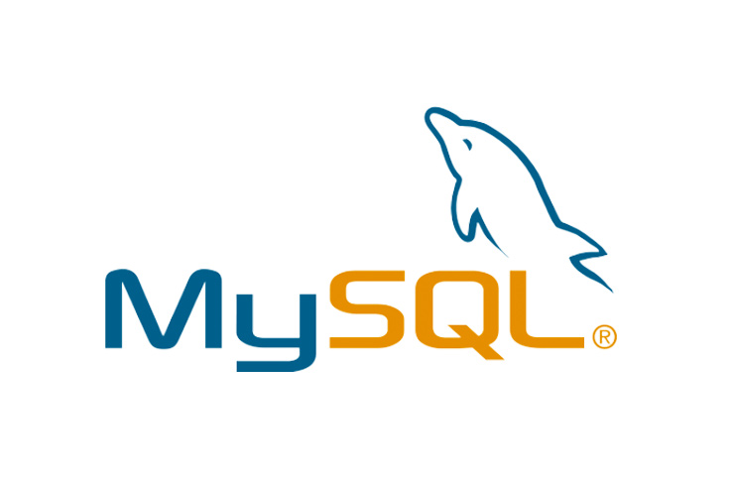
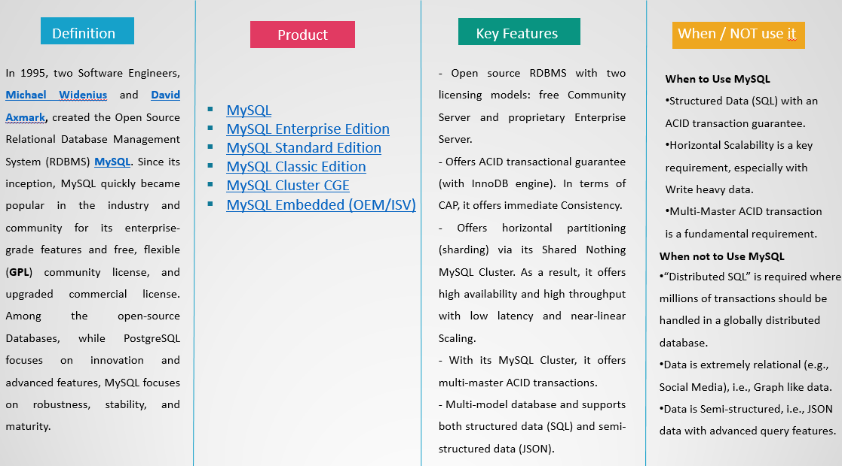
RDBMS Examples
MySQL
5

Slide 7

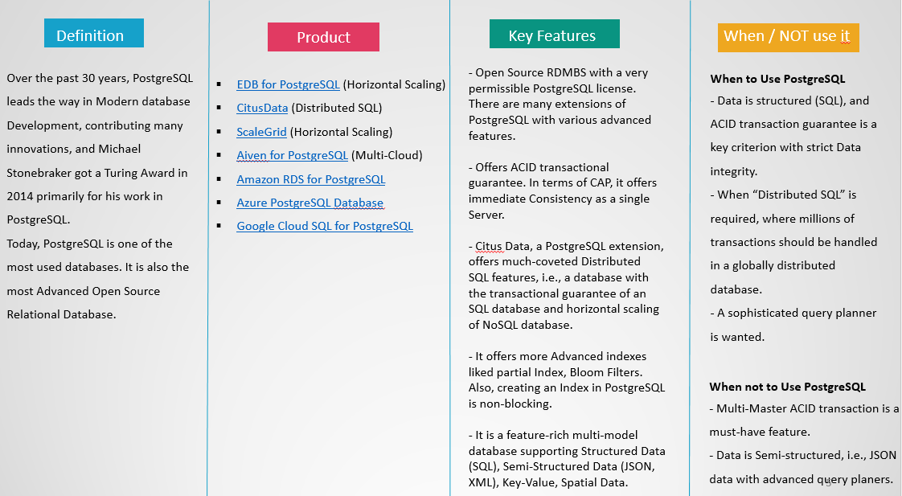
RDBMS Examples
PostgreSQL
6

Slide 8
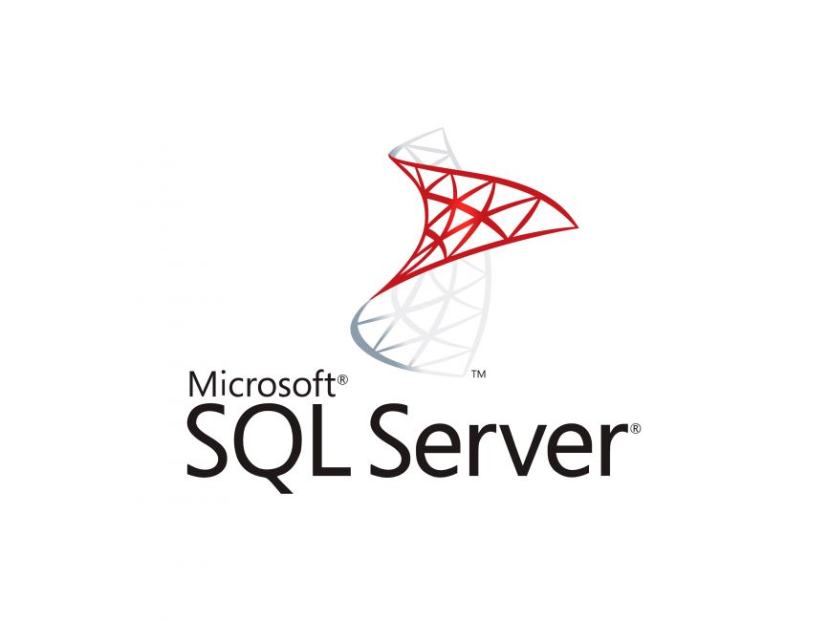
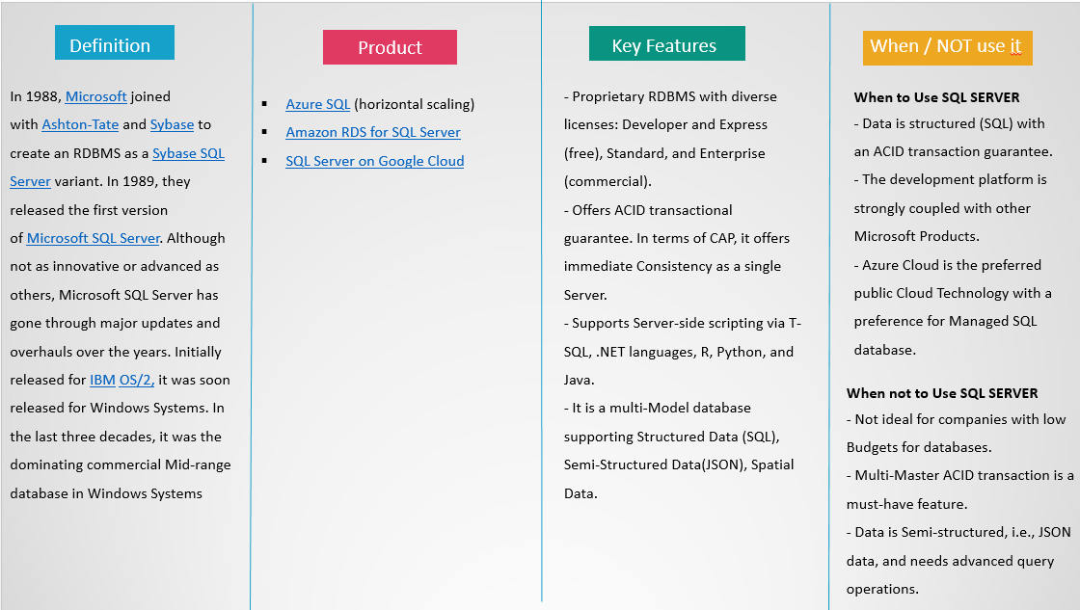
RDBMS Examples
Microsoft SQL Server
7

Slide 9
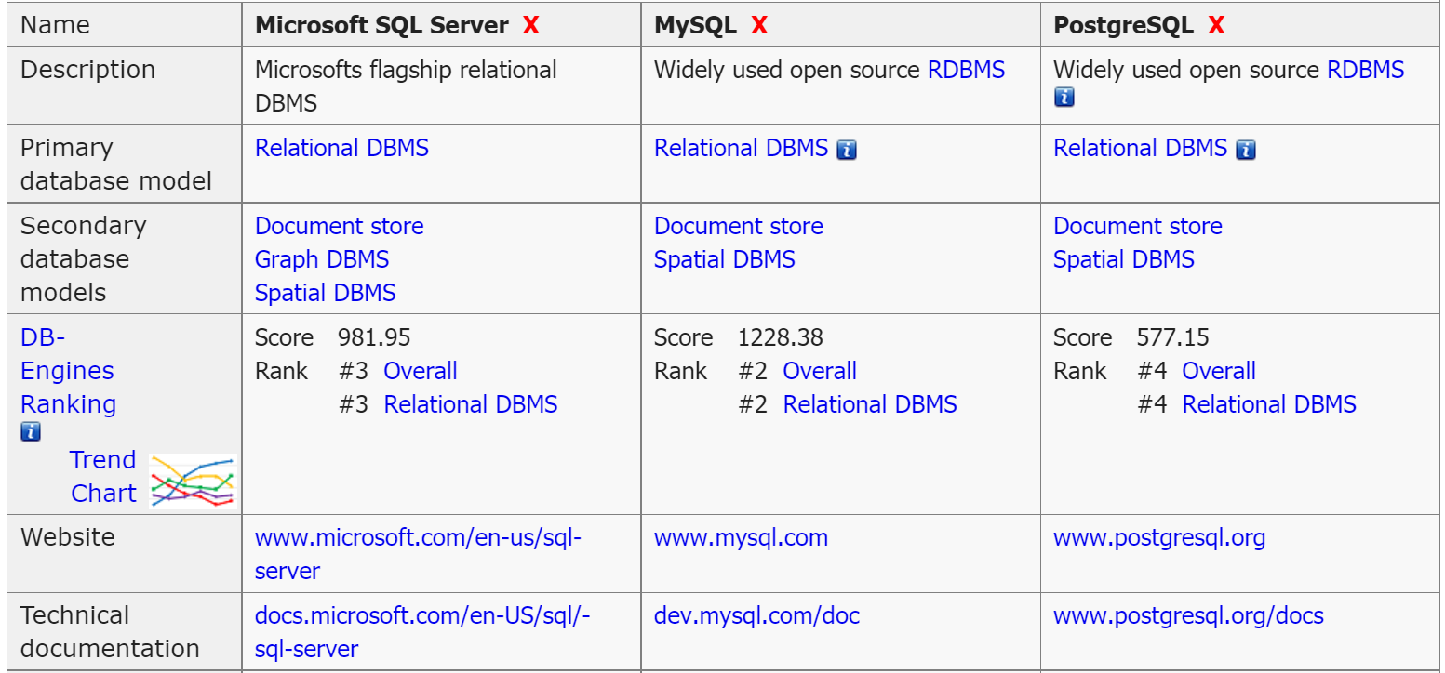
RDBMS Comparison
Microsoft SQL Server VS MySQL VS PostgreSQL
8

Slide 10
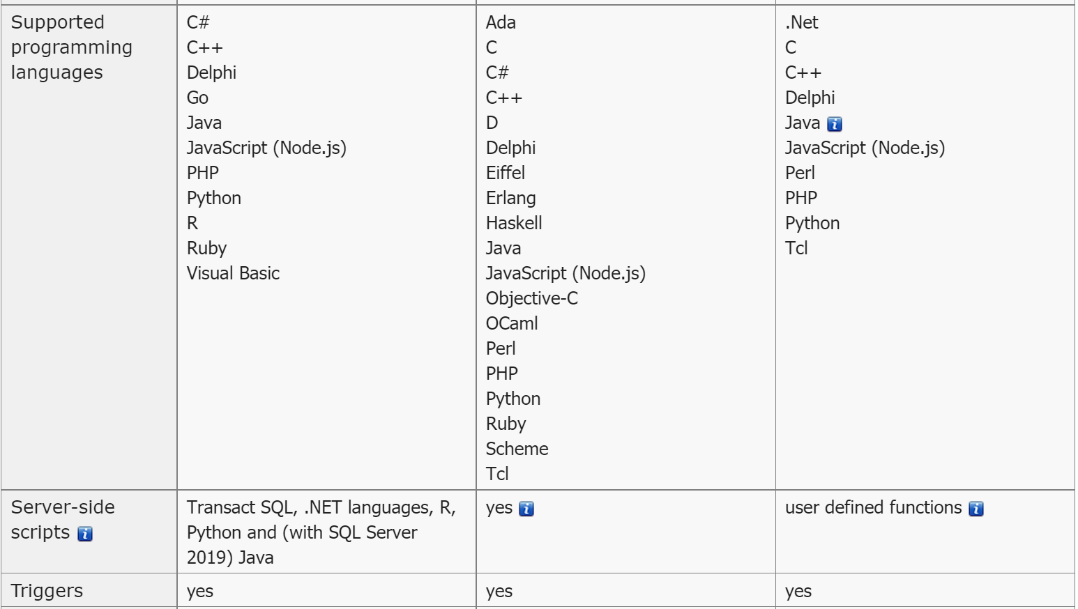
RDBMS Comparison
Microsoft SQL Server VS MySQL VS PostgreSQL
9

Slide 11

Thank You
10

