Slide 1
CSD310
Red Team Milestone
Ryan Monnier, Zach King, Jacob Achenbach
1-Mar-2025

Slide 2
Red Team Introduction
Ryan Monnier
TSgt in the USAF, since 2016. Previously served as an airborne Arabic linguist, currently training into offensive cyber operations
Zach King
A passionate software engineering student currently pursuing their degree at Bellevue University. With a strong foundation in IT principles and graphic design, they have cultivated a deep interest in software development, system architecture, and emerging technologies.
Jacob Achenbach
Been studying Computer Science since 2020. I have worked on various of projects and developer teams in the last two years.

Slide 3
Case Study Overview
Bacchus Winery: Inherited by Stan and Davis Bacchus from their father, George
Goal: Improve products and customer service using modern business methods
Current Operations:
Employees: Janet Collins (Finance), Roz Murphy (Marketing), Henry Doyle (Production), Maria Costanza (Distribution)
Products: Merlot, Cabernet, Chablis, Chardonnay
Suppliers: Bottles & corks, labels & boxes, vats & tubing
Business Challenge: Track inventory, distribution, employee work hours and also allow distributors to order online

Slide 4
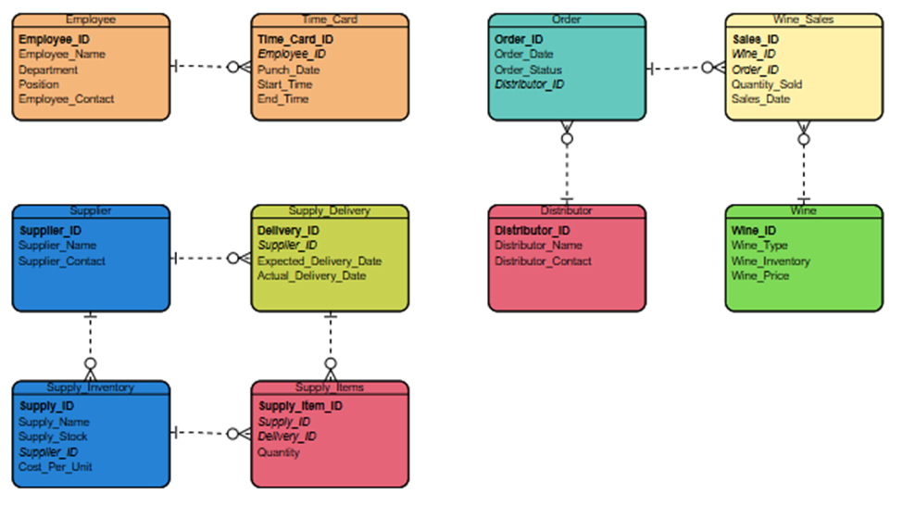
ERD

Slide 5
Reports Generated
We generated three key reports based on the needs of the winery:
Supplier Delivery Timeliness Report
Analyze if suppliers deliver on time and track delays
Wine Sales and Distribution Report
Evaluate wine sales, distributor performance, and inventory levels
Employee Time Report
Track employee working hours over the last four quarters.

Slide 6
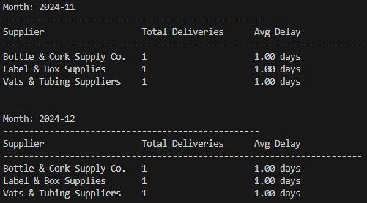
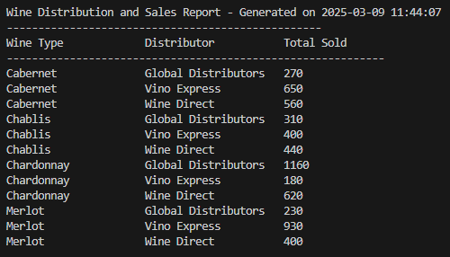
Reports Generated - Supplier Delivery Timeliness
Monthly report tracking delays of supply shipments from the suppliers of Bacchus Winery
This will allow management to analyze supplier timeliness trends and make the best decisions going forward

Slide 7
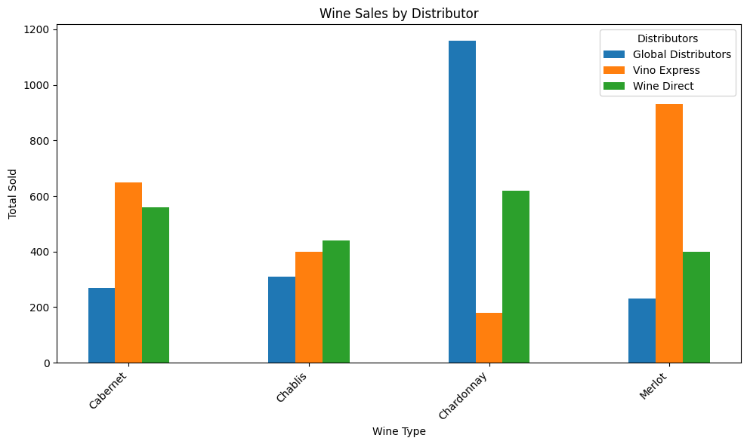
Reports Generated – Annual Wine Sales and Distribution
The bar graph for wine sales and distribution gives a clear overview of which distributors are ordering which wines.
We can see that our Chardonnay is most popular, by far, among the Global Distributors.

Slide 8
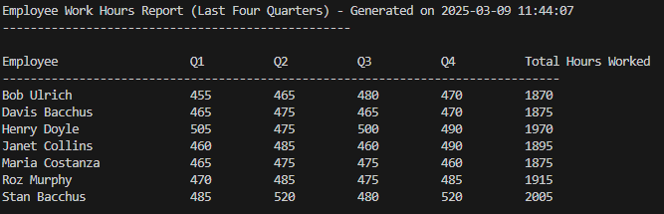
Reports Generated - Employee Time Report
The employee work hours report allows Bacchus Winery management to analyze quarterly reports on employee work hours.

Slide 9
Assumptions
Data Availability: Assumed that all relevant data for deliveries, sales, and time worked is accurately recorded in the database
Supply Delays: Assumed that suppliers' delay dates are recorded and provided in a timely manner
Wine Distribution: Assumed the winery's sales data reflects accurate sales figures per distributor and wine type
Employee Time Tracking: Assumed that employee time cards are correctly filled and submitted monthly

Slide 10
Conclusions
Supplier performance is generally on time but some delays were noticed, particularly in the early months of 2024
Wine sales are varied, with Merlot and Chardonnay performing well, but Cabernet and Chablis sales may need attention
Employee work hours seem to be steady and consistent, with only small deviations

