Slide 1

DevOps
Ryan Monnier
27-September-2025
Implementing a Just Culture
CSD 380
Module 9

Slide 2
What Is “Just Culture”?
Just Culture Definition:
Balancing system accountability with personal responsibility; distinguishing human error, at-risk behavior, and reckless behavior
Why it matters:
Encourages reporting, improves patient safety, reduces fear, promotes learning.

Slide 3
Common Barriers to Implementing a Just Culture
Leadership Resistance & Inconsistent Accountability
Punitive Policies & Structures
Fear Among Staff & Reporting Hesitancy
Ambiguity in Behavior Classification & Training Gaps
Cultural Inertia & Resource Constraints

Slide 4
Barrier #1 – Leadership Resistance & Inconsistent Accountability
Many leaders are uncomfortable with reducing punitive responses (fear of liability, public perception)
Inconsistent enforcement: some reckless behaviors are punished, some are not; bias between roles (e.g. physicians vs. nurses)
Lack of clarity on what behaviors are considered “reckless”

Slide 5
Barrier #2 – Policies & Structures That Reinforce Punitive Culture
Existing policies might mandate discipline for errors, tied to outcomes rather than behavior or system failures
Bylaws, codes of conduct, job descriptions that don’t align with just culture principles
Investigative procedures that focus on who is at fault rather than how the system failed

Slide 6
Barrier #3 – Fear Among Staff & Reporting Hesitancy
Staff may fear retribution, blame, or punishment, so they under-report incidents or near misses
Cultural norms that blame individuals if things go wrong, especially when harm has occurred
Lack of trust that reported issues will be handled fairly

Slide 7
Barrier #4 – Ambiguity in Behavior Classification & Inconsistent Training
Differentiating among “error,” “at-risk behavior,” and “reckless behavior” can be hard. These are nuanced categories
Without consistent training, employees may misunderstand expectations
Different interpretations across units or roles lead to perceived unfairness

Slide 8
Barrier #5 – Cultural Inertia, Resource and Implementation Constraints
Long-standing blame culture habits are hard to change
Resource constraints: time, leadership commitment, training, data systems to support learning
Lack of alignment in incentives or metrics (if metrics penalize errors rather than reward improvements)

Slide 9
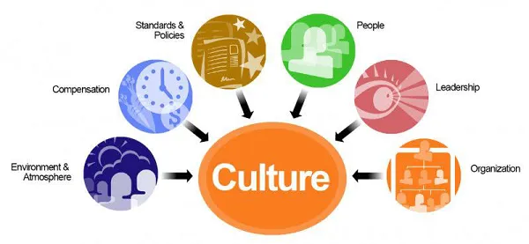
Elements of a “Just Culture”
All components need to work towards creating the same culture

Slide 10
Strategies & Recommendations for Overcoming Barriers
Leadership education & commitment: ensure that those at top understand just culture, commit to its principles
Policy review & revision: remove or change punitive policies that discourage reporting; clarify expectations
Consistent training & behavior algorithms: teaching the difference among error, at-risk, reckless behavior
Build trust & psychological safety: encourage reporting without fear of unjust punishment
Metrics & feedback: measure culture, get staff input, monitor consistency of accountability.

Slide 11
Conclusion
While just culture offers many benefits, implementation faces serious challenges
The biggest barrier is often mindset + fear. Without addressing leadership, policies, and staff perceptions, efforts may stall
With deliberate work, training, clear policies, and resources, organizations can shift toward a just culture that supports learning and safety

Slide 12
References
Advanced Clinical Solutions. (n.d.). How can health & social care create a culture of patient safety? https://www.advancedclinicalsolution.co.uk/how-can-health-social-care-create-a-culture-of-patient-safety
Boysen, P. G., II. (2013). Just culture: A foundation for balanced accountability and patient safety. The Ochsner Journal, 13(3), 400-406. https://www.ncbi.nlm.nih.gov/pmc/articles/PMC3776518/
Fridell, K., & colleagues. (2023). Requirements for implementing a ‘just culture’ within healthcare organizations: An integrative review. [Journal name if available]. https://www.ncbi.nlm.nih.gov/pmc/articles/PMC10186448/
Page, A. H. (2007, October 1). Making just culture a reality: One organization’s approach. PSNet, Agency for Healthcare Research and Quality. https://psnet.ahrq.gov/perspective/making-just-culture-reality-one-organizations-approach

