Slide 1
Web stack: react.js
WDD230
Ismael Rojas

Slide 2
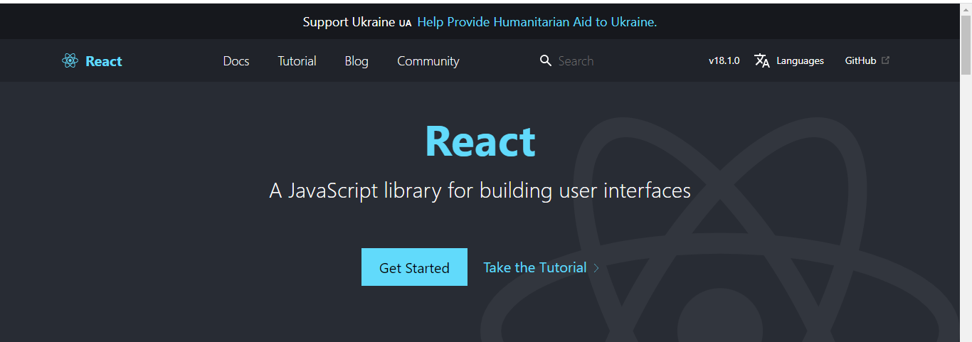
What is React?
React is a library for building user interfaces and can be used to build mobile applications.

Slide 3
How does React use JavaScript?
React utilizes features of modern JavaScript for many of its patterns. Its biggest departure from JavaScript comes with the use of JSX syntax. JSX extends JavaScript’s syntax so that HTML-like code can live alongside it. For example:
const heading = <h1>Mozilla Developer Network</h1>;
Let’s see the code!

Slide 4

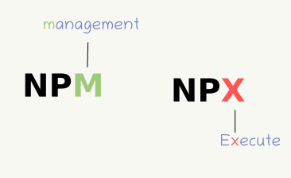
What are the requirements to use react?
This Photo by Unknown Author is licensed under CC BY

Slide 5
Making the first app
Install Node.js
Initialize the App
Exploring the first component - <App/>
Import
App component
Export

Slide 6
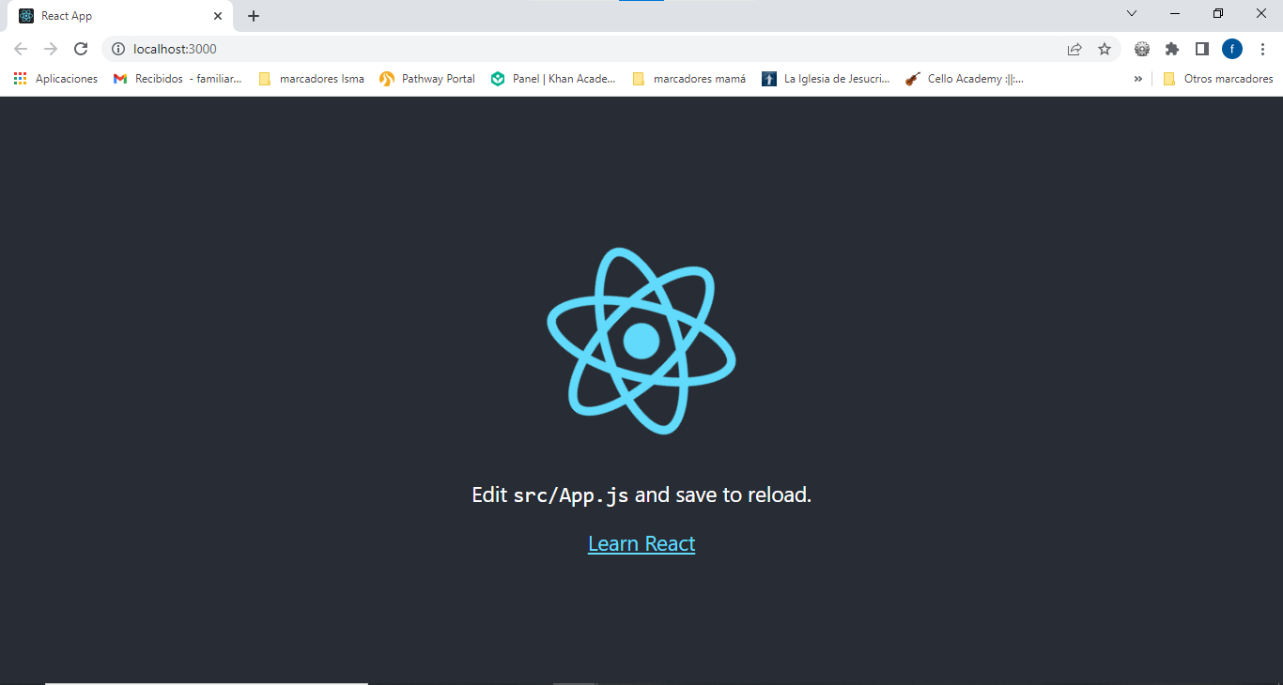
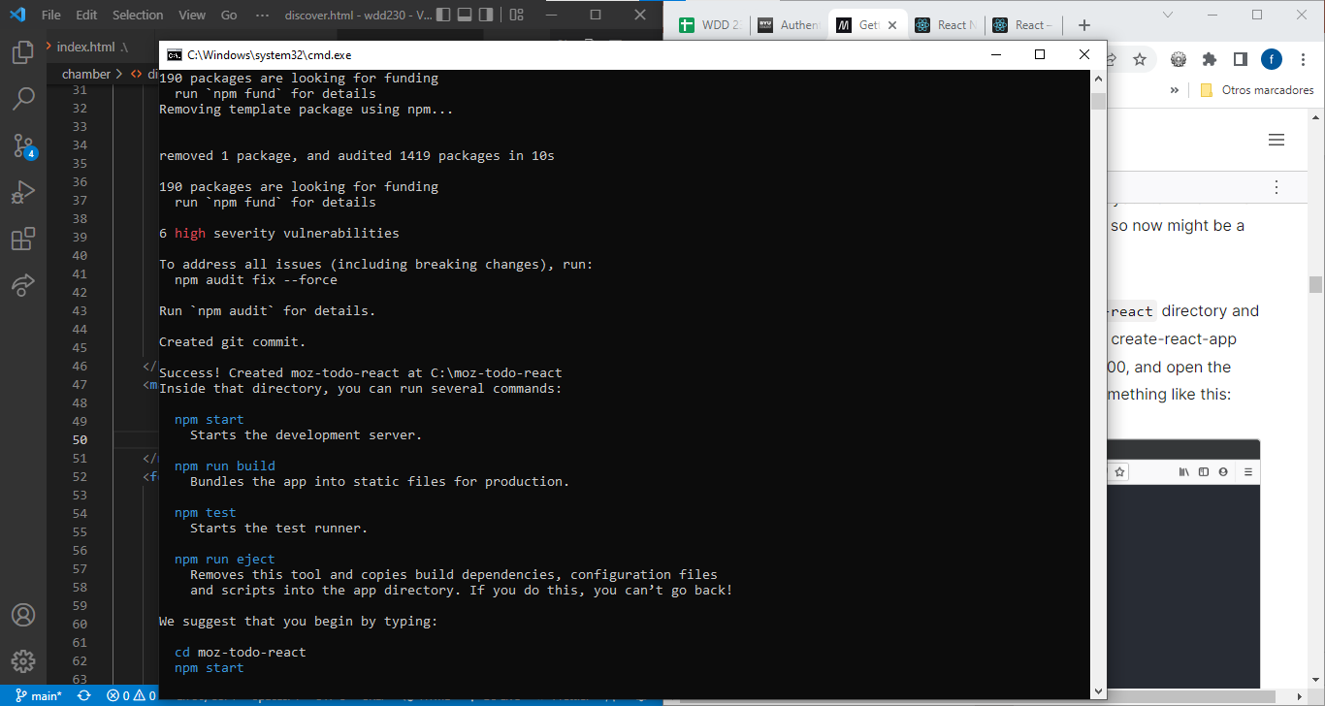
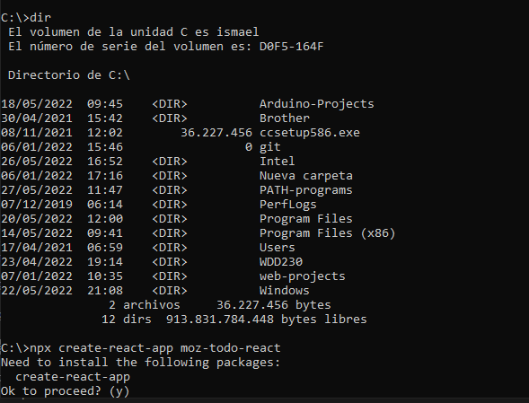
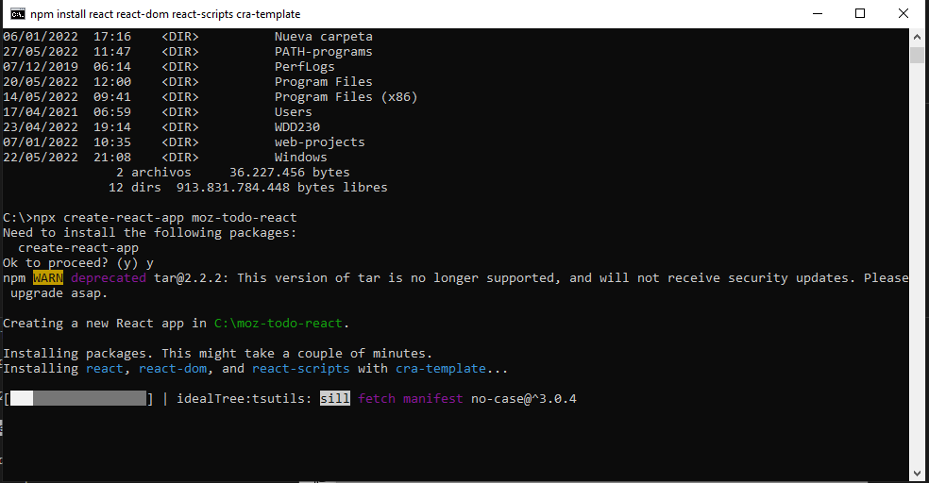
Installing node.js & Initializing the app

Slide 7
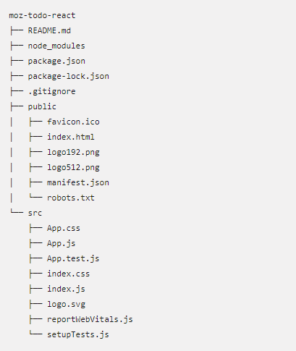
Application structure

Slide 8
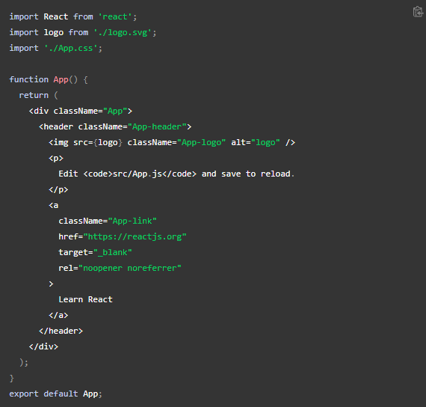
Exploring App code - IMport

Slide 9
Exploring app code – App component

Slide 10
Exploring app component - export

