Slide 1
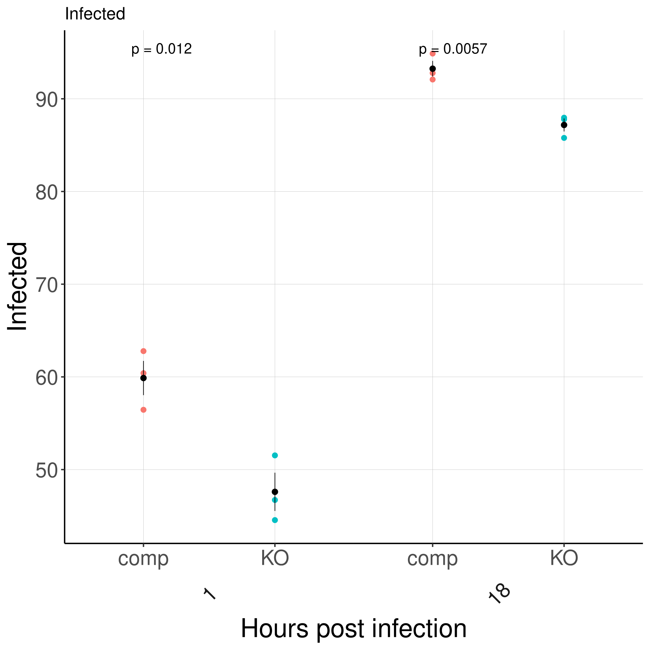
Percent Infected of BV2 cells
Is there a phagocytosis or control difference difference?

Slide 2
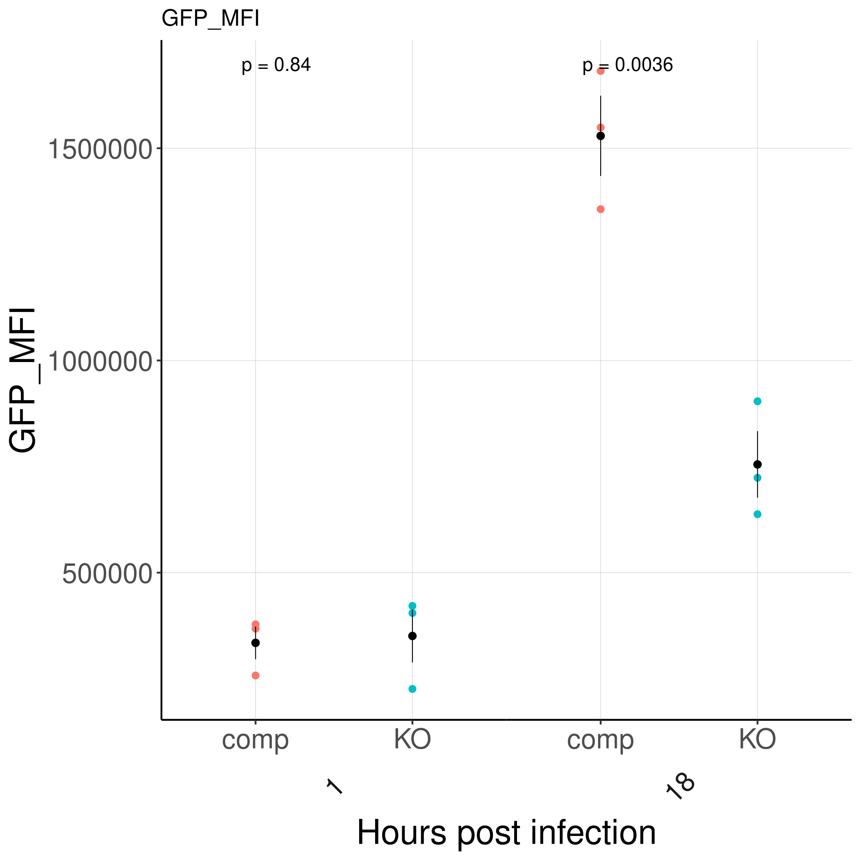
GFP_MFI of BV2 cells
Is there a phagocytosis or control difference difference?

Slide 3
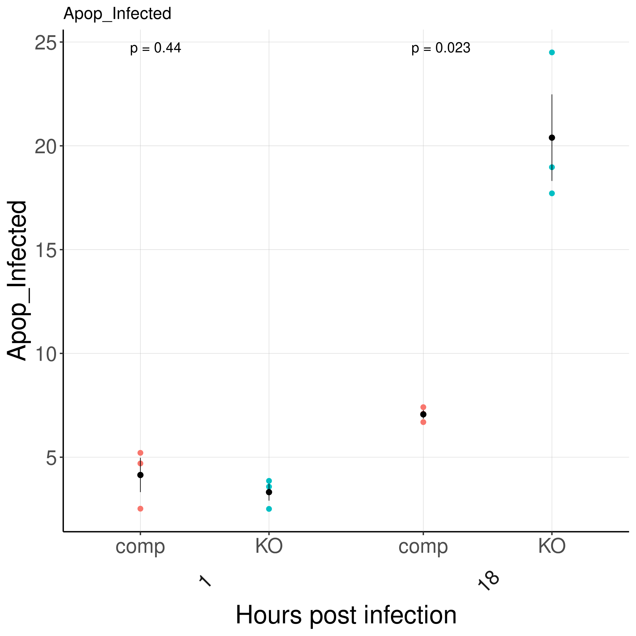
Percent FLICA+ of infected cells
Is Sptlc2 required for survival of mycobacterial infection?

Slide 4
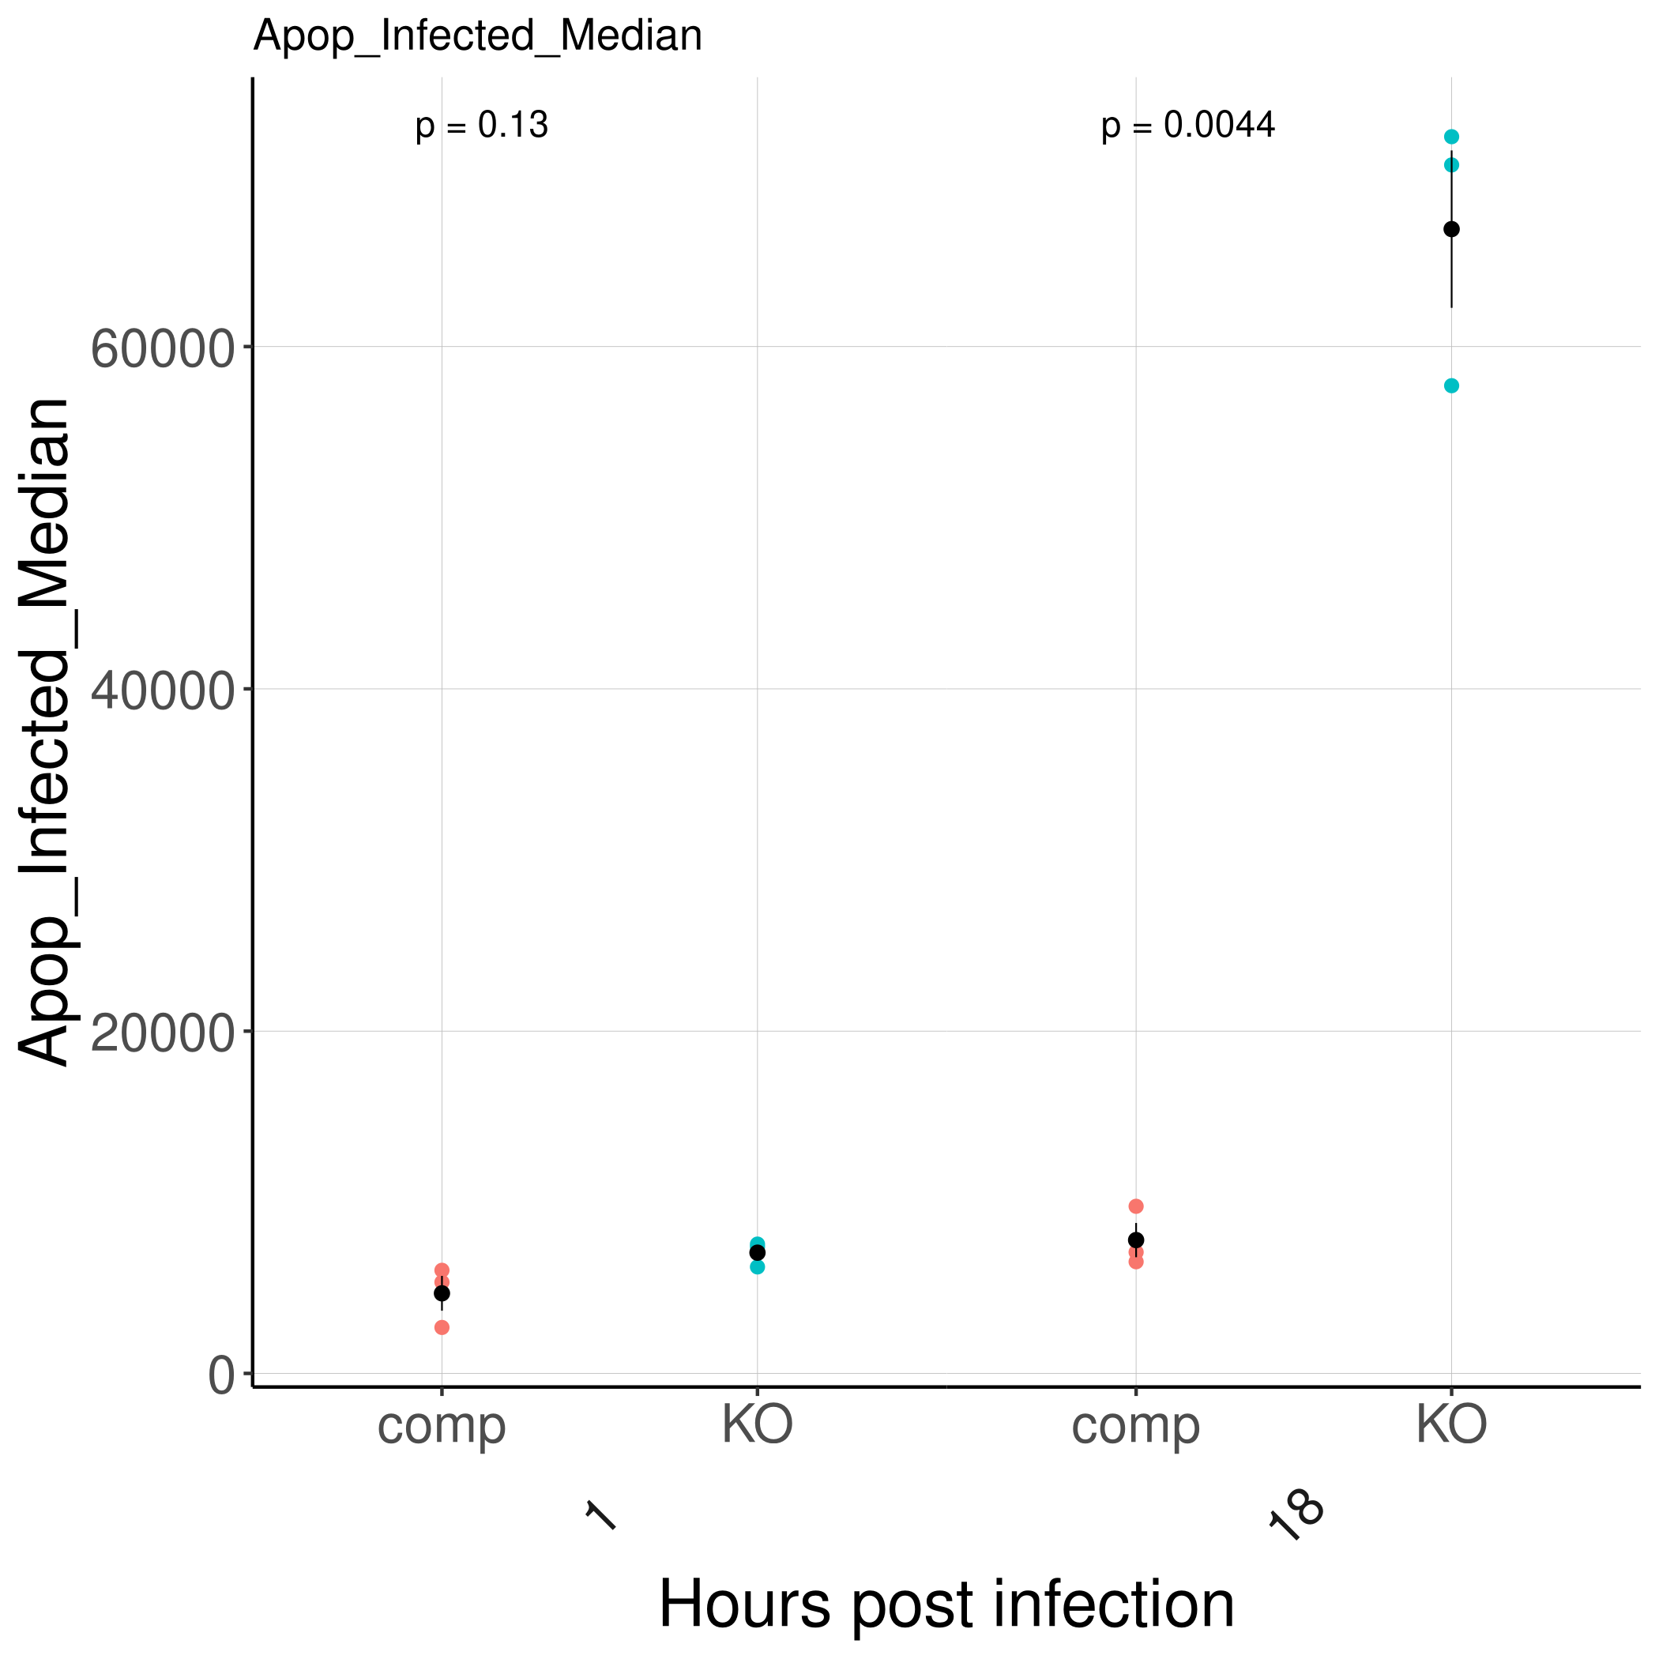
FLICA+ of infected cells

Slide 5
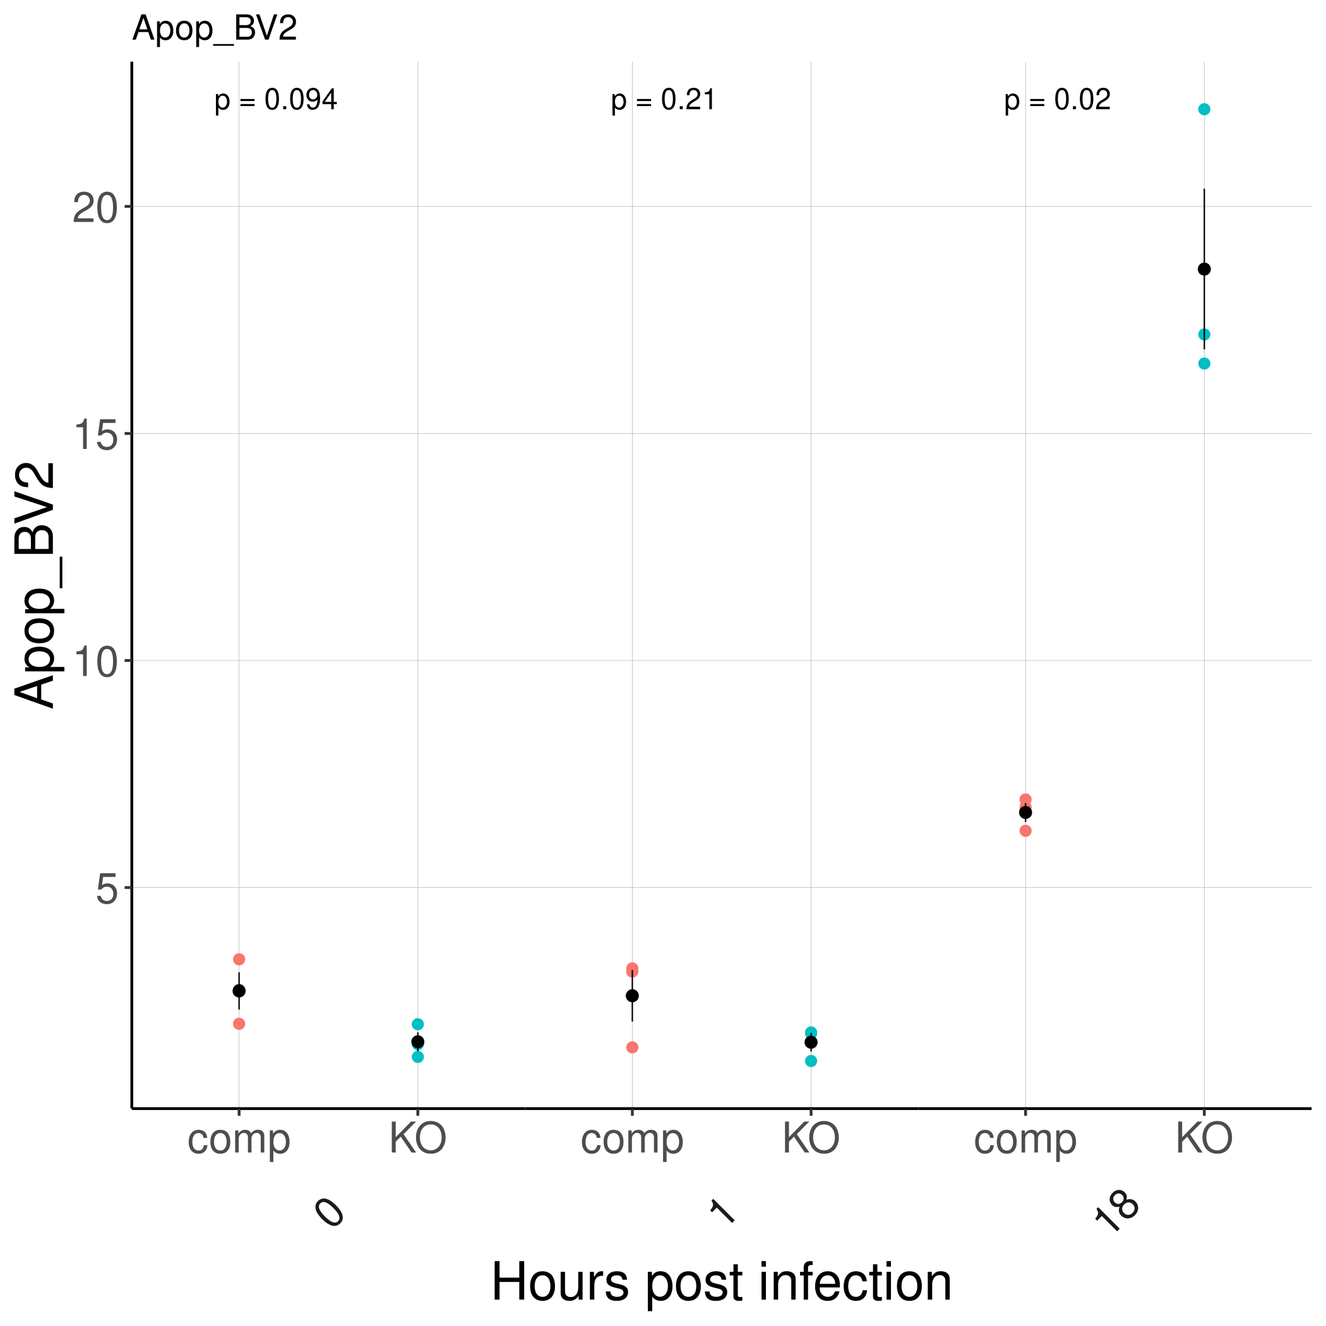
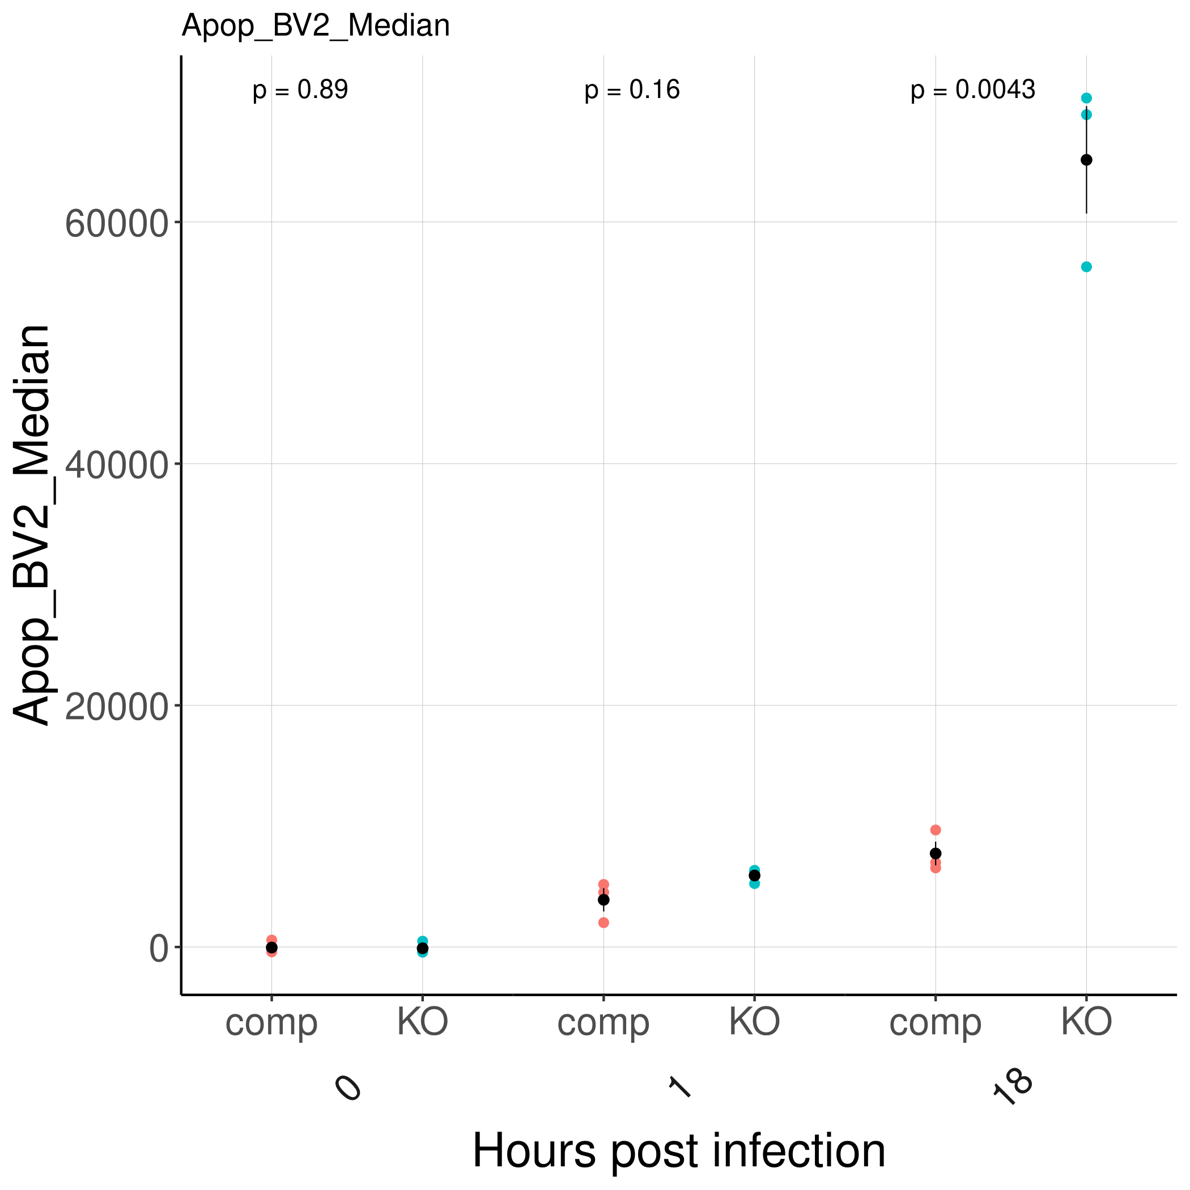
FLICA+ of BV2 cells

