Slide 1
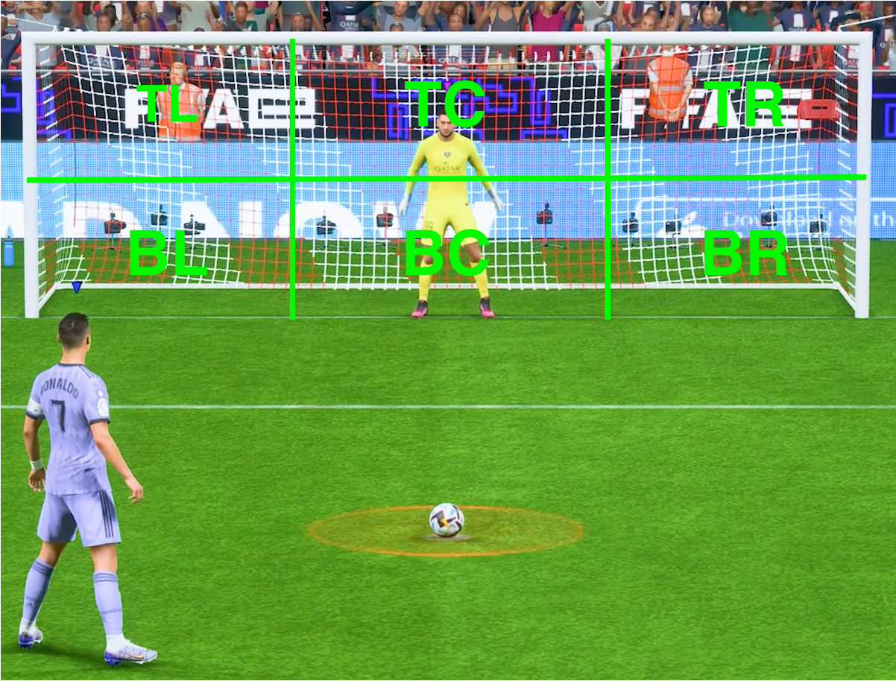
Analyzing Human Motion for Predicting Penalty Direction in Football
Supervisor : Saeed Saadatnejad
Berrada Ismael
Communication Systems
8 credits
Decléty Tanguy
Robotics
8 credits

Slide 2
What is the problem
Predicting the direction of a penalty kick solely based on the kicker's run-up remains a challenging task in sports analytics.

Slide 3
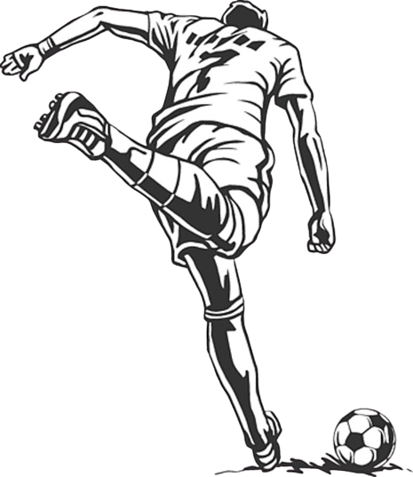
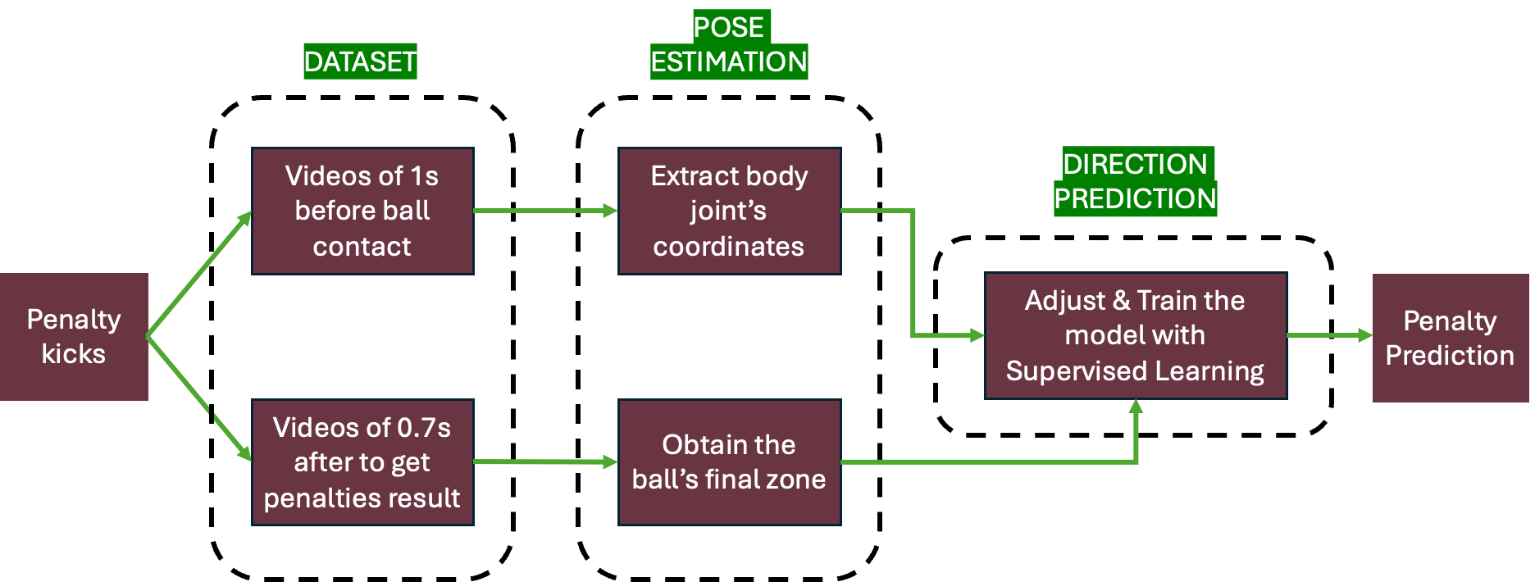
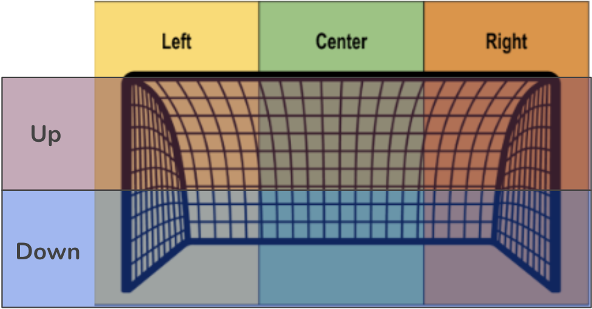
Detailed Statement: "The project aims to predict the direction of a penalty kick by analyzing the pose and run-up of the kicker in the second before the kick."

Slide 4

Quick reminder :
Already accomplished | What is left
-> Collecting data : 1000 FIFA videos and some real videos but of poor quality for the pose estimation -> Standardization of videos -> Initial development of the pose estimation model | -> Improve the pose estimation model for real and fifa videos -> Expand dataset & enhance the automatic labeling -> Implement & train the model based on ST_Trans

Slide 5
Since the midterm presentation

Slide 6
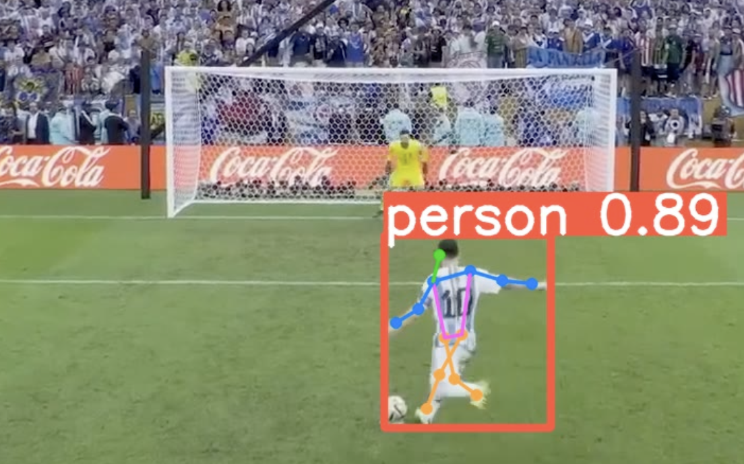
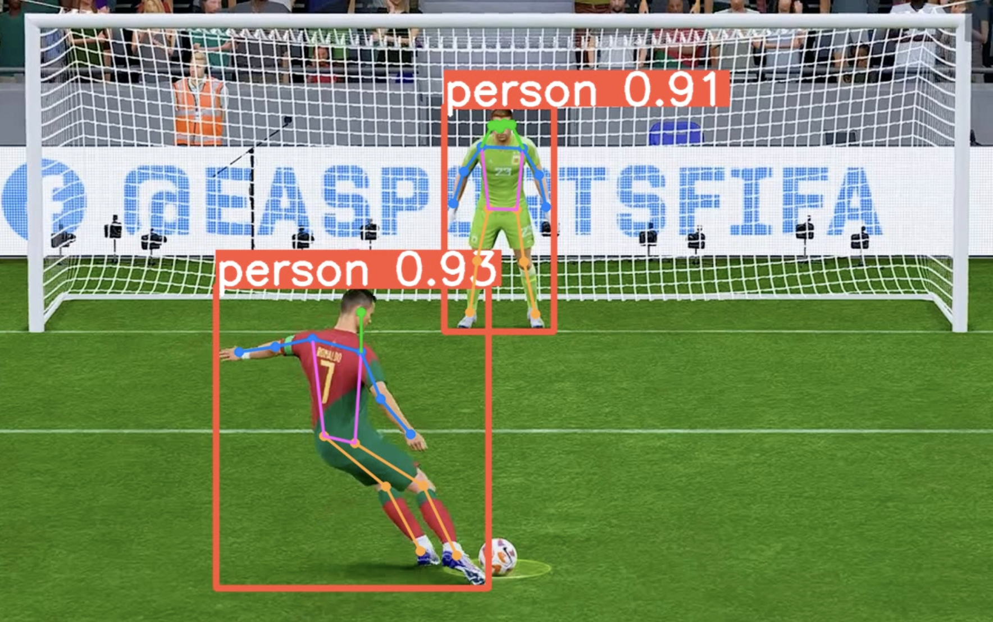
Pose estimation
Implementation of a new pose estimation model
Yolov8 (latest version of pose estimation model)
Extracting important key points
Implementing certainty score for each key point

Slide 7

Expanding Dataset
Standardization of the input :
30 frames : 12 body joints coordinates (x,y, certainty score)
30*36 → 1’080 inputs per penalty
Enhancement of automatic labeling
More than 1’500 videos in total :
125 penalties from real footage
1’385 from FIFA 23

Slide 8

Model Implementation
Inspired from ST_Trans model
4 convolutional layers for feature extraction
8 transformer layers to focus on different aspects of the data
8 residuals blocks to refine learned features across layers
37.29 % | 2.03 % | 17.04 %
21.42 % | 0.23 % | 21.81 %
Unbalanced dataset :
To avoid overfitting → reduced to 4 zones, removal of BC & TC.
Tuning of hyperparameters (learning rate, etc) with Optuna.

Slide 9
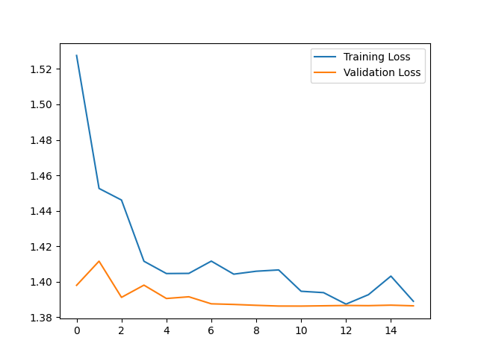
Results
Training data : 1’000 penalties
Validation data : 100 penalties
Testing data : 100 penalties
Accuracy : 35 %
Improvement of only 10%

Slide 10
Limitations & Improvements
Unbalanced set → data collection
Data augmentation : symmetrical inversion, rotation, etc.
Dimensionality reduction : PCA, etc.
3D pose estimation instead of 2D
Integration of additional features (right-footed or left-footed for instance)

