Slide 1

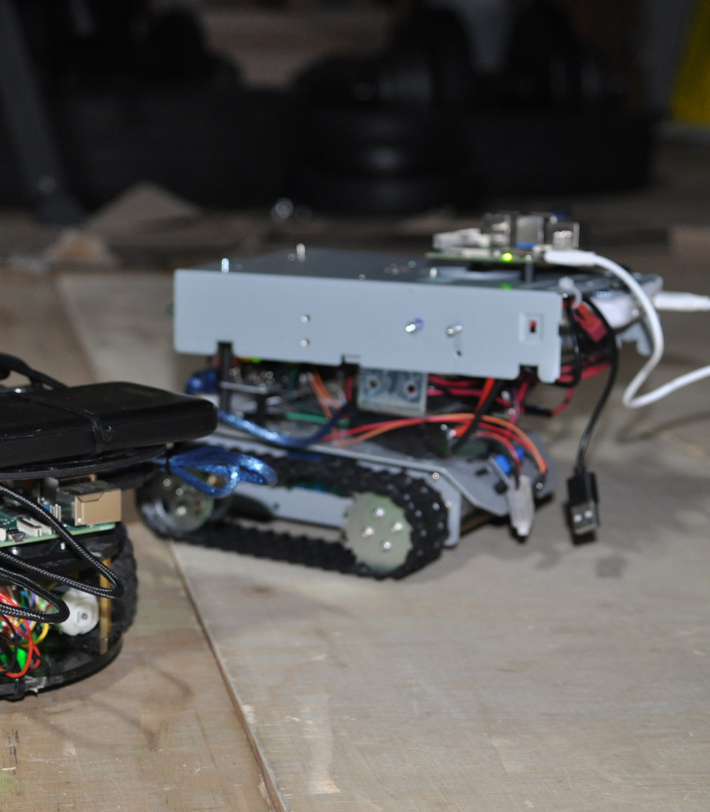
RESEARCH DISCUSSION
From Sim-to-Real
Navigation to Future
Robotics Research
Directions
Ismaele Carbonari
University of Trento
Meeting with FBK 3DOM
June 2026
Notes:
Timing: 0:30 Visual cue: Open on the complete simulator, immediately framing the work as an integrated research system. Speaker notes: Thank you for the opportunity to discuss my work. I will briefly present the navigation and validation framework developed for my BSc thesis, then use it as a starting point for possible collaboration directions with 3DOM. The central idea is transferability: the result is not tied to one robot, but to a modular framework that preserves the high-level planner while adapting perception, estimation and actuation to each platform.

Slide 2
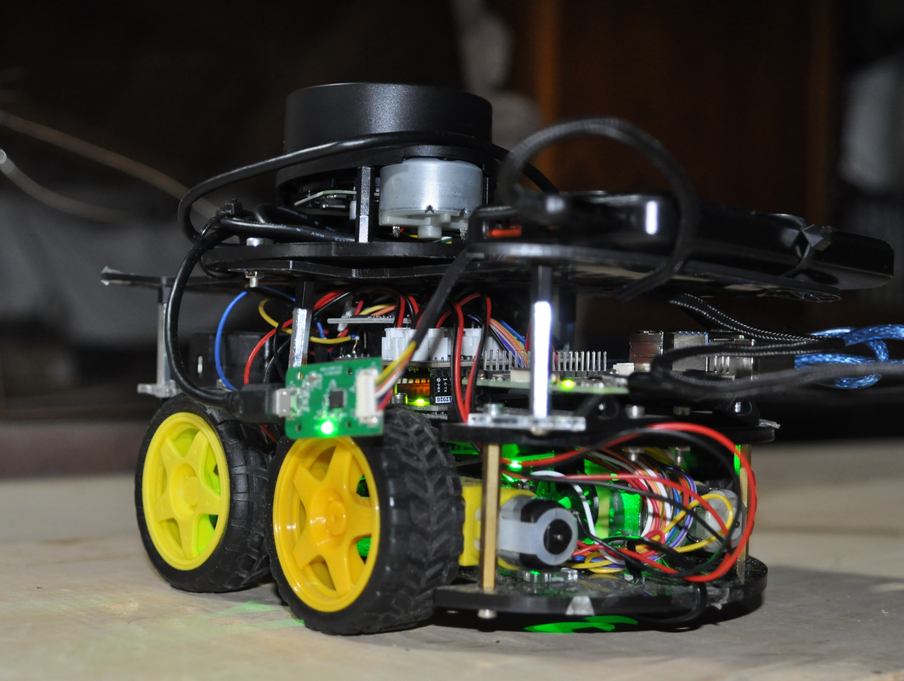
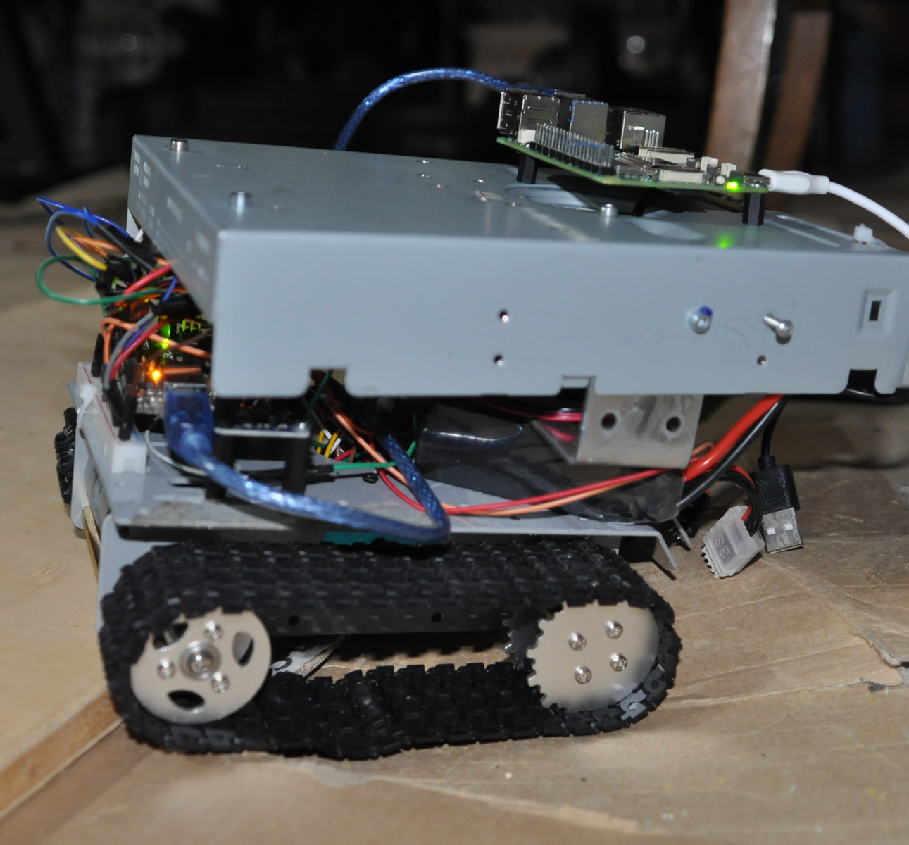
BACKGROUND
About me
Building robotic systems from software architecture to physical deployment
BSc Computer Science
University of Trento
Autonomous navigation
State estimation
Embedded systems
Real robot deployment
PATH TO THE CURRENT WORK
2024
Personal robotics
projects
2025
Autonomous navigation
prototype
2026
Sim-to-real BSc thesis
+ tracked extension
NEXT
Research
collaboration
C/C++ · embedded systems · LiDAR · SLAM · state estimation · real deployment
Notes:
Timing: 1:00 Visual cue: Use the two robots as evidence of hands-on work, then move quickly across the timeline. Speaker notes: My background is in computer science, but my strongest interest is at the boundary between algorithms and physical systems. Personal robotics projects led to an autonomous navigation prototype and then to the sim-to-real thesis, including the tracked robot extension. Across that progression I worked with C and C++, embedded firmware, LiDAR sensing, state estimation, communication and real deployment. The next step I am exploring is research collaboration.

Slide 3
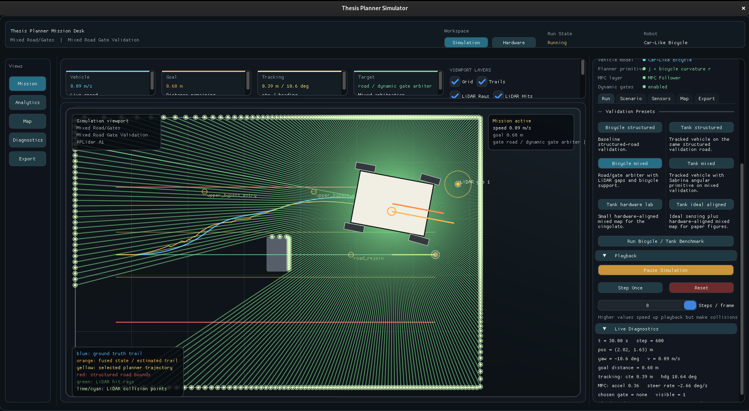
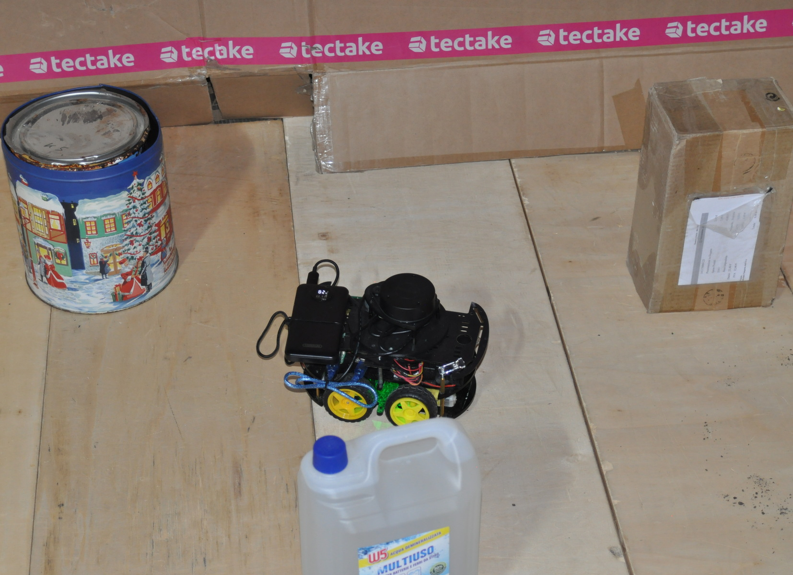
THESIS MOTIVATION
A planner that works in simulation is not yet a robotic system
Transfer objective: preserve the navigation framework while adapting sensing, control and actuation to heterogeneous platforms.
MEASURE THE GAP
SIMULATION
PHYSICAL SYSTEM
Sensor noise
Wheel slip
Actuator saturation
Communication delay
Estimation error
Vehicle kinematics
Goal: build an experimental infrastructure that makes the sim-to-real gap observable and quantitatively comparable.
Notes:
Timing: 1:00 Visual cue: The visual bridge is the thesis problem: the same task is seen once in simulation and once through hardware telemetry. Speaker notes: The thesis started from a practical objective: identify what must be added around a planner before it can operate on a real robot. Simulation hides several effects that become dominant on hardware, including slip, motor asymmetry, sensor noise, delays and model mismatch. My objective was therefore not to force simulation and hardware to look identical, but to make their differences measurable and attributable to specific layers of the system.

Slide 4

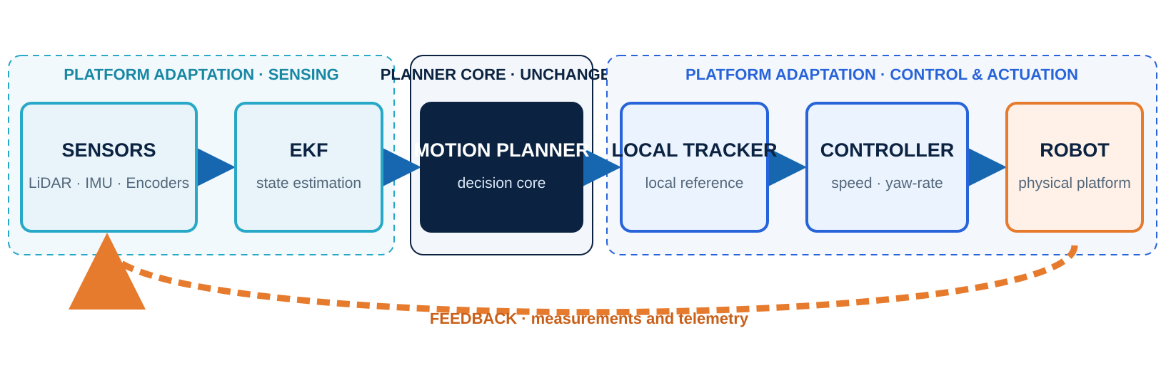
ISMAELE CARBONARI · FBK 3DOM
SYSTEM ARCHITECTURE
One decision layer, multiple platform-dependent interfaces
The planner operates on geometric abstractions; sensing and actuation adapt to the robot.
The planner remains unchanged while sensing, tracking and actuation adapt to the platform.
Notes:
Timing: 1:15 Visual cue: Keep the audience on the dark planner block, then move outward to the adapters and feedback loop. Speaker notes: This is the architecture that organizes the work. LiDAR, IMU and encoders are fused into a state estimate. The planner selects a motion primitive and produces a local reference. A tracker converts that reference into speed and yaw-rate targets, while the low-level layer maps them to the physical actuators. The planner is deliberately isolated from platform details. The feedback path closes the loop through measurements and telemetry, and it is also what makes experimental validation possible.

Slide 5

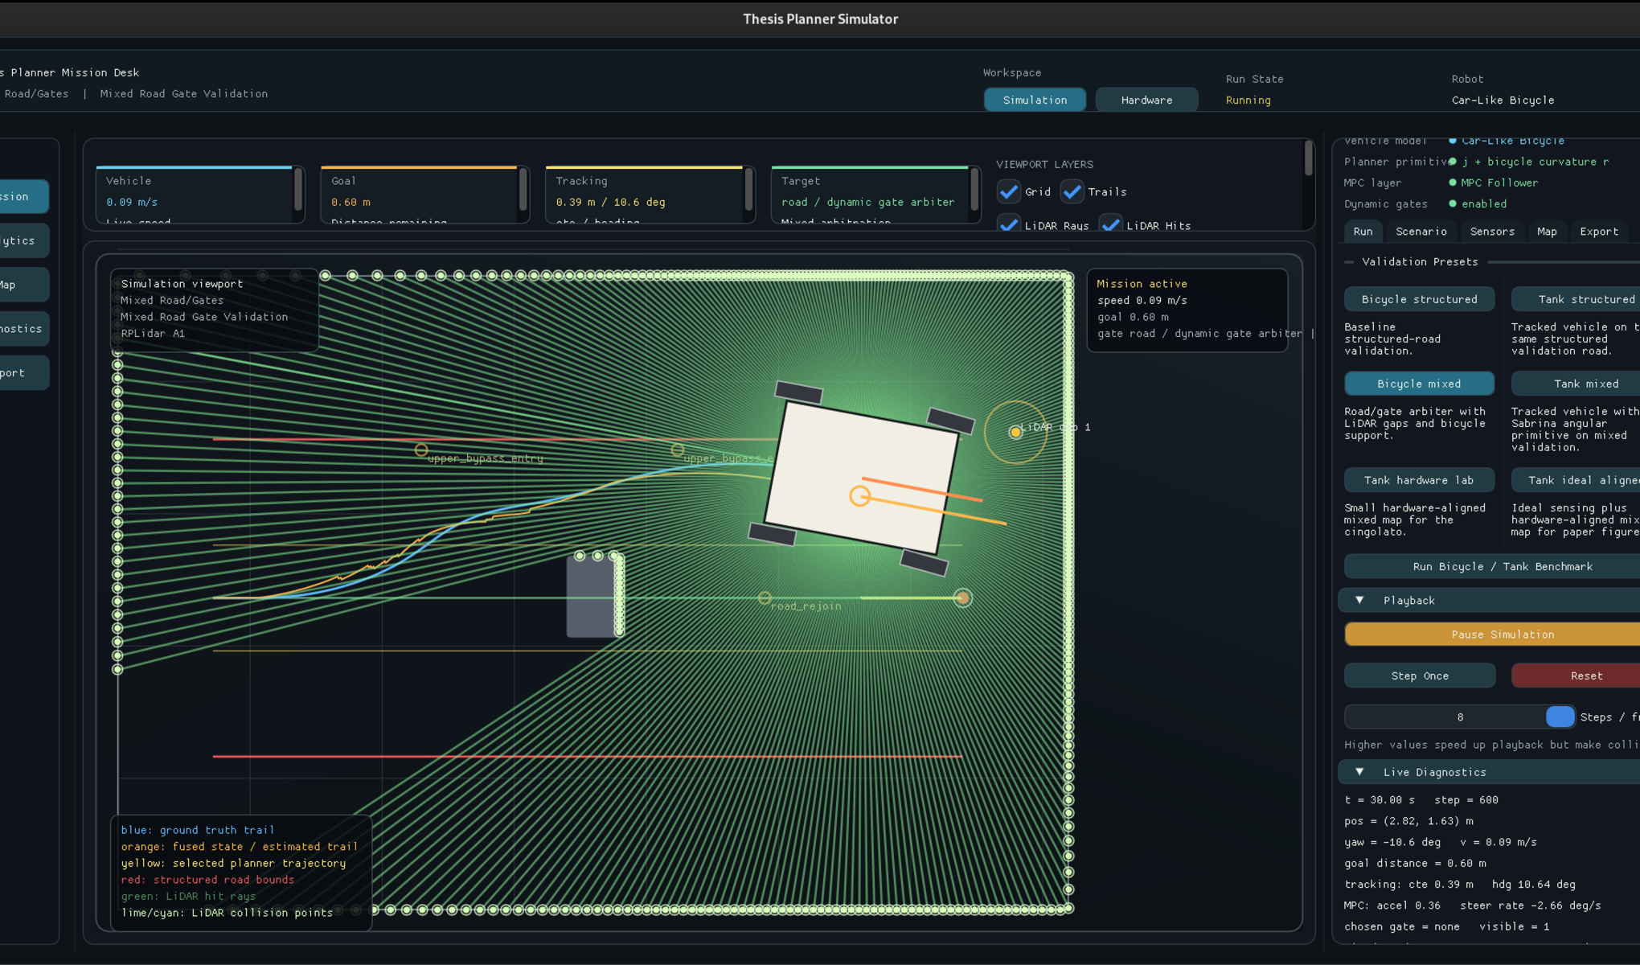
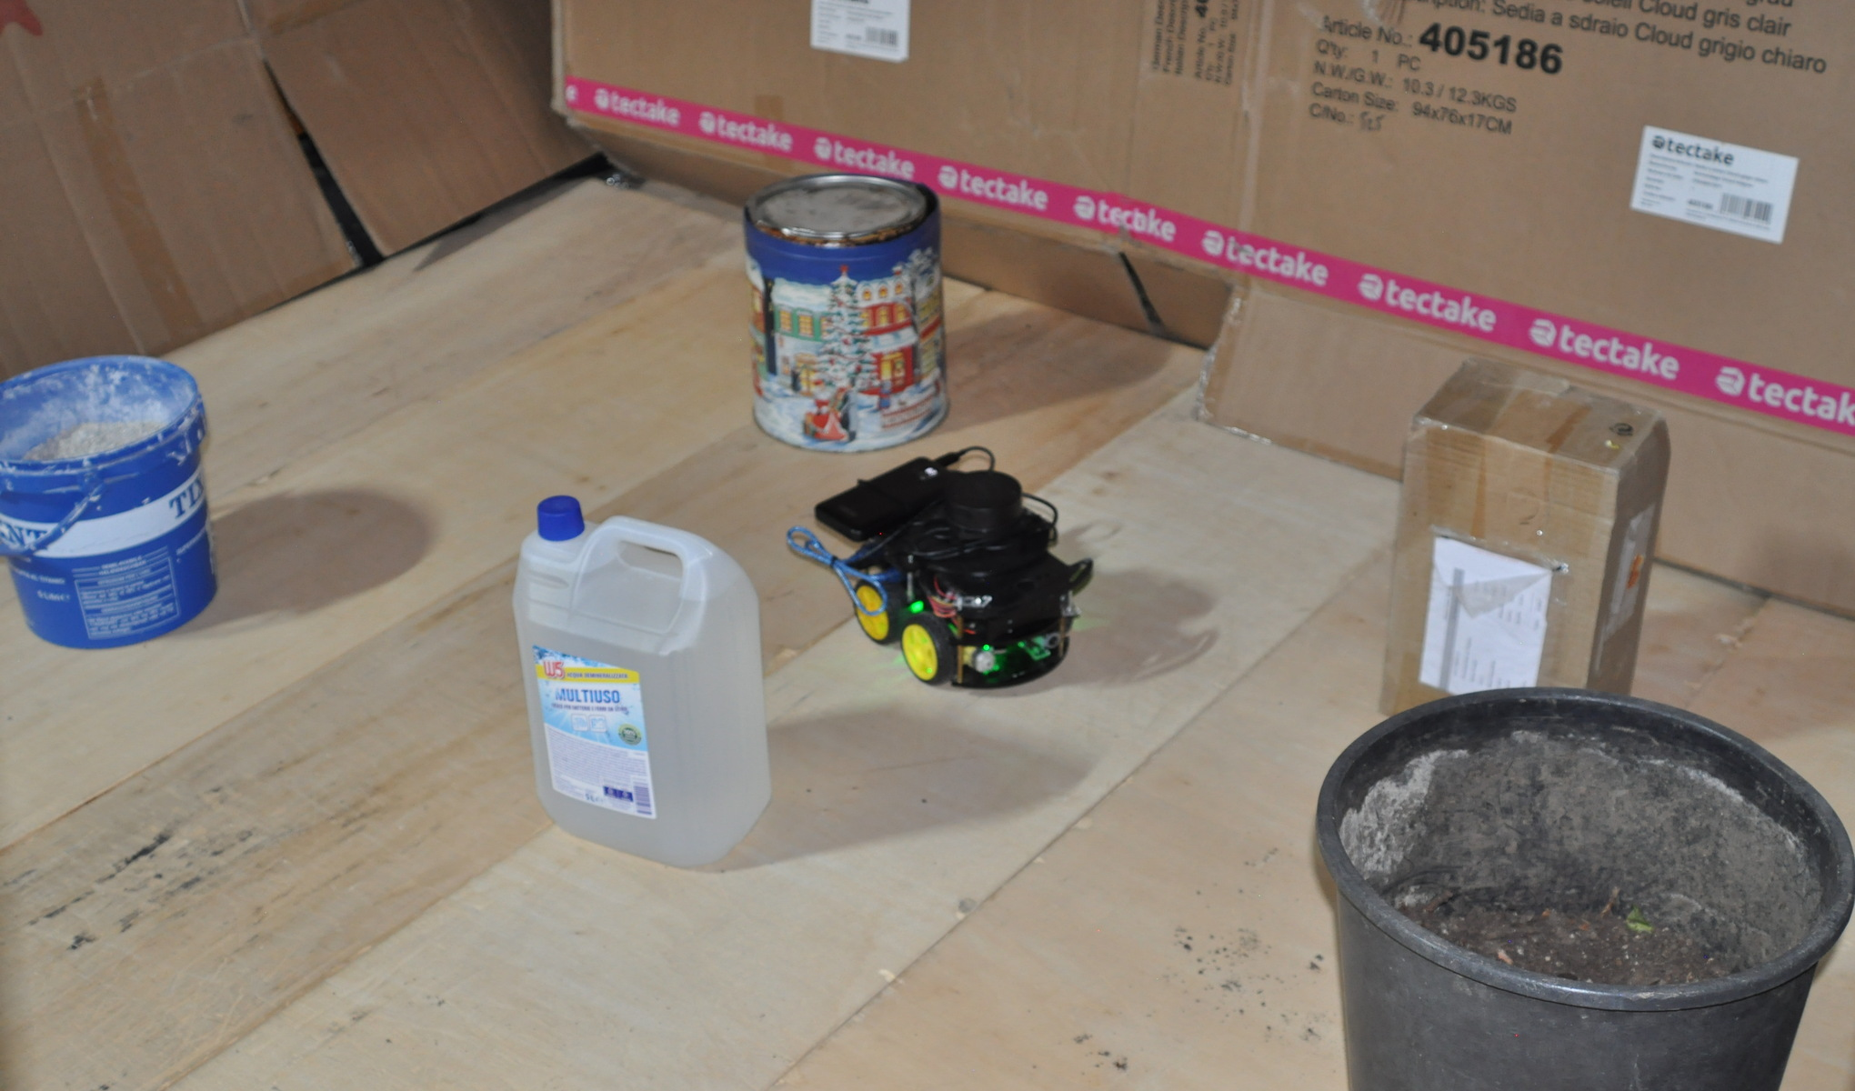
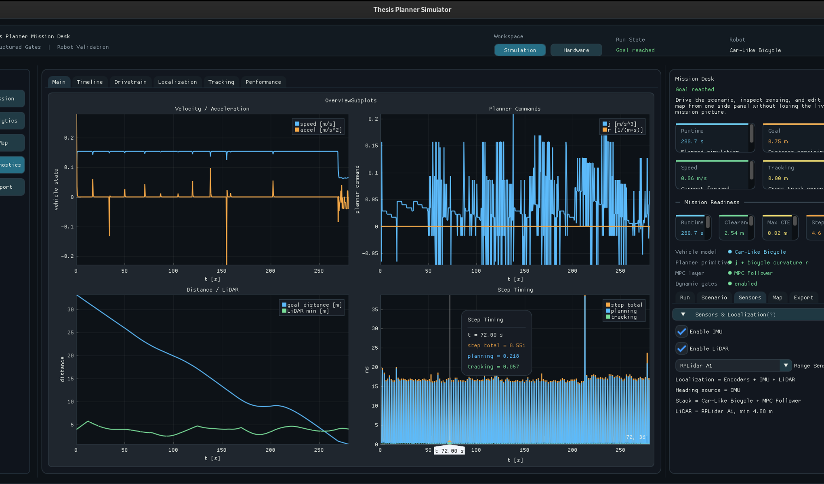
THESIS CONTRIBUTIONS
What I developed
A complete experimental stack around an existing general planner
Simulation
Real robot integration
Experimental validation
●Custom C++ simulator
●Synthetic sensors
●GUI, telemetry and reports
●Firmware and serial protocol
●EKF and hardware interfaces
●LiDAR-to-gate perception
●Structured navigation
●Unstructured navigation
●Mixed road / gate behavior
Contribution boundary
The planner was not redesigned; the infrastructure required to execute, observe and validate it on real robots was engineered.
Notes:
Timing: 0:50 Visual cue: Treat the three columns as one stack: simulator, hardware bridge, and evidence. Speaker notes: The contribution is broader than connecting a planner to motors. I developed a custom simulator with synthetic sensing and reporting, the hardware integration including firmware and a structured serial protocol, and the analysis pipeline used across structured, unstructured and mixed navigation. This is the engineering layer that turns an algorithm into an experimentally testable robotic system.

Slide 6
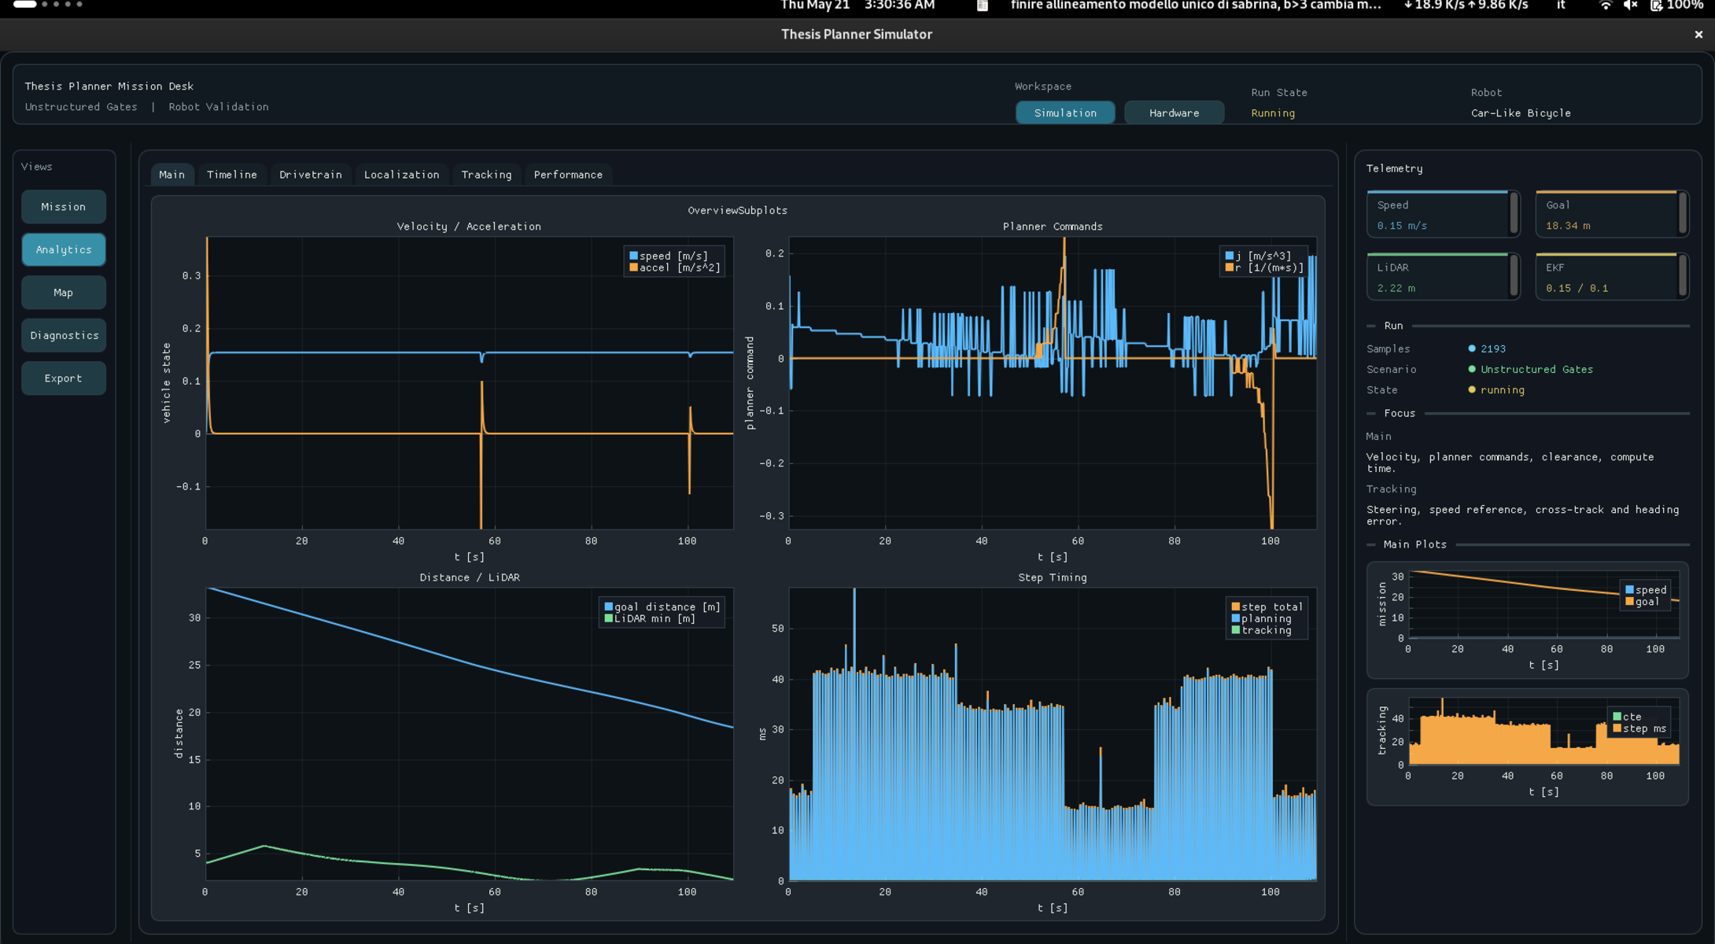
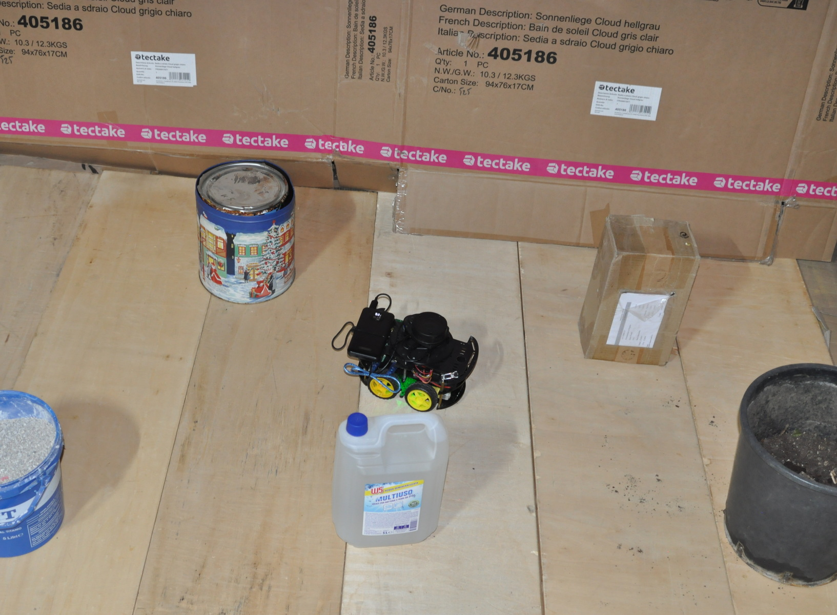
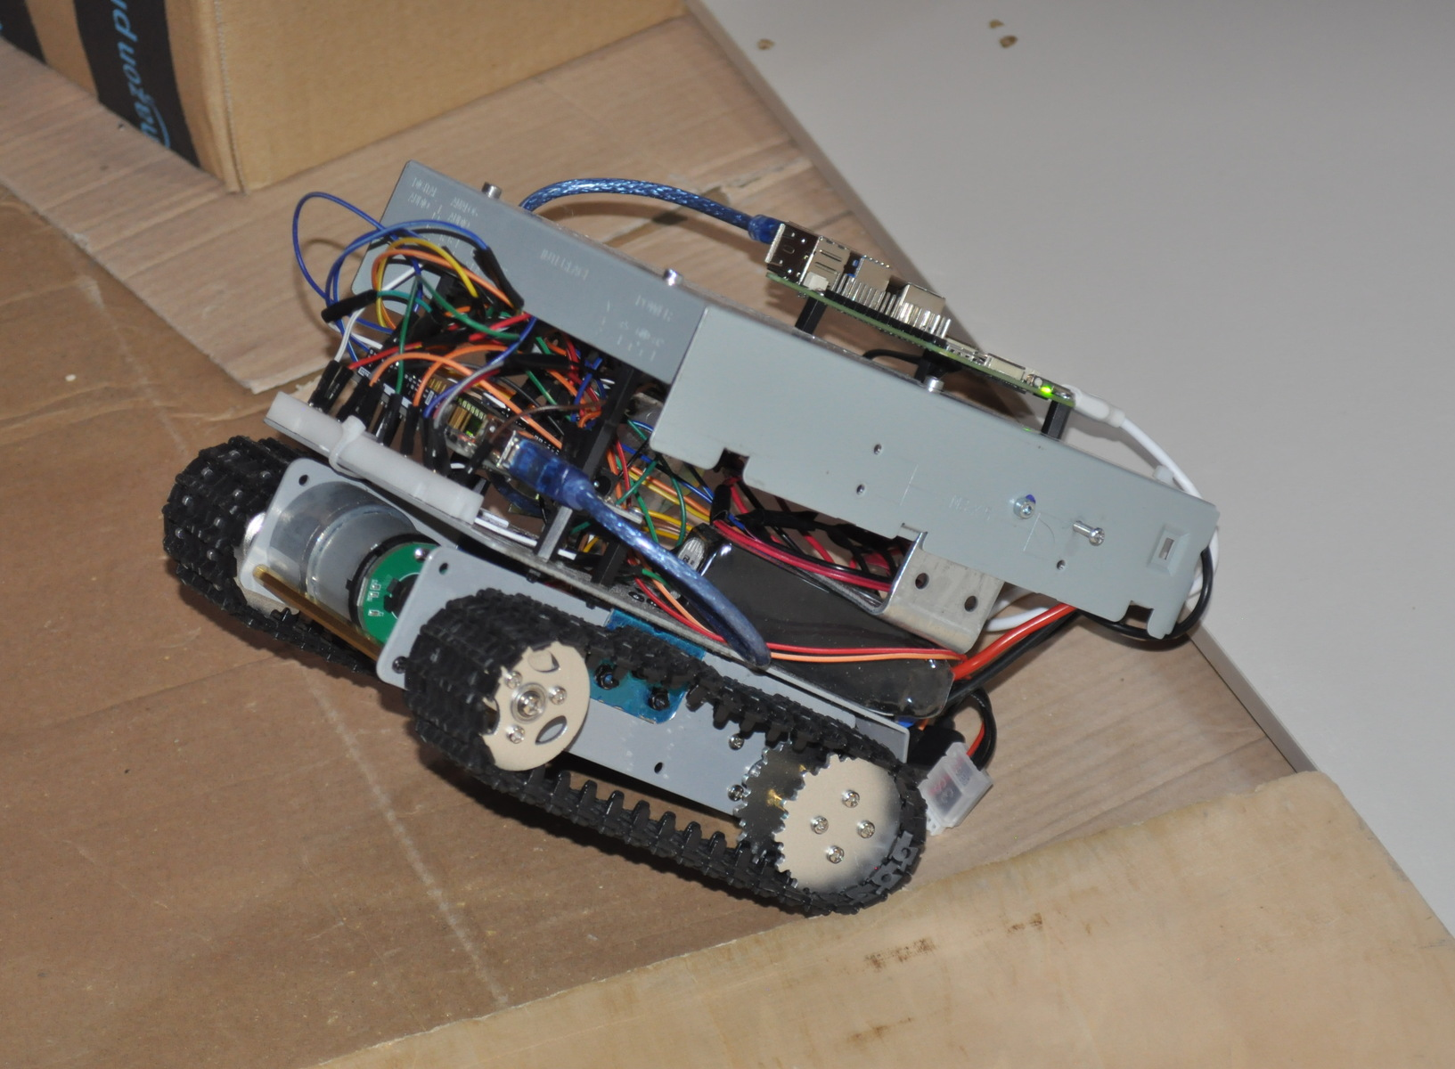
SYSTEM DEMONSTRATION
Unified architecture: simulation and hardware
Same navigation logic, consistent interface across different physical platforms
ROBOT CAR
TRACKED ROBOT
Agnostic Core
Same planner · Same navigation · Different platforms
SIMULATED ENVIRONMENT
Logic validation in an ideal scenario
Notes:
Timing: 0:40 Visual cue: Let the images carry the slide: simulator first, then the two physical platforms. Speaker notes: This is the system in operation. The simulator exposes sensing, state, selected references and telemetry. The same navigation architecture is then connected to the robot car and the tracked robot. The physical implementation changes, but the high-level decision logic and experimental workflow remain shared.

Slide 7
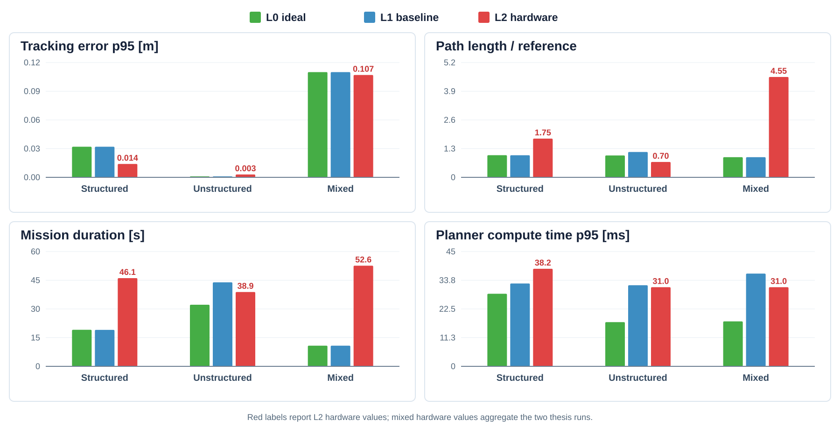
ISMAELE CARBONARI · FBK 3DOM
SIM-TO-REAL VALIDATION
Evaluation of decision architecture across three levels
L0: Ideal Simulation • L1: Hardware-Informed Baseline • L2: Physical Robot
3 / 3 navigation modes completed
< 40ms planner compute time p95
Main gap
Physical execution effects:
slippage
heading dynamics
recovery motion
Evidence first • summary second
THESIS DATA • TRACKING · PATH EFFICIENCY · DURATION · COMPUTE TIME
Notes:
Timing: 1:25 Visual cue: Read the four thesis metrics together, then summarize the result through the three KPI blocks. Speaker notes: The comparison was performed at three levels: ideal simulation, a hardware-informed simulated baseline and the physical robot. The four plots are taken directly from the thesis analysis and compare tracking error, path efficiency, mission duration and planner computation. All navigation modes completed their tasks and planner computation remained below forty milliseconds at p95. The larger gap was not decision failure, but the physical cost of execution: heading dynamics, recovery motion, slip and actuator behavior.

Slide 8
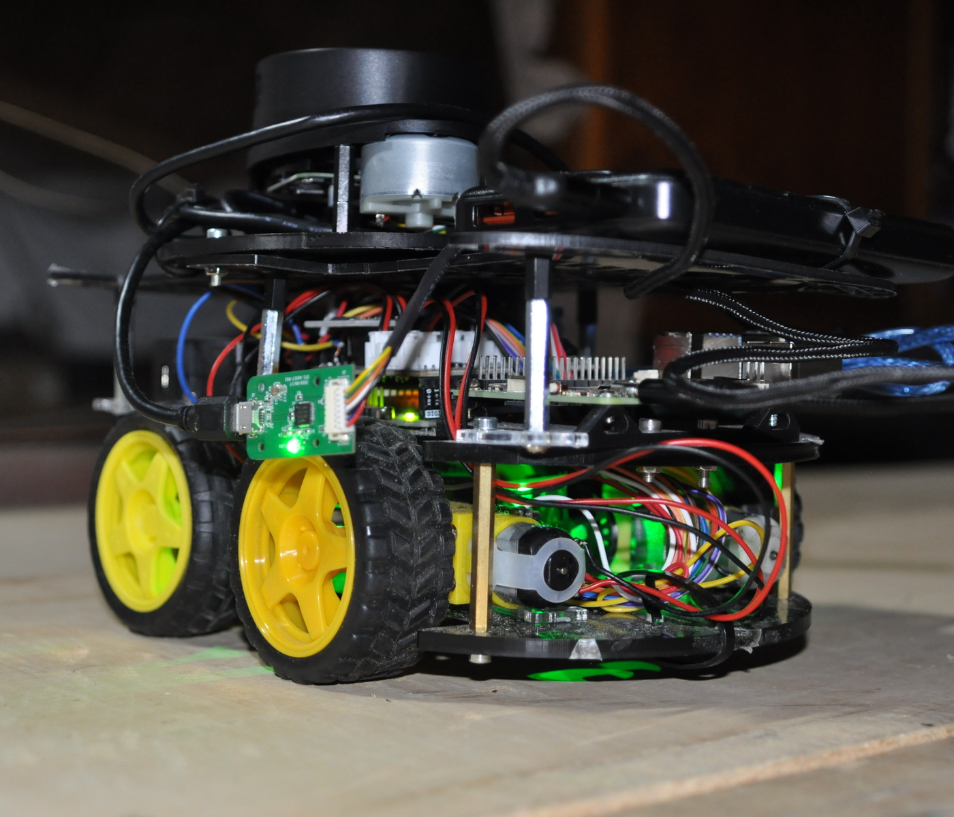
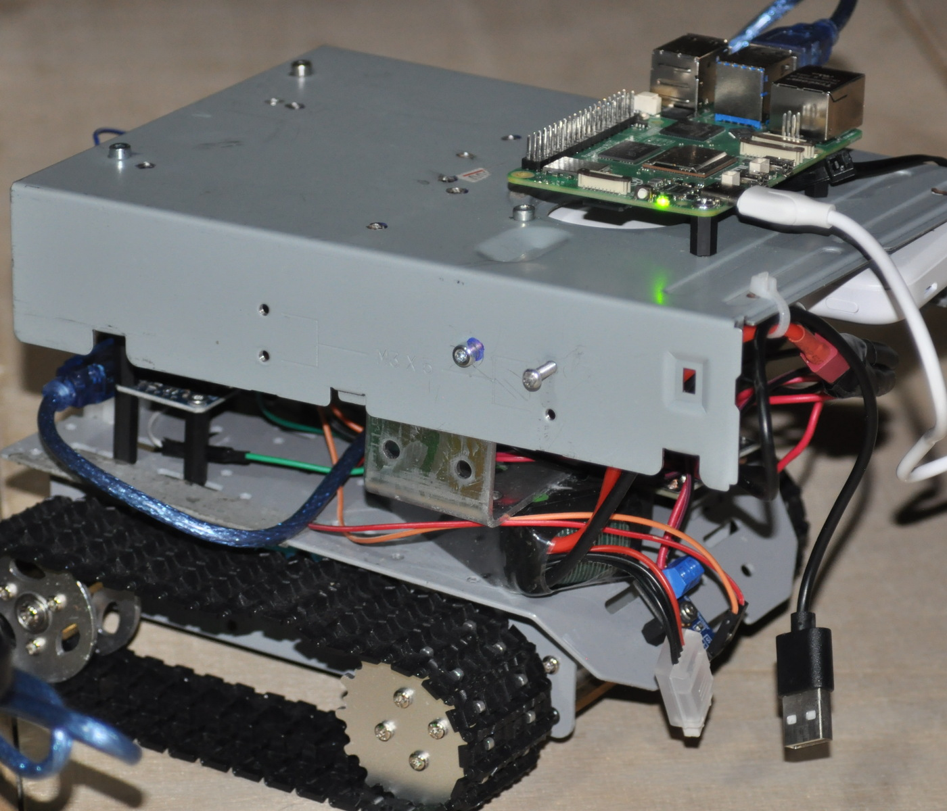
ISMAELE CARBONARI · FBK 3DOM
PLATFORM PORTABILITY
From robot car to tracked robot
Portability was tested by changing the locomotion model and hardware interface, not the high-level planner.
UNCHANGED
Planner · Gate Selection Validation Pipeline
CHANGED
Vehicle Kinematics · Actuation Mapping Hardware Interface
ROBOT CAR
TRACKED ROBOT
The framework changed less than the robot.
High-level navigation remained stable; embodiment-specific interfaces were replaced.
Notes:
Timing: 1:30 Visual cue: The center block is the thesis in one visual: what stayed fixed and what changed. Speaker notes: The second platform tests the claim that the framework is not specific to the car. The car and tracked robot have different physical behavior, especially during rotation. The execution chain therefore changed in the locomotion model, actuator mapping and hardware interface. The planner, navigation logic, gate selection and validation workflow remained the same. This is the strongest condensed message of the thesis: portability is achieved by isolating embodiment-specific layers.

Slide 9
CONNECTION TO 3DOM
A shared focus on autonomy that must work in the field
My current framework addresses navigation transfer; 3DOM adds richer perception, mapping and operational environments.
MY CURRENT WORK
POTENTIAL 3DOM CONNECTION
Navigation & state estimation
GNSS-denied autonomy
Mapping foundations
Spatial perception & 3D mapping
Sim-to-real validation
Field deployment
Mobile robot deployment
Autonomous field systems
COLLABORATION VALUE
Transferable autonomy connects field robotics with mapping, spatial perception and deployable validation.
Notes:
Timing: 1:00 Visual cue: Read the slide horizontally: each existing capability opens a richer research problem with 3DOM. Speaker notes: The connection I see is not only thematic. My work contributes a modular navigation and validation base. The four strongest links to 3DOM are GNSS-denied autonomy, spatial perception and mapping, field deployment, and autonomous systems. The possible collaboration therefore has a clear interface: reuse the transfer and validation framework while introducing more capable sensors, environments and spatial representations.

Slide 10
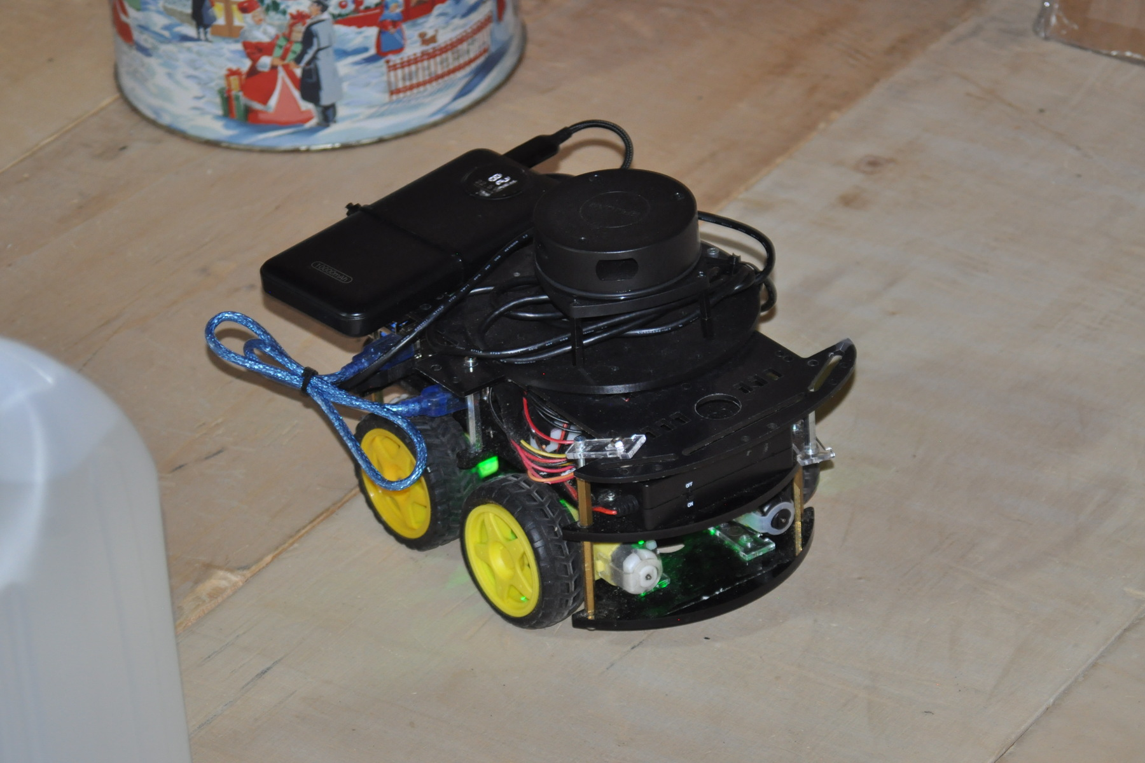
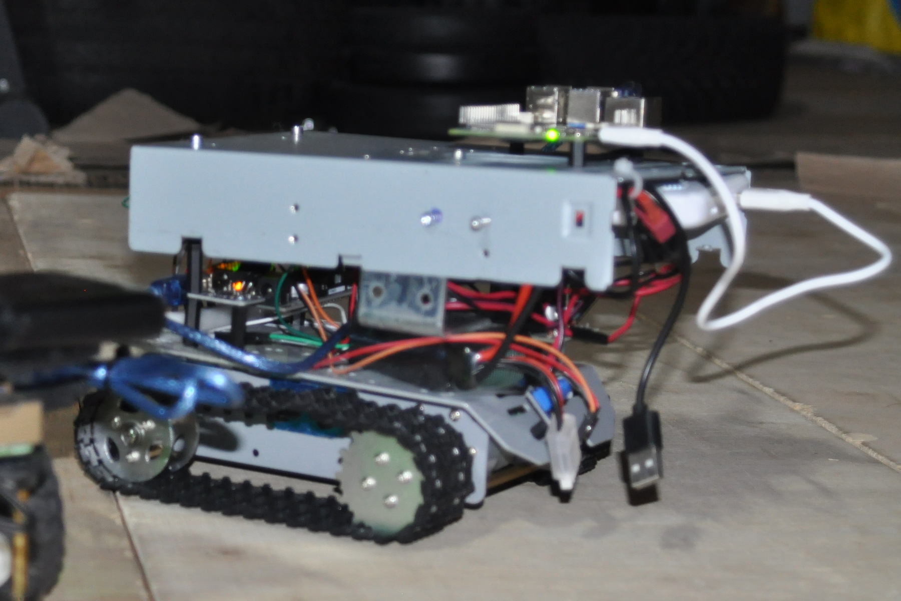
ISMAELE CARBONARI · FBK 3DOM
POSSIBLE RESEARCH ROADMAP
From thesis prototype to collaborative field autonomy
A progression from controlled validation to deployable, collaborative autonomy
COMPLETED
RESEARCH TRANSITION
RESEARCH HORIZON
Validated Core
Field Platforms
Field Robotics
3D Perception
Collaborative Autonomy
simulator · car · tracked robot
outdoor deployment · richer perception
Robot car
Tracked robot
Higher scale · richer sensing · greater autonomy
The thesis is the first experimental layer of a broader research trajectory.
Notes:
Timing: 0:40 Visual cue: Move quickly from completed work on the left to the research horizon on the right. Speaker notes: I see the thesis as the first layer of a longer trajectory. The robot car established the complete framework, and the tracked robot tested portability. The next transition is field deployment on larger platforms with richer perception and less controlled environments. From there, the research can expand toward field robotics, spatial perception and collaborative autonomy without committing the roadmap to one specific platform.

Slide 11
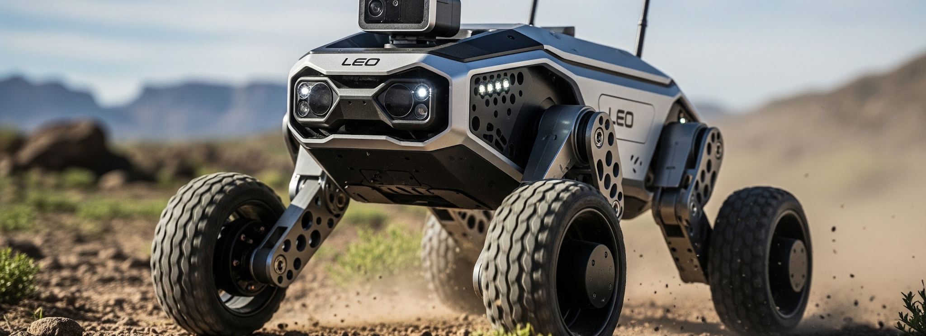
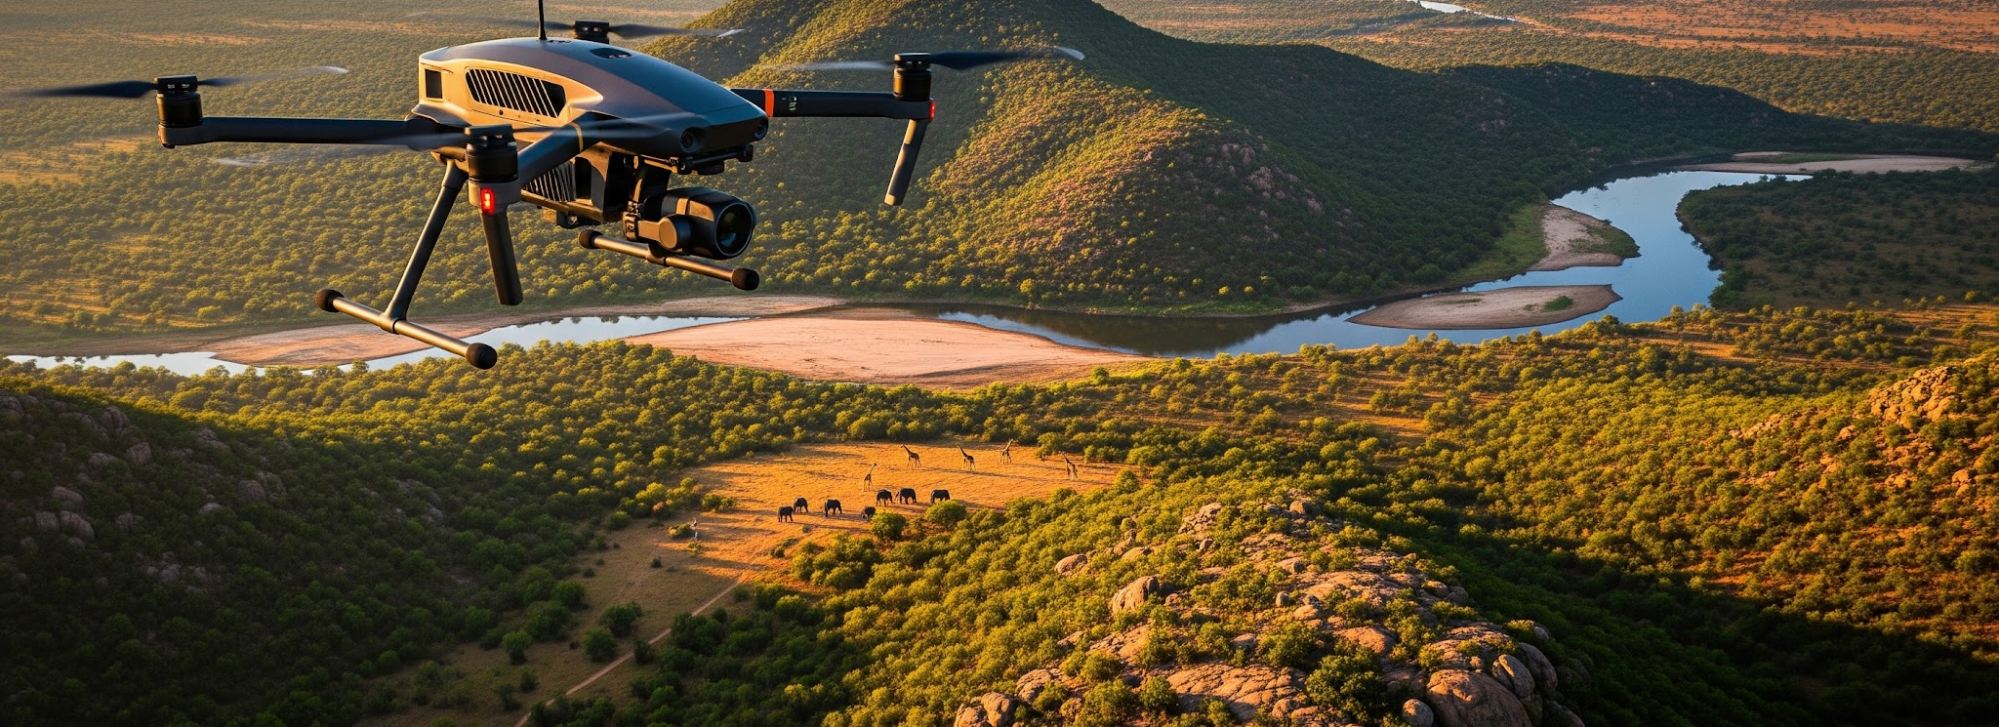
ISMAELE CARBONARI · FBK 3DOM
POSSIBLE PLATFORMS
Two complementary directions for collaboration
Ground and aerial systems expose different embodiments to the same autonomy and validation framework
GROUND PLATFORM
AERIAL PLATFORM
Expected outcome: outdoor autonomous navigation
Expected outcome: adaptive aerial missions
Visual-LiDAR SLAM
Autonomous exploration
GNSS-denied field validation
Dynamic flight autonomy
Mission replanning
Large-scale monitoring
Ex: wildlife monitoring and anti-poaching support
SHARED VALIDATION GOAL
Evaluate one autonomy framework across ground and aerial embodiments using comparable metrics.
Notes:
Timing: 1:00 Visual cue: Give equal time to ground and aerial robotics, then explain how each direction stresses the framework differently. Speaker notes: I see both directions as scientifically interesting because they stress the framework in different ways. Leo Rover is the most direct continuation of the thesis: it preserves ground mobility while introducing outdoor SLAM, exploration and GNSS-denied validation. The UAV direction is particularly interesting because it would require rethinking planning and autonomy on a fundamentally different embodiment, including dynamic mission replanning and large-scale monitoring.

Slide 12

ISMAELE CARBONARI · FBK 3DOM
LONG-TERM INTERESTS
Toward collaborative field autonomy
A progression from reliable navigation toward collaborative field autonomy
Autonomous Navigation
SLAM & Mapping
GNSS-denied Robotics
Field Robotics
Multi-Robot Systems
01
02
03
04
05
Computer Vision
3D Perception
semantic and visual cues
geometry and spatial context
ENABLING TECHNOLOGIES SUPPORT THE FULL PROGRESSION
Goal: transferable autonomy that becomes progressively more spatially aware and collaborative.
Notes:
Timing: 0:35 Visual cue: Follow the numbered progression from left to right, then identify vision and 3D perception as enabling technologies. Speaker notes: My interests form a progression rather than a collection of independent topics. Reliable navigation leads to SLAM and mapping, then to operation without GNSS, field robotics and eventually multi-robot systems. Computer vision and 3D perception are enabling technologies across this progression. The common goal is autonomy that remains transferable, spatially grounded and experimentally accountable.

Slide 13
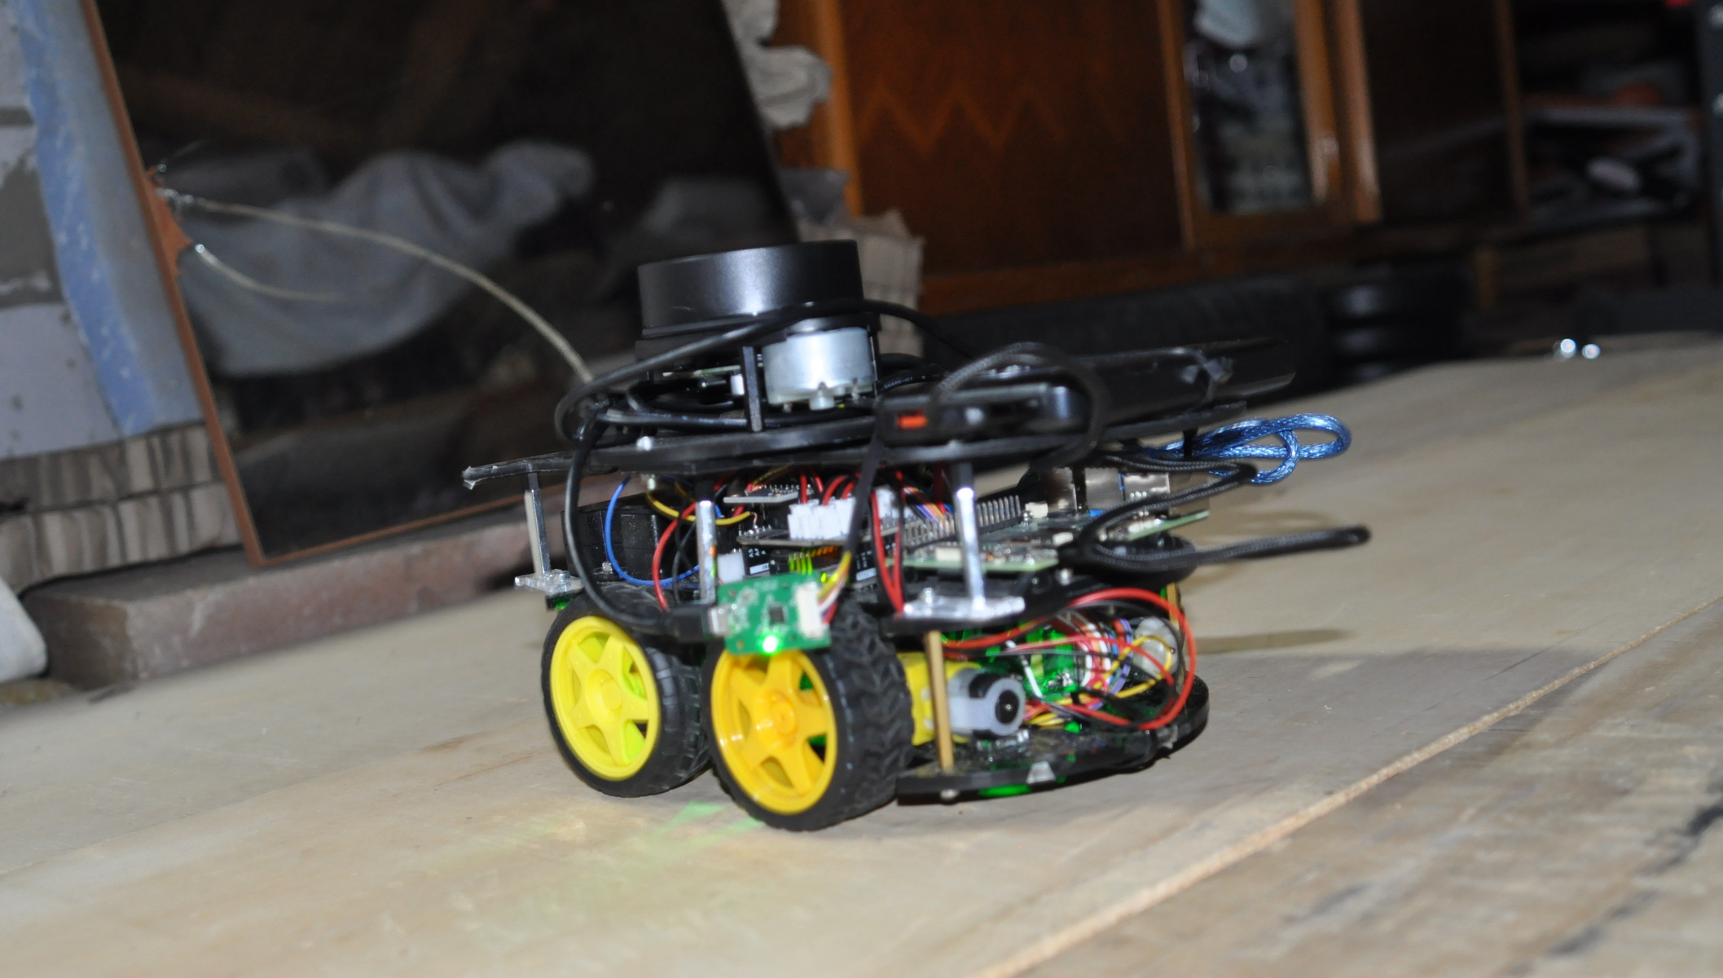
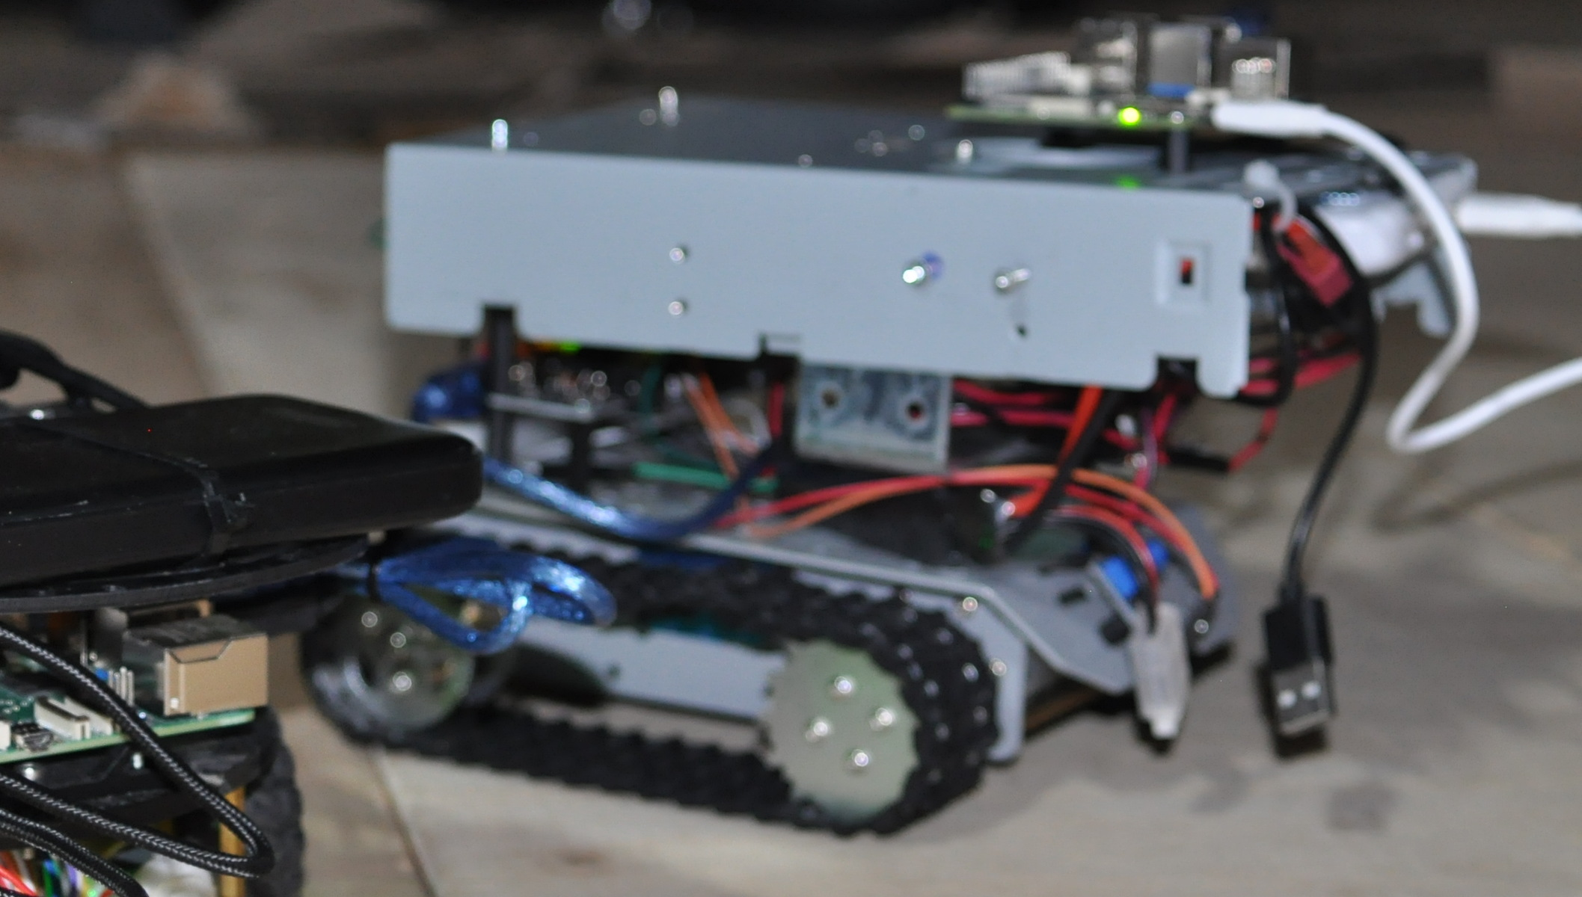
DISCUSSION
Platforms change.
The framework evolves.
PLATFORM EVOLUTION
Robot Car
The main outcome of my thesis is not a specific robot, but a modular navigation and validation framework that can be transferred across heterogeneous robotic platforms.
Tracked Robot
Ground Robotics
The framework scales across platforms; each embodiment introduces new sensing and deployment challenges.
Aerial Robotics
Collaborative Systems
DISCUSSION
Which platform is the best next step for extending the framework?
Notes:
Timing: 0:30 Visual cue: Close on the platform progression, then use the final question to open the discussion. Speaker notes: The platforms can change from the robot car to tracked, ground, aerial and collaborative systems. The durable contribution is the framework that makes this transfer observable and testable. I would be very interested in discussing which platform offers the strongest next step for extending and testing the framework. Thank you.

