Slide 1
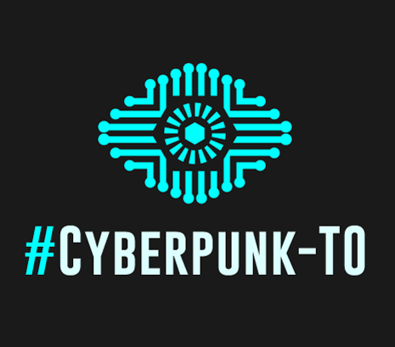
Talk #1:
Our Cyberpunk Present
By: Ismael Sarepta

Slide 2
Who am I?
Author of the Madame Einzige series
Essayist and blogger. Topics: geopolitics, class conflict, surveillance states, big history, philosophy
Tech interests: cryptography, cybersecurity, privacy, reverse engineering (hacking), automation and programming, AI, Free and Open Source Software (FOSS)

Slide 3
Intellectual Background
Originally a self-taught hacker w/ philosophy & history background, later real software & engineering, computer science
Influences: Oswald Spengler’s Decline of the West, Hegelian Dialectic, Carlyle's Great Man theory
Nietzsche’s Master/Slave-Morality Complex, growth of Judaeo-Christian morality in secularism, repression of arete (excellence / virtue)
Heidegger on technomediation and the nihilation of the self; Deleuze & Guitratti Capitalism and Schizophrenia
Existential interest in Malthusian collapses, rise of totalitarianism, atrocities, war
+: History Manifesto, Gaia Hypothesis, No Logo

Slide 4

Madame Einzige
First novel in series, Amor Fati, published in February/March 2013. Set in Central Asia, 2033
Distinctly non-Urban, non-Western/East-Asian. Russian & Middle-Eastern milieu
In writing Cyberpunk in the 21st century, one isn’t sure if they’re writing a story or just describing reality

Slide 5

Madame Σinzige:
Forecasts
Fulfilled:
  Black Turbans → ISIS (a false-flag movement too?)
  The Surveillance Panopticon, and a hero to blow the whistle (Lukas Cermack → Edward Snowden)
  Drone hacking/kamikazing; computerized spoofing on the battlefield
Pending:
  Red Heads → Militant Socialist-Sufi movement to counter the influence of Wahabism/Salafism
  Russian superstate – re-annexation of former USSR
  Miniaturized deep-learning systems, sophistication of hacker tools
  Deep state planning with Surveillance + Big Data

Slide 6
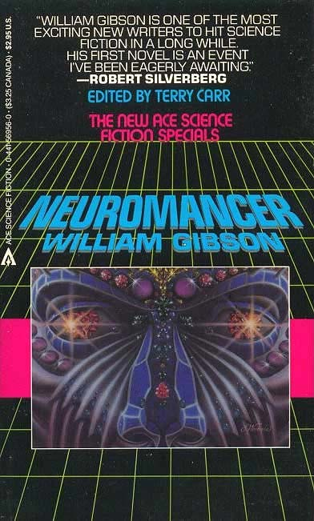
Cyberpunk: Background
Coined by Canadian-US author William Gibson for short story The Gernsback Continuum (1981)
Cyberpunk conceived as antithesis to Space-Age Utopian views of the future of the 1950s-60s
Other famous authors: Neal Stephenson, Bruce Sterling
Titles: Ghost in the Shell, The Matrix, Deus Ex, Akira

Slide 7
Cyberpunk: Foreshadowing the Future
We today are disillusioned by the Utopianist future swindled to us by sketchy marketeer-charlatans of the 1990s DotCom bubble and cloud services of 2000/10s. Snowden Leaks. Daily mass data breaches.
Destruction of the private sphere. Violation of basic historic levels of privacy on a very personal level: enabling stalkers, private opinions leading to job loss, profiling
Cyberpunk foreshadows post-Cold War world of US unipolarity, corporations subverting power of communities and nation-states; inklings of this existed in the 80s and red scares of 20s-50s
For foreseeable future, the State and certain corporations are only going to get stronger

Slide 8
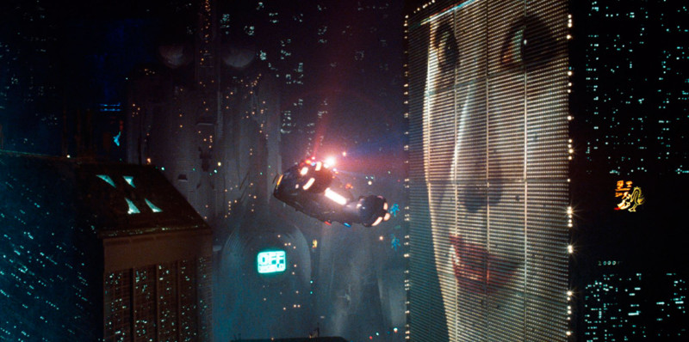
Cyberpunk: Themes
The State serving the interests of Mega-corporations
High-Tech, low life: high-tech society that doesn’t address basic problems: the unintended consequences of techno-hype; enslavement to a system.
Asymmetric & Neo-endemic warfare
Body modification / augmentation
Desolation of the environment

Slide 9

Themes: the Mega-corporation and the State
The Mega-corporation rules society proxied through the state, sometimes directly. Policing and armed conflict relegated to the State but defense contractors private; decisions determined by censuses of corps
Corps have oligarchic, often internationalist interests, power to subvert local and national sovereignty
Major theme in Cyberpunk, but goes back to 19th /early 20th socialist fiction like The Iron Heel, Westerns
Counter-examples where corp are subservient to the state: Cisco’s role in the Great Firewall of China, Google/Yahoo!’s collaboration with Chinese censors
RL: Schneier’s New Feudal Model: Much of everyday life is mediated by Cloud systems that warehouse our data – we are beholden to the Corp. to advocate for our rights (Apple case)

Slide 10
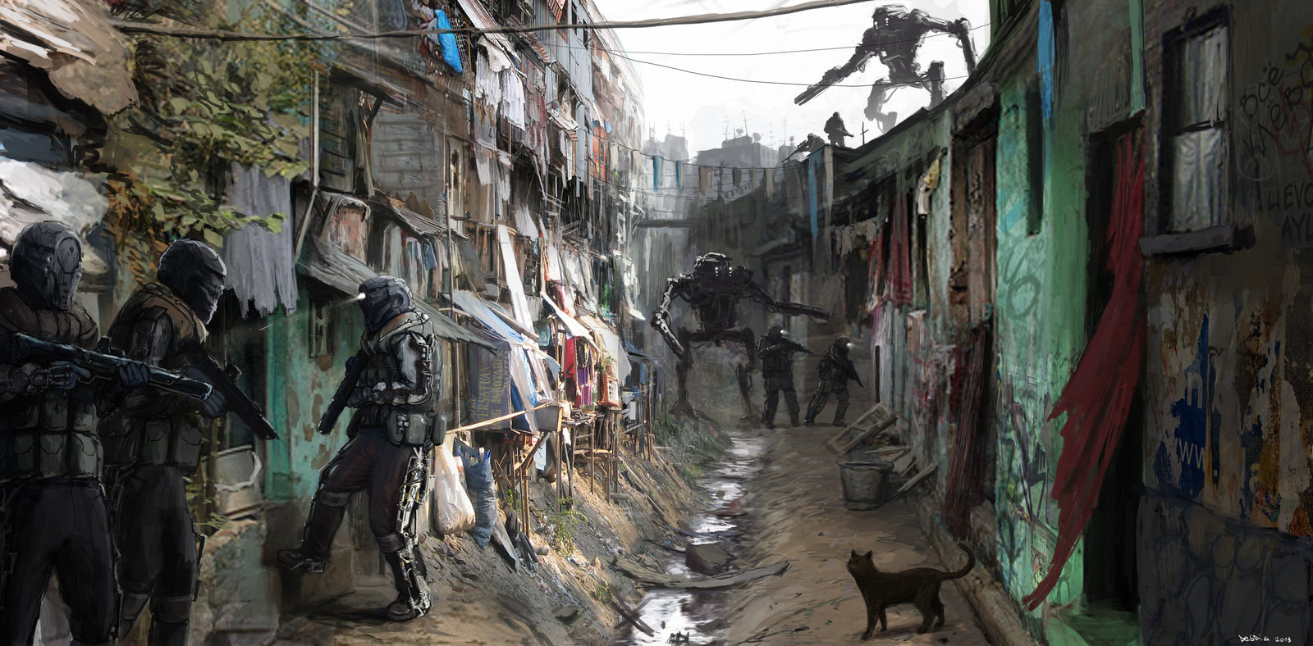
Theme: High Tech, Low Life
Utopianist vision sold with tech that may improve efficiency and reduced labour, but often leads to vendor-lock-in and general human dependency
Growing divide between rich and poor (esp. in USA), the technologists and non-technologists, knowledgeable and uninformed
Gini coefficient, measure of income inequality, low in ‘developed’ world, except USA. This theme currently better reflects USA, Latin America, China, former USSR than rest of developed world. Despite Gini coefficient, unrest in Britain, France of poor immigrants + crime
The material and labor demands of developed world outsourced perpetuates imperialism, ‘low life’ (Latin America, China)
Does Cyberpunk conform to classic Marxist depictions of class conflict, or is it just populist?

Slide 11
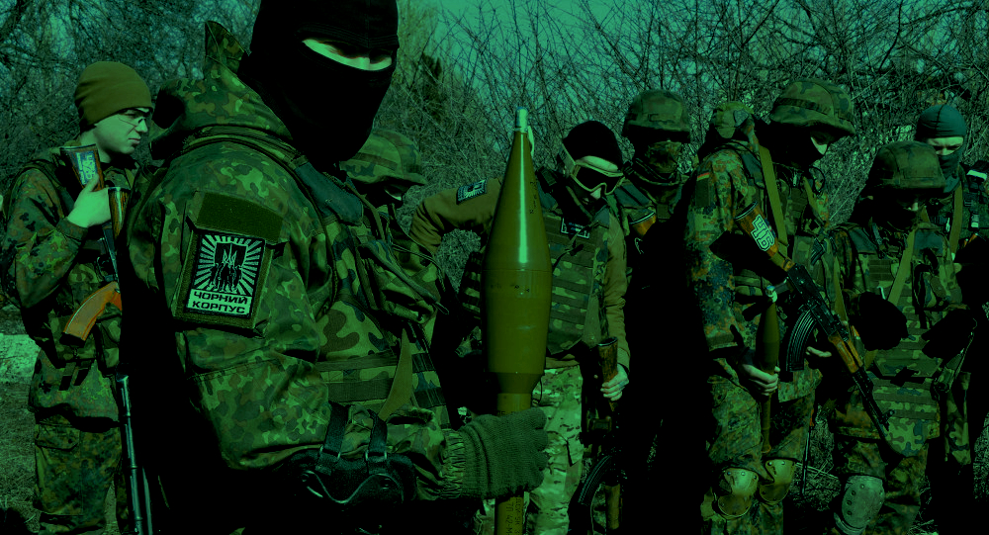
Theme: Asymmetric Warfare
The Nation State has a professional standing military + military-industrial complex, but cannot subdue small irregular forces, terrorists
USSR & US Invasions of Afghanistan, Vietnam, US in Iraq, Palestinian-Israeli, Uyghur-Chinese, Syrian Civil war
Is asymmetric warfare unique to colonial warfare? How much asymmetry in conflict between two ‘developed’ states? (WW2: Partisans)
Hackers and exploiting tech “trump-cards” in war and conflict – in cyberpunk, hacker can one-up whole organizations. Today, the State has all the resources to research and deploy all the 0-days they want to hack the enemy. Sometimes hackers break through and cause outcry (Snowden, Assange), but not much resulting change
In hot war with jamming, EMP, attacks on public utilities, traditional hacking may not mean much

Slide 12
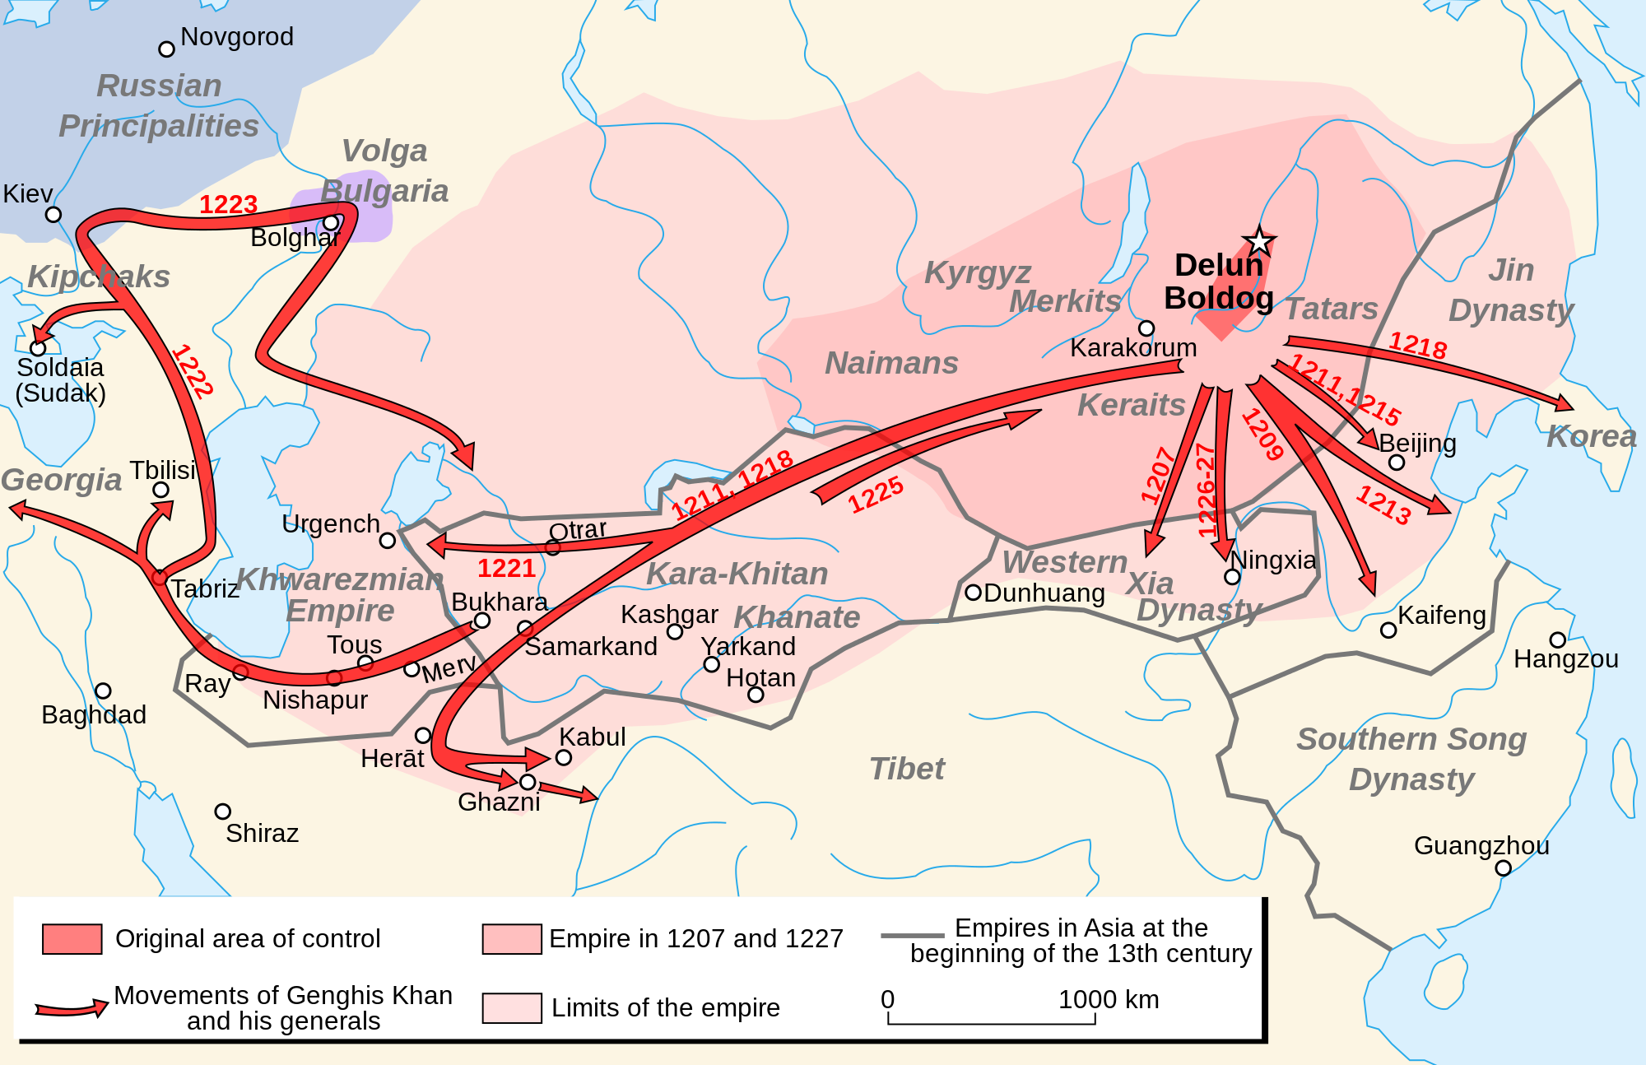
Theme: Asymmetric Warfare
Historically, asymmetric military configurations could radically change history. Eg:
Horseback archery, composite bows, and rise of Steppe Empires (Persians, Huns, Mongols). Estimated 3-4:1 Chinese:Mongol ratio for each phase of Mongol invasion of China. (Invasion of Song Dynasty: 1.5m Chinese vs 450k Mongol)
Gunpowder, steel and rise of the Western powers has origins in asymmetric warfare: Cortes (1.5k Spaniards vs. 300k Aztecs) & Pizarro (160 Spaniards), Anglo-Indian wars, Opium Wars
Both imperial and guerilla warfare are asymmetric

Slide 13
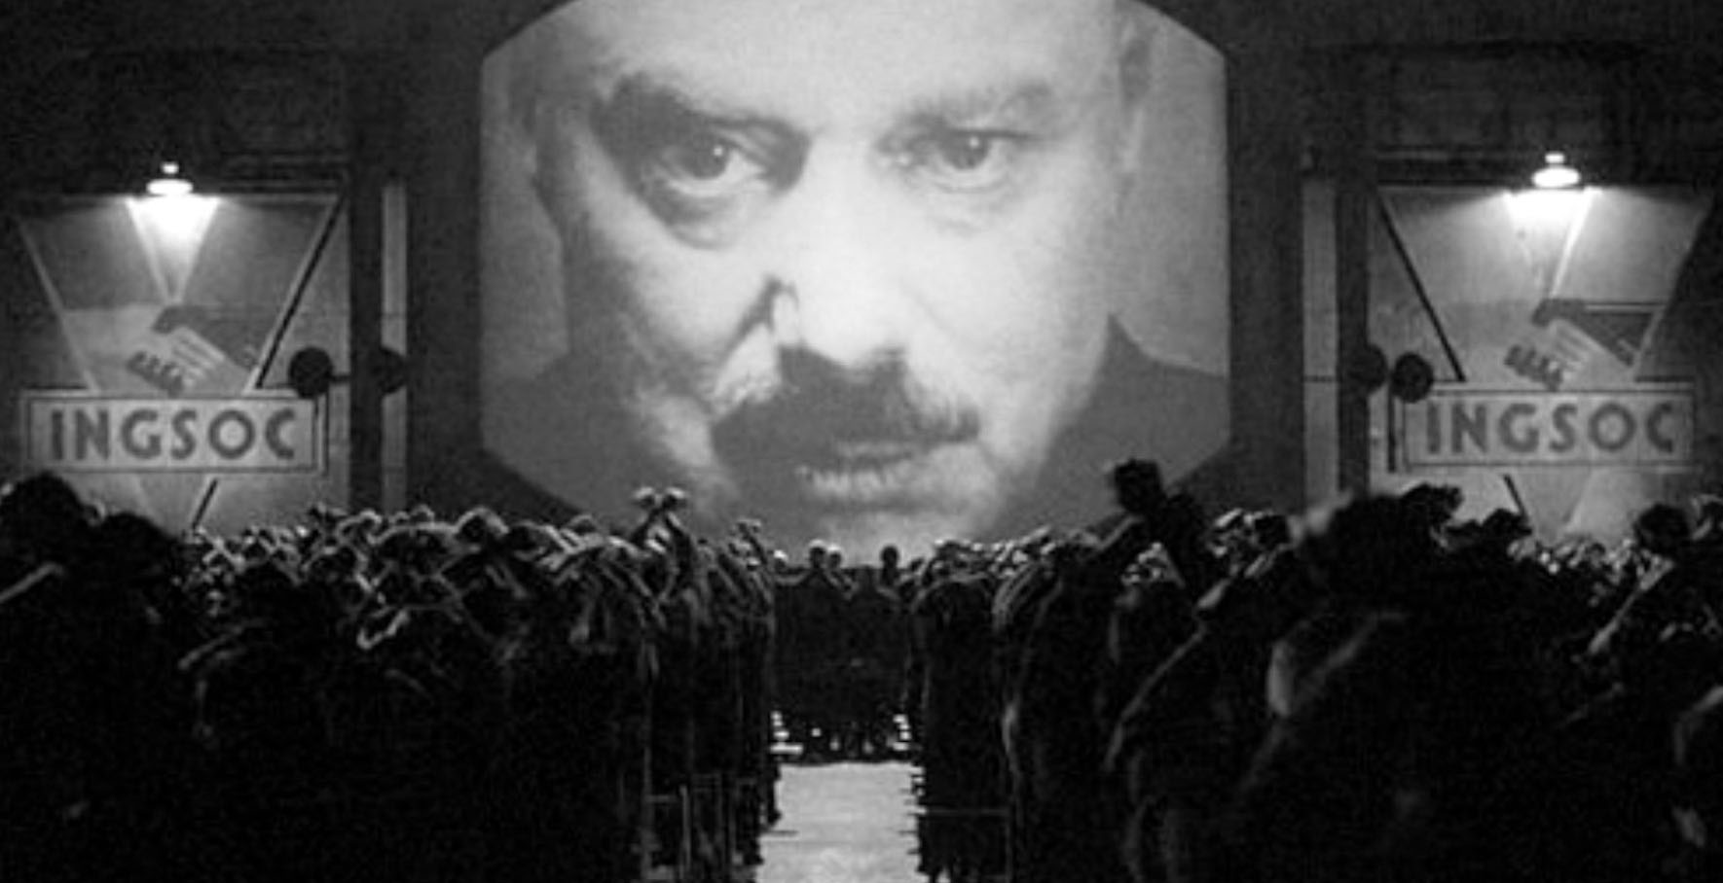
Theme: Neoendemic Warfare:
“We’ve always been at war with Eastasia” (1984)
“Endemic warfare is the state of continual, low-threshold warfare in a tribal warrior society. Endemic warfare is often highly ritualized and plays an important function in assisting the formation of a social structure among the tribes' men by proving themselves in battle.” (Wikipedia)
Staple of Pax Americana is the necessity for perpetual war: War on Drugs & Terrorism, instigating instability for installment of pro-US regimes (Arab Spring, Donbass, everything in Latin America, failures in Syria, Afghanistan), saber-rattling w/ Iran, NK, China, Russia
Increases economic, industrial, and military preparedness of war and state monopoly on violence (militarization of police).
Cyberspace exists in a state of Endemic war: cyber attacks, trolling, doxxing, exploiting, etc. Blackhat groups, Anonymous, lulzsec; ‘Whitehat’ corps like MacAfee, OWS.
Neoendemic also heavily ritualized in popular portrayals of hackers, and commercial branding like Heartbleed, VENOM

Slide 14
Enemy in the Skyscraper: Threats to Privacy and Freedom
Domestic and foreign spying: NSA, but also everyone
Irresponsible Centralization
Legislation, regulatory bodies designed to enable an protect interests of the oligarchs
Astroturfing / 50-cent armies / content throttling on Social Media
Consolidation of media: Comcast, Walt Disney, Time Warner. Is this the future of social media?
Poorly designed systems – legacy and contemporary. IoT.
Militarization of cyberspace: GHOSTnet, STUXnet
Organized crime, Blackhats, Dark web services

Slide 15
Emerging Privacy-Centered Technologies & Concepts
Homomorphic Encryption – you can perform functions on encrypted data, so Clouds don’t store your data in plaintext
Mesh networks – decentralized, interconnected network topologies
Data ephemerality – data you produce will self-destruct, not be stored in database for unknown time
Decentralization vs. Centralization debate

Slide 16

Red Queen Hypothesis of Privacy and Personal Sovereignty
Tech. literacy is as important in 21st century as reading/writing has been since 19th
Same tech that harvests us can be used to free us:
Massive deep-learning systems may either can be used to spoof, obfuscate, and destroy our presence
Tracking systems make decisions based on metadata & statistical profiling of payloads, spoofable

Slide 17
A Doomsday Scenario: Cryptopocalypse
Quantum Computing (QC) will revolutionize cryptography, strengthening encryption algorithms significantly… but also create Quantum Computers for hacking
During transition, QCs will easily brute force through all existing crypto schemas (DH, RSA, etc), running attacks against already harvested data, industrial and military vulnerabilities
DoD will withhold publishing, to give US military-crypto headstart to the QC game; may kick off new Cold War-level intrigue a la Nukes
Well-executed Cryptopocalypse may result in compound strengthening of US Intelligence, or be trump-card of new emerging agency

Slide 18
What is to be done?
Ludditism is not the solution – cannot to unlearn, nor possible to influence system without using tech. Fallacy: All organisms tool, automate, and shape their environment.
Increased tech-literacy, transparency of hardware & software organizations
Better tools for code auditing, detecting obfuscation, sketchy commits to key FOSS projects
Centralization vs. Decentralization – either schemes may empower corrupt subversive power, or be freeing
Advocacy, legislation, watchdogs, public interest/outcry
Cultural movements, like Cyberpunk itself

Slide 19
Educate Yourself
eff.org – The Electronic Frontier Foundation; Legal and technical aspects of privacy, digital rights, surveillance, forensics, and due process.
privacytools.io – Tools and explanations to help protect online privacy; not a silver-bullet
alternativeto.net – Search alternative software
fried.com/privacy – A comprehensive, beginner’s guide to network privacy
fsf.org – Free Software Foundation

