Slide 1
Loan Default Risk Prediction in SACCOs

Slide 2
Problem Statement
Umurenge SACCOs rely on manual and traditional methods for assessing borrower creditworthiness.
These methods are subjective, error-prone, and inefficient, leading to poor decision-making.
As a result:
High-risk clients are sometimes granted loans, increasing loan defaults.
Eligible clients may be unfairly denied, reducing trust and satisfaction.
This creates challenges in financial sustainability, efficiency, and credibility.
There is a strong need for a machine learning–based financial risk prediction model to ensure accurate, objective, and data-driven credit risk assessment.

Slide 3
Dataset Description
Dataset size: 200 synthetic records.
Features: Gender, Marital Status, Education Level, Employment Status,
Income, Loan Amount, Loan Term, Past Repayment History, Credit Score.
Target: Loan Eligibility (1/0).

Slide 4
EDA Findings
Demographics: Majority employed & married.
Loan Patterns: Higher income → higher eligibility.
Repayment History: Strongest predictor.
Outliers in very high income & loan amounts.

Slide 5
Feature Engineering
One-hot encoding for categorical features.
Standard Scaler for numerical features.
Stratified split for balanced classes.
Justification: Fair model performance.

Slide 6
Modal building and Evaluation process
In this project, the model development process started with preparing the dataset by handling missing values, encoding categorical features, and scaling numerical variables to ensure consistency. Different machine learning algorithms such as Logistic Regression, Decision Trees, Random Forests, and Gradient Boosting were considered. Among these, ensemble methods (Random Forest/Gradient Boosting) provided the best balance between accuracy and robustness. Hyperparameter tuning was performed using techniques like Grid Search and Cross-Validation to optimize model performance. The trained model was then evaluated on a hold-out test dataset using metrics such as accuracy, precision, recall, F1-score, and ROC-AUC to ensure reliability. Finally, the best performing model was selected and saved for deployment in the Streamlit application to make real-time loan default predictions.

Slide 7
Conclusion & Future Work
ML automates loan risk assessment.
Reduces errors & saves time.
Future work:
- Use larger real-world datasets.
- Advanced models (XGBoost, Neural Nets).
- Deploy as full SACCO web service.

Slide 8
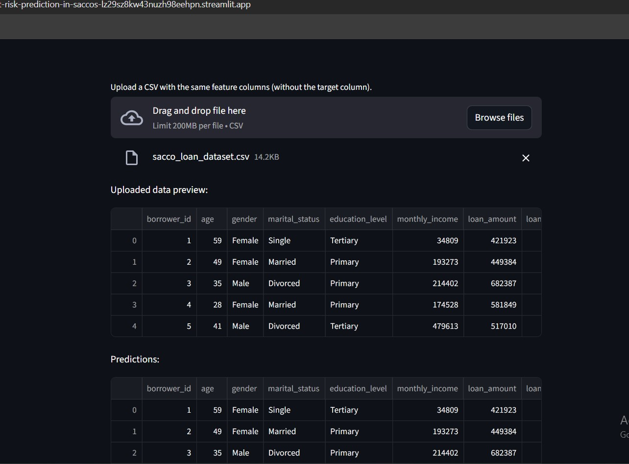
Public Deployment

Slide 9
