Slide 1
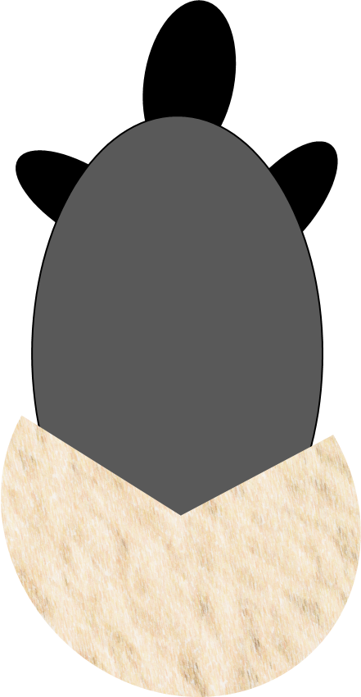
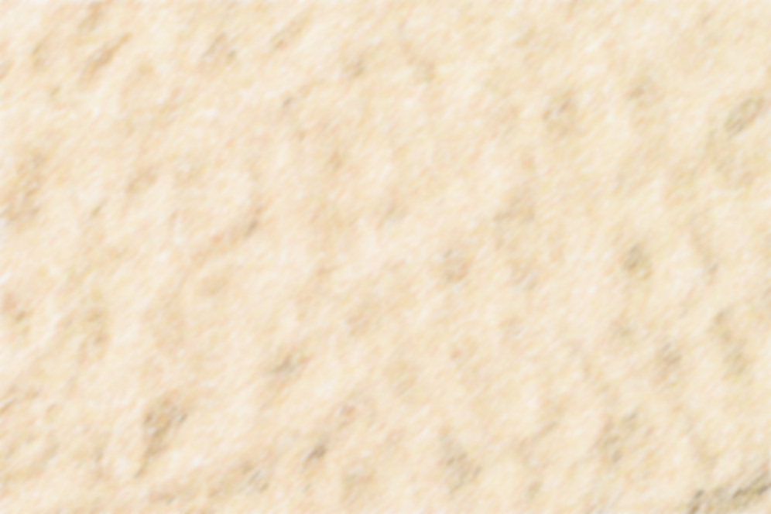
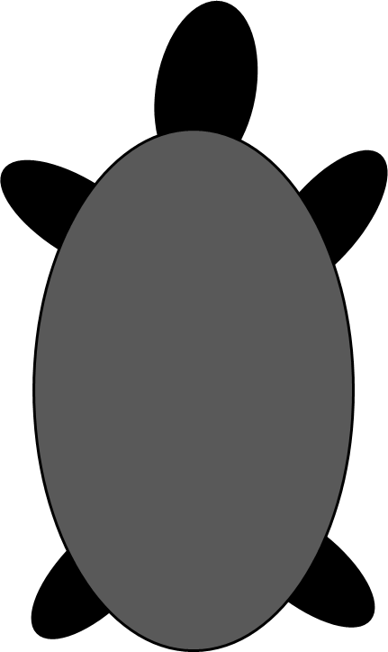
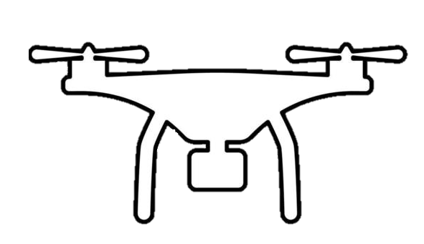
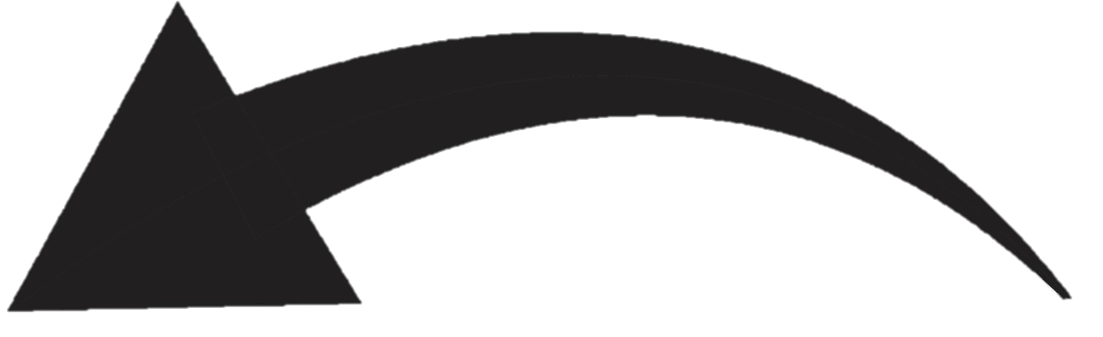
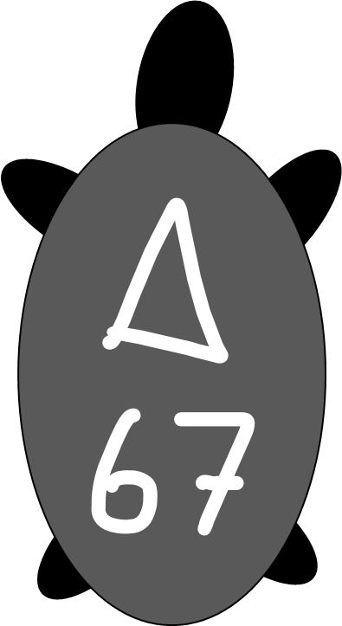
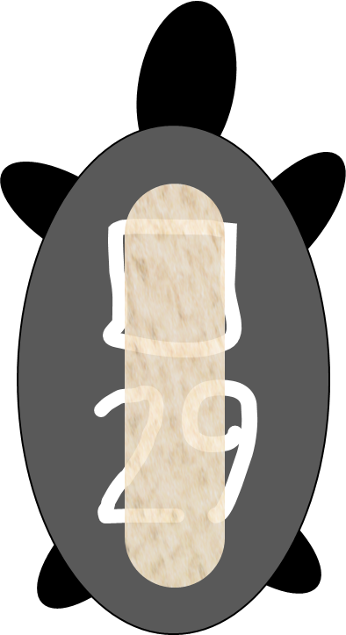
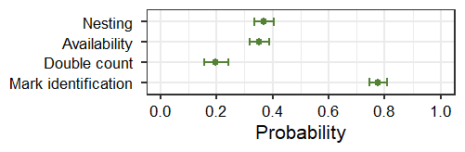
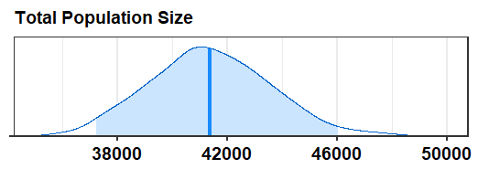
1. Drone-derived orthomosaics
2. Sources of variation
2a
Open population
Individual states:
a) nesting; b) walking
Unavailable individuals
Double counting
Unidentifiable marks
2b
4
3
5
5. Model estimates
3. Mark-resight data
4. Overall counts data
Multistate open-population capture-recapture model
Population counts model
Entry process
Daily abundance
Number of entries and departures
Total population size
Nesting probability
Availability probability
Mark-identification prob.
Double count proportion

Slide 2
