Slide 1
Single observer (Binomial) N-mixture model
 |  | λ
 |  | 0.1 | 0.2 | 0.3 | 0.5 | 1 | 2 | 4 | 8
φ | 0.1 | 28 (28-28) | 20 (20-20) | 23 (19-26) | 21 (21-25) | 27 (21-28) | 19 (19-19) | 20 (11-24) | 15 (15-15)
 | 0.2 | 10 (9-14) | 13 (8-13) | 14 (8-14) | 12 (10-13) | 12 (9-18) | 14 (9-19) | 10 (9-19) | 9 (7-12)
 | 0.3 | 8 (6-8) | 7 (5-8) | 7 (6-8) | 5 (5-9) | 7 (5-10) | 13 (6-15) | 10 (7-16) | 8 (7-12)
 | 0.4 | 5 (5-5) | 4 (4-6) | 5 (4-6) | 4 (4-8) | 5 (4-8) | 6 (5-10) | 9 (5-10) | 9 (4-10)
 | 0.5 | 4 (3-4) | 4 (3-5) | 4 (3-4) | 4 (3-5) | 4 (3-7) | 6 (4-8) | 6 (4-10) | 8 (4-10)
 | 0.6 | 3 (3-3) | 3 (3-3) | 3 (3-3) | 4 (3-5) | 3 (3-5) | 4 (3-7) | 4 (3-10) | 6 (3-10)
 | 0.7 | 2 (2-3) | 3 (2-3) | 2 (2-3) | 3 (2-4) | 3 (2-4) | 3 (2-6) | 4 (3-9) | 5 (3-10)
 | 0.8 | 2 (2-2) | 2 (2-2) | 2 (2-2) | 2 (2-3) | 2 (2-3) | 3 (2-5) | 3 (2-7) | 4 (2-9)
Double observer (Multinomial) N-mixture model
 |  | λ
 |  | 0.1 | 0.2 | 0.3 | 0.5 | 1 | 2 | 4 | 8
φ | 0.1 | 21 (20-20) | 22 (15-22) | 19 (16-19) | 18 (18-23) | 18 (16-27) | 18 (16-26) | 15 (9-22) | 16 (14-17)
 | 0.2 | 9 (9-11) | 7 (7-10) | 9 (7-11) | 8 (7-11) | 10 (7-14) | 8 (7-17) | 12 (7-18) | 8 (7-13)
 | 0.3 | 7 (5-7) | 5 (4-6) | 6 (4-7) | 6 (5-6) | 6 (5-9) | 10 (5-12) | 9 (6-16) | 8 (5-20)
 | 0.4 | 3 (3-5) | 4 (3-5) | 4 (3-5) | 4 (3-5) | 4 (3-7) | 6 (4-10) | 6 (4-10) | 7 (5-10)
 | 0.5 | 3 (3-3) | 3 (3-4) | 3 (3-4) | 3 (3-4) | 3 (3-5) | 4 (3-7) | 4 (3-10) | 7 (3-10)
 | 0.6 | 2 (2-3) | 2 (2-3) | 2 (2-3) | 3 (2-3) | 3 (2-4) | 3 (2-4) | 3 (2-7) | 5 (3-10)
 | 0.7 | 2 (2-2) | 2 (2-2) | 2 (2-2) | 2 (2-3) | 2 (2-3) | 3 (2-4) | 3 (2-6) | 4 (2-9)
 | 0.8 | 2 (2-2) | 2 (2-2) | 2 (2-2) | 2 (2-2) | 2 (2-3) | 2 (2-3) | 2 (2-4) | 3 (2-7)

Slide 2
a. Single observer (Binomial) N-mixture model
 |  | λ
 |  | 0.1 | 0.2 | 0.3 | 0.5 | 1 | 2 | 4 | 8 | 12 | 20 | 40
φ | 0.1 | 28 (28-28) | 20 (20-20) | 23 (19-26) | 21 (21-25) | 27 (21-28) | 19 (19-19) | 20 (11-24) | 15 (15-15) | 11 (11-17) | 17 (12-19) | 21 (11-23)
 | 0.2 | 10 (9-14) | 13 (8-13) | 14 (8-14) | 12 (10-13) | 12 (9-18) | 14 (9-19) | 10 (9-19) | 9 (7-12) | 10 (7-15) | 13 (7-15) | 11 (7-13)
 | 0.3 | 8 (6-8) | 7 (5-8) | 7 (6-8) | 5 (5-9) | 7 (5-10) | 13 (6-15) | 10 (7-16) | 8 (7-12) | - | - | -
 | 0.4 | 5 (5-5) | 4 (4-6) | 5 (4-6) | 4 (4-8) | 5 (4-8) | 6 (5-10) | 9 (5-10) | 9 (4-10) | - | - | -
 | 0.5 | 4 (3-4) | 4 (3-5) | 4 (3-4) | 4 (3-5) | 4 (3-7) | 6 (4-8) | 6 (4-10) | 8 (4-10) | 5 (3-15) | 11 (4-15) | 10 (4-15)
 | 0.6 | 3 (3-3) | 3 (3-3) | 3 (3-3) | 4 (3-5) | 3 (3-5) | 4 (3-7) | 4 (3-10) | 6 (3-10) | - | - | -
 | 0.7 | 2 (2-3) | 3 (2-3) | 2 (2-3) | 3 (2-4) | 3 (2-4) | 3 (2-6) | 4 (3-9) | 5 (3-10) | - | - | -
 | 0.8 | 2 (2-2) | 2 (2-2) | 2 (2-2) | 2 (2-3) | 2 (2-3) | 3 (2-5) | 3 (2-7) | 4 (2-9) | - | - | -
b. Double observer (Multinomial) N-mixture model
 |  | λ
 |  | 0.1 | 0.2 | 0.3 | 0.5 | 1 | 2 | 4 | 8 | 12 | 20 | 40
φ | 0.1 | 21 (20-20) | 22 (15-22) | 19 (16-19) | 18 (18-23) | 18 (16-27) | 18 (16-26) | 15 (9-22) | 16 (14-17) | 15 (11-18) | 11 (11-11) | 13 (11-19)
 | 0.2 | 9 (9-11) | 7 (7-10) | 9 (7-11) | 8 (7-11) | 10 (7-14) | 8 (7-17) | 12 (7-18) | 8 (7-13) | 11 (6-13) | 12 (7-13) | 11 (5-15)
 | 0.3 | 7 (5-7) | 5 (4-6) | 6 (4-7) | 6 (5-6) | 6 (5-9) | 10 (5-12) | 9 (6-16) | 8 (5-20) | - | - | -
 | 0.4 | 3 (3-5) | 4 (3-5) | 4 (3-5) | 4 (3-5) | 4 (3-7) | 6 (4-10) | 6 (4-10) | 7 (5-10) | - | - | -
 | 0.5 | 3 (3-3) | 3 (3-4) | 3 (3-4) | 3 (3-4) | 3 (3-5) | 4 (3-7) | 4 (3-10) | 7 (3-10) | 9 (3-15) | 9 (3-15) | 14 (3-15)
 | 0.6 | 2 (2-3) | 2 (2-3) | 2 (2-3) | 3 (2-3) | 3 (2-4) | 3 (2-4) | 3 (2-7) | 5 (3-10) | - | - | -
 | 0.7 | 2 (2-2) | 2 (2-2) | 2 (2-2) | 2 (2-3) | 2 (2-3) | 3 (2-4) | 3 (2-6) | 4 (2-9) | - | - | -
 | 0.8 | 2 (2-2) | 2 (2-2) | 2 (2-2) | 2 (2-2) | 2 (2-3) | 2 (2-3) | 2 (2-4) | 3 (2-7) | - | - | -

Slide 3
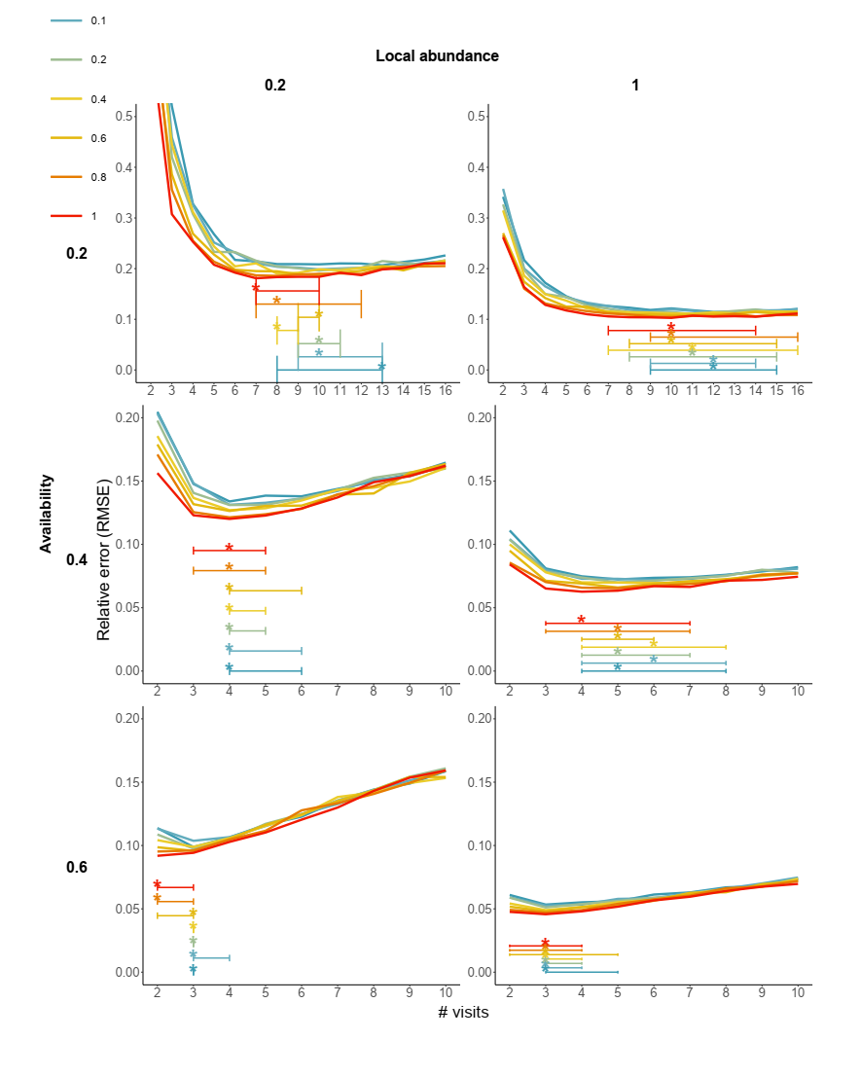
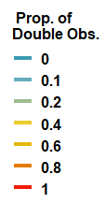

Slide 4
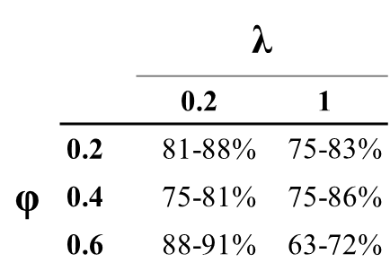
 |  | λ
 |  | 0.2 | 1
φ | 0.2 | 81-88% | 75-83%
 | 0.4 | 75-81% | 75-86%
 | 0.6 | 88-91% | 63-72%

