Slide 1
Network Intrusion Detection Combined Hybrid Sampling With Machine Learning
Md. Ismail Hossain (0421052092)
Md. Sadiqul Amin (0421052106)

Slide 2
Outline
1. Introduction
2. Existing Work
3. Our Proposal
4. Data Set
5. Methodology
Plan A
Plan B
6. Conclusion
7. Reference

Slide 3
Technical Terms
NIDS
AIDS
Hybrid Sampling
SVM

Slide 4
Introduction Intrusion Detection System (IDS)
An intrusion detection system (IDS) is a device or software application that monitors a network for malicious activity or policy violations. Any malicious activity or violation is typically reported or collected centrally using a security information and event management system.

Slide 5
Introduction IDS Hierarchy
Detection
Source
Detection
Methods
IDS
NIDS
SIDS
AIDS
SIDS+AIDS
HIDS

Slide 6



Introduction Network-based Intrusion Detection System (NIDS)
A network-based intrusion detection system (NIDS) detects malicious traffic on a network. NIDS usually require promiscuous network access in order to analyze all traffic, including all unicast traffic. Generally, NIDS are passive devices that do not interfere with the traffic they monitor.

Slide 7
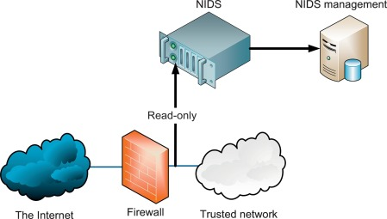
Introduction NIDS
Atypical NIDS architecture. The NIDS sniffs the internal interface of the firewall in read-only mode and sends alerts to a NIDS Management server.

Slide 8
Introduction Anomaly-based Intrusion Detection System (AIDS)
An anomaly-based intrusion detection system, is an intrusion detection system for detecting both network and computer intrusions and misuse by monitoring system activity and classifying it as either normal or anomalous.

Slide 9
Previous Works
Statistical Based
DoS attack detection system that uses multivariate correlation analysis (MCA) for accurate network traffic characterization by extracting the geometrical correlations between network traffic features. [5]
PCA-based multivariate statistical network monitoring (MSPC) for anomaly detection. [6]

Slide 10
Previous Works
Knowledge based
Defense Mechanisms Against Distributed Denial of Service (DDoS) Flooding Attacks [7]
Machine Learning based
Combination of genetic fuzzy systems and pairwise learning for improving detection rates on Intrusion Detection Systems [8]
Novel hybrid intrusion detection method integrating anomaly detection with misuse detection [9]
Network Intrusion Detection Combined Hybrid Sampling With Deep Hierarchical Network [10]

Slide 11
Our Proposal
In our proposed method we will use hybrid sampling on our data set to make our dataset balanced then we will use different machine learning models and compare them. Our goal is to improve the accuracy and time complexity.
Machine Learning Model
Data set
Hybrid Sampling

Slide 12
Novelty
Currently existing research shows that using machine learning model on hybrid sampling achieved accuracy is <= 82% [3]
Using CNN model on hybrid sampling data set accuracy was achieved 81.95%[3]
Using hybrid sampling on dataset and trained BiLSTM model on that dataset the accuracy was achieved 75.08%[3]
We will try to improve the existing accuracy and after that we will compare our result with previous work.

Slide 13
Our Work
Data Set: NSL KDD
Hybrid Sampling: (SMOTE + OSS)
Machine Learning Model: Support Vector Machine (SVM)
Hybrid Sampling
(SMOTE + OSS)
Machine Learning Model
(SVM & CART)
Data Set
(NSL KDD)

Slide 14
Our Work
Hybrid Sampling
Data set NSL KDD
Majority
Minority
Under Sampling (OSS)
Over Sampling
(SMOTE)
Balanced Dataset

Slide 15
Methodology
First, we will perform hybrid sampling in our data set to make our data set balanced.
Then we will train different Machine learning model.
Test our models.
We observe the performance of these models.
Select the most accurate model.

Slide 16
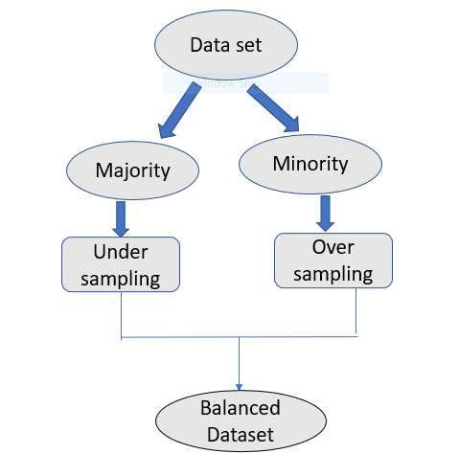
Methodology
Plan A (Support Vector Machine)
Model Training
Training data
ML model
SVM
Test Data
Classification result

Slide 17
Methodology
Plan B (Classification And Regression Trees)
Model Training
Training data
ML model
CART
Test Data
Classification result

Slide 18
Data Set (NSL KDD)
Kddcup.names
training_attack_types
KDDTrain+.txt

Slide 19
Data Extraction
Fetching data
Load data:
from google.colab import files uploaded = files.upload()
Read Data:
with open("training_attack_types", 'r') as f:
print(f.read())

Slide 20
Data Extraction
The data set doesn't include column names, so let's add them.
columns = (['duration' ,'protocol_type' ,'service' ,'flag’ , 'src_bytes' ,'dst_bytes' ,'land' ,'wrong_fragment' ,'urgent' ,'hot' ,'num_failed_logins’ , 'logged_in' ,'num_compromised' ,'root_shell' ,'su_attempted' ,'num_root' ,'num_file_creations’ , 'num_shells' ,'num_access_files' ,'num_outbound_cmds' ,'is_host_login' ,'is_guest_login' ,'count’ , 'srv_count' ,'serror_rate' ,'srv_serror_rate' ,'rerror_rate' ,'srv_rerror_rate' ,'same_srv_rate' ,'diff_srv_rate' ,'srv_diff_host_rate’ , 'dst_host_count' ,'dst_host_srv_count' ,'dst_host_same_srv_rate' ,'dst_host_diff_srv_rate' ,'dst_host_same_src_port_rate' ,'dst_host_srv_diff_host_rate’ , 'dst_host_serror_rate' ,'dst_host_srv_serror_rate' ,'dst_host_rerror_rate' ,'dst_host_srv_rerror_rate' ,'attack' ,'level’])
df.columns = columns test_df.columns = columns

Slide 21
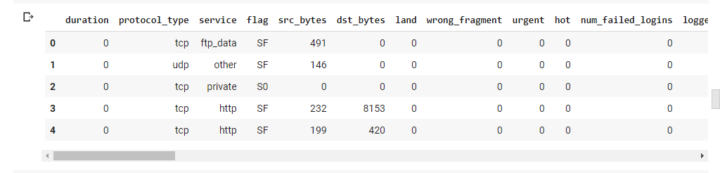
Data Extraction
Training data after adding class

Slide 22
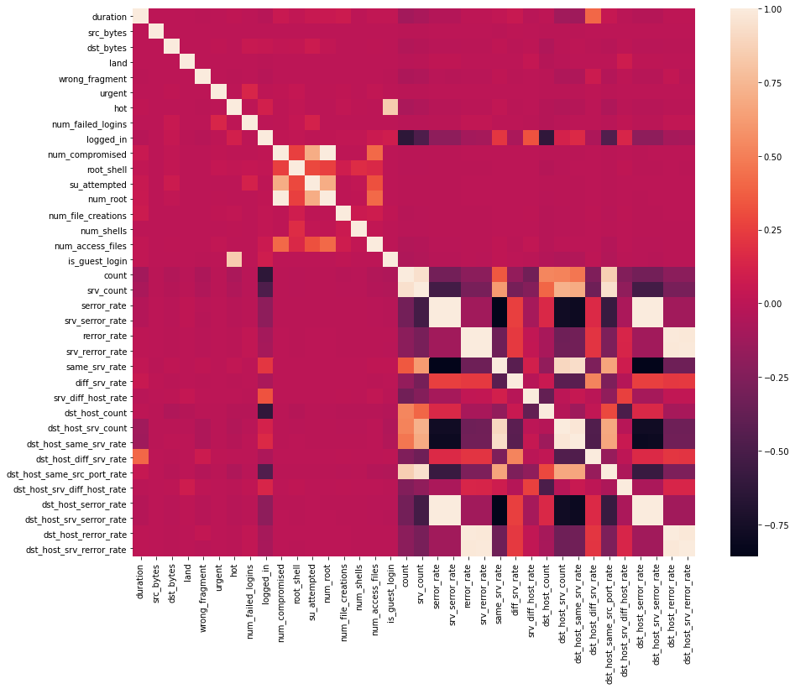
Data Preprocessing
Data Correlation – Found the highly correlated variables using heatmap and ignore them for analysis.

Slide 23
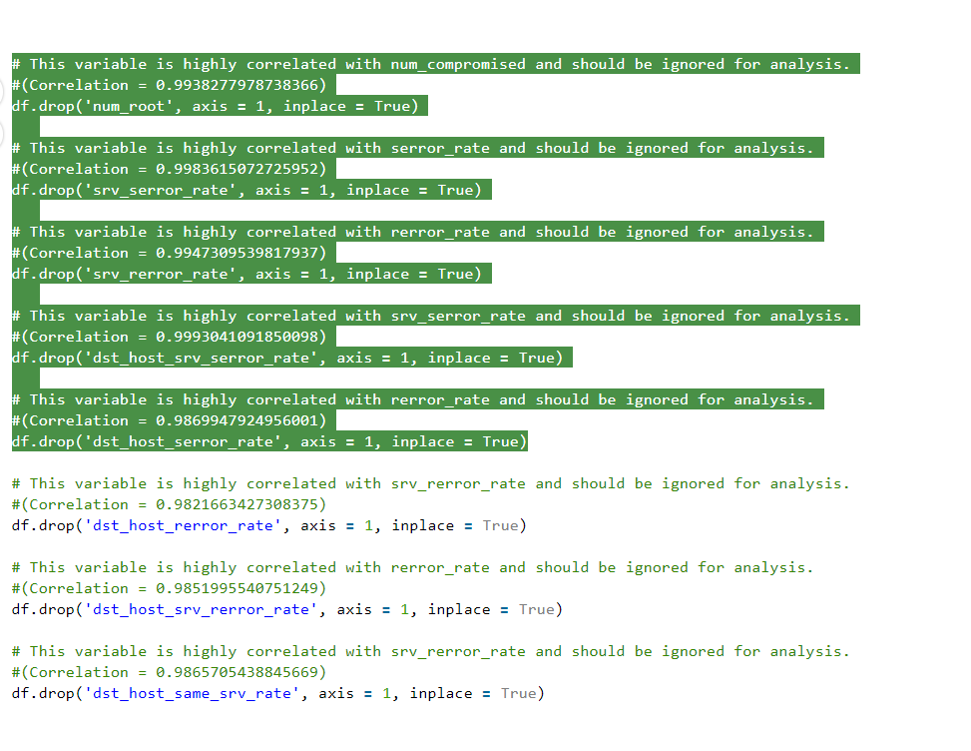
Data Preprocessing
Ignoring the highly correlated variables

Slide 24
Feature Engineering
Feature Mapping – Apply feature mapping on features such as : ‘protocol_type’ & ‘flag’.
# protocol_type feature mapping
pmap = {'icmp':0, 'tcp':1, 'udp':2}
df['protocol_type'] = df['protocol_type'].map(pmap)
# flag feature mapping
fmap = {'SF':0, 'S0':1, 'REJ':2, 'RSTR':3, 'RSTO':4, 'SH':5, 'S1':6, 'S2':7, 'RSTOS0':8, 'S3':9, 'OTH':10}
df['flag'] = df['flag'].map(fmap)

Slide 25
Splitting the Data Set
Train data set 67%
Test data set 33%
# Split test and train data
X_train, X_test, y_train, y_test = train_test_split(X, y, test_size = 0.33, random_state = 42)
print(X_train.shape, X_test.shape)
print(y_train.shape, y_test.shape)
(125973, 32) (84401, 31) (41572, 31) (84401, 1) (41572, 1)

Slide 26
Synthetic Minority Oversampling Technique (SMOTE)
Nitesh Chawla, et al. in their 2002 paper
In Imbalance data set too few examples of the minority class for a model to effectively learn the decision boundary.
One way to solve this problem is to oversample the examples in the minority class. This can be achieved by simply duplicating examples from the minority class in the training dataset prior to fitting a model. This can balance the class distribution but does not provide any additional information to the model.

Slide 27
One Sided Selection (OSS)
Under sampling technique
Uses Tomek Links and the condensed Nearest Neighbor
Use to remove redundant examples from the interior of the density of the majority class.

Slide 28
Model Fit
Support Vector Machine (SVM)
#SVM
#Import svm model
from sklearn import svm
#Create a svm Classifier
clf = svm.SVC(kernel='linear') # Linear Kernel
print(y_train_hyb.shape)
print(X_train_hyb.shape)
start_time = time.time()
clfg.fit(X_train_hyb, y_train_hyb.ravel())

Slide 29
Result
 | SVM | CART
Training Time | 98.08201670646667 | 0.735231876373291
Testing Time | 14.745504379272461 | 0.011311531066894531
Accuracy | 0.953911286442798 | 0.9950928509573752

Slide 30
Result Comparison
Feature | Existing work | Our work (SVM) | Our work (CART)
Data set | NSL KDD | NSL KDD | NSL KDD
Sampling Technique | Hybrid Sampling(SMOTE + OSS) | Hybrid Sampling(SMOTE + OSS) | Hybrid Sampling(SMOTE + OSS)
ML model | CNN-BiLSTM | SVM | CART
Accuracy | 84.95% | 95.39% | 99.51%

Slide 31
Conclusion
Our trained model perform better than (CNN + BiLSTM)
Our best result is 99.51% accuracy which we got using CART decision tree.
Our training time was also comparatively low maximum 98 seconds.

Slide 32
Reference
Data:
https://github.com/InitRoot/UNSW_NB15
https://www.kaggle.com/hassan06/nslkdd
Paper:
D. Papamartzivanos, F. G. Marmol, and G. Kambourakis, ``Introducing deep learning self-adaptive misuse network intrusion detection systems,‘’
IEEE Access, vol. 7, pp. 1354613560, 2019.
S. M. Kasongo and Y. Sun, ``A deep learning method with lter based feature engineering for wireless intrusion detection system,''
IEEE Access, vol. 7, pp. 3859738607, 2019.
Network Intrusion Detection Combined Hybrid Sampling With Deep Hierarchical Network KAIYUAN JIANG , WENYA WANG , AILI WANG , AND HAIBIN WU

Slide 33
Reference
4. An Anomaly Intrusion Detection System Using C5 Decision Tree Classifier
Ansam Khraisat(B), Iqbal Gondal, and Peter Vamplew
5. Tan Z, Jamdagni A, He X, Nanda P, Liu RP (2014) A system for denial-of-service attack detection based on multivariate correlation analysis.
IEEE Transactions on Parallel and Distributed Systems 25(2):447–456
6. J. Camacho, A. Pérez-Villegas, P. García-Teodoro, and G. Maciá-Fernández, "PCA- based multivariate statistical network monitoring for anomaly detection,"
Computers & Security, vol. 59, pp. 118–137, 6// 2016

Slide 34
Reference
7. Zargar J, Tipper (2013) A survey of defense mechanisms against distributed denial of service (DDoS) flooding attacks.
IEEE Communications Surveys & Tutorials 15(4):2046–2069
8. S. Elhag, A. Fernández, A. Bawakid, S. Alshomrani, and F. Herrera, "On the combination of genetic fuzzy systems and pairwise learning for improving detection rates on intrusion detection systems,"
Expert Syst Appl, vol. 42, no. 1, pp. 193–202, 1// 2015
9. G. Kim, S. Lee, and S. Kim, "A novel hybrid intrusion detection method
integrating anomaly detection with misuse detection,"
Expert Syst Appl, vol. 41, no. 4, Part 2, pp. 1690–1700, 2014/03/01/ 2014

