Slide 1
A Comparative Study of
Practical Machine Learning
Regression • Classification • Clustering
Md Ismail Hossain
MSc Applied Artificial Intelligence
South East Technological University, Ireland
Practical ML project report | 2026

Slide 2
Three tasks, three evaluation goals
Different datasets require different representations, split strategies, and success metrics.
Task | Dataset / scale | Objective | Main evaluation
Regression | BLE-GSpeed: ~910,780 observations; ~382 sessions | Predict walking speed from BLE signal features | MAE, RMSE, R²; error within ±0.1
Classification | NSL-KDD: normal vs. attack | Detect attack connections | Precision, recall, F1, ROC-AUC, PR-AUC
Clustering | Product titles: 35,311 records | Group similar products from text | Silhouette, inertia, noise share; post-hoc NMI
Match the target
Evaluate fairly
Interpret critically
Align feature representation with the unit and
structure of the label.
Fit transforms on training data only; reserve
test data.
High scores still require leakage and
generalisation checks.
Practical Machine Learning • MSc Applied Artificial Intelligence 02

Slide 3
Data overview and quality checks
Dataset size, missing values, duplicates, labels, and modelling scope.
Dataset | Size / structure | Missing / duplicates | Target or input | Important note
BLE-GSpeed | ~910,780 rows × 8 columns | Missing RSSI possible; forward-fill within user/session/device | Speed; one label per walking session | ~382 sessions; rows are not independent examples
NSL-KDD | Cleaned network connection feature matrix | Workflow drops columns containing missing values and removes constants | Normal=0; attack=1 | Eight correlated features removed; service dropped
Product titles | 35,311 rows × 7 columns | 0 missing cells; 0 exact duplicate rows; 30,993 unique title strings | Product Title only | 3,184 distinct titles repeat; metadata excluded from input
Data-quality takeaway: repeated measurements and repeated titles are not automatically duplicates; their meaning depends on the task.
Practical Machine Learning • MSc Applied Artificial Intelligence 03

Slide 4
Preprocessing pipelines
Task-specific transformations with explicit leakage controls.
BLE-GSpeed — time series
NSL-KDD — tabular
Product titles — text
1. Sort readings chronologically.
2. Forward-fill RSSI within user/session/device only.
3. Aggregate irregular readings into initial 500-ms
windows.
4. Extract RSSI statistics and temporal features.
5. Aggregate windows to one row per labelled
session.
6. Keep sessions intact across splits.
1. Clean names; remove missing/constant fields.
2. Remove eight selected correlated features; drop
service.
3. Map protocol and flag to integers; target
normal=0/attack=1.
4. Split before fitting transformations.
5. Fit median imputation and MinMax
scaling on training only.
6. Apply SMOTE to training data only.
1. Strip column whitespace; retain repeated titles.
2. Exclude IDs and reference labels from model input.
3. TF-IDF: lowercase, strip accents, word
unigrams+bigrams.
4. min_df=2; max_df=0.98; sublinear TF; L2
normalisation.
5. Matrix: 35,311 × 37,178; density ≈0.041%.
6. DBSCAN: sample 10,000 titles, SVD to 50
dimensions, L2-normalise.
Practical Machine Learning • MSc Applied Artificial Intelligence 04

Slide 5
Train, validation, and test strategy
The supervised tasks use held-out evaluation; clustering is evaluated without target labels.
NSL-KDD: supervised split
BLE-GSpeed: session-level evaluation
Stratified 70% train / 15% validation / 15% test.
Hyperparameters selected on validation; selected models refitted on
train + validation; test held out.
Initial window-level experiments have test metrics. Later session-level
models are reported on validation only; final held-out test metrics
were not supplied.
Product clustering: unsupervised
Leakage controls / caveats
K-Means++ tested K=2–15. DBSCAN applied to a 10,000-title
sample after 50-dimensional TruncatedSVD. Category labels used
only post hoc.
Train-only imputation, scaling and SMOTE; keep BLE sessions intact;
test on unseen users next. Clustering depends on text representation,
sample, and parameters.
Practical Machine Learning • MSc Applied Artificial Intelligence 05

Slide 6
Regression: BLE-GSpeed results
Session-level aggregation improved validation substantially; generalisation still needs to be tested.
Experiment | Split | MAE | RMSE | R² | Within ±0.1
Initial window LR | Test | 0.20506 | 0.26440 | -0.01178 | 35.04%
Initial window RF | Test | 0.21132 | 0.26895 | -0.04689 | 32.54%
Tuned window RF | Test | 0.18939 | — | 0.09437 | —
Session LR | Validation | 0.08948 | 0.11623 | 0.85355 | 63.79%
Session tuned RF | Validation | 0.01302 | 0.01880 | 0.99617 | 100.00%
Session mean baseline | Validation | 0.24374 | 0.30378 | -0.00037 | 31.03%
Main finding
Next step
Feature aggregation aligned to the session-level speed label.
Audit target leakage and evaluate the tuned model on held-out sessions
and unseen users.
Practical Machine Learning • MSc Applied Artificial Intelligence 06

Slide 7
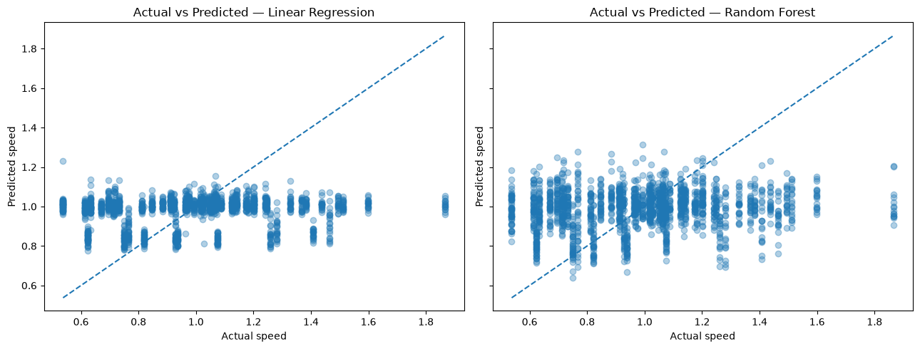
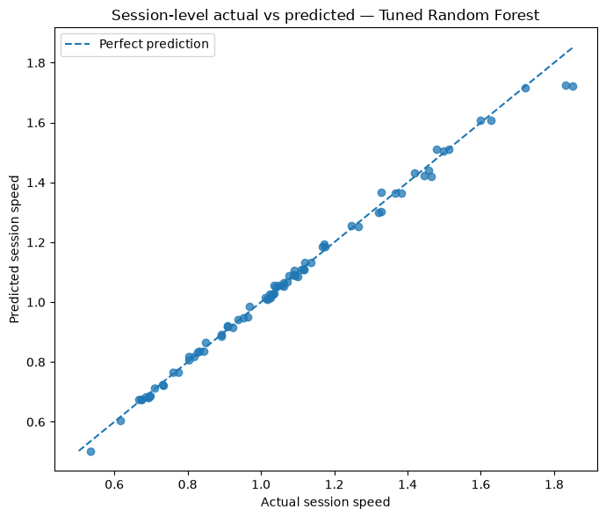
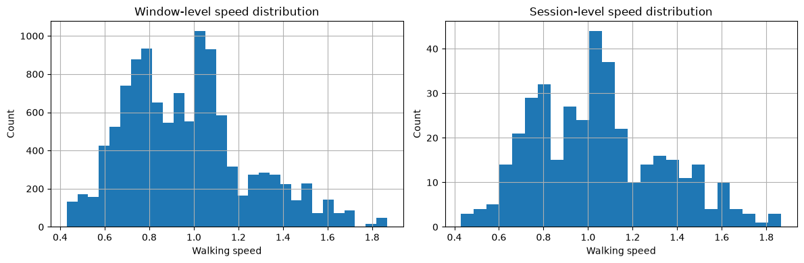
BLE-GSpeed: visual diagnostics
The window-level plots show weak calibration; session-level aggregation aligns predictions much more closely with the ideal line.
Window-level: actual vs. predicted
Session-level tuned Random Forest
Session-level speed distribution
Interpretation
Evaluation caveat
Window-level predictions cluster near the mean; session-level predictions track the
ideal line much more closely.
The session-level plot is validation evidence, not a final held-out test result.
Practical Machine Learning • MSc Applied Artificial Intelligence 07

Slide 8
Classification: validation comparison
Attack F1 and recall guided model selection; ROC-AUC and PR-AUC measure ranking quality.
Model | Accuracy | Precision | Recall | F1 | ROC-AUC | PR-AUC
Decision Tree | 0.9952 | 0.9950 | 0.9948 | 0.9949 | 0.9952 | 0.9922
KNN | 0.9944 | 0.9939 | 0.9941 | 0.9940 | 0.9973 | 0.9959
Logistic Regression | 0.9533 | 0.9554 | 0.9437 | 0.9495 | 0.9883 | 0.9887
Decision Tree
KNN
Logistic Regression
Strongest threshold-based validation metrics among tested models.
Highest validation ROC-AUC and PR-AUC;
more expensive prediction.
Fast prediction, but lower attack recall and F1.
Pipeline: stratified split → train-only imputation/scaling → training-only SMOTE → validation-based selection.
Practical Machine Learning • MSc Applied Artificial Intelligence 08

Slide 9
Classification: held-out test comparison
Final NSL-KDD test metrics after selection and refitting on training + validation data.
Model | Accuracy | Precision | Recall | F1 | Balanced Acc. | ROC-AUC | PR-AUC
Decision Tree | 0.9954 | 0.9949 | 0.9952 | 0.9951 | 0.9954 | 0.9957 | 0.9927
KNN | 0.9951 | 0.9944 | 0.9950 | 0.9947 | 0.9951 | 0.9982 | 0.9973
Logistic Regression | 0.9525 | 0.9569 | 0.9402 | 0.9485 | 0.9517 | 0.9880 | 0.9883
Best threshold-based model
Ranking quality vs. speed
Decision Tree: 99.54% accuracy, 99.52% attack recall, 99.51% attack F1.
KNN: ROC-AUC 0.9982 and PR-AUC 0.9973; prediction ≈1.1853 s vs. 0.0014 s
for Decision Tree.
Logistic Regression prediction ≈0.0006 s; attack recall was 94.02%. These results do not guarantee performance on live traffic.
Practical Machine Learning • MSc Applied Artificial Intelligence 09

Slide 10
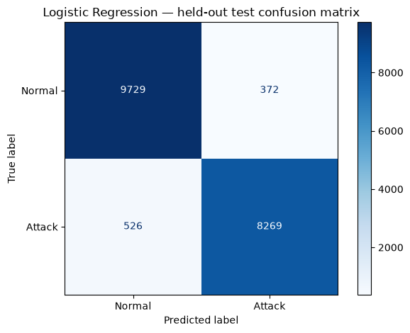
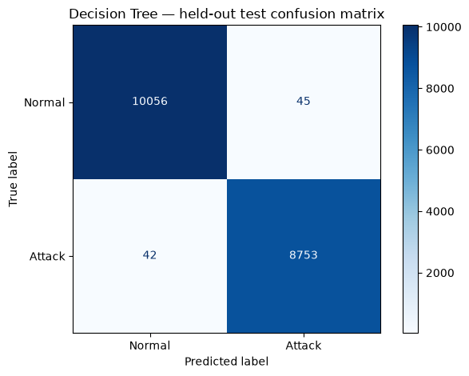
NSL-KDD: confusion matrix comparison
Held-out test predictions. Rows are true labels; columns are predicted labels.
Logistic Regression
Decision Tree
Logistic Regression
Decision Tree
372 false positives and 526 false negatives.
45 false positives and 42 false negatives; far fewer errors on this test set.
Practical Machine Learning • MSc Applied Artificial Intelligence 10

Slide 11
Product clustering and overall findings
TF-IDF provides a scalable baseline, but cluster separation remains weak.
Method | Data / parameters | Result | Interpretation
K-Means++ | K=2–15 | Best sampled cosine silhouette: 0.0489 at K=14 | Low separation; no decisive elbow
DBSCAN | 10,000 titles; SVD to 50 dimensions | 273 non-noise clusters; 46.71% noise | Fragmented density structure; parameter-sensitive
Post-hoc NMI | Compared with category labels | K-Means: 0.6326; DBSCAN: 0.3964 | Category association, not proof of exact-product deduplication
Across tasks
Next steps
Improve clustering
Preprocessing and evaluation design strongly influence results.
Test BLE on unseen users; audit leakage;
evaluate IDS on independent data.
Normalise product titles and model codes;
test character n-grams; tune DBSCAN.
Conclusion: use task-appropriate metrics, preserve evaluation boundaries, and treat promising results as evidence to validate—not guarantees.
Practical Machine Learning • MSc Applied Artificial Intelligence 11

Slide 12
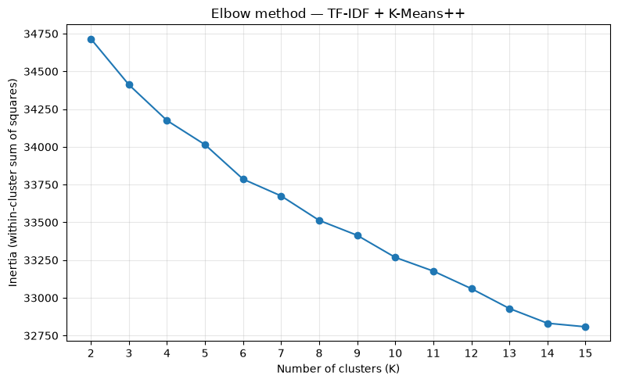
Product clustering: choosing K
The elbow curve decreases gradually; there is no sharp, decisive elbow in the tested range.
Tested range
K-Means++ evaluated for K = 2–15.
Selected candidate
K = 14 gave the highest sampled cosine
silhouette: 0.0489.
Interpretation
Silhouette remains low, suggesting overlapping
product-title clusters.
Clustering is exploratory: title normalisation, feature representation, and parameter tuning remain important.
Practical Machine Learning • MSc Applied Artificial Intelligence 12

