Slide 1
Unit Testing with JUnit
Alessandro Marchetto
Fondazione Bruno Kessler - IRST

Slide 2
Iterative Software development
Write and execute unit tests
Execute acceptance tests
Write acceptance tests
increment
+
system
Prioritized
functionalities
“Written before”
“Executed after the development”

Slide 3
Testing tools
Jemmy/Abbot/JFCUnit/…
FIT/Fitnesse (High level)
GUI
Perfomance and
Load Testing
JMeter/JUnitPerf
Cactus
Business
Logic
HttpUnit/Canoo/Selenium
Junit (Low level)
Web UI
Persistence
Layer
Junit/SQLUnit/XMLUnit

Slide 4
Testing with JUnit
Junit is a unit test environment for Java programs developed by Erich Gamma and Kent Beck.
    Writing test cases
    Executing test cases
    Pass/fail? (expected result = obtained result?)
Consists in a framework providing all the tools for testing.
  framework: set of classes and conventions to use them.
It is integrated into eclipse through a graphical plug-in.

Slide 5
Junit (3.x and 4.x)
Test framework
  test cases are Java code
  test case = “sequence of operations +inputs + expected values”
Test code
testDoubleOf2(){ //..
doubleOf2();
//..
}
Production code
int doubleOf2(){ //…
}

Slide 6
JUnit 3.x for testing programs
JUnit tests
  “substitute the use of main() to check the program behaviour”
All we need to do is:
  write a sub-class of TestCase
  add to it one or more test methods
  run the test using JUnit
  junit.framework.*

Slide 7
Framework elements
TestCase
  Base class for classes that contain tests
assert*()
  Method family to check conditions
TestSuite
  Enables grouping several test cases
Testcase 1
Testsuite
Testcase 2
Testcase 3

Slide 8
An example
class Stack {
public boolean isEmpty(){ ... }
public void push(int i){ ... }
public int pop(){ ... }
…
}
import junit.framework.TestCase;
public class StackTester extends TestCase {
public StackTester(String name) {
super(name);
}
public void testStack() {
Stack aStack = new Stack();
if(!aStack.isEmpty()) {
System.out.println(“Stack should be empty!”);
aStack.push(10);
aStack.push(-4);
System.out.println(“Last element:“ + aStack.pop());
System.out.println(“First element: “ +aStack.pop());
}
}
Must begin with “test”

Slide 9
Assert*()
Method family to check conditions …
They are public methods defined in the base class TestCase
Their names begin with “assert” and are used in test methods
  es. assertTrue(“stack should be empty”, aStack.empty());
If the condition is false:
  test fails
  execution skips the rest of the test method
  the message (if any) is printed
If the condition is true:
  execution continues normally

Slide 10
Assert*()
for a boolean condition
  assertTrue(“message for fail”, condition);
  assertFalse(“message”, condition);
for object, int, long, and byte values
  assertEquals(expected_value, expression);
for float and double values
  assertEquals(expected, expression, error);
for objects references
  assertNull(reference)
  assertNotNull(reference)
…
obtained
http://junit.org/apidocs/org/junit/Assert.html

Slide 11
Assert: example
public void testStack() {
Stack aStack = new Stack();
assertTrue(“Stack should be empty!”, aStack.isEmpty());
aStack.push(10);
assertTrue(“Stack should not be empty!”,!aStack.isEmpty());
aStack.push(4);
assertEquals(4, aStack.pop());
assertEquals(10, aStack.pop());
}
class Stack {
public boolean isEmpty(){ ... }
public void push(int i){ ... }
public int pop(){ ... }
…
}

Slide 12
One concept at a time …
Code Modularization …
public class StackTester extends TestCase {
public void testStackEmpty() {
Stack aStack = new Stack();
assertTrue(“Stack should be empty!”, aStack.isEmpty());
aStack.push(10);
assertTrue(“Stack should not be empty!”, !aStack.isEmpty());
}
public void testStackOperations() {
Stack aStack = new Stack();
aStack.push(10);
aStack.push(-4);
assertEquals(-4, aStack.pop());
assertEquals(10, aStack.pop());
}
}

Slide 13
Working rule
For each test case class, JUnit
  execute all of its public test methods
    i.e. those whose name starts with “test”
  ignores everything else …
Test classes can contain “helper methods” provided that are:
  non public, or
  whose name does not begin with “test”

Slide 14
TestSuite
junit.framework.*
Groups several test cases:
public class AllTests extends TestSuite {
public static TestSuite suite() {
TestSuite suite = new TestSuite();
suite.addTestSuite(StackTester.class);
suite.addTestSuite(AnotherTester.class);
return suite;
}
}

Slide 15
Test of “Exceptions”
There are two cases:
  We expect a normal behavior and then no exceptions.
  We expect an anomalous behavior and then an exception.

Slide 16
We expect a normal behavior …
try {
// We call the method with correct parameters
object.method("Parameter");
assertTrue(true); // OK
} catch(PossibleException e){
fail(“method should not fail !!!");
}
class TheClass {
public void method(String p)
throws PossibleException
{ /*... */ }
}

Slide 17
We expect an exception …
try {
// we call the method with wrong parameters
object.method(null);
fail(“method should fail!!");
} catch(PossibleException e){
assertTrue(true); // OK
}
class TheClass {
public void method(String p)
throws PossibleException
{ /*... */ }
}

Slide 18
SetUp() and tearDown()
setUp() method initialize object(s) under test.
  called before every test method
tearDown() method release object(s) under test
  called after every test case method.
ShoppingCart cart;
Book book;
protected void setUp() {
cart = new ShoppingCart();
book = new Book(“JUnit", 29.95);
cart.addItem(book);
}
…

Slide 19
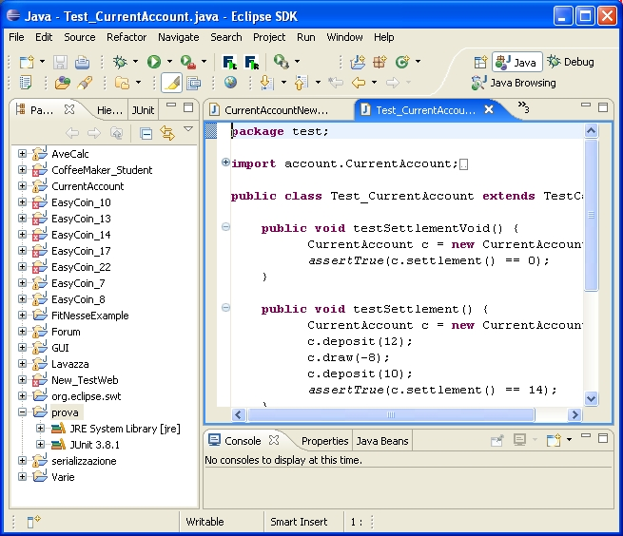
Junit in eclipse - Setup
In Eclipse
  Create a new project
  Open project’s property window (File -> Properties)
  Select: Java build path
  Select: libraries
  Add Library
  Select Junit
    Select the type 3.x or 4.x

Slide 20
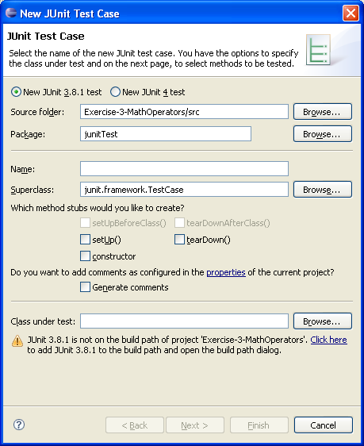
Create a new JUnit test case
Eclipse Menu
File Edit Source Refactor Navigate Search Project Run Window Help
File
  New
    Junit Test Case
      Set the parameters:
        Junit 3.x or 4.x
        name of the class
        etc.
      Finish

Slide 21
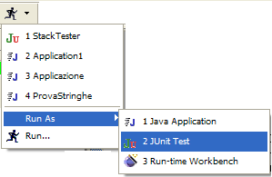
Run as JUnit Test
Eclipse Menu
File Edit Source Refactor Navigate Search Project Run Window Help
Run
  Run As
    Junit Test

Slide 22
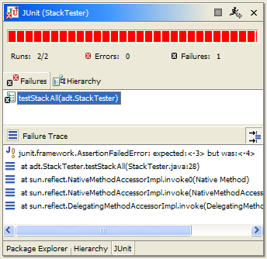

Red / Green Bar
Fail
Pass
expected <-3> but was <-4>

Slide 23
JUnit 3.x and JUnit 4.x
Most things are about equally easy
  JUnit 4 can still run JUnit 3 tests
All the old assertXXX methods are the same
JUnit 4 has some additional features
JUnit 4 provides protection against infinite loops
Junit 4 uses annotations (@)

Slide 24
From JUnit 3.x to 4.x
JUnit 4 requires Java 5 or newer
Don’t extend junit.framework.TestCase; just use an ordinary class
Import org.junit.* and org.junit.Assert.*
  Use a static import for org.junit.Assert.*
  Static imports replace inheritance from junit.framework.TestCase
Use annotations instead of special method names:
  Instead of a setUp method, put @Before before some method
  Instead of a tearDown method, put @After before some method
  Instead of beginning test method names with ‘test’, put @Test before each test method

Slide 25
Annotations in J2SE
J2SE 5 introduces the Metadata feature (data about data)
Annotations allow you to add decorations to your code (remember javadoc tags: @author )
Annotations are used for code documentation, compiler processing (@Deprecated ), code generation, runtime processing
New annotations can be created by developers
http://java.sun.com/docs/books/tutorial/java/javaOO/annotations.html

Slide 26
Annotations in J2SE … an example
…. @Override — it is a predefined annotation used by the Java compiler
It informs the compiler that the element (a method) is meant to override an element declared in a superclass
  // mark method as a superclass method
  // that has been overridden
  @Override
  public int overriddenMethod() { …}
While it's not required to use this annotation when overriding a method, it helps to prevent errors. If a method marked with @Override fails in correctly overriding the original method in its superclass, the compiler generates an error.

Slide 27
Junit 4.x for testing programs
Import the JUnit 4 classes you need
import org.junit.*;
import static org.junit.Assert.*;
Declare your (conventional) Java class
public class MyProgramTest {
Declare any variables you are going to use, e.g., an instance of the class being tested
MyProgram program;
int [ ] array;
int solution;

Slide 28
Junit 4.x for testing programs (2)
If needed, define one method to be executed just once, when the class is first loaded. For instance, when we need to connecting to a database
@BeforeClass
public static void setUpClass() throws Exception {
// one-time initialization code
}
If needed, define one method to be executed just once, to do cleanup after all the tests have been completed
@AfterClass
public static void tearDownClass() throws Exception {
// one-time cleanup code
}

Slide 29
Junit 4.x for testing programs (3)
If needed, define one or more methods to be executed before each test, e.g., typically for initializing values
@Before
public void setUp() {
program = new MyProgram();
array = new int[] { 1, 2, 3, 4, 5 };
}
If needed, define one or more methods to be executed after each test, e.g., typically for releasing resources (files, etc.)
@After
public void tearDown() {
}

Slide 30
@Before and @After methods
More than one @Before and/or @After methods can be defined in a test case
  Attention: we don’t know in what order they will execute
We can inherit @Before and @After methods from a superclass; execution is as follows:
    Execute the @Before methods in the superclass
    Execute the @Before methods in this class
    Execute a @Test method in this class
    Execute the @After methods in this class
    Execute the @After methods in the superclass

Slide 31
Junit 4.x for testing programs (4)
- A test method is annotated with @Test
It takes no parameters, and returns no result.
All the usual assertXXX methods can be used
@Test
public void sum() {
assertEquals(15, program.sum(array));
assertTrue(program.min(array) > 0);
}

Slide 32
Additional Features of @Test
To avoid infinite loops, an execution time limit can be used. The time limit is specified in milliseconds. The test fails if the method takes too long.
@Test (timeout=10)
public void greatBig() {
assertTrue(program.ackerman(5, 5) > 10e12);
}
Some method calls should throw an exception. We can specify that an exception is expected. The test will pass if the expected exception is thrown, and fail otherwise
@Test (expected=IllegalArgumentException.class)
public void factorial() {
program.factorial(-5);
}

Slide 33
Parameterized tests
import org.junit.runner.RunWith;
import org.junit.runners.Parameterized;
import org.junit.runners.Parameterized.Parameters;
Using @RunWith(value=Parameterized.class) and a method @Parameters, a test class is executed with several inputs
@RunWith(value=Parameterized.class)
public class FactorialTest {
private long expected;
private int value;
@Parameters
public static Collection data() {
return Arrays.asList( new Object[ ][ ] { { 1, 0 }, { 1, 1 }, { 2, 2 }, { 120, 5 } });
}
public FactorialTest(long expected, int value) { // constructor
this.expected = expected;
this.value = value;
}
@Test
public void factorial() {
assertEquals(expected, new Calculator().factorial(value));
}
}
Parameters used to exercise
different instances of the class

Slide 34
Test suites
import org.junit.runners.Suite;
import org.junit.runners.Suite.SuiteClasses;
As before, you can define a suite of tests
@RunWith(value=Suite.class)
@SuiteClasses(value={
value=test1.class,
value=test2.class
})
public class AllTests { … }
It could be empty

Slide 35
Additional features of Junit 4
Instead of JUnit 3’s AssertionFailedError, now failed tests throw an AssertionError
There is now an additional version of assertEquals for arrays of objects:
assertEquals(Object[] expected, Object[] actual)
JUnit 3 had an assertEquals(p, p) method for each kind of primitive p, but JUnit 4 only has an assertEquals(object, object) and depends on autoboxing
@Override
public boolean equals(Object o){
… return …;
}

Slide 36
Autoboxing example
Consider the following method:
  “long sum(long x, long y) { return x + y; }”
and the following test:
  @Test
  public void sum() {
  assertEquals(4, s.sum(2, 2));
  }
  it fails and gives:
    expected: <4> but was: <4>
This is for the autoboxing
  assertEquals no longer exists for primitives, only for objects!
  Hence, the 4 is autoboxed to an Integer, while sum returns a long
  The error message means: expected int 4, but got long 4
  To make this work, change the 4 to a “4L” or “(long)4”
  assertEquals((long)4, s.sum(2, 2));
Note that this problem has been fixed starting form JUnit 4.4

Slide 37
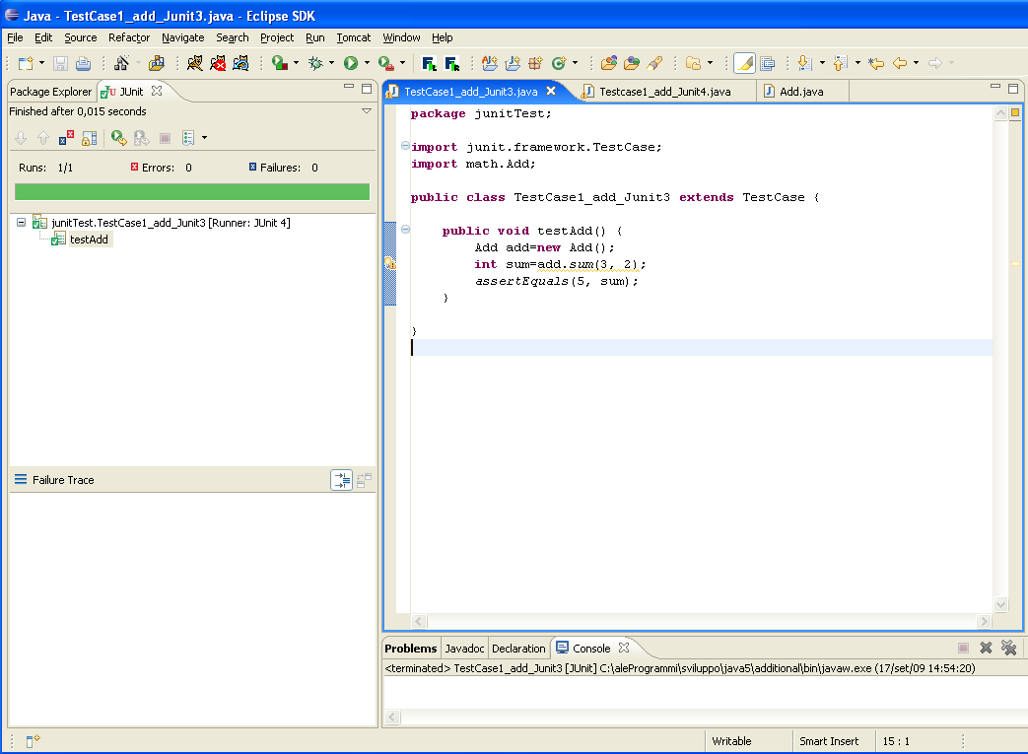
Summarizing… an example (Junit 3.x)
Test case 1
public class Add {
public static int sum (int a, int b) {
return a+b;
}
}
import junit.framework.TestCase; import math.Add; public class TestCase1_add_Junit3 extends TestCase { public void testAdd() { Add add=new Add(); int sum=add.sum(3, 2); assertEquals(5, sum); } }

Slide 38
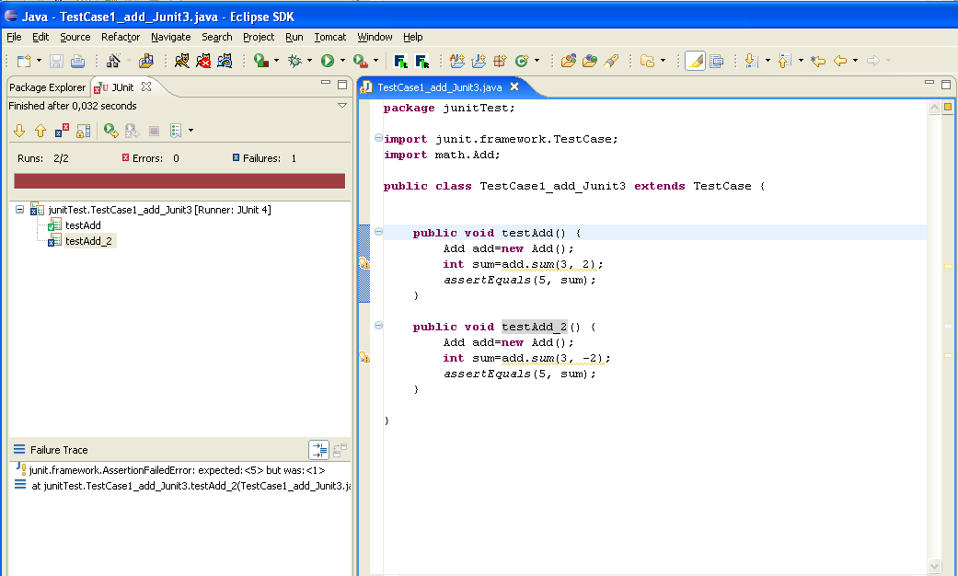
Summarizing… an example (Junit 3.x)
Test case 2
import junit.framework.TestCase; import math.Add; public class TestCase1_add_Junit3 extends TestCase { public void testAdd() {… } public void testAdd_2() { Add add=new Add(); int sum=add.sum(3, -2); assertEquals(5, sum); } }

Slide 39
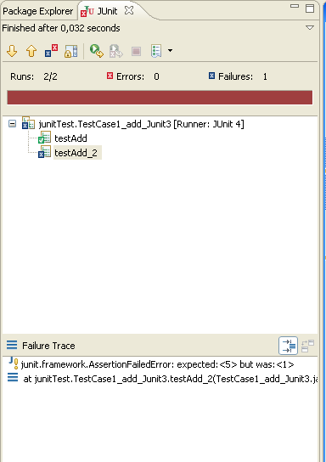
Summarizing… an example (Junit 3.x)
Test case 2
import junit.framework.TestCase; import math.Add; public class TestCase1_add_Junit3 extends TestCase { public void testAdd() {… } public void testAdd_2() { Add add=new Add(); int sum=add.sum(3, -2); assertEquals(5, sum); } }

Slide 40
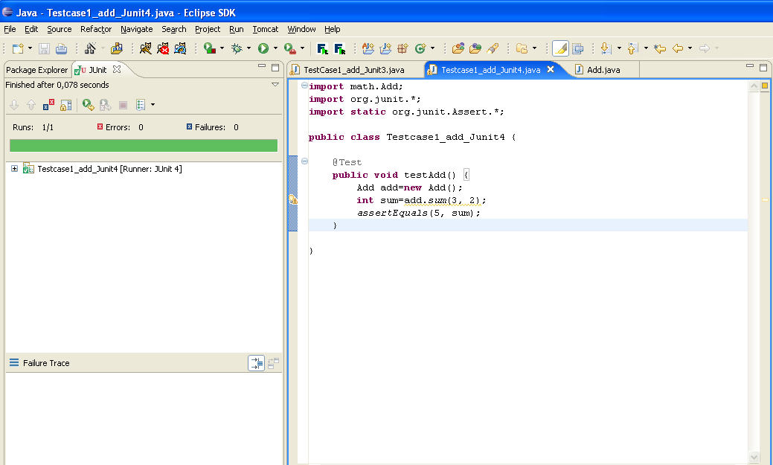
Summarizing… an example (Junit 4.x)
public class Add {
public static int sum (int a, int b) {
return a+b;
}
}
import math.Add; import org.junit.*; import static org.junit.Assert.*; public class Testcase1_add_Junit4 { @Test public void testAdd() { Add add=new Add(); int sum=add.sum(3, 2); assertEquals(5, sum); } }

Slide 41
When testing programs?
Test last
  The conventional way for testing in which testing follows the implementation
Test first
  The Extreme-Programming view in which testing is used as a developement tool

Slide 42
Test last
New functionality
Understand
Implement functionality
Write tests
Run all tests
fail
Rework
Result?
pass
Next functionality

Slide 43
Test first
“Extreme programming” (XP) champions the use of tests as a development tool …
“Extreme programming” (XP) champions the use of tests as a development tool …
New functionality
Understand
Add a single test
Add code for the test
Run all test
fail
No
Rework
Result?
pass
Functionality
complete?
Yes
Next functionality

Slide 44
Test First Advantages
Each method has associated a testcase
  the confidence of our code increases …
It simplifies:
  refactoring/restructuring
  maintenance
  the introduction of new functionalities
Test first help to build the documentation
  testcases are good “use samples”
Programming is more fun …

Slide 45
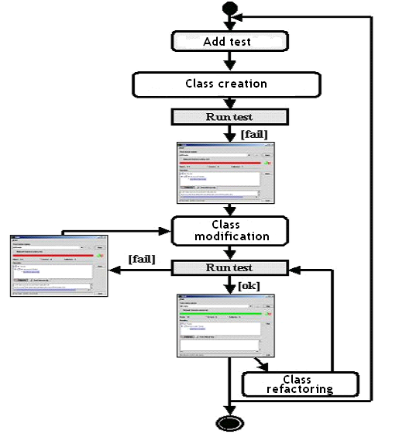
Test-first with Junit
Add a testcase
Add the skeleton of the class and methods (without body)
Run test
Rework
Refactoring
“improving the structure”
Run test

Slide 46
Junit in practice …
Existing system: a class current account to manage a bank account
    deposit
    withdraw
Add a new functionality
    settlement
Example:
CurrentAccount cc = new CurrentAccount();
cc.deposit(12);
cc.draw(-8);
cc.deposit(10);
cc.settlement()
expected value 14 euro!

Slide 47
Add a testcase

Slide 48
Add Testcases for the settlement method
class Test_CurrentAccount extends TestCase{
public void test_settlementVoid() {
CurrentAccount c = new CurrentAccount();
assertEquals(0, c.settlement());
}
public void test_settlement() {
CurrentAccount c = new CurrentAccount();
c.deposit(12);
c.draw(-8);
c.deposit(10);
assertEquals(14, c.settlement());
}
}
test first …

Slide 49
Add the skeleton of the class and methods (without body)

Slide 50
Add the skeletone code of
the method
class CurrentAccount {
int account[];
int lastMove;
CurrentAccount(){
lastMove=0;
account=new int[10];
}
public void deposit(int value){
account[lastMove]=value;
lastMove++;
}
public void draw(int value) {
account[lastMove]=value;
lastMove++;
}
public int settlement() {return 0;}
public static void main(String args[]) {}
}
class Test_CurrentAccount extends TestCase{
public void test_settlementVoid() {
currentAccount c = new currentAccount();
assertEquals(0, c.settlement());
}
public void test_settlement() {
currentAccount c = new currentAccount();
c.deposit(12);
c.draw(-8);
c.deposit(10);
assertEquals(14, c.settlement());
}
}

Slide 51
Run test

Slide 52
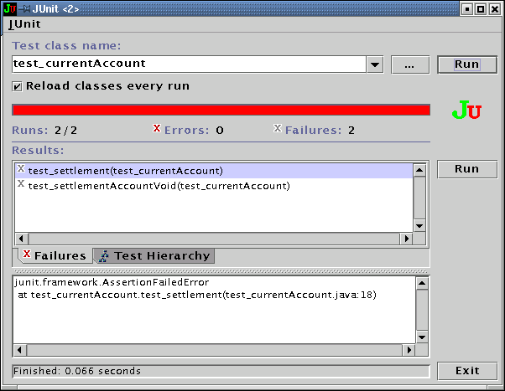
Run Junit (first time)

Slide 53
Rework

Slide 54
Rework
class CurrentAccount {
int account[];
int lastMove;
CurrentAccount(){
lastMove=0; account=new int[10];
}
public void deposit(int value){ …}
public void draw(int value) { …}
public int settlement() {
int result = 0
for (int i=0; i<account.length; i++) {
result = result + account[i];
}
return result;
}
public static void main(String args[]) {}
}
class Test_CurrentAccount extends TestCase{
public void test_settlementVoid() {
currentAccount c = new currentAccount();
assertEquals(0, c.settlement());
}
public void test_settlement() {
currentAccount c = new currentAccount();
c.deposit(12);
c.draw(-8);
c.deposit(10);
assertEquals(14, c.settlement());
}
}

Slide 55
Run test

Slide 56
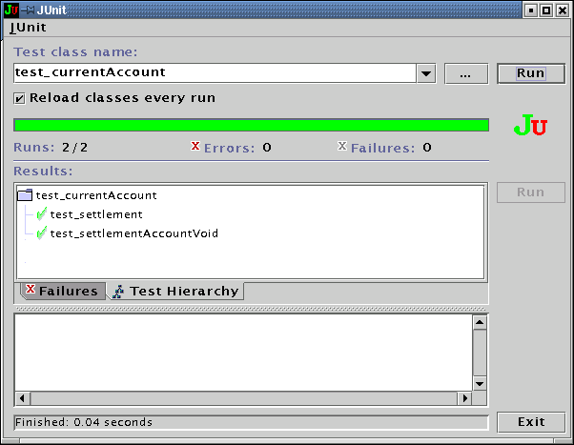
Run Junit (second time)

Slide 57
Add a testcase

Slide 58
Add a new testcase
class CurrentAccount {
int account[];
int lastMove;
CurrentAccount(){
lastMove=0; account=new int[10];
}
public void deposit(int value){ …}
public void draw(int value) { …}
public int settlement() {
int result = 0
for (int i=0; i<account.length; i++) {
result = result + account[i];
}
return result;
}
public static void main(String args[]) {}
}
class Test_currentAccount extends TestCase{
…
public void test_realCaseSettlement() {
currentAccount c = new currentAccount();
for (int i=0; i <10 ; i++)
c.deposit(1);
c.draw(-10);
assertEquals(0, c.settlement());
}
}

Slide 59
Run test

Slide 60
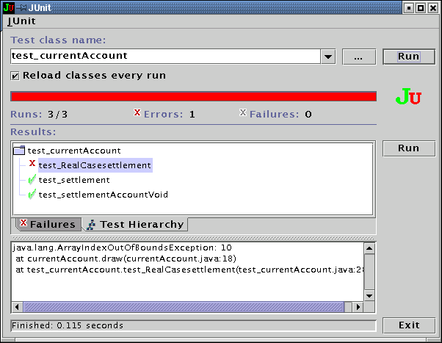
Run JUnit (third time)
Run time error

Slide 61
Rework

Slide 62
Rework
class CurrentAccount {
int account[];
int lastMove;
CurrentAccount(){
lastMove=0; account=new int[100];
}
public void deposit(int value){ …}
public void draw(int value) { …}
public int settlement() {
int result = 0
for (int i=0; i<account.length; i++) {
result = result + account[i];
}
return result;
}
public static void main(String args[]) {}
}
class Test_currentAccount extends TestCase {
…
public void test_realCaseSettlement() {
currentAccount c = new currentAccount();
for (int i=0; i <10 ; i++)
c.deposit(1);
c.draw(-10);
assertTrue(0, c.settlement());
}
}

Slide 63
Run test

Slide 64
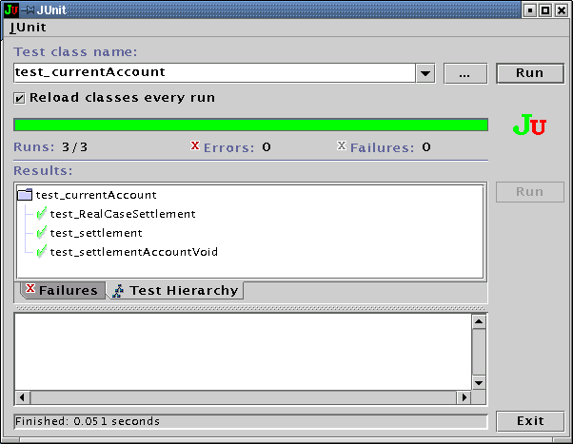
Run JUnit (fourth time)

Slide 65
Refactoring
“improving the structure”

Slide 66
public class CurrentAccount {
List account = new LinkedList();
public void deposit(int value) {
account.add(new Integer(value));
}
public void draw(int value) {
account.add(new Integer(value));
}
public int settlement() {
int result = 0;
Iterator it=account.iterator();
while (it.hasNext()) {
Integer value_integer = (Integer)it.next();
int val = value_integer.intValue();
result = result + val;
}
return result;
}
}
Refactoring
“changing the data structure: Array --> List”

Slide 67
Run test

Slide 68
Run JUnit (fifth time)

Slide 69
The End

Slide 70
xUnit
Junit: it is one of many in the xUnit family….
NUnit
  It is an open source unit testing framework for Microsoft .NET.
  It serves the same purpose as JUnit does in the Java world.
2.1 ActionScript 2.2 Ada 2.3 BPEL 2.4 C 2.5 C++ 2.6 ColdFusion (CFML) 2.7 Delphi 2.8 Emacs Lisp 2.9 Fortran 2.10 Haskell 2.11 Internet 2.12 Java 2.13 JavaScript 2.14 Lasso 2.15 MATLAB 2.16 MySQL 2.17 .NET programming languages 2.18 Objective-C 2.19 Ocaml 2.20 PegaRULES Process Commander | 2.21 Perl 2.22 PHP 2.23 PL/SQL 2.24 PowerBuilder 2.25 Prolog 2.26 Python 2.27 REALbasic 2.28 Ruby 2.29 SAS 2.30 Scala 2.31 Shell 2.32 Simulink 2.33 Smalltalk 2.34 SQL 2.35 Tcl 2.36 Transact-SQL 2.37 Visual FoxPro 2.38 Visual Basic 2.39 XML 2.40 XSLT 2.41 Other

Slide 71

“The tip of the iceberg”
Coverage testing (JCoverage, Clover, …)
Integration testing
System/GUI testing (Jemmy, Abbot, …)
Testing legacy applications
Testing J2EE applications
Testing database applications.
Testing EJBs
Testing Web applications (HttpUnit, JWebUnit, …)
Testing Web services
Testing in isolation with Mock Objects
…

Slide 72
References
Reference WebSite: http://ww.junit.org
JUnit 4.0 in 10 minutes http://www.instrumentalservices.com/media/articles/java/junit4/JUnit4.pdf
Quick and easy introduction http://clarkware.com/articles/JUnitPrimer.html
Ted Husted, Vincent Massol. JUnit in Action. Book.
Kent Beck, Eric Gamma, Test Infected: Programmers Love Writing Tests. http://junit.sourceforge.net/doc/testinfected/testing.htm
Bryan Dollery. JUnit and Its Extensions Make Unit Testing Your Java Code Much Easier. http://www.devx.com/Java/Article/9614
Test First Demo: http://rm.mirror.garr.it/mirrors/eclipse/technology/phoenix/demos/testfirst/testfirst.html
An early look at JUnit 4, http://www.ibm.com/developerworks/java/library/j-junit4.html
http://today.java.net/pub/a/today/2006/12/07/junit-reloaded.html
http://www.devx.com/Java/Article/31983/1763/page/2

