Slide 1


Adventure
Works
Adventure Works Cycles – End-to-End Data Engineering & Business Intelligence Solution

Slide 2

Project Outline
Adventure Works Cycles, a multinational bike manufacturer, seeks a robust analytics solution to store, process, and analyze sales data for better monitoring and decision-making. The project will:
Design and implement a Data Warehouse (DW) from the existing OLTP database using SSIS.
Build a Business Intelligence (BI) solution in Power BI to transform data into actionable insights.

Slide 3

Project Objectives
Enable fast and reliable business intelligence reporting
Handle complex and multilingual data efficiently
Track historical changes using Slowly Changing Dimensions (SCD Type 1 & 2)
Optimize data refresh using incremental (delta) loading

Slide 4
Project Scope and Requirements
Part 1 – Data Engineering
Design and load the DW from the OLTP system with optimized performance.
Ensure minimal impact on OLTP resources.
Implement data change handling (append-only for facts, overwrite for customers, partial history for product pricing).
Part 2 – Business Intelligence
Create interactive Power BI dashboards covering sales KPIs, customer trends, and product performance.
Provide drill-through pages for customer, order, and product details.

Slide 5


Tools & Technologies
SQL Server
SSIS (SQL Server Integration Services)
Adventure Works OLTP Database
Dimensional modeling for OLAP schema
Power BI

Slide 6
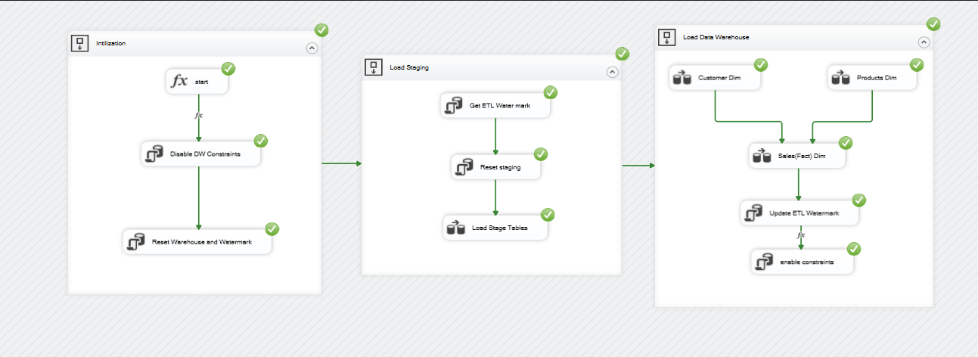
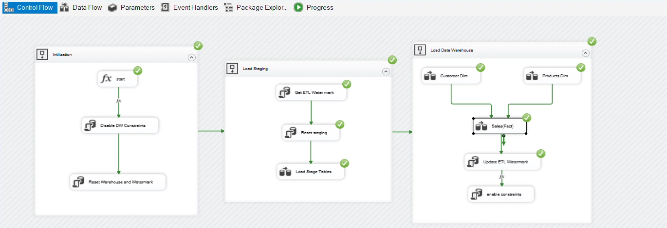
SSIS Pipeline Visualization
First : Initial Load
Built SSIS control and data flows for:
Data extraction from OLTP
Staging and transformation
Loading dimension and fact tables
Second : Incremental Load
Used watermark logic to detect and load only new or changed records
Improved efficiency by avoiding full reloads
Ensured data freshness with minimal system impact

Slide 7
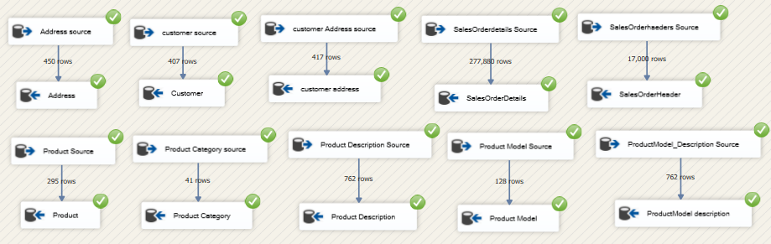
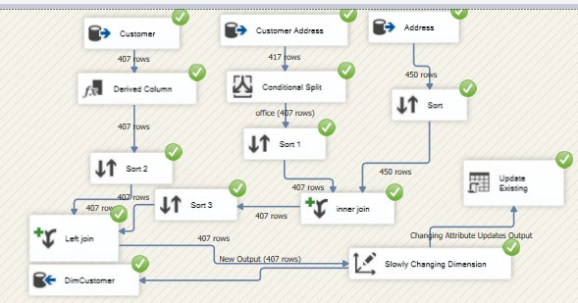
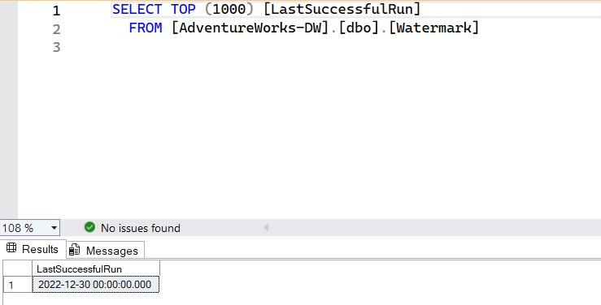
Staging (Initial )
Customer Dim (Initial)
Watermark

Slide 8
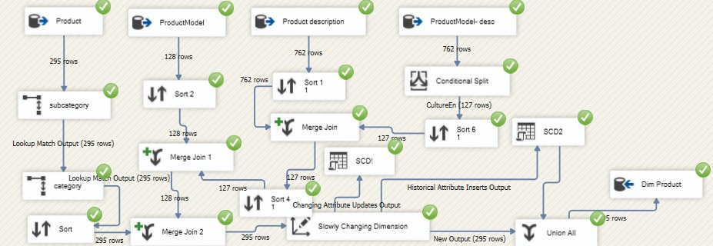
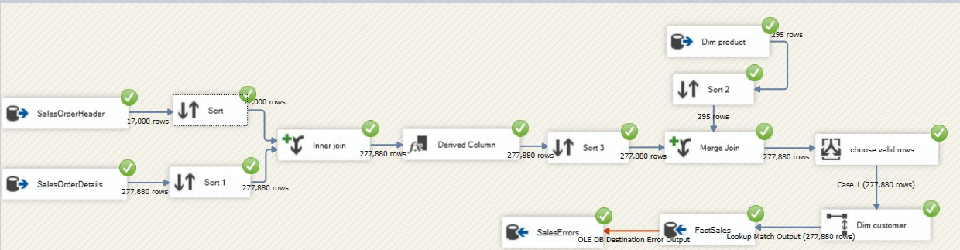
Product Dim (Initial)
Sales Fact (Initial)

Slide 9
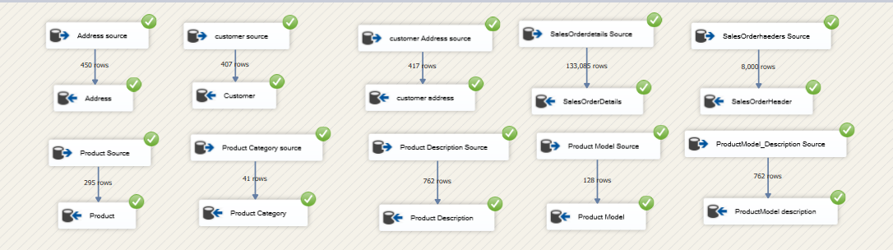
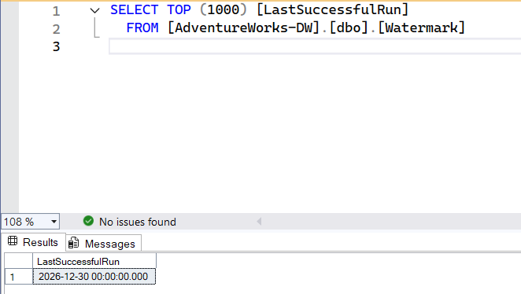
Staging (Incremental )
Customer Dim (Incremental)
Watermark

Slide 10
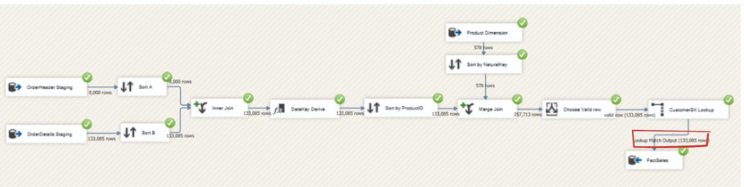
Product Dim (Incremental)
Sales Fact (Incremental)

Slide 11
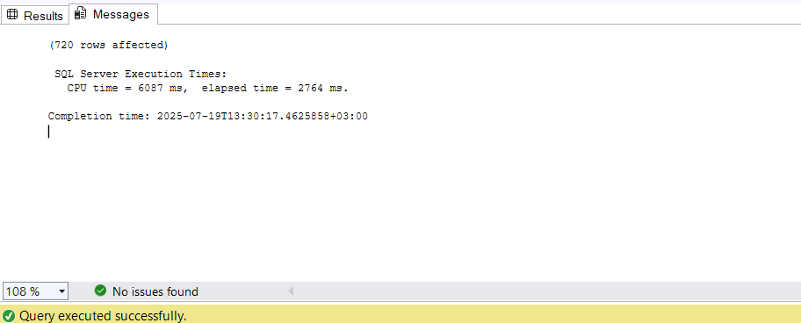
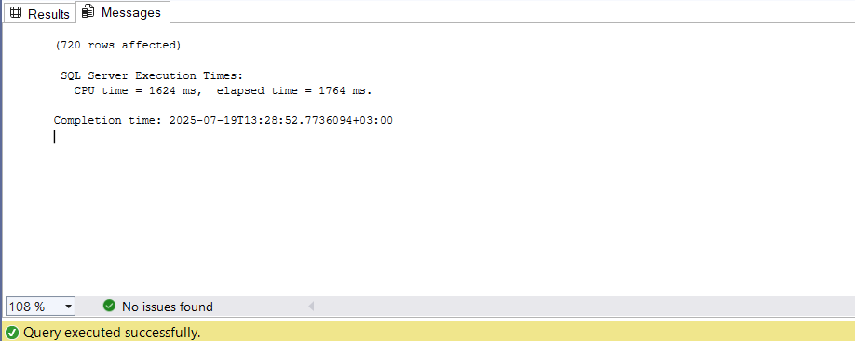
Performance Comparison
OLTP - Data Base
OLAP - Data Warehouse

Slide 12

From Data to Insights – Power BI Dashboard
Purpose of the Dashboard
Provide a comprehensive sales overview for Adventure Works Cycles
Track key business KPIs: Revenue, Profit, Margin, Orders, Customers
Enable customer & product deep-dives for better decisions
Allow managers to filter by date & location for targeted analysis
Why Power BI?
Interactive & dynamic visualizations
Faster decision-making with near real-time insights
Bridges the gap between operational systems (OLTP) and analytical systems (OLAP)

Slide 13
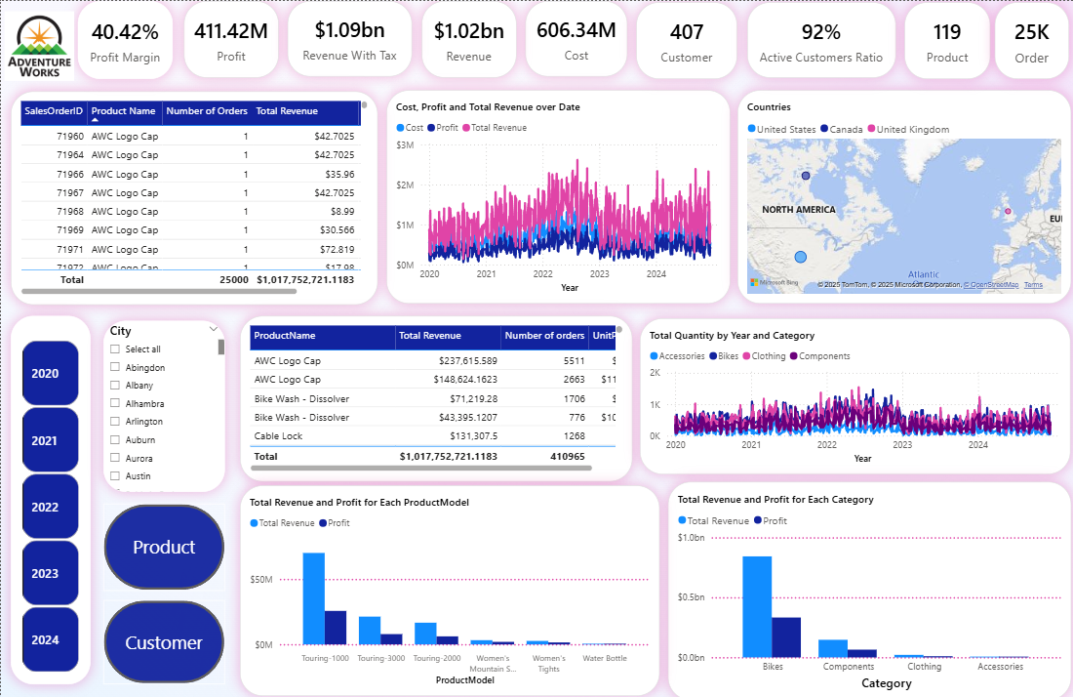
Sales Overview Dashboard
The Sales page serves as the entry point for analysis. It presents core KPIs such as revenue, cost, profit, margin, and active customers, along with sales trends over time.
Using exclusive disclosure buttons, users can seamlessly switch the focus between customer-related and product-related insights, keeping the analysis clear and uncluttered

Slide 14
Product Analysis View (via Sales Page)
Switching to the Product Analysis view provides insights into product categories and models.
It highlights the most ordered and most profitable products, as well as quantity trends over time, supporting better inventory and product strategy decisions.

Slide 15
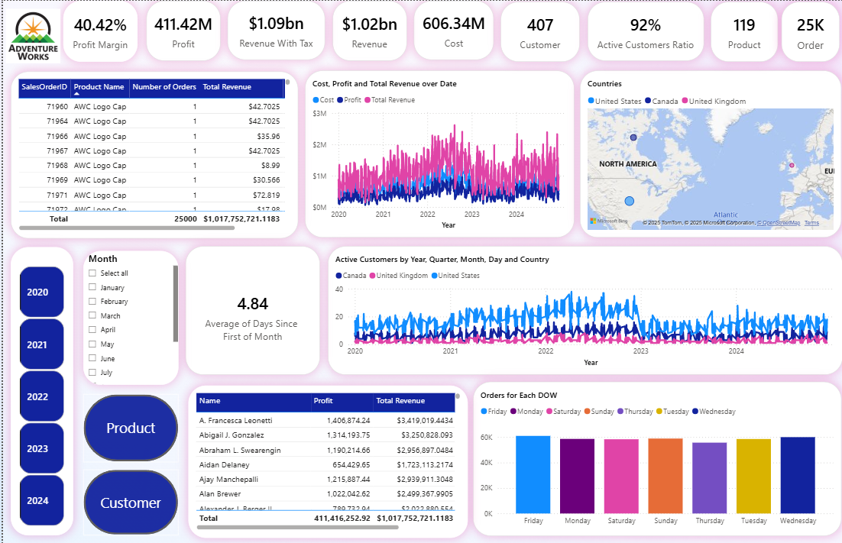
Customer Analysis View (via Sales Page)
the dashboard highlights key customer metrics: active customers by location and time, average shipping days, and ordering patterns across the week.
This view helps the business monitor customer engagement and service efficiency.

Slide 16
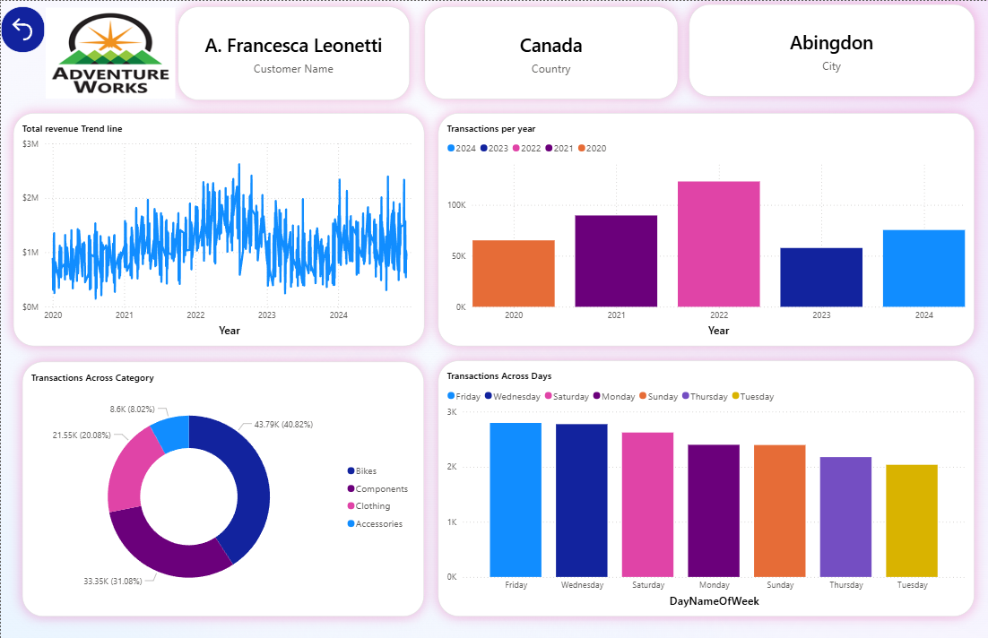
Customer Drill-Through Page
From the Sales page, users can drill through to a Customer detail page.
This page provides in-depth information about an individual customer
including order history, spending behavior, and activity trends, enabling personalized engagement strategies.

Slide 17
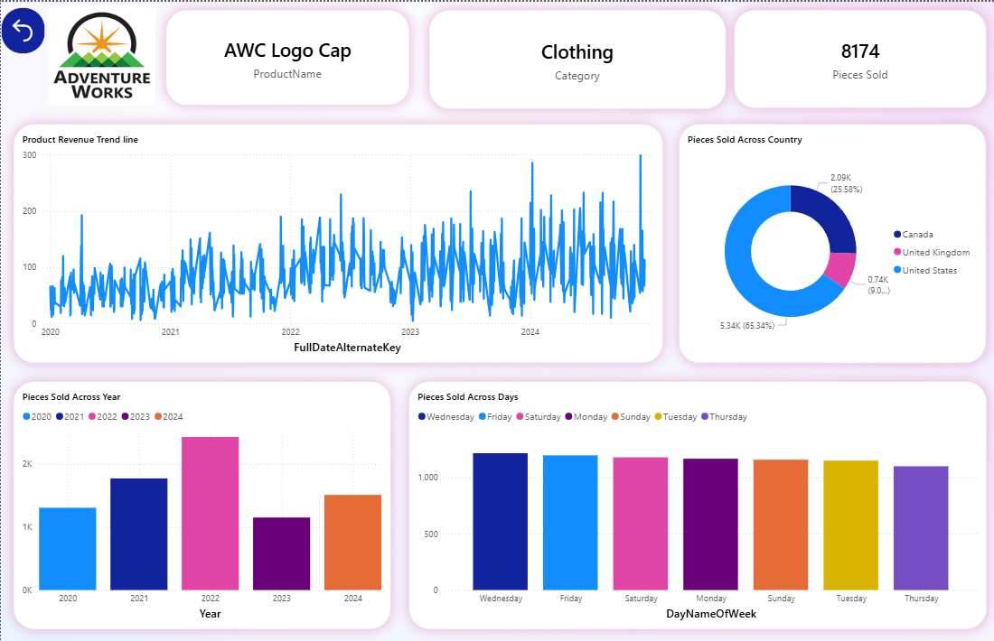
Product Drill-Through Page
The Product drill-through page provides detailed insights on a single product.
It shows sales performance, profitability, and order history
enabling managers to make informed decisions about pricing, promotions, and stock management.

Slide 18
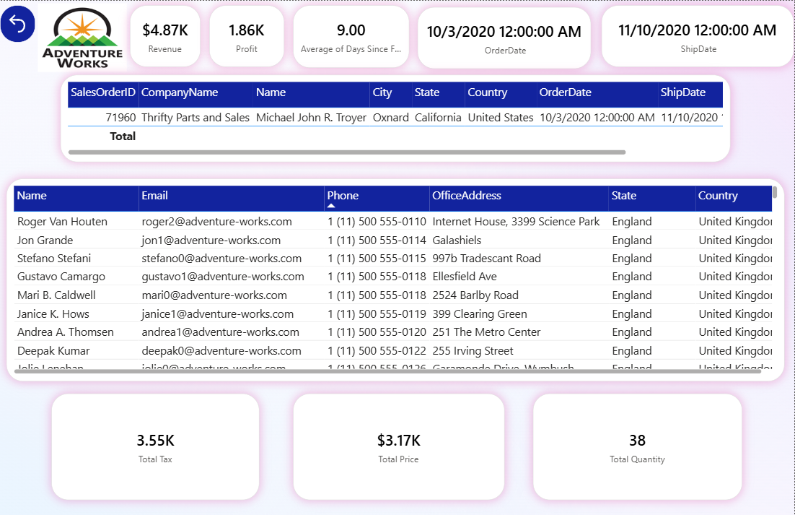
Order Drill-Through Page
The Order drill-through page allows users to explore individual order details, including value, shipping time, and fulfillment performance.
This supports operational monitoring and ensures bottlenecks can be quickly identified and resolved.

Slide 19

Project Key Achievements
Successfully implemented a complete SSIS-based ETL pipeline.
Built a robust, multilingual, history-aware data warehouse.
Significantly reduced reporting times for analytical queries.
Enabled clear separation between OLTP (operational) and OLAP (analytical) systems.
Designed and prepared an interactive Power BI dashboard to visualize insights and support data-driven decision-making.

Slide 20

Thank You

