Slide 1
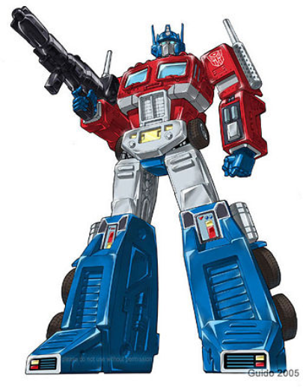

LLMs and Transformers
ENSSEA
Ismail Sadouki – Final year Statistician & Data Scientist | ML/LLM
Github: github.com/ismailsadouki
Lecture 0: Introduction

Slide 2
LLMs and Transformers
ENSSEA
What is Language Model.
What Are LLMs
What happens Inside LLM
Lecture 1: Tokenization and Word Vectors
Lec 2 : Language Models, RNNs, and LSTM
Lec 3: Transformers and Attentin mechanism
Lec 4 : Pretraining (Scaling, Systems, Data) and fine-tuning
Lec 5: Post-training (RLHF, SFT, DPO, GRPO)
Lec 6: LLM reasoning
Lec 7: Agentic LLMs
Lec 8: LLM evaluation
Lec9 LLM inference
Major Applications of Transformers
Recent Trends and Remaining Weaknesses of LLMs

Slide 3
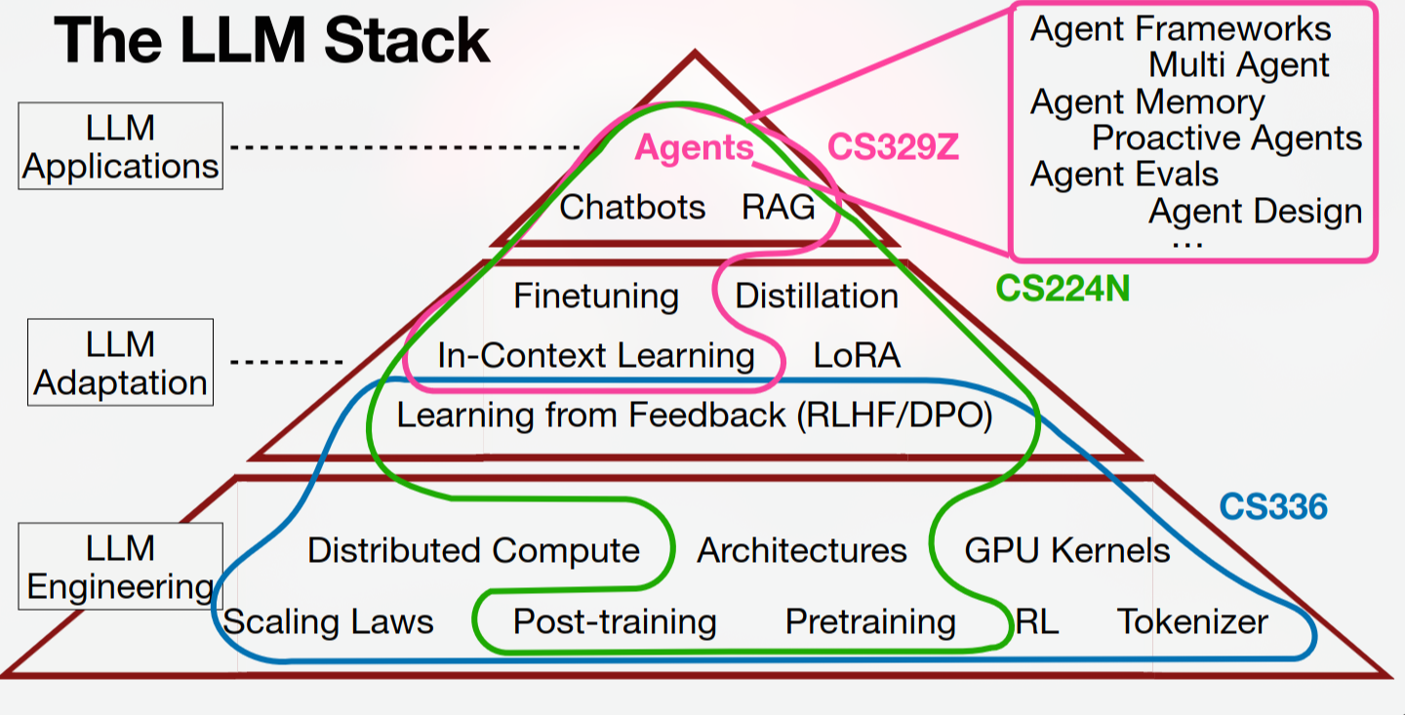
1950
3

Slide 4
What is Language Model?
5

Slide 5
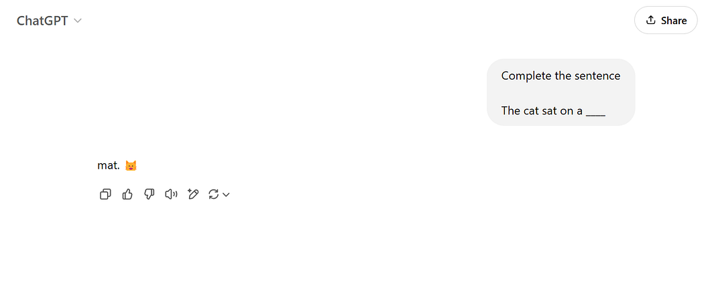
Imagine we want to teach a computer to predict the next word in a sentence. For example, if we give it the sentence “The cat sat on a…”, the computer should predict that the next word is “mat.”
4

Slide 6
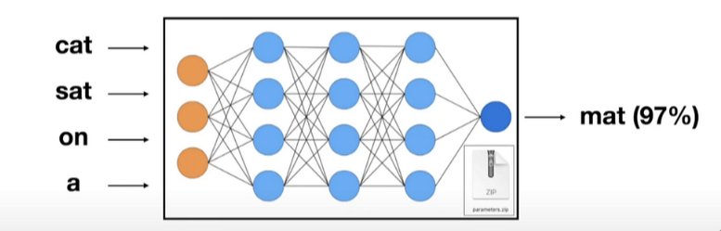
Imagine we want to teach a computer to predict the next word in a sentence. For example, if we give it the sentence “The cat sat on a…”, the computer should predict that the next word is “mat.”
This is called language modeling. The computer is learning to model the probability of different words appearing in a sequence.
4

Slide 7
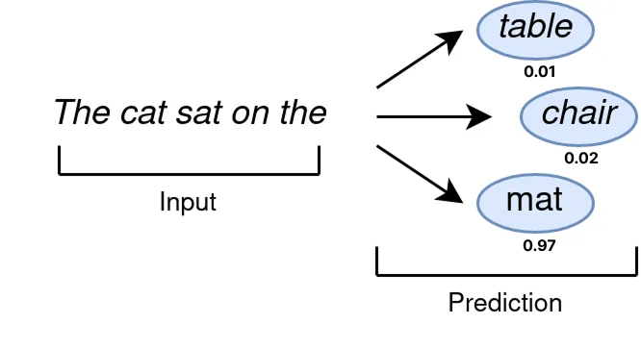
How LLMs Generate Text
Once the LLM is trained, it can generate text by predicting one word at a time. It starts with a prompt (which is essentially the initial text input you provide, like a question or a statement), and then predicts the most likely next word. It then adds that word to the sequence and predicts the next word, and so on. This is why LLMs are an example of what we call Generative AI
4

Slide 8
Definition
A language model (LM) is a probabilistic model that learns the statistical patterns of language and estimates the probability of a sequence of tokens or the next token given the preceding context.
Given a sequence of tokens
$$X = (X_{1,}X_{2,}....,X_{n})$$
An autoregressive language model factorizes the joint probability as:
4

Slide 9
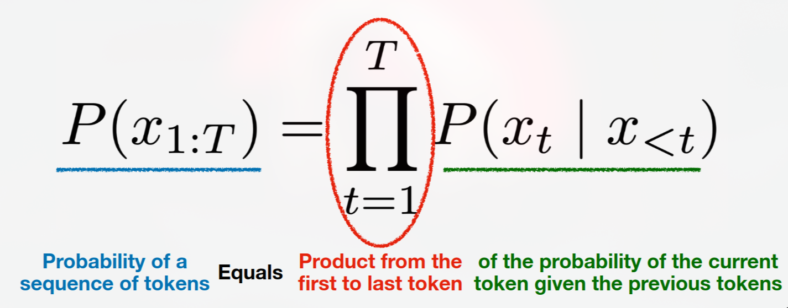
Definition
An autoregressive language model factorizes the joint probability as:
4

Slide 10
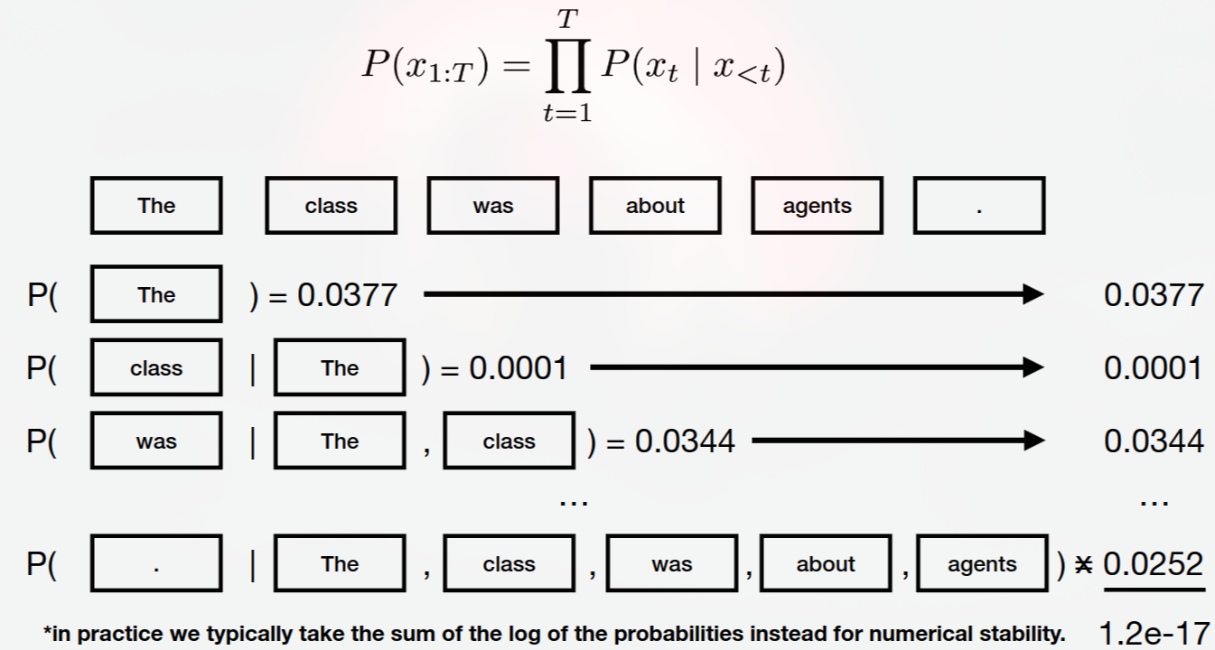
Definition
Key idea: A language model learns to assign probabilities to possible language sequences based on patterns learned from data.
4

Slide 11
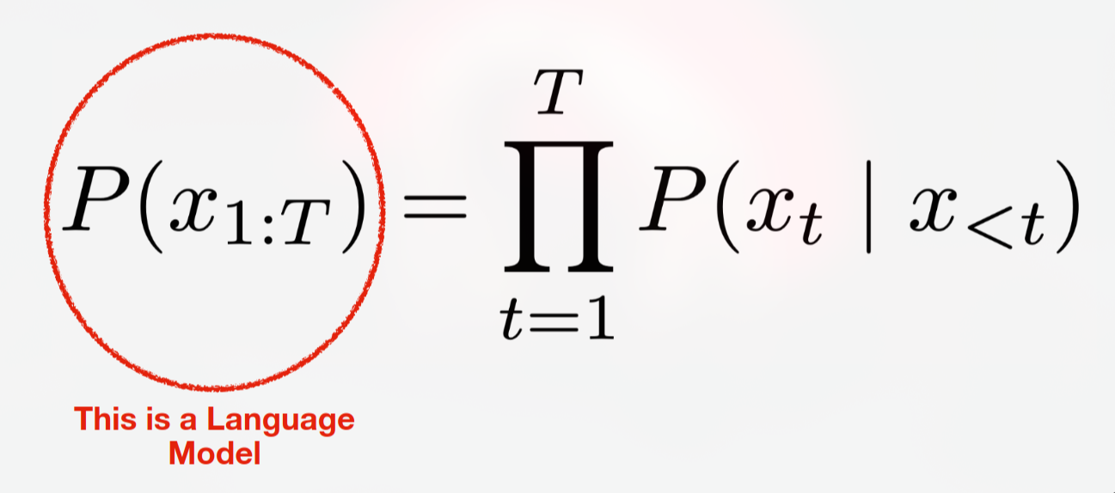
Definition
4

Slide 12
NOTE
Not every language model is autoregressive. Masked language models, for example, predict masked tokens using bidirectional context. The equation above describes the autoregressive family.
4

Slide 13
What Are Large Language Models?
5

Slide 14
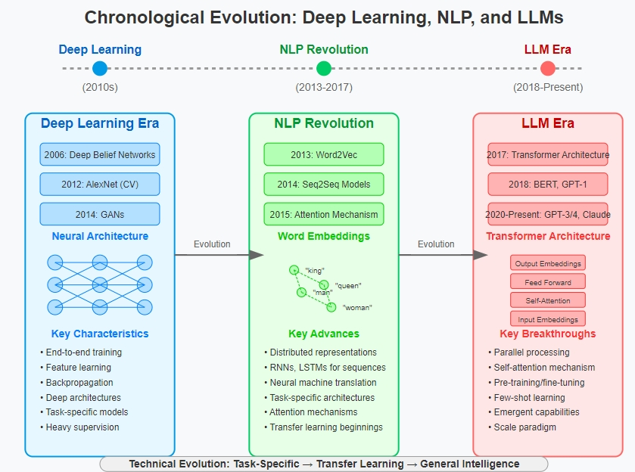
A brief history of Language Models Architectures. Pre-LLM era: task-specific NLP models
1.4T
4

Slide 15
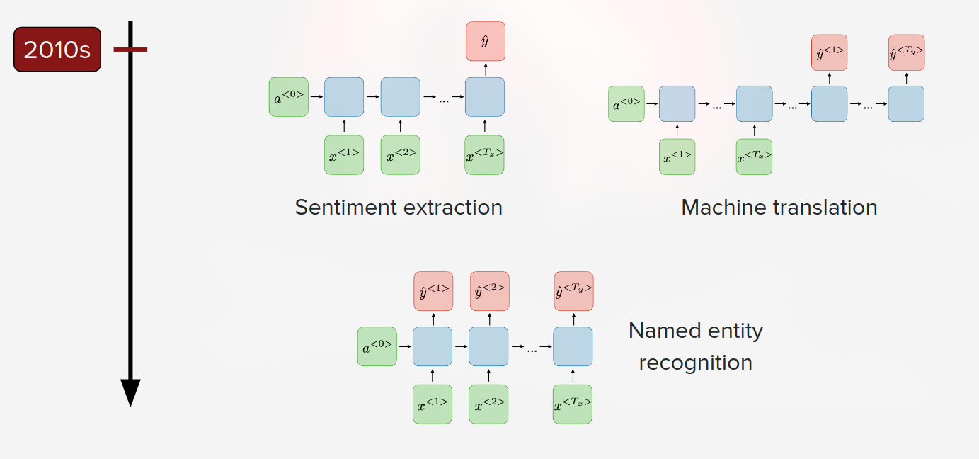
A brief history of Language Models Architectures. Pre-LLM era: task-specific NLP models
• N-gram Models (Pre 2010s)
• First Neural Language Model (2003)
• Recurrent Neural Network Language Models (2010)
• Long Short Term Memory (Invented 1997 & popularized for LMs 2014)
1.4T
4

Slide 16
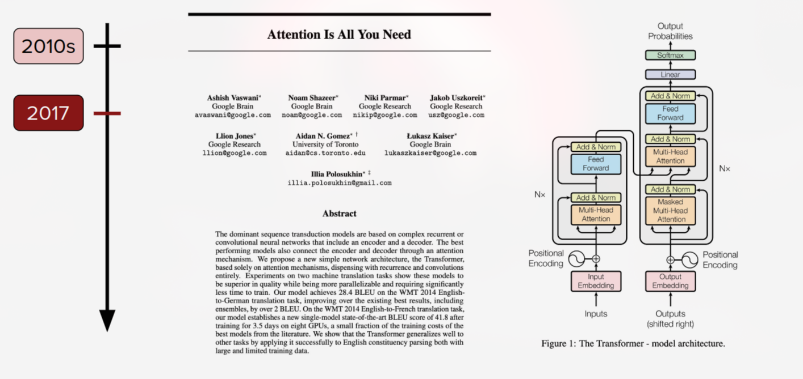
Attention is all you need paper.
1.4T
4

Slide 17
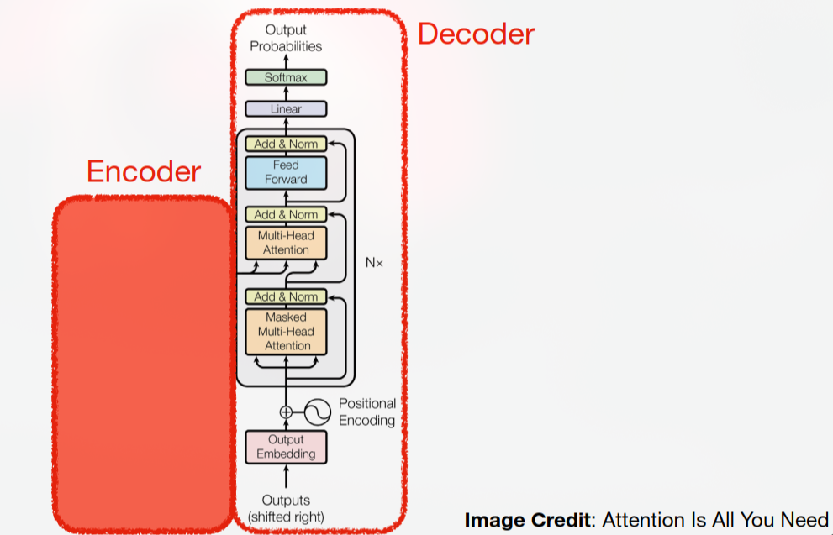
Decoder-only Transformer
Encoder-only: BERT.
Decoder-only: GPT, LLaMA, Qwen, Mistral.
Encoder–decoder: T5, original Transformer (2017).
1.4T
4

Slide 18
Definition: What makes them large?
Large Language Models (LLMs) are language models with large-scale neural network architectures, trained on massive text datasets using substantial computational resources to learn rich linguistic and semantic representations.
1.4T
4

Slide 19
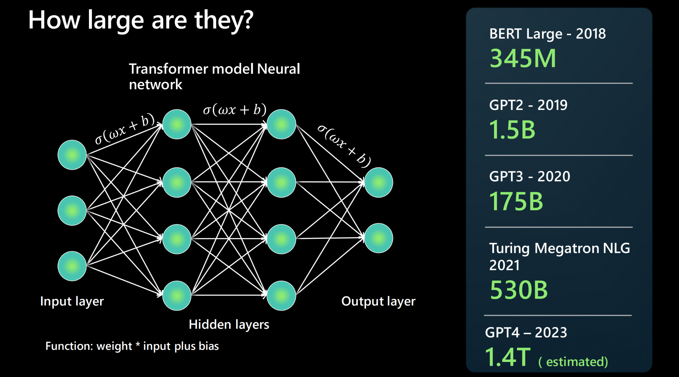
Definition: Large model architectures
The more parameters a model has, the more data it can process, learn from, and generate.
For each connection between two neurons of the neural network architecture, there is a function: weight * input + bias. These produce numerical values that determine how the model processes language. They are rather large - reporting millions of parameters in 2018 to trillions of parameters calculated in 2023 (by GPT4)
1.4T
4

Slide 20
Language models trained on more and more data
1.4T
30B
200B
<100M
3B
13 y.o.
Human
BERT
(2018)
RoBERTa
(2019)
GPT-3
(2020)
Chinchilla
(2022)
# tokens seen during training
https://babylm.github.io/
4

Slide 21
The distinction
An LLM is not fundamentally a different concept from a language model. It is a large-scale language model that learns from extensive data and computational training.
Language Model | Large Language Model
General concept | Large-scale language model
Can be small or large | Typically large
Can use statistical or neural methods | Typically deep neural networks
May perform specific language tasks | Can support a broad range of language tasks
4

Slide 22
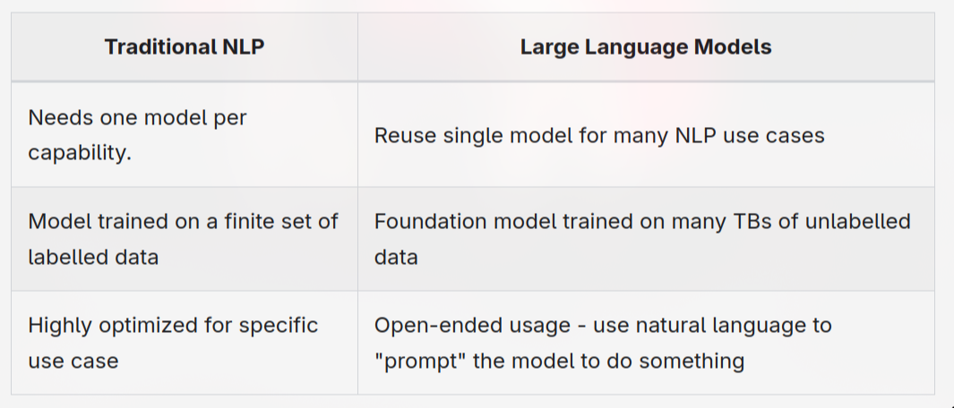
How does LLM differ from NLP?
4

Slide 23
What doesn't a LLM do?
While large language models drive rich and powerful generative AI experiences, it's important to remember that the LLM:
Does NOT Understand language. It's just a predictive engine. Based on text patterns it has previously seen, it can predict completions for the given text input. It does not understand the context or meaning of that content - e,g, it does not understand math.
Does NOT Understand facts. There are no separate 'modes' for information retrieval vs. creative writing. The model just predicts the next most probable token in the ongoing sequence.
Does NOT Understand manners, emotion or ethics. Don't anthropomorphize LLMs by attributing human characteristics to them, or claiming they "understand" something. The output is simply the outcome of training data guided by the given prompts.
4

Slide 24
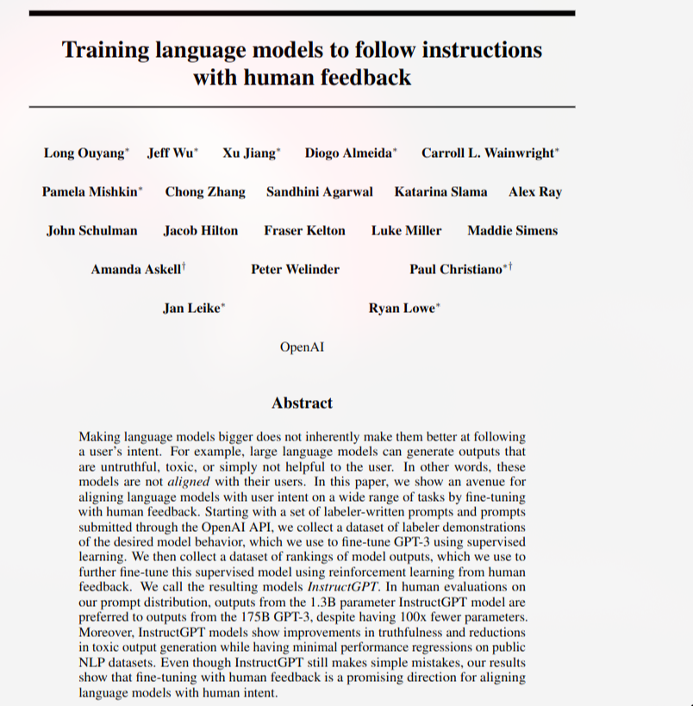
InstructGPT paper: Training language models to follow instructions with human feedback
4

Slide 25
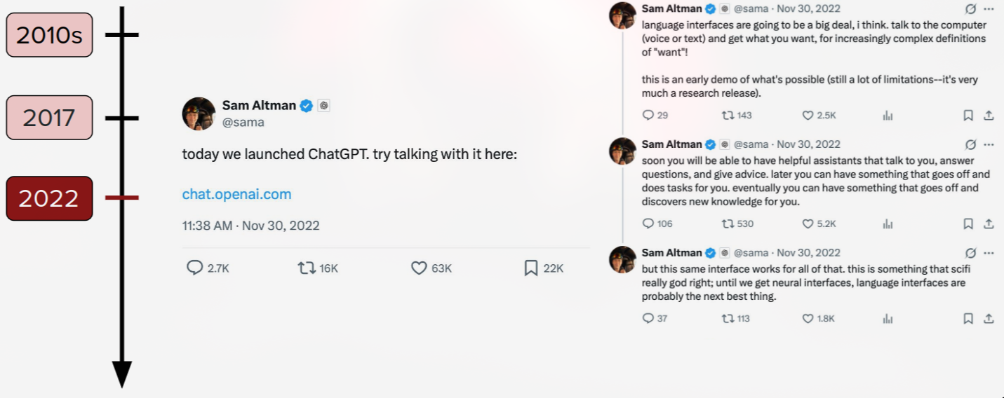
Launch of ChatGPT, "conversational" era
4

Slide 26
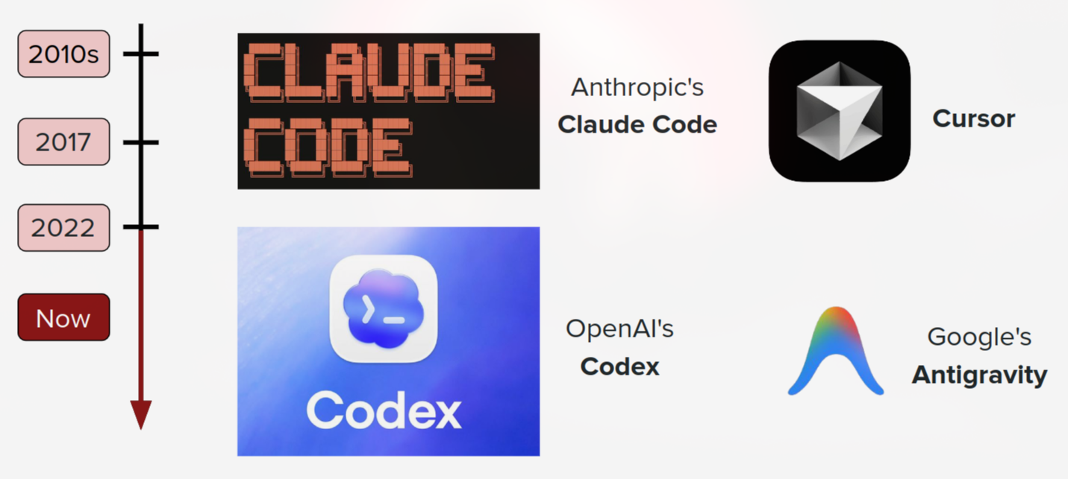
Agentic era!
4

Slide 27
What happens inside an LLM?
5

Slide 28
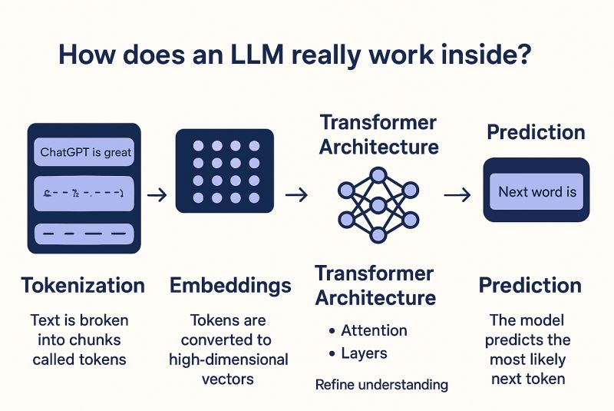
What happens inside an LLM
4

Slide 29
Tokenization and Word Vectors
4

Slide 30
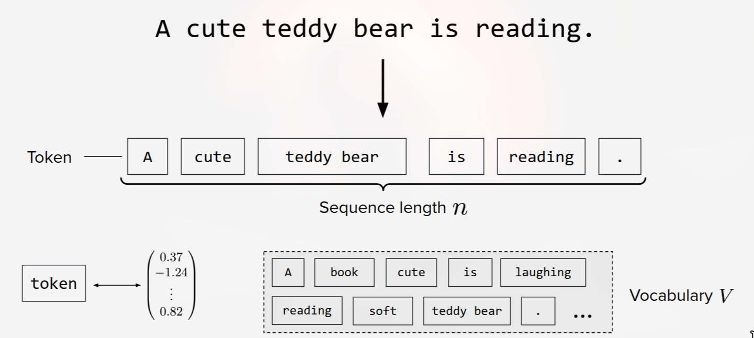
Tokenization: : From Text to Tokens
Tokenization is the process of splitting text into smaller units called tokens and mapping each token to an integer ID. The model does not directly process raw text. It receives a sequence of token IDs.
4

Slide 31
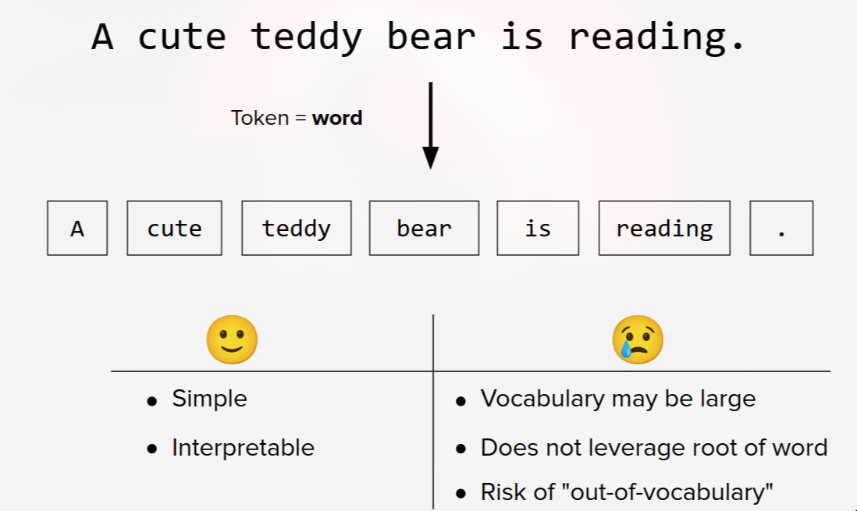
Tokenization: word-level
4

Slide 32
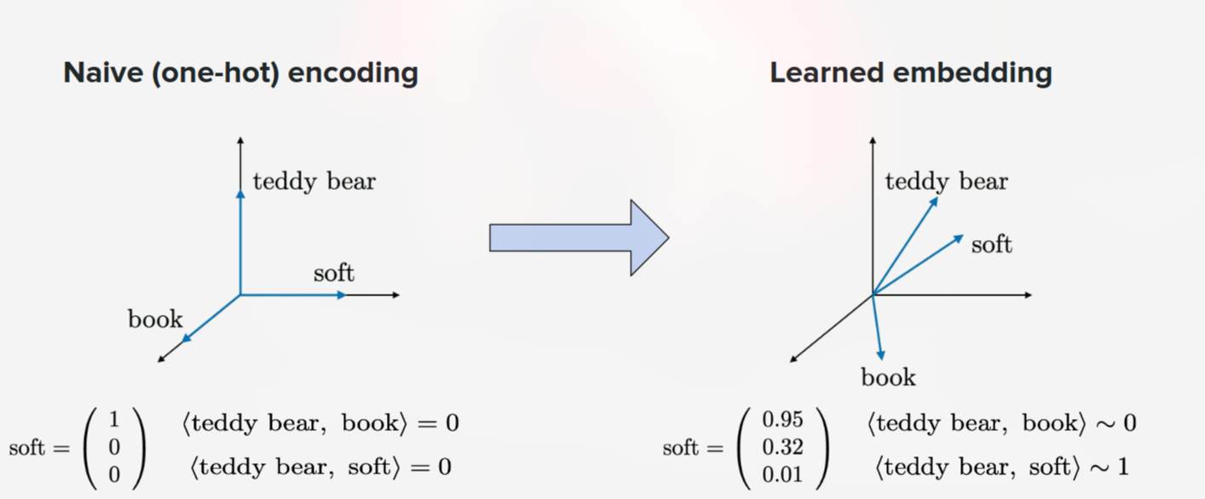
Token representations
How do we convert those tokens into numerical vectors that a neural network can process?
4

Slide 33
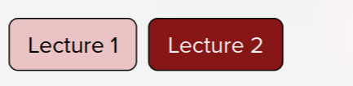
Language Models and RNNs
4

Slide 34
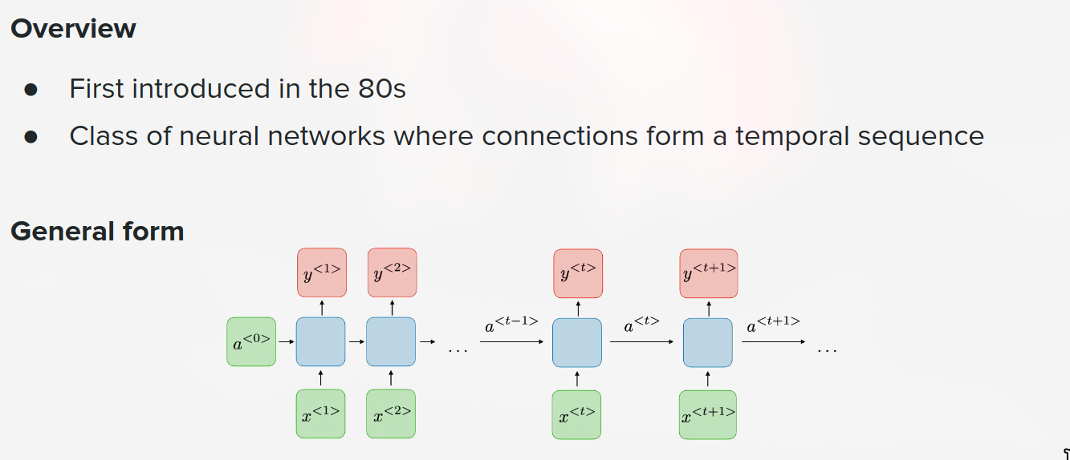
Recurrent Neural Networks (RNNs)
4

Slide 35
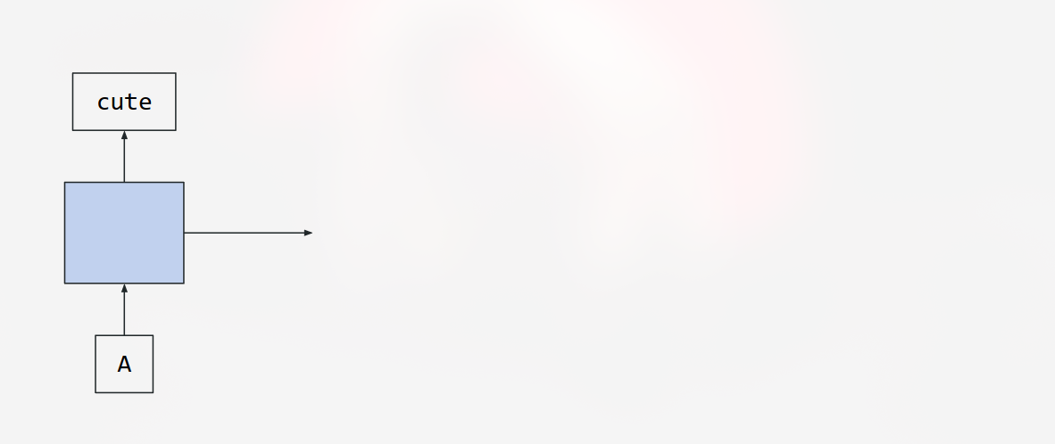
Recurrent Neural Networks (RNNs)
4

Slide 36
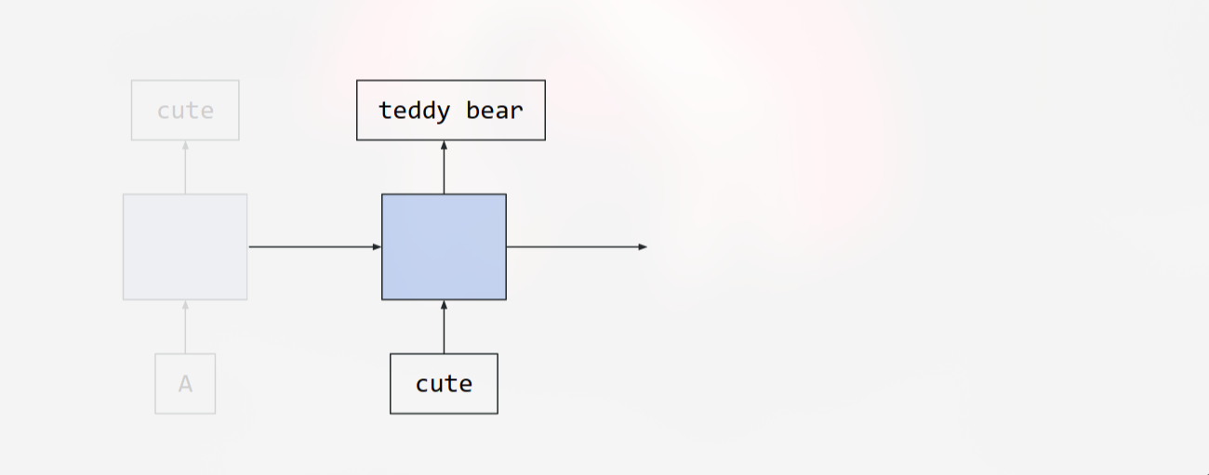
Recurrent Neural Networks (RNNs)
4

Slide 37
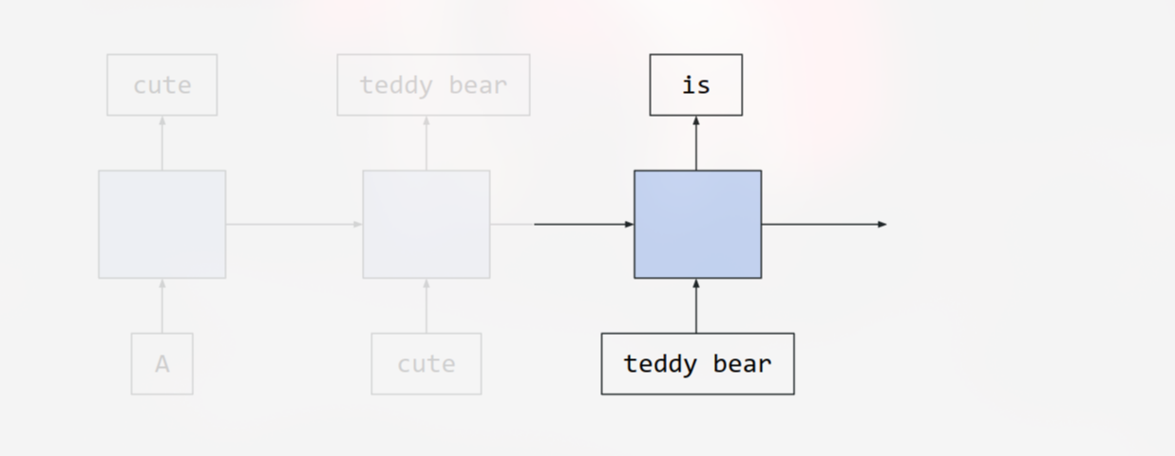
Recurrent Neural Networks (RNNs)
4

Slide 38
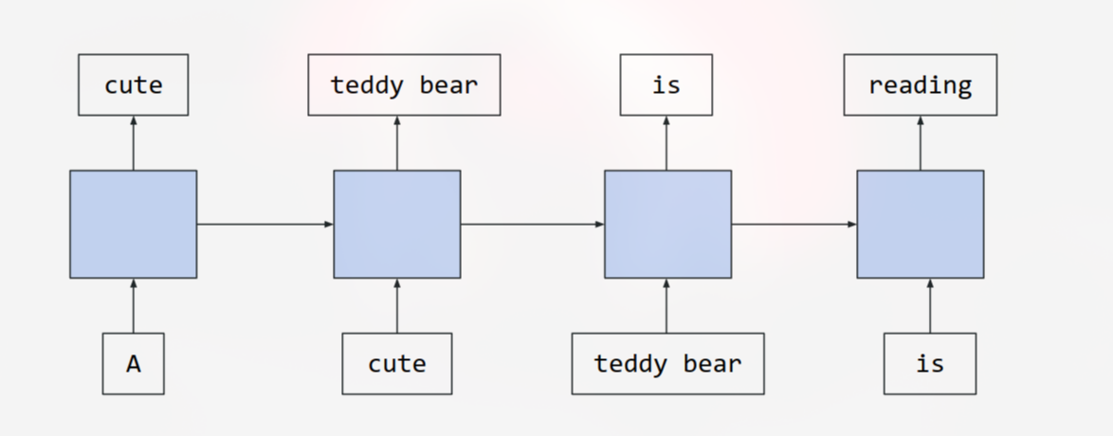
Recurrent Neural Networks (RNNs)
4

Slide 39
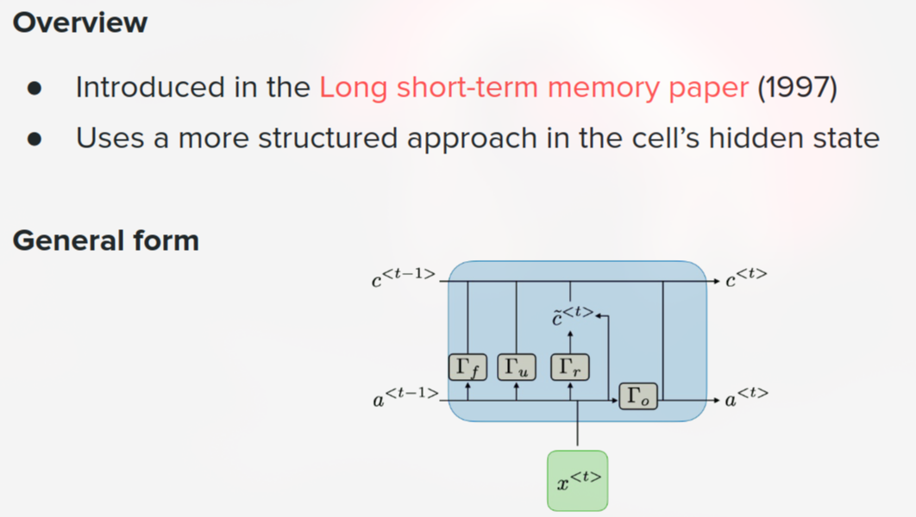
Long Short-Term Memory (LSTM)
4

Slide 40
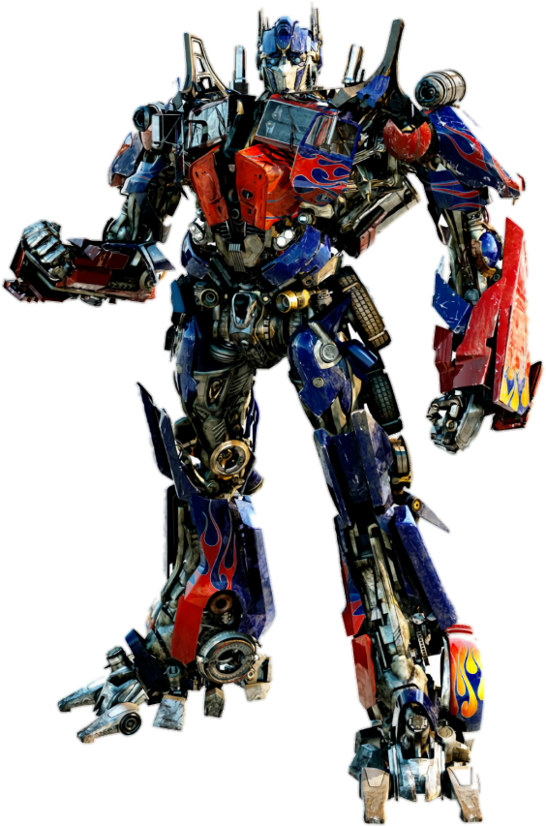

Transformers
4

Slide 41
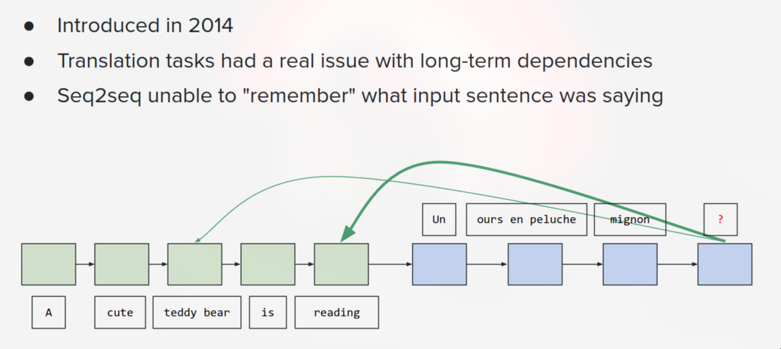
History of attention
4

Slide 42
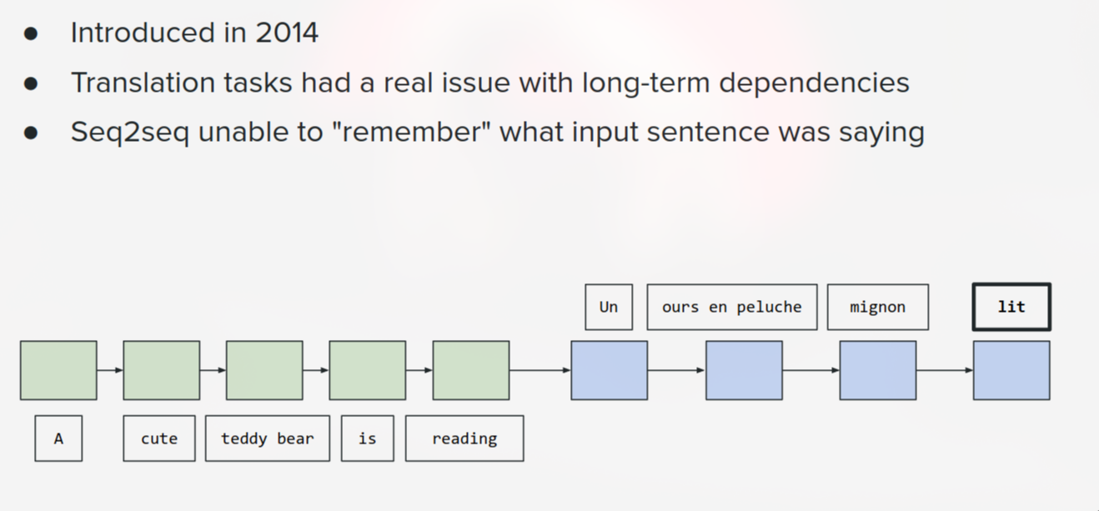
History of attention
4

Slide 43
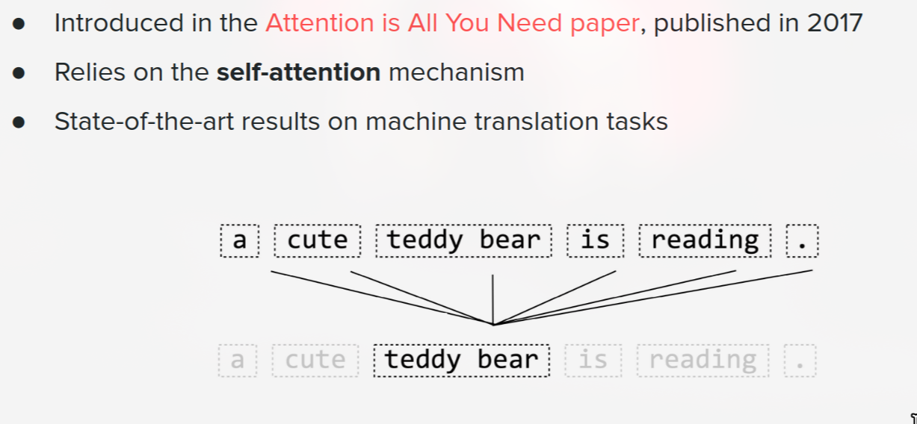
Self-attention mechanism
4

Slide 44
Self-Attention: How Do Tokens Understand Context?
Self-attention is a mechanism that computes how much each token should attend to other tokens in the same sequence to build context-aware representations.
This is the key mechanism that allows Transformers to capture long-range dependencies without the sequential bottleneck of RNNs—a token at position 1 can directly attend to position 1000 in a single operation.
4

Slide 45
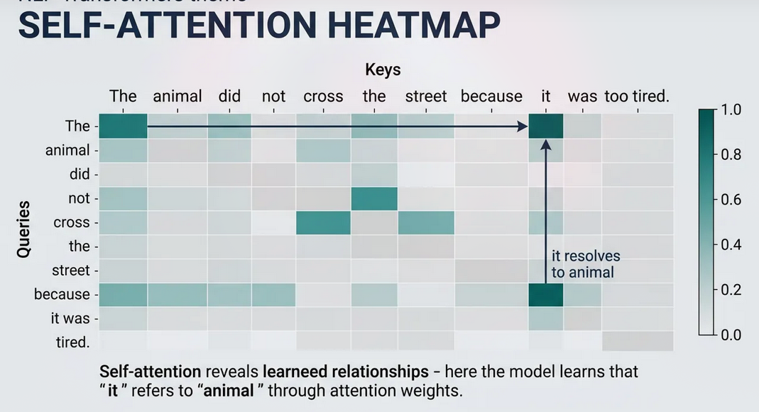
Self-Attention: How Do Tokens Understand Context?
When processing the word `it`, the model can use information from other words, including `animal`, to construct a context-aware representation.
This allows the model to capture relationships between words, even when they are separated by several other tokens.
4

Slide 46
Self-Attention: How Do Tokens Understand Context?
Each token can look at other tokens.
The model computes attention scores to measure their relevance.
These scores determine how information from other tokens is combined.
The resulting representation incorporates contextual information.
4

Slide 47
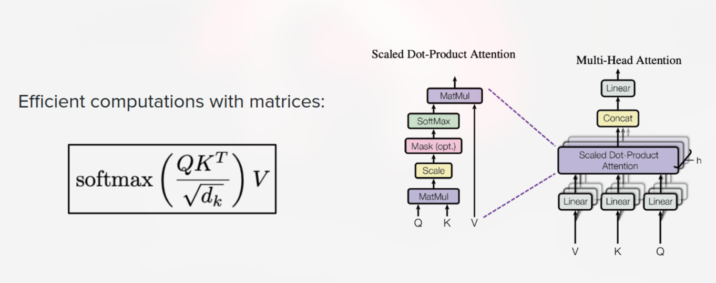
Attention mechanism
4

Slide 48
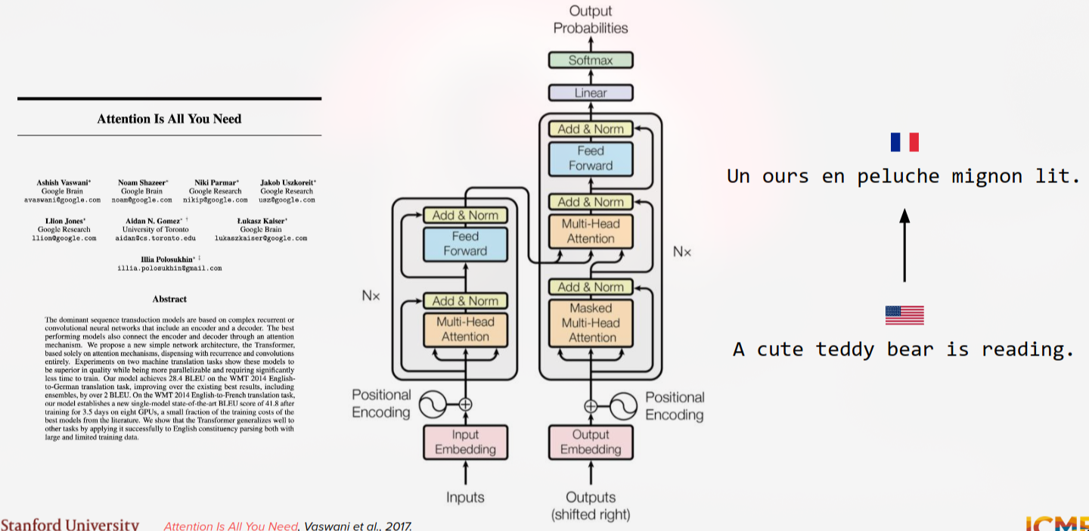
Transformer architecture
4

Slide 49
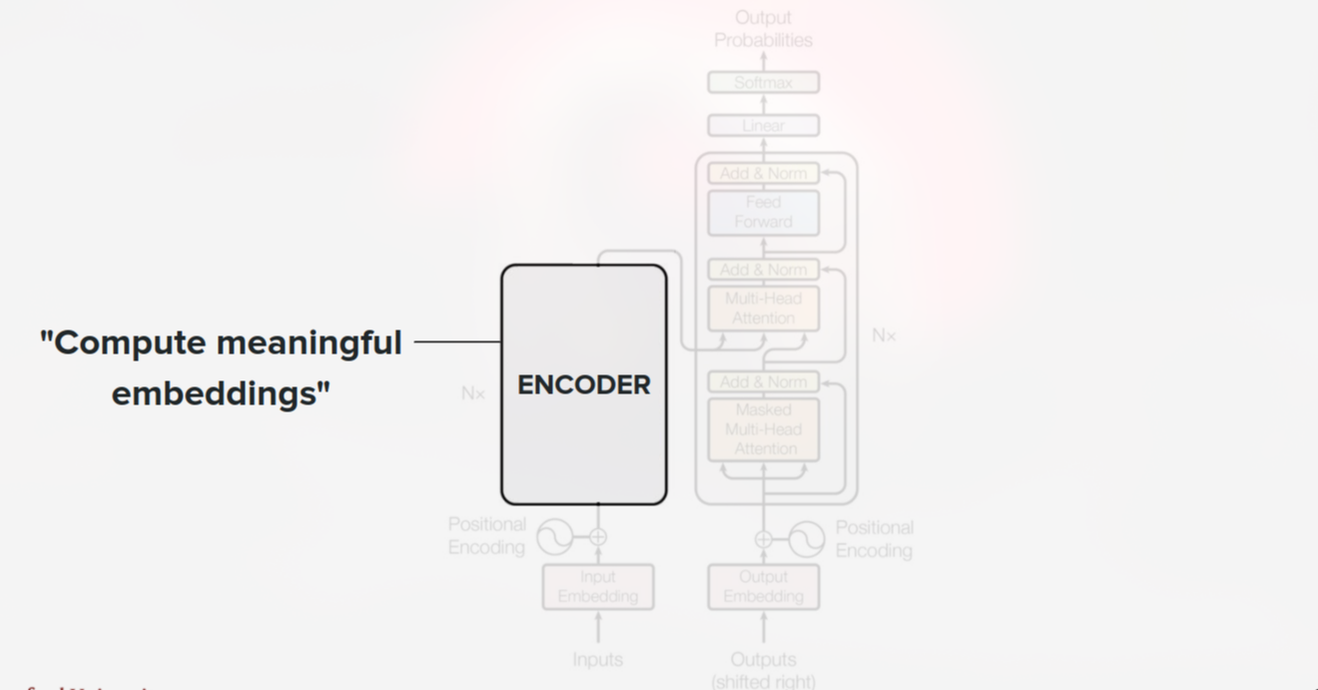
Transformer architecture
4

Slide 50
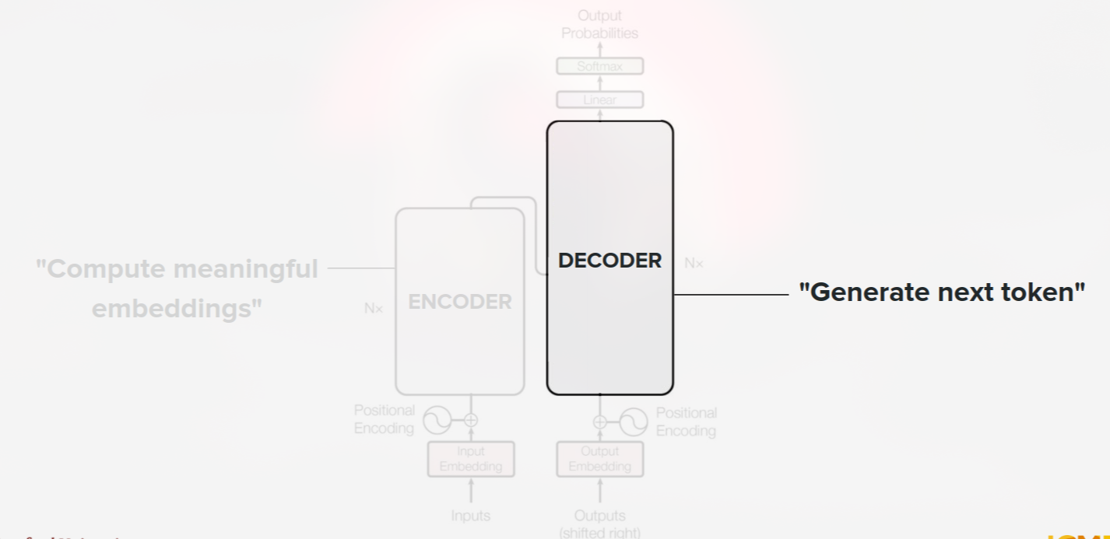
Transformer architecture
4

Slide 51
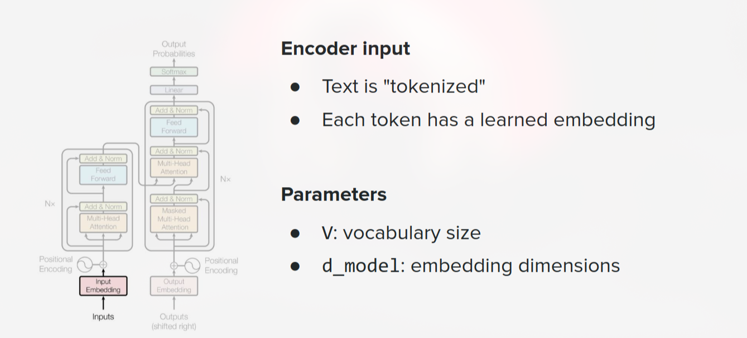
Encoder input…
4

Slide 52
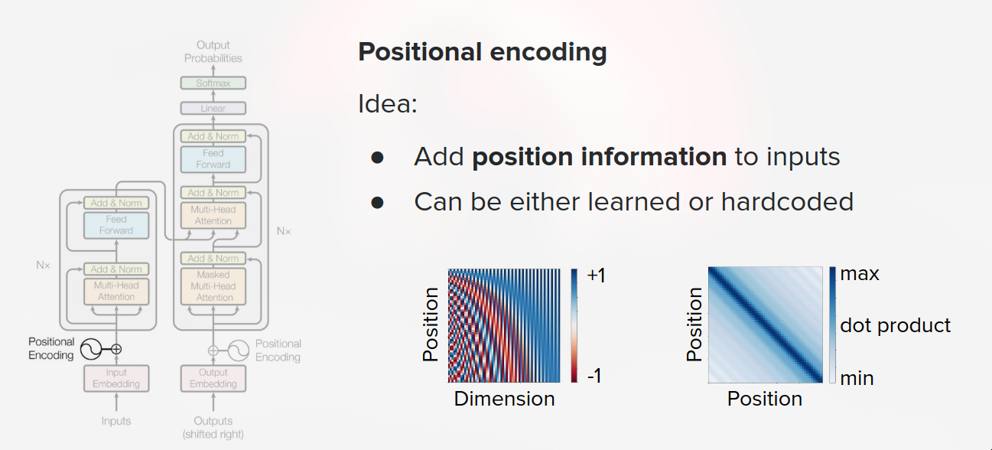
...with a trick!
4

Slide 53
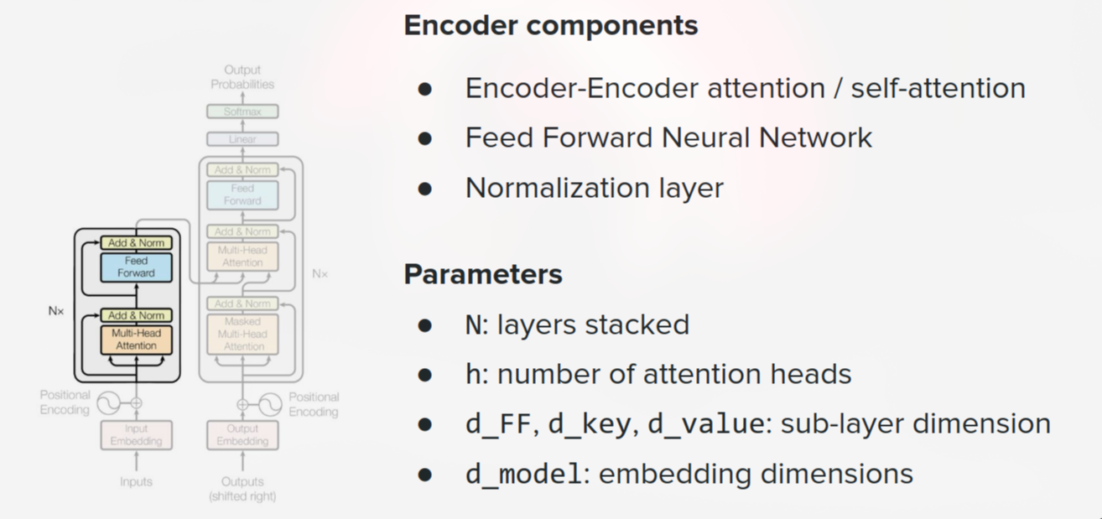
Encoder
4

Slide 54
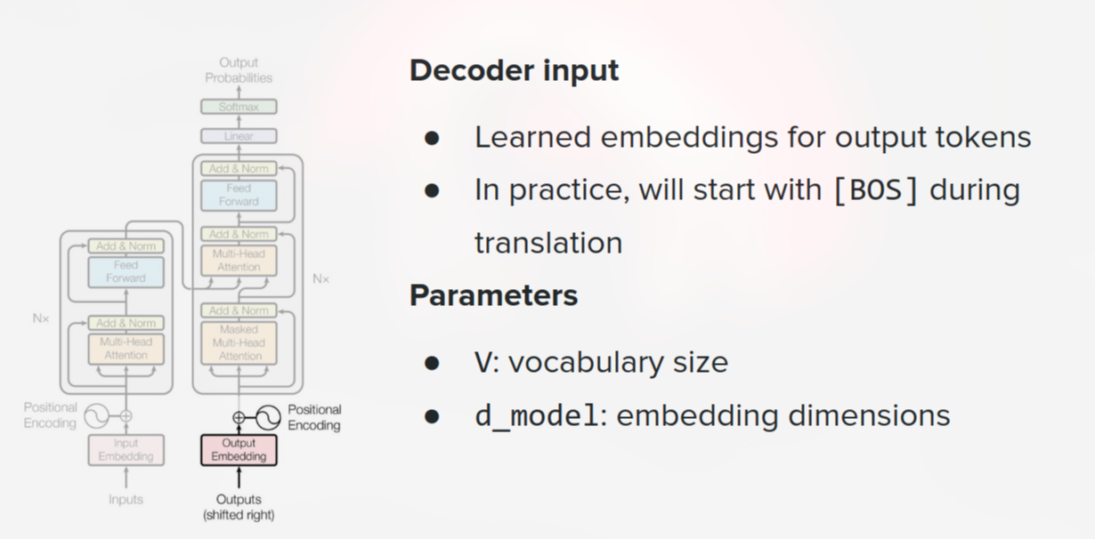
Decoder input, with position information
4

Slide 55
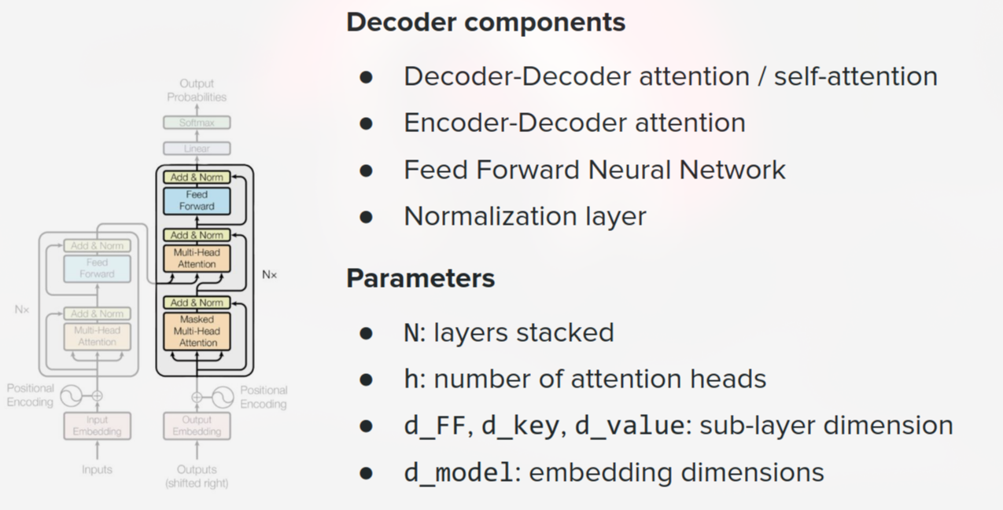
Decoder
4

Slide 56
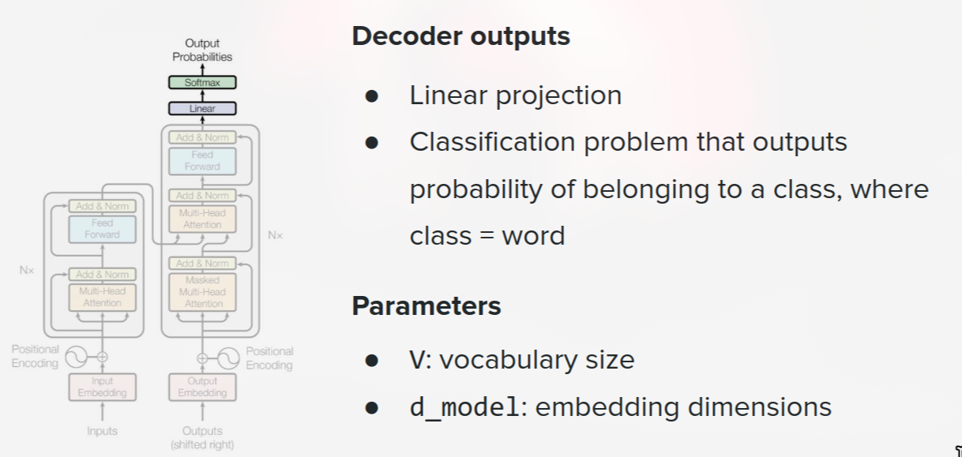
Output
4

Slide 57

Pretraining (Scaling, Systems, Data) and fine-tuning
4

Slide 58
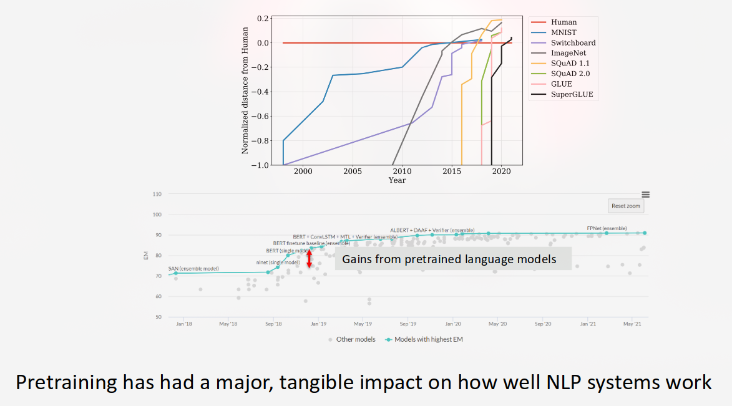
LLM Pre-training: Learning from Large-Scale Data
Pre-training is the initial training stage in which a model learns general language patterns and representations from a large corpus of data.
4

Slide 59
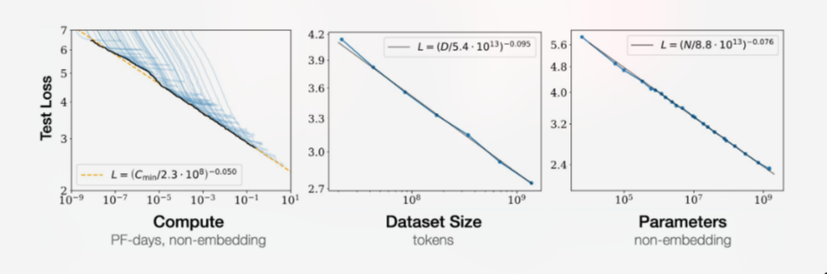
What happens during pre-training?
Collect and process large datasets (text, code, and potentially multimodal data).
Tokenize the data.
Train a neural network to predict tokens.
Update millions or billions of parameters using gradient descent.
4

Slide 60
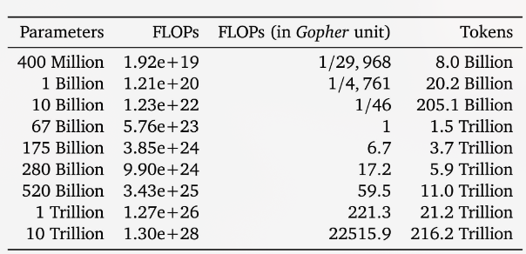
What happens during pre-training?
Collect and process large datasets (text, code, and potentially multimodal data).
Tokenize the data.
Train a neural network to predict tokens.
Update millions or billions of parameters using gradient descent.
4

Slide 61
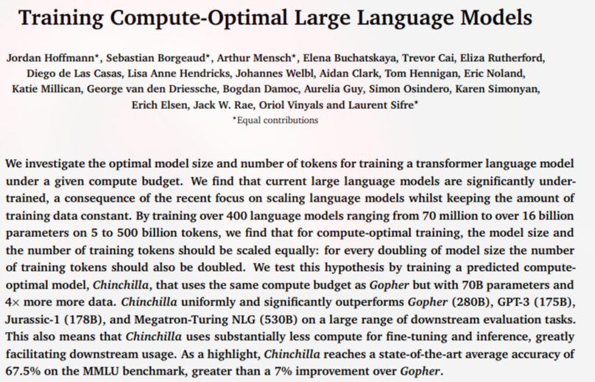
What happens during pre-training?
How many model parameters your LLM should have.
How much training data (tokens) you need.
How to allocate a fixed computational budget between model size and training data.
the idea of compute-optimal scaling: having a larger model does not necessarily make it better if you don't provide enough training tokens.
4

Slide 62
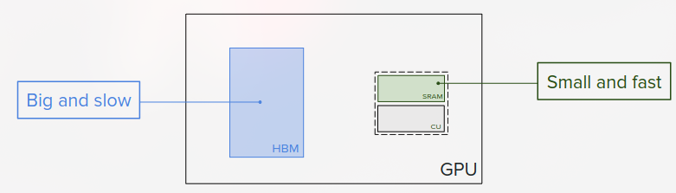
ENSSEA students and computer science knowledge!
4

Slide 63
Pretraining
Initialized model
4

Slide 64
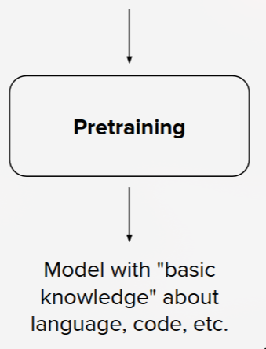
Pretraining
Initialized model
4

Slide 65
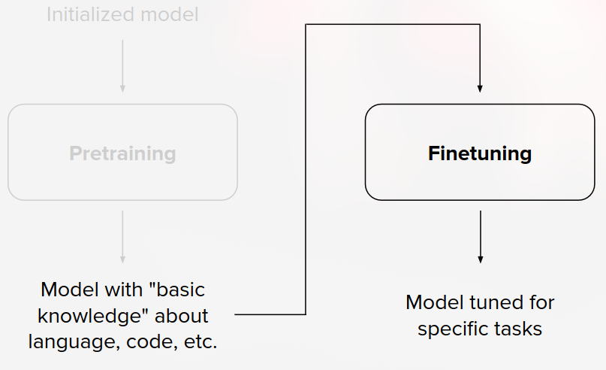
Finetuning: Adapting the Model
Fine-tuning is the process of further training a pre-trained model on a more specific dataset to adapt its behavior to a particular task or objective.
4

Slide 66



Common fine-tuning approaches:
4

Slide 67


Common fine-tuning approaches:
4

Slide 68


Post-training (RLHF, SFT, DPO)
5

Slide 69



Post-training (RLHF, SFT, DPO)
5

Slide 70

Language models as multitask assistants? are they building an internal model of how the world works?
scale + pretraining may be quietly turning LMs into general-purpose world simulators, even though they were never explicitly trained to be one.
5

Slide 71

Language models as multitask assistants?
ENSSEA is located in ___________
5

Slide 72

Language models as multitask assistants?
Post-training refers to the stages performed after pre-training to adapt a base language model to follow instructions, become more helpful, align with human preferences, and perform specific tasks.
5

Slide 73


Language models as multitask assistants?
Post-training refers to the stages performed after pre-training to adapt a base language model to follow instructions, become more helpful, align with human preferences, and perform specific tasks.
5

Slide 74

Language modeling ≠ assisting users
ENSSEA is located in ___________
Language models are not aligned with user intent.
Finetuning to the rescue!
5

Slide 75

Instruction finetuning and performance gains
ENSSEA is located in ___________
5

Slide 76

Instruction finetuning and performance gains
ENSSEA is located in ___________
5

Slide 77


LLM tuning
5

Slide 78
LLM tuning
5

Slide 79


PPO/GRPO
5

Slide 80

DPO vs RL (PPO, REINFORCE, …)
DPO and PPO are very different optimizers.
It is learning directly from preferences vs. using RL update rules.
It is also not really online vs offline RL, but that is more muddled.
More discussion:
https://twitter.com/srush_nlp/status/1729896568956895370, https://www.interconnects.ai/p/the-dpo-debate, https://www.youtube.com/watch?v=YJMCSVLRUNs
5

Slide 81
LLM reasoning
5

Slide 82

LLM reasoning
LLM reasoning refers to a model's ability to process information, follow logical steps, solve problems, and generate conclusions based on a given context.
5

Slide 83

LLM reasoning
LLM reasoning refers to a model's ability to process information, follow logical steps, solve problems, and generate conclusions based on a given context.
5

Slide 84
How can LLMs perform reasoning?
Chain-of-Thought (CoT): Generate intermediate reasoning steps before the final answer.
Self-consistency: Generate multiple reasoning paths and select a consistent answer.
Tool-assisted reasoning: Use external tools such as Python, calculators or search engines.
Planning and decomposition: Break complex problems into smaller subproblems.
5

Slide 85
Reasoning and AI Agents
An LLM can reason without being an agent. An agent can also make decisions without an LLM. Combining reasoning models with tools and action loops allows us to build more capable AI agents.
5

Slide 86

Agentic LLMs
5

Slide 87
Agentic LLMs: From Generating Text to Taking Actions
An Agentic LLM is an LLM-based system that can autonomously work toward a goal by reasoning, planning, selecting actions, using external tools, observing results, and adapting its next steps.
5

Slide 88

Agentic LLMs: From Generating Text to Taking Actions
5

Slide 89
Agentic LLMs: From Generating Text to Taking Actions
The process can repeat:
5

Slide 90
What Makes an LLM Agent?
5

Slide 91
Examples of Agentic LLM Applications
5

Slide 92
LLM vs Agentic LLM
LLM | Agentic LLM
Receives a prompt | Receives a goal
Generates a response | Plans and executes actions
Usually responds directly | Can interact with external tools
One interaction may be sufficient | May require multiple action-observation cycles
An LLM is a model. An agent is a system built around a model (often an LLM), tools, memory and an execution loop.
Not every agent needs an LLM: traditional agents can use rules, search algorithms, optimization or reinforcement learning.
5

Slide 93


RAG
RAG gives an LLM access to external knowledge.
5

Slide 94

RAG
RAG is an architecture that combines information retrieval with text generation. It retrieves relevant information from an external knowledge source and provides it to an LLM as context to generate a response.
5

Slide 95

RAG
5

Slide 96

Reasoning and AI Agents
An LLM can reason without being an agent. An agent can also make decisions without an LLM. Combining reasoning models with tools and action loops allows us to build more capable AI agents.
5

Slide 97

ReAct: Reasoning + Acting
ReAct gives an LLM a structured way to reason and interact with tools.
ReAct is a prompting and agent framework that interleaves reasoning and actions. The LLM reasons about what to do, executes an action through a tool, observes the result, and then decides what to do next.
5

Slide 98

Building AI Agents
Why?
2. How?
3. Ingredients?
What can they do?
Key thesis: Humans will communicate with AI using natural language and AI will operate machines allowing for more intuitive and efficient operations
5

Slide 99

AI Agents
5

Slide 100
Why human-like AI Agents?
Can do what you can do: Able to use existing interfaces designed for humans & operate outside programmatic boundaries
2. Digital extension of you: Can act as an extension of the user and act on their behalf
3. Less-restrictive boundaries: Can handle logins, payments, etc. and interact with services without any API restrictions
4. Simple action space: Need only click & type action primitives
5. Self-learning: Can learn from the user and self-improve with more interactions
5

Slide 101

5

Slide 102
5

Slide 103
LLM evaluation
5

Slide 104
LLM inference
5

Slide 105
Major Applications
of Transformers
5

Slide 106

5

Slide 107

5

Slide 108

Vision: Analyzing Images & Videos
Vision Transformer (ViT)
5

Slide 109

Vision: Generating Images & Video
Images: Stable Diffusion, Dall-E, Midjourney, etc.
5

Slide 110


Robotics, Simulations, Physical Tasks
E.g. Voyager, Mobile ALOHA
5

Slide 111



Playing Games
E.g. AlphaGo, AlphaStar,
AI for MOBAs (e.g. Dota 2 / LoL)
5

Slide 112



Biology + Healthcare
E.g. Med-PaLM, AlphaFold
5

Slide 113

Agent Computer Interaction
5

Slide 114

Agent-to-Agent Communication
5

Slide 115

Agent-to-Agent Communication
5

Slide 116

Agent-to-Agent Communication
5

Slide 117

Agent-to-Agent Communication
5

Slide 118

Agent-to-Agent Communication
5

Slide 119

Agent-to-Agent Communication
5

Slide 120

Agent-to-Agent Communication
5

Slide 121

Agent-to-Agent Communication
5

Slide 122
Agent-to-Agent Communication
5

Slide 123
Recent Trends and Remaining Weaknesses of LLMs
5

Slide 124

BabyLM: Children vs. LLMs
Children are different due to several reasons:
LMs do statistical learning, which requires more data to learn statistical relations between words and get abstraction/generalization/reasoning
Children may learn in smarter, e.g. more explicit compositional/hierarchical manners, learning abstraction/generalization/reasoning more easily
5

Slide 125
Memory Augmentation & Personalization
5

Slide 126
New Knowledge or “Memorizing”?
When LLM is prompted and says something, is what it says truly “novel/new”?
Innovation vs. Regurgitation: ongoing debates about whether LLMs can truly invent new ideas or are primarily recombining existing knowledge (since learn patterns from lots of text)
Test-time Contamination: models might regurgitate rather than synthesize information due to overlap between training and evaluation data, leading to misleading benchmark results
Cognitive Simulation: some argue LLMs mimic human thought processes, suggesting a form of "understanding," while others see this as simply “sophisticated pattern matching”
Ethical and Practical Implications: this impacts trustworthiness, copyright issues, and the educational use of LLM outputs
E.g. copyright lawsuit by New York Times (NYT) on OpenAI!
5

Slide 127
Continual Learning
AKA, infinite and permanent fundamental self-improvement
Similar to humans: we constantly learn everyday from every interaction
Don’t need to “finetune ourselves” once in a while
Very challenging, could be the key to AGI!
Currently work on: finetune a small model based on traces from better model or same model after filtering those traces
More like re-training and distillation than true “continual learning”
Work showing that reasonably sampled data with interjected augmented reasoning and further filtering can be used to further finetune or optimize (e.g. using DPO)
E.g. UltraChat-200k and Zephyr
E.g. LLMs Can Self-Improve paper
5

Slide 128
Interpretability of LLMs
Enormous number of parameters trained on tons of data → “huge black-box” that is hard to interpret and understand
More work on interpretability is required
Would allow us to better understand models, leading to better ideas of what/how to improve, easier control, and better alignment/safety
Mechanistic interpretability: understand how individual components + operations in an ML model contribute to its overall decision-making process
Goal: unpack the "black box" of models for clearer insight into how they work
5

Slide 129

Model Modularity + Mixture of Experts (MoE)
Mixture of Experts (MoE) very prevalent these days in LLMs:
E.g. GPT-4, Gemini, etc.
Goal: have several models/“experts” work together to solve a problem
Each expert may be specialized for a task/purpose
Try to use the diff skill-sets together to arrive at a generation
Research on how to better define and connect these “experts”
5

Slide 130
Model Modularity + Mixture of Experts (MoE)
Single model variation (?)
- Potential to segment/compartmentalize a single NN model into different compartments with their own focus, similar to the human brain?
- E.g. part of the network for fact-based info, another for spatial reasoning, another for mathematical + logical reasoning, etc.
Maybe add more layers on top of the foundation model
Particular layers correspond to something (e.g. new domain), and try to tune these new layers specifically
5

Slide 131
Self-Improvement / Self-Reflection
Found models can reflect on their own output to iteratively improve/refine them
Examples of works: ReAct, Reflexion, Self-refine
Training LMs with Language Feedback: https://arxiv.org/abs/2204.14146
5

Slide 132


Self-Improvement / Self-Reflection
Tried multiple layers/levels of self-reflection… showing continual improvement
- Hypothesize that results will improve to a certain point and then degrade, and depends both on the model scale and the task at hand
- Some folks believe that AGI is a “constant state of self-reflection”
Can investigate further improvements to chain-of-thought reasoning and self-reflection
5

Slide 133
Hallucination Problem
Model “does not know when it does not know”
Due to sampling procedure, generates text and sounds confident about it, even when littered with factual errors
Can enhance through retrieval (e.g. through Google), and also:
-Internal-based “fact verification”
- Output verification and regeneration (self-refinement/improvement)
- Modifying the token sampling to shy away from hallucination
- Some way to “predict hallucination” before generation and prevent it
“Confidence” rating would also help check the reliability of the output
5

Slide 134
Reasoning: Sufficient? Intermediate Guidance Helps…
Chain-of-thought (CoT) - series of intermediate reasoning steps
Shown to improve LLM performance on complex reasoning tasks
Inspired by human thought process: decompose multi-step problems
Also provides an interpretable window into behavior of the model (how it arrived at an answer, where it goes wrong in its reasoning path)
CoT exploits the fact that deep down in the model's weights, it knows more about the problem than just prompting it to get a response
5

Slide 135

Sources & Acknowledgments
These slides were inspired by and incorporate selected diagrams and visual materials from the following Stanford courses:
Stanford CS224N – Natural Language Processing with Deep Learning
Stanford CME295 – Transformers & Large Language Models
Stanford CS25 – Transformers United
Stanford CS 329Z - Engineering AI Agents
Full credit goes to the original instructors and contributors. All reused materials remain the property of their respective owners.
Thank you, Stanford, for everything you continue to give to the world.
5

Slide 136

Now, it's your turn to transform!
5

