Slide 1
Capstone Project
Airbnb Booking Analysis By Patan Ismail Alli Khan (pathanismailalikhan@gmail.com)

Slide 2
What is Airbnb ?
Airbnb, as in “Air Bed and Breakfast,” is a service that lets property owners rent out their spaces to travelers looking for a place to stay. Travelers can rent a space for multiple people to share, a shared space with private rooms, or the entire property for themselves.
Airbnb is based on a peer-to-peer business model. This makes it simple, easy to use, and tends to be more profitable for both parties. The model also gives you the opportunity to customize and personalize your guests’ experience the way you want.

Slide 3
Problem Statement
Since 2008, guests and hosts have used Airbnb to expand on travelling possibilities and present a more unique, personalized way of experiencing the world. Today, Airbnb became one of a kind service that is used and recognized by the whole world. Data analysis on millions of listings provided through Airbnb is a crucial factor for the company. These millions of listings generate a lot of data that can be analysed and used for security, business decisions, understanding of customers' and providers (hosts) behavior and performance on the platform, guiding marketing initiatives, implementation of innovative additional services and much more.
This dataset has around 49,000 observations in it with 16 columns and it is a mix of categorical and numeric values.
Explore and analyze the data to discover key understandings.

Slide 4
Workflow
Data Cleaning
And Manipulation
Exploratory
Data
Analysis
Data
Understanding

Slide 5
Data Understanding
minimum_nights - Minumum number of nights to be paid for
number_of_reviews - Number of reviews given for the listing
last_review - Date of the last review given to the listing
reviews_per_month - No.of review given per month
calculated_host_listings_count - Total number of listings for host
availability_365
Number of days listing
is available
id - Unique id of listing
name - Name of the listing
host_id - Unique id of host
host_name - Name of the host
neighbourhood_group - Location of the listing
neighbourhood - Area of the listing
latitude - Latitude of listing
longitude - Longitude of listing
room_type - Type of rooms
price - Price of listing

Slide 6
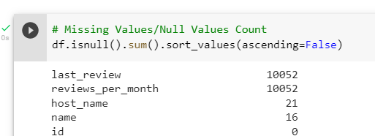

Data Cleaning and Manipulation
Our Dataset has 4 column's with Null Values
1. We can replace reviews_per_month with 0 as these Stays might not have been rated at all.
2. last_review is a date column. Replacing this with any random date might corrupt the dataset
3. We will not be using host_name and name columns
in our analysis.

Slide 7
Exploratory Data Analysis
Numerical Features | Categorical Features
id | name
host_id | host_name
price | neighbourhood
minimum_nights | neighbourhood_group
number_of_reviews | room_type
calculated_host_listings_count
availability_365

Slide 8
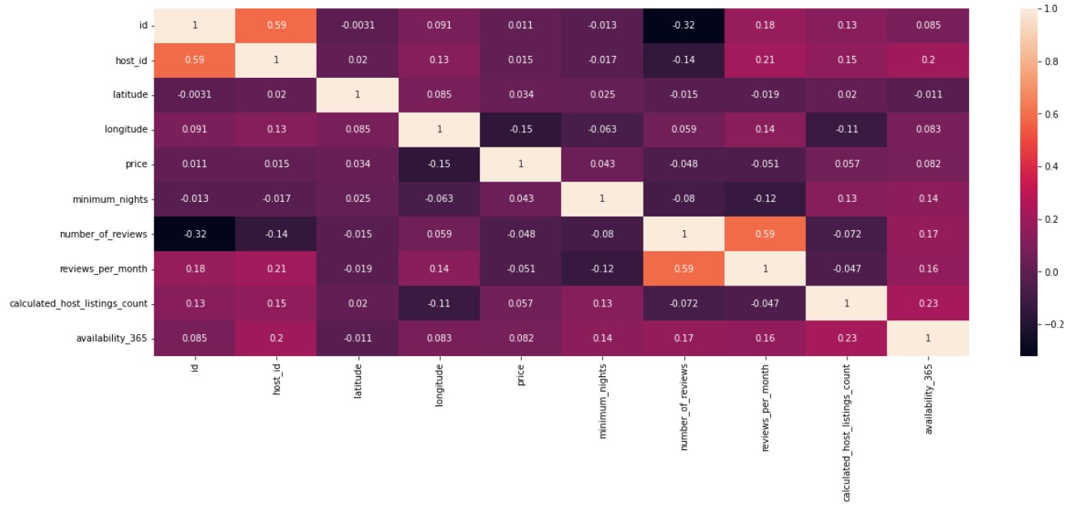
Correlation between features
From the above Heat Map we can see that there is no correlation
between any of the features.

Slide 9
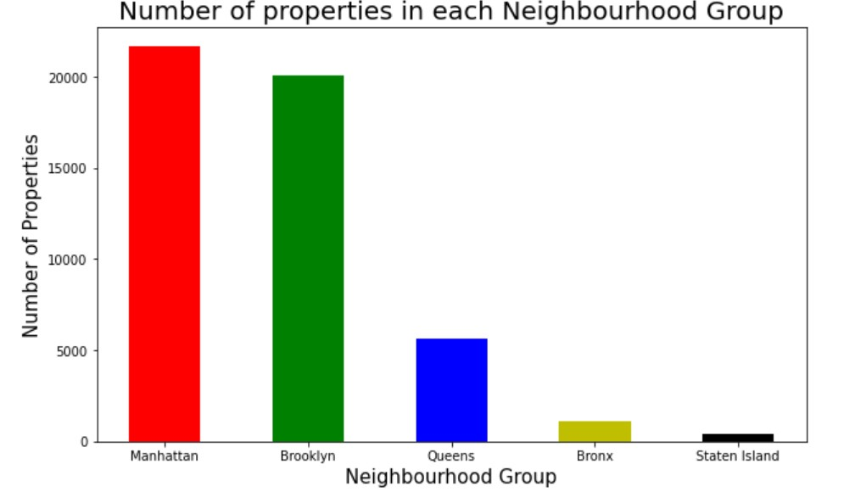
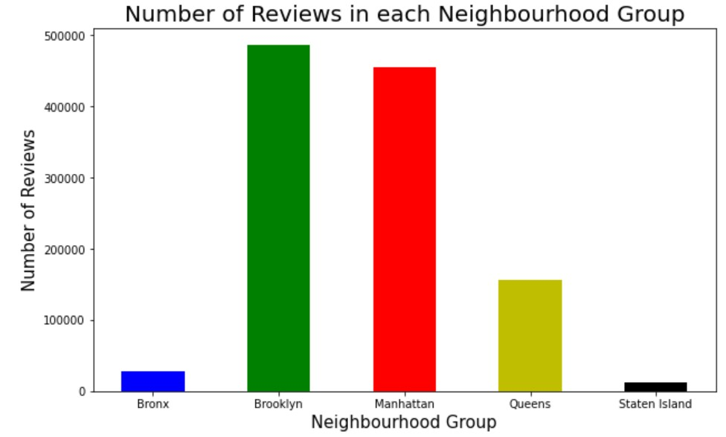
From the above bar graphs we can see that most number of properties are in Manhattan and Most number of reviews are for Brooklyn location properties.

Slide 10
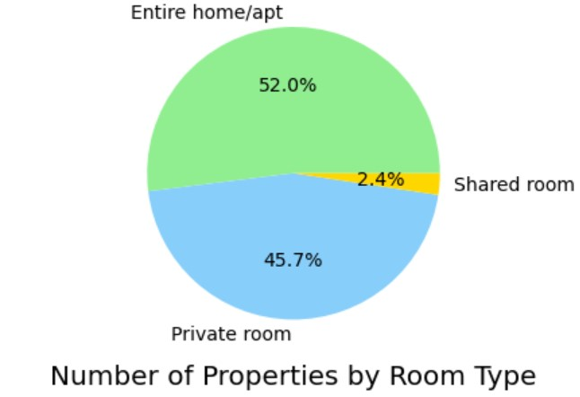
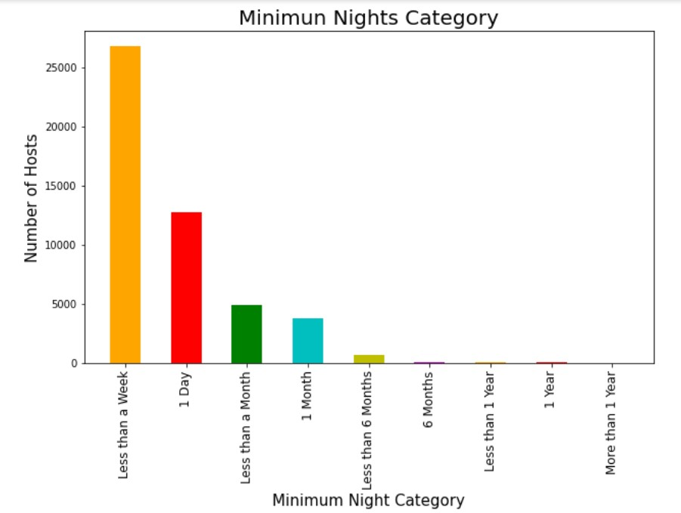
From the above Pie chart we can see that most properties offer Entire home or apartment room type.
The Bar graph shows that many properties prefer minimum 1 day or less that a week nights to be paid for

Slide 11
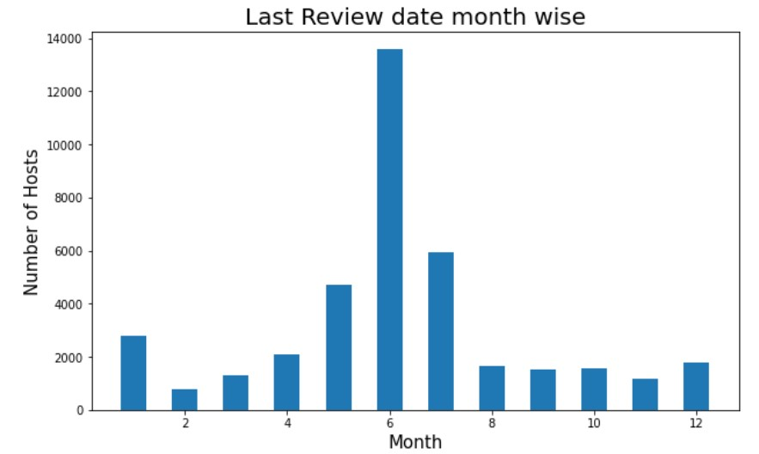
From the above bar graphs we can observe that Most number of people have either vacated / changed there property in the month of June

Slide 12
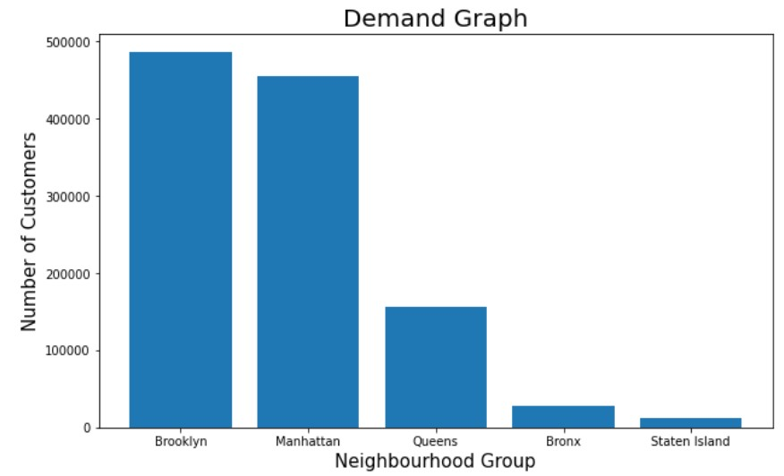
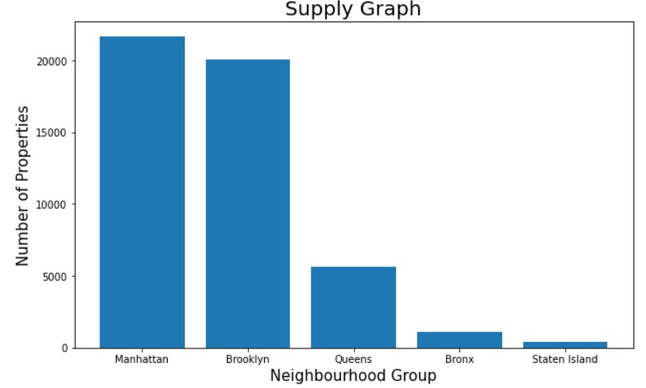
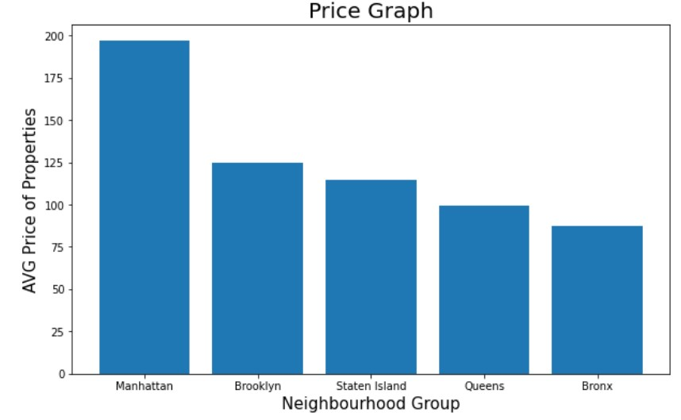
From the above bar graphs we can observe that
1.Brooklyn has high demand for properties
2.More Properties are available in Manhattan
3.Manhattan has the highest average price

Slide 13
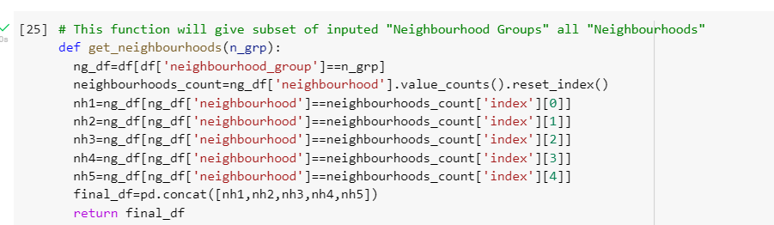
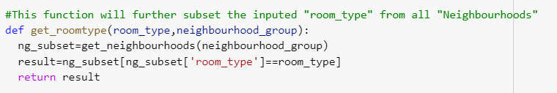
Exploring into Neighborhoods
The above function will take Neighborhood group as input and return the subset of all Neighborhoods in that group.
The above function will take room type and Neighborhood group as
input and further subset for each room type.

Slide 14
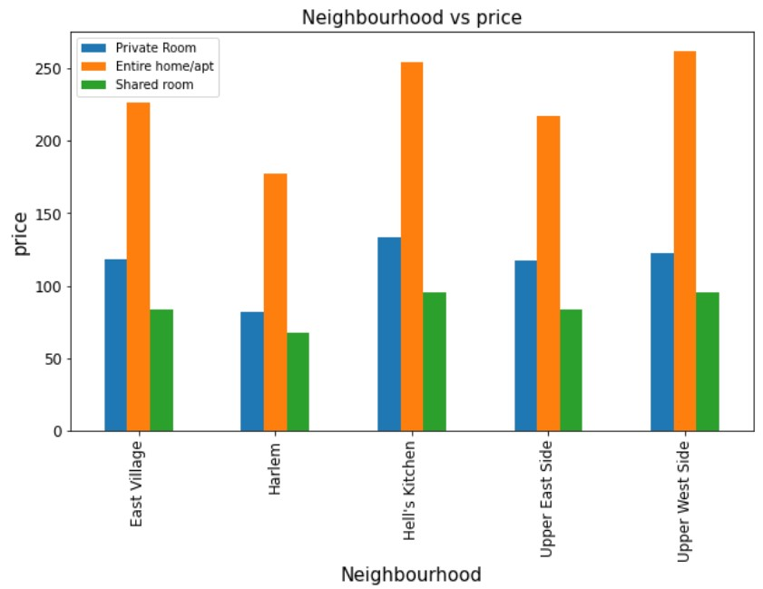
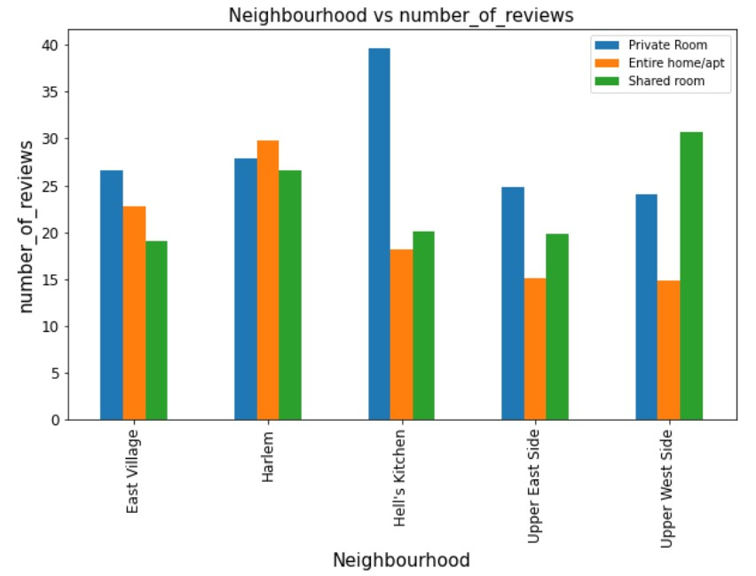
Manhattan
From the above bar graphs we can observe that
1. Hell's Kitchen and Upper West side in Manhattan have Highest Average Price
2. Hell's Kitchen has the highest number of reviews for Private room Type
of Properties.

Slide 15
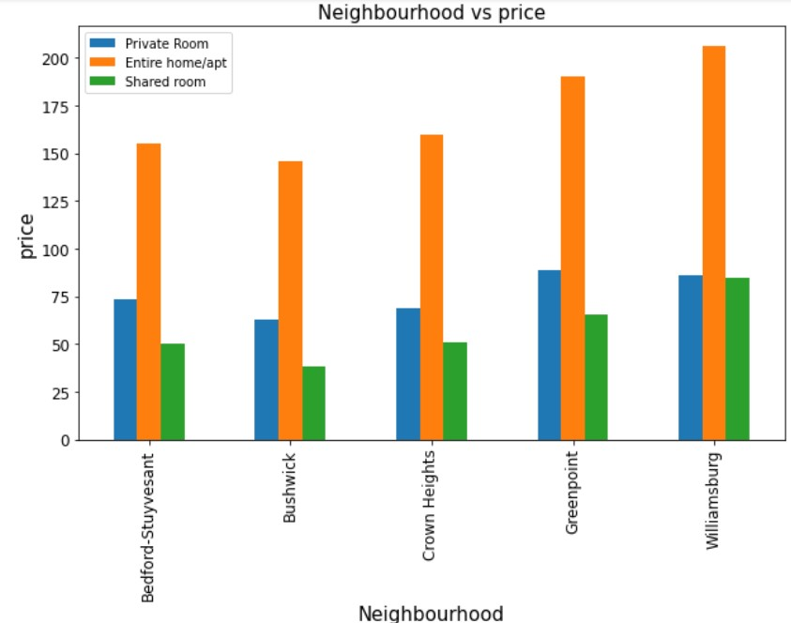
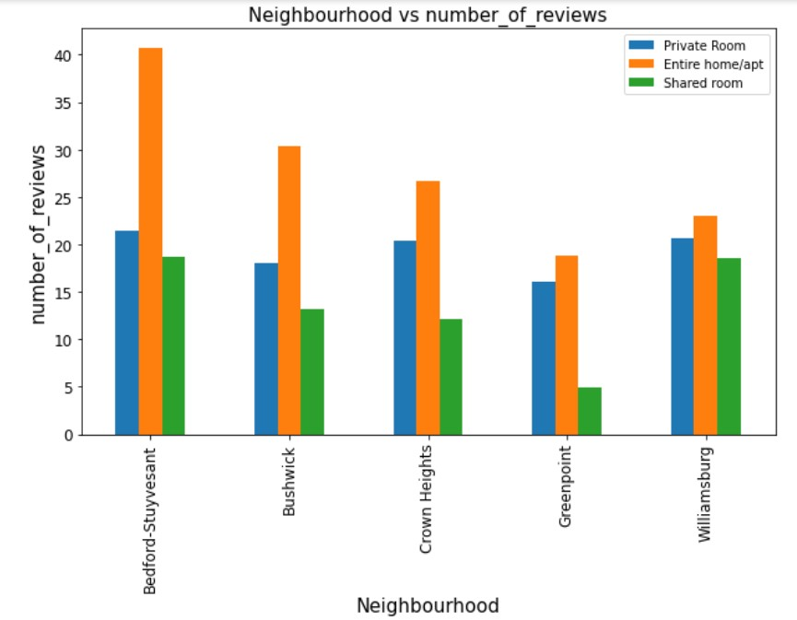
Brooklyn
From the above bar graphs we can observe that
1. Williamsburg in Brooklyn has the Highest Average Price for all room types.
2. Most reviews are for the Entire home/apt type in Brooklyn and Williamsburg has the least reviews for Entire home/apt type.

Slide 16
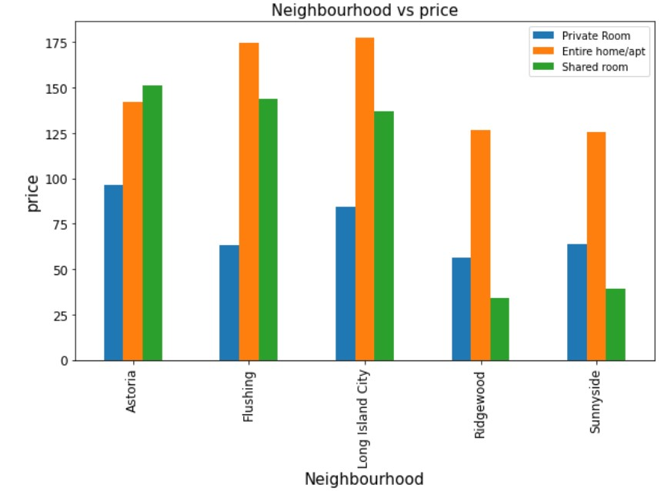
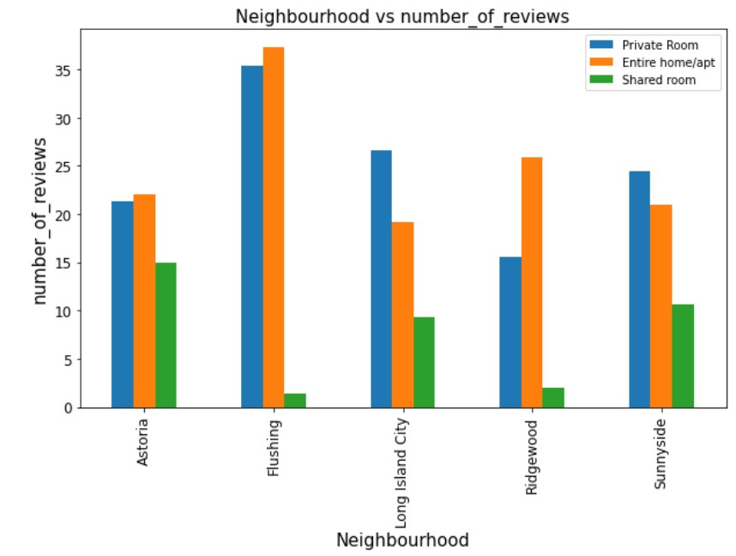
Queens
From the above bar graphs we can observe that
1. The Maximum price in Queens is very less compared to Manhattan and Brooklyn.
2. Entire home/apt and Private Room Type in the Flushing Area has
highest number of reviews compared to other Areas.

Slide 17
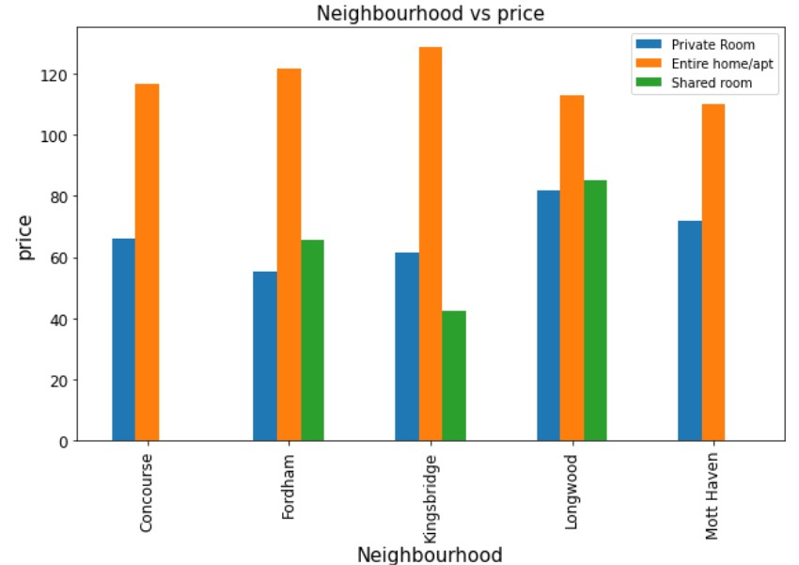
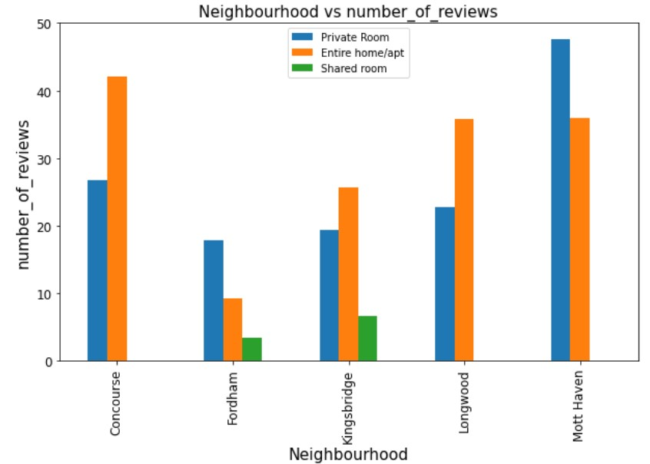
Bronx
From the above bar graphs we can observe that
1.Entire home/apt Type Prices are high in almost all Areas in Bronx.
2. Most of the reviews are for Entire home/apt or Private Room type.

Slide 18
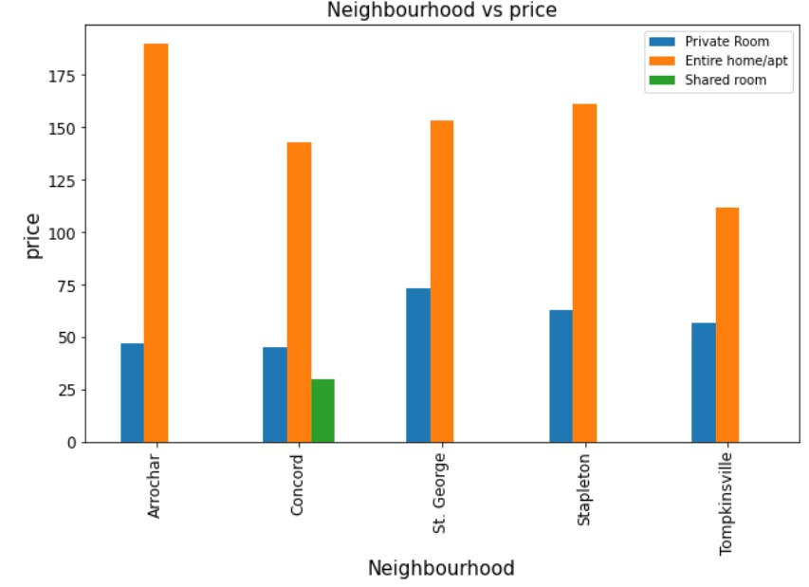
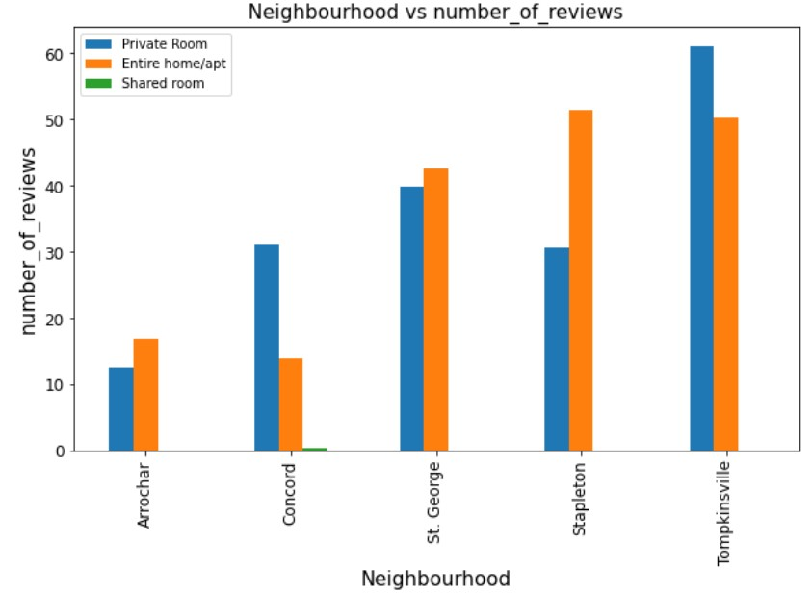
Staten Island
From the above bar graphs we can observe that
1.Only Concord Area is having shared room type in Staten Island
2. Most reviews are for Tompkinsville Area.

Slide 19
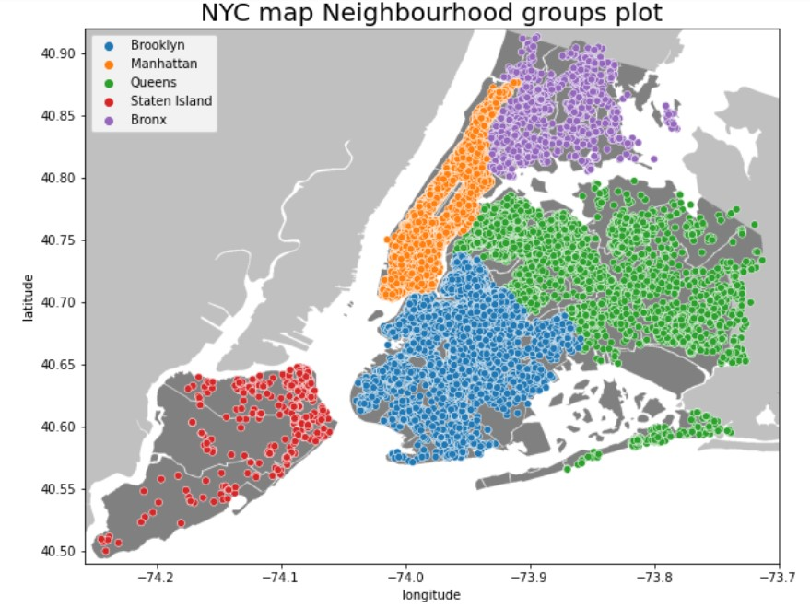
From the above graph we can see an overview of the properties listed in the New York City differentiated by locations.

Slide 20
Conclusion
1.Most number of Properties are in Manhattan and Brooklyn followed by Queens.
2.Most people prefer Brooklyn and Manhattan followed by Queens
3.Most people prefer Entire home/apt type followed by private rooms and only few people prefer Shared room type.
4.Most people have either vacated or changed the property in the month of June.
5.Airbnb can increase number of properties in Brooklyn as there is large demand and get higher profits
6. In Manhattan, Hell's Kitchen and Upper West side have Highest Average Price
7. in Brooklyn , Williamsburg has the Highest Average Price for all room types.
8. The Maximum price in Queens is very less compared to Manhattan
and Brooklyn and its even lower in Bronx.
9.Only Concord area in Staten Island has shared room.

Slide 21
THANK YOU

