Slide 1

Page - 1- 1
Logo
Its logo space
Remove HOME icon
Move Hajj, Umrah and other icon to right side

Slide 2
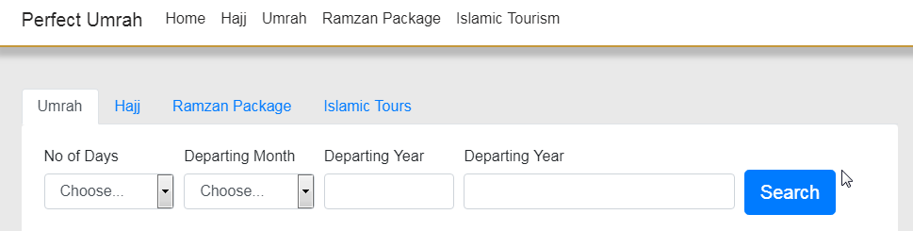
Page - 2- 1
1
Remove above red box icon. Its just repeating from below

Slide 3
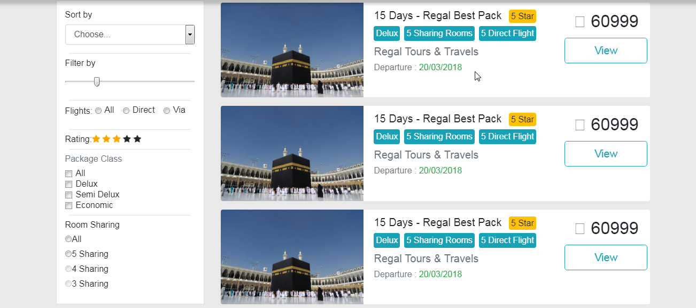
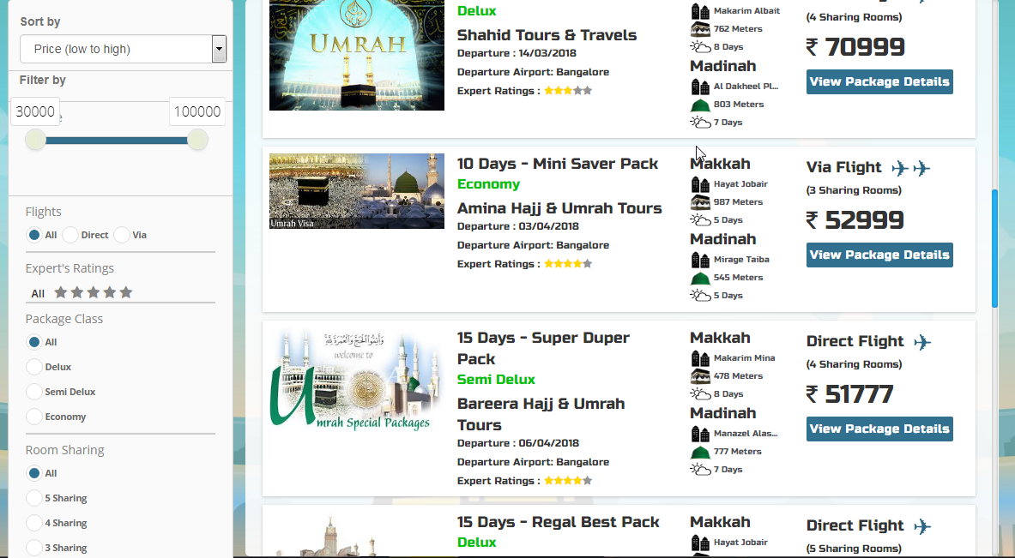
Page - 2- 2
Your template
Our website
IN PAGE 2, Maintain as per our website including sort by and all filters as shown above.

Slide 4
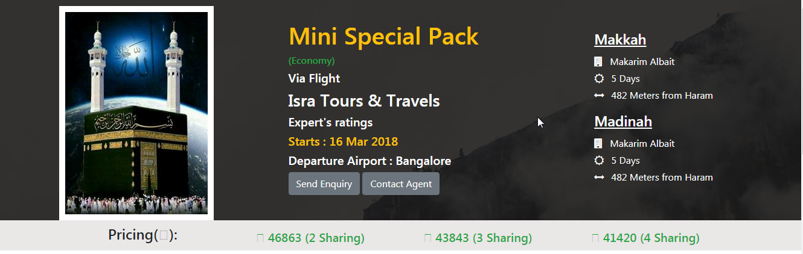
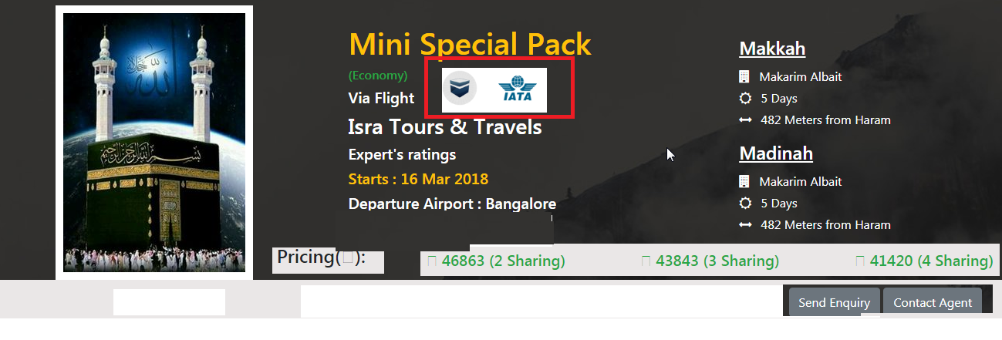
Page - 3- 1

Slide 5
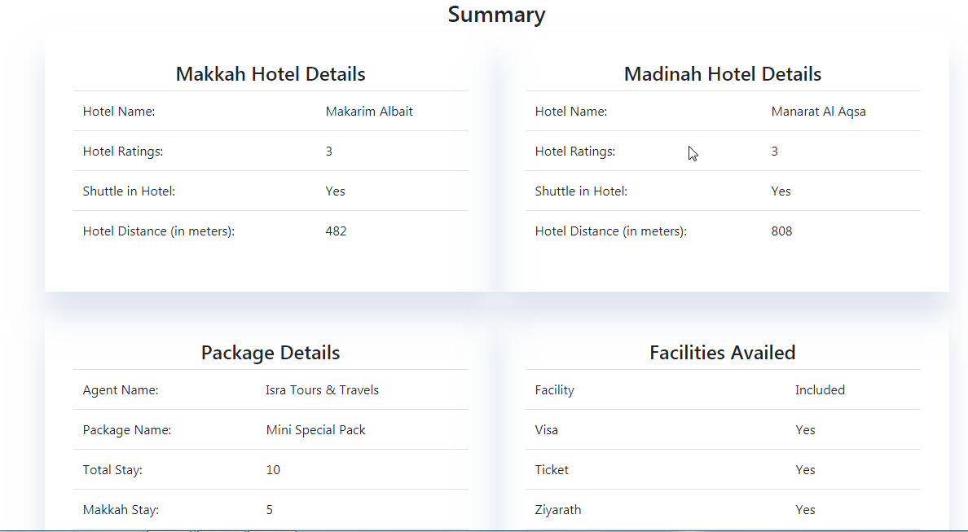
Page -3- 2
Make package and facilities detail up and hotel details down

