Slide 1
The C Programming Language
C is a general-purpose programming language created by Dennis Ritchie at the Bell Laboratories in 1972.
It is a very popular language, despite being old. The main reason for its popularity is because it is a fundamental language in the field of computer science.
C is strongly associated with UNIX, as it was developed to write the UNIX operating system.
https://w3schools.com/c/c_intro.php?external_link=true
İsmail Başaran, 2024

Slide 2
What is C used for?
Embedded systems
Operating systems
System applications
Machine learning algorithms
“C is for Can. It can even fix your relationships! You just have to believe.”
Browsers and their extensions
Databases
Desktop applications
Web servers
https://www.upwork.com/resources/what-is-c#:~:text=The%20C%20programming%20language%20works,by%20your%20computer%20at%20runtime.

Slide 3
Tech Giants that uses C Language
Most of the software by Adobe are developed using ‘C’ programming language.
Google’s Chromium is built using ‘C’ programming language.
The world’s most popular databases, including Oracle, MySQL, PostgreSQL, SQL Server are coded in C and C++.
Operating systems such as Apple’s OS X, Microsoft’s Windows OS, Linux OS and Symbian OS are developed using ‘C’ language.
https://medium.com/@parth-dobariya/fascinating-facts-of-c-language-f467e73c9792

Slide 4
How C works?
Computers don’t speak the same language we do.
This means that we need to convert our source files (human readable text files) into 1’s and 0’s (which can be understood by the machine: microcontroller, computer/laptop).
Fortunately, there are many C compilers that do this conversion for us.
https://medium.com/@parth-dobariya/fascinating-facts-of-c-language-f467e73c9792
https://x-engineer.org/c-programming-works/

Slide 5
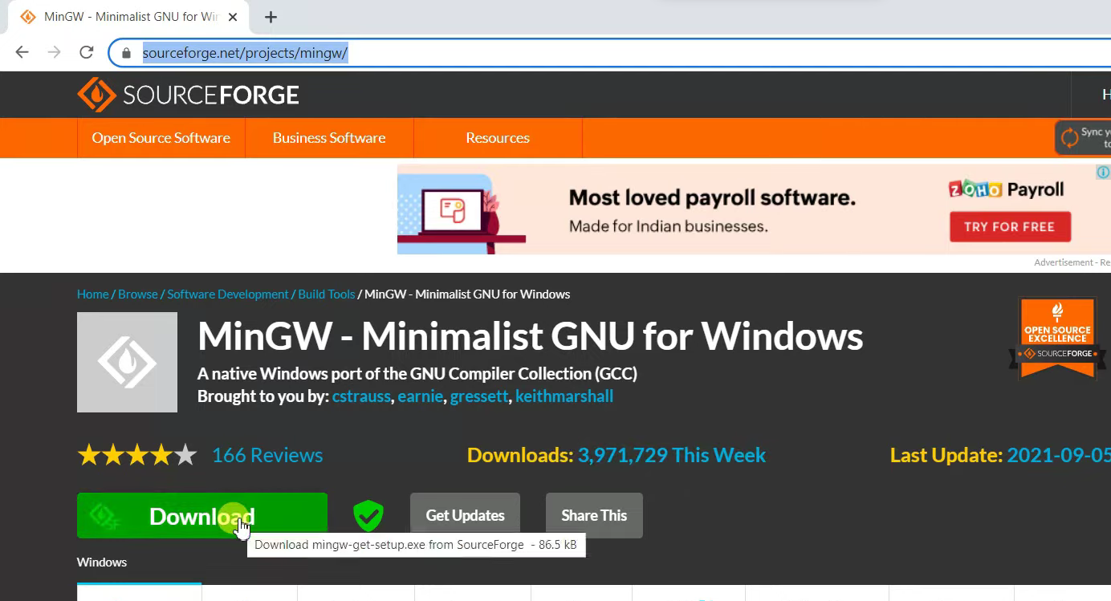
How to Install C Compilers on Windows?
https://sourceforge.net/projects/mingw/

Slide 6
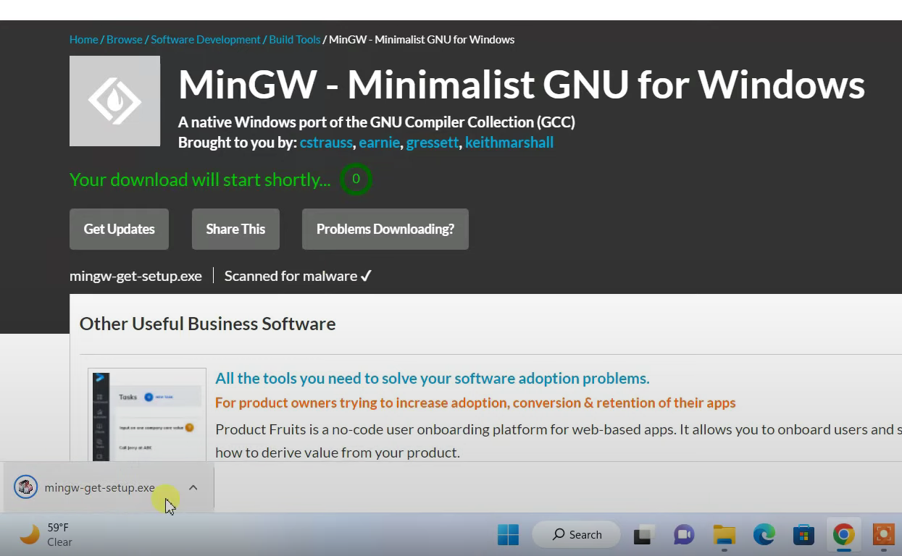
How to Install C Compilers on Windows?

Slide 7
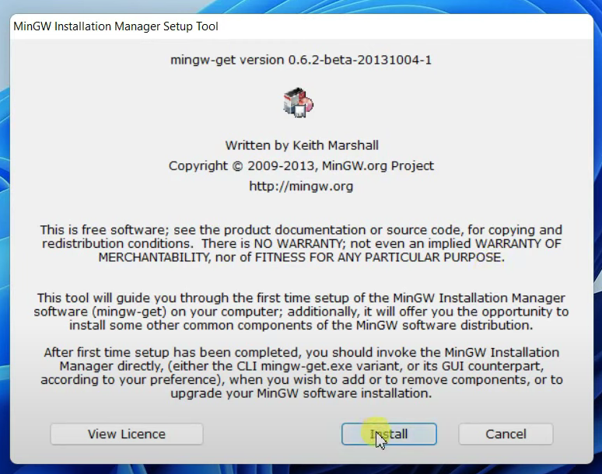
How to Install C Compilers on Windows?

Slide 8
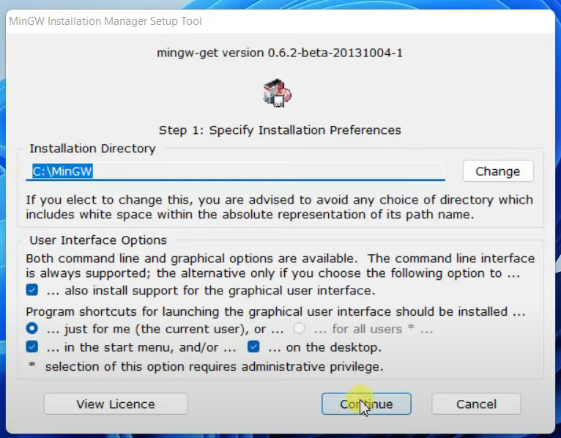
How to Install C Compilers on Windows?

Slide 9
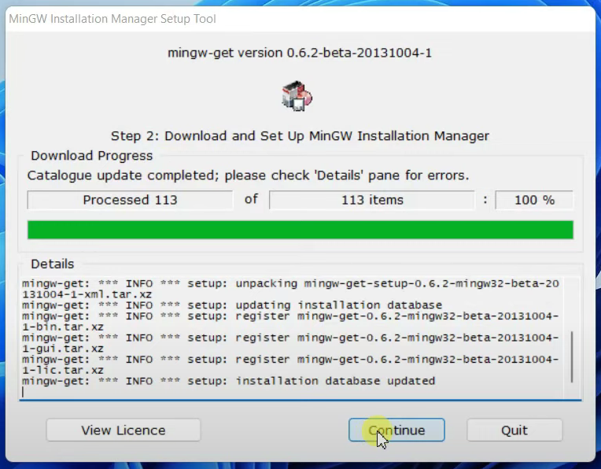
How to Install C Compilers on Windows?

Slide 10
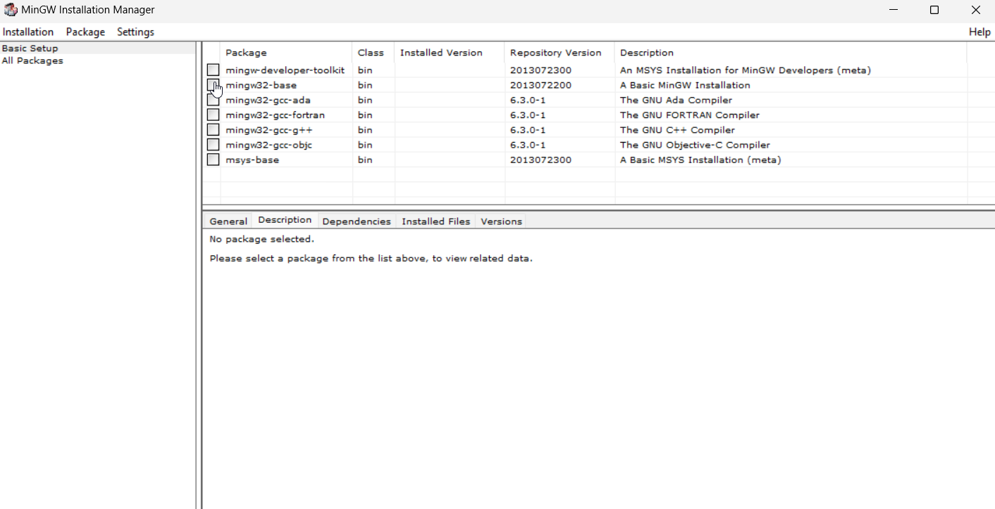
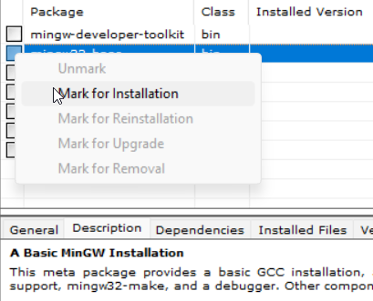
How to Install C Compilers on Windows?
Repeat these steps for base and gcc-g++.

Slide 11
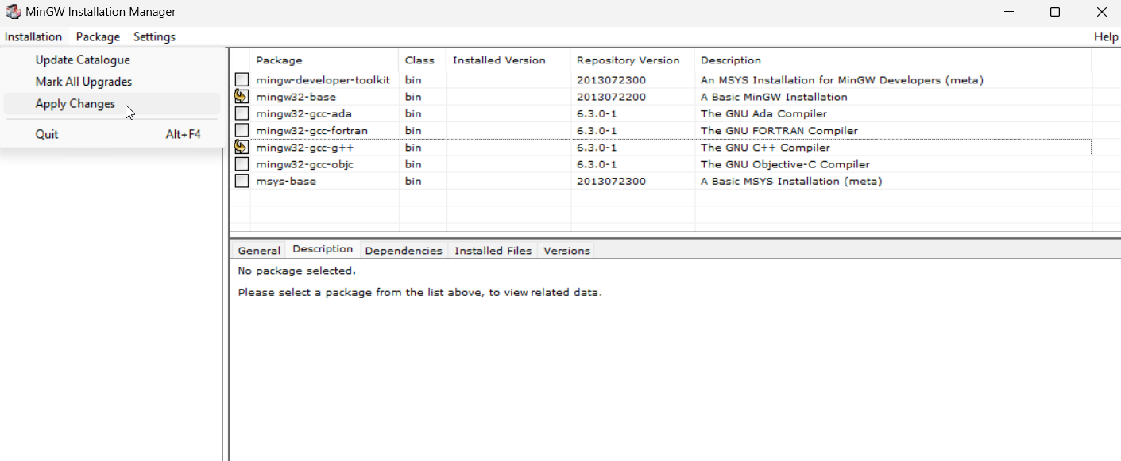
How to Install C Compilers on Windows?

Slide 12
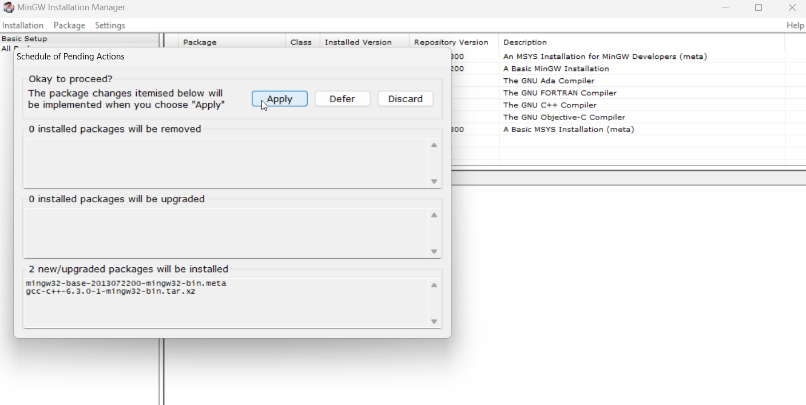
How to Install C Compilers on Windows?

Slide 13
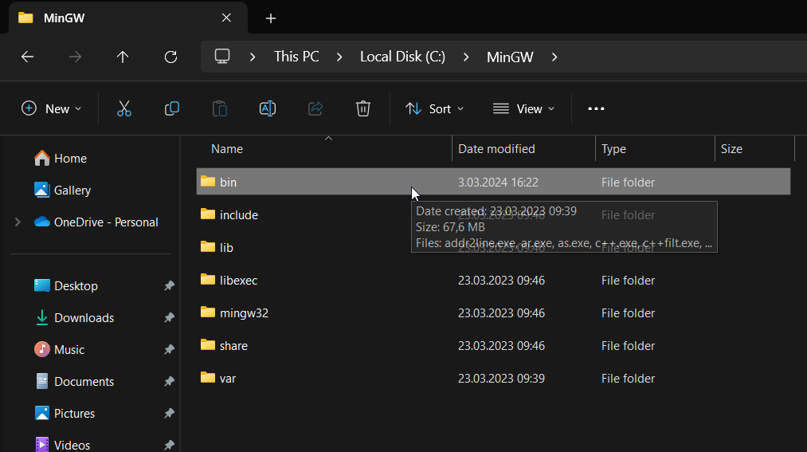
How to Install C Compilers on Windows?
Now you can close mingw-installer and go to file explorer.

Slide 14
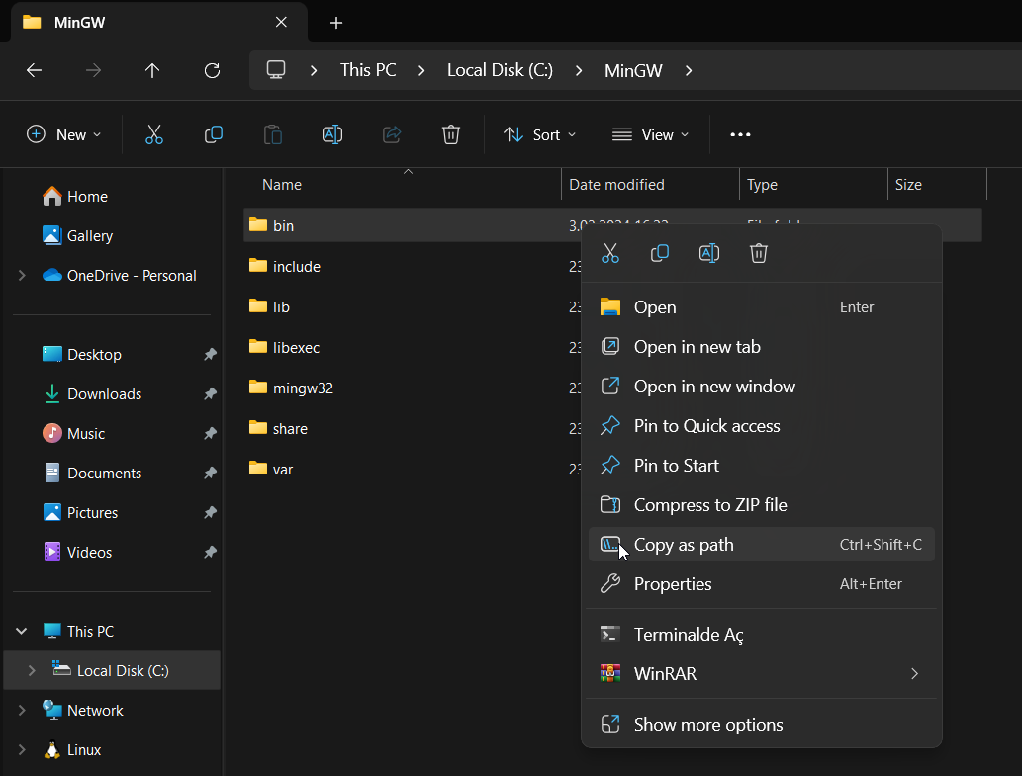
How to Install C Compilers on Windows?
Right click on bin folder.
Then click copy as path.

Slide 15
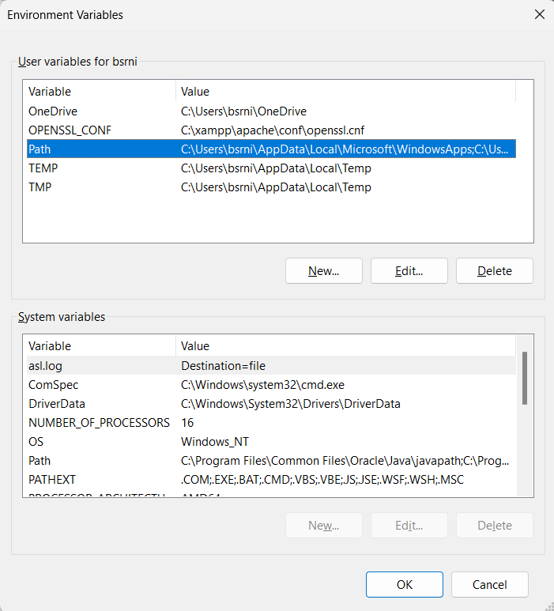
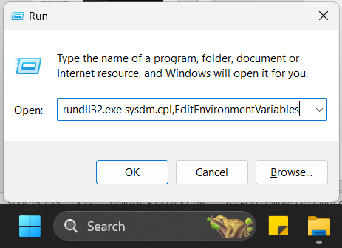
How to Install C Compilers on Windows?
Press Win + R , write “rundll32.exe sysdm.cpl,EditEnvironmentVariables” and hit Enter.
Then double click on “Path”.

Slide 16
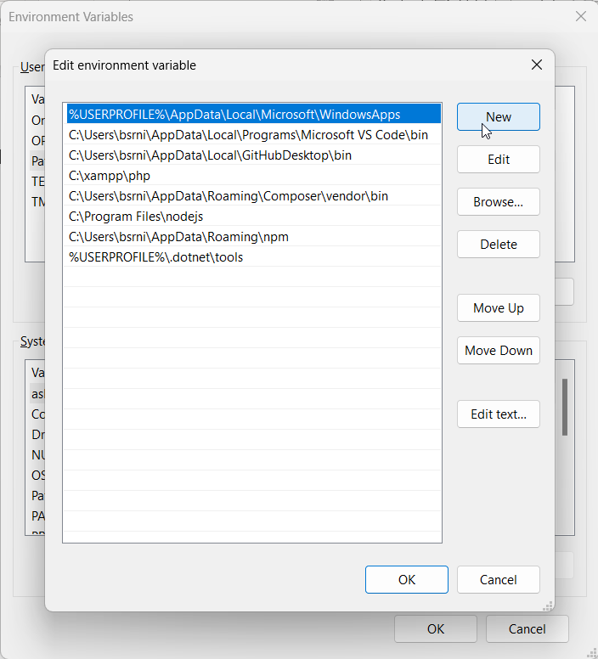
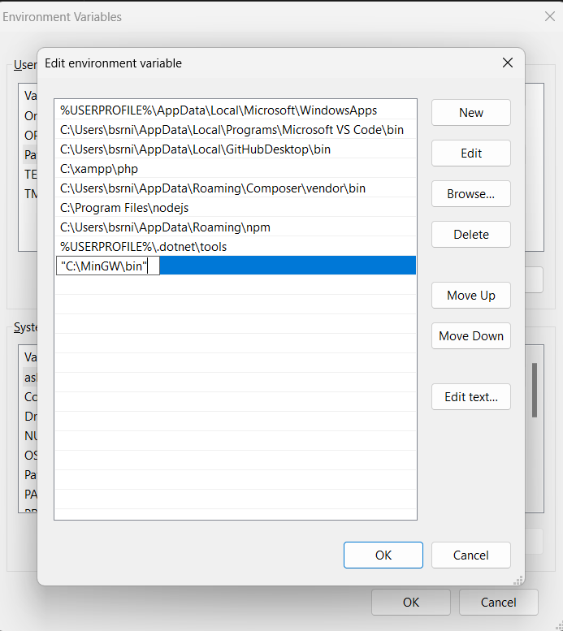
How to Install C Compilers on Windows?
Don’t forget to remove quote marks.

Slide 17
How to Install C Compilers on macOS and Linux distros?
macOS: https://medium.com/@mohamed.touati/how-to-install-and-run-c-in-visual-studio-code-on-mac-os-e5f7b59fed3e
Linux Distros: https://www.scaler.com/topics/c/install-c-on-linux/

Slide 18
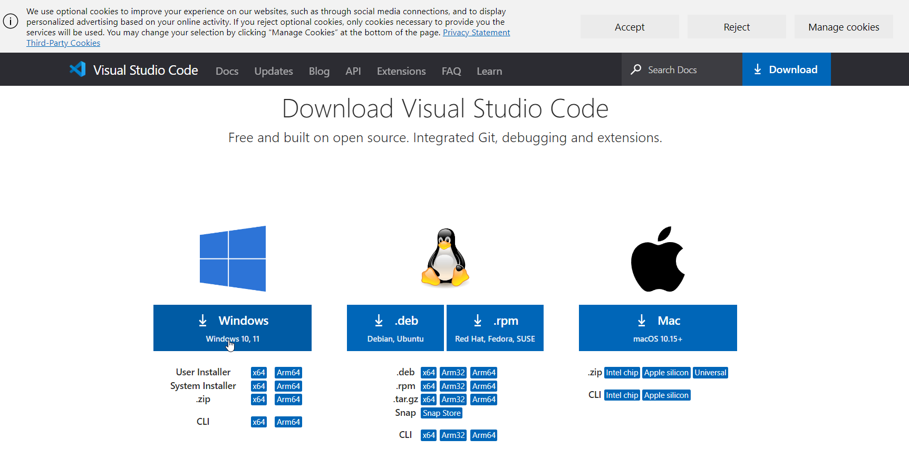
How to Setup an VSCODE for C programming?
https://code.visualstudio.com/download

Slide 19
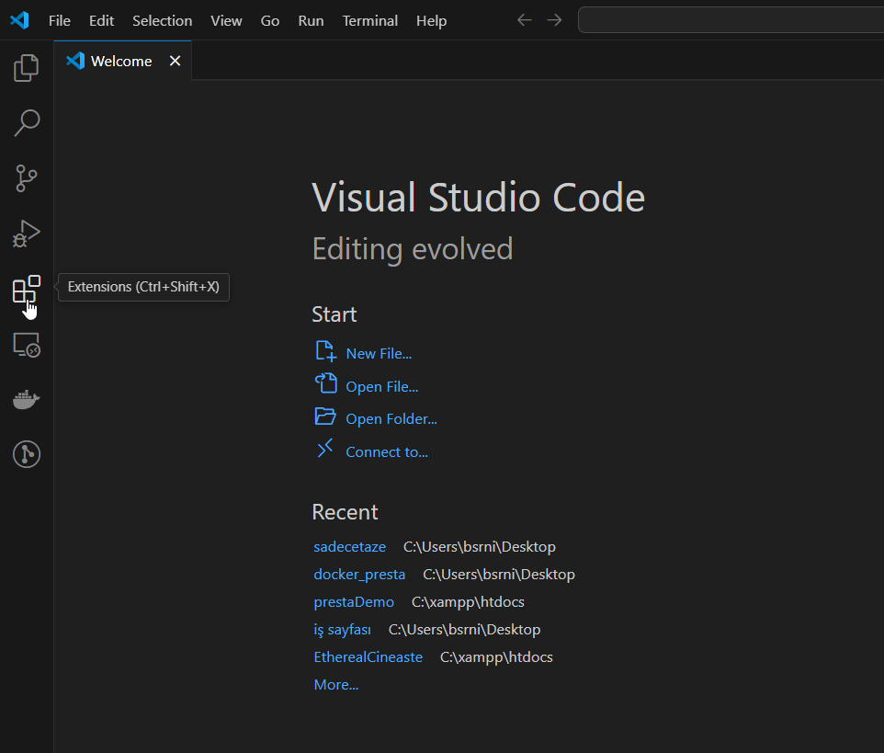
How to Setup an VSCODE for C programming?
Run VSCode and go to extensions.

Slide 20
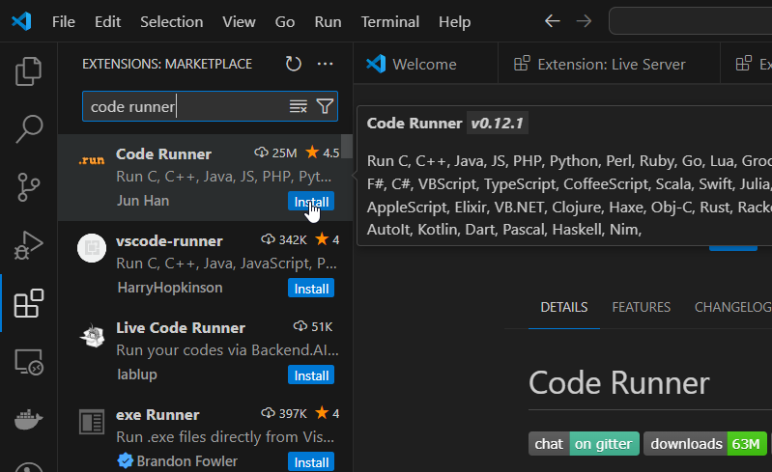
How to Setup an VSCODE for C programming?
Search for “code runner” and install.

Slide 21
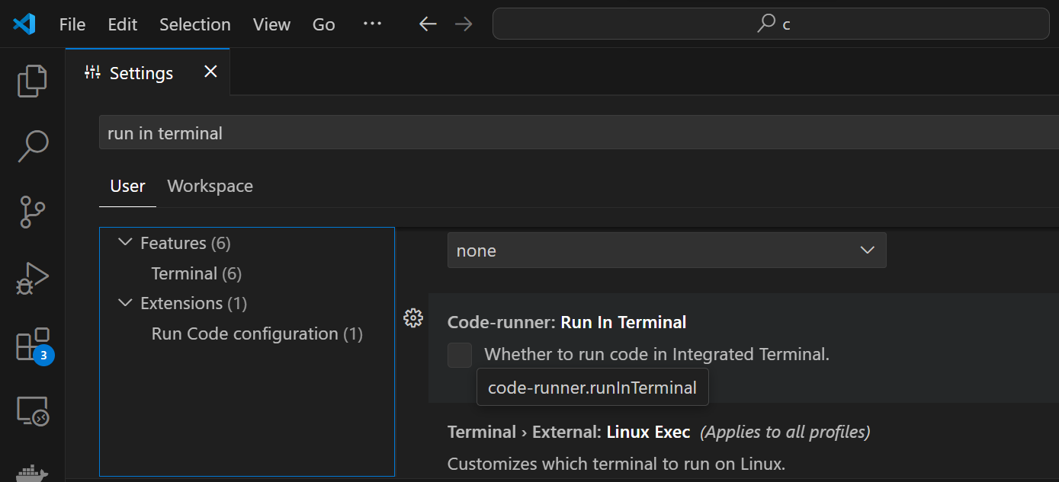
How to Setup an VSCODE for C programming?
Press CTRL+, then search for run in terminal. Check the box for “Code-runner: Run In Terminal.

Slide 22
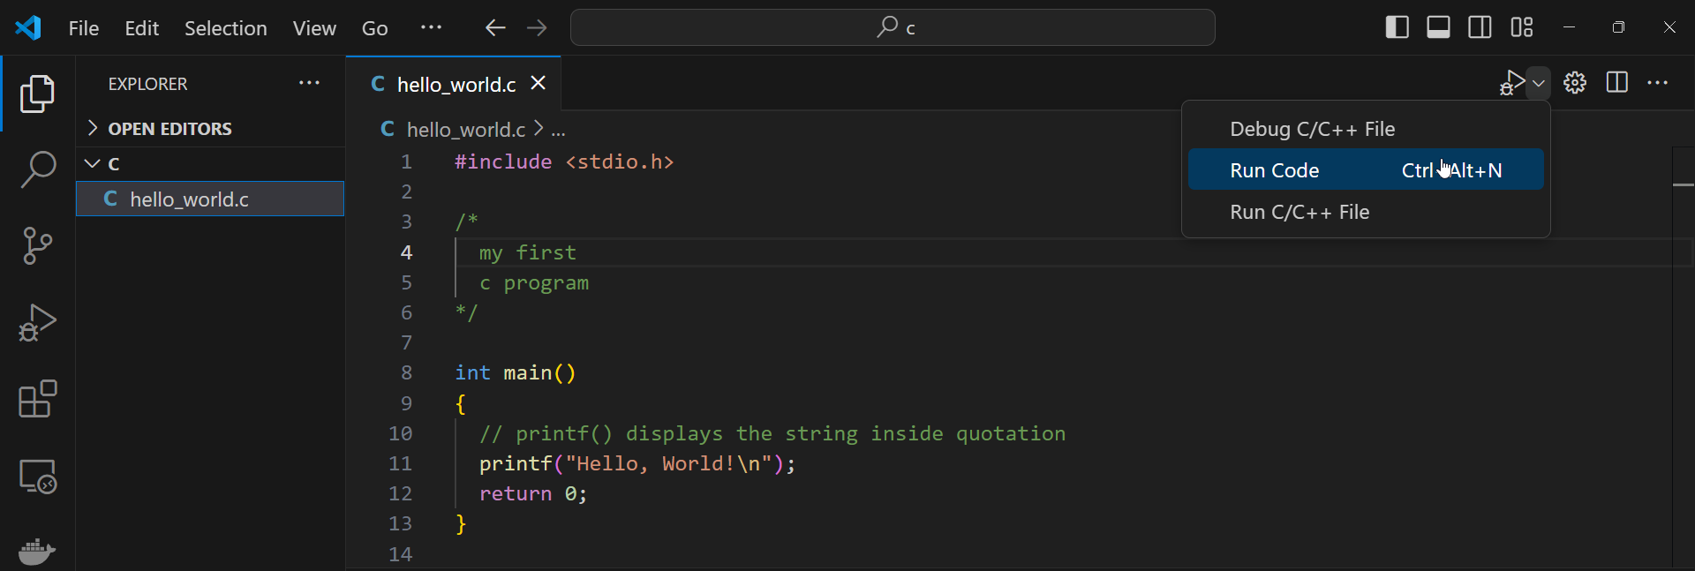
Your First C Program

Slide 23
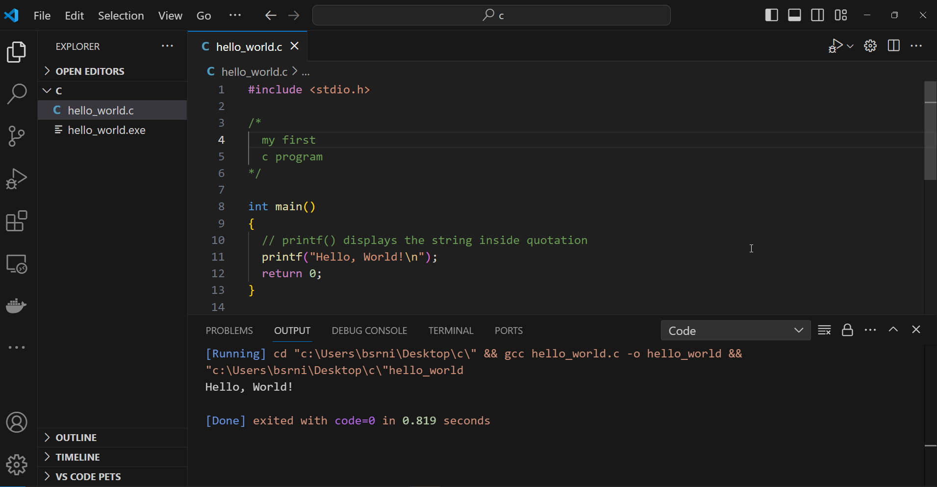
Your First C Program

Slide 24
What does this code do?
The #include directive tells the preprocessor to insert the contents of another file into the source code. Include directives are typically used to include the C header files for C functions that are held outside of the current source file.
#include <stdio.h>
/*
my first
c program
*/
int main()
{
// printf() displays the string inside quotation
printf("Hello, World!\n");
return 0;
}
Any text between // and the end of the line is ignored by the compiler (will not be executed).
Multi-line comments starts with /* and ends with */.
This is called a function. Any code inside its curly brackets will be executed.
[Running] cd "c:\Users\bsrni\Desktop\c\" && gcc hello_world.c -o hello_world && "c:\Users\bsrni\Desktop\c\"hello_world
Hello, World!
[Done] exited with code=0 in 0.819 seconds

Slide 25
Variables
Names can contain letters, digits and underscores
Names must begin with a letter or an underscore (_)
Names are case-sensitive (myVar and myvar are different variables)
Names cannot contain whitespaces or special characters like !, #, %, etc.
Reserved words (such as int) cannot be used as names
dataType variableName = value;
dataType variableName;
variableName = value;
declaration with initialization
declaration
assignment later
int x = 5;
float f_x;
f_x = 5.41;

Slide 26
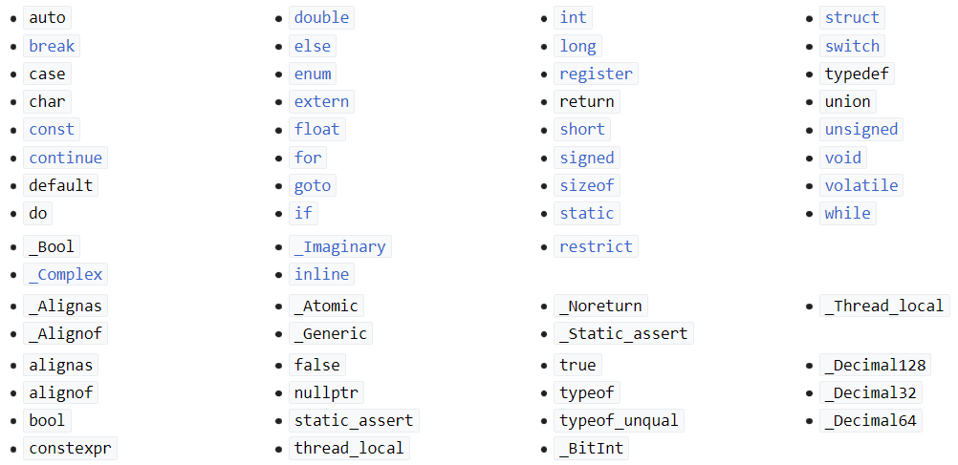
Reserved Words / Keywords

Slide 27
Constants
A constant in C is a variable that cannot be modified once it is declared in the program.
We can not make any change in the value of the constant variables after they are defined.
Unlike variables, we can initialize constant variables only when declaring them.
const dataType VARIABLE_NAME = value;
const float PI = 3.14;

Slide 28
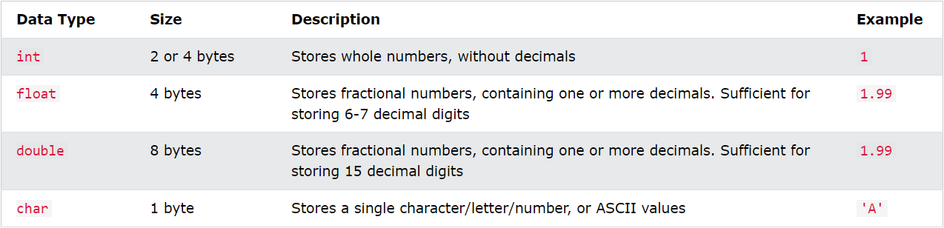
Data Types
char hi[] = "Hello World!";
int myNumbers[10] = {1, 2, 3, 4, 5, 6, 25, 50, 75, 100};
double myNumbers2[5] = {1.1, 2.2, 3.3, 4.4, 5.5};

Slide 29
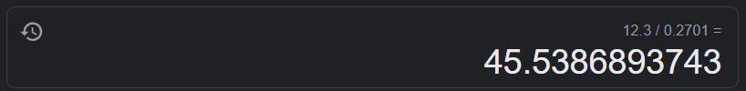
Float vs Double
#include <stdio.h>
int main(){ /* Single and double precision floating point numbers */
float x = 12.3/0.2701;
double y = 12.3/0.2701;
printf("Single Precision (float): %.15f\n", x);
printf("Double Precision (double): %.15lf\n", y); return 0;
}
[Running] cd "c:\Users\bsrni\Desktop\c\" && gcc variables.c -o variables && "c:\Users\bsrni\Desktop\c\"variables
Single Precision (float): 45.538688659667969
Double Precision (double): 45.538689374305811 [Done] exited with code=0 in 0.253 seconds

Slide 30
typedef
typedef existing_name alias_name;
#include <stdio.h>
typedef int integer;
typedef float real;
int main()
{
integer a = 10;
real b = 10.5;
printf("a = %d\n", a);
printf("b = %f\n", b);
return 0;
}

Slide 31
Type Casting
(type) expression
int x = 10;
int y = 4;
float result;
result = x / y;
printf("%f\n", result); // prints 2.00
result = (float)x / y;
printf("%f\n", result); // prints 2.50
result = 10.0 / y;
printf("%f\n", result); // prints 2.50
printf("%d\n", (int)result); // prints 2

Slide 32
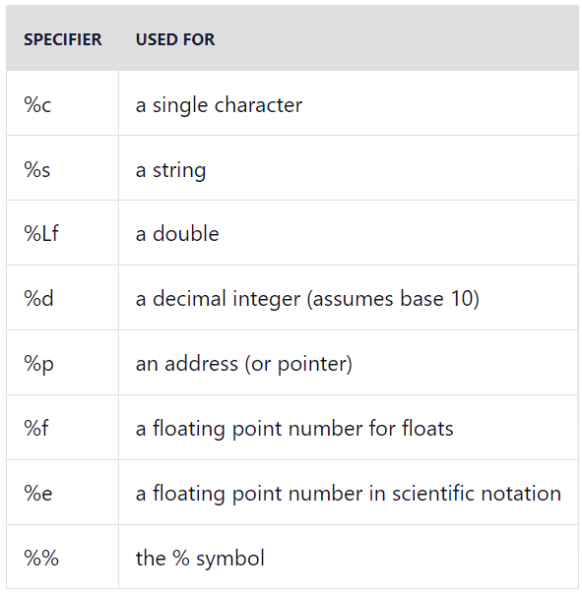
Format Specifiers
#include <stdio.h>
int main()
{
int x = 1;
float cgpa = 3.59;
double result = 3.59 / 12;
char c = 'A';
char hi[] = "Hello World!";
int *ptr = &x;
printf("use d for integer: %d\n", x);
printf("use f for float: %f\n", cgpa);
printf("use lf for double: %lf\n", result);
printf("use c for char: %c\n", c);
printf("use s for string: %s\n", hi);
printf("use p for address: %p\n", ptr);
printf("use double percent sign: %%");
return 0;
}

Slide 33
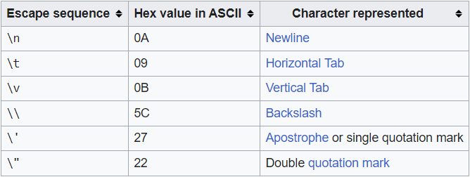
Escape Sequences
printf("hello world!\n");
printf("a\tb\n");
printf("\"There are lies, damned lies, and statistics\"\n- Mark Twain");
printf("path to file: C:\\Users\\pc\\Desktop");

Slide 34
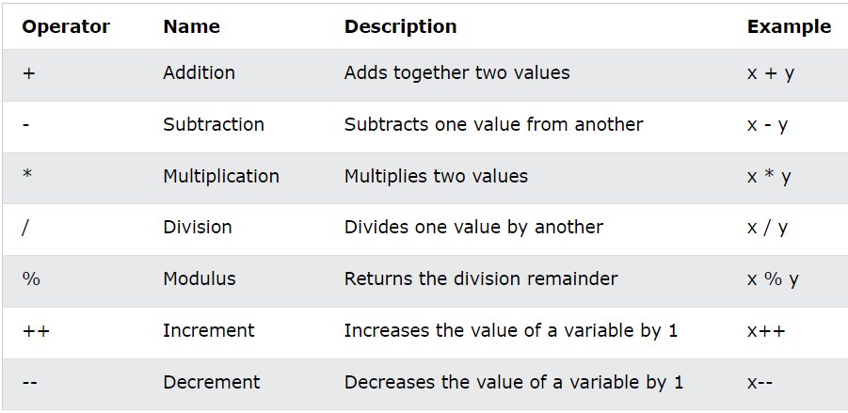
Arithmetic Operators

Slide 35
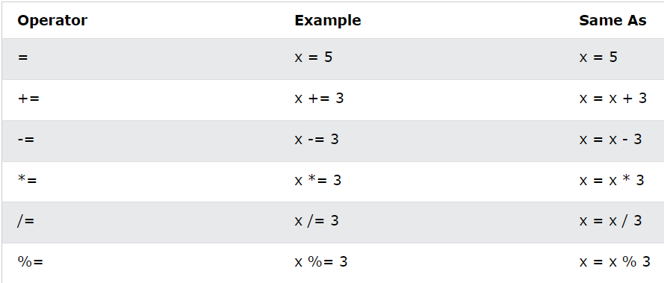
Assignment Operators

Slide 36
User Input
int age;
printf("enter your age: ");
scanf("%d", &age);
printf("your age is %d\n", age);
float gpa;
printf("enter your gpa: ");
scanf("%f", &gpa);
printf("\nyour gpa is %f\n", gpa);
char c;
printf("\nenter your grade: ");
scanf(" %c", &c);
printf("\nyour grade is %c\n", c);
char name[20];
printf("\nenter your name: ");
scanf("%s", name);
printf("\nyour name is: %s\n", name);

Slide 37
Multi-word String Input
char fullName[50];
printf("\nenter your full name: ");
scanf("%s", fullName);
printf("\nyour full name is: %s\n", fullName);
PS C:\Users\bsrni\Desktop\c> gcc .\9_user_input.c ; .\a.exe
enter your full name: john doe
your full name is: john

Slide 38
Multi-word String Input Using fgets Function
char fullName[50];
printf("\nenter your full name: ");
fgets(fullName, sizeof(fullName), stdin);
printf("\nyour full name is: %s\n", fullName);
PS C:\Users\bsrni\Desktop\c> gcc .\9_user_input.c ; .\a.exe
enter your full name (using fgets): john doe
your full name is (using fgets): john doe

Slide 39
Functions
A function is a block of code which only runs when it is called.
You can pass data, known as parameters, into a function.
Functions are used to perform certain actions, and they are important for reusing code: Define the code once and use it many times.
void functionName()
{
//code
}
int main()
{
sayHi();
return 0;
}
void sayHi()
{
printf("Hello World!\n");
}
int main()
{
sayHi();
return 0;
}

Slide 40
Returning Values
int fun()
{
return 3+2;
}
int main()
{
x = fun();
printf("x = %d", fun()); return 0;
}
returnType functionName()
{
//code
return x;
}
x = 5

Slide 41
Functions Parameters
Information can be passed to functions as a parameter. Parameters act as variables inside the function.
Parameters are specified after the function name, inside the parentheses. You can add as many parameters as you want, just separate them with a comma.
returnType functionName(int i, char c, float f, char string[]){
//code
}
void sayHi(char name[]){
printf("Hello %s", name);
}
void sum(int x, int y){
printf("sum of %d and %d: %d", x, y, x + y);
}

Slide 42
Declaration and Definition
Declaration: the function's name, return type, and parameters (if any)
Definition: the body of the function (code to be executed)
For code optimization, it is recommended to separate the declaration and the definition of the function.
You will often see C programs that have function declaration above main() and function definition below main(). This will make the code better organized and easier to read.
void fun(){ // declaration
// definition (the body of the function)
}

Slide 43
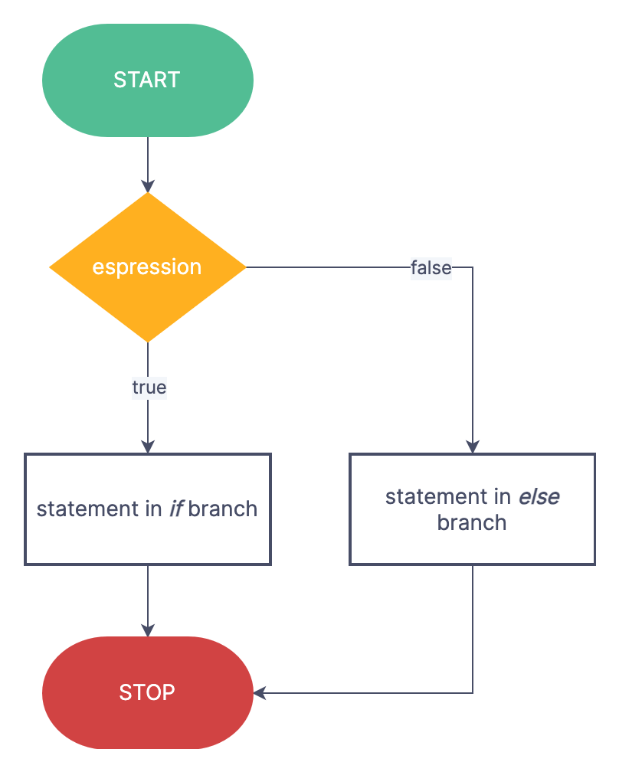
if … else
if (/* condition */)
{
/* code to be executed if
condition is true */
}
else
{
/* code to be executed if
condition is false */
}

Slide 44
if … else
#include <stdio.h>
int main()
{
int score;
printf("enter your score: ");
scanf("%d", &score);
if (score >= 80)
{
printf("congrats! you passed.");
}
else
{
printf("you failed.");
}
return 0;
}
PS C:\Users\bsrni\Desktop\c> cd "c:\Users\bsrni\Desktop\c\" ; if ($?) { gcc 11_if_else.c -o 11_if_else } ; if ($?) { .\11_if_else }
enter your score: 60
you failed.
PS C:\Users\bsrni\Desktop\c> cd "c:\Users\bsrni\Desktop\c\" ; if ($?) { gcc 11_if_else.c -o 11_if_else } ; if ($?) { .\11_if_else }
enter your score: 80
congrats! you passed.
PS C:\Users\bsrni\Desktop\c> cd "c:\Users\bsrni\Desktop\c\" ; if ($?) { gcc 11_if_else.c
-o 11_if_else } ; if ($?) { .\11_if_else }
enter your score: 100
congrats! you passed.

Slide 45
Comparison operators
Less than: a < b
Less than or equal to: a <= b
Greater than: a > b
Greater than or equal to: a >= b
Equal to a == b
Not Equal to: a != b
Logical operators
Logical AND: &&
Logical OR: ||
Logical NOT: !
int years = 30;
int rank = 5;
if (years > 20 && rank > 5){
printf("you passed.");
}
else{
printf("you failed.");
}
int years = 40;
int rank = 1;
if (years > 40 || rank > 9){
printf("you passed.");
}
else{
printf("you failed.");
}
int x = 1;
int y = 1;
if (x != y){
printf("not same");
}
else{
printf("same");
}

Slide 46
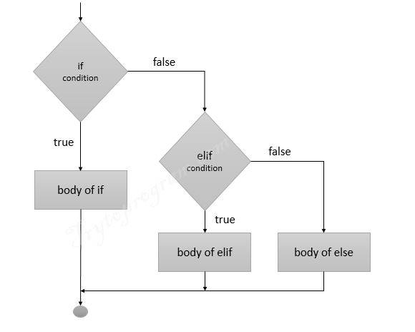
else if
int score;
printf("enter your score: ");
scanf("%d", &score);
if (score >= 80)
{
printf("congrats! you passed.");
}
else if (60 >= score < 80)
{
printf("no worries. you can still pass the class.");
}
else
{
printf("you failed.");
}

Slide 47
Max Function
int findMax(int a, int b, int c)
{
if (a >= b && a >= c)
{
return a;
}
else if (b >= a && b >= c)
{
return b;
}
else
{
return c;
}
}

Slide 48
switch case
int day = 4; switch (day){
case 1:
printf("Monday");
break;
case 2:
printf("Tuesday");
break;
case 3:
printf("Wednesday");
break;
case 4:
printf("Thursday");
break;
case 5:
printf("Friday");
break;
case 6:
printf("Saturday");
break;
case 7:
printf("Sunday");
break;
}
switch (expression)
​{
case constant1:
// statements
break;
case constant2:
// statements
break;
.
.
.
default:
// default statements
}

Slide 49
Loops
Loops can execute a block of code as long as a specified condition is reached.
Loops are handy because they save time, reduce errors, and they make code more readable.
while, do…while, for.

Slide 50
While Loop
#include <stdio.h>
int main()
{
int a = 10;
while (a > 0)
{
printf("a is %d\n", a);
}
return 0;
}
while (/*condition*/)
{
// code block to be executed
}
a is 10
a is 10
a is 10
a is 10
a is 10
a is 10
a is 10
a is 10

Slide 51
While Example
#include <stdio.h>
int main()
{
int n = 0;
while (n != 12)
{
printf("enter a number between 0-20: ");
scanf("%d", &n);
}
printf("congrats!\n");
return 0;
}
enter a number between 0-20: 13
enter a number between 0-20: 14
enter a number between 0-20: 11
enter a number between 0-20: 12
congrats!

Slide 52
do…while Loop
The do…while loop is a variant of while loop.
This loop will execute the code block once, before checking if the condition is true, then it will repeat the loop as long as the condition is true.
return 0;
do
{
// code block to be executed
} while (/*condition*/);

Slide 53
do…while Loop
#include <stdio.h>
int main(){ int a = 0, b = 0;
printf("Output of while loop\n");
while (a < 5){
a++;
printf("a: %d\n", a);
}
printf("Output of do - while loop\n");
do{
b++;
printf("b: %d\n", b);
} while (b < 5);
return 0;
}
Output of while loop
a: 1
a: 2
a: 3
Output of do - while loop
b: 1
b: 2
b: 3
Output of while loop
a: 3
Output of do - while loop
b: 3
Output of while loop
Output of do - while loop
b: 6

Slide 54
for Loop
When you know exactly how many times you want to loop through a block of code, use the for loop instead of while
for (initializationStatement; testExpression; updateStatement)
{
// code to be executed
}

Slide 55
for Loop Example
int factorial(int n)
{
int result = 1;
for (int i = 1; i <= n; i++)
{
result *= i;
}
return result;
}
enter a number: 0
factorial of 0 is: 1
enter a number: 3
factorial of 3 is: 6
enter a number: 6
factorial of 6 is: 720

Slide 56
Recursion
Recursion is the technique of making a function call itself. This technique provides a way to break complicated problems down into simple problems which are easier to solve.
Recursion may be a bit difficult to understand. The best way to figure out how it works is to experiment with it.

Slide 57
Recursion
#include<stdio.h>
int multiplyNumbers(int n);
int main() {
int n;
printf("enter a number: ");
scanf("%d",&n);
printf("factorial of %d is %d", n, multiplyNumbers(n));
return 0;
}
int multiplyNumbers(int n) {
if (n>=1)
return n*multiplyNumbers(n-1);
else
return 1;
}
enter a number: 0
factorial of 0 is: 1
enter a number: 3
factorial of 3 is: 6
enter a number: 6
factorial of 6 is: 720

Slide 58
Adresses
When a variable is created in C, a memory address is assigned to the variable.
The memory address is the location of where the variable is stored on the computer.
When we assign a value to the variable, it is stored in this memory address.
To access it, use the reference operator (&), and the result represents where the variable is stored.
#include <stdio.h>
int main() {
int a = 1;
printf("The address of a is %p\n", &a);
return 0;
}
The address of a is 0061FF1C

Slide 59
Pointers
A pointer is a variable that stores the memory address of another variable as its value.
A pointer variable points to a data type (like int) of the same type, and is created with the * operator.
dataType* pointerName = &variable;
dataType * pointerName = &variable;
dataType *pointerName = &variable;
#include <stdio.h> int main() {
int a = 1;
int* p = &a;
printf("The address of a is %p\n", p);
return 0;
}
The address of a is 0061FF18

Slide 60
Dereference
You can also get the value of the variable the pointer points to, by using the * operator (the dereference operator):
#include <stdio.h>
int main() {
int a = 1;
int* p = &a;
printf("The address of a is %p\n", p);
printf("The value of a is %d\n", *p);
return 0;
}
The address of a is 0061FF18
The value of a is 1

Slide 61
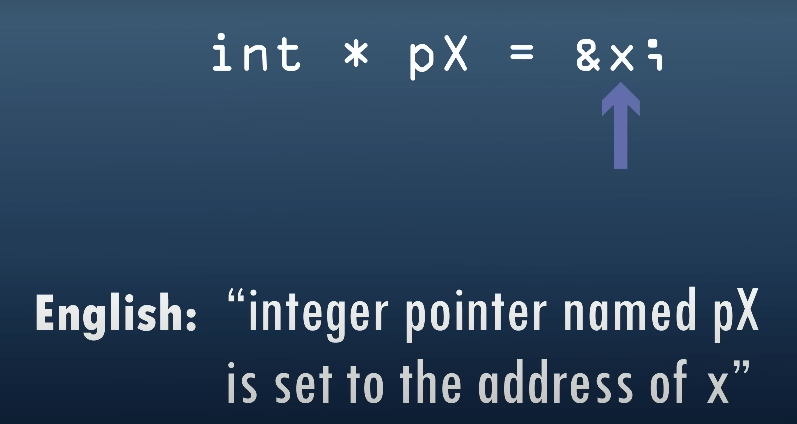
https://www.youtube.com/watch?v=2ybLD6_2gKM&t=354s

Slide 62
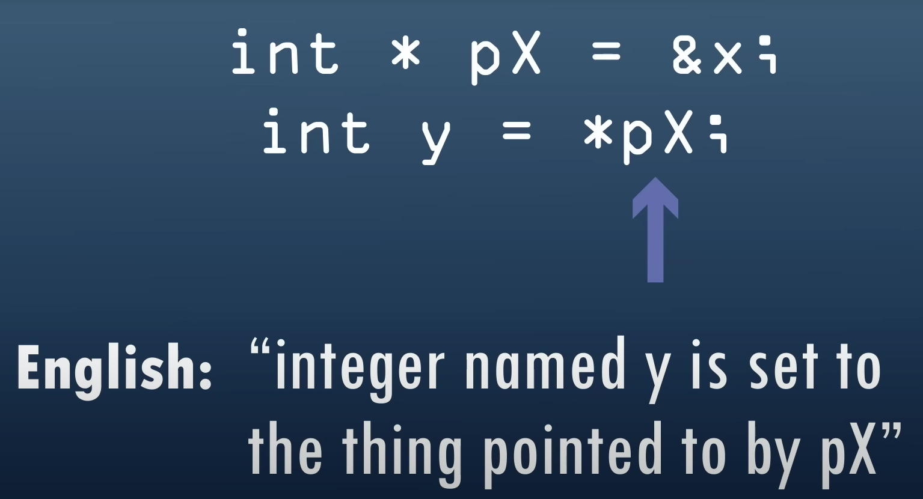
https://www.youtube.com/watch?v=2ybLD6_2gKM&t=354s

Slide 63
Asteriks (*)
When used in declaration (int* ptr), it creates a pointer variable.
When not used in declaration, it act as a dereference operator.

Slide 64
Arrays and Pointers
#include <stdio.h>
int main(){
int array[6] = {1, 2, 3, 4, 5, 6};
int i;
for (i = 0; i < 4; i++){
printf("%p\n", &array[i]);
}
}
0061FF04
0061FF08
0061FF0C
0061FF10
0061FF14
0061FF18
int a = 1;
printf("%d\n", sizeof(array[0]));
printf("%d\n", sizeof(a));
4
4

Slide 66
Accessing Array Elements Using Pointers
#include <stdio.h>
int main(){
int array[6] = {1, 2, 3, 4, 5, 6};
int i;
for (i = 0; i < 4; i++){
printf("%p\n", &array[i]);
}
}
0061FF04
0061FF08
0061FF0C
0061FF10
0061FF14
0061FF18
printf("%d\n", *array);
printf("%d\n", *(array + 1));
printf("%d\n", *(array + 2));
printf("%d\n", *(array + 3));
1
2
3
4

Slide 67
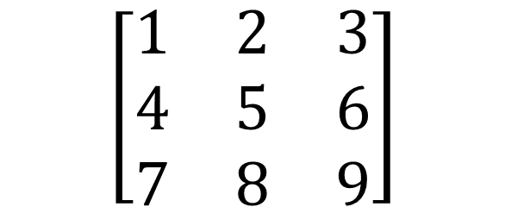
2-Dimensional Arrays
A multidimensional array is basically an array of arrays.
A 2D array is also known as a matrix (a table of rows and columns).
int array[3][3] = {{1, 2, 3}, {4, 5, 6}, {7, 8, 9}};
$$\left[\begin{matrix}1 & 2 & 3 \\ 4 & 5 & 6 \\ 7 & 8 & 9\end{matrix}\right]$$

Slide 68
Nested Loops for 2D Arrays
#include <stdio.h>
int main()
{
int array[3][3] = {{1, 2, 3}, {4, 5, 6}, {7, 8, 9}};
int i, j;
for (i = 0; i < 3; i++){
for (j = 0; j < 3; j++){
printf("%d ", array[i][j]);
}
printf("\n");
}
return 0;
}
1 2 3
4 5 6
7 8 9

Slide 69
Structures
Structures (also called structs) are a way to group several related variables into one place.
Each variable in the structure is known as a member of the structure.
Unlike an array, a structure can contain many different data types (int, float, char, etc.).
struct student{
int roll_no;
char name[20];
float marks;
};
struct structName {
dataType variableName;
datatype variableName;
};
struct student s1;
printf("Roll number: %d\n", s1.roll_no);
printf("Name: %s\n", s1.name);
printf("Marks: %.2f\n", s1.marks);

Slide 70
Initialize Structure Members
struct structureName str;
str.member1 = value1;
str.member2 = value2;
str.member3 = value3;
struct structureName str = { value1, value2, value3 };
struct structure_name str = { .member1 = value1, .member2 = value2, .member3 = value3 };
struct struct_name{
int x = 0; // COMPILER ERROR: cannot initialize members here
int y = 0; // COMPILER ERROR: cannot initialize members here
};

Slide 71
typedef for Structures
typedef struct existing_struct_name alias_name;
#include <stdio.h>
typedef struct {
int x;
int y;
} Point;
int main() {
Point p1 = {1, 2};
printf("p1.x = %d, p1.y = %d\n", p1.x, p1.y);
return 0;
}

Slide 72
Structure Pointers
ptr->x
=
(*ptr).x
#include <stdio.h>
struct Point {
int x, y;
};
int main(){
struct Point str = { 1, 2 };
struct Point* ptr = &str;
printf("%d %d", ptr->x, ptr->y);
return 0;
}

Slide 73
File Operations
FILE *fptr;
// Open a file in writing mode
fptr = fopen("filename.txt", "w");
// Write some text to the file
fprintf(fptr, "Some text");
// Close the file
fclose(fptr);
r - open a file in read mode.
w - opens or create a text file in write mode.
a - opens a file in append mode.
r+ - opens a file in both read and write mode.
a+ - opens a file in both read and write mode.
w+ - opens a file in both read and write mode.

