Slide 1

Classifying MR Images And Detecting Tumors Using ANNs In Image Processing, And The Contribution Of Ensemble Techniques To Accuracy Rate
Department Of Software Engineering
Istanbul Aydin University
Advisor: Assoc. Dr. Ferdi SONMEZ
Fall 2023 - 2024

Slide 2
Table Of Contents
Introduction
Problem Statement
Project’s Objectives
ANN Models
VGG16
AlexNet
GoogLeNet
Ensemble Techniques
Single Image Prediction UI
Inputs (Dataset)
Results
References

Slide 3
Problem Statement
In today's healthcare sector, technology has advanced significantly. Medical imaging devices enable the detection of many diseases. Particularly in the context of MRI, medical image analysis is crucial for the accurate diagnosis and timely treatment of various health conditions, including tumor detection. However, in some cases, performing these analyses poses challenges. Artificial Neural Networks (ANNs) offer great promise in automating the classification of MRI images and detecting tumors. However, achieving optimal performance in terms of accuracy and precision presents significant challenges.

Slide 4
Project Objectives
The project aims to automate the classification of MRI images by training Artificial Neural Network (ANN) models within the scope of the stated problems. Algorithms are employed to improve accuracy rates and sensitivity in tumor detection processes. Ensemble techniques are applied to enhance the success rates of the models. Models that successfully undergo all these processes are analyzed with metric values to assess their applicability and reliability in clinical environments within the healthcare sector.

Slide 5

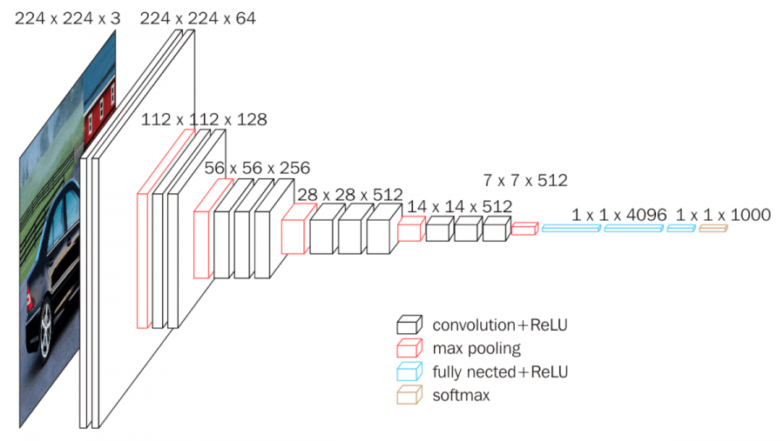
VGG16 Architecture
The VGG16 architecture consists of 16 layers, including 13 convolutional layers and 3 fully connected layers. Convolutional layers are used for pattern and feature recognition tasks, while fully connected layers connect all input neurons to output neurons, often employed in classification processes. VGG16 utilizes Rectified Linear Unit (ReLU) activation functions to enhance learning capacity. It operates with input dimensions of 224x224 pixels and RGB images.
Fig1 : VGG16 Structure

Slide 6
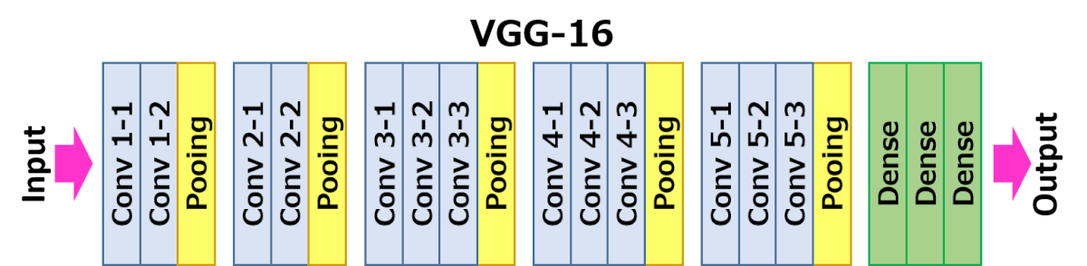
VGG16 Architecture
The input layer is the starting point of the model and generally accepts RGB inputs of 224x224 pixels. Conv. 1-1 and Conv. 1-2 are the first convolutional layers. They learn basic-level features, applying ReLU activation to zero out negative values. Conv. 2-1 and Conv. 2-2 begin to learn higher-level features, capturing patterns using feature maps from the previous layer. Conv. 3-1, 3-2, and 3-3 learn mid-level features of the input image, utilizing larger and more complex filters while merging feature maps from the previous layer. Conv. 4-1, Conv. 4-2, and Conv. 4-3 extract features using filters of different scales. Conv. 5-1, Conv. 5-2, and Conv. 5-3 learn global features of objects and patterns, extracting features from broader areas.
Pooling layers, on the other hand, reduce the size of the feature map using max pooling after each convolutional layer.
In the Dense layer, Fully Connected layers perform regression to reach the final result.
Fig2 : VGG16 Layers

Slide 7
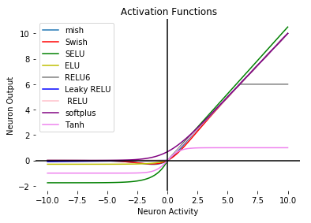
ReLU Activation Function
ReLU (Rectified Linear Unit) is used as an activation function in neural networks. The ReLU function returns zero for negative inputs and leaves positive inputs unchanged.
In the VGG16 model, ReLU is typically used after the feature extraction layers. This helps enhance the model's learning capacity and facilitates the learning of non-linear relationships.
Fig3 : Activation Functions Graph

Slide 8
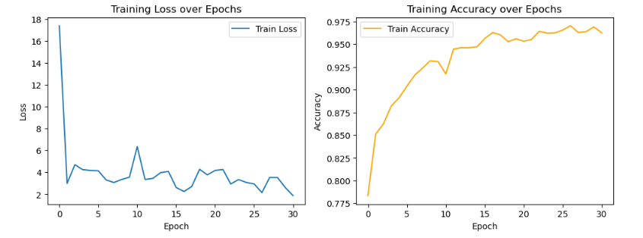
Metric Values Of The Trained VGG16 Model
Fig4 : VGG16 Training loss over Epoch Plot Graph
Fig5 : VGG16 Training Accuracy over Epochs Plot Graph

Slide 9
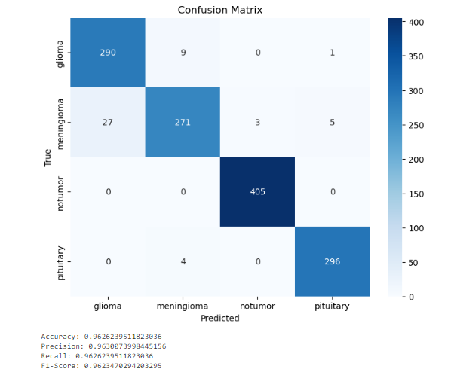
Metric Values Of The Trained VGG16 Model
Fig6 : VGG16 Confusion Matrix Graph

Slide 10
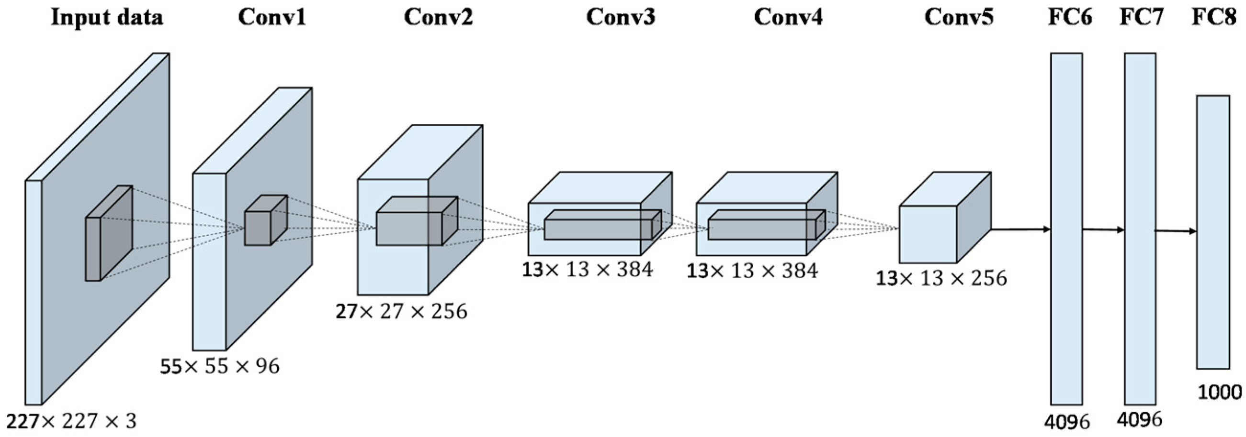
AlexNET Architecture
AlexNet consists of 8 layers, with 5 convolutional layers and 3 fully connected layers. Convolutional layers, particularly effective on large datasets, increase learning capacity, and ReLU functions accelerate the learning process. Fully connected layers are employed for classification tasks. AlexNet incorporates the Dropout feature to prevent overfitting.
Fig7 : AlexNET Structure

Slide 11
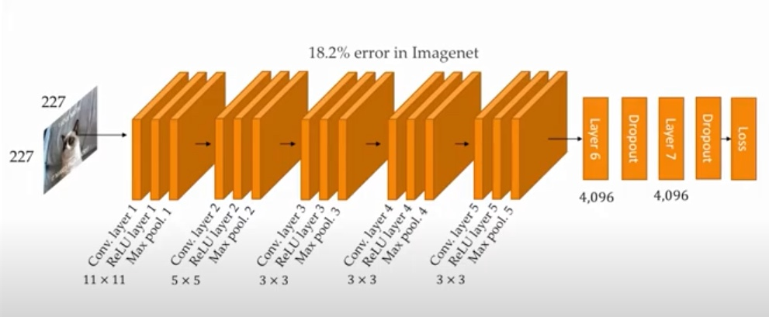
AlexNET Architecture
The Input layer serves as the starting point for the model, accepting RGB inputs of size 227x227 pixels. The 1st Convolutional layer performs convolution with 96 filters, resulting in a feature map of size 55x55x96. In the 1st Max Pooling layer, a max pooling operation is performed to reduce the size of the feature map, resulting in a size of 27x27x96.In the 2nd Convolutional layer, ReLU activation is applied again, and a normalization operation is performed. In the 2nd Max Pooling Layer, the feature map size from the previous layer, which was 27x27x256, is reduced to 13x13x256.The 3rd Convolutional layer uses ReLU activation without normalization. In the 4th Convolutional layer, ReLU is applied, and the feature map size becomes 13x13x384. The 5th Convolutional layer also uses ReLU, and after this layer, the 3rd Max Pooling Layer is applied, resulting in a feature map size of 6x6x256.In the Fully Connected Layers, there are two fully connected layers with ReLU activation. Dropout techniques are employed to reduce overfitting. The output layer utilizes the Softmax activation to obtain probabilities.
Fig8 : AlexNET Layers

Slide 12

Softmax Activation Function
Softmax is an activation function used in multi-class classification problems. It takes a vector as input and returns the probability distribution of each element in that vector. It is commonly used in output layers to normalize the probabilities between classes, making the total probability sum to 1. This facilitates obtaining prediction probabilities and allows us to easily select the class with the highest probability.
Fig9 : Activation Functions Graph

Slide 13
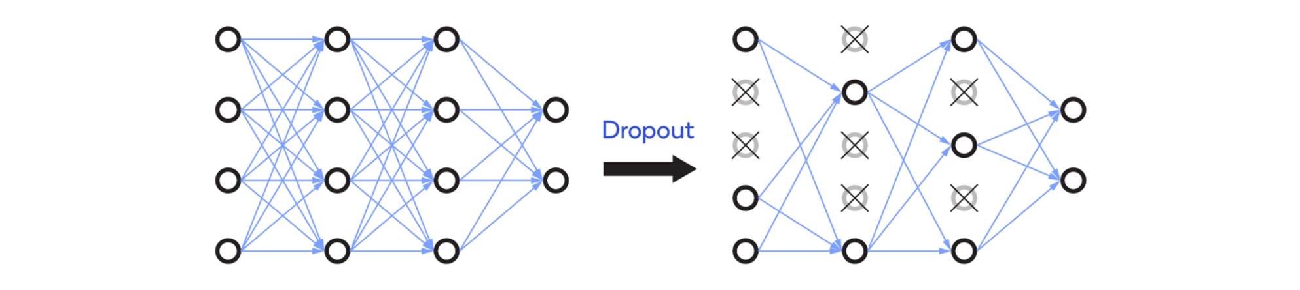
Dropout Technique
Dropout is a regularization technique used in neural networks such as AlexNet. Dropout involves randomly dropping out neurons, preventing the network from becoming overly dependent on specific neurons and features, thus helping to prevent overfitting. Dropout prevents the network from excessively adapting to a specific class or feature, allowing more general results to be generated.
Fig10 : Dropout Technique Visualization

Slide 14
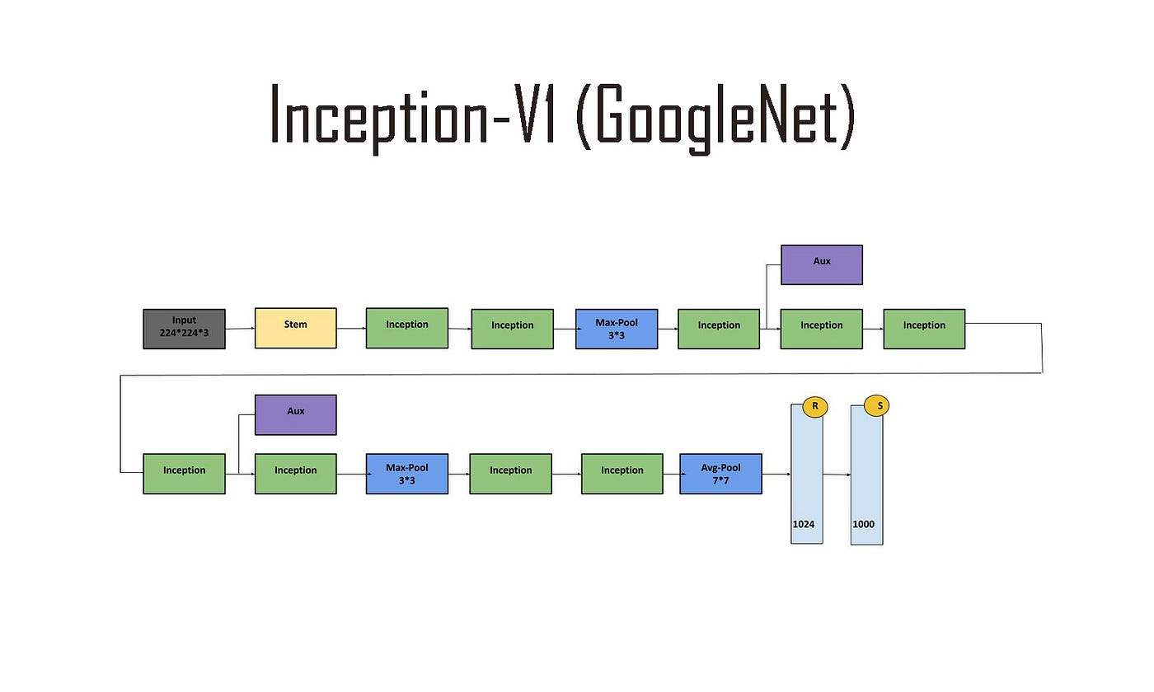
GoogleNET Architecture
The GoogleNet architecture comprises 22 layers, including Convolutional Layers, Reduction Layers, Fully Connected Layers, and Auxiliary Classifiers. Its distinctive feature is the use of the Inception module. The Inception module enhances feature extraction by concurrently utilizing various filter sizes and convolution types, reducing computational costs through depth reduction layers. GoogleNet includes auxiliary classifiers during training to expedite learning.
Fig11 : GoogleNET Structure

Slide 15
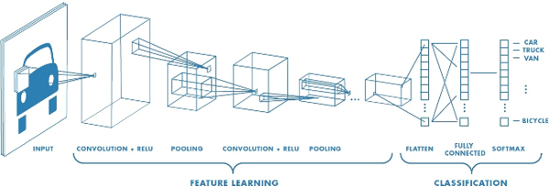
GoogleNET Architecture
GoogleNet accepts a 224x224 pixel RGB image as input. The initial convolutional layers perform operations on the image to extract basic features. Inception modules are specialized convolutional modules designed to capture features at different scales, with each module containing different filters working in parallel. The Reduction Layer aims to reduce the size of feature maps, lowering computational costs and may involve pooling and convolution operations. Fully Connected Layers assist the network in making the final classification based on the learned features. The output layer typically uses softmax activation to produce results.
Fig12 : GoogleNET Layers

Slide 16
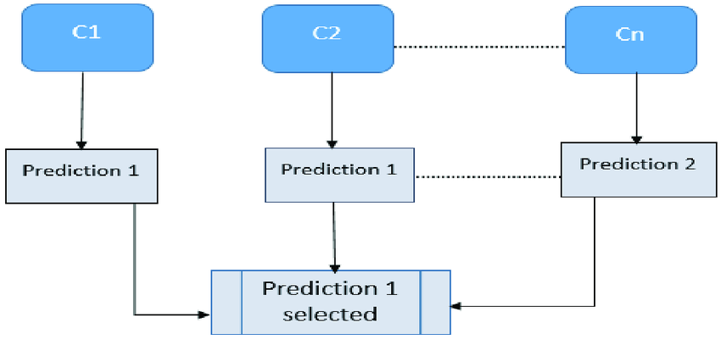
Hard Voting Classifier
Hard voting is an ensemble technique in machine learning where models are used collectively. Hard voting involves taking the classification results of different models and making a final prediction by selecting the class that each model votes for the most. This can enhance the overall performance of the model. Consequently, it enables the generation of stronger and more stable predictions compared to a single model. Additionally, ensemble models are generally more resistant to overfitting.
Fig13 : Hard Voting Technique Visualization

Slide 17
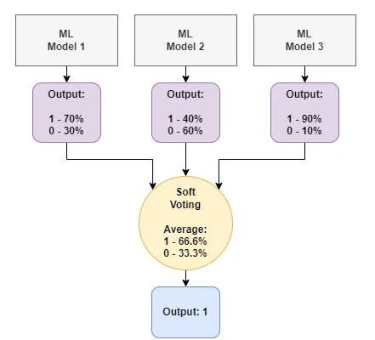
Soft Voting Classifier
Soft Voting is an ensemble technique in machine learning where models are used collectively. Soft Voting combines the predictions of different models with probability values and makes the final prediction based on these probabilities. Soft Voting takes into account the confidence or probability values that each model assigns to each class and aims to achieve more precise results by assigning a certain weight to the prediction of each model.
Fig14 : Soft Voting Technique Visualization

Slide 18

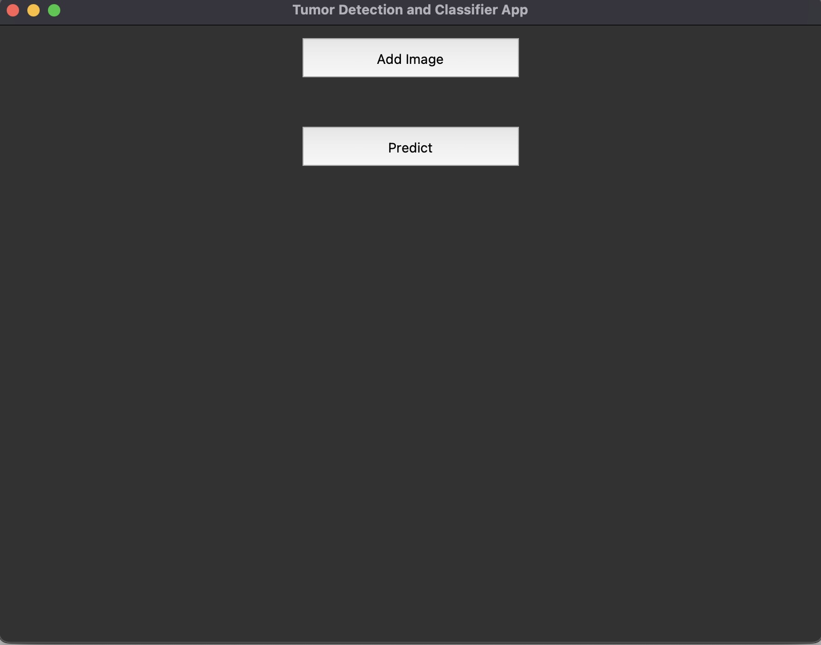
Single Image Prediction UI
In this interface, users will be able to upload the input in the appropriate format by clicking the “Add Image" button on their device. Afterward, when they click the “Predict" button, they will be able to see the prediction returned by the code running in the background. The code on the backend contains a pre-trained model, and suitable configurations (such as the appropriate scaling ratio for the model) are provided. After converting the input into an image array, the prediction process is carried out, the image is classified, and the response is returned.
Fig15: User Interface Prototype

Slide 19
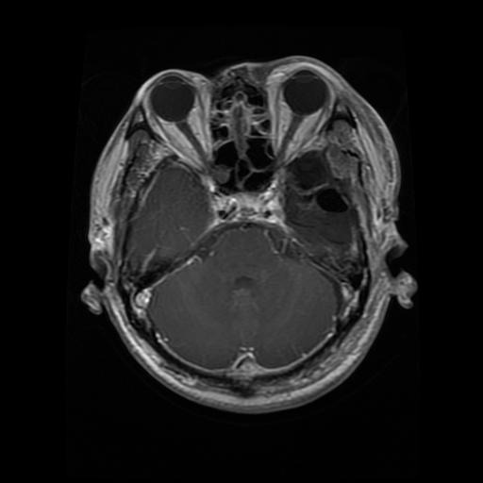
Inputs (Dataset)
The dataset consists of brain MR images in .jpg format, with dimensions varying according to the model requirements (224x224 px for AlexNet and VGGNet, and 299x299 px for GoogleNet). It includes four classes and is divided into training and test data, totaling approximately 7500 images. Among these, 1500 images are allocated for testing, while 6000 images are used for training. The training and test datasets are categorized based on brain tumor classes, which include "no_tumor," "glioma," "meningioma," and "pituitary."
Fig15 : Brain MR / Dataset Example

Slide 20
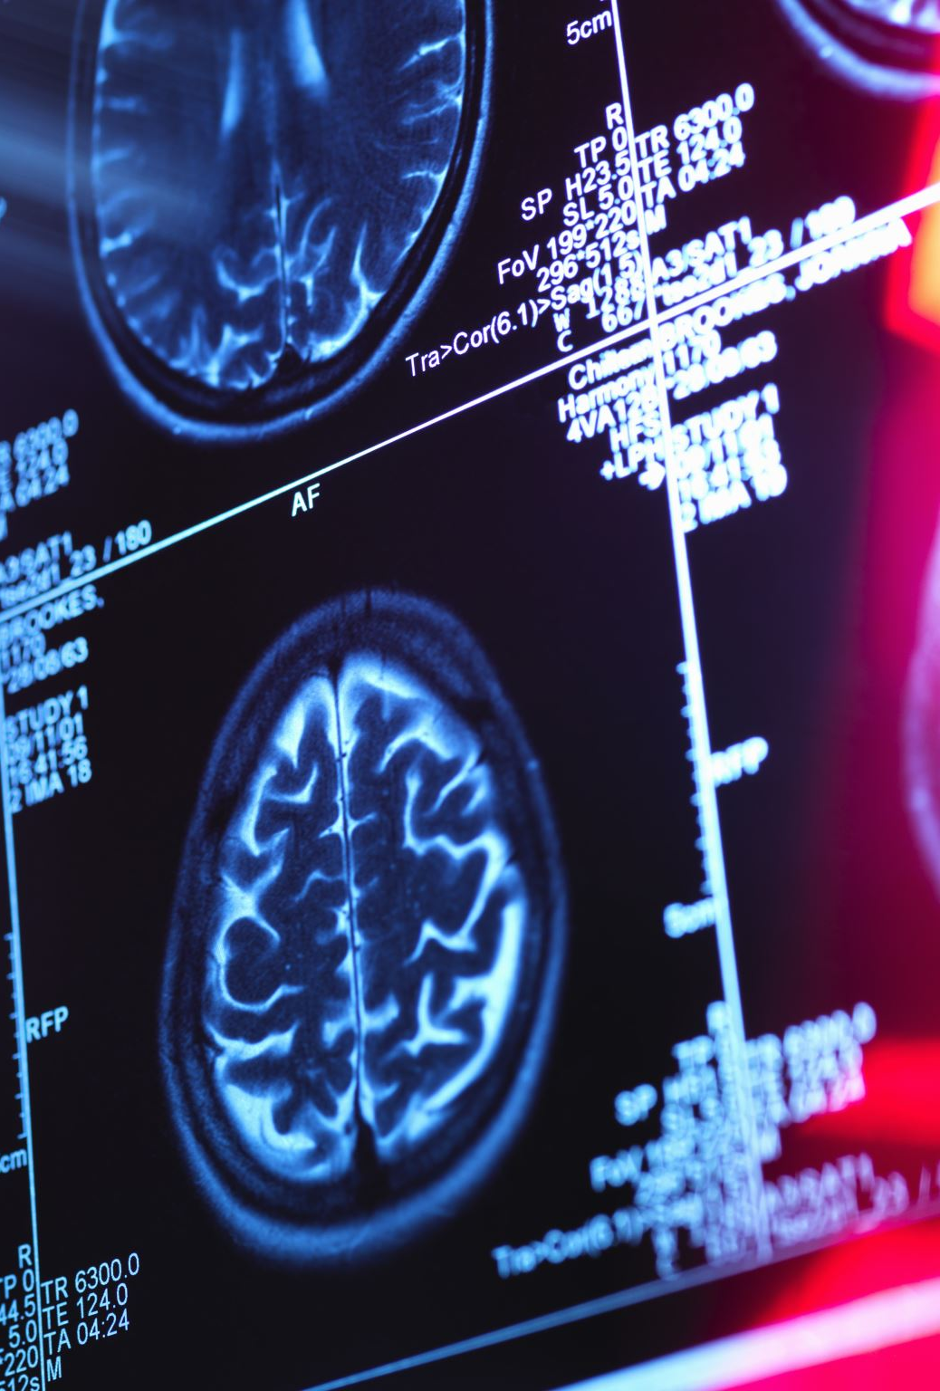
Result
﻿In end, mind tumors pose a substantial challenge inside the contemporary medical world, representing a complicated problem. Early diagnosis, correct category, and suitable treatment are critical for patients. ANNs and ensemble models have emerged as effective gear within the field of clinical imaging, contributing to widespread advancements in current years. The use of artificial neural networks and ensemble models for the type of brain tumors complements diagnostic accuracy, presenting a greater powerful and reliable prognosis. Ensemble models aim to combine a couple of gaining knowledge of models to achieve stronger and extra sturdy predictions. Hard vote casting and tender balloting are commonly used techniques to aggregate predictions from specific models. Both hard balloting and soft voting are effective techniques for enhancing the achievement fee of ensemble models. Hard voting relies on the bulk opinion of models to generate reliable and strong predictions, whereas tender balloting considers the confidence degrees of models to produce more unique and informed predictions. Therefore, using those techniques is regularly useful for those seeking to decorate the fulfillment charge of ensemble models, ensuing in extra robust and reliable effects.
These models come to be tremendous tools in the healthcare zone when factors inclusive of variety, error repayment, and wide learning capability come collectively. Consequently, it's far predicted that those models will be greater broadly hired inside the destiny of machine learning-based totally clinical diagnostic and classification structures.

Slide 21
References
https://www.osti.gov/servlets/purl/1597584
https://www.analyticsvidhya.com/blog/2021/07/metrics-to-evaluate-your-classification-model-to-take-the-right-decisions/
https://docs.clarifai.com/tutorials/how-to-evaluate-an-image-classification-model/
https://digitalcommons.unl.edu/cgi/viewcontent.cgi?article=1215&context=civilengfacpub
https://www.tensorflow.org/tutorials/images/classification?hl=tr
https://pyimagesearch.com/2017/03/20/imagenet-vggnet-resnet-inception-xception-keras/
https://colab.research.google.com/github/d2l-ai/d2l-en-colab/blob/master/chapter_convolutional-modern/alexnet.ipynb
https://www.analyticsvidhya.com/blog/2018/10/understanding-inception-network-from-scratch/
https://www.ncbi.nlm.nih.gov/pmc/articles/PMC10526310/
https://dergipark.org.tr/tr/download/article-file/3125175
https://www.aans.org/en/Patients/Neurosurgical-Conditions-and-Treatments/Brain-Tumors
https://www.kaggle.com/datasets/masoudnickparvar/brain-tumor-mri-dataset/data
https://www.tensorflow.org/api_docs/python/tf/keras/
https://neurohive.io/en/popular-networks/vgg16/
https://medium.com/@mygreatlearning/everything-you-need-to-know-about-vgg16-7315defb5918
https://www.researchgate.net/figure/Architecture-of-ensemble-hard-voting-classifier-Architecture-of-ensemble-hard-voting_fig2_369318773
https://ilyasbinsalih.medium.com/what-is-hard-and-soft-voting-in-machine-learning-2652676b6a3
https://www.saltdatalabs.com/blog/deep-learning-101-transformer-activation-functions-explainer-relu-leaky-relu-gelu-elu-selu-softmax-and-more
https://www.macnica.co.jp/en/business/semiconductor/articles/qualcomm/141224/
https://dennishnf.com/posts/projects/2017-04_image-classification-using-googlenet-convolutional-neural-network-on-a-raspberry-pi/page.html

