Slide 1
Traveling Salesman Problem
The TSP involves finding the minimum traveling cost for visiting a fixed set of customers.
The vehicle must visit each customer exactly once and return to its point of origin also called depot.
The objective function is the total cost of the tour.

Slide 2
Traveling Salesman Problem
3
2
4
3
2
2
3
2
1
4
1
4
3
5
5
The total number of solutions is (n-1)! /2 if the distances are symmetric.
For example, if there are 50 customers to visit, the total number of solutions is 49!/2=3.04x10⁶².

Slide 3
Traveling Salesman Problem
Solution
3
2
4
3
2
2
3
2
1
4
1
4
3
5
5
If the depot is located at node 1, then the optimal tour is 1-5-2-3-4-1 with total cost equal to 11.

Slide 4
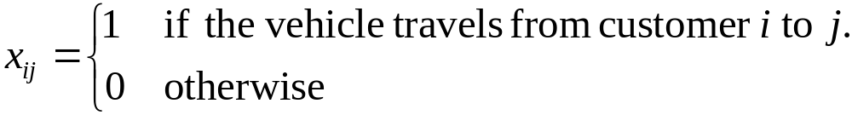
Traveling Salesman Problem
Mathematical Programming
Inputs: n = number of customers including the depot
c_{ij} = cost of traveling from customer i to j
Decision variables:

Slide 5
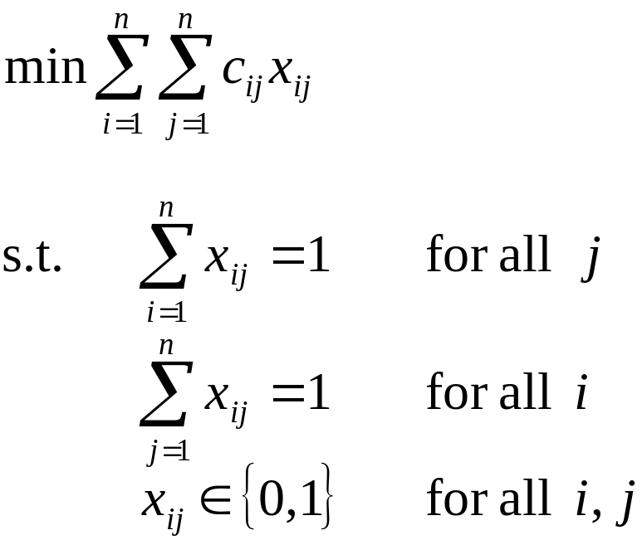
Traveling Salesman Problem
(1)
(2)
Constraints (1) and (2) ensure that each customer is visited exactly once.

Slide 6
Traveling Salesman Problem
3
2
4
3
2
2
3
2
1
4
1
4
3
5
5
minimize 2x₁₂+3x₁₃+2x₁₄+3x₁₅+3x₂₃+4x₂₄+...+5x₄₅
s.t. x₁₂+x₁₃+x₁₄+x₁₅ = 1 for node 1
x₂₁+x₃₁+x₄₁+x₅₁ = 1 for node 1
...
...

Slide 7
Traveling Salesman Problem
2
3
1
4
5
Is this solution feasible to our formulation?
We need additional constraints, so-called subtour elimination constraints.

Slide 8
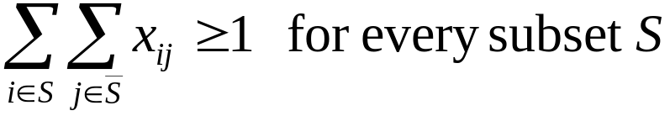
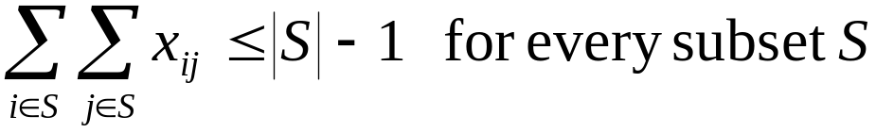
Traveling Salesman Problem
2
3
1
4
5

Slide 9


Traveling Salesman Problem
Subtour elimination constraints for the example:
2
3
1
4
5
2
3
1
4
5

Slide 10
Traveling Salesman Problem
Heuristics for the TSP
1. Construction Heuristics
build a feasible solution by adding a node to the partial tour one at a time and stopping when a feasible solution is found.
Many construction heuristics are also called greedy heuristics because they seek to maximize the improvement at each step.

Slide 11
Traveling Salesman Problem
Nearest Neighbor
Step 1. Start with any node as the beginning of the path.
Step 2. Find the node closest to the last node added to the path.
Step 3. Repeat Step 2 until all nodes are contained in the path. Then, join the first and last nodes.

Slide 12
Traveling Salesman Problem
3
2
4
3
Start with node 2.
2
2
3
2
1
4
Nodes added Tour
2 2
5 2-5
1 2-5-1
4 2-5-1-4
3 2-5-1-4-3
2-5-1-4-3-2
1
4
3
5
5
2
3
3
2
1
2
4
1
3
5

Slide 13
Traveling Salesman Problem
Nearest Insertion
Step 1. Start with a node i only.
Step 2. Find node k such that c_{ik} is minimal and form subtour i–k–i.
Step 3. Selection step. Given a subtour, find node k not in the subtour closest to any node in the subtour.
Step 4. Insertion step. Find the arc (i,j) in the subtour which minimizes c_{ik}+c_{kj}-c_{ij}. Insert k between i and j.
Step 5. Go to step 3 unless we have a Hamiltonian cycle.

Slide 14
Traveling Salesman Problem
Farthest Insertion
Step 1. Start with a node i only.
Step 2. Find node k such that c_{ik} is maximal and form subtour i–k–i.
Step 3. Selection step. Given a subtour, find node k not in the subtour farthest from any node in the subtour.
Step 4. Insertion step. Find the arc (i,j) in the subtour which minimizes c_{ik}+c_{kj}-c_{ij}. Insert k between i and j.
Step 5. Go to step 3 unless we have a Hamiltonian cycle.

Slide 15
Traveling Salesman Problem
Arbitrary Insertion
Step 1. Start with a node i only.
Step 2. Find node k such that c_{ik} is minimal and form subtour i–k–i.
Step 3. Selection step. Arbitrarily select node k not in the subtour to enter the subtour.
Step 4. Insertion step. Find the arc (i,j) in the subtour which minimizes c_{ik}+c_{kj}-c_{ij}. Insert k between i and j.
Step 5. Go to step 3 unless we have a Hamiltonian cycle.

Slide 16
Traveling Salesman Problem
Cheapest Insertion
Step 1. Start with a node i only.
Step 2. Find node k such that c_{ik} is minimal and form subtour i–k–i.
Step 3. Insertion step. Find arc (i,j) in the subtour and node k not, such that c_{ik}+c_{kj}-c_{ij} is minimal and, then, insert k between i and j.
Step 4. Go to step 3 unless we have a Hamiltonian cycle.

Slide 17
Traveling Salesman Problem
Clarke and Wright Savings Heuristic
1. Select any node as the central depot which is denoted as node 0. Form subtours i-0-i for i=1,2,...,n. (Each customer is visited by a separate vehicle)
2. Compute savings s_{ij}=c_{0i} + c_{0j} - c_{ij} for all i,j
3. Identify the node pair (i,j) that gives the highest saving s_{ij}
4. Form a new subtour by connecting (i,j) and deleting arcs (i,0) and (0, j) if the following conditions are satisfied
a) both node i and node j have to be directly accessible from node 0
b) node i and node j are not in the same tour.

Slide 18
Traveling Salesman Problem
Clarke and Wright Savings Heuristic
5. Set s_{ij}=-∞, which means that this node pair is processed.
Go to Step 3, unless we have a tour.

Slide 19
Traveling Salesman Problem
Heuristics for the TSP
2. Improvement Heuristics
begin with a feasible solution and successively improve it by a sequence of exchanges while maintaining a feasible solution throughout the process.

Slide 20
Traveling Salesman Problem
Heuristics for the TSP
1
2
3
4
1
2
3
4

Slide 21
Traveling Salesman Problem
Two exchange heuristics (2-opt)
Starting with any tour, we consider the effect of removing any two arcs in the tour and replacing them with the unique set of two arcs that form a different tour.
If we find a tour with a lower cost than the current tour, the we use it as the new tour.
When no possible exchange can produce a tour that is better than the current tour, we stop.

Slide 22
Traveling Salesman Problem
3
3
2
3
2
3
4
2
2
2
2
3
2
4
1
4
1
1
4
5
3
5
3
5
5
Suppose the initial tour is given as 1-2-3-4-5 with cost 15.

Slide 23
Traveling Salesman Problem
3
3
2
3
2
3
2
2
2
2
1
4
4
1
3
5
5
3
5
Remove 1-2 and 3-4
5
3
2
3
3
4
Add 1-3 and 2-4
cost=18
1
4
3
5
5

Slide 24
Traveling Salesman Problem
3
3
2
3
2
3
2
2
2
1
4
4
1
3
5
5
3
5
Remove 1-2 and 4-5
5
3
2
3
1
2
Add 1-4 and 2-5
cost=11
1
4
2
3
5

Slide 25
Traveling Salesman Problem
There are n (n-1)/2 - n possible ways of removing and adding arcs. In this case, n=5, and we have 5 combinations.
The best tour obtained from the process at the first iteration is 2-3-4-1-5-2 with cost 11.
We use this solution as the starting tour and apply the process again.

Slide 26
Vehicle Routing Problem
The vehicle routing problem involves finding a set of trips, one for each vehicle, to deliver known quantities of goods to a set of customers.
The objective is to minimize the travel costs of all trips combined.
There may be upper bounds on the total load of each vehicle and the total duration of its trip.
The most basic Vehicle Routing Problem (VRP) is the single-depot capacitated VRP.

Slide 27
Vehicle Routing Problem
Inputs: n = number of customers
K = number of vehicles available
c_{ij} = cost of traveling from customer i to j
d_{i} = demand of customer i
Q_{k} = capacity of vehicle k
n=14, K=5, Q_{k}=100
45
5
35
2
3
1
14
20
15
13
40
10
4
5
25
12
25
6
11
10
80
45
60
30
10
7
8
9

Slide 28
Vehicle Routing Problem
45
5
35
2
20
3
1
14
15
13
40
5
10
4
12
11
25
6
10
25
10
7
8
9
80
45
60
30
Each customer must be visited by a vehicle
The demand assigned to vehicle k must not exceed its capacity
The tour for vehicle k begins at the depot, visits all its customers and returns to the depot.

Slide 29
Vehicle Routing Problem
Iterated Tour Partitioning Heuristic
1. Find the traveling salesman tour through all customers and the depot.
2. Starting at the depot and following the tour in any arbitrary orientation, partition the path into disjoint segments such that the total demand in each segment does not exceed the vehicle capacity Q.

Slide 30
Vehicle Routing Problem
20
5
10
Q=60
15
25
5
25
20
15
10
10
The TSP tour

Slide 31
Vehicle Routing Problem
20
5
10
Q=60
15
25
5
25
20
15
10
10

Slide 32
Vehicle Routing Problem
Sweep Heuristic (Gillett and Miller)
1. Calculate the polar coordinates of all customers where the center is the depot and an arbitrary customer is chosen to be at angle 0. Reorder the customers so that
0 = θ₁≤ θ₂≤ ... ≤ θ_{n}
2. Starting from the unrouted customer i with smallest angle θ_{i} construct a new cluster by sweeping consecutive customers i+1, i+2 ... until the capacity constraint will not allow the next customer to be added.
3. Continue Step 2 until all customers are included in a cluster.
4. For each cluster constructed, solve the TSP on the subset of customers and the depot.

Slide 33
Vehicle Routing Problem
Clarke and Wright Savings Heuristic
1. Form subtours i-0-i for i=1,2,...,n. (Each customer is visited by a separate vehicle)
2. Compute savings s_{ij}=c_{0i} + c_{0j} - c_{ij} for all i,j
3. Identify the node pair (i,j) that gives the highest saving s_{ij}
4. Form a new subtour by connecting (i,j) and deleting arcs (i,0) and (0, j) if the following conditions are satisfied
a) both node i and node j have to be directly accessible from node 0
b) node i and node j are not in the same tour.
c) forming the new subtour does not violate any of the constraints associated with the vehicles

Slide 34
Vehicle Routing Problem
Clarke and Wright Savings Heuristic
5. Set s_{ij}=-∞, which means that this node pair is processed.
Go to Step 3, unless all node pairs with s_{ij} ≥ 0 are processed.

Slide 35
Vehicle Routing Problem
A chain of convenience stores has seven locations in one city. Each week goods must be delivered from a central warehouse to the stores. Items are packaged in standard-sized containers. The following table gives he number of containers that must be delivered for one week and the one-way travel times in minute between each pair of customers. Each delivery vehicle has a capacity for 80 containers. The company would like to make all deliveries within an 8-hour shift on a single day of the week.

Slide 36
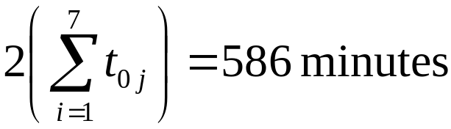
Vehicle Routing Problem
i / j 0 1 2 3 4 5 6 7 Req
0 - 20 57 51 50 10 15 90
1 20 - 51 10 55 25 30 53 46
2 57 51 - 50 20 30 10 47 55
3 51 10 50 - 50 11 60 38 33
4 50 55 20 50 - 50 60 10 30
5 10 25 30 11 50 - 20 90 24
6 15 30 10 60 60 20 - 12 75
7 90 53 47 38 10 90 12 - 30
When each customer is serviced individually from the
depot, the total travel time becomes

Slide 37
Vehicle Routing Problem
Savings
i / j 1 2 3 4 5 6 7
1 -
2 26 -
3 61 58 -
4 15 87 51 -
5 5 37 50 10 -
6 5 62 6 5 5 -
7 57 100 103 130 10 93 -
s₄₇ = t₀₄ + t₀₇ - t₄₇ = 50 + 90 - 10 = 130
Because the total demand is 60, we may combine these routes.

Slide 38
Vehicle Routing Problem
The next largest savings is s₃₇=103. If we try combine customer 3 with customer 7 (who is already combined with customer 4), the total demand on the route would be 93, which exceeds the vehicle capacity.
We therefore move on to the next-largest savings, s₂₇=100. Adding customer 2 also violates the capacity constraint.
So does the next-largest savings, s₆₇=93.

Slide 39
Vehicle Routing Problem
i / j 1 2 3 4 5 6 7 Req
1 - 46
2 26 - 55
3 61 58 - 33
4 15 87 51 - 30
5 5 37 50 10 - 24
6 5 62 6 5 5 - 75
7 57 100 103 130 10 93 - 30
Route: 0-4-7-0 0-3-1-0 0-2-5-0 0-6-0
Time: 150 81 97 30
Capacity 60 79 79 75

