Slide 1
Team No. 45
AI Automated Vehicle Insurance Estimation System with damage assessor
Presentation By,
Mahanidhi GK (23BTRCL139)
Mohammed Sohail (23BTRCL101)
Mohammed Ismail (23BTRCL152)
Mohamed Ajmal(23BTRCL005)
Guided By,
Dr. Sugumar R,
Associate Professor / CSE- AIML

Slide 2
CONTENTS
Abstract
Introduction
System requirement
Literature Survey
Existing system
Block diagram
Proposed System
Conclusion
References

Slide 3
ABSTRACT
With advancements in computer vision and machine learning, it is now possible to automate much of this assessment pipeline. Deep learning models, particularly Convolutional Neural Networks (CNNs), have demonstrated the ability to analyse vehicle images and detect damage with accuracy comparable to trained human assessors. Simultaneously, ensemble machine learning models can predict claim amounts by learning patterns from historical insurance data. Combining these two technologies — image-based damage detection and data-driven claim estimation — into a single integrated system can drastically reduce assessment time, improve consistency, and bring transparency to the claims process. This project proposes such a system, using MobileNetV2 for transfer learning-based damage detection and a Random Forest Regressor for claim amount prediction, deployed as an accessible web application using Streamlit.

Slide 4
INTRODUCTION
With the increasing automation in today's world, the need for intelligent systems that can assess physical damage and make financial decisions from visual data has grown exponentially. Be it processing motor insurance claims, evaluating accident severity, or estimating vehicle repair costs, automated damage assessment is becoming a critical capability across the insurance and automotive industries. Traditional methods for vehicle damage evaluation rely on manual inspection by licensed surveyors, which are accurate in controlled settings but no longer compatible with today's high-volume, fast-turnaround demands, as insurance companies process thousands of claims daily and physical inspection of every vehicle introduces significant delays.

Slide 5
These methods also make the procedure of claim processing highly subjective and complex, as different assessors may evaluate identical damage differently, and they can only work effectively when vehicles are presented in person under ideal conditions, which is not always possible to achieve. So, AI-driven approaches for automated damage detection and claim estimation, like Convolutional Neural Networks (CNNs), Transfer Learning, and Ensemble Regression models were introduced.

Slide 6
SYSTEM REQUIREMENT
Software CONFIGURATION
OS: Windows 10/11, Ubuntu 18.04+, macOS
Programming: Python 3.8+ (Recommended: 3.10)
IDE: Jupyter Notebook, VS Code, PyCharm
Hardware CONFIGURATION
CPU: Intel Core i5 (10th Gen) / AMD Ryzen 5 (Minimum), Intel Core i7/i9 (Recommended)
GPU: NVIDIA GTX 1650 (Minimum), NVIDIA RTX 3060 / Tesla A100 (Recommended)
RAM: 8GB (Minimum), 16GB - 32GB (Recommended)
Storage: 256GB SSD + 1TB HDD (Minimum), 512GB - 1TB SSD (Recommended)

Slide 7
LITERATURE SURVEY
1. A comprehensive review of object detection techniques using both machine learning and deep learning approaches. It highlights the limitations of traditional methods like SIFT and HOG, which struggle with real-time processing and complex image conditions. The authors emphasize the superiority of deep learning methods such as R-CNN, YOLO, and RetinaNet, which offer faster and more accurate object detection. The paper also discusses the advantages, challenges, and applications of object detection in various fields, including healthcare, autonomous vehicles, and surveillance. Future scopes, such as advancements in autonomous vehicles and augmented reality, are also explored. The review underscores the growing importance of object detection in automating and enhancing real-world applications.

Slide 8
2. The paper presents an innovative system for automated car damage detection and insurance claim estimation using deep learning. The system employs the YOLO (You Only Look Once) algorithm for real-time damage detection and a regression model to calculate claim amounts based on damage severity and vehicle age. Built with Python Flask, the web application offers a user-friendly interface for image uploads and claim processing. The YOLO model achieved high precision and recall, while the regression model demonstrated accurate claim estimations. The system addresses inefficiencies in traditional insurance processes, offering faster, more accurate, and transparent claim assessments. Future improvements include dataset expansion and mobile compatibility enhancements.

Slide 9
Introduction of an ensemble of 10 YOLOv5 deep learning models, optimized for high precision and low false positives, significantly improving over traditional methods like DCN+. The system leverages a custom dataset, TartesiaDS, labeled by professional appraisers, ensuring real-world applicability. The ensemble approach achieves faster inference times and better scalability, making it suitable for large-scale deployment. The study also compares YOLOv5 and YOLOv8 ensembles, highlighting their trade-offs in precision and recall. This work advances vehicle damage detection, offering a robust solution for automating insurance claims with high accuracy and efficiency.

Slide 10
4. Efficient object detection and classification approach using the Enhanced Moving Object Detection (EMOD) algorithm, optimized for motion videos. The method employs a convolutional neural network (CNN) enhanced with a Manta Ray-based search optimization technique. Preprocessing involves noise reduction and contrast enhancement using polynomial adaptive antialiasing and boundary area preservation algorithms. EMOD improves detection accuracy, particularly for smaller objects, by leveraging grid-based bounding box prediction and contrast-enhanced image sequences. The approach is validated on UAV datasets, achieving high accuracy (97.43%) and outperforming traditional methods like Deep Belief Networks (DBN) and Recurrent Neural Networks (RNN) in precision, recall, and F-measure. The study highlights EMOD's potential for real-time object detection in complex environments, offering significant advancements in computer vision applications.

Slide 11
5. Exploration of the use of synthetic data to enhance object detection accuracy in autonomous vehicles. It addresses challenges in machine learning, such as data scarcity, noise, and imbalance, by generating high-quality synthetic datasets using Unity. Two systems, System-1 (trained on real data) and System-2 (trained on real and synthetic data), are evaluated using the YOLO model. Results show that System-2 outperforms System-1, achieving a 3% improvement in accuracy and superior performance in precision, recall, and mean average precision. The study demonstrates that synthetic data can effectively augment real-world datasets, improving model robustness and generalization, particularly in dynamic environments like autonomous driving. This approach offers a promising solution for training reliable machine learning models in data-scarce domains.

Slide 12
EXISTING SYSTEM
VGG16 / ResNet-based Damage Classifiers:
Earlier deep learning approaches for vehicle damage detection used heavier CNN architectures like VGG16 and ResNet-50, trained from scratch or with basic fine-tuning. While accurate, these models are computationally expensive, require large datasets, and are too slow for real-time deployment on standard hardware.Example: Viola-Jones algorithm for face detection.
Example: Research systems that trained VGG16 on car damage datasets to classify damage severity into categories like minor, moderate, and total loss.
Faster R-CNN for Damage Localization:
Region-based CNNs (R-CNN, Faster R-CNN) were applied to vehicle damage by drawing bounding boxes around damaged regions. While these provide spatial localization of damage, they require bounding box annotations during training (far more laborious than simple image-level labels) and are significantly slower than classification-only approaches.

Slide 13
Example: Academic papers using Faster R-CNN on annotated vehicle datasets to detect and locate specific damage types such as dents, scratches, and broken parts.
Tractable AI / CCC Intelligent Solutions (Commercial Platforms):
Commercial AI platforms used by large insurers that analyse vehicle photos submitted via mobile apps to estimate repair costs. These are closed, proprietary systems not accessible to independent developers, require enterprise licensing, and are tightly coupled to their own repair network databases.
Example: Tractable’s photo-based appraisal tool used by Ageas Covea and other major European insurers
Linear Regression for Claim Amount Prediction::
Simple linear regression models trained on historical claim data assume a direct proportional relationship between input features (vehicle age, incident type) and claim amount. These fail to capture non-linear interactions

Slide 14
Example: Early actuarial data models used by insurers before ensemble ML methods became standard, relying on a handful of handpicked variables with manually assigned weights.
Single Decision Tree Regressor:
A single decision tree trained on insurance claim data creates explicit if-else rules partitioning the feature space. While interpretable, a single tree overfits easily, is highly sensitive to small changes in training data, and produces unstable predictions — problems that Random Forest (an ensemble of 200 trees) directly addresses.
Example: Used in early insurance analytics dashboards where explainability was prioritised over prediction accuracy.

Slide 15
LIMITATION OF EXISTING SYSTEM
Dependency on Physical Presence:
Excessive processing time and human dependency
Heavyweight Deep Learning Models:
Struggles with variations such as scale, occlusion, rotation, lighting.
Massively affects the model with slight variations.
Limited generalization:
Earlier CNN-based damage detection approaches used architectures with tens of millions of parameters, making them impractical to deploy in lightweight web or mobile applications.
No integration between detection and estimation:
Existing image-based damage detection systems and claim amount estimation systems operate in complete isolation. The output of a damage classifier is never automatically fed into a financial prediction model
Linear Models ignoring feature interaction:
Statistical regression approaches used in traditional insurance analytics assume simple linear relationships between input variables and claim amounts. In reality, factors like brand tier, fuel type, vehicle age, and damage severity interact in highly non-linear ways that linear models fundamentally cannot capture.
Conclusion:
The proposed system addresses these limitations by combining MobileNetV2 Transfer Learning for efficient, image-based damage detection — eliminating the need for physical presence — with a Random Forest Regressor that captures non-linear interactions between vehicle attributes and claim amounts.

Slide 16
PROPOSED SYSTEM
Proposed System - Overview
Objective:
To automatically detect vehicle damage from uploaded images and estimate insurance claim amounts using AI, eliminating the need for manual inspection for initial assessments.
Key Features:
Automated Damage Detection: Usage of EfficientNetB0 (Transfer Learning) to classify vehicle images as damaged or undamaged with a confidence score.
Severity Classification: Mapping model confidence scores to damage severity levels (Minor / Moderate / Severe) to guide claim processing.
AI-Powered Claim Estimation: Usage of a Random Forest Regressor trained on real insurance claim data to predict the vehicle claim amount based on damage severity and vehicle attributes.
Session-Based Data Flow: Damage severity and confidence automatically carry over from the detection page to the claim estimator via session state, enabling a seamless two-step workflow.

Slide 17
Rule-Based Fallback: A formula-driven estimation system (based on brand tier, fuel type, depreciation, and severity) activates automatically if the ML model is unavailable.
Interactive Claim Breakdown: Waterfall chart visualization showing how each factor (severity, brand, fuel type, depreciation) contributes to the final estimated claim amount.
Advantages:
Handles both unstructured data (images) and structured data (tabular vehicle records) within a single unified system.
Transfer learning on EfficientNetB0 achieves strong classification performance with a small dataset (13,945 images) by leveraging ImageNet pretrained weights.
Ensemble-based Random Forest prediction reduces variance and handles non-linear relationships between vehicle attributes and claim amounts.
Fully browser-based web application — no installation required for end users, accessible via Streamlit.

Slide 18
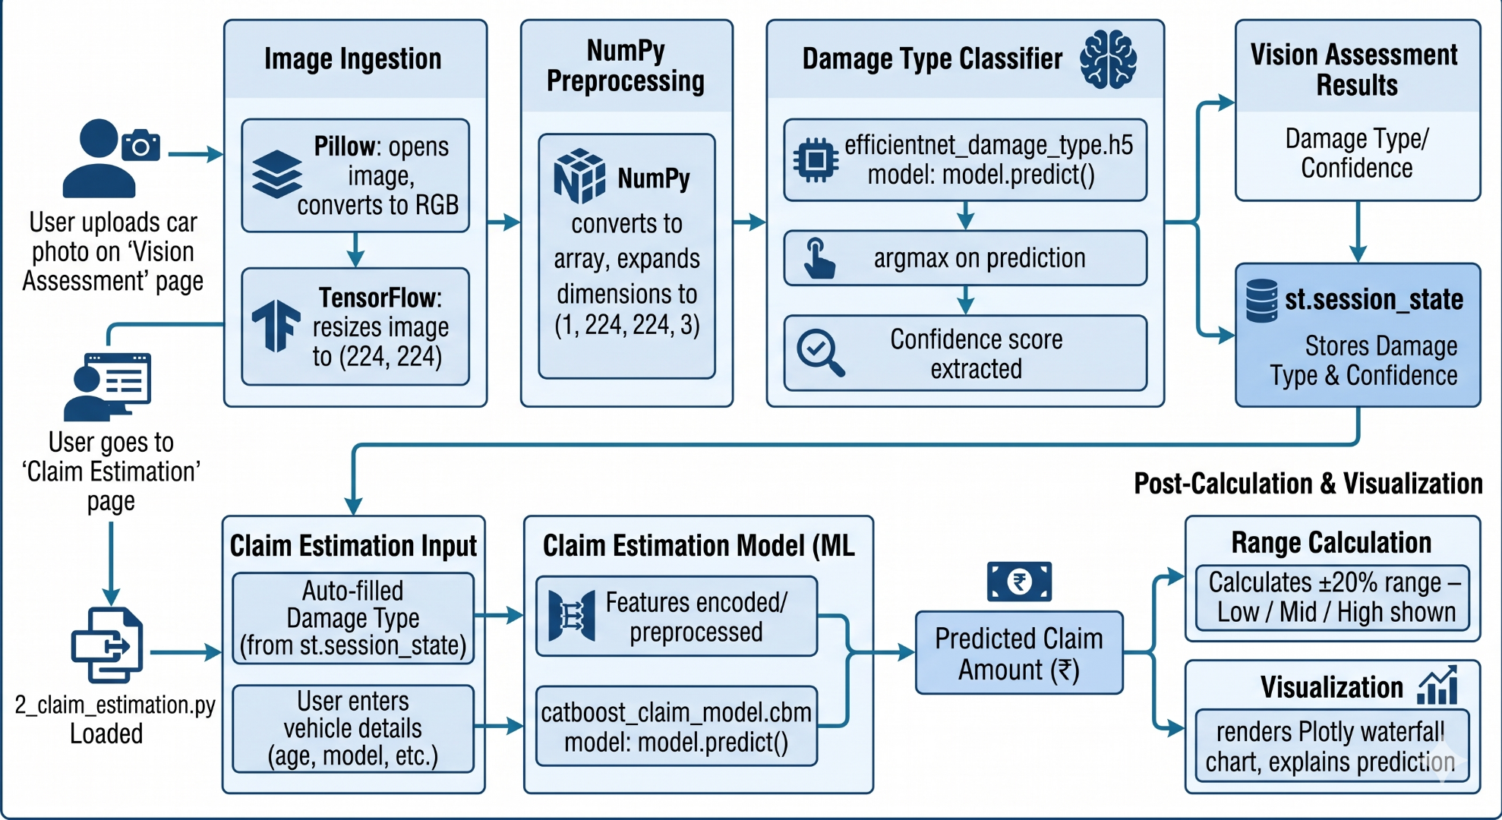
Architecture Diagram

Slide 19
Proposed System - Model Architecture
Model-1 : EfficientNetB0 (Damage Detection)
Backbone (feature extractor):
EfficientNetB0 (Pre-trained on ImageNet):
Depthwise Separable Convolutions: Splits standard convolution into depthwise + pointwise convolutions, drastically reducing parameters and computation.
Inverted Residual Blocks (Bottleneck layers): Expands low-dimensional features to high-dimensional space, applies depthwise convolution, then compresses back improving representational power.
Batch Normalization: Applied after every convolutional layer to normalize outputs and stabilize training.
ReLU6 Activation: Bounded activation function (clips at 6) for better performance on low-precision hardware.
Linear Bottlenecks: Prevents information loss when compressing feature maps.
Custom Classification Head (Task-Specific Layers):
GlobalAveragePooling2D: Collapses spatial dimensions (height × width) into a single vector per feature map, reducing overfitting compared to Flatten.
Dense(128, ReLU): Fully connected layer for high-level feature learning.
Dropout(0.5): Randomly drops 50% of neurons during training

Slide 20
to prevent overfitting.
Fine-Tuning:
Phase 1 (Feature Extraction):
All EfficientNetB0 backbone layers are frozen; only the custom head is trained with lr=0.001.
Phase 2 (Fine-Tuning):
Last 30 layers of the backbone are unfrozen and retrained with a lower lr=0.0001 to adapt pretrained ImageNet features to vehicle damage patterns without catastrophic forgetting.

Slide 21
Model 2: Claim Estimation (CatBoost Regressor):
Training Process:
Model Comparison: Both Random Forest (n_estimators=200, max_depth=15) and Gradient Boosting (n_estimators=200, max_depth=5, lr=0.1) trained and evaluated; best model selected by R² score.
Train/Test Split: 80% training / 20% testing, random_state=42.
Preprocessing: Label Encoding applied to all categorical columns (auto_make, auto_model, incident_severity, incident_type, collision_type).
Features Used: 6 columns from the 40-column dataset (auto_make, auto_model, auto_year, incident_severity, incident_type, collision_type).
Target Variable: vehicle_claim (claim amount in USD).
Estimation Formula: Claim = Base x BrandMult. Fuel Mult x (1 – Depreciation/100)
Evaluation Metrics:
R² Score (Coefficient of Determination): Measures how well the model explains variance in claim amounts.
MAE (Mean Absolute Error): Average absolute difference between predicted and actual claim amounts.
RMSE (Root Mean Squared Error): Penalizes larger prediction errors more heavily than MAE.
Results:
Best Model: Random Forest Regressor (outperformed Gradient Boosting)
R² Score: 0.7958 — model explains ~79.6% of variance in claim amounts.
MAE: $6,410.03 — average prediction error in claim estimation.
Feature importance chart saved as feature_importance.png, with incident_severity and auto_make ranking as the most influential features.

Slide 22
Training and Evaluation
Training Process:
Early Stopping: Stop training if validation loss does not improve for 5 epochs (patience=5), restoring best weights automatically.
Model Comparison: Random Forest Regressor and Gradient Boosting Techniques.
Batch Size: 32 for efficient training.
Epochs: 20 (Phase 1: Feature Extraction) + 10 (Phase 2: Fine-Tuning) = 30 maximum epochs with 80-20 train test split.
Optimizer: Adam with learning rate 0.001 (Phase 1) and 0.0001 (Phase 2 fine-tuning to prevent overwriting pretrained weights).
Data Augmentation: Rotation (±30°), width/height shift (20%), shear (20%), zoom (20%), horizontal flip, and pixel normalization (÷255).
Evaluation Metrics:
R² Score: Balances precision and recall for better evaluation
MAE (Mean Absolute Error): Average absolute difference between predicted and actual claim amounts.
Results:
R² Score : 0.7958 - model explains ~79.6% of variance in claim amounts.
MAE : 6410.03 - average prediction error in claim estimation.

Slide 23
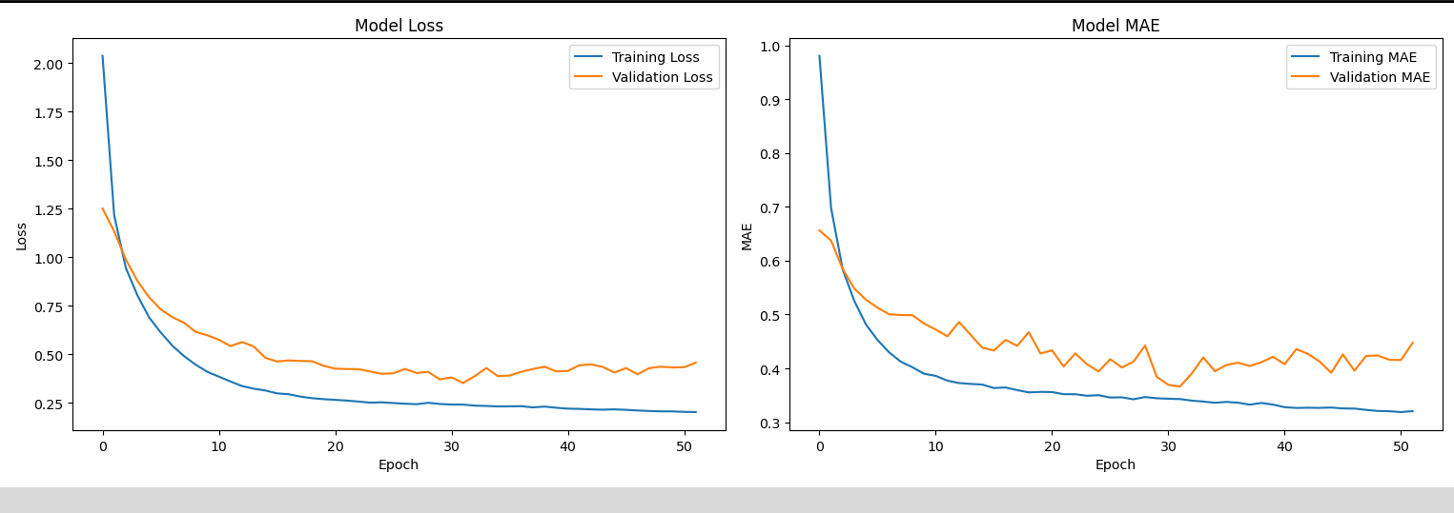
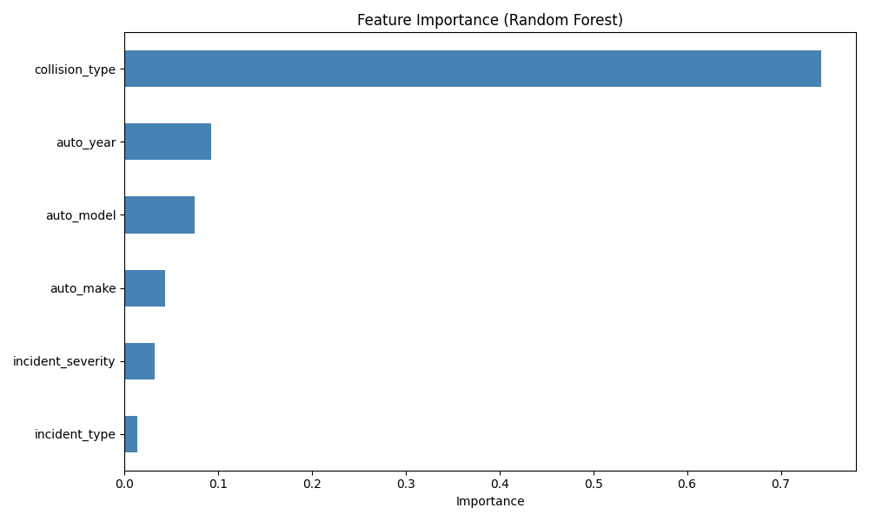

Slide 24
Proposed System – Future Plans
Use the selected model to be trained with the specific datasets.
Update predictions iteratively for each day.
Output:
Made a deep learning model used for automated car insurance claim.
Incorporate the model with a user-friendly application using streamlit.

Slide 25
CONCLUSION
Summary of Work:
Developed a deep learning-based model using EfficientNetB0 for Damage detection and classification in damaged vehicles.
Developed a machine learning-based model which uses CatBoost Regressor for claim amount estimation along with a waterflow chart.
Key Achievements:
Found the optimal model for damage detection and claim amount estimation.
Discovered a key implementation for the ML model.
Future Work:
Compare and evaluate various other model performance.
Improve model robustness for different conditions.

Slide 26
REFERENCES
Automated Car Damage Assessment Using Computer Vision: Insurance Company Use Case : by Sergio A. Pérez-Zarate U, Daniel Corzo-Garcia , Jose L Pro-Martin, Juan A. Ålvarez-Garcia 3 Miguel A. Martinez-del-Amor üc) and David Femändez-Cabrera.
AUTOMATED CAR DAMAGE DETECTION AND INSURANCE CLAIMING USING DEEP LEARNING : Salunke Sayali Anil*1, Gawali Chaitali Rajendra*2, Shelke Gitanjali Ramesh*3, Sangle Pratiksha Malhari*4, Shahrukh Shekh*5*1,2,3,4,5Computer Engineering Department, Shri Chhatrapati Shivaji Maharaj College Of Engineering, Nepti, Ahmednagar, Savitribai Phule Pune University Pune, India.

Slide 27
3. Automated Car Damage Assessment Using Computer Vision:
Insurance Company Use Case: Sergio A. Pérez-Zarate 1,2,* , Daniel Corzo-García 1, Jose L. Pro-Martín 1,2, Juan A. Álvarez-García 3 ,
Miguel A. Martínez-del-Amor 2,4 and David Fernández-Cabrera 1
4. Vehicle Damage Detection Using Machine Learning and Segmentation to Aid Insurance Claims
DOI:10.1109/INDICON59947.2023.10440856
by Mohit Venkatesh, Rishabh Oruganti, Shreyas A Katti, Karpagavalli Subramanian

Slide 28
5. Enhancing Object Detection Accuracy in Autonomous Vehicles Using Synthetic Data Sergei Voronin Wellington Institute of Technology Wellington, New Zealand Abubakar Siddique Wellington Institute of Technology Wellington, New Zealand Muhammad Iqbal Higher Colleges of Technology Fujairah, United Arab Emirates

Slide 29
THANK YOU

