Slide 1
PulseEV Proposal
Enterprise EV Fleet Lifecycle Intelligence & Compliance
CONFIDENTIAL BRIEFING FOR CEO & CBO • PULSEEV OPERATIONS

Slide 2
The Core Problem: Legacy EV Lifecycle Chaos
• Compliance & RTO Penalties
Delivered vehicles operating without active plates cause severe transport regulatory auditing risks, fines, and operational delays.
• Safety & Recall Exposure
Conducting battery campaign swaps without rigid serial-number matching voids manufacturer warranties and exposes the firm to liability.
• Operational Maintenance Gaps
Manual scheduling systems miss critical milestone checks (1K, 5K, 10K, 20K km) because they fail to track real-time odometer readings.

Slide 3
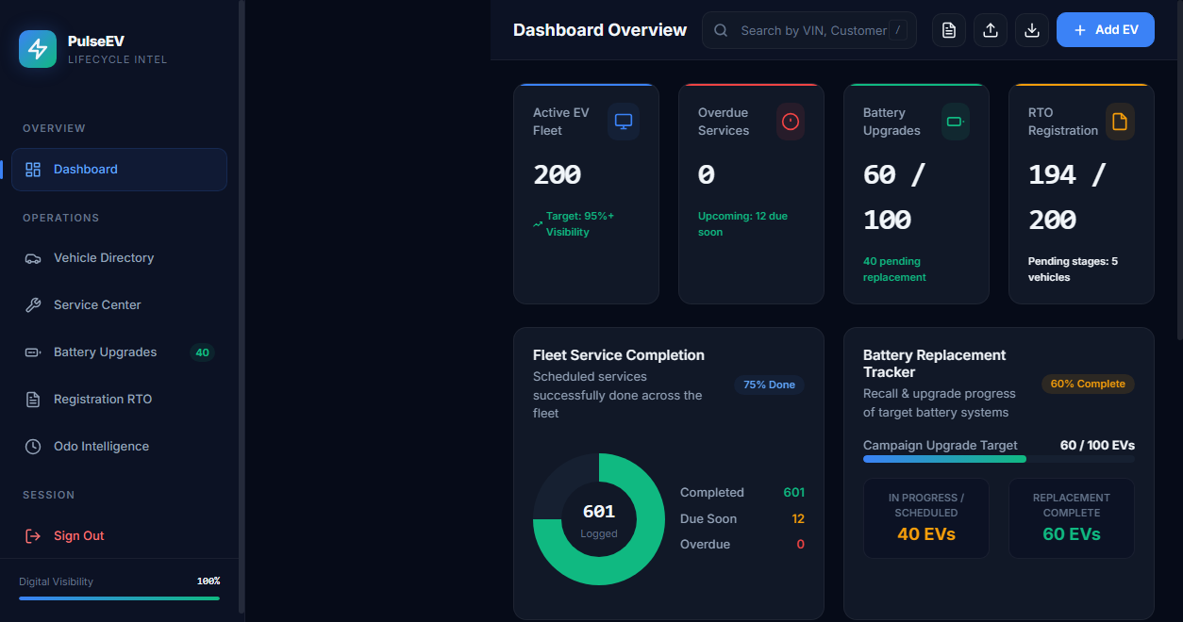
The Solution: PulseEV Central Portal
• Unified Source of Truth
Consolidates odometer mileage history, scheduled service packages, recall campaigns, and plate registrations in a single, central database.
• Strict Validation Rules
Enforces typo-safe dropdown parameters (models, statuses, booleans) to maintain data hygiene and verify matching serial numbers.

Slide 4
Measurable Business Impact & ROI
• 0% Compliance Delays
Automating document staging and plate logging speeds up the registry pipeline, getting vehicles on the road faster.
• 100% Serialization Audits
Logs and matches retired vs. replacement battery pack serial numbers, preserving thousands of dollars in warranty assets.
• Active Odometer Analytics
Predicts service schedules based on daily driving trends, closing service backlogs and expanding vehicle longevity.

Slide 5
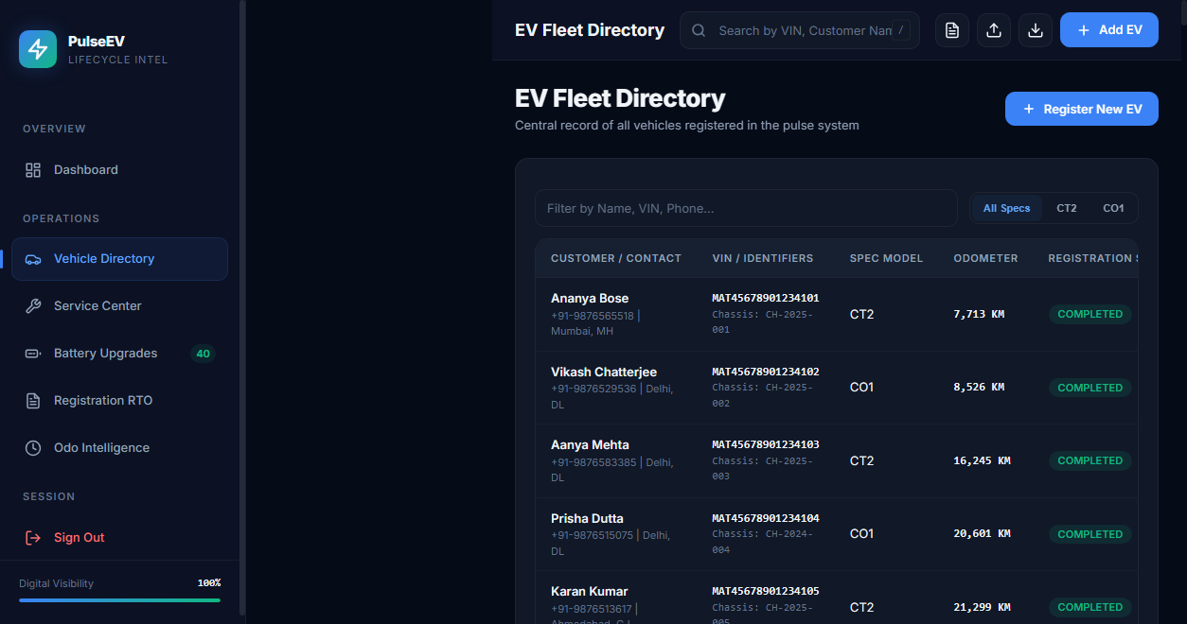
Role-Based Workspaces for Your Teams
• Fleet Directors Dashboard
Access high-level visual charts, progress metrics, and recall campaign completion rates in real-time.
• Support Ops Smart Search
Audit specific vehicles instantly via a global '/' hotkey search querying VIN, customer name, or phone number.
• Field Service Technicians Form
Simple dialog boxes to input completed services, log odometer readings, and report battery swaps.

Slide 6
Built to Scale: Bulk Excel/CSV Operations
• Validating Spreadsheet Templates
Includes instructions, required columns, and data dictionary guidelines to ensure accurate data entry.
• Input Validation Warnings
Restricts parameters like model names (CT2/CO1) to prevent database entry typos.
• Zero-Friction In-Browser Upload
Processes .xlsx and .csv files: matches and updates mileage for existing VINs, and registers new vehicle profiles.

Slide 7
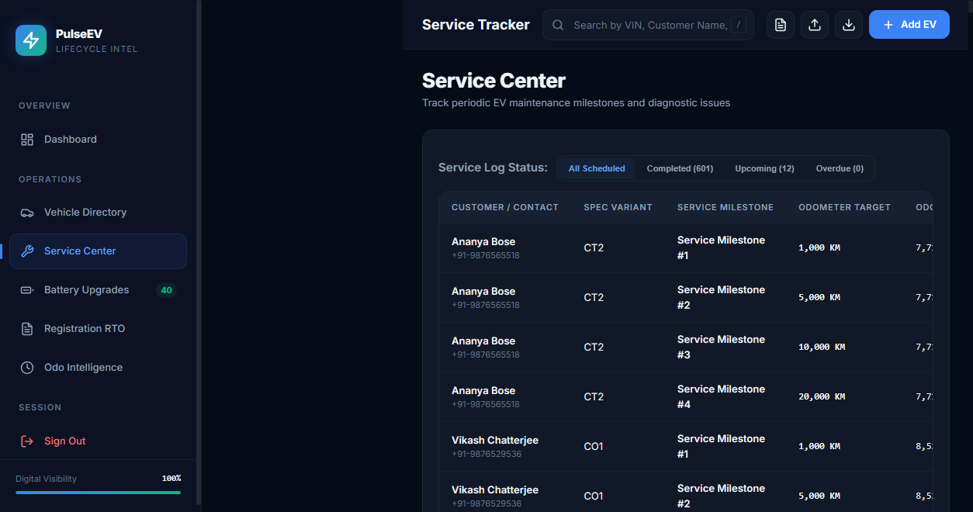
Enterprise-Grade Architecture
• FastAPI Backend Framework
High-performance Python API server with secure JWT authentication, bcrypt encryption, and SQLAlchemy ORM.
• Vanilla JavaScript SPA Frontend
Clean, bundle-free client design. Uses local caching to support offline access and local backups.
• Flexible Multi-DB Integrations
Supports local SQLite databases for developer testing and Neon PostgreSQL for production environments.

Slide 8
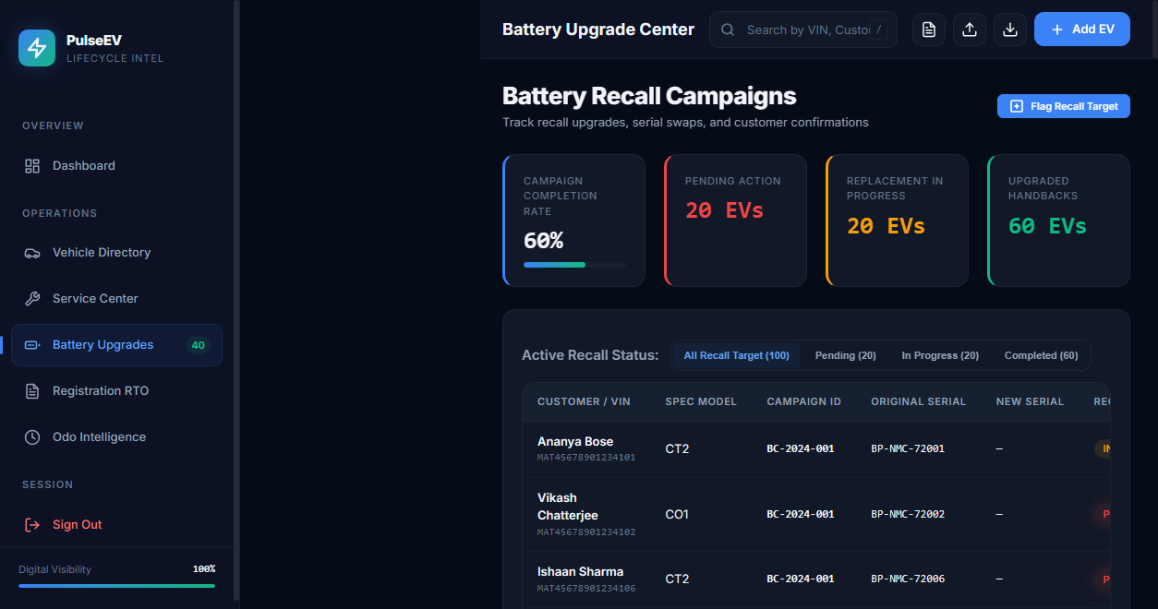
Proof of Concept: 200-Vehicle Demo
• Seeded Evaluation Fleet
Features 200 pre-seeded customer records to demonstrate system responsiveness and database performance under scale.
• Service Center & Technician Assignments
Audits odometer logs, completed km milestones, and technician assignments.
• Recall Campaigns Tracker
Tracks retired battery serials, replacement status, and signed customer sign-offs.

Slide 9
Let's Drive Your EV Operations Forward
We are ready to schedule a 15-minute operational briefing or deploy a live Proof of Concept (PoC) using your templates.
Contact: ismail@pulseev-operations.com

