Slide 1
Textile Today Network
Web & Mobile Application Development

Slide 2
Key Features
Both the app (Browser base & Mobile app) have push notification system
The whole system should be secured enough (Browser base app, Mobile app & Admin panel)
Developed system (Browser base app, Mobile app & Admin panel) must ensure user’s security and privacy.

Slide 3
Application Architecture
1. The Network
2. Knowledge Volt
3. Trainings
4. Events
5. Jobs & Career
Classified
ads
Forum
8. Support

Slide 4
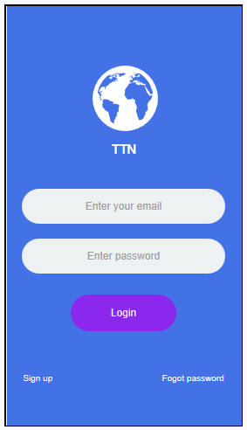
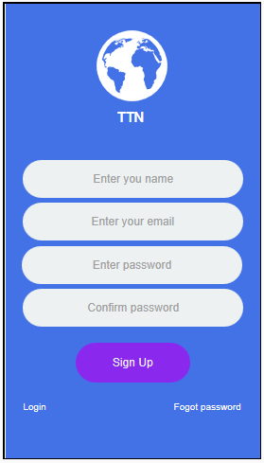
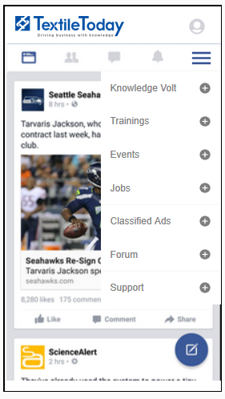
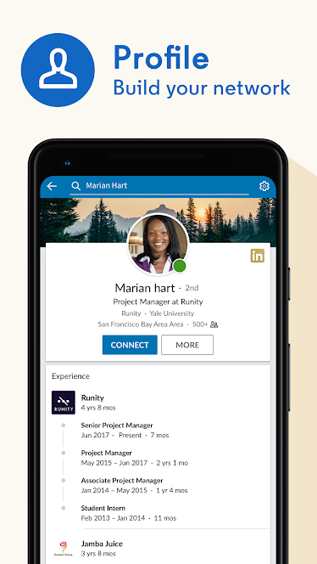
Module 1. The Network

Slide 5
Module 1. The Network (Profile)
Personal information
Contact information
Interests
Achievements & Badges
Work history
Educational backgrounds
Other social media links

Slide 6
Module 1. The Network (User Types)
Normal User
Subscriber
Advertiser
Trainer
Trainee
Correspondents
Contributors
One user can hold multiple user type and we can increase types of user at any time. It will be dynamic.

Slide 7
Module 1. The Network (Profile)
Basic Settings
Name, Picture, Email, Password, Change Password
Profession/Career oriented details
Professional Profile Setting
Member profile
Interest Group (Network) Setting
Select interested categories from 10 TTN categories
Select whether member wants to keep ‘Associates’ in his/her network.
Manage TTN Subscription along with other purchases
Subscription Settings

Slide 8
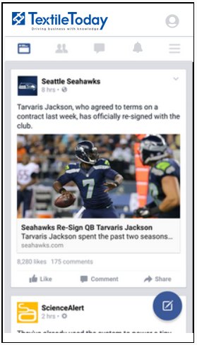
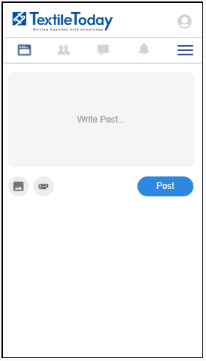
Module 1. The Network (Real-time Newsfeed)
News, Discussions
Paid Ads
Classified Ads
Job postings
Upcoming trainings
Events
Based on Member’s Interest Group

Slide 9
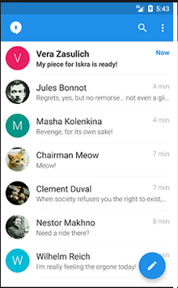
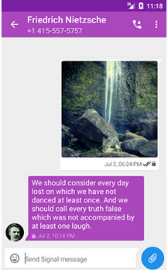
Module 1. The Network (Conversations)
Like, Comment, Reply
Chat Client
Text Messages
Photos
Files

Slide 10
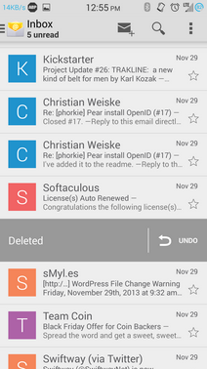
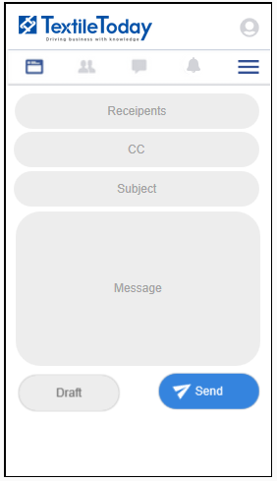
Module 1. The Network (Email)

Slide 11
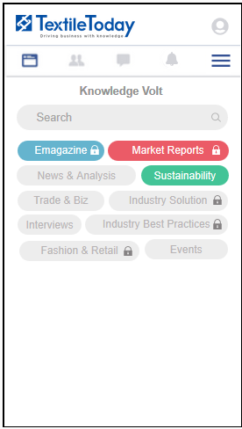
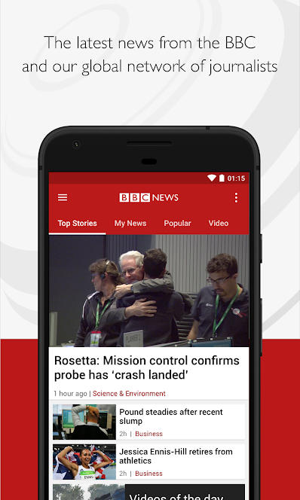
Module 2: Knowledge volt
News & Articles
Market Reports
EMagazine
Downloads
Based on their interest group

Slide 12
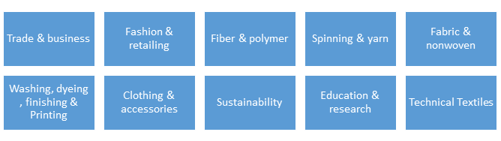
Module 2. Knowledge Volt (Interests Groups)

Slide 13
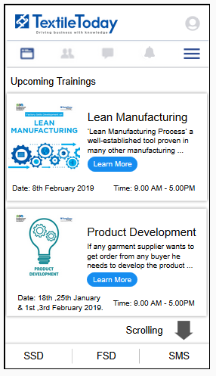
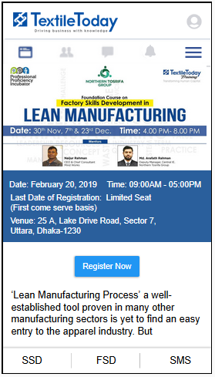
Module 3: Trainings
Upcoming & Featured Workshops
Free Workshops
Push Notification
Mentor’s Profile
Certificates
Achievements
Track Classes

Slide 14
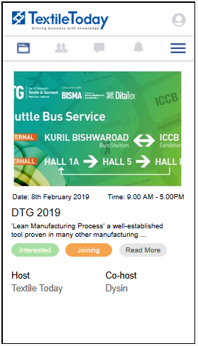
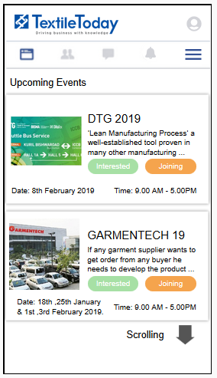
Module 4: Events
Upcoming & Featured Events
Interested & Joining Button
Seminar & Conference
Fair & Exhibition
Award & Certifications
One Click Registration

Slide 15
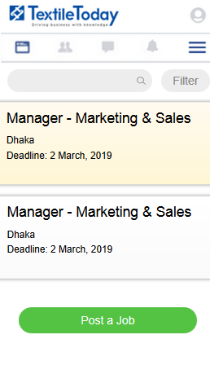
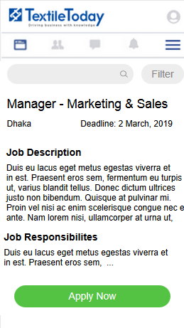
Module 5: Jobs & Career
Browse & Apply
Post for Hiring
Featured Job Openings
Job Filter
CV Search

Slide 16
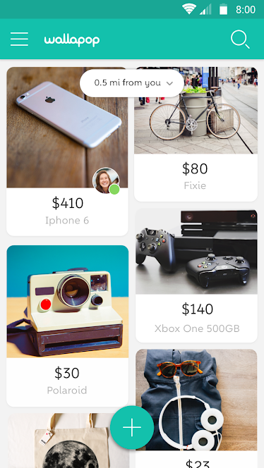
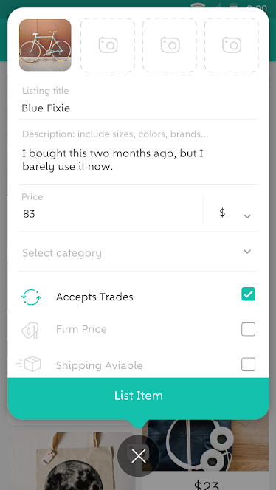
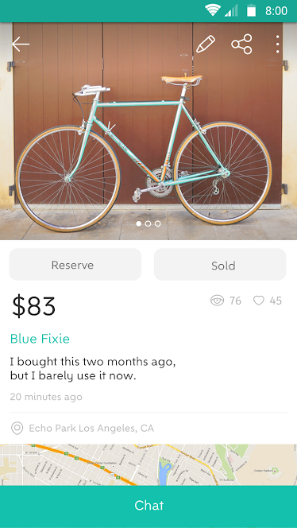
Module 6: Classified Ads

Slide 17
Module 6: Classified Ads
Sell or Buy Ads
Ad Tickets
Featured Ads
Buyer & Seller In-App Chat
Wishlist

Slide 18
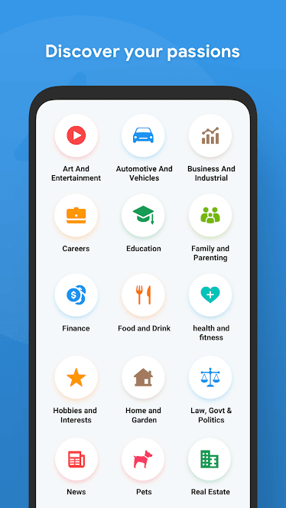
Module 7: Forum
Opening Discussions
Categories
Discussion Tickets
Best Answers
Discussion Comment/Reply

Slide 19
Module 8: Support
Live chat
Opening Tickets
Support Categories
Ticket replies

Slide 20
Membership Access Control
Services | Free Member | Associated Member | Premium
The Network | Limited | Full Access | Full Access
Knowledge Volt | Limited | Full Access | Full Access
Trainings | Limited | Limited | Limited
Events | Limited | Limited | Limited
Jobs | Limited | Limited | Full Access
Classified Ads | Limited | Limited | Full Access
Forum | Limited | Full Access | Full Access
Support | Full Access | Full Access | Full Access

Slide 21
Tickets
Free limited tickets for users based on user types
Ticket purchase
Expiration

Slide 22
CRM Integrations
Subscriber Management
Contacts Management
Distribution Module
Reports

Slide 23
Payments & Billing
Payment Gateway for online purchase
Payment records
Billing notifications

Slide 24
Payments & Billing
Payment Gateway for online purchase
Payment records
Billing notifications

