Slide 1


HACKATHON 2024
LNRS HACKATHON 2024

Slide 2

ABOUT ME
Name: Ismail Wangde
Email Id: wangdeismail@gmail.com
Contact No: 9309369799
Github Account: https://github.com/ismailwangde
Topic: Handwritten Notes recognition
College: MPSTME (NMIMS)
Student Id: 70092100112
Repo Link: github.com/ismailwangde/LNRSHACKATHON_ISMAILWANGDE

Slide 3
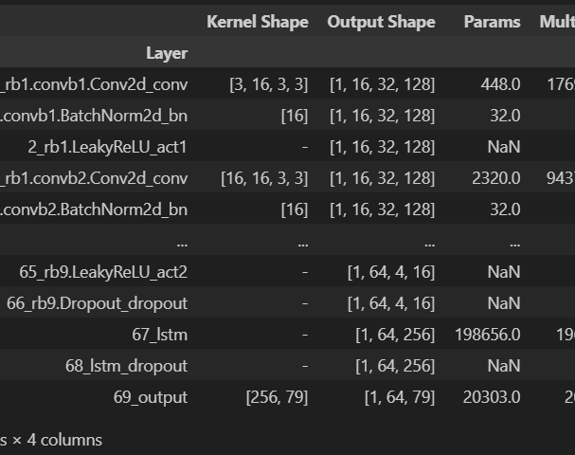
Model Architecture
Convolution Neural Network and Long Short Term Memory for building the model using Pytorch.
Pytesseract: Word level Extraction
Mltu: for various tasks such as metrics, callbacks, preprocessing, transformers, augmentation.

Slide 4
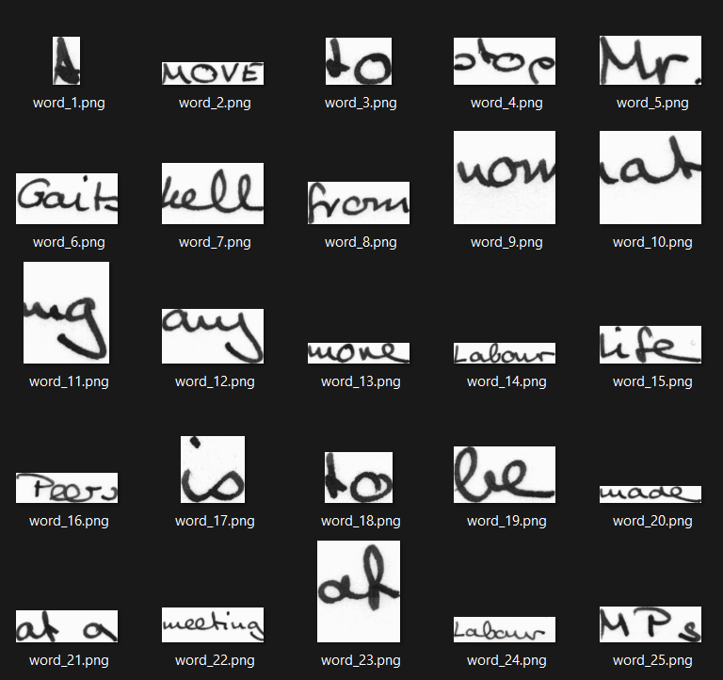
Word level Extraction
For input into the model as the model is trained on word level.
Output: “1 MOVE to stop Mr. Gait kell from”

