Slide 1
ESI PROJECT
Ardi Aasmaa, Kadri Oluwagbemi, Kristjan Veskimäe, Polad Mahmudov, Tural Ismayilov

Slide 2
Design
KISS / Keep it simple, stupid - U.S. Navy 1960
Less value objects
Edge cases
Min # of states
Fail fast
Verify parameters
Database fields
Push callbacks
Need work from partner

Slide 3
BuildIt
External IDs
PlantInventoryEntry
PurchaseOrder
Track supplier
No open extension

Slide 4
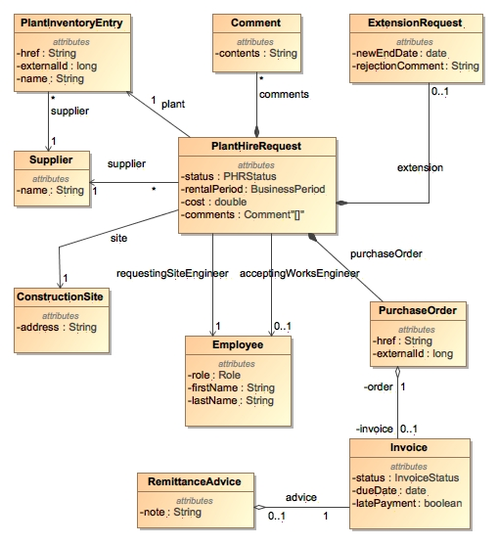
BuildIt domain model

Slide 5
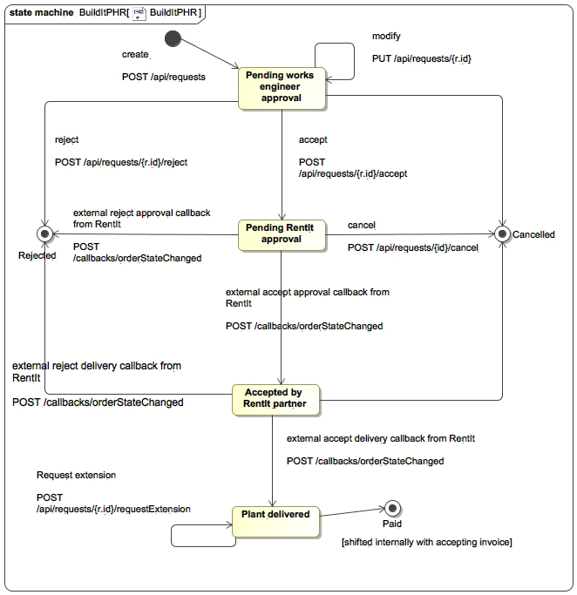
BuildIt PHR state model

Slide 6
RentIt
Plant reservation
Synchronous extension answer

Slide 7
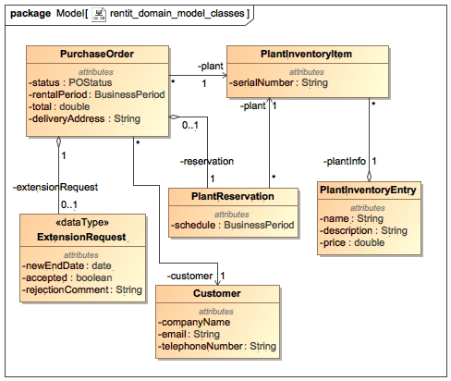
RentIt domain model

Slide 8
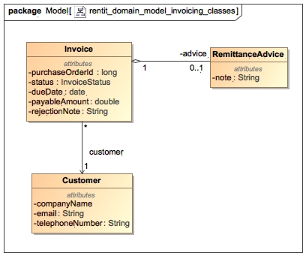
RentIt Invoicing submodule

Slide 9
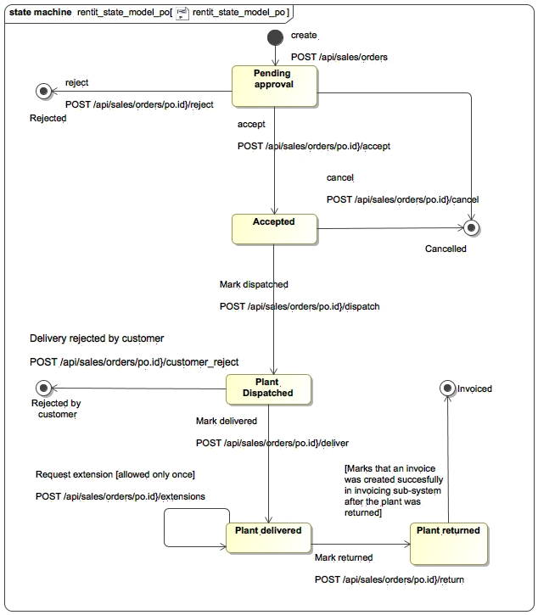
RentIt PO state model

Slide 10
Integration
In-house RentIt
Team 1 (B79586)
Team 2 (B79605)

Slide 11
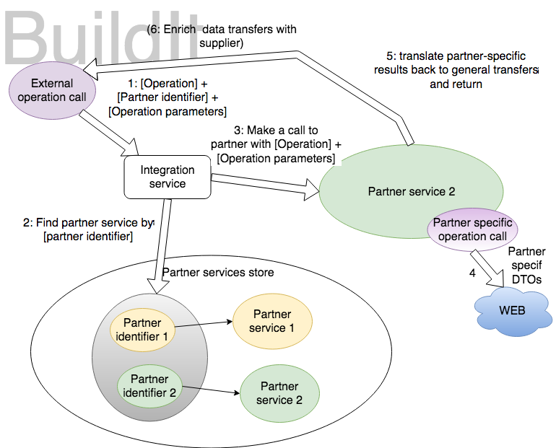
Integration with service adapters

Slide 12
Takeaways
Change is inevitable
Affordances - ?!
Task division
By component
E.g. “Tom works on invoicing in RentIt back-end”, “Bill works on invoicing in BuildIt back-end” & “Mary works on front-end”
hard to sync work
By functionality
Full-stack development by one programmer
?

Slide 13
Thank you! & Demo

