Slide 1
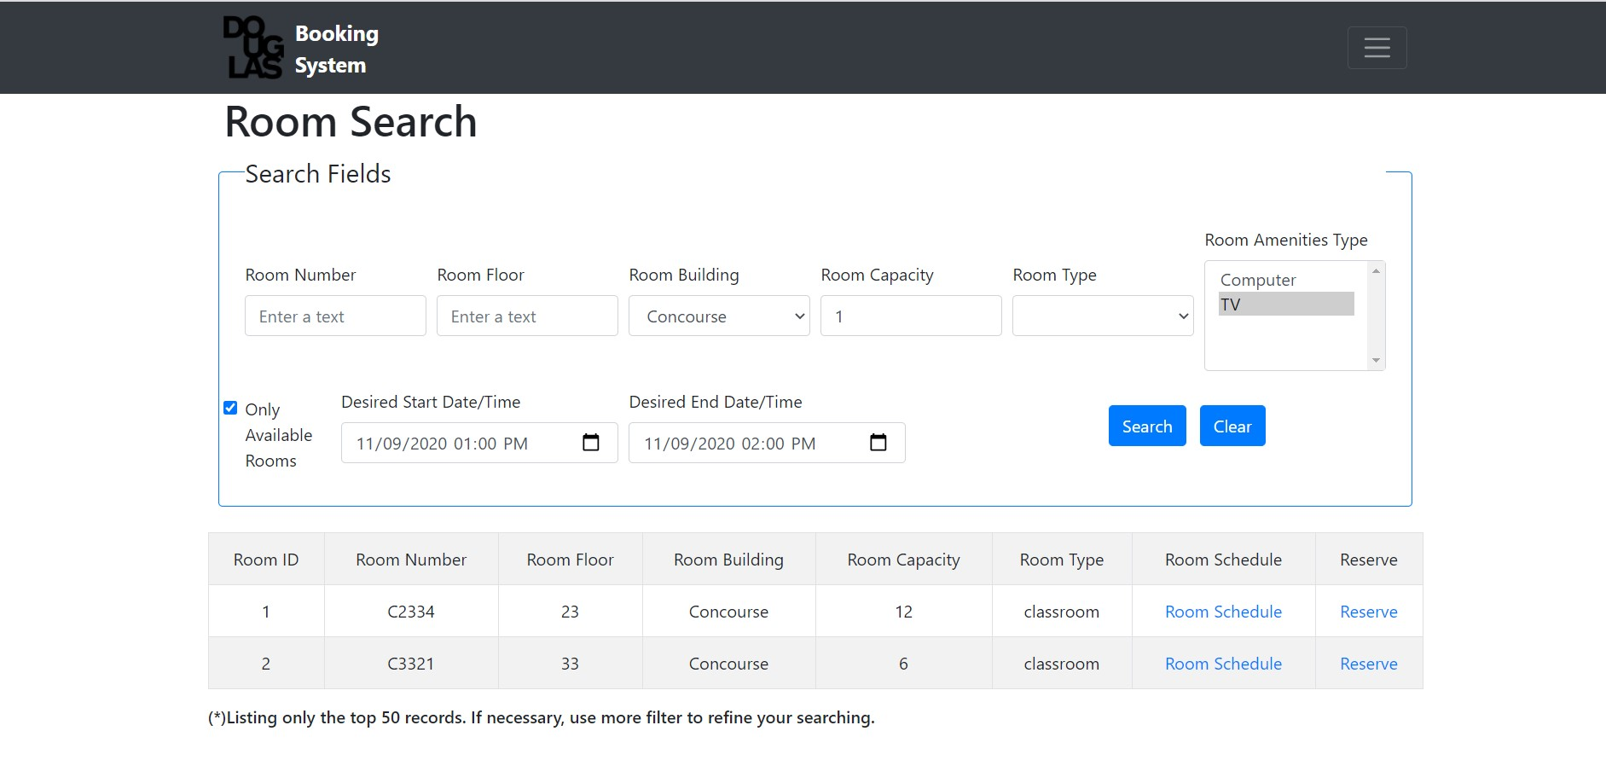
Field to search by the minimum room capacity
Field to search by Amenities available in the Room
Fields to search by Room Location
Field to search by Room Type
Field to search by Room Number
Fields to search for available rooms to reserve
Button to reset the search form
List of Rooms return by the searching
Button to submit the searching
Option to open the Room Schedule
Option to open the Room Reservation form

