Slide 1
LMS (Learning Management System) Project

Slide 2
Project Objectives
Provide certain users like Teachers & Students with an overview of their courses.
Presentation of the data is in the form of graphs and other visual elements.

Slide 3
Project Framework
The project is powered using Django 2.0 for Python.
Web pages are written using HTML and JavaScript.
Graphs inside the web pages are written in JavaScript.
Data passed to the graphs are in JSON format and are fed into the graphs dynamically through Django’s Interface.

Slide 4
Work Done
Front-End
Back-End
Front-End (Charts)
WIMS Installation
Programming in Django
Students
Teachers

Slide 5
Front End Design:
Login Page:
Login Form
Dashboard:
Top bar
Slidebar Navigator
Tiles
Charts
Student Message
Responsive design (smartphone, tablets, PC and laptop)

Slide 6
Front End (Charts)
Following JavaScript libraries are used to illustrate statistics in the project
Charts JS
Flot Charts
Morris Charts
Sparkline Charts
Rickshaw Charts

Slide 7
Student Profile
Personal info
Contact Info
Academic info
Academic Achievements

Slide 8
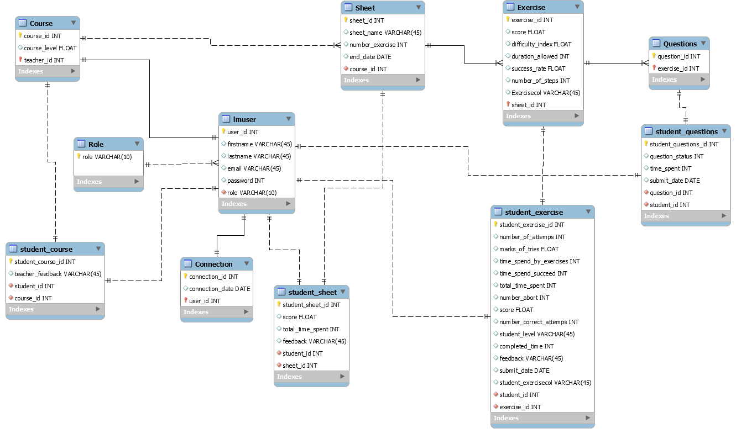
UML Diagram
Classes
Course
Student Course
Role
LMS User
Connections
Sheet
Student Sheet
Exercise
Student Exercise
Question
Student Questions

Slide 9
Reading and understanding the interviews
Extracting the fields(Columns) and tables which are necessary for the database
For the Front-end, base on the requirements obtained from the interviews, various charts have been selected to have a good dashboard for the LMS
Sphinx tool is going to be used for the code documentation

Slide 10
Work to be done
Implement view for other users:
Anti-Cheat User
Didactician
Implement more charts for each user

Slide 11
Thank you!

