Slide 1
Network Applications: DNS; Network App Programming--UDP
Qiao Xiang
https://qiaoxiang.me/courses/cnns-xmuf21/index.shtml
10/05/2021
This deck of slides are heavily based on CPSC 433/533 at Yale University, by courtesy of Dr. Y. Richard Yang.

Slide 2
Outline
Admin. and recap
DNS
High-level design
Details
Extensions/alternatives
Network app programming
UDP

Slide 3
Admin
Assignment Two linked on the schedule page
Oct. 28, in class or by email to the instructor

Slide 4
Recap: Client-Server Paradigm
application
transport
network
data link
physical
The basic paradigm of network applications is the client-server (C-S) paradigm
Some key design questions to ask about a C-S application:
extensibility
scalability
robustness
security
request
reply
application
transport
network
data link
physical

Slide 5
Recap: Email App
Some key design features of Email
Separate protocols for different functions
email access (e.g., POP3, IMAP)
email transport (SMTP)
Separation of envelop and message body (end-to-end arguments)
envelop: simple/basic requests to implement transport control;
message body: fine-grain control through ASCII header and message body
MIME type as self-describing data type
Status code in response makes message easy to parse
user
agent
mail
server
user
agent
SMTP
mail
server
user
agent
SMTP
SMTP
mail
server
user
agent
POP3 or
IMAP SMTP
user
agent
user
agent

Slide 6
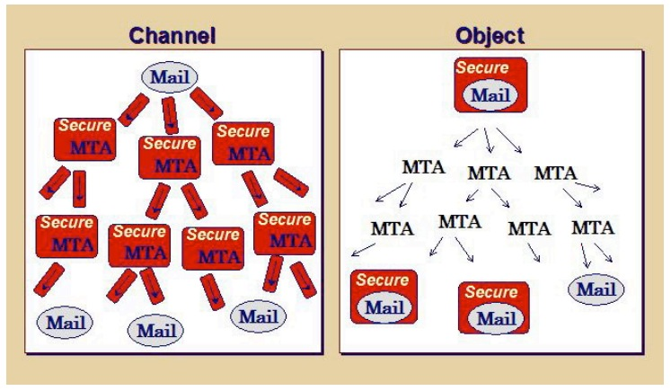
Recap: Email Authentication Approaches
Sender Policy Frame (SPF)
DomainKeys Identified Mail (DKIM) Authenticated Results Chain (ARC)
Notes:
https://support.google.com/mail/answer/1366858?hl=en
http://support.simpledns.com/KB/a62/configuring-dns-records-for-domainkeys-dkim.aspx
https://dmarc.org/presentations/ARC-Overview-2016Q3-v01.pdf

Slide 7
Summary: Some Key Remaining Issues about Email
Basic: How to find the email server of a domain?
Scalability/robustness: how to find multiple servers for the email domain?
Security
SPF: How does SPF know if its neighbor MTA is a permitted sender of the domain?
DKIM: How does DKIM retrieve the public key of the author domain?

Slide 8
Recap: Domain Name System (DNS)
Function
map between (domain name, service) to value, e.g.,
(xmu.edu.cn, addr) -> 210.34.0.35
(xmu.edu.cn, email) -> cmsn1.xmu.edu.cn
clients
DNS
Hostname, Service
Address
routers
servers
Notes:
Why name: easy to remember, one-level of indirection

Slide 9
Recap: DNS Records
http://www.iana.org/assignments/dns-parameters/dns-parameters.xhtml
DNS: stores resource records (RR)
RR format: (name, type, value, ttl)
Type=A
name is hostname
value is IP address
Type=CNAME
name is an alias of a “canonical” (real) name
value is canonical name
Type=NS
name is domain (e.g. xmu.edu.cn)
value is the name of the authoritative name server for this domain
Type=MX
value is hostname of mail server associated with name
Type=SRV
general extension for services
Type=TXT
general txt
Type=PTR
a pointer to another name

Slide 10
Recap: Observations
MX can return multiple servers
DNS may rotate the servers in answer
Address can also return multiple addresses
SPF is encoded as the txt type

Slide 11
Outline
Admin. and recap
DNS
High-level design
Details

Slide 12
DKIM Example
Send email from hotmail and check message
Notes:
https://support.google.com/mail/answer/1366858?hl=en
http://support.simpledns.com/KB/a62/configuring-dns-records-for-domainkeys-dkim.aspx
Try TXT record for gmail.com dig txt gmail.com

Slide 13
DKIM Example
DKIM / ARC: Msg: ARC-Message-Signature: i=1; a=rsa-sha256; c=relaxed/relaxed; d=microsoft.com; s=arcselector9901; h=From:Date:Subject:Message-ID:Content-Type:MIME-Version; bh=bO91TxHI+4MjgAusrfg0EWGiDmvQ5hZRZ/aqb1MKLY8=; …
DKIM-Signature: v=1; a=rsa-sha256; c=relaxed/relaxed;
d=hotmail.com; s=selector1; h=From:Date:Subject:Message-
ID:Content-Type:MIME-Version:X-MS-Exchange-
SenderADCheck;…
Query: dig arcselector9901._domainkey.microsoft.com txt
DKIM introduces a session key to allow multiple public keys
<session>._domainkey.<domain>

Slide 14

DNS Design: Dummy Design
DNS itself can be considered as a client-server system as well
How about a dummy design: introducing one super Internet DNS server?
THE DNS server of the Internet
IP address
resolve <name>
register <name>
OK/used already

Slide 15
Problems of a Single DNS Server
Scalability and robustness bottleneck
Administrative bottleneck

Slide 16
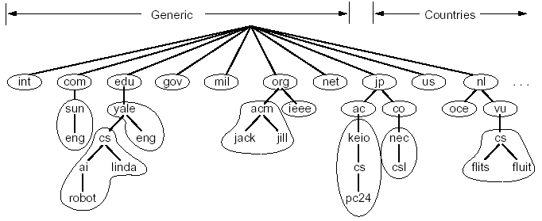
DNS: Distributed Management of the Domain Name Space
A distributed database managed by authoritative name servers
divided into zones, where each zone is a sub-tree of the global tree
each zone has its own authoritative name servers
an authoritative name server of a zone may delegate a subset (i.e. a sub-tree) of its zone to another name server
cn
pku
xmu
mail
cwc
called a zone

Slide 17
Email Architecture + DNS
user
agent
mail
server
user
agent
SMTP
mail
server
user
agent
SMTP
SMTP
mail
server
user
agent
POP3 or
IMAP SMTP
DNS
user
agent
user
agent

Slide 18
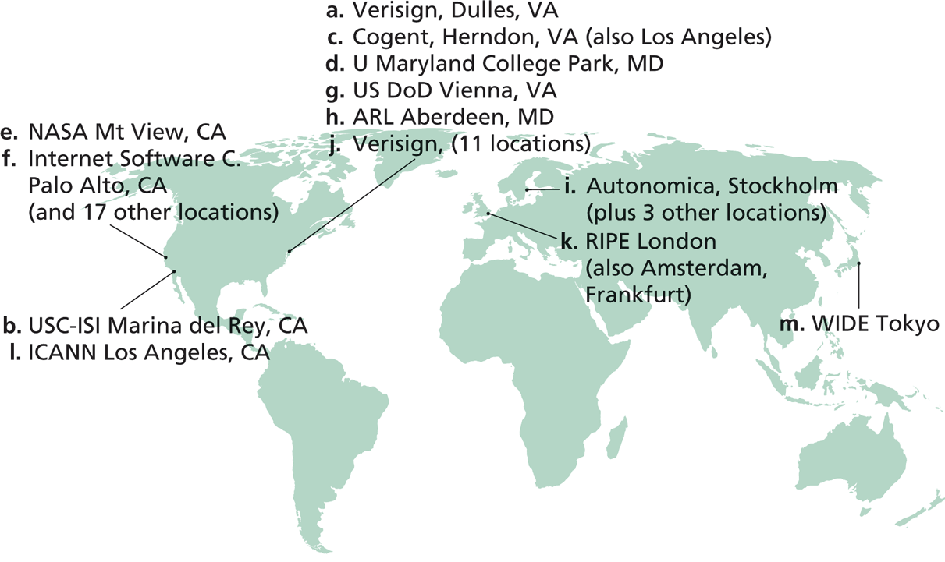
Root Zone and Root Servers
The root zone is managed by the root name servers
13 root name servers worldwide
See http://root-servers.org/ for more details

Slide 19
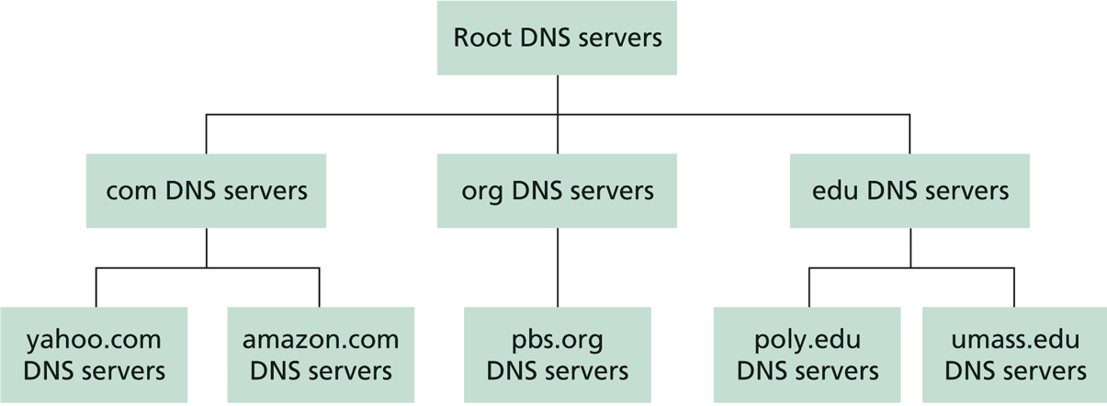
Linking the Name Servers
Each name server knows the addresses of the root servers
Each name server knows the addresses of its immediate children (i.e., those it delegates)
Top level domain (TLD)
Q: how to query a hierarchy?

Slide 20
DNS Message Flow: Two Types of Queries
Recursive query:
The contacted name server resolves the name completely
Iterated query:
Contacted server replies with name of server to contact
“I don’t know this name, but ask this server”

Slide 21

Two Extreme DNS Message Flows
root name server
root name server
Iterative query
Recursive query
1
1
2
2
6
client
TLD name server
client
5
TLD name server
3
4
5
4
3
6
A: ALL the load has to go through the root server!
Q: Issues of the two approaches?
authoritative name server
authoritative name server
informatics.xmu.edu.cn
informatics.xmu.edu.cn

Slide 22
Typical DNS Message Flow: The Hybrid Case
root name server
Host knows only local name server
Local name server is learned from DHCP, or configured, e.g. /etc/resolv.conf
Local DNS server helps clients resolve DNS names
2
iterated query
3
4
7
local name server
130.132.1.9
TLD name server
6
5
1
8
authoritative name server
dns.cs.umass.edu
requesting host
cyndra.cs.yale.edu
gaia.cs.umass.edu

Slide 23
Typical DNS Message Flow: The Hybrid Case
root name server
Host knows only local name server
Local name server is learned from DHCP, or configured, e.g. /etc/resolv.conf
Local DNS server helps clients resolve DNS names
Benefits of local name servers (often called resolvers)
simplifies client
caches/reuses results
2
iterated query
3
4
7
local name server
TLD name server
6
5
1
8
authoritative name server
dns.cs.umass.edu
requesting host
harvard.edu
gaia.cs.umass.edu

Slide 24
Outline
Admin. and recap
DNS
High-level design
Details

Slide 25
DNS Message Format?
Basic encoding decisions: UDP/TCP, how to encode domain name, how to encode answers…
DNS
DNS
TCP
UDP
TCP
UDP
IP
IP
Ethernet
Wireless
Cable/DSL
Ethernet
Wireless
Cable/DSL
25
Notes:
Basic questions: how to encode domain name; how to do compression…

Slide 26
Observing DNS Messages
Capture the messages
DNS server is at port 53
Display and clear DNS cache
MacOS: https://support.apple.com/en-us/HT202516 sudo killall -HUP mDNSResponder
Ubuntu:
sudo systemd-resolve --flush-caches
sudo systemd-resolve --statistics
Try to load the dns-capture file from class Schedule page, if you do not want live capture

Slide 27
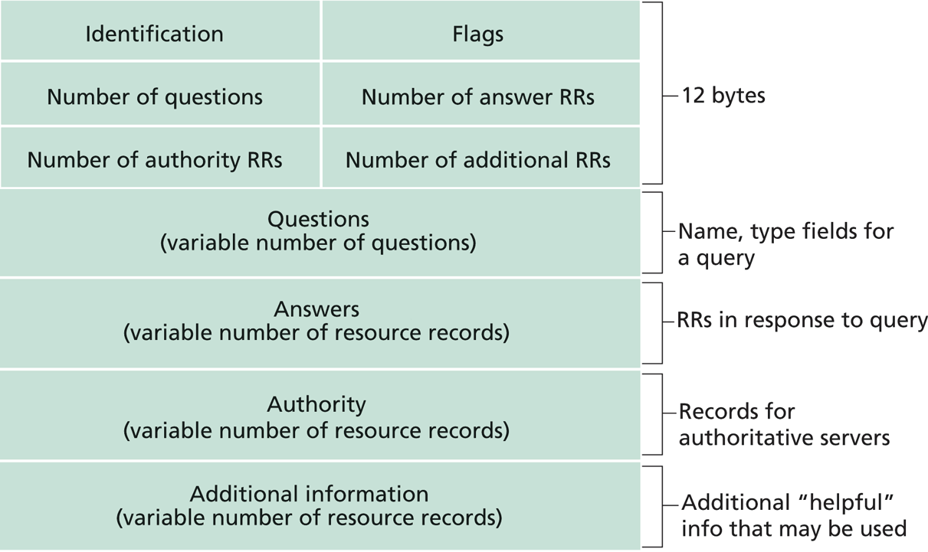
DNS Protocol, Messages
https://www.ietf.org/rfc/rfc1035.txt
DNS protocol : typically over UDP (can use TCP); query and reply messages, both with the same message format

Slide 28
DNS Details
Header (Sec. 4.1.1 of https://www.ietf.org/rfc/rfc1035.txt)
Encoding of questions (Sec. 4.1.2):
[Label-length label-chars]
Encoding of answers (Sec. 4.1.3)
Pointer format (http://www.iana.org/assignments/dns-parameters/dns-parameters.xhtml)
See example DNS packets

Slide 29
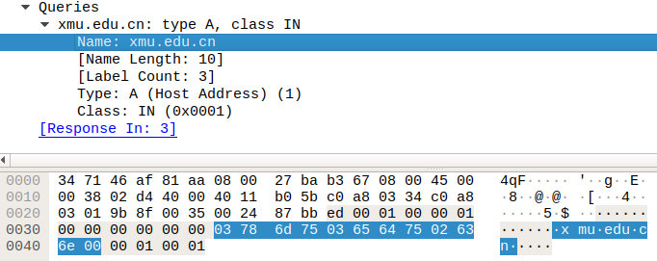
Name Encoding
cn
xmu
edu
length

Slide 30
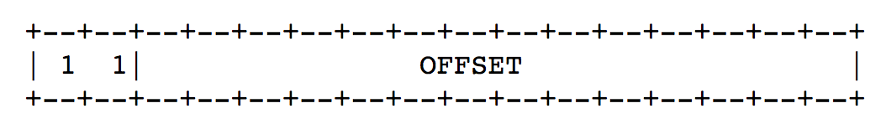
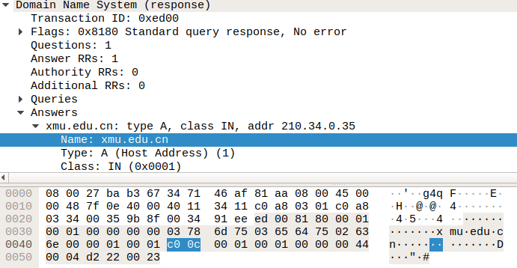
Message Compression (Label Pointer)
question
DNS start
Answer: offset 12

Slide 31
Recap: DNS Protocol, Messages
https://www.ietf.org/rfc/rfc1035.txt
Many features: typically over UDP (can use TCP); query and reply messages with the same message format; length/content encoding of names; simple compression; additional info as server push

Slide 32
What DNS did Right?
Hierarchical delegation avoids central control, improving manageability and scalability
Redundant servers improve robustness
see http://www.internetnews.com/dev-news/article.php/1486981 for DDoS attack on root servers in Oct. 2002 (9 of the 13 root servers were crippled, but only slowed the network)
Caching reduces workload and improves robustness
Proactive answers reduce # queries on server and latency on client

Slide 33
Problems of DNS
Simple query model, relatively static resource values and types make it harder to implement generic service discovery
e.g., service discovery of all printers
Although theoretically you can update the values of the records, it is rarely enabled
Early binding (separation of DNS query from application query) does not work well in mobile, dynamic environments
e.g., load balancing, locate the nearest printer
Each local domain needs servers, but an ad hoc domain may not have a DNS server

Slide 34
Outline
Admin. and recap
DNS
High-level design
Details
Extensions/alternatives

Slide 35
Discussions
What extension(s) to standard DNS operations do we need to allow service discovery, say to implement Bonjour (discover all local printers)?
each printer needs to provide the following info: host, port, printer info (e.g., support postscript)

Slide 36


DNS-Service Discovery
Leverage DNS message format, but each node can announce its own services
169.254.1.219
Printer
Network
169.254.10.29
169.254.4.51

Slide 37
Realizing DNS-SD without Central DNS Server: mDNS
Multicast in a small world
no central address server
each node is a responder
link-local addressing
send to multicast address: 224.0.0.251
169.254.1.219
Printer
Network
169.254.10.29
169.254.4.51

Slide 38
Example
Use the avahi-publish-service command on Ubuntu as example
Advertise (register) an LPR printer on port 515 avahi-publish-service test _printer._tcp . 515 pdl=application/postscript
port
Name of instance providing the service
<type_service>. <transport>
Txt for additional data
38

Slide 39
Example
Use the dns-sd command on Mac as example
Advertise (register) an LPR printer on port 515 dns-sd -R "test" _printer._tcp . 515 pdl=application/postscript
port
Name of instance providing the service
domain (. means default, which is local
<type_service>. <transport>
Txt for additional data
39

Slide 40
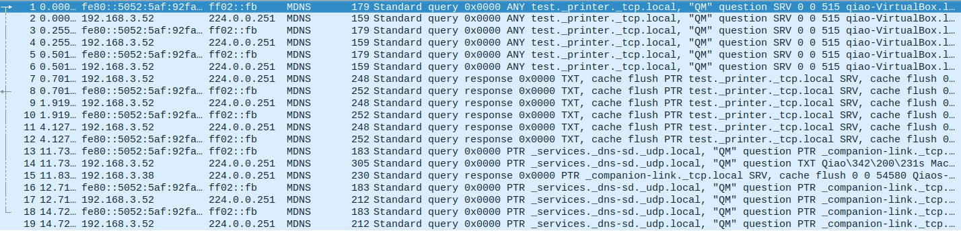

Slide 41
Offline Exercise
Use the dns-sd /avahi-publish-service command as example
Advertise (register) a web page on local machine dns-sd -R "My Test" _http._tcp . 80 path=/path-to-page.html
41

Slide 42
Issue: How to Query
Query needs a back pointer, PTR records
Exercise: Use the dns-sd / avahi-service-publish command as example
Browse web pages on local machines dns-sd -B _http._tcp
avahi-browse –rt _http._tcp

Slide 43
Network Service Discovery in Android
Based on DNS-SD/mDNS
Foundation for peer-to-peer/Wi-Fi Direct in Android
See https://developer.android.com/training/connect-devices-wirelessly/nsd.html for programming using nsd

Slide 44
Backup Slides (General Service/Naming Discovery)

Slide 45
General Service/Naming Discovery Paradigm: Linda
“Distributed workspace” by David Gelernter in the 80’s at Yale
Very influential in naming and resource discovery
Key issues
How to name services/resources
How to resolve names

Slide 46
The Linda Paradigm
Naming scheme:
arbitrary tuples (heterogeneous-type vectors)
Name resolution:
Nodes write into shared memory
Nodes read matching tuples from shared memory
exact matching is required for extraction

Slide 47
Linda: Core API
out(): writes tuples to shared space
example: out("abc", 1.5, 12).
result: insert (“abc”, 1.5, 12) into space
read(): retrieves tuple copy matching arg list (blocking)
example: read(“abc”, ? A, ? B)
result: finds (“abc”, 1.5, 12) and sets local variables A = 1.5, B = 12. Tuple (“abc”, 1.5, 12) is still resident in space.
in(): retrieves and deletes matching tuple from space (blocking)
example: same as above except (“abc”, 1.5, 12) is deleted
eval(expression): similar to out except that the tuple argument to eval is evaluated
example: eval("ab",-6,abs(-6)) creates tuple (“ab”, -6, 6)
Notes:
eval()
evaluates a tuple on the server

Slide 48
Linda Extension: JavaSpaces
Industry took Linda principles and made modifications
add transactions, leases, events
store Java objects instead of tuples
a very comprehensive service discovery system
Definitive book, “JavaSpaces Principles, Patterns, and Practice”

