Slide 1
Network Layer: Global Internet Routing (Interdomain, BGP)
Qiao Xiang
https://qiaoxiang.me/courses/cnns-xmuf21/index.shtml
12/07/2021
This deck of slides are heavily based on CPSC 433/533 at Yale University, by courtesy of Dr. Y. Richard Yang.

Slide 2
Outline
Admin and recap
Network control plane
Routing
Link weights assignment
Routing computation
Basic routing computation protocols
Distance vector protocols (distributed computing)
Link state protocols (distributed state synchronization)
Global Internet routing

Slide 3
Admin
If you haven't done so, please let me and TA know your project topic as soon as possible
Final exam
Similar format as midterm
You still get to bring a cheatsheet
Cover lectures 16-27
17 + 1 (bonus) question

Slide 4
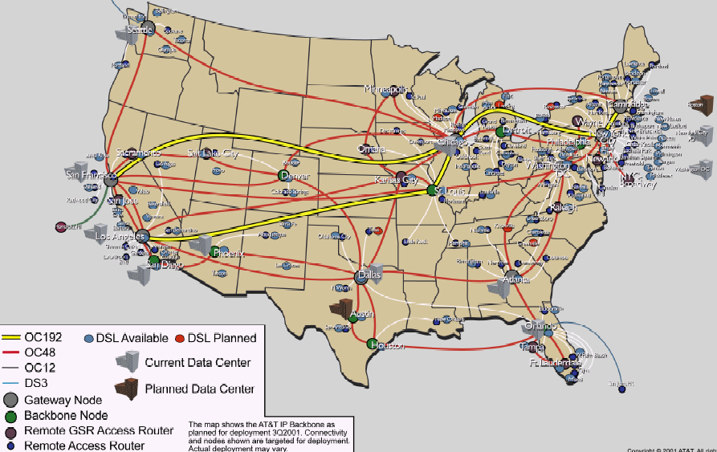
Recap: Routing Context
Routing
Goal: determine “good” paths
(sequences of routers) thru
networks from source to dest.
Often depends on a graph abstraction:
graph nodes are routers
graph edges are physical links
links have properties: delay, capacity, $ cost, policy
5
B
3
C
2
5
A
2
1
F
3
1
2
D
E
1

Slide 5
Recap: Routing Computation using Distance Vector/Bellman-Ford Routing
Distributed computation: At node i, computes
One way to understand BFA is to consider it as a dynamic programming alg, propagating from dest to other nodes
destination
j
i

Slide 6
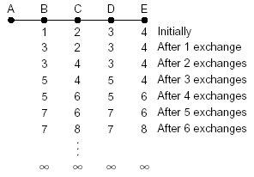
Recap: Fixing DV/BFA
Property of BFA
Bad news may propagate slowly due to loops
Techniques
Reverse poison
Avoid two-node loops
DSDV
Using destination seq to partition into epochs
A good example of analysis using global invariants
Diffusive Update Alg (DUAL)
Utilize backup routes

Slide 7
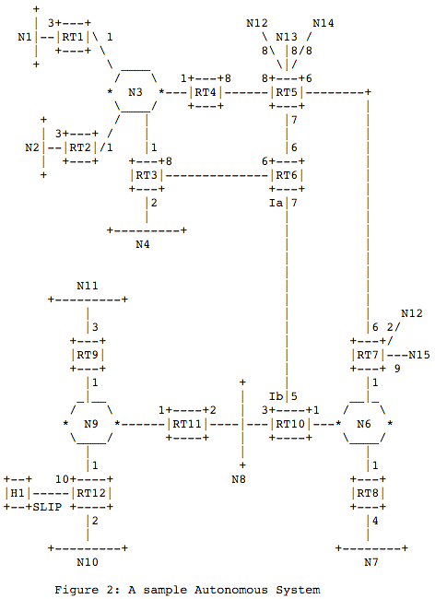
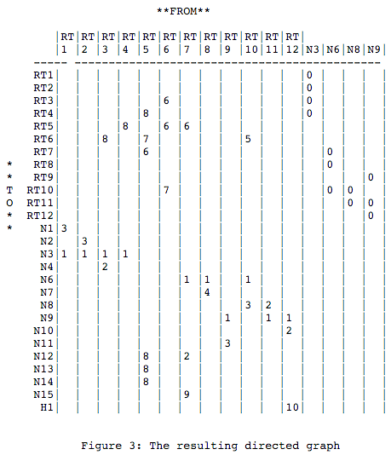
Recap: Link State Routing
Basic idea: instead of distributed computing of routes, only distributed state distribution (synchronization)
Link state distribution can still have much complexity, e.g.,
out of order delivery
partition and reconnect
scalability
Notes:
Simplicity
churns before convergence
path exploration; counting-to-infinity
not enough information when making routing decision (only next-hops and their distance estimates)
While distance-vector protocols are appropriate for small internetworks, and require much less configuration and management
- IGRP was a significant improvement over RIP, which had a hop count restriction that limited the size of an internetwork. IGRP supports internetworks with up to 255 hops.
IGRP:
Upon router startup, IGRP broadcast request messages to other routers. Upon receipt of the message, router send their routing tables to the startup router. Routing tables contain entries for each of the networks that a router can reach. At regular intervals, routers automatically transmit their routing tables to other routers which in turn update their own routing tables if there are changes in the topology. A triggered update occurs if the network topology changes. Triggered updates allow quick responses to changes in the network. When routers add entries to routing tables, 1 is added to the hop count to account for the hop between the router and the neighbor from which it received the route information. When a route is entered into the routing table, a timer is set. As routing table updates arrive and a route entry is verified to still be valid, the timer is reset. If a known router fails to appear in an update and in subsequent updates, the timer will run out and the route entry will be purged.

Slide 8
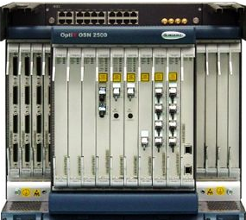
Roadmap: Routing Computation Architecture Spectrum
Dijkstra
Distributed Bellman Ford
Distributed Link State
Dijkstra
Datapath
Distributed Bellman Ford
Distributed Link State
Dijkstra
Datapath
Distributed Bellman Ford
Distributed Link State
Datapath
Notes:
RIP: 1988 RFC1058 OSFPv2: RFC2328

Slide 9
Outline
Admin and recap
Network control plane
Routing
Link weights assignment
Routing computation
Basic routing computation protocols
Distance vector protocols (distributed computing)
Link state protocols (distributed state synchronization)
Global Internet routing

Slide 10
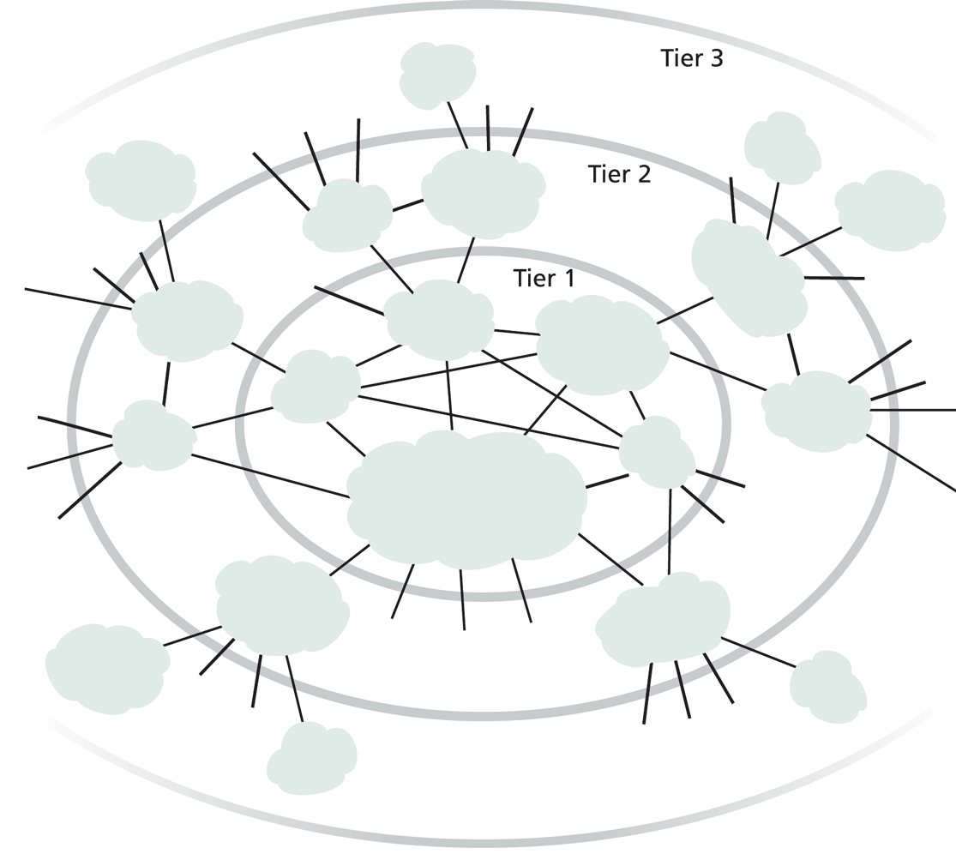
Exercise
Does it work to use DV or LS as we discussed for global Internet routing?
Notes:
DV: so many loops,
LS/DV: scalability

Slide 11
Requirements and Solution of Current Global Internet Routing
Scalability: handle network size (#devices) much higher than typical DV or LS can handle
Solution: Introduce new abstraction to reduce network (graph) size
Autonomy: allow each network to have individual preference of routing (full control of its internal routing; control/preference of routing spanning multiple networks)
Solution: hierarchical routing and policy routing
Notes:
Other than scale, what else?

Slide 12
New Abstraction: Autonomous Systems (AS)
Abstract each network as an autonomous system (AS), identified by an AS number (ASN)
Conceptually the global routing graph consists of only autonomous systems as nodes
http://www.bgplookingglass.com/list-of-autonomous-system-numbers

Slide 13
Routing with Autonomous Systems
Internet routing is divided into intra-AS routing and inter-AS routing
Intra-AS routing (also called intradomain routing)
A protocol running insides an AS is called an Interior Gateway Protocol (IGP), each AS can choose its own protocol, such as RIP, E/IGRP, OSPF, IS-IS
Inter-AS routing (also called interdomain routing)
A protocol runs among autonomous systems is also called an Exterior Gateway Protocol (EGP)
The de facto EGP protocol is BGP

Slide 14
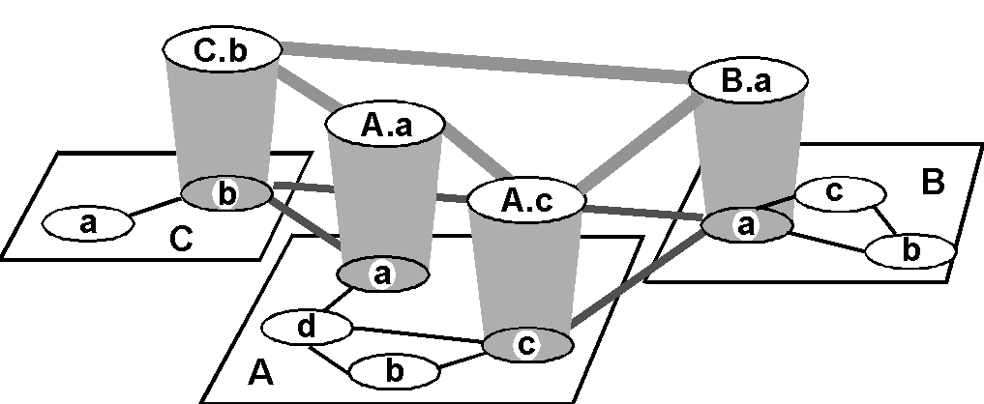
Routing with Autonomous Systems
Inter-AS routers form an overlay
Gateway routers participate in intradomain to learn internal routes.
Gateway routers of same AS share learned external routes using iBGP.
AS C
(RIP intra
AS B
(OSPF intra
AS A
(OSPF intra
routing)
routing)
routing)
i
a
b
e
eBGP
iBGP
f
g
Gateway routers of diff. auto. systems exchange routes using eBGP
d
c
h

Slide 15
Routing with Autonomous Systems
border (exterior gateway) routers
C.b
B.a
A.a
b
A.c
c
a
C
a
b
a
B
d
c
A
b
interior (gateway) routers

Slide 16
Summary: Internet Routing Architecture
Autonomous systems have flexibility to choose their own intradomain routing protocols
allows autonomy
Only a small # of routers (gateways) from each AS in the interdomain level
improves scalability
Interdomain routing using AS topology instead of detailed topology
improves scalability/privacy

Slide 17
Outline
Admin and recap
Network control plane
Routing
Link weights assignment
Routing computation
Basic routing computation protocols
Global Internet routing
Basic architecture
BGP (Border Gateway Protocol): The de facto Inter-domain routing standard

Slide 18
BGP Basic Operations
BGP is a Path Vector protocol
similar to Distance Vector protocol
a border gateway sends to a neighbor entire path (i.e., a sequence of ASNs) to a destination, e.g.,
gateway X sends to neighbor N its path to dest. Z:
path (X,Z) = X,Y1,Y2,Y3,…,Z
if N selects path(X, Z) advertised by X, then: path (N,Z) = N, path (X,Z)
Z
N
X

Slide 19
BGP Basic Operations
Establish session on
TCP port 179
AS1
BGP session
Exchange all
active routes
AS2
while (connection is ALIVE) exchange UPDATE message select best available route
if route changes, export to neigh.
Exchange incremental
updates

Slide 20
BGP Messages
Four types of messages
OPEN: opens TCP connection to peer and authenticates sender
UPDATE: advertises new path (or withdraws old)
KEEPALIVE keeps connection alive in absence of UPDATES; also ACKs OPEN request
NOTIFICATION: reports errors in previous msg; also used to close connection

Slide 21
Outline
Admin and recap
Network control plane
Routing
Link weights assignment
Routing computation
Basic routing computation protocols
Global Internet routing
Basic architecture
BGP (Border Gateway Protocol): The de facto Inter-domain routing standard
Basic operations
BGP as a policy routing framework (control interdomain routes)

Slide 22
BGP Policy Routing Framework:
Label Route Information Sources
RIP process
OSPF process
BGP process
BGP
RIP routing table
OSPF Routing table
BGP routing table
RIP
domain
OS kernel
OSPF
domain
Routing Information Base (RIB)
Forwarding Information Base (FIB)
22

Slide 23
BGP Policy Routing Framework: Decision Components
route selection policy: rank paths
1 3 0
1 0
routing cache
select best path
export policy: which paths export to which neighbors
export path to neighbors
AT&T
Qwest
Internet2
Yale
23

Slide 24
BGP Example (1)
AS D
d
E
AS A
(OSPF)
d->a2: I can reach
hosts in D; my path: D
Export to E: i->e: I can reach hosts in D; path: IAD
a2
a2->a1: I can reach
hosts in D; path: D
a1->i: I can reach hosts in D; my path: AD
a1
No export to F (effect?)
i
F
AS C
Route selection policy:
- Shortest AS Path policy:
Choose AD using a1
i2->i: I can reach hosts in D; path: BCD
b->i: I can reach hosts
in D; my path: BCD
AS B
(OSPF intra
Export policy controls ingress, i.e., who can use I
routing)
i2
b
b->i2: I can reach hosts
in D; my path: BCD
AS I
Notes:
Choose

Slide 25
BGP Example (2)
AS D
d
E
AS A
(OSPF)
d->a2: I can reach
hosts in D; my path: D
Export to E: i->e: I can reach hosts in D; path: IBCD
a2
a2->a1: I can reach
hosts in D; path: D
a1->i: I can reach hosts in D; my path: AD
a1
F
i
AS C
Selection policy: - Low local_pref for A
- Shortest AS Path
- Prefer eBGP
Called hot potato (why?)
i2->i: I can reach hosts in D; path: BCD
b->i: I can reach hosts
in D; my path: BCD
AS B
(OSPF intra
Outcome: Choose BCD using b
routing)
i2
b
b->i2: I can reach hosts
in D; my path: BCD
AS I
Notes:
Choose

Slide 26
BGP Example (3)
AS D
d
E
AS A
(OSPF)
d->a2: I can reach
hosts in D; my path: D
Export to E: i->e: I can reach hosts in D; path: IBCD
a2
a2->a1: I can reach
hosts in D; path: D
a1->i: I can reach hosts in D; my path: AD
a1
F
i
AS C
Selection policy: - Low local pref A
- Shortest AS Path
- Prefer iBGP
Called cold potato (why?)
i2->i: I can reach hosts in D; path: BCD
b->i: I can reach hosts
in D; my path: BCD
AS B
(OSPF intra
Outcome: Choose BCD using i2
routing)
i2
b
b->i2: I can reach hosts
in D; my path: BCD
AS I
Notes:
Choose

Slide 27
Observing BGP Paths
Using one of the looking glass servers: http://www.bgp4.as/looking-glasses
https://www.gin.ntt.net/looking-glass/

Slide 28
Outline
Admin and recap
Network control plane
Routing
Link weights assignment
Routing computation
Basic routing computation protocols
Global Internet routing
Basic architecture
BGP (Border Gateway Protocol): The de facto Inter-domain routing standard
Basic operations
BGP as a policy routing framework (control interdomain routes)
Policy/interdomain routing analysis

Slide 29
Motivation: Policy Routing Stability
A policy routing system can be considered as a system to aggregate local preferences, but aggregation may not be always successful.
The BAD GADGET example:
- 0 is the destination
- the route selection policy of each AS is to prefer its counter clock-wise neighbor
preferred
2 1 0
2 0
2
4
less
preferred
0
3 2 0
3 0
1 3 0
1 0
1
3
3
Policy (preferences) aggregation fails: routing instability !

Slide 30
General Framework of Preference Aggregation
Also called Social Choice
Given individual preferences, define a framework to aggregate individual preferences:
A set of choices: a, b, c, …
A set of voters 1, 2, …
Each voter has a preference (ranking) of all choices, e.g.,
voter 1: a > b > c
voter 2: a > c > b
voter 3: a > c > b
A well-specified aggregation rule (protocol) computes an aggregation of ranking, e.g.,
Society (network): a > b > c
Notes:
https://en.wikipedia.org/wiki/Arrow%27s_impossibility_theorem

Slide 31
Example: Aggregation of Global Preference
A
S
D
B
Choices (for S->D route): SAD, SBD, SABD, SBAD
Voters S, A, B, D
Each voter has a preference, e.g.,
S: SAD > SBD > SABD > SBAD
…
Notes:
https://en.wikipedia.org/wiki/Arrow%27s_impossibility_theorem

Slide 32
Arrow’s Aggregation Framework
Axioms:
Transitivity
if a > b & b > c, then a > c
Unanimity:
If all participants prefer a over b (a > b) => a > b
Independence of irrelevant alternatives (IIA)
Social ranking of a and b depends only on the relative ranking of a and b among all participants
Result:
Arrow’s Theorem: Any constitution that respects transitivity, unanimity and IIA is a dictatorship.
Notes:
https://en.wikipedia.org/wiki/Arrow%27s_impossibility_theorem

Slide 33
Proofs of Arrow’s Theorem
There are quite a few proofs, and the six-page paper linked on the Schedule page gives three simple proofs.
Below, I give the key insight of the proof using approach 1.

Slide 34
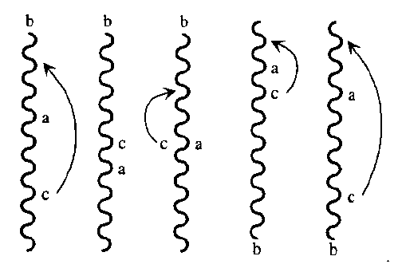
The Extremal Lemma
Let choice b be chosen arbitrarily. Assume that every voter puts b at the very top or the very bottom of his ranking. Then society must as well (even if half voters put b at the top and half at the bottom)
Proof: by contradiction.
Assume there exist a and c such that society has a >= b; b >= c.
By transitivity, a >= c
We can move c above a w/o changing ab or cb votes, leading to c > a
By unanimity, c > a

Slide 35
Step 1: Existence of Pivotal Voter
Let choice b be chosen arbitrarily. There exist a voter n* = n(b) who is extremely pivotal for b in the sense that by changing his vote at some profile, he can move b from the very bottom to the very top in the social ranking.
Proof:
Consider an extreme profile where b is at the bottom of each voter.
Consider voter from 1 to n, and we move b from bottom to top one-by-one.
The first voter whose change causes b to move to the top is n*
By unanimity, this change must happen at the latest when n*=n

Slide 36
Step 2: n*=n(b) is dictator of any pair ac not involving b
Proof
Consider a from ac pair. We show that if a >_{n*} c, then constitution protocol has a > c
Let profile before n* moves b to top as profile I
Let profile after n* moves b to top as profile II
Construct profile III from II by letting n* move a above b; all others can arrange ac as they want, but leave b in extreme position
a>b in profile I, and a,b is equivalent by IIA in profiles I and III
b>c in profile II, and bc is equivalent by IIA in profiles II and III
b
.
.
.
b
.
.
.
.
.
.
b
.
.
.
b
.
.
.
b
Profile I
Constitution protocol: b bottom
b
.
.
.
b
.
.
.
b
.
.
.
.
.
.
b
.
.
.
b
Profile II
Constitution protocol : b top
1 2 n* . N
b
.
.
.
b
.
.
.
a
b
.
c
.
.
.
b
.
.
.
b
Constitution protocol: a > b since ab same as I
Profile III
b > c since bc same as II

Slide 37
Step 3: n* is dictator for every pair ab
Consider c not equal to a or b
There exists n(c) who is a dictator of any pair not involving c, such as the pair ab, i.e.,
For any profile, if a >_{n(c)} > b, a > b in constitution protocol
n(c) must be n*
Assume not.
Consider Profile I and Profile II.
Since n(c) is not n*, n(c) ranking of ab does not change in Profile I and Profile II.
When n* changes ab ranking between Profile I and Profile II, the global ranking of ab changes.
Contradiction.

Slide 38
Outline
Admin and recap
Network control plane
Routing
Link weights assignment
Routing computation
Basic routing computation protocols
Global Internet routing
Basic architecture
BGP (Border Gateway Protocol): The de facto Inter-domain routing standard
Basic operations
BGP as a policy routing framework (control interdomain routes)
Policy/interdomain routing analysis
Global preference aggregation and Arrow’s Theorem
Local preference aggregation

Slide 39
BGP w/ Local Preference
BGP preferences are typically local (only on paths start from itself)
Hence the preferences have dependency (priority)
The “closer” a node to the destination, the more “powerful” it may be
210
20
2
0
130
10
1
3
320
30
1 3 0
2 1 0
3 2 0
1 0
2 0
3 0

Slide 40
Complete Dependency: P-Graph
Complete dependency can be captured by a structure called P-graph
Nodes in P-graph are feasible paths
Edges represent priority (low to high)
A directed edge from path N₁P₁ to P₁
intuition: to let N₁ choose N₁P₁, P₁ must be chosen and exported to N₁
A directed edge from a lower ranked path to a higher ranked path
intuition: the higher ranked path should be considered first
210
20
2
0
130
10
1
3
320
30
1 3 0
2 1 0
3 2 0
1 0
2 0
3 0
Any observation on the P-graph?

Slide 41
P-Graph and BGP Convergence
If the P-graph of the networks has no loop, then policy routing converges.
intuition: choose the path node from the partial order graph with no out-going edge to non-fixed path nodes, fix the path node, eliminate all no longer feasible; continue
Example: suppose we swap the order of 30 and 320
210
20
2
1 3 0
2 1 0
3 0
0
130
10
1
3
30
320
1 0
2 0
3 2 0

