Slide 1
Network Transport Layer: Network Resource Allocation Framework
Qiao Xiang
https://qiaoxiang.me/courses/cnns-xmuf21/index.shtml
11/25/2021
This deck of slides are heavily based on CPSC 433/533 at Yale University, by courtesy of Dr. Y. Richard Yang.

Slide 2
Admin.
Lab assignment 3 & 4 due on Nov. 30
Lab assignment 5 overview this afternoon

Slide 3
Outline
Admin and recap
Transport congestion control
what is congestion (cost of congestion)
basic congestion control alg.
TCP/Reno congestion control
TCP Cubic
TCP/Vegas
network wide resource allocation
general framework
objective function: axiom derivation of network-wide objective function
algorithm: general distributed algorithm framework
application: TCP/Reno TCP/Vegas revisited

Slide 4
Recap: TCP/Reno Throughput Modeling
=>
=>
This is called the TCP throughput sqrt of loss rate law.

Slide 5
Recap: TCP/Reno Throughput Modeling
cwnd
TD
W
ssthresh
W/2
Time
congestion
avoidance
Total packets sent per cycle = (W/2 + W)/2 * W/2 = 3W²/8
Assume one loss per cycle
=> p = 1/(3W²/8) = 8/(3W²)
=>

Slide 6
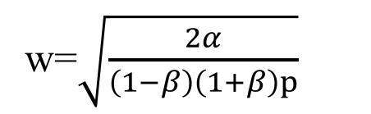

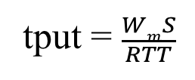
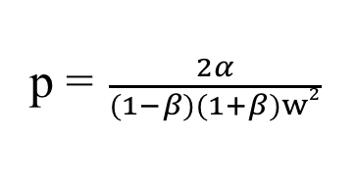

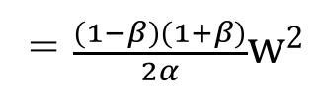
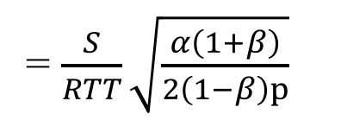

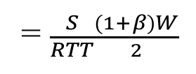
Recap: Generic AIMD and TCP Friendliness
cwnd
TD
W
ssthresh
βW
Time
congestion
avoidance
Total packets sent per cycle =
$$\frac{βW+W}{2}$$
$$\frac{(1−β)W}{α}$$
=$\frac{(1−β)(1+β)}{2α}w2$
w=$\sqrt{\frac{2α}{\left(1−β\right)\left(1+β\right)p}}$
Assume one loss per cycle
p =$\frac{2α}{(1−β)(1+β)w2}$
tput = $\frac{WmS}{RTT}$
= $\frac{S}{RTT}\sqrt{\frac{α\left(1+β\right)}{2\left(1−β\right)p}}$
= $\frac{S}{RTT}\frac{(1+β)W}{2}$
TCP friendly =>
$$α=3 \frac{1−β}{1+β}$$

Slide 7
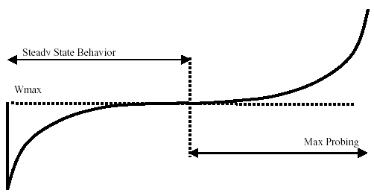


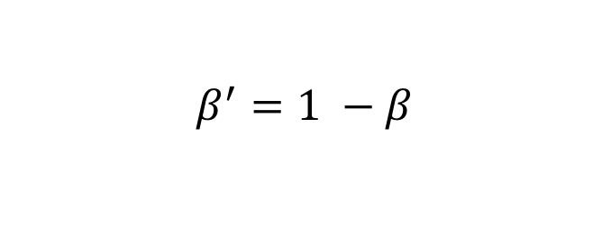
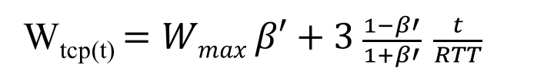
Recap: TCP Cubic
$$β^{′}=1 −β$$
W_{tcp(t)} $=Wmax β′+3 \frac{1−β′}{1+β′} \frac{t}{RTT}$
convex region
slow down
concave region
where C is a scaling factor, t is the elapsed time from the last window reduction, and β is a constant multiplication decrease factor

Slide 8
Outline
Admin and recap
Transport congestion control
what is congestion (cost of congestion)
basic congestion control alg.
TCP/Reno congestion control
TCP Cubic
TCP/Vegas
network wide resource allocation
general framework

Slide 9
Motivation
So far our discussion is implicitly on a network with a single bottleneck link; this simplifies design and analysis:
efficiency/optimality (high utilization)
fully utilize the bandwidth of the link
fairness (resource sharing)
each flow receives an equal share of the link’s bandwidth

Slide 10
Network Resource Allocation
It is important to understand and design protocols for a general network topology
how will TCP allocate resource in a general topology?
how should resource be allocated in a general topology?

Slide 11
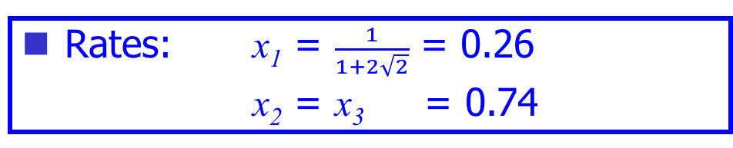
Example: TCP/Reno Rates
Rates: x₁ = $\frac{1}{1+2\sqrt{2}}$ = 0.26
x₂ = x₃ = 0.74
x₁
C= 1
C = 1
x₂
x₃

Slide 12
Example: TCP/Vegas Rates
Rates : x₁ = 1/3
x₂ = x₃ = 2/3
x₁
C= 1
C = 1
x₂
x₃

Slide 13

Example: Max-min Fairness
Max-min fairness: maximizes the throughput of the flow receiving the minimum (of resources)
Justification: John Rawls, A Theory of Justice (1971)
http://en.wikipedia.org/wiki/John_Rawls
This is a resource allocation scheme used in ATM and some other network resource allocation proposals

Slide 14
Example: Max-Min
Rates: x₁ = x₂ = x₃ = 1/2
x₁
C= 1
C = 1
x₂
x₃

Slide 15
Framework: Network Resource Allocation Using Utility Functions
A set of flows F
Let x_{f} be the rate of flow f, and the utility to flow f is U_{f}(x_{f}).
Maximize aggregate utility, subject to capacity constraints

Slide 16

Example: Maximize Throughput
$$Uf\left(xf\right)=xf$$
Optimal: x₁ = 0
x₂ = x₃ = 1
x₁
C= 1
C = 1
x₂
x₃

Slide 17
Example: Proportional Fairness
Optimal: x₁ = 1/3
x₂ = x₃ = 2/3
x₁
C= 1
C = 1
x₂
x₃

Slide 18
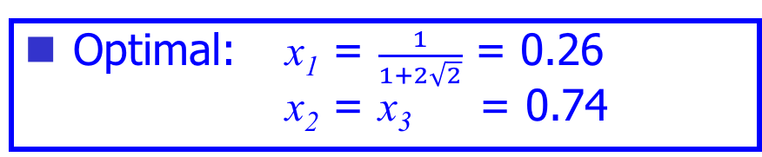
Example 3: a “Funny” Utility Function
Optimal: x₁ = $\frac{1}{1+2\sqrt{2}}$ = 0.26 x₂ = x₃ = 0.74
x₁
C= 1
C = 1
x₂
x₃

Slide 19
Summary: Allocations
Objective | Allocation (x1, x2, x3)
TCP/Reno | 0.26 | 0.74 | 0.74
TCP/Vegas | 1/3 | 2/3 | 2/3
Max Throughput | 0 | 1 | 1
Max-min | ½ | ½ | ½
Max sum log(x) | 1/3 | 2/3 | 2/3
Max sum of -1/(RTT² x) | 0.26 | 0.74 | 0.74
x₁
C= 1
C = 1
x₂
x₃

Slide 20
Questions
Forward engineering: systematically
design objective function
design distributed alg to achieve objective
Science/reverse engineering: what do TCP/Reno, TCP/Vegas achieve?
Objective | Allocation (x1, x2, x3)
TCP/Reno | 0.26 | 0.74 | 0.74
TCP/Vegas | 1/3 | 2/3 | 2/3
Max throughput | 0 | 1 | 1
Max-min | ½ | ½ | ½
Max sum log(x) | 1/3 | 2/3 | 2/3
Max sum of -1/(RTT² x) | 0.26 | 0.74 | 0.74

Slide 21
Outline
Admin and recap
Transport congestion control
what is congestion (cost of congestion)
basic congestion control alg.
TCP/Reno congestion control
TCP Cubic
TCP/Vegas
network wide resource allocation
general framework
objective function: an example of an axiom derivation of network-wide objective function

Slide 22
Network Bandwidth Allocation Using Nash Bargain Solution (NBS)
High level picture
given the feasible set of bandwidth allocation, we want to pick an allocation point that is efficient and fair
The determination of the allocation point should be based on “first principles” (axioms)

Slide 23
Network Bandwidth Allocation: Feasible Region
x₁
x₂
x₃
x₁
C= 1
C = 1
x₂
x₃

Slide 24
Nash Bargain Solution (NBS)
Assume a finite, convex feasible set in the first quadruant
Axioms
x₂
R
s
x₁
Notes:
The second two enforce consistency across scenarios

Slide 25
Nash Bargain Solution (NBS)
Assume a finite, convex feasible set in the first quadrant
Axioms
Pareto optimality
impossibility of increasing the rate of one user without decreasing the rate of another
symmetry
a symmetric feasible set yields a symmetric outcome
invariance of linear transformation
the allocation must be invariant to linear transformations of users’ rates
independence of irrelevant alternatives
assume s is an allocation when feasible set is R, s ∈T ⊂ R, then s is also an allocation when the feasible set is T
x₂
R
s
T
x₁
Notes:
The second two enforce consistency across scenarios

Slide 26
Nash Bargain Solution (NBS)
Surprising result by John Nash (1951)
the rate allocation point is the feasible point which maximizes
This is equivalent to maximize
In other words, assume each flow f has utility function log(x_{f})
I will give a proof for F = 2
think about F > 2
x₂
R
x₁

Slide 27
Nash Bargain Solution
Assume s is the feasible point which maximizes x1 * x2
Scale the feasible set so that s is at (1, 1)
how?
x₂
x1 * x2
s
1
x₁
1

Slide 28
Nash Bargain Solution
x₂
P
x1 * x2 = 1
x1 = x2
Question: after the transformation, is there any feasible point with x1 + x2 > 2?
Q
1
s
R
x1 + x2 = 2
x₁
1

Slide 29
Nash Bargain Solution
Consider the symmetric rectangle U containing the now feasible set
-> According to symmetry and Pareto, s is the allocation when feasible set is U
According to independence of irrelevant alternatives, the allocation of R is s as well.
x₂
x1 * x2 = 1
x1 = x2
1
s
R
x1 + x2 = 2
x₁
1
U

Slide 30
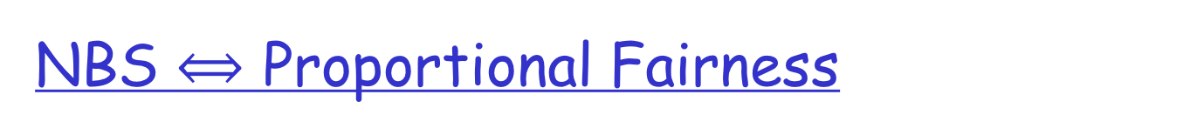
Allocation is proportionally fair if for any other allocation, aggregate of proportional changes is non-positive, e.g. if x_{f} is a proportional-fair allocation, and y_{f} is any other feasible allocation, then require

Slide 31
Questions to Think
Vary the axioms and see if you can derive any objective functions

Slide 32
Outline
Admin and recap
Transport congestion control
what is congestion (cost of congestion)
basic congestion control alg.
TCP/Reno congestion control
TCP Cubic
TCP/Vegas
network wide resource allocation
general framework
objective function: an example axiom derivation of network-wide objective function
algorithm: general distributed algorithm framework
application: TCP/Reno TCP/Vegas revisited

Slide 33
Recall: Resource Allocation Framework
The Resource-Allocation Problem:
Goal: Design a distributed alg to solve the problem.
Discussion：
What are typical approaches to solve optimization, e.g.,? max U(x)
Why is the Resource-Allocation problem hard to solve by a distributed algorithm?

Slide 34
A Two-Slide Summary of Constrained Convex Optimization Theory
f(x) concave
g(x) linear
S is a convex set
q
f(x)
Map each x in S, to [g(x), f(x)]
S
q
Top contour of map is concave
Easy to read solution from contour
For each slope q (>=0), computes f(x) – q g(x) of all mapped [f(x), g(x)]
g(x)
Notes:
The intersection w/ y-axis is f(x)-qg(x)
Important to draw the two cases of g(x)

Slide 35
A Two-Slide Summary of Constrained Convex Optimization Theory
f(x) concave
g(x) linear
S is a convex set
f(x)
q₁
q₂
S
q₃
D(q) is called the dual; q (>= 0) are called prices in economics
D(q) provides an upper bound on obj.
- According to optimization theory: when D(q) achieves minimum over all q (>= 0), then the optimization objective is achieved.
g(x)

Slide 36
x₁
Dual of the Primal
1
1
x₂
x₃

Slide 37
Dual of the Primal
x₁
1
1
x₂
x₃

Slide 38
Distributed Optimization: User Problem
Given p_{f} (=sum of dual var q_{l} along the path) flow f chooses rate x_{f} to maximize:
Using the price signals, the optimization problem of each user is independent of each other!

Slide 39
Distributed Optimization: User Problem
How should flow f adjust x_{f} locally?
At equilibrium (i.e., at optimal), x_{f} satisfies:

Slide 40
Interpreting Congestion Measure
q_{l}(t)
q₂(t)
x_{f}(t)

Slide 41
Distributed Optimization: Network Problem
The network (i.e., link l) adjusts the link signals q_{l} (assume after all flows have picked their optimal rates given congestion signal)

Slide 42
Distributed Optimization: Network Problem
how should link l adjust q_{l} locally?

Slide 43
System Architecture
SYSTEM(U):
USER_{f}:
NETWORK:

Slide 44
Decomposition Theorem
There exist vectors p , w and x such that
w_{f} = p_{f}x_{f} for f ∈ F
w_{f} solves USER_{f}(U_{f}; p_{f})
x solves NETWORK(w)
The vector x then also solves SYSTEM(U).

Slide 45
Outline
Admin and recap
Transport congestion control
what is congestion (cost of congestion)
basic congestion control alg.
TCP/Reno congestion control
TCP Cubic
TCP/Vegas
network wide resource allocation
general framework
objective function: an example axiom derivation of network-wide objective function
algorithm: a general distributed algorithm framework
application: TCP/Reno and TCP/Vegas revisited

Slide 46
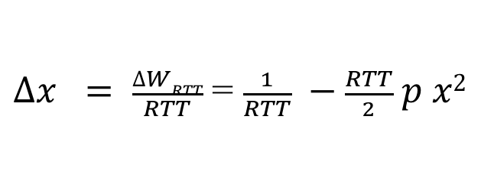
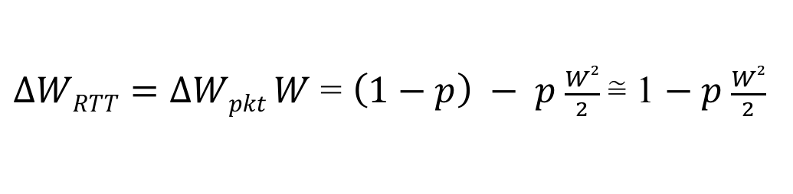

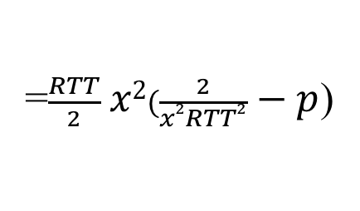
TCP/Reno Dynamics
$$∆Wpkt=\left(1−p\right)\frac{1}{W} −p \frac{W}{2}$$
$∆WRTT=∆Wpkt W$ = $\left(1−p\right) − p \frac{W2}{2} \text{≅}$ 1 $− p \frac{W2}{2}$
$∆x = \frac{∆WRTT}{RTT}$ = $\frac{1}{RTT} −\frac{RTT}{2} p x2$
=$\frac{RTT}{2} x2(\frac{2}{x2RTT2} − p$)

Slide 47
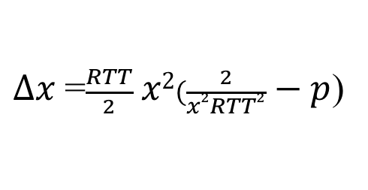
TCP/Reno Dynamics
$∆x$=$\frac{RTT}{2} x2(\frac{2}{x2RTT2} − p$)

Slide 48
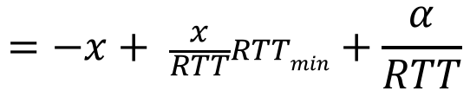
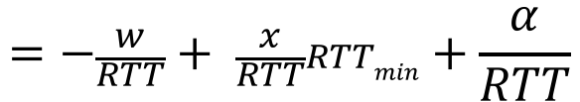
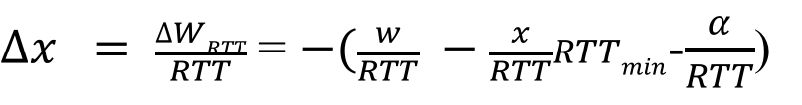
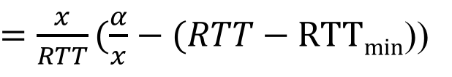
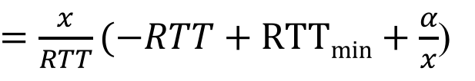
TCP/Vegas Dynamics
$∆x = \frac{∆WRTT}{RTT}$ = $−(\frac{w}{RTT} −\frac{x}{RTT}RTTmin$-$\frac{α}{RTT}$)
$$=−\frac{w}{RTT}+ \frac{x}{RTT}RTTmin+\frac{α}{RTT}$$
$$=−x+ \frac{x}{RTT}RTTmin+\frac{α}{RTT}$$
$=\frac{x}{RTT}(−RTT+RTTmin+\frac{α}{x}$)
$=\frac{x}{RTT}(\frac{α}{x}−(RTT−RTTmin$))

Slide 49
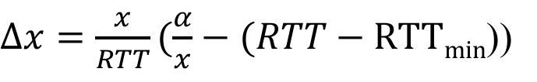
TCP/Vegas Dynamics
$∆x=\frac{x}{RTT}(\frac{α}{x}−(RTT−RTTmin$))

Slide 50
Summary: TCP/Vegas and TCP/Reno
Pricing signal is queueing delay T_{queueing}
Pricing signal is loss rate p

Slide 51
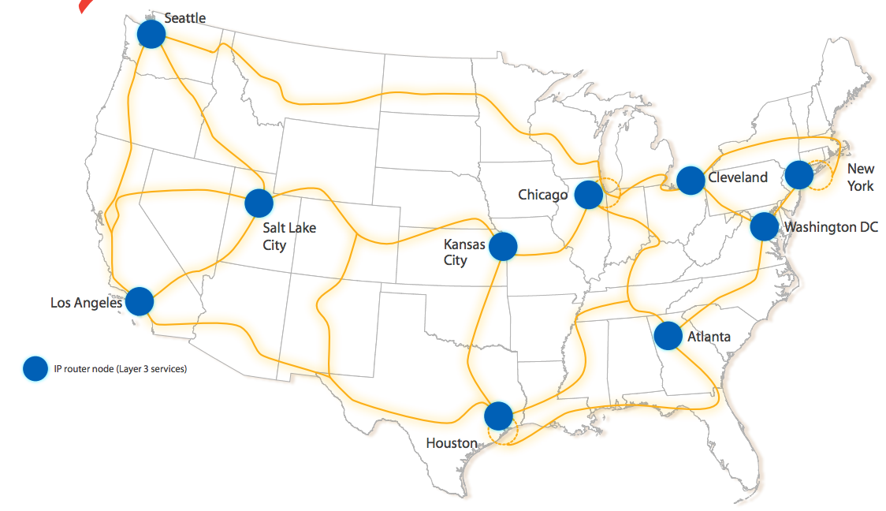
Discussion
Assume that you are given a set of flows deployed at a given network topology.
What is a simple way to predict TCP rate allocation?

Slide 52
Summary: Resource Allocation Frameworks
Forward (design) engineering:
how to determine objective functions
given objective, how to design effective alg
Reverse (understand) engineering:
understand current protocols (what are the objectives of TCP/Reno, TCP/Vegas?)
Additional pointers:
http://www.statslab.cam.ac.uk/~frank/pf/

