Slide 1
A Taxonomy of Communication Networks
Y. Richard Yang
http://zoo.cs.yale.edu/classes/cs433/
09/05/2017

Slide 2
Outline
Admin and recap
A taxonomy of communication networks

Slide 3
Admin
Please check the Schedule page for links to related readings

Slide 4
Recap
A protocol defines the format and the order of messages exchanged between two or more communicating entities, as well as the actions taken on the transmission or receipt of a message or other events.
Key Internet milestones and their implications:
ARPANET is sponsored by ARPA →
The initial IMPs (routers) were made by a small company →
Many networks →
Commercialization →
design should survive failures
keep the network simple
internetworking: need a network to connect networks
architecture supporting decentralized, autonomous systems

Slide 5
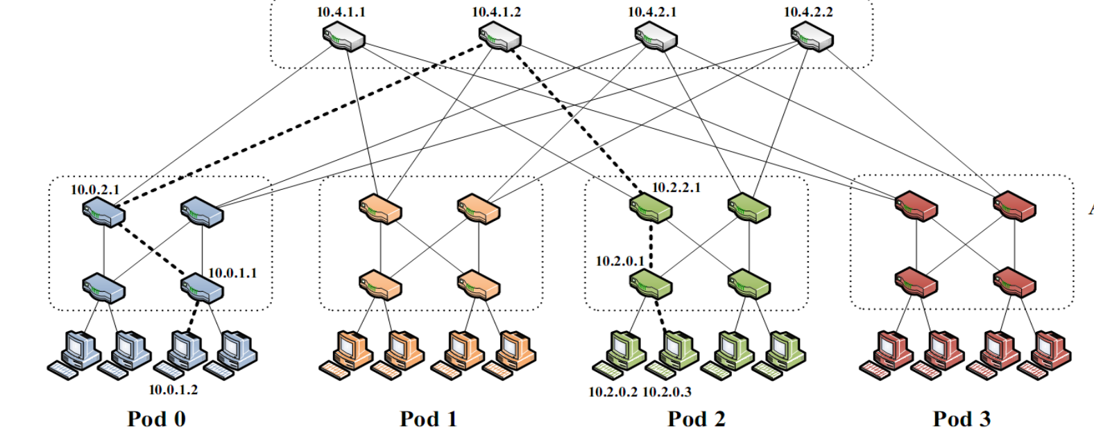
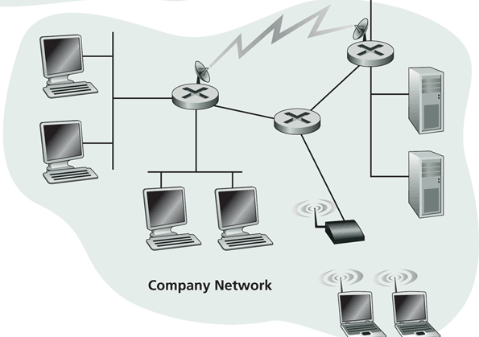
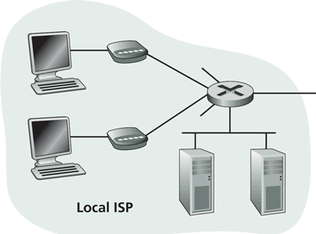
Recall: Internet Physical Infrastructure
Residential access, e.g.,
Cable, Fiber, DSL, Wireless
ISP
Backbone ISP
ISP
The Internet is a network of networks
Each individually administrated network is called an Autonomous System (AS)
~ 58000 ASes; Avg 5.7 hops; (http://bgp.potaroo.net/as2.0/bgp-active.html)
data center
Campus access, e.g.,
Ethernet, Wireless

Slide 6
Observing the Internet State
Read the manual of traceroute, and try it on a zoo machine
% /usr/sbin/traceroute <machine_name>
Look at the web sites of the routers you see through traceroute
Lookup ASN info
https://www.ultratools.com/tools/asnInfo
Routeviews to see connection info (e.g., neighbors) about a network: https://www.ripe.net/analyse/internet-measurements/routing-information-service-ris/routing-information-service-ris

Slide 7
Roadmap
So far we have looked at only the topology and physical connectivity of the Internet: a mesh of computers interconnected via various physical media
A basic question: how are data (the bits) transferred through communication networks?

Slide 8
Outline
Admin. and recap
A taxonomy of communication networks

Slide 9
Taxonomy of Communication Networks
communication networks
switched networks
broadcast networks
Broadcast networks
nodes share a common channel; information transmitted by a node is received by all other nodes in the network
examples: TV, radio
Switched networks
information is transmitted to a small sub-set (usually only one) of the nodes

Slide 10
A Taxonomy of Switched Networks
communication networks
switched networks
broadcast networks
circuit-switched networks (e.g., telephone)
packet-switched networks (e.g., Internet)
Circuit switching: dedicated circuit per call/session:
e.g., telephone, cellular voice
Packet switching: data sent thru network in discrete “chunks”
e.g., Internet, cellular data

Slide 11
Outline
Admin. and review
A taxonomy of communication networks
circuit switched networks

Slide 12
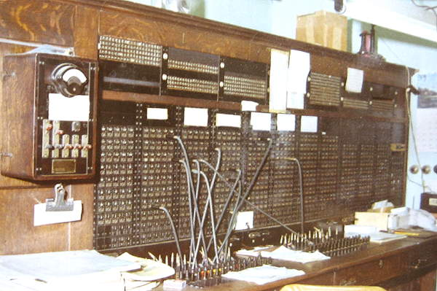
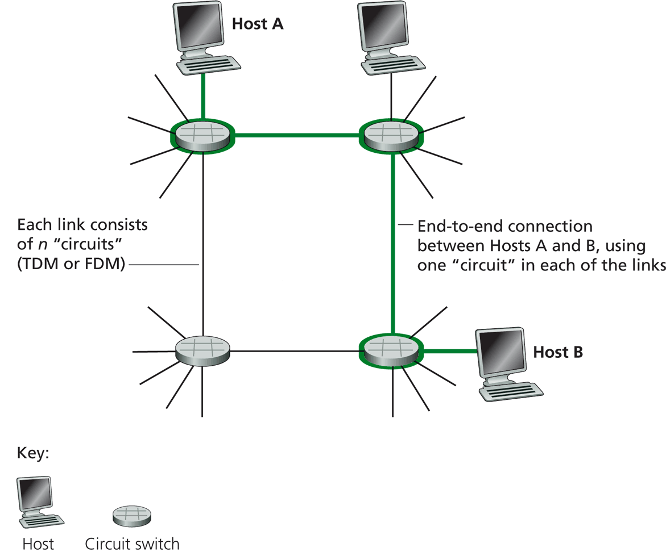
Circuit Switching
Each link has a number of “circuits”
sometime we refer to a “circuit” as a channel or a line
An end-to-end connection reserves one “circuit” at each link
First commercial telephone switchboard was opened in 1878 to serve the 21 telephone customers in New Haven
Notes:
http://www.classicrotaryphones.com/new-england-operators2_big.jpg

Slide 13
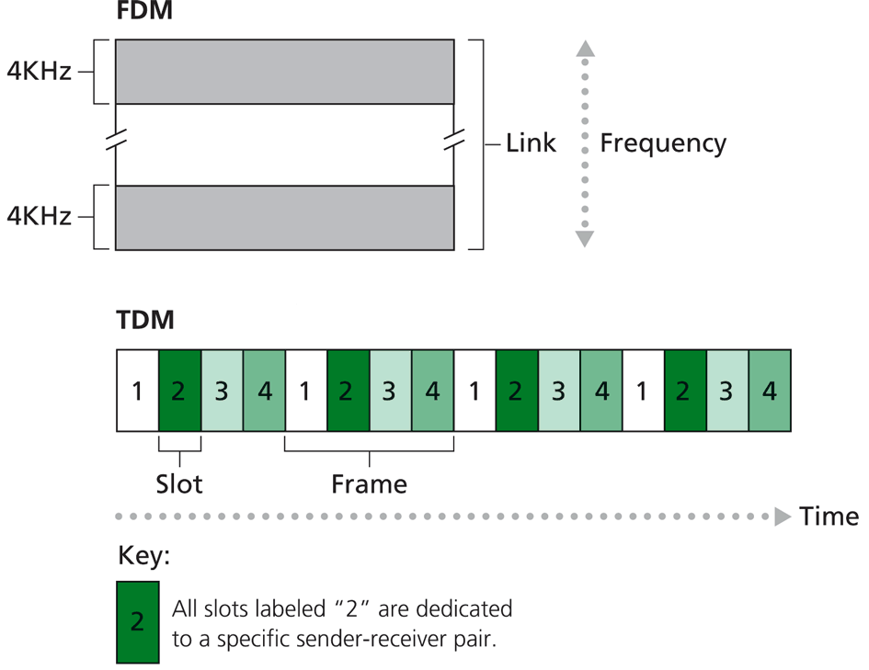
Circuit Switching: Resources/Circuits (Frequency, Time and others)
Divide link resource into “circuits”
frequency division multiplexing (FDM)
time division multiplexing (TDM)
others such as code division multiplexing (CDM), color/lambda division

Slide 14
Circuit Switching: The Process
Three phases
circuit establishment
data transfer
circuit termination

Slide 15
Timing Diagram of Circuit Switching
Host A
Host B
Node 1
Node 2
processing delay at Node 1
DATA
propagation delay
from A to Node 1
circuit establishment
propagation delay
from B To A
data transmission
circuit termination

Slide 16
Delay Calculation in Circuit Switched Networks
Propagation delay: delay for the first bit to go from a source to a destination
Propagation delay:
d = length of physical link
s = propagation speed in medium (~2x10⁵ km/sec)
prop. delay: d/s
DATA

Slide 17
Delay Calculation in Circuit Switched Networks
Transmission delay: time to pump data onto link at line rate
Transmission delay:
R = reserved bandwidth (bps)
L = message length (bits)
d/s
DATA
trans. delay = L/R

Slide 18
An Example
Propagation delay
suppose the distance between A and B is 4000 km, then one-way propagation delay is:
Transmission delay
suppose your iphone reserves a one-slot HSCSD channel
each HSCSD frame can transmit about 115 kbps
a frame is divided into 8 slots
then the transmission delay of using one reserved slot for a message of 1 Kbits:

Slide 19
An Example (cont.)
Suppose the setup message is very small, and the total setup processing delay is 200 ms
Then the delay to transfer a message of 1 Kbits from A to B (from the beginning until host receives last bit) is:
DATA
20 + 200
20
20
70

Slide 20
Outline
Admin. and review
A taxonomy of communication networks
circuit switched networks
packet switched networks

Slide 21
Packet Switching
Each end-to-end data flow (i.e., a sender-receiver pair) divided into packets
Packets have the following structure:
header and trailer carry control information (e.g., destination address, check sum)
where is the control information for circuit switching?
At each node the entire packet is received, processed (e.g., routing), stored briefly, and then forwarded to the next node; thus packet-switched networks are also called store-and-forward networks. On its turn, a packet uses full link bandwidth
Header
Data
Trailer

Slide 22
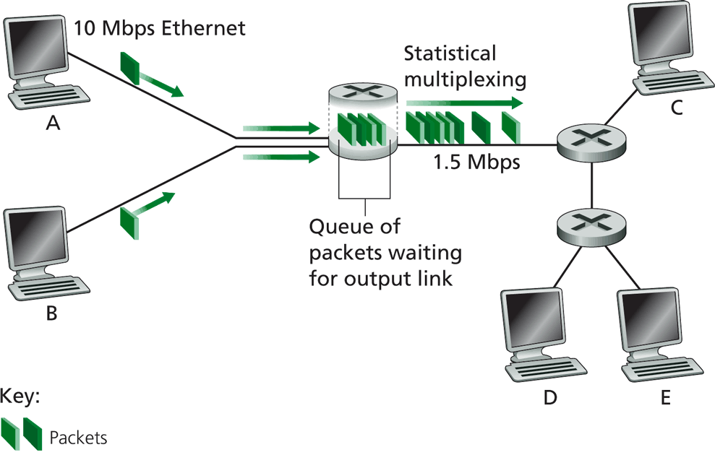
Packet Switching

Slide 23
Inside a Packet Switching Router
An output queueing switch
incoming links
node
outgoing links
Memory

Slide 24
Outline
Admin. and review
A taxonomy of communication networks
circuit switched networks
packet switched networks
circuit switching vs. packet switching

Slide 25

Packet Switching vs. Circuit Switching
The early history of the Internet was a heated debate between Packet Switching and Circuit Switching
the telephone network was the dominant network
Need to compare packet switching with circuit switching

Slide 26
Circuit Switching vs. Packet Switching
 | circuit switching | packet switching
resource usage | use a single partition bandwidth | use whole link bandwidth
reservation/setup | need reservation (setup delay) | no reservation
resource contention | busy signal (session loss) | congestion (long delay and packet losses)
charging | time | packet
header | no per-pkt header | per packet header
fast path processing | fast | per packet processing

Slide 27
Circuit Switching vs. Packet Switching
 | circuit switching | packet switching
resource usage | use a single partition bandwidth | use whole link bandwidth
reservation/setup | need reservation (setup delay) | no reservation
resource contention | busy signal (session loss) | congestion (long delay and packet losses)
charging | time | packet
header | no per-pkt header | per packet header
fast path processing | fast | per packet processing

Slide 28


Key Issue to be Settled
A key issue: what is the efficiency of resource partition?
Tool used to analyze the issue: queueing theory
Some basic results of queueing theory can be quite useful in many systems settings
5G
10G
5G
Notes:
10M bps link and 10 flows: partition into 10 1 Mbps or

Slide 29
Outline
Admin. and review
A taxonomy of communication networks
circuit switched networks
packet switched networks
circuit switching vs. packet switching
M/M queues and statistical multiplexing

Slide 30
Queueing Theory
Strategy:
model system state
if we know the fraction of time that the system spends at each state, we can get answers to many basic questions: how long does a new request need to wait before being served?
System state changes upon events:
introduce state transition diagram
focus on equilibrium: state trend neither growing nor shrinking (key issue: how to define equilibrium)
Our approach: We are not interested in extremely precise modeling, but want quantitative intuition

Slide 31
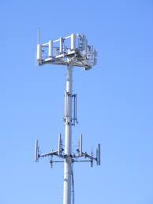
Warm up: Analysis of Circuit-Switching Blocking (Busy) Time
Assume a link has only a finite number of N circuits
Objective: compute the percentage of time that a new session (call) is blocked
Analogy in a more daily-life scenario?
Key parameters?
Notes:
Key input parameters?

Slide 32
Analysis of Circuit-Switching Blocking (Busy) Time
Consider a simple arrival pattern
client requests arrive at a rate of λ (lambda/second)
service rate: each call takes on average 1/μ second
Arrival and service patterns: memoryless (Markovian)
During a small interval Δt, the number of expected new arrivals is: λΔt
During a small interval Δt, the chance (fraction) of a current call finishes is: μΔt
This model is also called an M/M/N model

Slide 33
Analysis of Circuit-Switching Blocking (Busy) Time: State
system state: # of busy lines
0
1
k
k+1
N
p0
p1
pk
pk+1
pN
Q: How to characterize equilibrium?

Slide 34
Equilibrium = Time Reversibility [Frank Kelly]
Statistically cannot distinguish
state
k+1
k
time

Slide 35
Analysis of Circuit-Switching Blocking (Busy) Time: Sketch
system state: # of busy lines
λ
0
1
k
k+1
N
(k+1)μ
p0
p1
pk
pk+1
pN
at equilibrium (time resersibility) in one unit time: #(transitions k → k+1) = #(transitions k+1 → k)

Slide 36
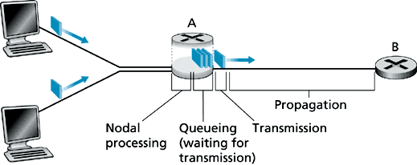
Queueing Analysis: Packet Switching Delay
Four types of delay at each hop
nodal processing delay: check errors & routing
queueing: time waiting for its turn at output link
transmission delay: time to pump packet onto a link at link speed
propagation delay: router to router propagation
The focus is on queueing and transmission delay
system state?

Slide 37
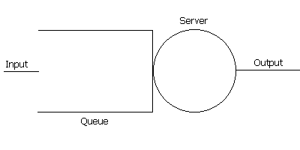
Packet Switching Delay
system state: #packets in queue
λ
0
1
k
k+1
N
μ
p0
p1
pk
pk+1
at equilibrium (time reversibility) in one unit time: #(transitions k → k+1) = #(transitions k+1 → k)

