Slide 1
Network Applications: DNS; Network App Programming--UDP
Qiao Xiang
https://qiaoxiang.me/courses/cnns-xmuf21/index.shtml
10/05/2021
This deck of slides are heavily based on CPSC 433/533 at Yale University, by courtesy of Dr. Y. Richard Yang.

Slide 2
Outline
Admin. and recap
DNS
High-level design
Details
Extensions/alternatives
Network app programming
UDP

Slide 3
Admin
Assignment Two linked on the schedule page
Oct. 26, in class or by email to the instructor

Slide 4
Recap: Client-Server Paradigm
application
transport
network
data link
physical
The basic paradigm of network applications is the client-server (C-S) paradigm
Some key design questions to ask about a C-S application:
extensibility
scalability
robustness
security
request
reply
application
transport
network
data link
physical

Slide 5
Recap: Email App
Some key design features of Email
Separate protocols for different functions
email access (e.g., POP3, IMAP)
email transport (SMTP)
Separation of envelop and message body (end-to-end arguments)
envelop: simple/basic requests to implement transport control;
message body: fine-grain control through ASCII header and message body
MIME type as self-describing data type
Status code in response makes message easy to parse
user
agent
mail
server
user
agent
SMTP
mail
server
user
agent
SMTP
SMTP
mail
server
user
agent
POP3 or
IMAP SMTP
user
agent
user
agent

Slide 6
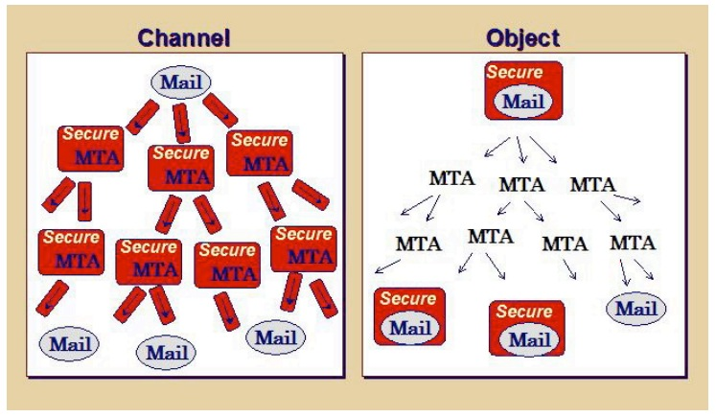
Recap: Email Authentication Approaches
Sender Policy Frame (SPF)
DomainKeys Identified Mail (DKIM) Authenticated Results Chain (ARC)
Notes:
https://support.google.com/mail/answer/1366858?hl=en
http://support.simpledns.com/KB/a62/configuring-dns-records-for-domainkeys-dkim.aspx
https://dmarc.org/presentations/ARC-Overview-2016Q3-v01.pdf

Slide 7
Summary: Some Key Remaining Issues about Email
Basic: How to find the email server of a domain?
Scalability/robustness: how to find multiple servers for the email domain?
Security
SPF: How does SPF know if its neighbor MTA is a permitted sender of the domain?
DKIM: How does DKIM retrieve the public key of the author domain?

Slide 8
Recap: Domain Name System (DNS)
Function
map between (domain name, service) to value, e.g.,
(xmu.edu.cn, addr) -> 210.34.0.35
(xmu.edu.cn, email) -> cmsn1.xmu.edu.cn
clients
DNS
Hostname, Service
Address
routers
servers
Notes:
Why name: easy to remember, one-level of indirection

Slide 9
Recap: DNS Records
http://www.iana.org/assignments/dns-parameters/dns-parameters.xhtml
DNS: stores resource records (RR)
RR format: (name, type, value, ttl)
Type=A
name is hostname
value is IP address
Type=CNAME
name is an alias of a “canonical” (real) name
value is canonical name
Type=NS
name is domain (e.g. xmu.edu.cn)
value is the name of the authoritative name server for this domain
Type=MX
value is hostname of mail server associated with name
Type=SRV
general extension for services
Type=TXT
general txt
Type=PTR
a pointer to another name

Slide 10
Recap: Observations
MX can return multiple servers
DNS may rotate the servers in answer
Address can also return multiple addresses
SPF is encoded as the txt type

Slide 11
Outline
Admin. and recap
DNS
High-level design
Details

Slide 12
DKIM Example
Send email from hotmail and check message
Notes:
https://support.google.com/mail/answer/1366858?hl=en
http://support.simpledns.com/KB/a62/configuring-dns-records-for-domainkeys-dkim.aspx
Try TXT record for gmail.com dig txt gmail.com

Slide 13
DKIM Example
DKIM / ARC: Msg: ARC-Message-Signature: i=1; a=rsa-sha256; c=relaxed/relaxed; d=microsoft.com; s=arcselector9901; h=From:Date:Subject:Message-ID:Content-Type:MIME-Version; bh=bO91TxHI+4MjgAusrfg0EWGiDmvQ5hZRZ/aqb1MKLY8=; …
DKIM-Signature: v=1; a=rsa-sha256; c=relaxed/relaxed;
d=hotmail.com; s=selector1; h=From:Date:Subject:Message-
ID:Content-Type:MIME-Version:X-MS-Exchange-
SenderADCheck;…
Query: dig arcselector9901._domainkey.microsoft.com txt
DKIM introduces a session key to allow multiple public keys
<session>._domainkey.<domain>

Slide 14

DNS Design: Dummy Design
DNS itself can be considered as a client-server system as well
How about a dummy design: introducing one super Internet DNS server?
THE DNS server of the Internet
IP address
resolve <name>
register <name>
OK/used already

Slide 15
Problems of a Single DNS Server
Scalability and robustness bottleneck
Administrative bottleneck

Slide 16
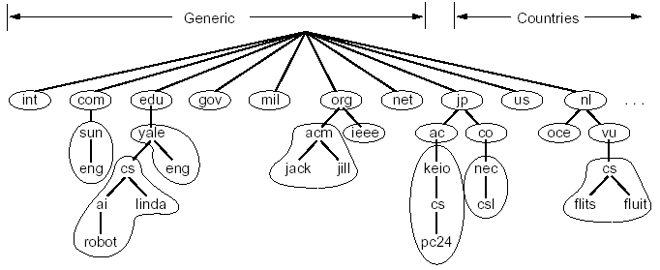
DNS: Distributed Management of the Domain Name Space
A distributed database managed by authoritative name servers
divided into zones, where each zone is a sub-tree of the global tree
each zone has its own authoritative name servers
an authoritative name server of a zone may delegate a subset (i.e. a sub-tree) of its zone to another name server
cn
pku
xmu
mail
cwc
called a zone

Slide 17
Email Architecture + DNS
user
agent
mail
server
user
agent
SMTP
mail
server
user
agent
SMTP
SMTP
mail
server
user
agent
POP3 or
IMAP SMTP
DNS
user
agent
user
agent

Slide 18
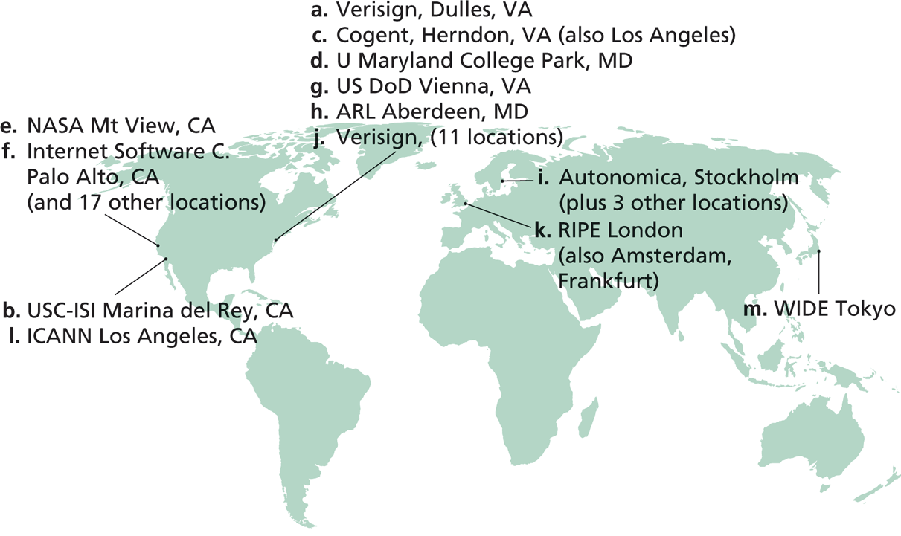
Root Zone and Root Servers
The root zone is managed by the root name servers
13 root name servers worldwide
See http://root-servers.org/ for more details

Slide 19
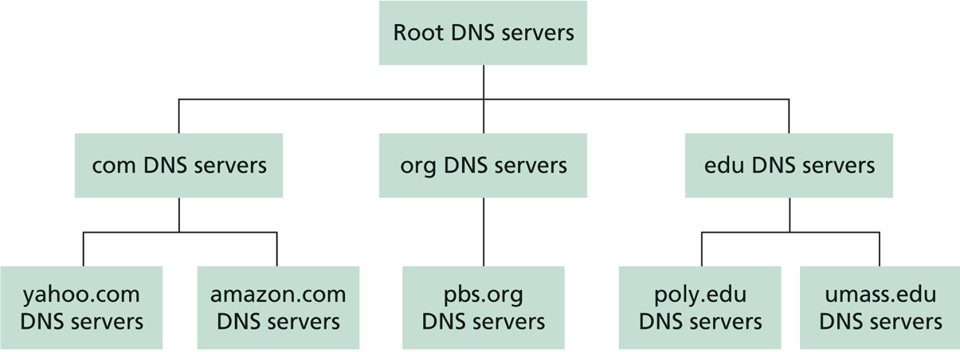
Linking the Name Servers
Each name server knows the addresses of the root servers
Each name server knows the addresses of its immediate children (i.e., those it delegates)
Top level domain (TLD)
Q: how to query a hierarchy?

Slide 20
DNS Message Flow: Two Types of Queries
Recursive query:
The contacted name server resolves the name completely
Iterated query:
Contacted server replies with name of server to contact
“I don’t know this name, but ask this server”

Slide 21

Two Extreme DNS Message Flows
root name server
root name server
Iterative query
Recursive query
1
1
2
2
6
client
TLD name server
client
5
TLD name server
3
4
5
4
3
6
A: ALL the load has to go through the root server!
Q: Issues of the two approaches?
authoritative name server
authoritative name server
informatics.xmu.edu.cn
informatics.xmu.edu.cn

Slide 22
Typical DNS Message Flow: The Hybrid Case
root name server
Host knows only local name server
Local name server is learned from DHCP, or configured, e.g. /etc/resolv.conf
Local DNS server helps clients resolve DNS names
2
iterated query
3
4
7
local name server
130.132.1.9
TLD name server
6
5
1
8
authoritative name server
dns.cs.umass.edu
requesting host
cyndra.cs.yale.edu
gaia.cs.umass.edu

Slide 23
Typical DNS Message Flow: The Hybrid Case
root name server
Host knows only local name server
Local name server is learned from DHCP, or configured, e.g. /etc/resolv.conf
Local DNS server helps clients resolve DNS names
Benefits of local name servers (often called resolvers)
simplifies client
caches/reuses results
2
iterated query
3
4
7
local name server
TLD name server
6
5
1
8
authoritative name server
dns.cs.umass.edu
requesting host
harvard.edu
gaia.cs.umass.edu

Slide 24
Outline
Admin. and recap
DNS
High-level design
Details

Slide 25
DNS Message Format?
Basic encoding decisions: UDP/TCP, how to encode domain name, how to encode answers…
DNS
DNS
TCP
UDP
TCP
UDP
IP
IP
Ethernet
Wireless
Cable/DSL
Ethernet
Wireless
Cable/DSL
25
Notes:
Basic questions: how to encode domain name; how to do compression…

Slide 26
Observing DNS Messages
Capture the messages
DNS server is at port 53
Display and clear DNS cache
MacOS: https://support.apple.com/en-us/HT202516 sudo killall -HUP mDNSResponder
Ubuntu:
sudo systemd-resolve --flush-caches
sudo systemd-resolve --statistics
Try to load the dns-capture file from class Schedule page, if you do not want live capture

Slide 27
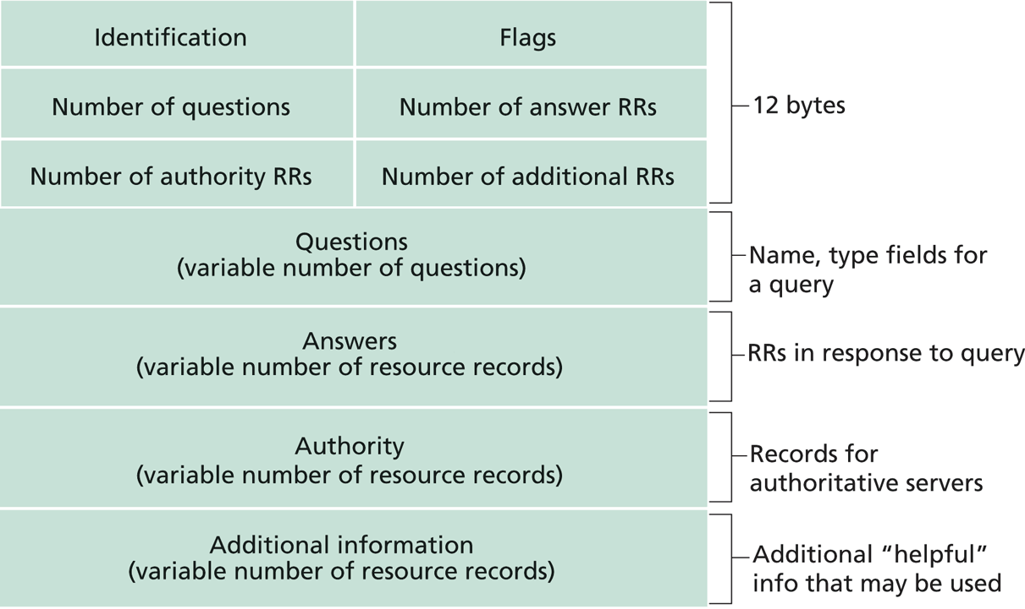
DNS Protocol, Messages
https://www.ietf.org/rfc/rfc1035.txt
DNS protocol : typically over UDP (can use TCP); query and reply messages, both with the same message format

Slide 28
DNS Details
Header (Sec. 4.1.1 of https://www.ietf.org/rfc/rfc1035.txt)
Encoding of questions (Sec. 4.1.2):
[Label-length label-chars]
Encoding of answers (Sec. 4.1.3)
Pointer format (http://www.iana.org/assignments/dns-parameters/dns-parameters.xhtml)
See example DNS packets

Slide 29
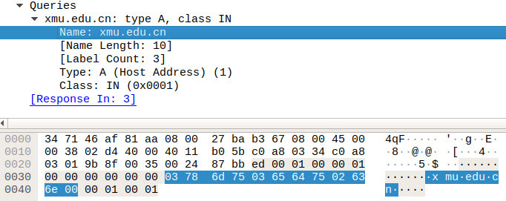
Name Encoding
cn
xmu
edu
length

Slide 30
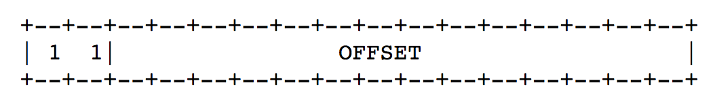
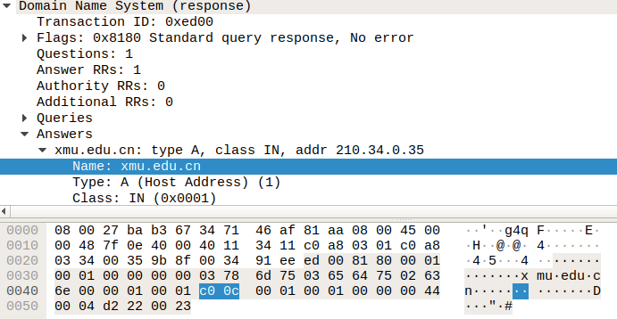
Message Compression (Label Pointer)
question
DNS start
Answer: offset 12

Slide 31
Recap: DNS Protocol, Messages
https://www.ietf.org/rfc/rfc1035.txt
Many features: typically over UDP (can use TCP); query and reply messages with the same message format; length/content encoding of names; simple compression; additional info as server push

Slide 32
What DNS did Right?
Hierarchical delegation avoids central control, improving manageability and scalability
Redundant servers improve robustness
see http://www.internetnews.com/dev-news/article.php/1486981 for DDoS attack on root servers in Oct. 2002 (9 of the 13 root servers were crippled, but only slowed the network)
Caching reduces workload and improves robustness
Proactive answers reduce # queries on server and latency on client

Slide 33
Problems of DNS
Simple query model, relatively static resource values and types make it harder to implement generic service discovery
e.g., service discovery of all printers
Although theoretically you can update the values of the records, it is rarely enabled
Early binding (separation of DNS query from application query) does not work well in mobile, dynamic environments
e.g., load balancing, locate the nearest printer
Each local domain needs servers, but an ad hoc domain may not have a DNS server

Slide 34
Outline
Admin. and recap
DNS
High-level design
Details
Extensions/alternatives

Slide 35
Discussions
What extension(s) to standard DNS operations do we need to allow service discovery, say to implement Bonjour (discover all local printers)?
each printer needs to provide the following info: host, port, printer info (e.g., support postscript)

Slide 36


DNS-Service Discovery
Leverage DNS message format, but each node can announce its own services
169.254.1.219
Printer
Network
169.254.10.29
169.254.4.51

Slide 37
Realizing DNS-SD without Central DNS Server: mDNS
Multicast in a small world
no central address server
each node is a responder
link-local addressing
send to multicast address: 224.0.0.251
169.254.1.219
Printer
Network
169.254.10.29
169.254.4.51

Slide 38
Example
Use the avahi-publish-service command on Ubuntu as example
Advertise (register) an LPR printer on port 515 avahi-publish-service test _printer._tcp . 515 pdl=application/postscript
port
Name of instance providing the service
<type_service>. <transport>
Txt for additional data
38

Slide 39
Example
Use the dns-sd command on Mac as example
Advertise (register) an LPR printer on port 515 dns-sd -R "test" _printer._tcp . 515 pdl=application/postscript
port
Name of instance providing the service
domain (. means default, which is local
<type_service>. <transport>
Txt for additional data
39

Slide 40
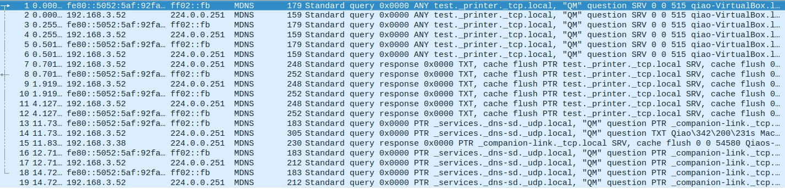

Slide 41
Offline Exercise
Use the dns-sd /avahi-publish-service command as example
Advertise (register) a web page on local machine dns-sd -R "My Test" _http._tcp . 80 path=/path-to-page.html
41

Slide 42
Issue: How to Query
Query needs a back pointer, PTR records
Exercise: Use the dns-sd / avahi-service-publish command as example
Browse web pages on local machines dns-sd -B _http._tcp
avahi-browse –rt _http._tcp

Slide 43
Network Service Discovery in Android
Based on DNS-SD/mDNS
Foundation for peer-to-peer/Wi-Fi Direct in Android
See https://developer.android.com/training/connect-devices-wirelessly/nsd.html for programming using nsd

Slide 44
Outline
Admin and recap
DNS
High-level design
Details
Extensions/alternatives
Network app programming
UDP

Slide 45
Socket Programming
Socket API
introduced in BSD4.1 UNIX, 1981
Two types of sockets
connectionless (UDP)
connection-oriented (TCP)
socket
an interface (a “door”) into which one
application process can both send and
receive messages to/from another (remote or
local) application process

Slide 46
Services Provided by Transport
User data protocol (UDP)
multiplexing/demultiplexing
Transmission control protocol (TCP)
multiplexing/demultiplexing
reliable data transfer
rate control: flow control
and congestion control
Host A
Host B
Hello
I am ready
DATA
ACK

Slide 47
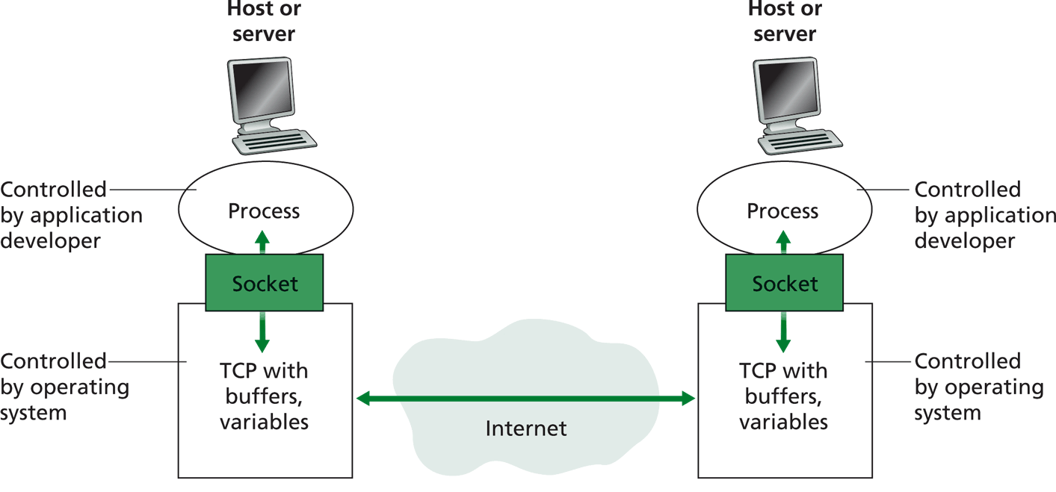
Big Picture: Socket
buffers,
states
buffers,
states

Slide 48
Outline
Admin. and recap
DNS
Basic network application programming
Overview
UDP (Datagram Socket)

Slide 49
DatagramSocket(Java) (Basic)
DatagramSocket()
constructs a datagram socket and binds it to any available port on the local host
DatagramSocket(int lport)
constructs a datagram socket and binds it to the specified port on the local host machine.
DatagramPacket(byte[] buf, int length)
constructs a DatagramPacket for receiving packets of length length.
DatagramPacket(byte[] buf, int length, InetAddress address, int port)
constructs a datagram packet for sending packets of length length to the specified port number on the specified host.
receive(DatagramPacket p)
receives a datagram packet from this socket.
send(DatagramPacket p)
sends a datagram packet from this socket.
close()
closes this datagram socket.

Slide 50
Connectionless UDP: Big Picture (Java version)
Server (running on serv)
Client
create socket,
port=x, for
incoming request:
create socket,
clientSocket =
DatagramSocket()
serverSocket =
DatagramSocket( x )
Create datagram using (serv, x) as (dest addr. port), send request using clientSocket
read request from
serverSocket
generate reply, create datagram using client
host address, port number
write reply to
serverSocket
read reply from
clientSocket
close
clientSocket

Slide 51
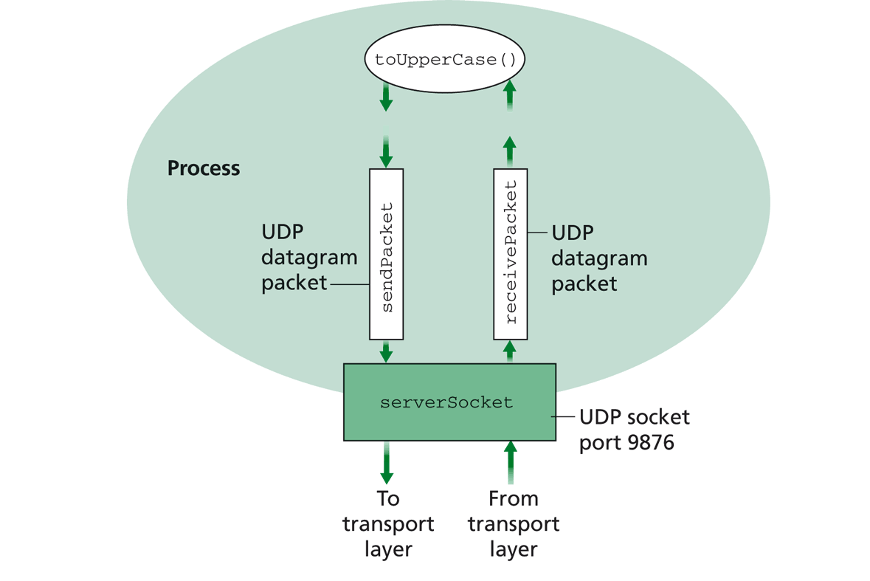
Example: UDPServer.java
A simple UDP server which changes any received sentence to upper case.

Slide 52
Java Server (UDP): Create Socket
import java.io.*;
import java.net.*;
class UDPServer {
public static void main(String args[]) throws Exception
{
DatagramSocket serverSocket = new DatagramSocket(9876);
Create
datagram socket
bind at port 9876
Check socket state:
%netstat –a –u –n

Slide 53
System State after the Call
server
128.36.232.5 128.36.230.2
UDP socket space
“*” indicates that the socket binds to all IP addresses of the machine: % ifconfig -a
address: {*:9876}
snd/recv buf:
local port
local address why shown as “*”?
address: {128.36.232.5:53}
snd/recv buf:

Slide 54
Binding to Specific IP Addresses
server
Public address: 128.36.59.2 Local address: 127.0.0.1
UDP socket space
InetAddress sIP1 =
InetAddress.getByName(“localhost”);
DatagramSocket ssock1 = new DatagramSocket(9876, sIP1);
InetAddress sIP2 = InetAddress.getByName(“128.36.59.2”);
DatagramSocket ssock2 = new DatagramSocket(9876,sIP2);
DatagramSocket serverSocket = new DatagramSocket(6789);
address: {127.0.0.1:9876}
snd/recv buf:
address: {128.36.59.2:9876}
snd/recv buf:
address: {*:6789}
snd/recv buf:
address: {128.36.232.5:53}
snd/recv buf:

Slide 55
UDP Demultiplexing
client
on server
server
P1
SP: x
Public address: 128.36.59.2 Local address: 127.0.0.1
DP: 9876
UDP socket space
S-IP: A
address: {127.0.0.1:9876}
snd/recv buf:
D-IP: 127.0.0.1
address: {128.36.59.2:9876}
snd/recv buf:
P2
SP: y
DP: 9876
S-IP: B
D-IP: 128.36.59.2
address: {128.36.232.5:53}
snd/recv buf:
client
IP: B
UDP demutiplexing is based on matching (dst address, dst port)

Slide 56
UDP Demultiplexing
Client
on server
server
P1
SP: x
Public address: 128.36.59.2 Local address: 127.0.0.1
DP: 9876
UDP socket space
S-IP: A
address: {127.0.0.1:9876}
snd/recv buf:
D-IP: 127.0.0.1
address: {128.36.59.2:9876}
snd/recv buf:
P3
address: {*:6789}
snd/recv buf:
SP: y
DP: 6789
S-IP: C
D-IP: 128.36.59.2
address: {128.36.232.5:53}
snd/recv buf:
client
IP: C
UDP demutiplexing is based on matching (dst address, dst port)

Slide 57
Per Socket State
Each Datagram socket has a set of states:
local address
send buffer size
receive buffer size
timeout
traffic class
See http://download.java.net/jdk7/archive/b123/docs/api/java/net/DatagramSocket.html
Example: socket state after clients sent msgs to the server

Slide 58
Java Server (UDP): Receiving
import java.io.*;
import java.net.*;
class UDPServer {
public static void main(String args[]) throws Exception
{
DatagramSocket serverSocket = new DatagramSocket(9876);
byte[] receiveData = new byte[1024];
byte[] sendData = null;
while(true)
{
DatagramPacket receivePacket =
new DatagramPacket(receiveData, receiveData.length);
serverSocket.receive(receivePacket);
Create space for
received datagram
Receive
datagram

Slide 59
DatagramPacket
Receiving
DatagramPacket(byte[] buf, int length)
constructs a DatagramPacket for receiving packets of length length.
DatagramPacket(byte[] buf, int offset, int length)
constructs a DatagramPacket for receiving packets starting at offset, length length.
Sending
DatagramPacket(byte[] buf, int length, InetAddress address, int port) constructs a datagram packet for sending packets of length length to the specified port number on the specified host.
DatagramPacket(byte[] buf, int offset, int length, InetAddress address, int port)

Slide 60
Java Server (UDP): Processing
getData() returns a pointer to an underlying buffer array; for efficiency, don’t assume receive() will reset the rest of the array
import java.io.*;
import java.net.*;
class UDPServer {
public static void main(String args[]) throws Exception {
…
// process data
String sentence = new String(receivePacket.getData(), 0, receivePacket.getLength());
String capitalizedSentence = sentence.toUpperCase();
sendData = capitalizedSentence.getBytes();
getLength() returns how much data is valid.

Slide 61
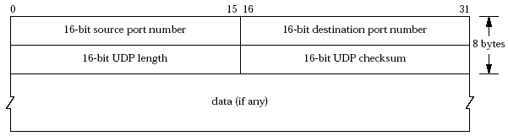
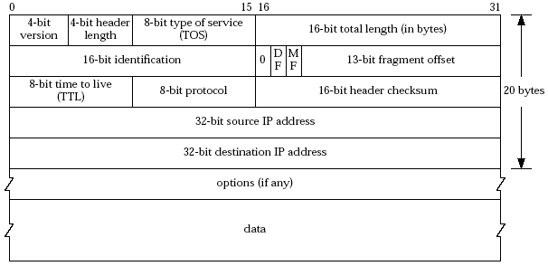
Java Server (UDP): Response
Java DatagramPacket:
getAddress()/getPort() returns the source address/port

Slide 62
Java server (UDP): Reply
InetAddress IPAddress = receivePacket.getAddress();
int port = receivePacket.getPort();
DatagramPacket sendPacket =
new DatagramPacket(sendData, sendData.length, IPAddress, port);
serverSocket.send(sendPacket);
}
}
}
Get IP addr
port #, of
sender
Create datagram
to send to client
Write out
datagram
to socket
End of while loop,
loop back and wait for
another datagram

Slide 63
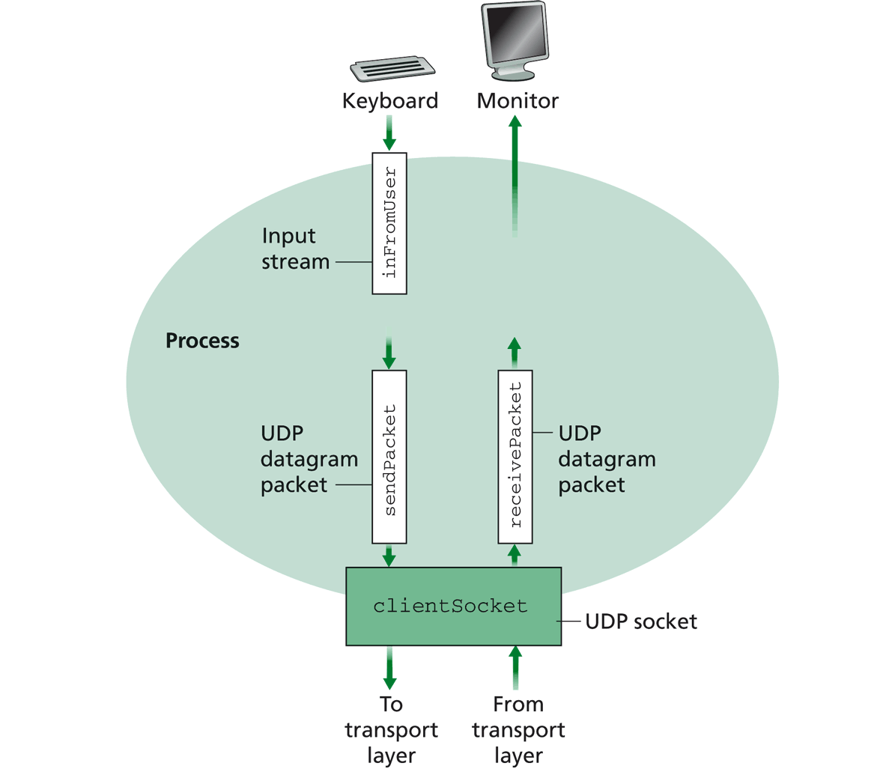
Example: UDPClient.java
A simple UDP client which reads input from keyboard, sends the input to server, and reads the reply back from the server.

Slide 64
Example: Java client (UDP)
import java.io.*;
import java.net.*;
class UDPClient {
public static void main(String args[]) throws Exception
{
BufferedReader inFromUser =
new BufferedReader(new InputStreamReader(System.in));
String sentence = inFromUser.readLine(); byte[] sendData = sentence.getBytes();
DatagramSocket clientSocket = new DatagramSocket();
InetAddress sIPAddress = InetAddress.getByName(“servname");
Create
input stream
Create
client socket
Translate
hostname to IP
address using DNS

Slide 65
Example: Java client (UDP), cont.
Create datagram with data-to-send,
length, IP addr, port
DatagramPacket sendPacket =
new DatagramPacket(sendData, sendData.length, sIPAddress, 9876);
clientSocket.send(sendPacket);
byte[] receiveData = new byte[1024];
DatagramPacket receivePacket =
new DatagramPacket(receiveData, receiveData.length);
clientSocket.receive(receivePacket);
String modifiedSentence =
new String(receivePacket.getData());
System.out.println("FROM SERVER:" + modifiedSentence);
clientSocket.close();
}
}
Send datagram
to server
Read datagram
from server

Slide 66
Demo
%ubuntu: java UDPServer
%netstat to see buffer
%ubuntu: java UDPClient <server>
%wireshark to capture traffic
Notes:
System.out.println(clientSocket.getLocalAddress());
System.out.println(clientSocket.getLocalPort());
System.out.println(clientSocket.getReceiveBufferSize());
System.out.println(clientSocket.getSendBufferSize());
System.out.println(clientSocket.getSoTimeout());
System.out.println( java.nio.charset.Charset.defaultCharset() );

Slide 67
Discussion on Example Code
A simple upper-case UDP echo service is among the simplest network service.
Are there any problems with the program?
Notes:
System.out.println(clientSocket.getLocalAddress());
System.out.println(clientSocket.getLocalPort());
System.out.println(clientSocket.getReceiveBufferSize());
System.out.println(clientSocket.getSendBufferSize());
System.out.println(clientSocket.getSoTimeout());
System.out.println( java.nio.charset.Charset.defaultCharset() );

Slide 68
Backup Slides (General Service/Naming Discovery)

Slide 69
General Service/Naming Discovery Paradigm: Linda
“Distributed workspace” by David Gelernter in the 80’s at Yale
Very influential in naming and resource discovery
Key issues
How to name services/resources
How to resolve names

Slide 70
The Linda Paradigm
Naming scheme:
arbitrary tuples (heterogeneous-type vectors)
Name resolution:
Nodes write into shared memory
Nodes read matching tuples from shared memory
exact matching is required for extraction

Slide 71
Linda: Core API
out(): writes tuples to shared space
example: out("abc", 1.5, 12).
result: insert (“abc”, 1.5, 12) into space
read(): retrieves tuple copy matching arg list (blocking)
example: read(“abc”, ? A, ? B)
result: finds (“abc”, 1.5, 12) and sets local variables A = 1.5, B = 12. Tuple (“abc”, 1.5, 12) is still resident in space.
in(): retrieves and deletes matching tuple from space (blocking)
example: same as above except (“abc”, 1.5, 12) is deleted
eval(expression): similar to out except that the tuple argument to eval is evaluated
example: eval("ab",-6,abs(-6)) creates tuple (“ab”, -6, 6)
Notes:
eval()
evaluates a tuple on the server

Slide 72
Linda Extension: JavaSpaces
Industry took Linda principles and made modifications
add transactions, leases, events
store Java objects instead of tuples
a very comprehensive service discovery system
Definitive book, “JavaSpaces Principles, Patterns, and Practice”

Slide 73
Backup Slides (Java in a Nutshell)

Slide 74
High-level Picture
C/C++
Prog 1
Prog 2
Prog 1; Arch 1
Prog 1; Arch n
Prog 2; Arch 1
Prog 2; Arch n’

Slide 75
Java Virtual Machine
To be platform independent, Java designers introduced Java Virtual Machine (JVM), a machine different from any physical platform, but a virtual machine
The language of the virtual machine is referred to as bytecode
Thus Java actually has two programming languages
A Java compiler translates Java source code (.java files) into bytecode (in .class files)
Each Java software program needs to be compiled only once: from the Java source code to bytecode
Other languages (e.g., Jruby, Jython, Scala) may also compile to bytecode

Slide 76
Java Execution
To execute a Java program, another piece of software called an interpreter, translates between bytecode and the actual machine
an interpreter is specific to a specific platform
the interpreter understands java bytecode, and then issues instructions in the specific platform for which it is written
we also say that an interpreter provides a java virtual machine (JVM)

Slide 77
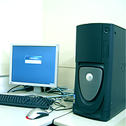



Java Translation and Execution
Java source code
Java compiler
Java bytecode
bytecode interpreter
for Windows
bytecode interpreter
for Mac
bytecode interpreter
for Android
bytecode interpreter
for Linux

Slide 78
Comparing Traditional (e.g., C/C++) and Java Software Development
Traditional, e.g., C/C++
Java
A developer writes a program in C/C++
The C/C++ source code is generally considered proprietary, and not released
The developer compiles the C/C++ program for each platform it intends to support, and distributes one version for each platform
thus each program has multiple compiled versions
each compiled version can run by itself
Platform dependency handled by each software developer
A developer writes a program in Java
The Java source code is generally considered proprietary, and not released
The developer compiles the Java program to bytecode, and distributes the bytecode version
thus each program has only one compiled version
the compiled bytecode needs an interpreter for each platform
Platform dependency handled by platform vendor

Slide 79
High-level Picture
C/C++
Prog 1
Prog 2
Prog 1; Arch 1
Prog 1; Arch n
Prog 2; Arch 1
Prog 2; Arch n’
Java
Prog 1
Prog 2
Prog 1/bytecode
Prog 2/bytecode
Interp; Arch 1
Interp; Arch n

Slide 80


Recall: Java Programming Steps
Programming in Java consists of 3 simple steps
Create and edit “Java source code” (.java files)
Compile into “Java bytecode” (.class files)
Execute bytecode with a “Java interpreter”
source code
byte code
compile
run
output
80

Slide 81
Programming in Java (Step 1): Create/Edit
The basic way is to use a text editor
Example editors: vim, sublime, Notepad, TextEdit (Format/Make Plain Text) etc.
Note: MS Word is NOT a text editor
The key is that your .java file cannot include any markup or stylistic formatting; just text.
You enter your Java code following Java Language syntax (more soon).
81
Notes:
81
:syntax on
~/.vimrc

Slide 82
Programming in Java (Step 2): Compile
Compile a Java program $ javac HelloWorld.java
Take a look to see that HelloWorld.class is generated $ ls HelloWorld.java HelloWorld.class
82
Notes:
82

Slide 83
Programming in Java (Step 3): Execute
Run Java interpreter
$ java HelloWorld
83
Notes:
83

Slide 84
First Java Program
/*************************************
* Prints “Hello World”
* Everyone’s first Java program.
*************************************/
public class Hello {
public static void main(String[] args) {
System.out.println("Hello, world!");
}
}

Slide 85
Another Java Program
public class Hello2 {
public static void main(String[] args) {
System.out.println("Hello, world!");
System.out.println();
System.out.println("This program produces");
System.out.println("four lines of output");
}
}

Slide 86
Programming in Java: Method 2
Another way is to use an Integrated Development Environment (IDE)
Example IDEs: Eclipse, IDEA, DrJava, etc.
An IDE usually presents the user with a space for text (like an editor) but layers additional features on top of the text for the user's benefit.
Note: The underlying file contains pure text, just like a text editor.
These features can be very useful and save time.
Example features are GUI compile, GUI execution, code completion, and syntax highlighting.
IDEs take more time to get started than a simple text editor, e.g.,
set up where to find the “java” and “javac” programs
find out where does the IDE save my file
86
Notes:
86

Slide 87
Java Syntax Structure: A Top-Down View
A class:
has a name, defined in a file with same name Convention we follow: capitalize each English word
starts with {, and ends with }
includes a group of methods
public class <class name> {
public static void main(String[] args) {
<statement>;
<statement>;
...
<statement>;
}
}
A method:
has a name Convention we follow: lowercase first word, capital following
starts with {, and ends with }
includes a group of statements
statement:
a command to be executed
end with ;
Notes:
The book as a program analogy: need to write chapter name, paragraph name, before you can write a sentence.

Slide 88
The System.out.println statement
A statement that prints a line of output on the console.
pronounced "print-linn”
Two ways to use System.out.println :
System.out.println(<string>);
Prints the given message <string> as output.
System.out.println();
Prints a blank line of output.
Notes:
88

Slide 89
Java program structure
A top-down view
A bottom-up view

Slide 90
Java Syntax: A Bottom-Up View
// Comment 1: A Java program
/* Comment 2: a long comment
*********************************/
public class Hello {
public static void main(String[] args) {
System.out.println("Hello, world!");
System.out.println();
System.out.println("This program produces");
System.out.println("four lines of output");
}
}
Notes:
The top-down view is good because we can read at the bigger picture. Hence small details do not change our understanding. For example, removing ; {
Computers are stupid and hence read without a bigger picture. You can think we read in 2D and computer in 1D (scan sequentially)

Slide 91
Java Syntax: A Bottom-Up View
// Comment 1: A Java program
/* Comment 2: a long comment
*********************************/
public class Hello {
public static void main(String[] args) {
System.out.println("Hello, world!");
System.out.println();
System.out.println("This program produces");
System.out.println("four lines of output");
}
}
Basic Java syntax units
white space and comments
identifiers (words)
symbols: { } “ ( ) < > [ ] ; = …
strings
numbers
Notes:
The top-down view is good because we can read at the bigger picture. Hence small details do not change our understanding. For example, removing ; {
Computers are stupid and hence read without a bigger picture. You can think we read in 2D and computer in 1D (scan sequentially)

Slide 92
Syntax: White Space
White space
includes spaces, new line characters, tabs
white space is used to separate other entities
extra white space is ignored
White space allows a Java program to be formatted in many ways, and should be formatted to enhance readability
the usage of white space forms part of programming style
92
Notes:
92

Slide 93
Syntax: Comments
comment: A note written in source code by the programmer to describe or clarify the code.
Comments are ignored by the compiler
Useful for other people (and yourself!) to understand your code
Two types of comments in Java
single-line comments use //…
// this comment runs to the end of the line
multi-lines comments use /* … */
/* this is a very long
multi-line comment */
93
Notes:
93

Slide 94
Syntax: Identifier
Identifier: A name given to an item in a program.
Syntax requirement on identifier:
must start with a letter or _ or $
subsequent characters can be any of those or a number
Important: Java is case sensitive:
Hello and hello are different identifiers

Slide 95
Three Types of Identifiers
1. Identifiers chosen by ourselves when writing a program (such as HelloWorld)
2. Identifiers chosen by another programmer, so we use the identifiers that they chose (e.g., System, out, println, main)
public class HelloWorld
{
public static void main(String[] args)
{
System.out.println(“Hello World!”);
}
}

Slide 96
Three Types of Identifiers
3. Special identifiers called keywords or reserved words: A keyword has a special meaning in Java.
abstract default if private this
boolean do implements protected throw
break double import public throws
byte else instanceof return transient
case extends int short try
catch final interface static void
char finally long strictfp volatile
class float native super while
const for new switch
continue goto package synchronized
Java reserved words: they are all lowercase!

Slide 97
Syntax: Strings
string: A sequence of characters that starts and ends with a " (quotation mark character).
The quotes do not appear in the output.
Examples: "hello" "This is a string. It is very long!”
Restrictions:
May not span multiple lines "This is not a legal String."
Notes:
97

Slide 98
Examples
Which of the following are legal strings in Java?
"This is a string. It’s very long!"
"This cool string spans two lines. "
"It is a great thing when children cry, "I want my mommy"! "
Notes:
98

Slide 99
Escape Sequences
escape sequence: A special sequence of characters used to represent certain special characters in a string.
\b backspace
\t tab character
\n new line character
\" quotation mark character
\\ backslash character
Example: System.out.println("\\hello\nhow\tare \"you\"?\\\\");
Output: \hello how are "you"?\\

Slide 100
Comment on syntax errors
A syntax/compile error: A problem in the structure of a program that causes the compiler to fail, e.g.,
Missing semicolon
Too many or too few { } braces
Class and file names do not match
…
Compilers can’t (DO not) read minds.
Compilers don’t make mistakes.
If the program is not doing what you want, do NOT blame the computer---it’s YOU who made a mistake.

