Slide 1
Network Transport Layer: TCP Connection Management, Congestion Control
Qiao Xiang
https://qiaoxiang.me/courses/cnns-xmuf21/index.shtml
11/18/2021
This deck of slides are heavily based on CPSC 433/533 at Yale University, by courtesy of Dr. Y. Richard Yang.

Slide 2
Admin
Lab assignment 5 to be posted tomorrow
Class Project
15% of your final score
Please start ASAP
Talk to the instructor or TA to get feedback
Send your topic and team member list to TA

Slide 3
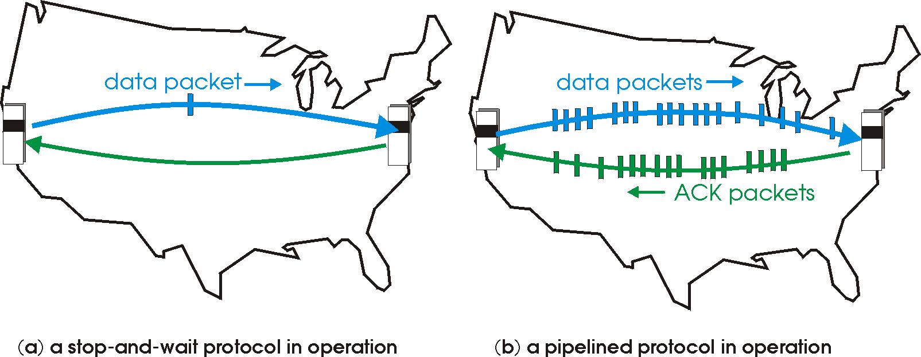
Recap: Reliable Transport
Basic structure: sliding window protocols
Realization: GBN or SR
General technique: pipelining.

Slide 4
Recap: TCP Reliable Data Transfer
Connection-oriented:
connection management
setup (exchange of control msgs) init’s sender, receiver state before data exchange
close
Full duplex data:
bi-directional data flow in same connection
A sliding window protocol
a combination of go-back-n and selective repeat:
send & receive buffers
cumulative acks
TCP uses a single retransmission timer
do not retransmit all packets upon timeout

Slide 5
Recap: TCP Segment Structure
32 bits
URG: urgent data
(generally not used)
counting
by bytes
of data
(not segments!)
source port #
dest port #
sequence number
ACK: ACK #
valid
acknowledgement number
head
len
not
used
U
rcvr window size
A
P
R
S
PSH: push data now
(generally not used)
F
flow control
checksum
ptr urgent data
RST, SYN, FIN:
connection management
(reset, setup teardown
commands)
Options (variable length)
application
data
(variable length)
Also in UDP

Slide 6
Recap: TCP Seq. #’s and ACKs
Seq. #’s:
byte stream “number” of first byte in segment’s data
ACKs:
seq # of next byte expected from other side
cumulative ACK in standard header
selective ACK in options
Host A
Host B
User
types
‘C’
Seq=42, ACK=79, data = ‘C’
host ACKs
receipt of
‘C’, echoes
back ‘C’
Seq=79, ACK=43, data = ‘C’
host ACKs
receipt
of echoed
‘C’
Seq=42, ACK=80
time
simple telnet scenario

Slide 7
Recap: TCP Reliable Data Transfer
Basic structure: sliding window protocol
Remaining issue: How to determine the “right” parameters?
timeout value
sliding window size?
Timeout = EstRTT + 4 * DevRTT
EstRTT = (1-alpha)*EstRTT + alpha*SampleRTT

Slide 8
Recap: Fast Retransmit
Issue: Timeout period often relatively long:
long delay before resending lost packet
Question: Can we detect loss faster than RTT?
Detect lost segments via duplicate ACKs
sender often sends many segments back-to-back
if segment is lost, there will likely be many duplicate ACKs
If sender receives 3 ACKs for the same data, it supposes that segment after ACKed data was lost:
resend segment before timer expires

Slide 9
Outline
Admin and Recap
TCP reliability
data seq#, ack, buffering
timeout realization
connection management

Slide 10
Why Connection Setup/When to Accept (Safely Deliver) First Packet?
sender
receiver
data 0
accept
ACK for 0
10

Slide 11
Why Connection Setup/When to Accept (Safely Deliver) First Packet?
sender
receiver
data 0 (transfer $1000 to B)
accept
ACK for 0 (n)
data 0 (transfer $1000 to B)
accept?
11
Notes:
a sender should not reuse a seq# before it is sure the packet has left the network

Slide 12
Recap: Transport “Safe-Setup” Principle
A general safety principle for a receiver R to accept a message from a sender S is the general “authentication” principle, which consists of two conditions:
Transport authentication principle:
[p1] Receiver can be sure that what Sender says is fresh
[p2] Receiver receives something that only Sender can say
We first assume a secure setting: no malicious attacks.
Exercise: Techniques to allow a receiver to check for freshness (e.g., add a time stamp)?

Slide 13
Generic Challenge-Response Structure Checking Freshness
sender
receiver
I have data to send
deliver
Challenge (nonce)
Demonstrate knowing nonce; data

Slide 14
Three Way Handshake (TWH) [Tomlinson 1975]
Host A
Host B
SYN(seq=x)
notify initial seq#. Accept?
ACK(seq=x), SYN(seq=y)
think of y as a challenge
ACK(seq=y)
accept data only after
verified y is bounced back
x is the init. seq
DATA(seq=x+1)
SYN: indicates connection setup
Notes:
Syn(seq=x) could be duplicate or malicious

Slide 15
Scenarios with Duplicate Request/SYN Attack
Host A
Host B
SYN(seq=x)
accept?
ACK(seq=x), SYN(seq=y)
no such request
REJECT(seq=y)
reject

Slide 16
Scenarios with Duplicate Request/SYN Attack
Host A
Host B
SYN(seq=x)
accept?
ACK(seq=x), SYN(seq=y)
no such request
ACK(seq=z)
reject
REJECT(seq=y)

Slide 17
Make “Challenge y” Robust
To avoid that “SYNC ACK y” comes from reordering and duplication
for each connection (sender-receiver pair), ensuring that two identically numbered packets are never outstanding at the same time
network bounds the life time of each packet
a sender will not reuse a seq# before it is sure that all packets with the seq# are purged from the network
seq. number space should be large enough to not limit transmission rate
Increasingly move to cryptographic challenge and response
Notes:
Add QUIC design: QUIC uses a cryptographic handshake
Servers
front-end servers, which collectively handle billions of requests a day from web browsers and mobile apps across a wide range of services.
On the client side, we have deployed QUIC in
Chrome,
our mobile video streaming YouTube app, and in the
Google Search app on Android
TCP connections commonly incur at least one round-trip delay of connection setup time before any application data can be sent, and TLS adds two round trips to this delay

Slide 18
Connection Close
Why connection close?
so that each side can release resource and remove state about the connection (do not want dangling socket)
client
server
init. close
release
resource?
I am done. Are you done too?
close
I am done too. Goodbye!
release
resource?
close
release
resource?

Slide 19
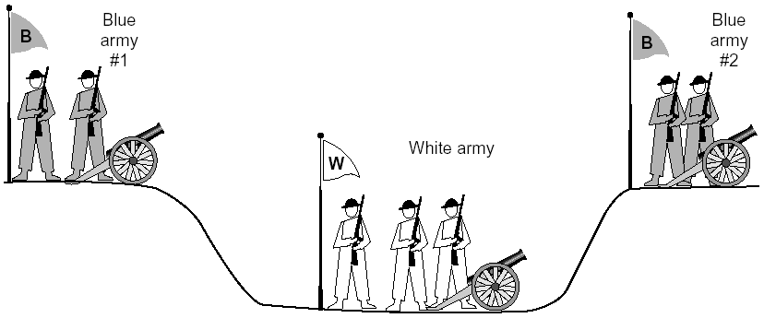
General Case: The Two-Army Problem
The gray (blue) armies need to agree on whether or not they will attack the white army. They achieve agreement by sending messengers to the other side. If they both agree, attack; otherwise, no. Note that a messenger can be captured!

Slide 20
Time_Wait
Generic technique: Timeout to “solve” infeasible problem
Instead of message-driven state transition, use a timeout based transition; use timeout to handle error cases
client
server
init. close
release
resource?
I am done. Are you done too?
Working
Closed
close
I am done too. Goodbye!
release
resource?
close
Working
Time_Waiit
Closed
release
resource?

Slide 21
Time_Wait Design Options
Design 1 (initiator time wait)
Design 2 (receiver time wait)
Host A
Host B
Host A
Host B
close
FIN
close
FIN
Time = n x timeout
Time to retry FIN after each timeout
Close after receive FIN
All states removed
ACK
Time to retransmit ACK
Close after first ACK
All states removed
ACK
All states removed
All states removed

Slide 22
TCP Four Way Teardown (For Bi-Directional Transport)
Host A
Host B
propose close A->B
close
FIN
A->B closed
ACK
close
propose close B->A
A->B closed
FIN
ACK
can retransmit the ACKif its ACK is lost
timed wait
closed
all states removed
closed
all states removed

Slide 23
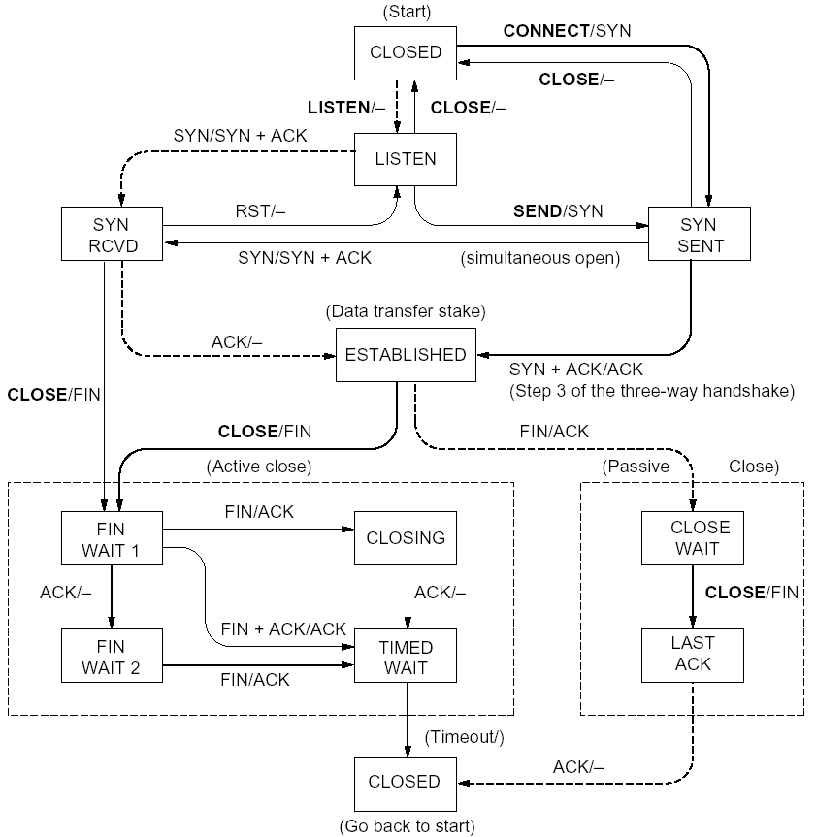
%netstat -t -a
CLOSED
SYN SENT
CLOSED
SYN
LISTEN
SYN RCVD
SYN/ACK
ESTABLSIHED
ACK
ESTABLSIHED
ESTABLSIHED
ESTABLSIHED
FIN WAIT 1
FIN
CLOSE WAIT
ACK
LAST ACK
FIN WAIT 2
FIN
TIME WAIT
ACK

Slide 24
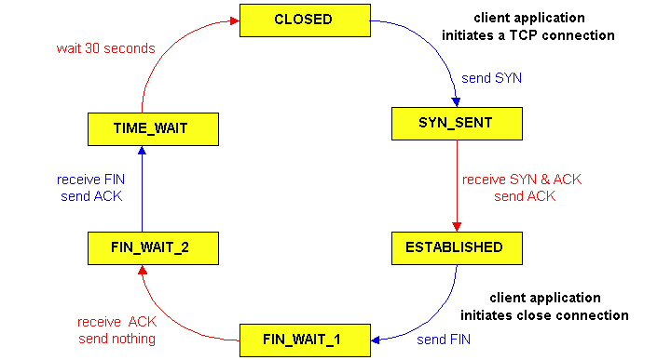
TCP Connection Management
CLOSED
SYN SENT
CLOSED
TCP lifecycle: init SYN/FIN
SYN
SYN RCVD
SYN/ACK
ESTABLSIHED
ACK
ESTABLSIHED
ESTABLSIHED
FIN WAIT 1
FIN
CLOSE WAIT
ACK
LAST ACK
FIN WAIT 2
FIN
TIME WAIT
ACK
http://dsd.lbl.gov/TCP-tuning/ip-sysctl-2.6.txt

Slide 25
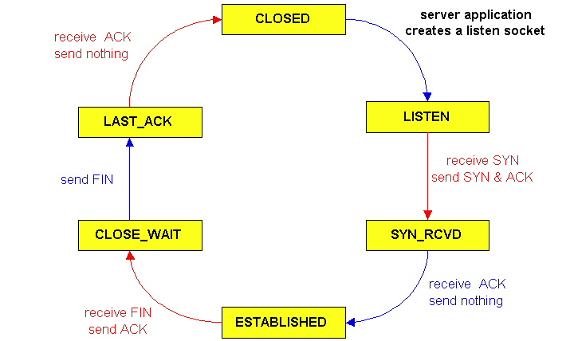
TCP Connection Management
CLOSED
SYN SENT
CLOSED
SYN
TCP lifecycle: wait for SYN/FIN
SYN RCVD
SYN/ACK
ESTABLSIHED
ACK
ESTABLSIHED
ESTABLSIHED
FIN WAIT 1
FIN
CLOSE WAIT
ACK
LAST ACK
FIN WAIT 2
FIN
TIME WAIT
ACK

Slide 26
A Summary of Questions
Basic structure: sliding window protocols
How to determine the “right” parameters?
timeout: mean + variation
sliding window size?

Slide 27
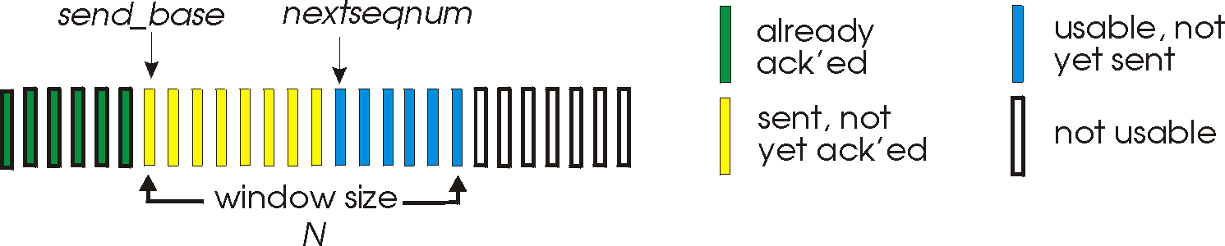
Sliding Window Size Function: Rate Control
Transmission rate determined by congestion window size, cwnd, over segments:
cwnd
cwnd segments, each with MSS bytes sent in one RTT:
cwnd * MSS
Rate =
Bytes/sec
RTT
Assume W is small enough. Ignore small details. MSS: Minimum Segment Size

Slide 28
Some General Questions
Big picture question:
How to determine a flow’s sending rate?
For better understanding, we need to look at a few basic questions:
What is congestion (cost of congestion)?
Why are desired properties of congestion control?

Slide 29
Roadmap
What is congestion
The basic CC alg
TCP/reno CC
TCP/Vegas
A unifying view of TCP/Reno and TCP/Vegas
Network wide resource allocation
Framework
Axiom derivation of network-wide objective function
Derive distributed algorithm

Slide 30
Outline
Admin and recap
TCP Reliability
Transport congestion control
what is congestion (cost of congestion)

Slide 31
Cause/Cost of Congestion: Single Bottleneck
flow 1
20 Mbps
5 Mbps
10 Mbps
flow 2 (5 Mbps)
20 Mbps
20 Mbps
router 1
router 2
- Flow 2 has a fixed sending rate of 5 Mbps
- We vary the sending rate of flow 1 from 0 to 20 Mbps
- Assume
no retransmission; link from router 1 to router 2 has infinite buffer
throughput: e2e packets delivered in unit time
Delay?
throughput of flow 1 & 2 (Mbps)
delay at central link
delay due to
randomness
10
sending rate by flow 1 (Mbps)
sending rate by flow 1 (Mbps)
5
0
5
5
0

Slide 32
Cause/Cost of Congestion: Single Bottleneck
router 3
router 5
flow 1
20 Mbps
5 Mbps
10 Mbps
flow 2 (5 Mbps)
20 Mbps
20 Mbps
router 1
router 2
router 4
router 6
Assume
no retransmission
the link from router 1 to router 2 has finite buffer
throughput: e2e packets delivered in unit time
Zombie packet: a packet dropped at the link from router 2 to router 5; the upstream transmission from router 1 to router 2 used for that packet was wasted!
throughput of flow 1 & 2 (Mbps)
10
sending rate by flow 1 (Mbps)
5
x
0
5

Slide 33
Summary: The Cost of Congestion
When sources sending rate too high for the network to handle”:
Packet loss =>
wasted upstream bandwidth when a pkt is discarded at downstream
wasted bandwidth due to retransmission (a pkt goes through a link multiple times)
High delay
packet
loss
knee
cliff
Throughput
congestion
collapse
Load
Delay
Load

Slide 34
Outline
Admin and recap
TCP Reliability
Transport congestion control
what is congestion (cost of congestion)
basic congestion control alg.

Slide 35
Rate-based vs. Window-based
Rate-based:
Congestion control by explicitly controlling the sending rate of a flow, e.g., set sending rate to 128Kbps
Example: ATM
Window-based:
Congestion control by controlling the window size of a sliding window, e.g., set window size to 64KBytes
Example: TCP
Discussion: rate-based vs. window-based

Slide 36
Sliding Window Size Function: Rate Control
Transmission rate determined by congestion window size, cwnd, over segments:
cwnd
cwnd segments, each with MSS bytes sent in one RTT:
cwnd * MSS
Rate =
Bytes/sec
RTT
Assume W is small enough. Ignore small details. MSS: Maximum Segment Size

Slide 37
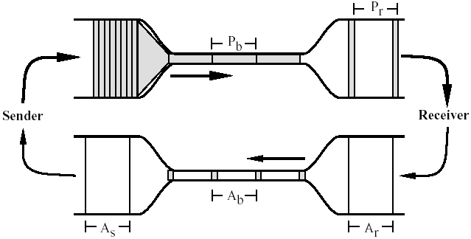
Window-based Congestion Control
Window-based congestion control is self-clocking: considers flow conservation, and adjusts to RTT variation automatically.
Hence, for better safety, more designs use window-based design.

Slide 38
The Desired Properties of a Congestion Control Scheme
Efficiency: close to full utilization but low delay
fast convergence after disturbance
Fairness (resource sharing)
Distributedness (no central knowledge for scalability)

Slide 39
Derive CC: A Simple Model
User 1
x₁
d = sum x_{i} > X_{goal}?
sum xi
User 2
x₂
x_{n}
User n
Flows observe congestion signal d, and locally take actions to adjust rates.

Slide 40
Linear Control
Proposed by Chiu and Jain (1988)
The simplest control strategy
Discussion: values of the parameters?

Slide 41
State Space of Two Flows
fairness line: x1=x2
x₂
x(0)
overload
efficiency line: x1+x2=C
underload
x₁

Slide 42
congestion
x₀
x₀
efficiency
efficiency: distributed linear rule
a=0
b=1
x₀
x₀
fairness
intersection

Slide 43
Implication: Congestion (overload) Case
In order to get closer to efficiency and fairness after each update, decreasing of rate must be multiplicative decrease (MD)
a_{D} = 0
b_{D} < 1

Slide 44
no-congestion
x₀
x₀
efficiency
efficiency: distributed linear rule
x₀
x₀
fairness
convergence

Slide 45
Implication: No Congestion Case
In order to get closer to efficiency and fairness after each update, additive and multiplicative increasing (AMI), i.e.,
a_{I} > 0, b_{I} > 1
Simply additive increase gives better improvement in fairness (i.e., getting closer to the fairness line)
Multiplicative increase may grow faster

Slide 46
Intuition: State Trace Analysis of Four Special Cases
 | Additive Decrease | Multiplicative Decrease
Additive Increase | AIAD (b_{I}=b_{D}=1) | AIMD (b_{I}=1, a_{D}=0)
Multiplicative Increase | MIAD (a_{I}=0, b_{I}>1, b_{D}=1) | MIMD (a_{I}=a_{D}=0)
Discussion: state transition trace.

Slide 47
AIMD: State Transition Trace
x₂
fairness line: x1=x2
overload
x₀
efficiency line: x1+x2=C
underload
x₁

Slide 48
Intuition: Another Look
Consider the difference or ratio of the rates of two flows
AIAD
difference does not change
MIMD
ratio does not change
MIAD
difference becomes bigger
AIMD
difference does not change
Notes:
AIAD: difference does not change
MIMD: ratio does not change
MIAD: difference becomes bigger
AIMD: difference does not change

Slide 49
Outline
Admin and recap
TCP Reliability
Transport congestion control
what is congestion (cost of congestion)
basic congestion control alg.
TCP/reno congestion control

Slide 50
TCP Congestion Control
Closed-loop, end-to-end, window-based congestion control
Designed by Van Jacobson in late 1980s, based on the AIMD alg. of Dah-Ming Chu and Raj Jain
Worked in a large range of bandwidth values: the bandwidth of the Internet has increased by more than 200,000 times
Many versions
TCP/Tahoe: this is a less optimized version
TCP/Reno: many OSs today implement Reno type congestion control
TCP/Vegas: not currently used
For more details: see TCP/IP illustrated; or read http://lxr.linux.no/source/net/ipv4/tcp_input.c for linux implementation

Slide 51
Mapping A(M)I-MD to Protocol
Basic questions to look at:
How to obtain d(t)--the congestion signal?
What values do we choose for the formula?
How to map formula to code?
Notes:
Implement d(t): loss/delay
Adjust window size
b_D: exponential backoff timeout after window size is 1

Slide 52
Obtain d(t) Approach 1: End Hosts Consider Loss as Congestion
Packets
1
2
3
4
5
6
7
Acknowledgements (waiting seq#)
2
3
4
4
4
4
Pros and Cons of endhosts using loss as congestion?
Assume loss => cong

Slide 53


Obtain d(t) Approach 2: Network Feedback (ECN: Explicit Congestion Notification)
Sender reduces rate if ECN received.
Pros and Cons of ECN?
Sender 1
Receiver bounces marker back to sender in ACK msg
Receiver
Sender 2
Network marks ECN Mark (1 bit) on pkt according to local condition, e.g., queue length > K

Slide 54
Mapping A(M)I-MD to Protocol
Basic questions to look at:
How to obtain d(t)--the congestion signal?
What values do we choose for the formula?
How to map formula to code?
Notes:
Implement d(t): loss/delay
Adjust window size
b_D: exponential backoff timeout after window size is 1

Slide 55
TCP/Reno Formulas
Multiplicative Increase (MI)
double the rate: x(t+1) = 2 x(t)
Additive Increase (AI)
Linear increase the rate: x(t+1) = x(t) + 1
Multiplicative decrease (MD)
half the rate: x(t+1) = 1/2 x(t)

Slide 56
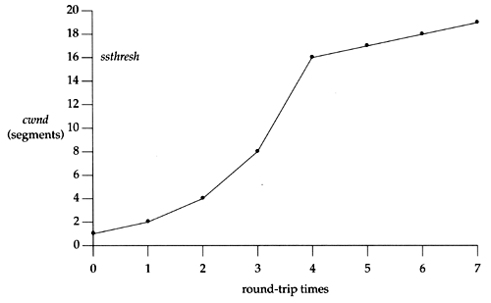
TCP/Reno Formula Switching (Control Structure)
Two “phases”
slow-start
Goal: getting to equilibrium gradually but quickly, to get a rough estimate of the optimal of cwnd
Formula: MI
congestion avoidance
Goal: Maintains equilibrium and reacts around equilibrium
Formula: AI MD

Slide 57
TCP/Reno Formula Switching (Control Structure)
Important variables:
cwnd: congestion window size
ssthresh: threshold between the slow-start phase and the congestion avoidance phase
If cwnd < ssthresh
MI
Else
AIMD
Notes:
AI: increases window by 1 per round
MD: cuts window size
to half when detecting congestion by 3DUP
to 1 if timeout
if already timeout, doubles timeout

Slide 58
MI: Slow Start
Algorithm: MI
double cwnd every RTT until network congested
Goal: getting to equilibrium gradually but quickly, to get a rough estimate of the optimal of cwnd

Slide 59
MI: Slow-start
Initially:
cwnd = 1;
ssthresh = infinite (e.g., 64K);
For each newly ACKed segment:
if (cwnd < ssthresh)
/* MI: slow start*/
cwnd = cwnd + 1;
cwnd = 1
segment 1
ACK for segment 1
cwnd = 2
segment 2
segment 3
ACK for segments 2 + 3
cwnd = 4
segment 4
segment 5
segment 6
segment 7
cwnd = 6
cwnd = 8

Slide 60
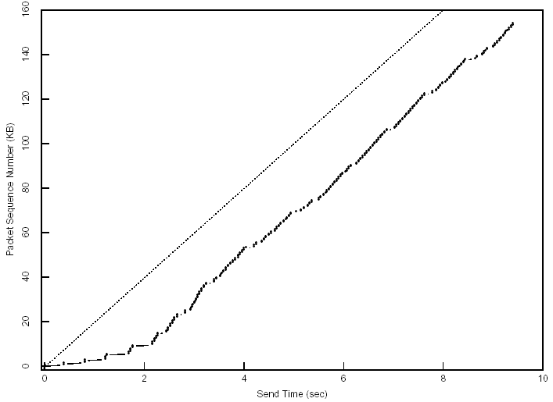
Startup Behavior with Slow-start
See [Jac89]

Slide 61
AIMD: Congestion Avoidance
Algorithm: AIMD
increases window by 1 per round-trip time (how?)
cuts window size
to half when detecting congestion by 3DUP
to 1 if timeout
if already timeout, doubles timeout
Goal: Maintains equilibrium and reacts around equilibrium

Slide 62
TCP/Reno Full Alg
Initially:
cwnd = 1;
ssthresh = infinite (e.g., 64K);
For each newly ACKed segment:
if (cwnd < ssthresh) // slow start: MI
cwnd = cwnd + 1;
else
// congestion avoidance; AI cwnd += 1/cwnd;
Triple-duplicate ACKs:
// MD
cwnd = ssthresh = cwnd/2;
Timeout:
ssthresh = cwnd/2; // reset
cwnd = 1;
(if already timed out, double timeout value; this is called exponential backoff)

Slide 63
TCP/Reno: Big Picture
cwnd
TD
TD
TD
ssthresh
TO
ssthresh
ssthresh
ssthresh
Time
slow
start (MI)
congestion
avoidance (AIMD)
congestion
avoidance
congestion
avoidance
slow
start
congestion
avoidance
TD: Triple duplicate acknowledgements
TO: Timeout

