Slide 1
Network Applications: Email, DNS
Qiao Xiang
https://qiaoxiang.me/courses/cnns-xmuf21/index.shtml
9/30/2021
This deck of slides are heavily based on CPSC 433/533 at Yale University, by courtesy of Dr. Y. Richard Yang.

Slide 2
Outline
Admin. and recap
Application layer overview
Network applications
Email
DNS

Slide 3
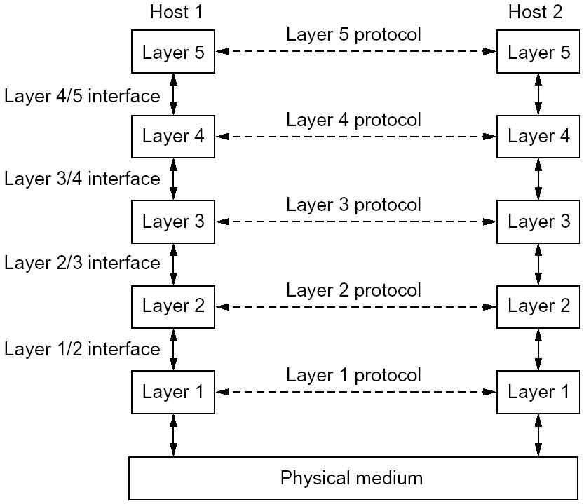
Recap: Layering
Why layering
reference model
modularization
Concepts
service, interface, and protocol
physical vs logical communication
Key design decision
end-to-end arguments to place functions in layers

Slide 4
Some Implications of Layered Architecture
A packet as a stack container
Each layer needs multiplexing and demultiplexing to serve layer above
…
Hn-1
Hn
Ln
Has a field to indicate which higher layer requires the service
Ln-1

Slide 5
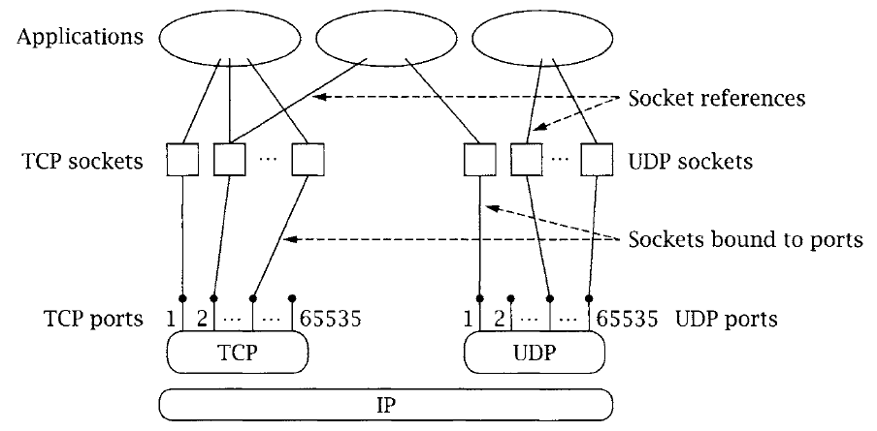
Multiplexing/Demultiplexing

Slide 6
Recap: The Big Picture of the Internet
Hosts and routers:
~ 1 bill. hosts
organized into ~50K networks
backbone links 100 Gbps
Software:
datagram switching with virtual circuit support
layered network architecture
use end-to-end arguments to determine the services provided by each layer
the 5-layer hourglass architecture of the Internet
Email
WWW
FTP
Telnet
SSL
TCP
UDP
IP
Ethernet
Wireless
Cable/DSL

Slide 7
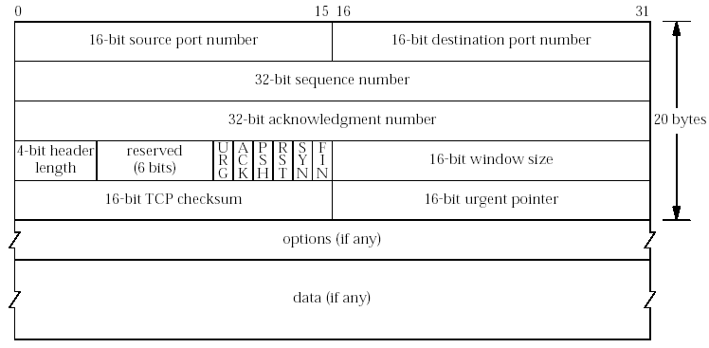
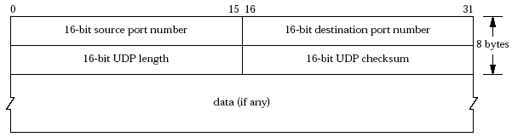
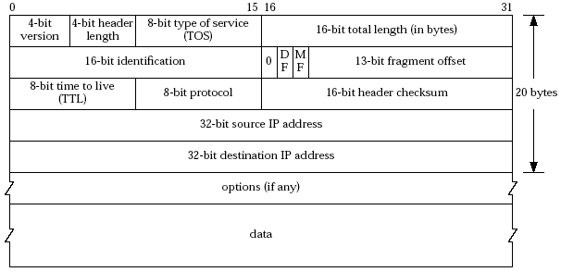

Formats of main protocols
Tip: services map to header fields

Slide 8
Outline
Admin. and recap
Application layer overview

Slide 9
Application Layer: Goals
Conceptual + implementation aspects of network application protocols
client server paradigm
peer to peer paradigm
network app. programming
Learn about applications by examining common applications
smtp/pop
dns
http (1, 1.1, /2)
content distribution
peer-to-peer

Slide 10
Network Applications vs. Application-layer Protocols
Network application: communicating, distributed processes
a process is a program that is running within a host
a user agent is a process serving as an interface to the user
web: browser
streaming audio/video: media player
processes communicate by an application-layer protocol
e.g., email, Web
Application-layer protocols
one “piece” of an app
define messages exchanged by apps and actions taken
implementing services by using the service provided by the lower layer, i.e., the transport layer
application
transport
network
data link
physical
application
transport
network
data link
physical

Slide 11
App. and Trans.: App. Protocols and their Transport Protocols
An application needs to choose the transport protocol
Application
layer protocol
smtp [RFC 821]
telnet [RFC 854]
http [RFC 2068]
ftp [RFC 959]
proprietary
(e.g., Vocaltec)
NFS
proprietary
Underlying
transport protocol
TCP/SSL
TCP
TCP/SSL
TCP
typically UDP
TCP or UDP
typically UDP but moving to http
Application
e-mail
remote terminal access
Web
file transfer
Internet telephony
remote file server
streaming multimedia

Slide 12
Client-Server Paradigm
Typical network app has two pieces: client and server
application
transport
network
data link
physical
Client (C):
initiates contact with server (“speaks first”)
typically requests service from server
for Web, client is implemented in browser; for e-mail, in mail reader
Server (S):
provides requested service to client
e.g., Web server sends requested Web page; mail server delivers e-mail
request
reply
application
transport
network
data link
physical

Slide 13
Client-Server Paradigm: Key Questions
application
transport
network
data link
physical
request
Key questions to ask about a C-S application
- Is the application extensible?
- Is the application scalable?
- How does the application handle server failures (being robust)?
- How does the application handle security?
reply
application
transport
network
data link
physical

Slide 14
Outline
Admin. and recap
Application layer overview
Network applications
Email

Slide 15
Electronic Mail
Still active
80B emails/day
3.9B active email boxes
A highly recommended reading: a history of Email development
linked on the Schedule page

Slide 16
Recall: SMTP
C: auth login
S: 334 VXNlcm5hbWU6
C: eG11Y25ucw==
S: 334 UGFzc3dvcmQ6
C: MzM0ZjU2MDVkZjE1MDRmOQ==
S: 235 OK Authenticated
C: mail from:xmucnns@sina.com
S: 250 ok
C: rcpt to:qiaoxiang@xmu.edu.cn
S: 250 ok
C: data
S: 354 End data with <CR><LF>.<CR><LF>
C: Date:2021-9-22 12:36
C: From:xmucnns@sina.com
C: To:qiaoxiang@xmu.edu.cn
C: Subject:test smtp
C:
C: Hello, Qiao.
C:
C: .
S: 250 ok queue id 11479549283321
C: quit
S: 221 smtp-97-27.smtpsmail.fmail.bx.sinanode.com
S: Connection closed by foreign host.

Slide 17
Electronic Mail: Components
outgoing
message queue
user mailbox
user
agent
Three major components:
User agents
Mail servers
Protocols
Mail transport protocol
SMTP
Mail access protocols
POP3: Post Office Protocol [RFC 1939]
IMAP: Internet Mail Access Protocol [RFC 1730]
mail
server
user
agent
SMTP
mail
server
user
agent
SMTP
mail
server
SMTP
user
agent
POP3 or
IMAP SMTP
user
agent
user
agent

Slide 18
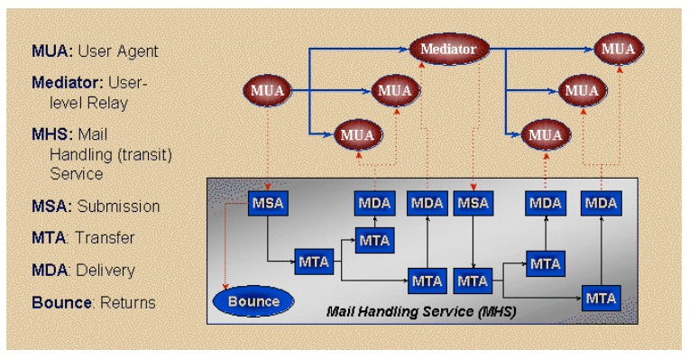
Email Transport Architecture
http://www.maawg.org/sites/maawg/files/news/MAAWG_Email_Authentication_Paper_2008-07.pdf

Slide 19
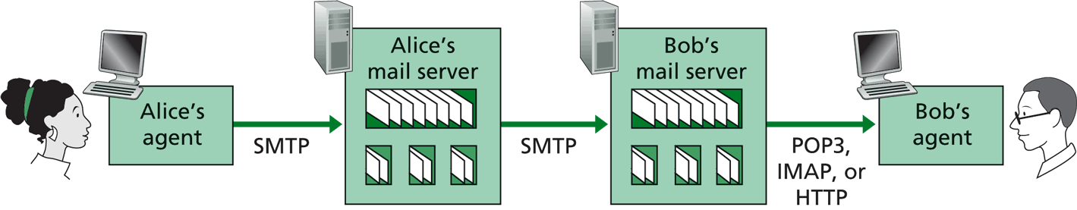
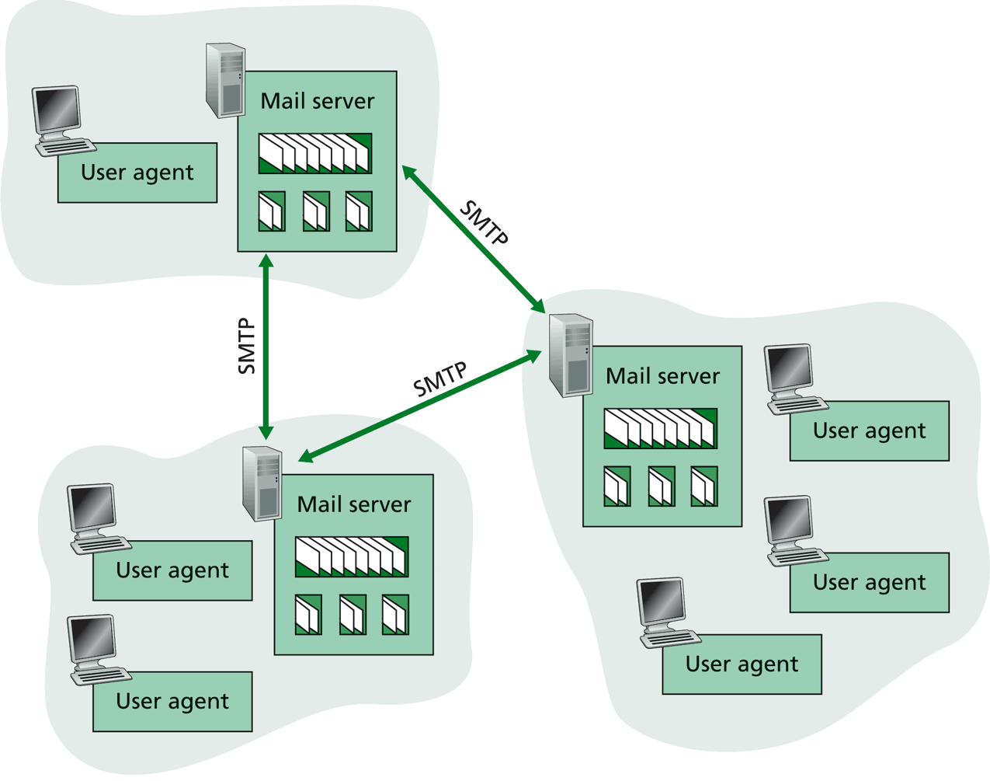
SMTP: Mail Transport Protocol Messages (Envelop Messages)
C: auth login
S: 334 VXNlcm5hbWU6
C: eG11Y25ucw==
S: 334 UGFzc3dvcmQ6
C: MzM0ZjU2MDVkZjE1MDRmOQ==
S: 235 OK Authenticated
C: mail from:xmucnns@sina.com
S: 250 ok
C: rcpt to:qiaoxiang@xmu.edu.cn
S: 250 ok
C: data
S: 354 End data with <CR><LF>.<CR><LF>
C: Date:2021-9-22 12:36
C: From:xmucnns@sina.com
C: To:qiaoxiang@xmu.edu.cn
C: Subject:test smtp
C:
C: Hello, Qiao.
C:
C: .
S: 250 ok queue id 11479549283321
C: quit
S: 221 smtp-97-27.smtpsmail.fmail.bx.sinanode.com
S: Connection closed by foreign host.
Email text different from SMTP protocol message
%telnet smtp.sina.com 25

Slide 20
Mail Message Data
SMTP: protocol for exchanging email msgs
RFC 822: standard for text message format:
Header lines, e.g.,
To:
From:
Subject:
Body
the “message”, ASCII characters only
header
blank
line
body
Benefit of separating protocol and msg: easier extensibility

Slide 21
Message Format: Multimedia Extensions
MIME: multimedia mail extension, RFC 2045, 2056
Additional lines in msg header declare MIME content type
From: xmucnns@sina.com
To: qiaoxiang@xmu.edu.cn
Subject: Network map.
MIME-Version: 1.0
Content-Type: image/jpeg Content-Transfer-Encoding: base64
base64 encoded data .....
.........................
......base64 encoded data
MIME version
multimedia data
type, subtype,
parameter declaration
method used
to encode data
encoded data
Benefit of MIME type: self describing data type, adding extensibility.

Slide 22
Multipart Type: How Attachment Works
From: xmucnns@sina.com
To: qiaoxiang@xmu.edu.cn
Subject: Network map.
MIME-Version: 1.0
Content-Type: multipart/mixed; boundary=98766789
--98766789
Content-Transfer-Encoding: quoted-printable
Content-Type: text/plain
Hi,
Attached is network topology map.
--98766789
Content-Transfer-Encoding: base64
Content-Type: image/jpeg
base64 encoded data .....
.........................
......base64 encoded data
--98766789--

Slide 23
POP3 Protocol: Mail Retrieval
Authorization phase
client commands:
user: declare username
pass: password
server responses
+OK
-ERR
Transaction phase, client:
list: list message numbers
retr: retrieve message by number
dele: delete
quit
S: +OK sina pop3 server ready
C: user xmucnns
S: +OK welcome to sina mail
C: pass 334f5605df1504f9
S: +OK 4 messages (32377 octets)
C: list
S: +OK 4 messages (32377 octets)
S: 1 10410
S: 2 10748
S: 3 7859
S: 4 3360
S: .
C: retr 4
S: +OK 3360 octets
C: dele 2
C: quit
S: +OK
user successfully logged in
POP3 server signing off
%telnet pop.sina.com 110
Notes:
http://www.electrictoolbox.com/article/networking/pop3-commands/

Slide 24
Exercise
Register an email address at sina.com
Send an email to the registered email address using smtp
Retrieve using pop

Slide 25
Evaluation of SMTP/POP/IMAP
user
agent
mail
server
user
agent
Key questions to ask about a C-S application
- extensible?
- scalable?
- robust?
- security?
SMTP
mail
server
user
agent
SMTP
SMTP
mail
server
user
agent
POP3 or
IMAP SMTP
user
agent
user
agent

Slide 26
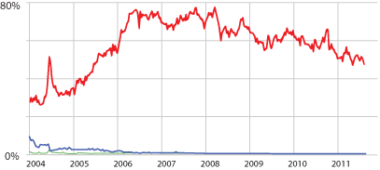
Email Security: Spam
Spam (Google)
Notes:
https://support.google.com/mail/answer/1366858?hl=en
http://www.securelist.com/en/analysis/204792282/Spam_in_January_2013
https://www.trustwave.com/support/labs/spam_statistics.asp
http://en.wikipedia.org/wiki/Bayesian_spam_filtering
http://www.pcworld.com/article/252206/google_explains_gmails_spam_filtering_process.html

Slide 27
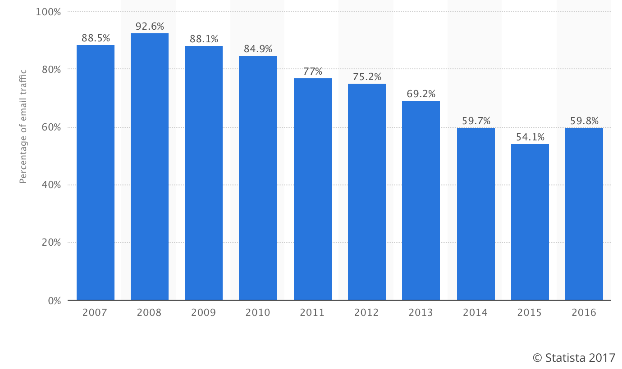
Email Security Issue: Spam
Source: https://www.statista.com/statistics/420400/spam-email-traffic-share-annual/

Slide 28
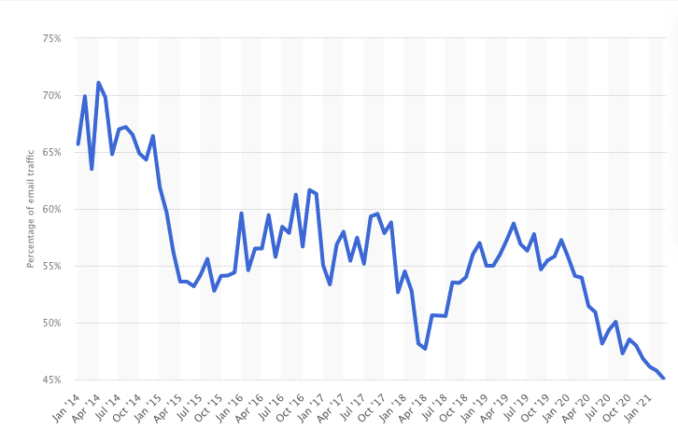
Email Security Issue: Spam
Source: https://www.statista.com/statistics/420391/spam-email-traffic-share/

Slide 29
Discussion: How May One Handle Email Spams?
Notes:
https://support.google.com/mail/answer/1366858?hl=en
http://support.simpledns.com/KB/a62/configuring-dns-records-for-domainkeys-dkim.aspx
http://www.slideshare.net/kka7/what-you-need-to-know-about-email-authentication

Slide 30
Detection Methods Used by GMail
Known phishing scams
Message from unconfirmed sender identity
Message you sent to Spam/similarity to suspicious messages
Administrator-set policies
https://support.google.com/mail/answer/1366858?hl=en
Notes:
https://support.google.com/mail/answer/1366858?hl=en
http://support.simpledns.com/KB/a62/configuring-dns-records-for-domainkeys-dkim.aspx

Slide 31
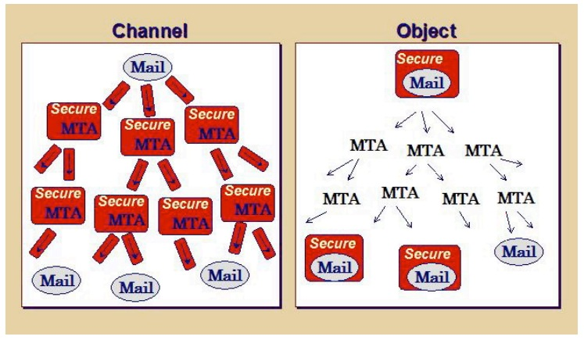
Email Authentication Approaches
Sender Policy Frame (SPF)
DomainKeys Identified Mail (DKIM) Authenticated Results Chain (ARC)
Notes:
https://support.google.com/mail/answer/1366858?hl=en
http://support.simpledns.com/KB/a62/configuring-dns-records-for-domainkeys-dkim.aspx
https://dmarc.org/presentations/ARC-Overview-2016Q3-v01.pdf

Slide 32
Sender Policy Framework (SPF RFC7208)
https://tools.ietf.org/html/rfc7208
MUA
smtp/submission
Is my neighbor m a permitted sender for the domain?
MTA
smtp
Border Outbound MTA m
smtp
Border Inbound MTA
neighbor MTA
pop/imap
validating MTA
MUA
Notes:
https://support.google.com/mail/answer/1366858?hl=en
http://support.simpledns.com/KB/a62/configuring-dns-records-for-domainkeys-dkim.aspx

Slide 33
Key Question for SPF?
How does SPF know if its neighbor MTA is a permitted sender of the domain?
Notes:
http://support.simpledns.com/KB/a62/configuring-dns-records-for-domainkeys-dkim.aspx
<selector>._domainkey.example.com
dig txt <selector>._domainkey.<domain> +short

Slide 34
DomainKeys Identified Mail (DKIM; RFC 5585)
A domain-level digital signature authentication framework for email, using public key crypto
E.g., mail.sina.com signs that the message is sent by mail.sina server
Basic idea of public key signature
Owner has both public and private keys
Owner uses private key to sign a message to generate a signature
Others with public key can verify signature
Assumption: difficult to get private key even w/ public key distributed
Notes:
mailing lists or account forwarding
https://blog.returnpath.com/how-to-explain-authenticated-received-chain-arc-in-plain-english-2/
https://support.google.com/mail/answer/1366858?hl=en
http://support.simpledns.com/KB/a62/configuring-dns-records-for-domainkeys-dkim.aspx

Slide 35
DomainKeys Identified Mail (DKIM)
MUA
smtp/submission
Is the message signed by the private key of the signing domain?
Signing MTA
smtp
MTA
smtp
VerifyingMTA
pop/imap
MUA
Notes:
https://support.google.com/mail/answer/1366858?hl=en
http://support.simpledns.com/KB/a62/configuring-dns-records-for-domainkeys-dkim.aspx

Slide 36
Example: RSA
1. Choose two large prime numbers p, q.
(e.g., 1024 bits each)
2. Compute n = pq, z = (p-1)(q-1)
3. Choose e (with e < n) that has no common factors
with z. (e, z are “relatively prime”).
4. Choose d such that ed-1 is exactly divisible by z.
(in other words: ed mod z = 1 ).
5. Public key is (n,e). Private key is (n,d).

Slide 37
RSA: Signing/Verification
0. Given (n,e) and (n,d) as computed above
1. To sign message, m, compute h = hash(m), then sign with private key
d
d
s = h mod n
(i.e., remainder when h is divided by n)
2. To verify signature s, compute
e
e
h’ = s mod n
(i.e., remainder when s is divided by n)
Magic
happens!
d
e
h = (h mod n)
mod n
The magic is a simple application of Euler’s generalization of
Fermat’s little theorem

Slide 38
Key Question about DKIM?
How does DKIM retrieve the public key of the author domain?
Notes:
http://support.simpledns.com/KB/a62/configuring-dns-records-for-domainkeys-dkim.aspx
<selector>._domainkey.example.com
dig txt <selector>._domainkey.<domain> +short

Slide 39
Summary: Some Key Remaining Issues about Email
Basic: How to find the email server of a domain?
Scalability/robustness: how to find multiple servers for the email domain?
Security
SPF: How does SPF know if its neighbor MTA is a permitted sender of the domain?
DKIM: How does DKIM retrieve the public key of the author domain?

Slide 40
Scalability/Robustness
Both scalability and robustness require that multiple email servers serve the same email address
need an email server’s IP address
client
mapping
sina.com
sina.com
sina.com
mail
server
mail
server
mail
server
130.132.50.7
130.132.50.8
130.132.50.9

Slide 41
Mapping Functions Design Alternatives
name (e.g., sina.com)
name (e.g., sina.com)
mapping
mapping
1 IP
multiple IPs
mapping
multiple IPs

Slide 42

Mapping Functions Design Alternatives
name (e.g., sina.com)
name (e.g., sina.com)
mapping
mapping
1 IP
load balancer (routing)
1 IP
1 IP
switch

Slide 43
Outline
Admin. and recap
Layered network architecture
Application layer overview
Network applications
Email
DNS

Slide 44
DNS: Domain Name System
Function
map between (domain name, service) to value, e.g.,
(xmu.edu.cn, addr) -> 210.34.0.35
(xmu.edu.cn, email) -> cmsn1.xmu.edu.cn
clients
DNS
Hostname, Service
Address
routers
servers
Notes:
Why name: easy to remember, one-level of indirection

Slide 45
DNS Records
http://www.iana.org/assignments/dns-parameters/dns-parameters.xhtml
DNS: stores resource records (RR)
RR format: (name, type, value, ttl)
Type=A
name is hostname
value is IP address
Type=CNAME
name is an alias of a “canonical” (real) name
value is canonical name
Type=NS
name is domain (e.g. xmu.edu.cn)
value is the name of the authoritative name server for this domain
Type=MX
value is hostname of mail server associated with name
Type=SRV
general extension for services
Type=TXT
general txt
Type=PTR
a pointer to another name

Slide 46
Discussion
Can DNS handle multiple values for the same (name, service)?

Slide 47
Try DNS: Examples
dig <name> <type>
Try xmu.edu.cn / others and various types
dig <domain> txt to retrieve spf
http://www.zytrax.com/books/dns/ch9/spf.html

Slide 48
Observations
MX can return multiple servers
DNS may rotate the servers in answer
Address can also return multiple addresses
SPF is encoded as the txt type

Slide 49
DKIM Example
Send email from hotmail and check message
Notes:
https://support.google.com/mail/answer/1366858?hl=en
http://support.simpledns.com/KB/a62/configuring-dns-records-for-domainkeys-dkim.aspx
Try TXT record for gmail.com dig txt gmail.com

Slide 50
DKIM Example
DKIM / ARC: Msg: ARC-Message-Signature: i=1; a=rsa-sha256; c=relaxed/relaxed; d=microsoft.com; s=arcselector9901; h=From:Date:Subject:Message-ID:Content-Type:MIME-Version; bh=bO91TxHI+4MjgAusrfg0EWGiDmvQ5hZRZ/aqb1MKLY8=; …
DKIM-Signature: v=1; a=rsa-sha256; c=relaxed/relaxed;
d=hotmail.com; s=selector1; h=From:Date:Subject:Message-
ID:Content-Type:MIME-Version:X-MS-Exchange-
SenderADCheck;…
Query: dig arcselector9901._domainkey.microsoft.com txt
DKIM introduces a session key to allow multiple public keys
<session>._domainkey.<domain>

Slide 51

DNS Design: Dummy Design
DNS itself can be considered as a client-server system as well
How about a dummy design: introducing one super Internet DNS server?
THE DNS server of the Internet
IP address
resolve <name>
register <name>
OK/used already

Slide 52
Problems of a Single DNS Server
Scalability and robustness bottleneck
Administrative bottleneck

Slide 53
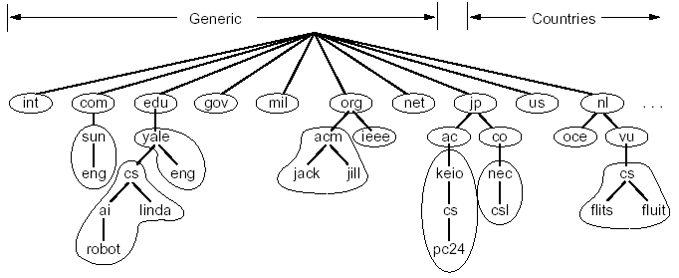
DNS: Distributed Management of the Domain Name Space
A distributed database managed by authoritative name servers
divided into zones, where each zone is a sub-tree of the global tree
each zone has its own authoritative name servers
an authoritative name server of a zone may delegate a subset (i.e. a sub-tree) of its zone to another name server
cn
pku
xmu
mail
cwc
called a zone

Slide 54
Email Architecture + DNS
user
agent
mail
server
user
agent
SMTP
mail
server
user
agent
SMTP
SMTP
mail
server
user
agent
POP3 or
IMAP SMTP
DNS
user
agent
user
agent

Slide 55
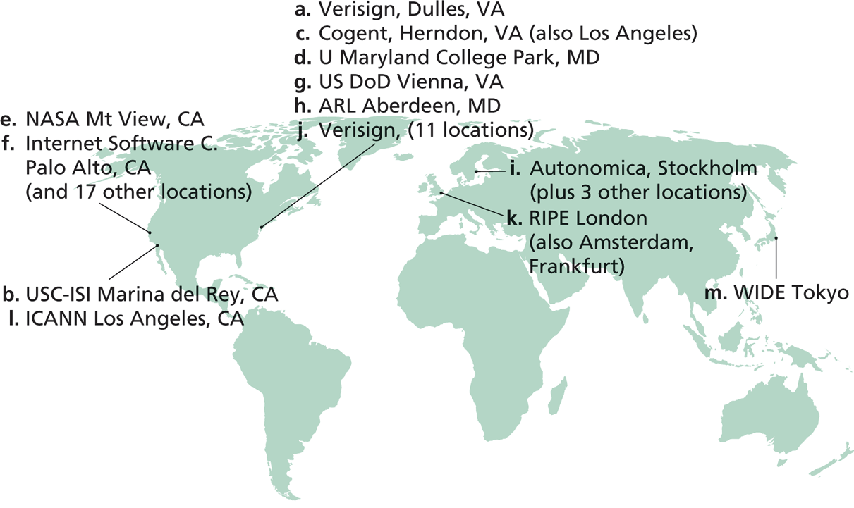
Root Zone and Root Servers
The root zone is managed by the root name servers
13 root name servers worldwide
See http://root-servers.org/ for more details

Slide 56
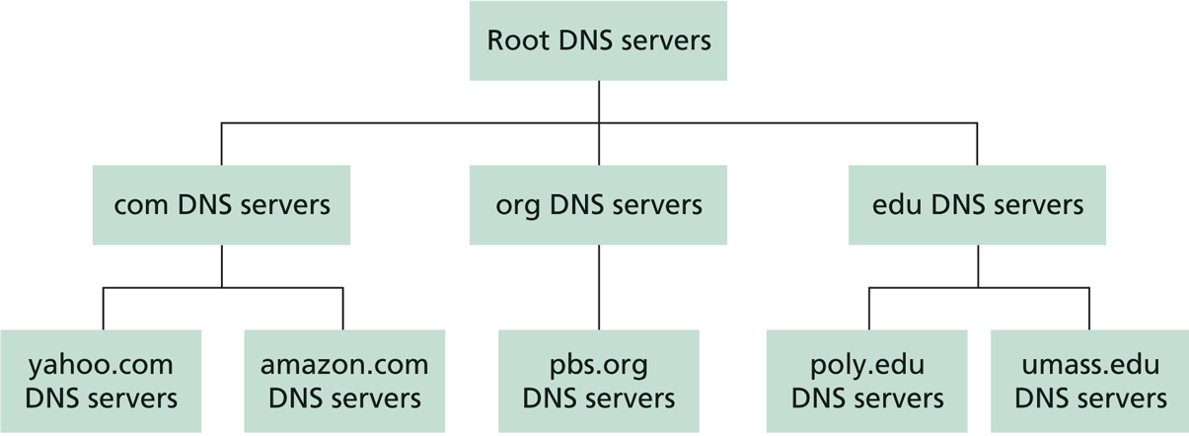
Linking the Name Servers
Each name server knows the addresses of the root servers
Each name server knows the addresses of its immediate children (i.e., those it delegates)
Top level domain (TLD)
Q: how to query a hierarchy?

Slide 57
DNS Message Flow: Two Types of Queries
Recursive query:
The contacted name server resolves the name completely
Iterated query:
Contacted server replies with name of server to contact
“I don’t know this name, but ask this server”

Slide 58

Two Extreme DNS Message Flows
root name server
root name server
Iterative query
Recursive query
1
1
2
2
6
client
TLD name server
client
5
TLD name server
3
4
5
4
3
6
A: ALL the load has to go through the root server!
Q: Issues of the two approaches?
authoritative name server
authoritative name server
informatics.xmu.edu.cn
informatics.xmu.edu.cn

Slide 59
Typical DNS Message Flow: The Hybrid Case
root name server
Host knows only local name server
Local name server is learned from DHCP, or configured, e.g. /etc/resolv.conf
Local DNS server helps clients resolve DNS names
2
iterated query
3
4
7
local name server
130.132.1.9
TLD name server
6
5
1
8
authoritative name server
dns.cs.umass.edu
requesting host
cyndra.cs.yale.edu
gaia.cs.umass.edu

Slide 60
Typical DNS Message Flow: The Hybrid Case
root name server
Host knows only local name server
Local name server is learned from DHCP, or configured, e.g. /etc/resolv.conf
Local DNS server helps clients resolve DNS names
Benefits of local name servers (often called resolvers)
simplifies client
caches/reuses results
2
iterated query
3
4
7
local name server
TLD name server
6
5
1
8
authoritative name server
dns.cs.umass.edu
requesting host
harvard.edu
gaia.cs.umass.edu

Slide 61
Outline
Admin. and recap
Layered network architecture
Application layer overview
Network applications
Email
DNS
High-level design
Details

Slide 62
DNS Message Format?
Basic encoding decisions: UDP/TCP, how to encode domain name, how to encode answers…
DNS
DNS
TCP
UDP
TCP
UDP
IP
IP
Ethernet
Wireless
Cable/DSL
Ethernet
Wireless
Cable/DSL
62
Notes:
Basic questions: how to encode domain name; how to do compression…

