Slide 1
Network Applications: HTTP/1.0
Y. Richard Yang
http://zoo.cs.yale.edu/classes/cs433/
9/26/2017

Slide 2
Admin
Assignment 2 status

Slide 3
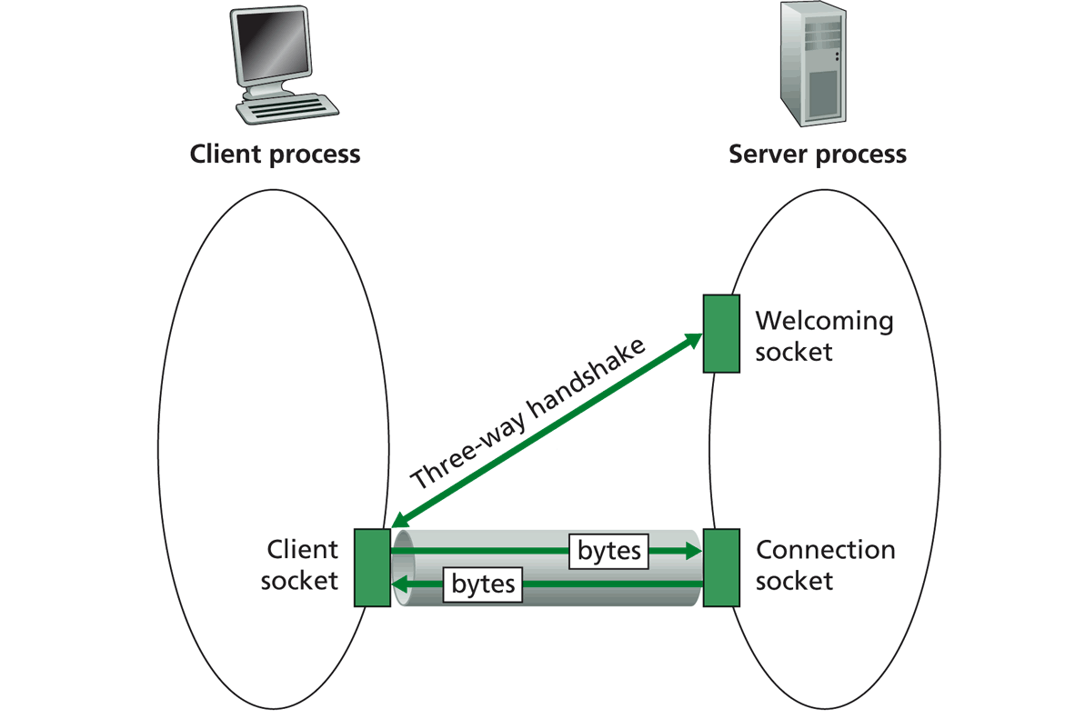
Recap: TCP Sockets
TCP server socket demux by 4-tuple:
source IP address
source port number
dest IP address
dest port number

Slide 4
Recap: FTP
A stateful protocol
state established by commands such as
USER/PASS, CWD, TYPE
Multiple TCP connections
A control connection
Data connections
Two approaches: PORT vs PASV
GridFTP: concurrent data connections; block data transfer mode
FTP
client
FTP
server
USER xxx
PASS xxx
CWD home
PORT clientip:cport
RETR index.html
Server initiates TCP data connection
server:20 clientip:cport
Notes:
A: someone (either server or client) needs to pick a new port

Slide 5
Outline
Recap
HTTP

Slide 6
From Opaque Files to Web Pages
Web page:
authored in HTML
addressed by a URL
URL has two components:
host name, port number and
path name
Most Web pages consist of:
base HTML page, and
several referenced objects
http request
User agent: Explorer
http response
http://www.cs.yale.edu:80/index.html
http request
Server
running
Apache Web
server
http response
User agent:
Firefox
The Web pages are requested through HTTP: hypertext transfer protocol

Slide 7
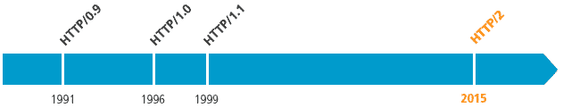
HTTP is Still Evolving
RFC 1945
RFC 2068
RFC 7540

Slide 8
HTTP 1.0 Message Flow
Server waits for requests from clients
Client initiates TCP connection (creates socket) to server, port 80
Client sends request for a document
Web server sends back the document
TCP connection closed
Client parses the document to find embedded objects (images)
repeat above for each image

Slide 9
HTTP 1.0 Message Flow (more detail)
0. http server at host www.cs.yale.edu waiting for TCP connection at port 80.
Suppose user enters URL www.cs.yale.edu/index.html
1a. http client initiates TCP connection to http server (process) at www.cs.yale.edu. Port 80 is default for http server.
1b. server “accepts” connection, ack. client
2. http client sends http request message (containing URL) into TCP connection socket
3. http server receives request message, forms response message containing requested object (index.html), sends message into socket (the sending speed increases slowly, which is called slow-start)
time

Slide 10
HTTP 1.0 Message Flow (cont.)
4. http server closes TCP connection.
5. http client receives response message containing html file, parses html file, finds embedded image
time
6. Steps 1-5 repeated for each of the embedded images

Slide 11
Discussion
How about we use FTP as HTTP?
FTP
client
FTP
server
FTP
client
FTP
server
TCP control connection
port 21 at server
TCP control connection
port 21 at server
PORT clientip:cport
PASV
serverip:sport
RETR index.html
RETR index.html
Server initiates TCP data connection
server:20 clientip:cport
Client initiates TCP data connection
of PASV returned serverip:sport
Notes:
Content negotiation, content type indication

Slide 12
HTTP1.0 Message Flow
HTTP1.0 servers are stateless servers: each request is self-contained
FTP
client
FTP
server
HTTP
client
HTTP
server
USER xxx
PASS xxx
CWD home
PORT clientip:cport
GET /home/index.html USER: xxx PASS: xxx
RETR index.html
Server initiates TCP data connection
server:20 clientip:cport
Server sends file on same connection

Slide 13
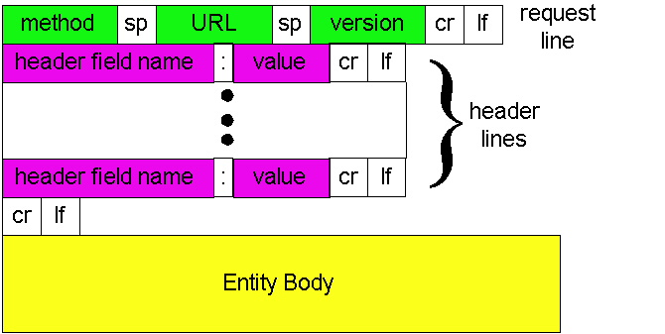
HTTP Request Message: General Format
ASCII (human-readable format)

Slide 14
Trying out HTTP (client side) for yourself
1. Telnet to your favorite Web server:
telnet www.cs.yale.edu 80
Opens TCP connection to port 80
(default http server port) at www.cs.yale.edu.
Anything typed in sent
to port 80 at www.cs.yale.edu
2. Type in a GET http request:
GET /index.html HTTP/1.0
By typing this in (hit carriage
return twice), you send
this minimal (but complete)
GET request to http server
3. Look at response message sent by the http server.

Slide 15
Trying out HTTP (client side) for yourself
Try telnet GET on www.yale.edu

Slide 16
HTTP Request Message Example: GET
Virtual host multiplexing
request line
(GET, POST,
HEAD, PUT, DELETE, TRACE … commands)
GET /somedir/page.html HTTP/1.0 Host: www.somechool.edu Connection: close
User-agent: Mozilla/4.0
Accept: text/html, image/gif, image/jpeg
Accept-language: en
(extra carriage return, line feed)
Connection management
header
lines
Carriage return,
line feed
indicates end
of message
Content negotiation

Slide 17
HTTP Response Message
status line
(protocol
status code
status phrase)
HTTP/1.0 200 OK
Date: Wed, 23 Jan 2008 12:00:15 GMT
Server: Apache/1.3.0 (Unix)
Last-Modified: Mon, 22 Jun 1998 …...
Content-Length: 6821
Content-Type: text/html
data data data data data ...
header
lines
data, e.g.,
requested
html file

Slide 18
HTTP Response Status Codes
In the first line of the server->client response message. A few sample codes:
200 OK
request succeeded, requested object later in this message
301 Moved Permanently
requested object moved, new location specified later in this message (Location:)
400 Bad Request
request message not understood by server
404 Not Found
requested document not found on this server
505 HTTP Version Not Supported

Slide 19
Trying Use Chrome to visit Course Page

Slide 20
Design Exercise
Workflow of an HTTP server processing a GET request that maps to a file: GET /somedir/page.html HTTP/1.0 Host: www.somechool.edu

Slide 21
Basic HTTP Server Workflow
Create ServerSocket(6789)
128.36.232.5 128.36.230.2
TCP socket space
state: listening
address: {*.6789, *.*}
completed connection queue: sendbuf:
recvbuf:
connSocket = accept()
read request from connSocket
state: established
address: {128.36.232.5:6789, 198.69.10.10.1500}
sendbuf:
recvbuf:
Map URL to file
state: listening
address: {*.25, *.*}
completed connection queue:
sendbuf:
recvbuf:
Read from file/ write to connSocket
close connSocket

Slide 22
Example Code
See BasicWebServer.java
Try using telnet and real browser, and fetch
file1.html
index.html
what difference in behavior?

Slide 23
Static -> Dynamic Content
Create ServerSocket(6789)
connSocket = accept()
It does not have to be a static file
read request from connSocket
Map URL to file
Read from file/ write to connSocket
close connSocket

Slide 24
Dynamic Content Pages
There are multiple approaches to make dynamic web pages:
Embed code into pages (server side include)
http server includes an interpreter for the type of pages
Invoke external programs (http server is agnostic to the external program execution)
http://www.cs.yale.edu/index.shtml
http://www.cs.yale.edu/cgi-bin/ureserve.pl
http://www.google.com/search?q=Yale&sourceid=chrome

Slide 25
Example SSI
See programming/examples-java-socket/BasicWebServer/ssi/index.shtml, header.shtml, …
Notes:
https://httpd.apache.org/docs/2.2/howto/ssi.html

Slide 26
Example SSI
See programming/examples-java-socket/BasicWebServer/ssi/index.shtml, header.shtml, …
To enable ssi, need configuration to tell the web server (see conf/apache-htaccess)
https://httpd.apache.org/docs/2.2/howto/htaccess.html (Server Side Includes example)
Notes:
https://httpd.apache.org/docs/2.2/howto/ssi.html

Slide 27
CGI: Invoking External Programs
Two issues
Input: Pass HTTP request parameters to the external program
Output: Redirect external program output to socket

Slide 28
Example: Typical CGI Implementation
Starts the executable as a child process
Passes HTTP request as environment variables
http://httpd.apache.org/docs/2.2/env.html
CGI standard: http://www.ietf.org/rfc/rfc3875
Redirects input/output of the child process to the socket

Slide 29
Example: CGI
Example:
GET /search?q=Yale&sourceid=chrome HTTP/1.0
setup environment variables, in particular $QUERY_STRING=q=Yale&sourceid=chrome
start search and redirect its input/output
https://docs.oracle.com/javase/7/docs/api/java/lang/ProcessBuilder.html

Slide 30
Example
https://httpd.apache.org/docs/2.2/howto/htaccess.html (CGI Example)
http://172.28.229.215/BasicWebServer/cgi/price.cgi?appl
#!/usr/bin/perl -w
$company = $ENV{'QUERY_STRING'};
print "Content-Type: text/html\r\n";
print "\r\n";
print "<html>";
print "<h1>Hello! The price is ";
if ($company =~ /appl/) {
my $var_rand = rand();
print 450 + 10 * $var_rand;
} else {
print "150";
}
print "</h1>";
print "</html>";
Notes:
https://httpd.apache.org/docs/2.2/howto/htaccess.html

Slide 31
Client Using Dynamic Pages
See ajax.html and wireshark for client code example
http://172.28.229.215/BasicWebServer/cgi/ajax.html

Slide 32
Discussions
What features are missing in HTTP that we have covered so far?

Slide 33
HTTP: POST
If an HTML page contains forms or parameter too large, they are sent using POST and encoded in message body

Slide 34
HTTP: POST Example
POST /path/script.cgi HTTP/1.0
User-Agent: MyAgent
Content-Type: application/x-www-form-urlencoded
Content-Length: 15
item1=A&item2=B
Example using nc: programming/examples-java-socket/BasicWebServer/nc/

Slide 35
Stateful User-server Interaction: Cookies
client
server
Goal: no explicit application level session
Server sends “cookie” to client in response msg
Set-cookie: 1678453
Client presents cookie in later requests
Cookie: 1678453
Server matches presented-cookie with server-stored info
authentication
remembering user preferences, previous choices
usual http request msg
usual http response +
Set-cookie: #
usual http request msg
Cookie: #
cookie-
specific
action
usual http response msg
usual http request msg
Cookie: #
cookie-
specific
action
usual http response msg

Slide 36
Authentication of Client Request
client
server
Authentication goal: control access to server documents
stateless: client must present authorization in each request
authorization: typically name, password
Authorization: header line in request
if no authorization presented, server refuses access, sends
WWW-authenticate:
header line in response
usual http request msg
401: authorization req.
WWW-authenticate:
usual http request msg
+ Authorization:line
usual http response msg
usual http request msg
+ Authorization:line
usual http response msg
time
Browser caches name & password so
that user does not have to repeatedly enter it.

Slide 37
Example: Amazon S3
Amazon S3 API
http://docs.aws.amazon.com/AmazonS3/latest/API/APIRest.html

Slide 38
HTTP as the Thin Waist
WebMail
WebApp…
HTTP
TCP
UDP
Ethernet
Wireless
Cable/DSL

Slide 39
Protocol Flow of Basic HTTP/1.0
>= 2 RTTs per object:
TCP handshake --- 1 RTT
client request and server responds --- at least 1 RTT (if object can be contained in one packet)
TCP SYN
TCP ACK
TCP/ACK; HTTP GET
base page
TCP SYN
TCP ACK
TCP/ACK; HTTP GET
image 1
Notes:
Typical approaches to reduce latency:
parallel TCP connections
persistent HTTP
cache and conditional GET

Slide 40
Discussion: How to Speedup HTTP/1.0

