Slide 1
Network Applications: Operational Analysis; Load Balancing among Homogeneous Servers
Y. Richard Yang
http://zoo.cs.yale.edu/classes/cs433/
10/10/2017

Slide 2
Outline
Admin and recap
High performance servers
Thread design
Asynchronous design
Overview
Multiplexed (selected), reactive programming
Asynchronous, proactive programming (asynchronous channel + future/completion handler)
Operational analysis
Multi-servers

Slide 3
Admin
Assignment three status and questions.

Slide 4
Asynchronous Channel using Future/Completion Handler
Java 7 introduces ASynchronousServerSocketChannel and ASynchornousSocketChannel beyond ServerSocketChannel and SocketChannel
accept, connect, read, write return Futures or have a callback. Selectors are not used
https://docs.oracle.com/javase/7/docs/api/java/nio/channels/AsynchronousServerSocketChannel.html
https://docs.oracle.com/javase/7/docs/api/java/nio/channels/AsynchronousSocketChannel.html

Slide 5
Asynchronous I/O
Asynchronous I/O | Description
AsynchronousFileChannel | An asynchronous channel for reading, writing, and manipulating a file
AsynchronousSocketChannel | An asynchronous channel to a stream-oriented connecting socket
AsynchronousServerSocketChannel | An asynchronous channel to a stream-oriented listening socket
CompletionHandler | A handler for consuming the result of an asynchronous operation
AsynchronousChannelGroup | A grouping of asynchronous channels for the purpose of resource sharing
https://docs.oracle.com/javase/8/docs/api/java/nio/channels/package-summary.html

Slide 6
Example Async Calls
abstract Future <AsynchronousSocketChannel> | accept(): Accepts a connection.
abstract <A> void | accept(A attachment, CompletionHandler<AsynchronousSocketChannel,? super A> handler): Accepts a connection.
abstract Future<Integer> | read(ByteBuffer dst): Reads a sequence of bytes from this channel into the given buffer.
abstract <A> void | read(ByteBuffer[] dsts, int offset, int length, long timeout,TimeUnit unit, A attachment, CompletionHandler<Long,? super A> handler): Reads a sequence of bytes from this channel into a subsequence of the given buffers.
https://docs.oracle.com/javase/8/docs/api/java/nio/channels/AsynchronousServerSocketChannel.html

Slide 7
Future
CompletionHandler
SocketAddress address = new InetSocketAddress(args[0], port);
AsynchronousSocketChannel client = AsynchronousSocketChannel.open();
Future<Void> connected = client.connect(address);
ByteBuffer buffer = ByteBuffer.allocate(100);
// wait for the connection to finish
connected.get();
// read from the connection
Future<Integer> future = client.read(buffer);
// do other things...
// wait for the read to finish...
future.get();
// flip and drain the buffer
buffer.flip();
WritableByteChannel out = Channels.newChannel(System.out);
out.write(buffer);
class LineHandler implements CompletionHandler<Integer, ByteBuffer> {
@Override
public void completed(Integer result, ByteBuffer buffer) {
buffer.flip();
WritableByteChannel out = Channels.newChannel(System.out);
try {
out.write(buffer);
} catch (IOException ex) {
System.err.println(ex);
}
}
@Override
public void failed(Throwable ex, ByteBuffer attachment) {
System.err.println(ex.getMessage());
}
}
ByteBuffer buffer = ByteBuffer.allocate(100);
CompletionHandler<Integer, ByteBuffer> handler = new LineHandler();
channel.read(buffer, buffer, handler);

Slide 8
Asynchronous Channel Implementation
Asynchronous is typically based on Thread pool. If you are curious on its implementation, please read https://docs.oracle.com/javase/8/docs/api/java/nio/channels/AsynchronousChannelGroup.html

Slide 9
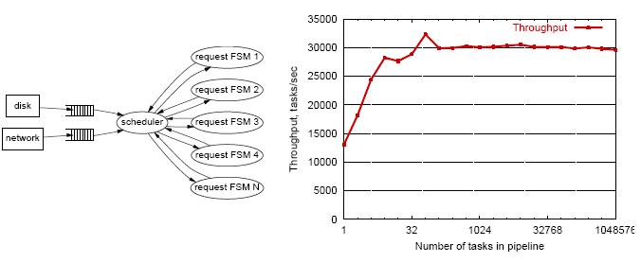
Summary: Event-Driven (Asynchronous) Programming
Advantages
Single address space for ease of sharing
No synchronization/thread overhead
Many examples: Click router, Flash web server, TP Monitors, NOX controller, Google Chrome (libevent), Dropbox (libevent), …

Slide 10
Problems of Event-Driven Server
Obscure control flow for programmers and tools
Difficult to engineer, modularize, and tune
Difficult for performance/failure isolation between FSMs

Slide 11
Summary: Architecture
Architectures
Multi threads
Asynchronous
Hybrid
Assigned reading: SEDA
Netty design

Slide 12

Summary: The High-Performance Network Servers Journey
Avoid blocking (so that we can reach bottleneck throughput)
Introduce threads
Limit unlimited thread overhead
Thread pool, async io
Coordinating data access
synchronization (lock, synchronized)
Coordinating behavior: avoid busy-wait
wait/notify; select FSM, Future/Listener
Extensibility/robustness
language support/design for interfaces

Slide 13
Beyond Class: Design Patterns
We have seen Java as an example
C++ and C# can be quite similar. For C++ and general design patterns:
http://www.cs.wustl.edu/~schmidt/PDF/OOCP-tutorial4.pdf
http://www.stal.de/Downloads/ADC2004/pra03.pdf

Slide 14
Recap: Best Server Design Limited Only by Resource Bottleneck
CPU
DISK
Before
NET
CPU
DISK
After
NET

Slide 15
Some Questions
When is CPU the bottleneck for scalability?
So that we need to add helper threads
How do we know that we are reaching the limit of scalability of a single machine?
These questions drive network server architecture design
Some basic performance analysis techniques are good to have

Slide 16
Outline
Admin and recap
High performance servers
Thread design
Asynchronous design
Operational analysis

Slide 17
Operational Analysis
Relationships that do not require any assumptions about the distribution of service times or inter-arrival times
Hence focus on measurements
Identified originally by Buzen (1976) and later extended by Denning and Buzen (1978).
We touch only some techniques/results
In particular, bottleneck analysis
More details see linked reading

Slide 18
Under the Hood (An example FSM)
exit
(throughput λ until some
center saturates)
start (arrival rate λ)
CPU
I/O request
File I/O
network
Memory cache

Slide 19
Operational Analysis: Resource Demand of a Request
CPU
V_{CPU} visits for S_{CPU} units of resource time per visit
Network
V_{Net} visits for S_{Net} units of resource time per visit
Disk
V_{Disk} visits for S_{Disk} units of resource time per visit
Memory
V_{Mem} visits for S_{Mem} units of resource time per visit

Slide 20
Operational Quantities
T: observation interval Ai: # arrivals to device i
Bi: busy time of device i Ci: # completions at device i
i = 0 denotes system

Slide 21
Utilization Law
The law is independent of any assumption on arrival/service process
Example: Suppose NIC processes 125 pkts/sec, and each pkt takes 2 ms. What is utilization of the network NIC?

Slide 22
Deriving Relationship Between R, U, and S for one Device
Assume flow balanced (arrival=throughput), Little’s Law:
Assume PASTA (Poisson arrival--memory-less arrival--sees time average), a new request sees Q ahead of it, and FIFO
According to utilization law, U = XS

Slide 23
Forced Flow Law
Assume each request visits device i Vi times

Slide 24
Bottleneck Device
Define Di = Vi Si as the total demand of a request on device i
The device with the highest Di has the highest utilization, and thus is called the bottleneck

Slide 25
Bottleneck vs System Throughput

Slide 26
Example 1
A request may need
10 ms CPU execution time
1 Mbytes network bw
1 Mbytes file access where
50% hit in memory cache
Suppose network bw is 100 Mbps, disk I/O rate is 1 ms per 8 Kbytes (assuming the program reads 8 KB each time)
Where is the bottleneck?

Slide 27
Example 1 (cont.)
CPU:
D_{CPU}=
Network:
D_{Net} =
Disk I/O:
Ddisk =
10 ms ( e.q. 100 requests/s)
1 Mbytes / 100 Mbps = 80 ms (e.q., 12.5 requests/s)
0.5 * 1 ms * 1M/8K = 62.5 ms (e.q. = 16 requests/s)

Slide 28
Example 2
A request may need
150 ms CPU execution time (e.g., dynamic content)
1 Mbytes network bw
1 Mbytes file access where
50% hit in memory cache
Suppose network bw is 100 Mbps, disk I/O rate is 1 ms per 8 Kbytes (assuming the program reads 8 KB each time)
Bottleneck: CPU -> use multiple threads to use more CPUs, if available, to avoid CPU as bottleneck

Slide 29
Interactive Response Time Law
System setup
Closed system with N users
Each user sends in a request, after response, think time, and then sends next request
Notation
Z = user think-time, R = Response time
The total cycle time of a user request is R+Z
In duration T, #requests generated by each user:
T/(R+Z) requests

Slide 30
Interactive Response Time Law
If N users and flow balanced:

Slide 31
Bottleneck Analysis
Here D is the sum of Di

Slide 32
Proof
We know
Using interactive response time law:

Slide 33
Summary: Operational Laws
Utilization law: U = XS
Forced flow law: Xi = Vi X
Bottleneck device: largest Di = Vi Si
Little’s Law: Qi = Xi Ri
Bottleneck bound of interactive response (for the given closed model):

Slide 34

In Practice: Common Bottlenecks
No more file descriptors
Sockets stuck in TIME_WAIT
High memory use (swapping)
CPU overload
Interrupt (IRQ) overload
[Aaron Bannert]

Slide 35
YouTube Design Alg.
http://video.google.com/videoplay?docid=-6304964351441328559#
while (true) { identify_and_fix_bottlenecks(); drink(); sleep(); notice_new_bottleneck(); }

Slide 36
Summary: High-Perf. Network Server
Avoid blocking (so that we can reach bottleneck throughput)
Introduce threads
Limit unlimited thread overhead
Thread pool, async io
Shared variables
Synchronization (lock, synchronized)
Avoid busy-wait
Wait/notify; FSM; asynchronous channel/Future/Handler
Extensibility/robustness
Language support/Design for interfaces
System modeling and measurements
Queueing analysis, operational analysis

Slide 37
Outline
Admin and recap
Single network server
Multiple network servers
Why multiple network servers

Slide 38
Why Multiple Servers?
Scalability
Scaling beyond single server throughput
There is a fundamental limit on what a single server can
process (CPU/bw/disk throughput)
store (disk/memory)
Scaling beyond single geo location latency
There is a limit on the speed of light
Network detour and delay further increase the delay
Notes:
Facebook 12 M HTTP/sec
http://www.datadoghq.com/2013/07/the-best-of-velocity-and-devopsdays-2013-part-ii/

Slide 39
Why Multiple Servers?
Redundancy and fault tolerance
Administration/Maintenance (e.g., incremental upgrade)
Redundancy (e.g., to handle failures)

Slide 40
Why Multiple Servers?
System/software architecture
Resources may be naturally distributed at different machines (e.g., run a single copy of a database server due to single license; access to resource from third party)
Security (e.g., front end, business logic, and database)
Today we focus mostly on the first benefit, for homogeneous (replica) servers

Slide 41
Discussion: Key Technical Challenges in Using Multiple Servers

Slide 42
Outline
Recap
Single network server
Multiple network servers
Why multiple servers
Multiple servers basic mechanism: request routing

Slide 43
Request Routing: Overview
Site A
Site B
?
- Global request routing: select a server site for each request
- Local request routing: select a specific server at the chosen site
Internet
Client

Slide 44
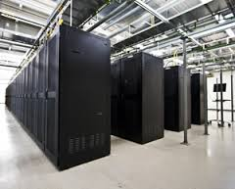
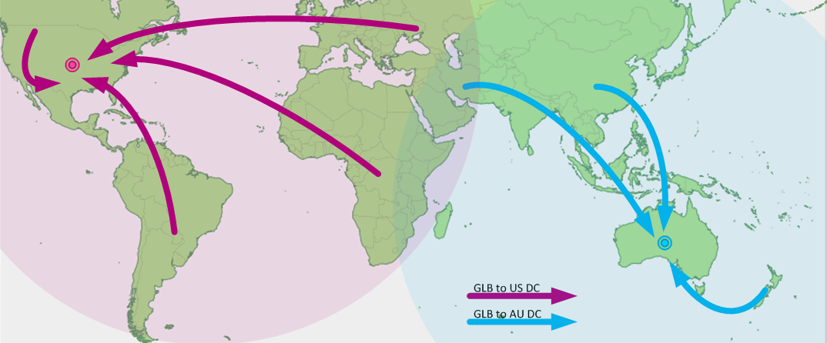
Request Routing: Overview
https://splash.riverbed.com/docs/DOC-1705

Slide 45
Request Routing: Basic Architecture
Site A
Site B
Major components
Server state monitoring
Load (incl. failed or not); what requests it can serve
Network path properties estimation
E.g., bw, delay, loss, network cost between clients and servers
Server assignment alg.
Request direction mechanism
?
Internet
Client
Notes:
What are challenges of each component?

Slide 46
Request Routing: Basic Architecture
server
state
net state: path property between servers/clients
server
selection algorithm
notify client
about selection (direction mech.)
requests

Slide 47
Network Path Properties
Why is the problem difficult?
Scalability: if do measurements, complete measurements grow with N * M, where
N is # of clients
M is # of servers
Complexity/feasibility in computing path metrics
M
N

Slide 48
Network Path Properties: Improve Scalability
Aggregation:
merge a set of IP addresses (reduce N and M)
E.g., when computing path properties, aggregates all clients sharing the same local DNS server
Sampling and prediction
Instead of measuring N*M entries, we measure a subset and predict the unmeasured paths
We will cover it later in the course
M servers
N’~100K local DNS servers
N~all Internet clients

Slide 49
Server Assignment
Why is the problem difficult?
What are potential problems of just sending each new client to the lightest load server?

Slide 50
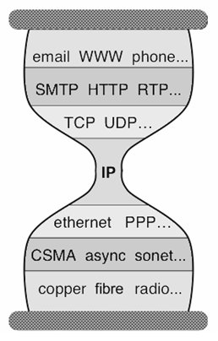
Client Direction Mechanisms
Key difficulty
May need to handle a large of clients
Basic types of mechanisms
Application layer, e.g.,
App/user is given a list of candidate server names
HTTP redirector
DNS: name resolution gives a list of server addresses
IP layer: Same IP address represents multiple physical servers
IP anycast: Same IP address shared by multiple servers and announced at different parts of the Internet. Network directs different clients to different servers
Smart-switch indirection: a server IP address may be a virtual IP address for a cluster of physical servers

Slide 51
Direction Mechanisms are Often Combined
App
DNS name1
DNS name2
IP1
IP2
IPn
Cluster1 in US East
Cluster2
in US West
Cluster2
in Europe
Load
balancer
Load
balancer
proxy
servers

Slide 52
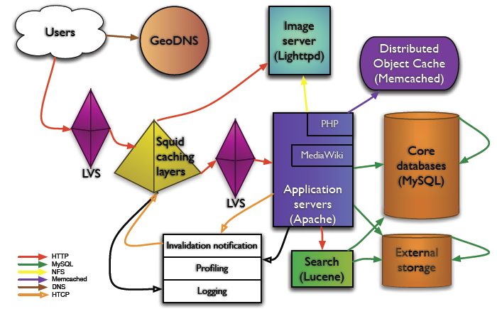
Example: Wikipedia Architecture
http://wikitech.wikimedia.org/images/8/81/Bergsma_-_Wikimedia_architecture_-_2007.pdf

Slide 53
Outline
Recap
Single network server
Multiple network servers
Why multiple servers
Request routing mechanisms
Overview
Application-layer

Slide 54
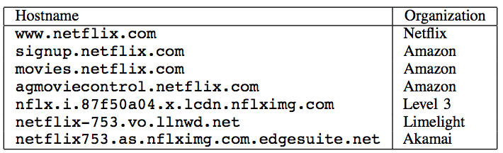
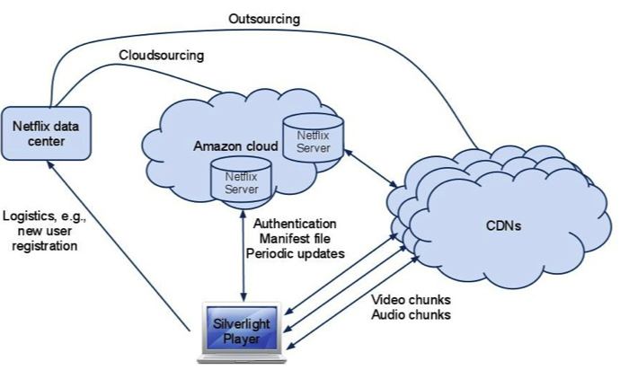
Example: Netflix

Slide 55
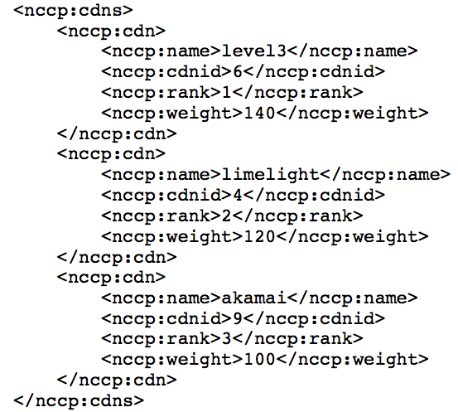
Example: Netflix Manifest File
Client player authenticates and then downloads manifest file from servers at Amazon Cloud

Slide 56
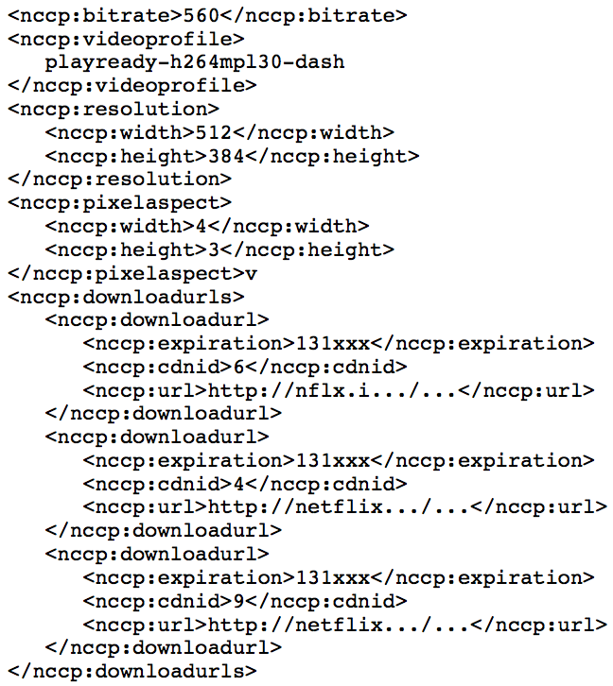
Example: Netflix Manifest File

Slide 57
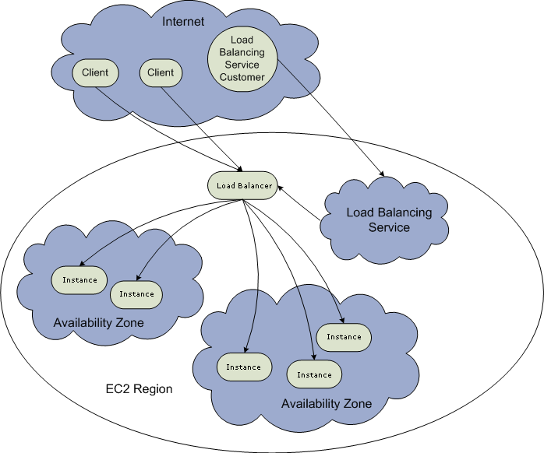
Example: Amazon Elastic Cloud 2 (EC2) Elastic Load Balancing
Use the create-load-balancer command to create an Elastic Load Balancer.
Use the register-instances -with-load-balancer command to register the Amazon EC2 instances that you want to load balance with the Elastic Load Balancer.
Elastic Load Balancing automatically checks the health of your load balancing Amazon EC2 instances. You can optionally customize the health checks by using the configure-healthcheck command.
Traffic to the DNS name provided by the Elastic Load Balancer is automatically distributed across healthy Amazon EC2 instances.
http://docs.aws.amazon.com/ElasticLoadBalancing/latest/DeveloperGuide/elastic-load-balancing.html

Slide 58
Details: Create Load Balancer
The operation returns the DNS name of your LoadBalancer. You can then map that to any other domain name (such as www.mywebsite.com) (how?) %aws elb create-load-balancer --load-balancer-name my-load-balancer --listeners "Protocol=HTTP,LoadBalancerPort=80,InstanceProtocol=HTTP,InstancePort=80" --availability-zones us-west-2a us-west-2b Result:
{ "DNSName": "my-load-balancer-123456789.us-west-2.elb.amazonaws.com”}
http://docs.aws.amazon.com/cli/latest/reference/elb/create-load-balancer.html

Slide 59
Details: Configure Health Check
The operation configures how instances are monitored, e.g., %aws elb configure-health-check --load-balancer-name my-load-balancer --health-check Target=HTTP:80/png,Interval=30,UnhealthyThreshold=2,HealthyThreshold=2,Timeout=3
Result:
{
"HealthCheck": {
"HealthyThreshold": 2,
"Interval": 30,
"Target": "HTTP:80/png",
"Timeout": 3,
"UnhealthyThreshold": 2
}
http://docs.aws.amazon.com/cli/latest/reference/elb/configure-health-check.html

Slide 60
Details: Register Instances
The operation registers instances that can receive traffic, %aws elb register-instances-with-load-balancer --load-balancer-name my-load-balancer --instances i-d6f6fae3
Result:
{ "Instances": [ {"InstanceId": "i-d6f6fae3“},
{"InstanceId": "i-207d9717“},
{"InstanceId": "i-afefb49b“}
]
}
http://docs.aws.amazon.com/cli/latest/reference/elb/register-instances-with-load-balancer.html

Slide 61
Outline
Recap
Single network server
Multiple network servers
Why multiple servers
Request routing mechanisms
Overview
Application-layer
DNS

Slide 62


Basic DNS Indirection and Rotation
%dig cnn.com
157.166.226.25
router
157.166.226.26
IP address
of cnn.com
157.166.255.18
157.166.226.25
157.166.226.26
IP address
of cnn.com
DNS server for cnn.com
157.166.226.26
157.166.226.25

Slide 63
CDN Using DNS (Akamai Architecture as an Example)
Content publisher (e.g., cnn)
provides base HTML documents
runs origin server(s); but delegates heavy-weight content (e.g., images) to CDN
Akamai runs
(~240,000) edge servers for hosting content
Deployment into 130 countries and 1600 networks
Claims 85% Internet users are within a single "network hop" of an Akamai CDN server.
customized DNS redirection servers to select edge servers based on
closeness to client browser, server load
Source: https://www.akamai.com/us/en/about/facts-figures.jsp

Slide 64
Linking to Akamai
Originally, URL Akamaization of embedded content: e.g.,
<IMG SRC= http://www.provider.com/image.gif > changed to
<IMG SRC = http://a661. g.akamai.net/hash/image.gif>
URL Akamaization is becoming obsolete and supported mostly for legacy reasons
Note that this DNS redirection unit is per customer, not individual files.

Slide 65
Exercise
Check any web page of cnn and find a page with an image
Find the URL
Use %dig +trace to see DNS load direction

Slide 66
Akamai Load-Balancing DNS Name
Akamai
e2466.dscg.akamaiedge.net (why two levels in the name?)

