Slide 1
Network Applications: Operational Analysis; Load Balancing among Homogeneous Servers; Application Overlays (P2P)
Qiao Xiang
https://qiaoxiang.me/courses/cnns-xmuf21/index.shtml
11/2/2021
This deck of slides are heavily based on CPSC 433/533 at Yale University, by courtesy of Dr. Y. Richard Yang.

Slide 2
Outline
Admin and recap
High performance servers
Thread design
Asynchronous design
Operational analysis
Multi-servers
Application overlays (peer-to-peer networks)

Slide 3
Admin
Lab assignment 3 status and questions
Move the due date from Nov. 11 to Nov. 14?

Slide 4
Future
CompletionHandler
SocketAddress address = new InetSocketAddress(args[0], port);
AsynchronousSocketChannel client = AsynchronousSocketChannel.open();
Future<Void> connected = client.connect(address);
ByteBuffer buffer = ByteBuffer.allocate(100);
// wait for the connection to finish
connected.get();
// read from the connection
Future<Integer> future = client.read(buffer);
// do other things...
// wait for the read to finish...
future.get();
// flip and drain the buffer
buffer.flip();
WritableByteChannel out = Channels.newChannel(System.out);
out.write(buffer);
class LineHandler implements CompletionHandler<Integer, ByteBuffer> {
@Override
public void completed(Integer result, ByteBuffer buffer) {
buffer.flip();
WritableByteChannel out = Channels.newChannel(System.out);
try {
out.write(buffer);
} catch (IOException ex) {
System.err.println(ex);
}
}
@Override
public void failed(Throwable ex, ByteBuffer attachment) {
System.err.println(ex.getMessage());
}
}
ByteBuffer buffer = ByteBuffer.allocate(100);
CompletionHandler<Integer, ByteBuffer> handler = new LineHandler();
channel.read(buffer, buffer, handler);

Slide 5
Recap: Operational Quantities
T: observation interval Ai: # arrivals to device i
Bi: busy time of device i Ci: # completions at device i
i = 0 denotes system

Slide 6
Recap: Operational Analysis—Fundamental Laws
Utilization law:
Forced flow law:
Bottleneck device:
Little’s Law:
Ui = XiSi
Xi = Vi X
Largest Di = Vi Si
Qi = Xi Ri

Slide 7
Example 1
A request may need
10 ms CPU execution time
1 Mbytes network bw
1 Mbytes file access where
50% hit in memory cache
Suppose network bw is 100 Mbps, disk I/O rate is 1 ms per 8 Kbytes (assuming the program reads 8 KB each time)
Where is the bottleneck?

Slide 8
Example 1 (cont.)
CPU:
D_{CPU}=
Network:
D_{Net} =
Disk I/O:
Ddisk =
10 ms ( e.q. 100 requests/s)
1 Mbytes / 100 Mbps = 80 ms (e.q., 12.5 requests/s)
0.5 * 1 ms * 1M/8K = 62.5 ms (e.q. = 16 requests/s)

Slide 9
Example 2
A request may need
150 ms CPU execution time (e.g., dynamic content)
1 Mbytes network bw
1 Mbytes file access where
50% hit in memory cache
Suppose network bw is 100 Mbps, disk I/O rate is 1 ms per 8 Kbytes (assuming the program reads 8 KB each time)
Bottleneck: CPU -> use multiple threads to use more CPUs, if available, to avoid CPU as bottleneck

Slide 10
Interactive Response Time Law
System setup
Closed system with N users
Each user sends in a request, after response, think time, and then sends next request
Notation
Z = user think-time, R = Response time
The total cycle time of a user request is R+Z
In duration T, #requests generated by each user:
T/(R+Z) requests

Slide 11
Interactive Response Time Law
If N users and flow balanced:

Slide 12
Bottleneck Analysis
Here D is the sum of Di

Slide 13
Proof
We know
Using interactive response time law:

Slide 14
Summary: Operational Laws
Utilization law: U = XS
Forced flow law: Xi = Vi X
Bottleneck device: largest Di = Vi Si
Little’s Law: Qi = Xi Ri
Bottleneck bound of interactive response (for the given closed model):

Slide 15

In Practice: Common Bottlenecks
No more file descriptors
Sockets stuck in TIME_WAIT
High memory use (swapping)
CPU overload
Interrupt (IRQ) overload
[Aaron Bannert]

Slide 16
YouTube Design Alg.
http://video.google.com/videoplay?docid=-6304964351441328559#
while (true) { identify_and_fix_bottlenecks(); drink(); sleep(); notice_new_bottleneck(); }

Slide 17
Summary: High-Perf. Network Server
Avoid blocking (so that we can reach bottleneck throughput)
Introduce threads
Limit unlimited thread overhead
Thread pool, async io
Shared variables
Synchronization (lock, synchronized)
Avoid busy-wait
Wait/notify; FSM; asynchronous channel/Future/Handler
Extensibility/robustness
Language support/Design for interfaces
System modeling and measurements
Queueing analysis, operational analysis

Slide 18
Outline
Admin and recap
Single, high-performance network server
Multiple network servers
Why multiple network servers

Slide 19
Why Multiple Servers?
Scalability
Scaling beyond single server throughput
There is a fundamental limit on what a single server can
process (CPU/bw/disk throughput)
store (disk/memory)
Scaling beyond single geo location latency
There is a limit on the speed of light
Network detour and delay further increase the delay
Notes:
Facebook 12 M HTTP/sec
http://www.datadoghq.com/2013/07/the-best-of-velocity-and-devopsdays-2013-part-ii/

Slide 20
Why Multiple Servers?
Redundancy and fault tolerance
Administration/Maintenance (e.g., incremental upgrade)
Redundancy (e.g., to handle failures)

Slide 21
Why Multiple Servers?
System/software architecture
Resources may be naturally distributed at different machines (e.g., run a single copy of a database server due to single license; access to resource from third party)
Security (e.g., front end, business logic, and database)
Today we focus mostly on the first benefit, for homogeneous (replica) servers

Slide 22
Discussion: Key Technical Challenges in Using Multiple Servers

Slide 23
Outline
Recap
Single network server
Multiple network servers
Why multiple servers
Multiple servers basic mechanism: request routing

Slide 24
Request Routing: Overview
Site A
Site B
?
- Global request routing: select a server site for each request
- Local request routing: select a specific server at the chosen site
Internet
Client

Slide 25

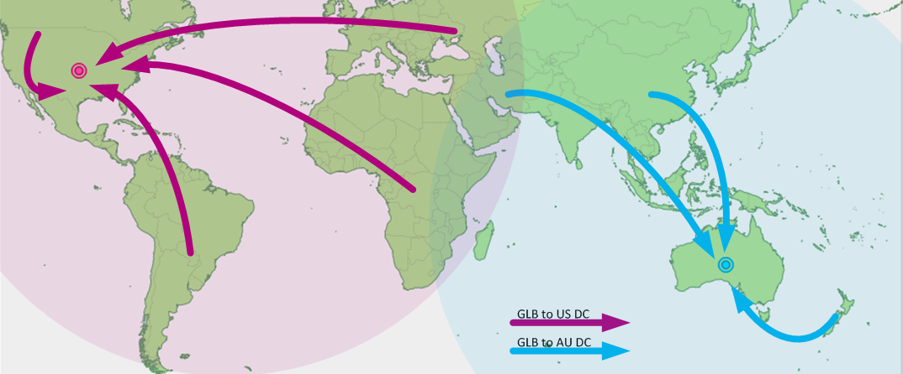
Request Routing: Overview
https://splash.riverbed.com/docs/DOC-1705

Slide 26
Request Routing: Basic Architecture
Site A
Site B
Major components
Server state monitoring
Load (incl. failed or not); what requests it can serve
Network path properties estimation
E.g., bw, delay, loss, network cost between clients and servers
Server assignment alg.
Request direction mechanism
?
Internet
Client
Notes:
What are challenges of each component?

Slide 27
Request Routing: Basic Architecture
server
state
net state: path property between servers/clients
server
selection algorithm
notify client
about selection (direction mech.)
requests

Slide 28
Network Path Properties
Why is the problem difficult?
Scalability: if do measurements, complete measurements grow with N * M, where
N is # of clients
M is # of servers
Complexity/feasibility in computing path metrics
M
N

Slide 29
Network Path Properties: Improve Scalability
Aggregation:
merge a set of IP addresses (reduce N and M)
E.g., when computing path properties, aggregates all clients sharing the same local DNS server
Sampling and prediction
Instead of measuring N*M entries, we measure a subset and predict the unmeasured paths
We will cover it later in the course
M servers
N’~100K local DNS servers
N~all Internet clients

Slide 30
Server Assignment
Why is the problem difficult?
What are potential problems of just sending each new client to the lightest load server?

Slide 31
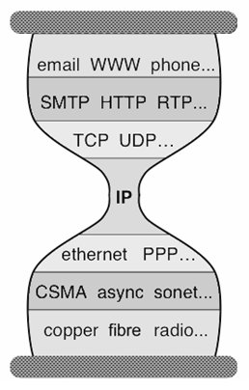
Client Direction Mechanisms
Key difficulty
May need to handle a large of clients
Basic types of mechanisms
Application layer, e.g.,
App/user is given a list of candidate server names
HTTP redirector
DNS: name resolution gives a list of server addresses
IP layer: Same IP address represents multiple physical servers
IP anycast: Same IP address shared by multiple servers and announced at different parts of the Internet. Network directs different clients to different servers
Smart-switch indirection: a server IP address may be a virtual IP address for a cluster of physical servers

Slide 32
Direction Mechanisms are Often Combined
App
DNS name1
DNS name2
IP1
IP2
IPn
Cluster1 in US East
Cluster2
in US West
Cluster2
in Europe
Load
balancer
Load
balancer
proxy
servers

Slide 33
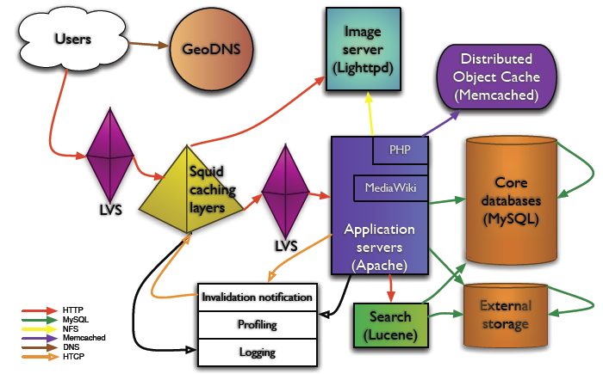
Example: Wikipedia Architecture
http://wikitech.wikimedia.org/images/8/81/Bergsma_-_Wikimedia_architecture_-_2007.pdf

Slide 34
Outline
Recap
Single, high-performance network server
Multiple network servers
Why multiple servers
Request routing mechanisms
Overview
Application-layer

Slide 35
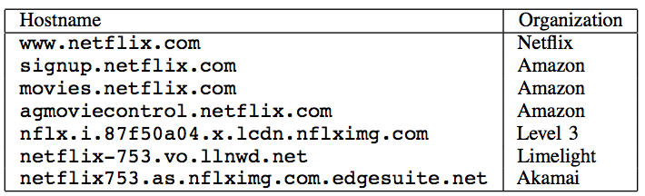
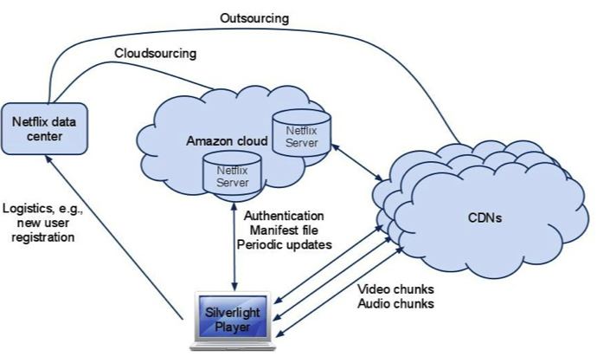
Example: Netflix

Slide 36
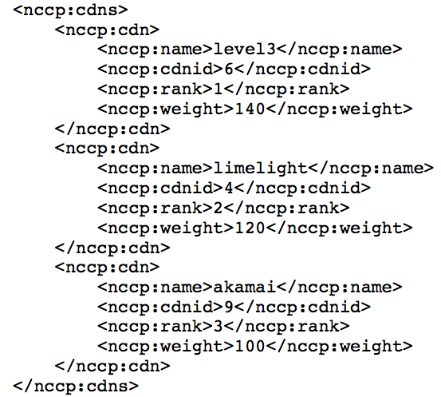
Example: Netflix Manifest File
Client player authenticates and then downloads manifest file from servers at Amazon Cloud

Slide 37
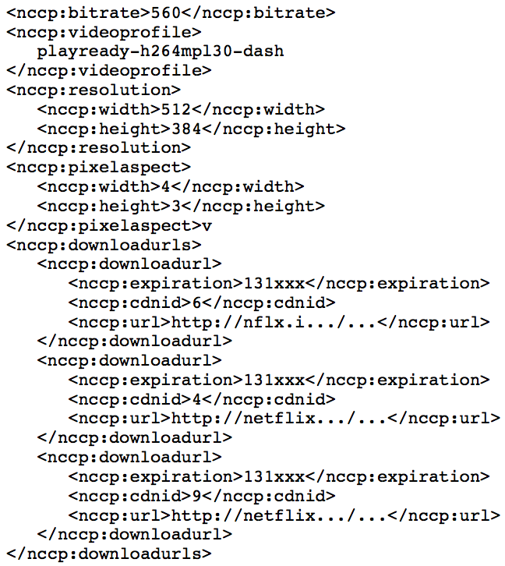
Example: Netflix Manifest File

Slide 38
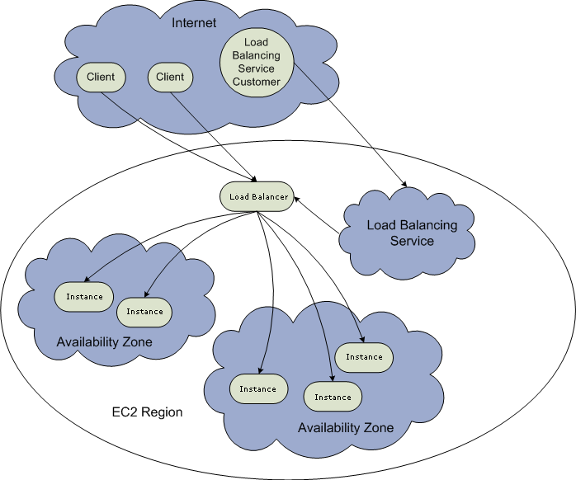
Example: Amazon Elastic Cloud 2 (EC2) Elastic Load Balancing
Use the create-load-balancer command to create an Elastic Load Balancer.
Use the register-instances -with-load-balancer command to register the Amazon EC2 instances that you want to load balance with the Elastic Load Balancer.
Elastic Load Balancing automatically checks the health of your load balancing Amazon EC2 instances. You can optionally customize the health checks by using the configure-healthcheck command.
Traffic to the DNS name provided by the Elastic Load Balancer is automatically distributed across healthy Amazon EC2 instances.
http://docs.aws.amazon.com/ElasticLoadBalancing/latest/DeveloperGuide/elastic-load-balancing.html

Slide 39
Details: Create Load Balancer
The operation returns the DNS name of your LoadBalancer. You can then map that to any other domain name (such as www.mywebsite.com) (how?) %aws elb create-load-balancer --load-balancer-name my-load-balancer --listeners "Protocol=HTTP,LoadBalancerPort=80,InstanceProtocol=HTTP,InstancePort=80" --availability-zones us-west-2a us-west-2b Result:
{ "DNSName": "my-load-balancer-123456789.us-west-2.elb.amazonaws.com”}
http://docs.aws.amazon.com/cli/latest/reference/elb/create-load-balancer.html

Slide 40
Details: Configure Health Check
The operation configures how instances are monitored, e.g., %aws elb configure-health-check --load-balancer-name my-load-balancer --health-check Target=HTTP:80/png,Interval=30,UnhealthyThreshold=2,HealthyThreshold=2,Timeout=3
Result:
{
"HealthCheck": {
"HealthyThreshold": 2,
"Interval": 30,
"Target": "HTTP:80/png",
"Timeout": 3,
"UnhealthyThreshold": 2
}
http://docs.aws.amazon.com/cli/latest/reference/elb/configure-health-check.html

Slide 41
Details: Register Instances
The operation registers instances that can receive traffic, %aws elb register-instances-with-load-balancer --load-balancer-name my-load-balancer --instances i-d6f6fae3
Result:
{ "Instances": [ {"InstanceId": "i-d6f6fae3“},
{"InstanceId": "i-207d9717“},
{"InstanceId": "i-afefb49b“}
]
}
http://docs.aws.amazon.com/cli/latest/reference/elb/register-instances-with-load-balancer.html

Slide 42
Outline
Recap
Single network server
Multiple network servers
Why multiple servers
Request routing mechanisms
Overview
Application-layer
DNS

Slide 43


Basic DNS Indirection and Rotation
%dig cnn.com
157.166.226.25
router
157.166.226.26
IP address
of cnn.com
157.166.255.18
157.166.226.25
157.166.226.26
IP address
of cnn.com
DNS server for cnn.com
157.166.226.26
157.166.226.25

Slide 44
CDN Using DNS (Akamai Architecture as an Example)
Content publisher (e.g., cnn)
provides base HTML documents
runs origin server(s); but delegates heavy-weight content (e.g., images) to CDN
Akamai runs
(~240,000) edge servers for hosting content
Deployment into 130 countries and 1600 networks
Claims 85% Internet users are within a single "network hop" of an Akamai CDN server.
customized DNS redirection servers to select edge servers based on
closeness to client browser, server load
Source: https://www.akamai.com/us/en/about/facts-figures.jsp

Slide 45
Linking to Akamai
Originally, URL Akamaization of embedded content: e.g.,
<IMG SRC= http://www.provider.com/image.gif > changed to
<IMG SRC = http://a661. g.akamai.net/hash/image.gif>
URL Akamaization is becoming obsolete and supported mostly for legacy reasons
Note that this DNS redirection unit is per customer, not individual files.

Slide 46
Exercise
Check any web page of cnn and find a page with an image
Find the URL
Use %dig [+trace] to see DNS load direction
https://cdn.cnn.com/cnnnext/dam/assets/211031110243-aguero-chest-pain-exlarge-169.jpg

Slide 47
Recap: CNAME based DNS Name
Typical design
Use cname to create aliases, e.g., http://cdn.cnn.com/cnnnext/dam/assets/170807134426-forest-bathing-00004819-medium-plus-169.jpg
cname: e12596.dscj.akamaiedge.net
why two levels in the name?

Slide 48
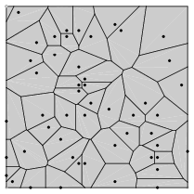
Two-Level Direction
high-level DNS determines proximity, directs to low-level DNS;
low-level DNS: who manages a close-by cluster of servers with different IP addresses
Input: dscg.akamaiedge.net & and client IP,
Output: region (low-level) DNS
Input: e2466.dscg.akamaiedge.net & and client IP
Output: specific servers

Slide 49
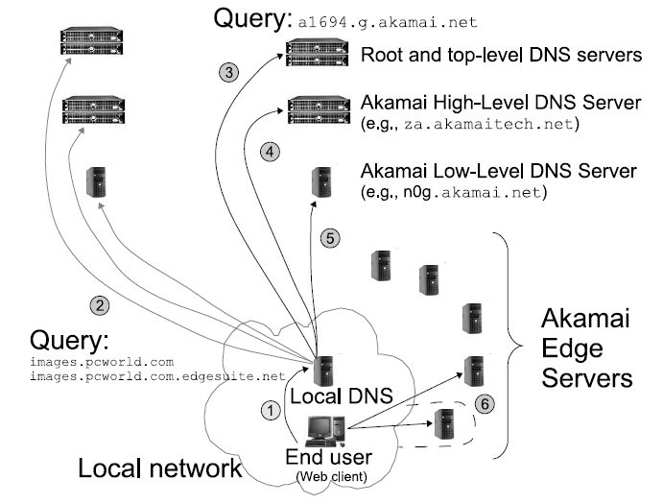
Akamai Load Direction
If the directed edge server does not have requested content,
it goes back to the original server (source) .
Notes:
High-level DNS determines client location and forward to the corresponding low level DNS

Slide 50
Two-Level DNS Mapping Alg
High-level
Typically geo-location matching from client to reg
Low-level
Typically secret, e.g., details of Akamai algorithms are proprietary
Typical goal: load balancing among servers

Slide 51
Akamai Local DNS LB Alg
A Bin-Packing algorithm (column 12 of Akamai Patent) every T second
Compute the load to each publisher k (called serial number)
Sort the publishers from increasing load
For each publisher, associate a list of random servers generated by a hash function
Hash range may be increasing, e.g., first hash [0,1], second [0, 3]
Assign the publisher to the first server that does not overload

Slide 52


Experimental Study of Akamai Load Balancing
Methodology
2-months long measurement
140 PlanetLab nodes (clients)
50 US and Canada, 35 Europe, 18 Asia, 8 South America, the rest randomly scattered
Every 20 sec, each client queries an appropriate CNAME for Yahoo, CNN, Fox News, NY Times, etc.
Akamai
Web replica 1
Akamai Low-Level
DNS Server
Akamai
Web replica 2
.……
Akamai
Web replica 3
Web client
See http://www.aqualab.cs.northwestern.edu/publications/Ajsu06DBA.pdf

Slide 53
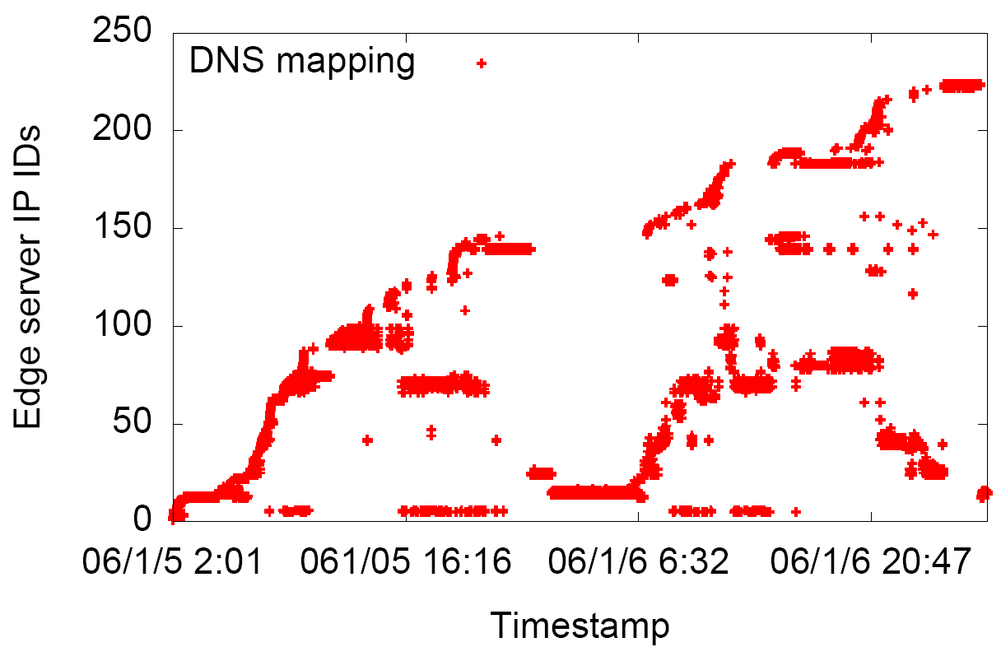
Server Pool: to Yahoo
Target: a943.x.a.yimg.com (Yahoo)
Client 1: Berkeley
Client 2: Purdue
day
Web replica IDs
Web replica IDs
06/1/05 16:16
night

Slide 54
Server Diversity for Yahoo
Majority of PL nodes
see between 10 and 50
Akamai edge-servers
Nodes far away
from Akamai
hot-spots

Slide 55
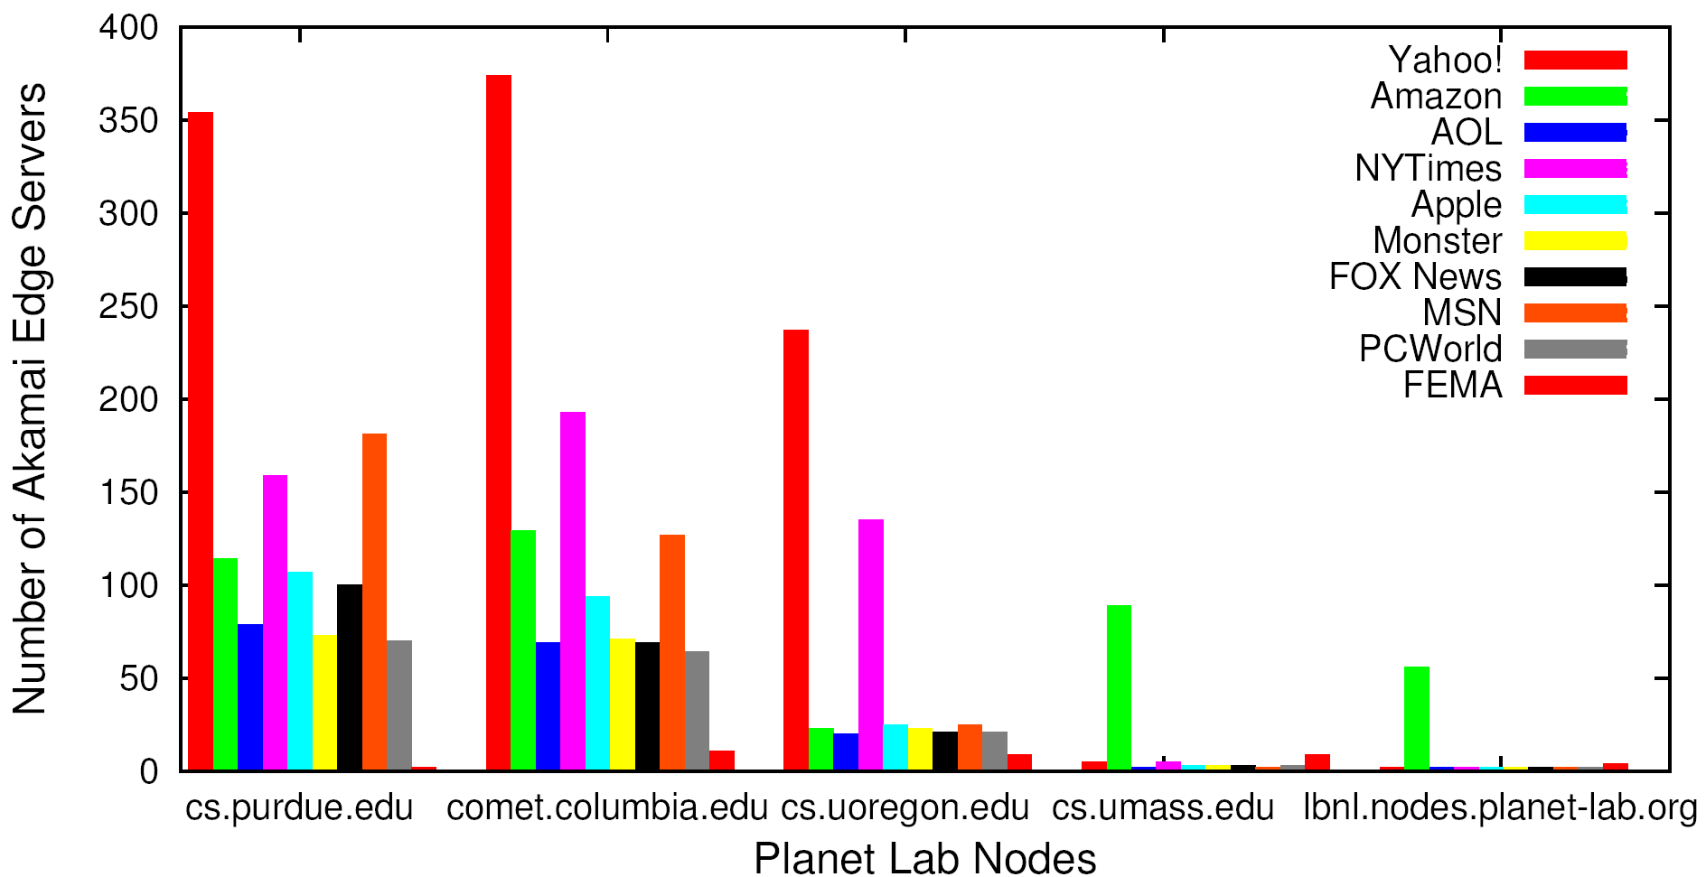
Server Pool: Multiple Akamai Hosted Sites
Number of Akamai Web Replicas
Clients

Slide 56
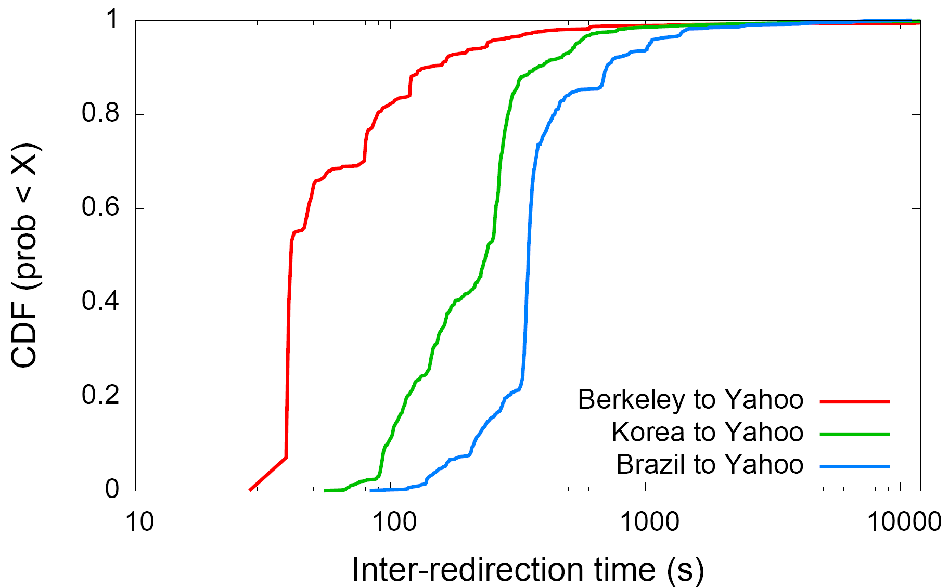
Load Balancing Dynamics
Berkeley
Brazil
Korea
56
Notes:
50% of the redirections are shorter than 40 seconds (Berkeley as example)

Slide 57

Redirection Effectiveness: Measurement Methodology
10 Best
Akamai
Replica Servers
………
ping
ping
ping
ping
Akamai Low-Level
DNS Server
Planet Lab Node
Notes:
Decouple server latency from network latency

Slide 58
Do redirections reveal network conditions?
Rank = r1+r2-1, where ri is rank of server i
16 means perfect correlation
0 means poor correlation
MIT and Amsterdam
are excellent
Brazil is poor

Slide 59
(Offline Read) Facebook DNS Load Direction
A system named Cartographer (written in Python) processes measurement data and configures the DNS maps of individual DNS servers (open source tinydns)
Notes:
https://splash.riverbed.com/docs/DOC-1705
Adam Lazur from the Traffic Team at Facebook gave a well-attended talk about the new load balancing architecture that Facebook had to come up with to deal with a billion users spread out over the entire planet. Adam gave us a glimpse into Facebook’s massive traffic handling.
A billion users means for Facebook over 12 million HTTP requests per second. To handle the load, traffic is first handled by a few TCP proxies, which then forward HTTP traffic to a larger group of HTTP proxies, which themselves sit in front of a even larger number of servers.
The geographical distribution of their users is such that the first act of load balancing is handled by DNS. Having an out-of-date DNS configuration means sending a lot of users’ HTTP queries to data centers that are not optimally close to them. And that translates pretty directly into slower requests (and less user engagement).
Most of the presentation was spent of Cartographer, a dynamic configuration engine for DNS. The job of Cartographer is to continuously provision Facebook’s DNS servers with a configuration that is updated based on various network conditions.
Aside from the technology, Adam’s talk was particularly candid about the initial results, their rollout strategy and the times they had to to fix things as they rolled out new versions (fairly quickly at that).

Slide 60
Discussion
Advantages of using DNS for using multiple servers (LB)
Leveraging existing DNS features (e.g., cname, hierarchy name for natural hierarchical redirection)
Leveraging existing DNS deployment/optimization
Disadvantages of using DNS
Distributed caching may lead to slow response
Only in the unit of IP addresses

Slide 61
Recap: Direction Mechanisms
App
DNS name1
DNS name2
IP1
IP2
IPn
Cluster1 in US East
Cluster2
in US West
Cluster2
in Europe
Load
balancer
Load
balancer
proxy
servers

Slide 62
Outline
Recap
Single, high-performance network server
Multiple network servers
Basic issues
Load direction
DNS (IP level)
Load balancer/smart switch (sub-IP level)

Slide 63
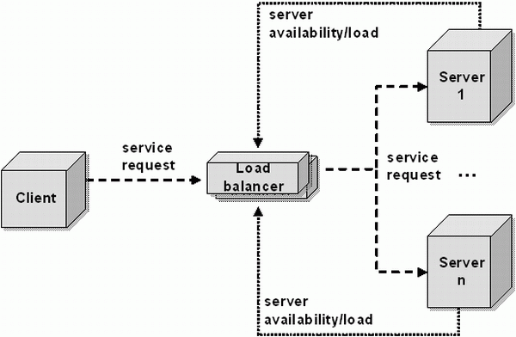
Smart Switch: Big Picture
smart switch

Slide 64
VIP Clustering
Goals
server load balancing
failure detection
access control filtering
priorities/QoS
request locality
transparent caching
L4: TCP
L7: HTTP
SSL
etc.
virtual IP addresses (VIPs)
smart switch
Clients
What to switch/filter on?
L3 source IP and/or VIP
L4 (TCP) ports etc.
L7 URLs and/or cookies
L7 SSL session IDs
server array

Slide 65
Load Balancer (LB): Basic Structure
RIP1
S=client
D=VIP
Server1
S=client
D=VIP
VIP
RIP2
Client
LB
Server2
RIP3
Server3
Problem of the basic structure?

Slide 66
Problem
S=client
D=VIP
Client to server packet has VIP as destination address, but real servers use RIPs
if LB just forwards the packet from client to a real server, the real server drops the packet
reply from real server to client has real server IP as source -> client will drop the packet
state: listening
address: {RealIP.6789, *:*}
completed connection queue: C1; C2 sendbuf:
recvbuf:
state:
address: {VIP:6789, 198.69.10.10.1500}
sendbuf:
recvbuf:
…
state:
address: {RealIP:6789, 198.69.10.10.1500}
sendbuf:
recvbuf:
…
server
client

Slide 67
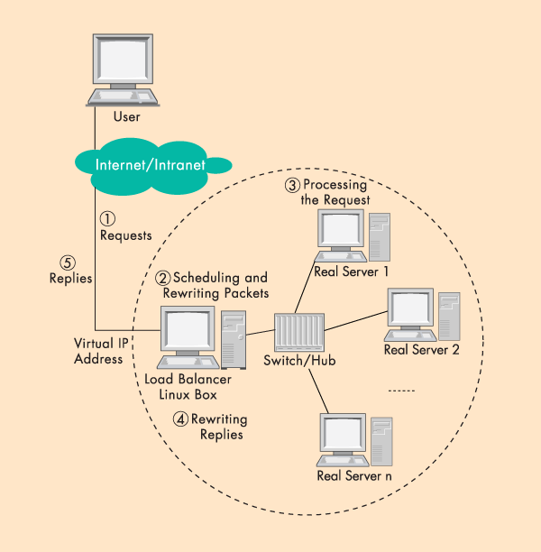
Solution 1: Network Address Translation (NAT)
LB does rewriting/ translation
Thus, the LB is similar to a typical NAT gateway with an additional scheduling function
Load Balancer

Slide 68
Example Virtual Server via NAT

Slide 69
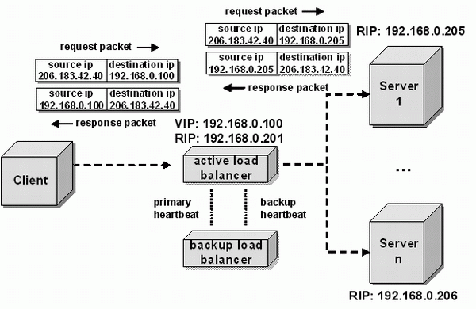
LB/NAT Flow

Slide 70
LB/NAT Flow

Slide 71
LB/NAT Advantages and Disadvantages
Advantages:
Only one public IP address is needed for the load balancer; real servers can use private IP addresses
Real servers need no change and are not aware of load balancing
Problem
The load balancer must be on the critical path and hence may become the bottleneck due to load to rewrite request and response packets
Typically, rewriting responses has more load because there are more response packets

Slide 72
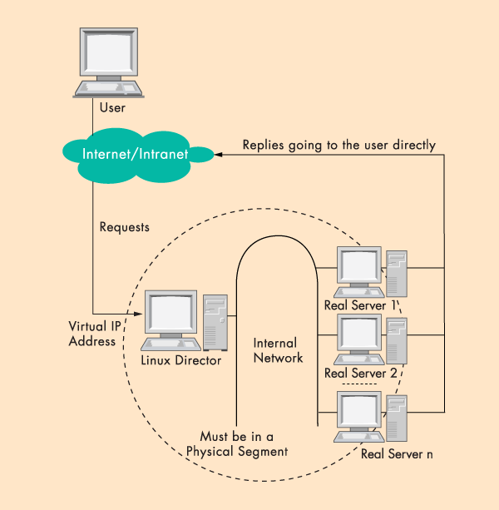
Goal: LB w/ Direct Reply
load
balancer
Connected
by a single switch

Slide 73
LB with Direct Reply: Implication
VIP
Server1
VIP
Client
LB
Server2
Server3
Direct reply
Each real server uses VIP as its IP address
Address conflict: multiple devices w/ the same IP addr

Slide 74
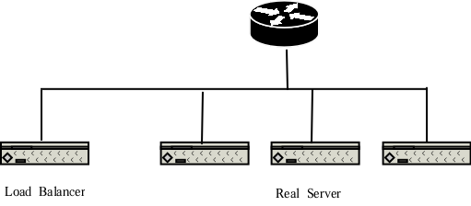
Why IP Address Matters?
VIP
Each network interface card listens to an assigned MAC address
A router is configured with the range of IP addresses connected to each interface (NIC)
To send to a device with a given IP, the router needs to translate IP to MAC (device) address
The translation is done by the Address Resolution Protocol (ARP)

Slide 75
ARP Protocol
ARP is “plug-and-play”:
nodes create their ARP tables without intervention from net administrator
A broadcast protocol:
Router broadcasts query frame, containing queried IP address
all machines on LAN receive ARP query
Node with queried IP receives ARP frame, replies its MAC address

Slide 76
ARP in Action
S=client
D=VIP
Router R
VIP
- Router broadcasts ARP broadcast query: who has VIP?
- ARP reply from LB: I have VIP; my MAC is MAC_{LB}
- Data packet from R to LB: destination MAC = MAC_{LB}

Slide 77
LB/DR Problem
Router R
VIP
VIP
VIP
VIP
ARP and race condition:
When router R gets a packet with dest. address VIP, it broadcasts an Address Resolution Protocol (ARP) request: who has VIP?
One of the real servers may reply before load balancer
Solution: configure real servers to not respond to ARP request

Slide 78
LB via Direct Routing
The virtual IP address is shared by real servers and the load balancer.
Each real server has a non-ARPing, loopback alias interface configured with the virtual IP address, and the load balancer has an interface configured with the virtual IP address to accept incoming packets.
The workflow of LB/DR is similar to that of LB/NAT:
the load balancer directly routes a packet to the selected server
the load balancer simply changes the MAC address of the data frame to that of the server and retransmits it on the LAN (how to know the real server’s MAC?)
When the server receives the forwarded packet, the server determines that the packet is for the address on its loopback alias interface, processes the request, and finally returns the result directly to the user

Slide 79
LB/DR Advantages and Disadvantages
Advantages:
Real servers send response packets to clients directly, avoiding LB as bottleneck
Disadvantages:
Servers must have non-arp alias interface
The load balancer and server must have one of their interfaces in the same LAN segment
Considered by some as a hack, not a clean architecture

Slide 80
Example Implementation of LB
An example open source implementation is Linux virtual server (linux-vs.org)
Used by
www.linux.com
sourceforge.net
wikipedia.org
More details on ARP problem: http://www.austintek.com/LVS/LVS-HOWTO/HOWTO/LVS-HOWTO.arp_problem.html
Many commercial LB servers from F5, Cisco, …
More details please read chapter 2 of Load Balancing Servers, Firewalls, and Caches

Slide 81
Problem of the Load Balancer Architecture
Server1
S=client
D=VIP
VIP
Client
LB
Server2
Server3
One major problem is that the LB becomes a single point of failure (SPOF).

Slide 82
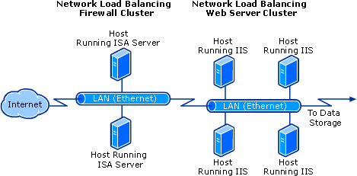
Solutions
Redundant load balancers
E.g., two load balancers (a good question to think offline)
Fully distributed load balancing
e.g., Microsoft Network Load Balancing (NLB)

Slide 83
Microsoft NLB
No dedicated load balancer
All servers in the cluster receive all packets
Key issue: one and only one server processes each packet
All servers within the cluster simultaneously run a mapping algorithm to determine which server should handle the packet. Those servers not required to service the packet simply discard it.
Mapping (ranking) algorithm: computing the “winning” server according to host priorities, multicast or unicast mode, port rules, affinity, load percentage distribution, client IP address, client port number, other internal load information
http://technet.microsoft.com/en-us/library/cc739506%28WS.10%29.aspx

Slide 84
Discussion
Compare the design of using Load Balancer vs Microsoft NLB

Slide 85
Recap: Direction Mechanisms
App
DNS name1
DNS name2
IP1
IP2
IPn
Cluster1 in US East
Cluster2
in US West
Cluster2
in Europe
Rewrite
Direct reply
Fault tolerance
Load
balancer
Load
balancer
proxy
servers

Slide 86
Outline
Admin and recap
Single, high-performance network server
Multiple servers
Overview
Basic mechanisms
Example: YouTube (offline read)

Slide 87
You Tube
http://video.google.com/videoplay?docid=-6304964351441328559#
02/2005: Founded by Chad Hurley, Steve Chen and Jawed Karim, who were all early employees of PayPal.
10/2005: First round of funding ($11.5 M)
03/2006: 30 M video views/day
07/2006: 100 M video views/day
11/2006: acquired by Google
10/2009: Chad Hurley announced in a blog that YouTube serving well over 1 B video views/day (avg = 11,574 video views /sec )

Slide 88
Pre-Google Team Size
2 Sysadmins
2 Scalability software architects
2 feature developers
2 network engineers
1 DBA
0 chefs

Slide 89
YouTube Design Alg.
while (true) { identify_and_fix_bottlenecks(); drink(); sleep(); notice_new_bottleneck(); }

Slide 90
YouTube Major Components
Web servers
Video servers
Thumbnail servers
Database servers

Slide 91
YouTube: Web Servers
Components
Netscaler load balancer; Apache; Python App Servers; Databases
Python
Web code (CPU) is not bottleneck
JIT to C to speedup
C extensions
Pre-generate HTML responses
Development speed more important
NetScaler
Apache
Web
servers
Python
App Server
Databases

Slide 92
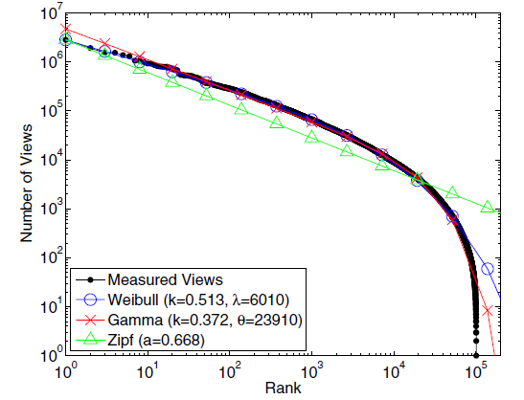
YouTube: Video Popularity
See “Statistics and Social Network of YouTube Videos”, 2008.

Slide 93
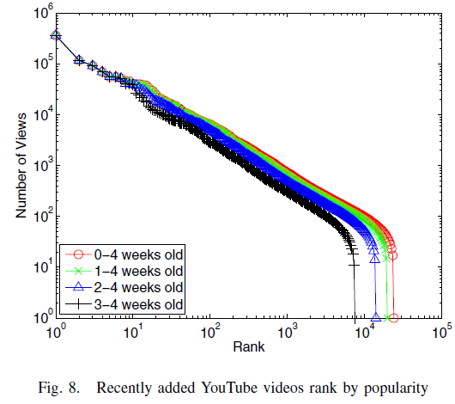
YouTube: Video Popularity
How to design a system to handle highly skewed distribution?
See “Statistics and Social Network of YouTube Videos”, 2008.

Slide 94
YouTube: Video Server Architecture
Tiered architecture
CDN servers (for popular videos)
Low delay; mostly in-memory operation
YouTube servers (not popular 1-20 per day)
CDN
Most popular
YouTube Colo 1
Request
Others
YouTube Colo N

Slide 95
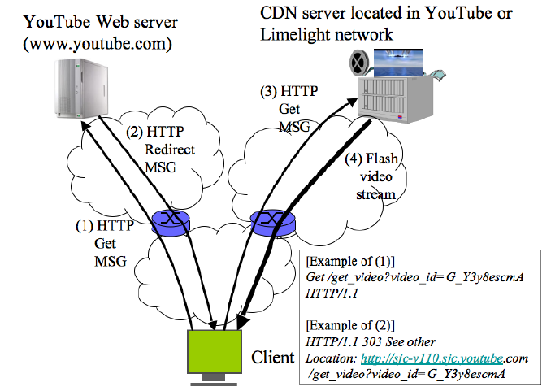
YouTube Redirection Architecture
YouTube servers

Slide 96
YouTube Video Servers
Each video hosted by a mini-cluster consisting of multiple machines
Video servers use the lighttpd web server for video transmission:
Apache had too much overhead (used in the first few months and then dropped)
Async io: uses epoll to wait on multiple fds
Switched from single process to multiple process configuration to handle more connections

Slide 97
Thumbnail Servers
Thumbnails are served by a few machines
Problems running thumbnail servers
A high number of requests/sec as web pages can display 60 thumbnails on page
Serving a lot of small objects implies
lots of disk seeks and problems with file systems inode and page caches
may ran into per directory file limit
Solution: storage switched to Google BigTable

Slide 98
Thumbnail Server Software Architecture
Design 1: Squid in front of Apache
Problems
Squid worked for a while, but as load increased performance eventually decreased: Went from 300 requests/second to 20
under high loads Apache performed badly, changed to lighttpd
Design 2: lighttpd default: By default lighttpd uses a single thread
Problem: often stalled due to I/O
Design 3: switched to multiple processes contending on shared accept
Problems: high contention overhead/individual caches

Slide 99
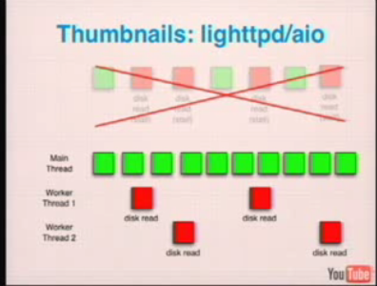
Thumbnails Server: lighttpd/aio

Slide 100
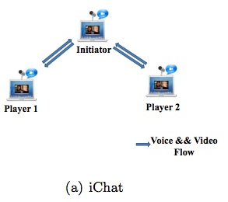
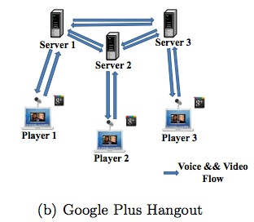
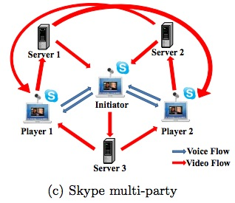
Example Server Systems
http://eeweb.poly.edu/faculty/yongliu/docs/imc12.pdf

Slide 101
Scalability of Server-Only Approaches
origin
DNS
edge. servers
C₀
client 1
client 2
client n
client 3

Slide 102
Outline
Admin and recap
Single, high-performance network server
Multiple servers
Application overlays
potential

Slide 103
An Upper Bound on Scalability
Idea: use resources from both clients and the server
Assume
need to achieve same rate to all clients
only uplinks can be bottlenecks
What is an upper bound on scalability?
server
C₀
C₁
client 1
C_{n}
C₂
C₃
client 2
client n
client 3

Slide 104
The Scalability Problem
Maximum throughput
R = min{C₀, (C₀+ΣC_{i})/n}
The bound is theoretically approachable
server
C₀
C₁
client 1
C_{n}
C₂
C₃
client 2
client n
client 3

Slide 105
Theoretical Capacity: upload is bottleneck
R = min{C₀, (C₀+ΣC_{i})/n}
Assume c₀ > (C₀+ΣC_{i})/n
Tree i: server → client i: c_{i} /(n-1) client i → other n-1 clients
Tree 0: server has remaining c_{m} = c0 – (c1 + c2 + … cn)/(n-1) send to client i: c_{m}/n
c₀
c_{i} /(n-1)
c_{n}
c_{i}
c₁
c₂
C₀
c_{m} /n
C_{n}
C₁
C₂
C_{i}

Slide 106
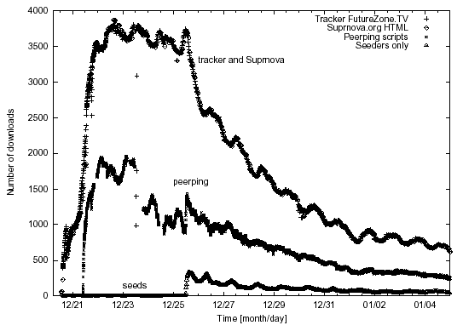
Why not Building the Trees?
servers
C₀
C₁
client 1
C_{n}
C₂
C₃
client 2
client n
Clients come and go (churns): maintaining the trees is too expensive
Each client needs N connections
client 3

Slide 107
Server+Host (P2P) Content Distribution: Key Design Issues
Robustness
Resistant to churns and failures
Efficiency
A client has content that others need; otherwise, its upload capacity may not be utilized
Incentive: clients are willing to upload
Some real systems nearly 50% of all responses are returned by the top 1% of sharing hosts
servers
C₀
C₁
client 1
C_{n}
C₂
C₃
client 2
client n
client 3

Slide 108
Discussion: How to handle the issues?
Robustness
Efficiency
Incentive
servers/ seeds
C₀
C₁
client 1
C_{n}
C₂
C₃
client 2
client n
client 3

Slide 109
Example: BitTorrent
A P2P file sharing protocol
Created by Bram Cohen in 2004
Spec at bep_0003: http://www.bittorrent.org/beps/bep_0003.html

Slide 110
BitTorrent: Lookup
HTTP GET MYFILE.torrent
MYFILE.torrent
webserver
http://mytracker.com:6969/
S3F5YHG6FEB
FG5467HGF367
F456JI9N5FF4E
…
user

Slide 111
Metadata (.torrent) File Structure
Meta info contains information necessary to contact the tracker and describes the files in the torrent
URL of tracker
file name
file length
piece length (typically 256KB)
SHA-1 hashes of pieces for verification
also creation date, comment, creator, …

Slide 112
Tracker Protocol
Communicates with clients via HTTP/HTTPS
Client GET request
info_hash: uniquely identifies the file
peer_id: chosen by and uniquely identifies the client
client IP and port
numwant: how many peers to return (defaults to 50)
stats: e.g., bytes uploaded, downloaded
Tracker GET response
interval: how often to contact the tracker
list of peers, containing peer id, IP and port
stats

Slide 113

Tracker Protocol
webserver
user
“register”
list of peers
ID1 169.237.234.1:6881
ID2 190.50.34.6:5692
ID3 34.275.89.143:4545
…
ID50 231.456.31.95:6882
tracker
…
Peer 50
Peer 1
Peer 2

Slide 114
Robustness and efficiency: Piece-based Swarming
Divide a large file into small blocks and request block-size content from different peers (why?)
If do not finish downloading a block from one peer within timeout (say due to churns), switch to requesting the block from another peer
Block: unit of download
File
Block: 16KB

Slide 115
Detail: Peer Protocol
(Over TCP)
Peers exchange bitmap representing content availability
bitfield msg during initial connection
have msg to notify updates to bitmap
to reduce bitmap size, aggregate multiple blocks as a piece
BitField/have
BitField/have
Remote Peer
Local Peer
0
1
0
1
Piece 256KB
Incomplete Piece

Slide 116

Peer Request
http://www.bittorrent.org/beps/bep_0003.html
If peer A has a piece that peer B needs, peer B sends interested to A
unchoke: indicate that A allows B to request
request: B requests a specific block from A
piece: specific data
1.interested/ 3. request
2. unchoke/ 4. piece

Slide 117
Key Design Points
request:
which data blocks to request?
unchoke:
which peers to serve?
1.interested/ 3. request
2. unchoke/ 4. piece

Slide 118
Request: Block Availability
Request (local) rarest first
achieves the fastest replication of rare pieces
obtain something of value

Slide 119
Block Availability: Revisions
When downloading starts (first 4 pieces): choose at random and request them from the peers
get pieces as quickly as possible
obtain something to offer to others
Endgame mode
defense against the “last-block problem”: cannot finish because missing a few last pieces
send requests for missing pieces to all peers in our peer list
send cancel messages upon receipt of a piece

Slide 120
BitTorrent: Unchoke
Periodically (typically every 10 seconds) calculate data-receiving rates from all peers
Upload to (unchoke) the fastest
constant number (4) of unchoking slots
partition upload bw equally among unchoked
1.interested/ 3. request
2. unchoke/ 4. piece
commonly referred to as “tit-for-tat” strategy

Slide 121
Optimistic Unchoking
Periodically select a peer at random and upload to it
typically every 3 unchoking rounds (30 seconds)
Multi-purpose mechanism
allow bootstrapping of new clients
continuously look for the fastest peers (exploitation vs exploration)

Slide 122
BitTorrent Fluid Analysis
Normalize file size to 1
x(t): number of downloaders (also known as leechers) who do not have all pieces at time t.
y(t): number of seeds in the system at time t.
λ: the arrival rate of new requests.
μ: the uploading bandwidth of a given peer.
c: the downloading bandwidth of a given peer, assume c ≥ μ.
θ: the rate at which downloaders abort download.
γ: the rate at which seeds leave the system.
η: indicates the effectiveness of downloader sharing, η takes values in [0, 1].

Slide 123



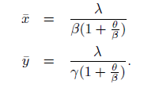
System Evolution
Solving steady state:
Define

Slide 124

System State
Q: How long does each downloader stay as a downloader?
λ

