Slide 1
Layered Network Architecture; Network Applications: Overview, EMail
Qiao Xiang
https://qiaoxiang.me/courses/cnns-xmuf21/index.shtml
9/28/2021
This deck of slides are heavily based on CPSC 433/533 at Yale University, by courtesy of Dr. Y. Richard Yang.

Slide 2
Outline
Admin. and recap
Layered network architecture
Application layer overview
Network applications
Email

Slide 3
Admin
Questions on Assignment One

Slide 4
Recap: Summary of the Taxonomy of Communication Networks
communication network
switched network
broadcast communication
packet-switched network
circuit-switched network
datagram network
virtual circuit network

Slide 5
Recap: Circuit Switching vs. Packet Switching
 | circuit switching | packet switching
resource usage | use a single partition bandwidth | use whole link bandwidth
reservation/setup | need reservation (setup delay) | no reservation
resource contention | busy signal (session loss) | congestion (long delay and packet losses)
charging | time | packet
header | no per-pkt header | per packet header
fast path processing | fast | per packet processing

Slide 6
Recap: Queueing Theory
Model system state
Introduce state transition diagram
Focus on equilibrium: state trend neither growing nor shrinking

Slide 7
Recap: Queueing Theory Analysis of Circuit-Switching
system state: # of busy lines
0
1
k
k+1
N
p0
p1
pk
pk+1
pN

Slide 8
Equilibrium = Time Reversibility [Frank Kelly]
=
Statistically cannot distinguish
=
=
state
Play the sequence backwards
k+1
k
time

Slide 9
Recap: Queueing Theory Analysis of Circuit-Switching
system state: # of busy lines
λ
0
1
k
k+1
N
(k+1)μ
p0
p1
pk
pk+1
pN
at equilibrium (time reversibility) in one unit time: #(transitions k → k+1) = #(transitions k+1 → k)

Slide 10
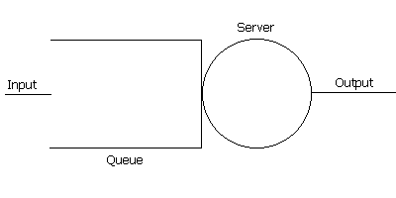
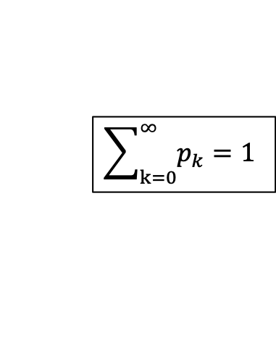
Recap: Queueing Theory Analysis of Packet Switching
system state: #packets in queue
λ
0
1
k
k+1
N
μ
p0
p1
pk
pk+1
at equilibrium (time reversibility) in one unit time: #(transitions k → k+1) = #(transitions k+1 → k)
$$\sum_{k=0}^{∞}{p_{k}}=1$$

Slide 11
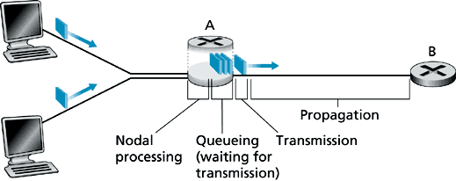
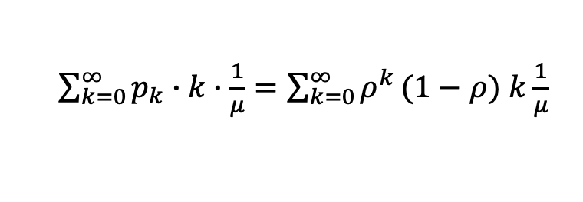
Recap: Analysis of Delay
λ
0
1
k
k+1
μ
Average queueing delay:
Transmission delay:
Queueing + transmission:
$\sum_{k=0}^{∞}{p_{k}}∙k∙\frac{1}{μ}=\sum_{k=0}^{∞}{ρ^{k}}(1−ρ)$ $k\frac{1}{μ}$

Slide 12
Recap: Analysis of Delay
For a demo of M/M/1, see: http://www.dcs.ed.ac.uk/home/jeh/Simjava/queueing/mm1_q/mm1_q.html

Slide 13

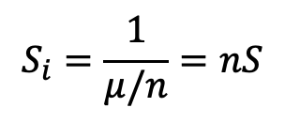
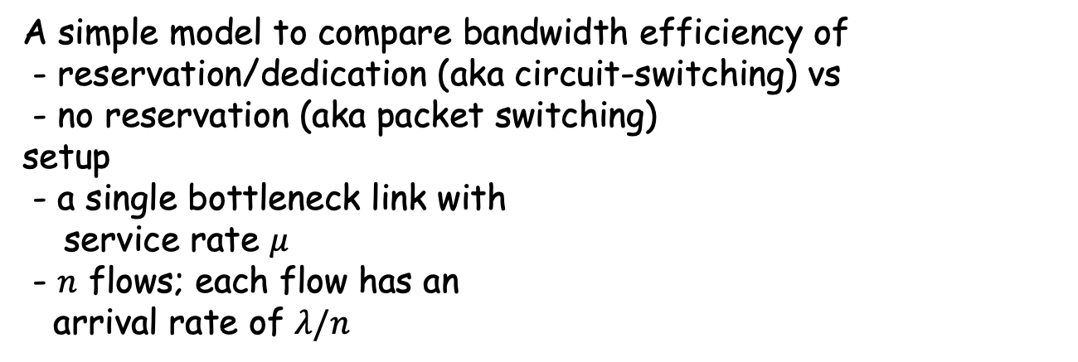
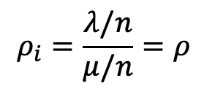
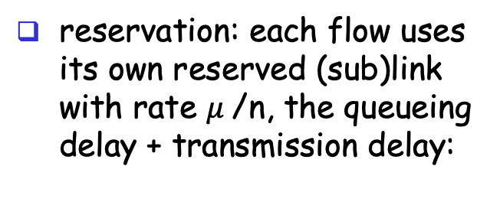
Recap: Statistical Multiplexing
A simple model to compare bandwidth efficiency of
- reservation/dedication (aka circuit-switching) vs
- no reservation (aka packet switching) setup
- a single bottleneck link with
service rate $μ$
- $n$ flows; each flow has an arrival rate of $λ/n$
no reservation: all arrivals into the single link, the queueing delay + transmission delay:
reservation: each flow uses its own reserved (sub)link with rate $μ$/n, the queueing delay + transmission delay:
For each flow i:
$$ρ_{i}=\frac{λ/n}{μ/n}=ρ$$
$$S_{i}=\frac{1}{μ/n}=nS$$

Slide 14
Summary of Progress
We have seen the hardware infrastructure, the basic communication scheme, a next key question is how to develop the software system.

Slide 15
Outline
Admin. and recap
Layered network architecture
what is layering?
why layering?
how to determine the layers?
ISO/OSI layering and Internet layering

Slide 16
What is Layering?
A technique to organize a networked system into a succession of logically distinct entities, such that the service provided by one entity is solely based on the service provided by the previous (lower level) entity.
Application
Application
Transport
Transport
Network
Network
Network
Datalink
Datalink
Datalink
Physical
Physical
Physical
Physical medium

Slide 17
Outline
Admin. and recap
Layered network architecture
what is layering?
why layering?

Slide 18
Why Layering?
Networks are complex !
many “pieces”:
hardware
hosts
routers
links of various media
software
applications
infrastructure
Dealing with complex systems: explicit structure allows identification of the relationship among a complex system’s pieces
layered reference model for discussion
Modularization eases maintenance, updating of system:
change of implementation of a layer’s service transparent to rest of system, e.g., changes in routing protocol doesn’t affect rest of system

Slide 19
An Example: No Layering
Application
Telnet
FTP
HTTP
Transmission
Media
Ether-net
Fiber
optic
Wireless
No layering: each new application has to be re-implemented for every network technology !

Slide 20
An Example: Benefit of Layering
Introducing an intermediate layer provides a common abstraction for network technologies
Application
Telnet
FTP
HTTP
Transport
& Network
Transmission
Media
Ethernet
Fiber
optic
Wireless

Slide 21
ISO/OSI Concepts
ISO – International Standard Organization
OSI – Open System Interconnection
Service – says what a layer does
Interface – says how to access the service
Protocol – specifies how the service is implemented
a set of rules and formats that govern the communications between two or more peers

Slide 22
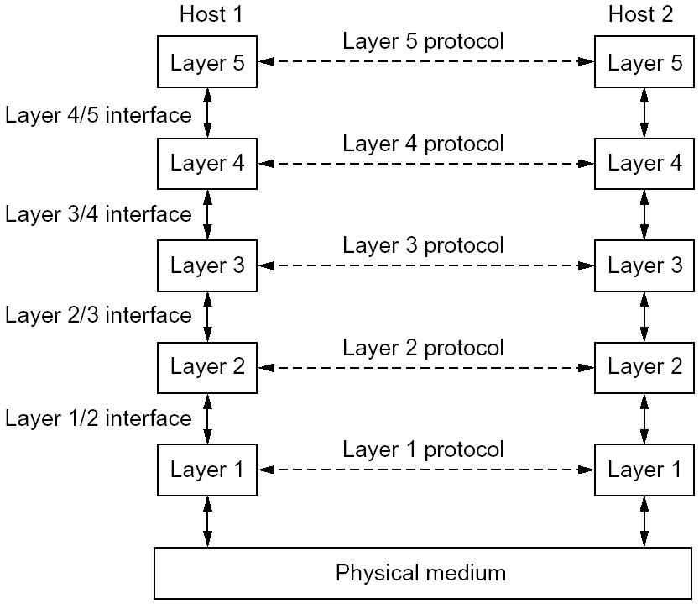
An Example of Layering

Slide 23
An Example of Layering

Slide 24
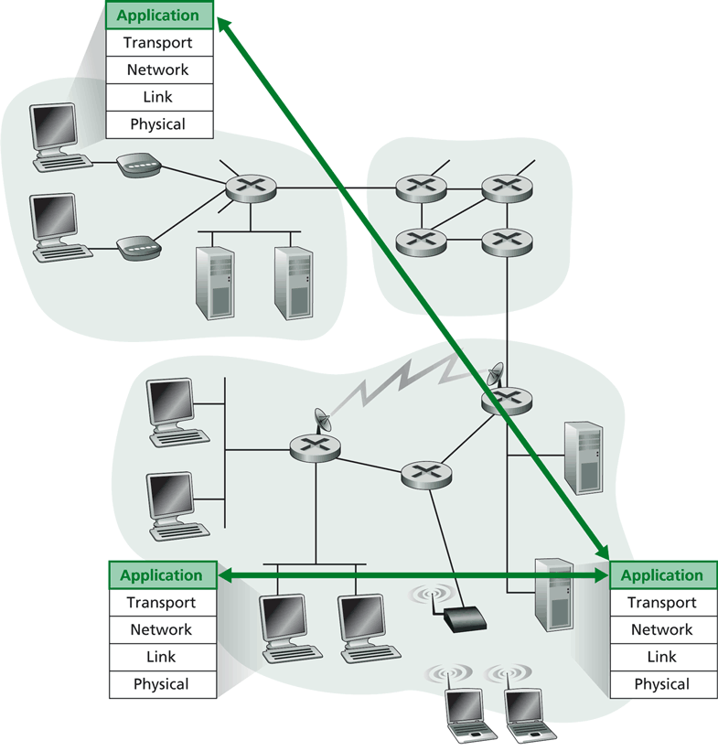
Layering -> Logical Communication
E.g.: application
provide services to users
application protocol:
send messages to peer
for example, HELO, MAIL FROM, RCPT TO are messages between two SMTP peers

Slide 25
Layering: Logical Communication
data
application
transport
network
link
physical
transport
E.g.: transport
Trans. msg for app
Transport protocol
add control info to form “segment”
send segment to peer
wait for peer to ack receipt; if no ack, retransmit
ack
network
link
physical
application
transport
network
link
physical
data
data
application
transport
network
link
physical
application
transport
network
link
physical
transport

Slide 26
Layering: Physical Communication
data
application
transport
network
link
physical
network
link
physical
application
transport
network
link
physical
data
application
transport
network
link
physical
application
transport
network
link
physical

Slide 27
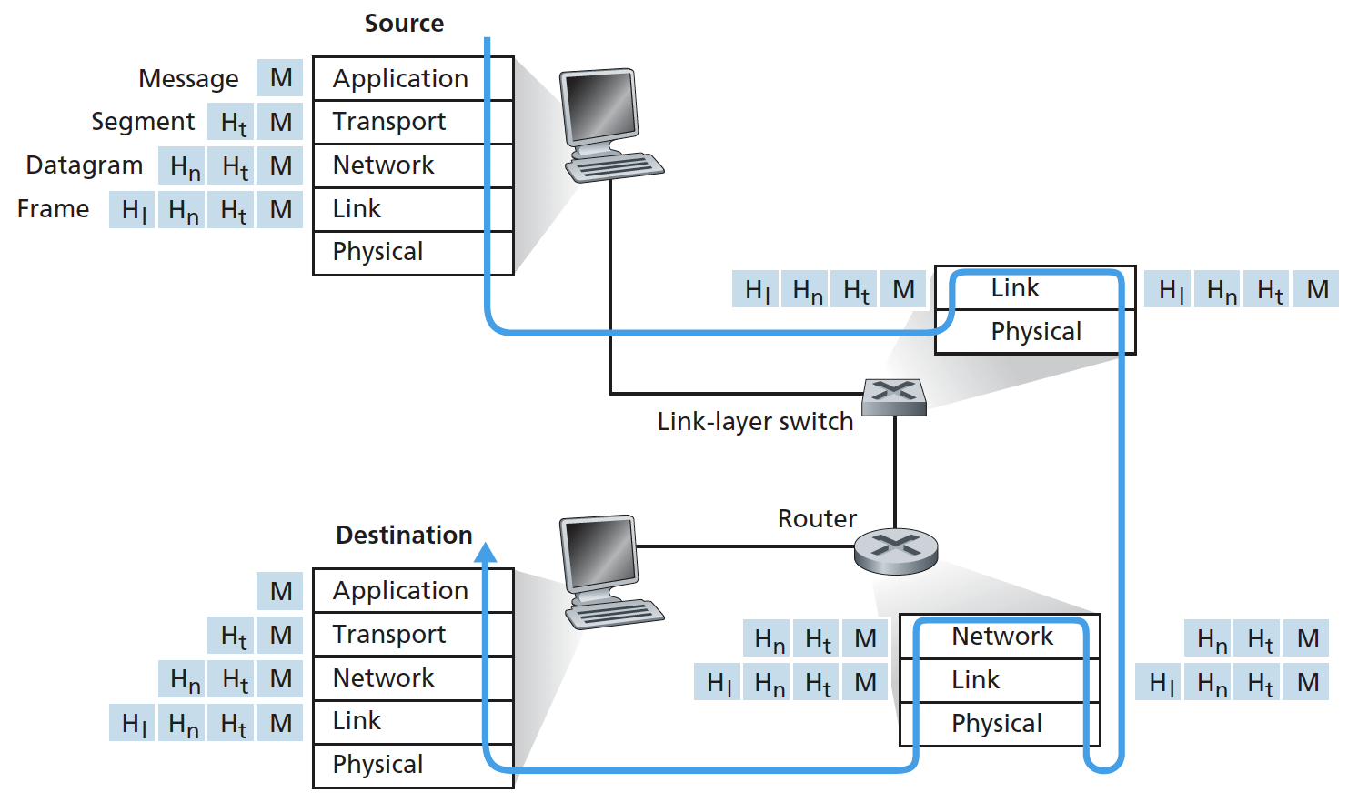
Protocol Layering and Meta Data
Each layer takes data from above
adds header (meta) information to its peer to create new data unit
passes new data unit to layer below

Slide 28
Packet as a Stack in a Layered Architecture
Application
Application
Transport
Transport
Network
Network
Network
Datalink
Datalink
Datalink
Physical
Physical
Physical
Physical medium

Slide 29
Some Implications of Layered Architecture
A packet as a stack container
Each layer needs multiplexing and demultiplexing to serve layer above
…
Hn-1
Hn
Ln
Has a field to indicate which higher layer requires the service
Ln-1

Slide 30
Key design issue:
How do you divide functionalities among the layers?

Slide 31
Outline
Admin. and recap
Layered network architecture
what is layering?
why layering?
how to determine the layers?

Slide 32
The End-to-End Arguments
The function in question can completely and correctly be implemented only with the knowledge and help of the application standing at the endpoints of the communication systems. Therefore, providing that questioned function as a feature of the communications systems itself is not possible.
J. Saltzer, D. Reed, and D. Clark, 1984

Slide 33
What does the End-to-End Arguments Mean?
The application knows the requirements best, place functionalities as high in the layer as possible
Think twice before implementing a functionality at a lower layer, even when you believe it will be useful to an application

Slide 34
Example: Where to Provide Reliability ?
S
A
R
L2
L2
L1
L1
L1
Solution 1: the network (lower layer L1) provides reliability, i.e., each hop provides reliability
Solution 2: the end host (higher layer L2) provides reliability, i.e., end-to-end check and retry

Slide 35
What are Reasons for Implementing Reliability at Higher Layer ?
The lower layer cannot completely provide the functionality
the receiver has to do the check anyway !
Implementing it at lower layer increases complexity, cost and overhead at lower layer
shared by all upper layer applications → everyone pays for it, even if you do not need it
The upper layer
knows the requirements better and thus may choose a better approach to implement it
S
A
R
L2
L2
L1
L1
L1
Notes:
First point: L1 may first ack and then crash; then the function fails; if L2 crash; the application crashes also->fate sharing

Slide 36
Are There Reasons Implementing Reliability at Lower Layer ?
Improve performance, e.g., if high cost/delay/… on a local link
improves efficiency
reduces delay
Share common code, e.g., reliability is required by multiple applications
S
A
R
L2
L2
L1
L1
L1
Notes:
S to A: San francisco to Yale router
A to R: Yale router to a wireless laptop (e.g., 10% success rate)

Slide 37
Summary: End-to-End Arguments
If a higher layer can do it, don’t do it at a lower layer -- the higher the layer, the more it knows about the best what it needs
Add functionality in lower layers iff it
(1) is used by and improves performance of a large number of (current and potential future) applications,
(2) does not hurt (too much) other applications, and
(3) does not increase (too much) complexity/overhead
Practical tradeoff, e.g.,
allow multiple interfaces at a lower layer (one provides the function; one does not)
Notes:
Issue: does not reduce complexity/cost
upper layer needs to be developed for all interfaces

Slide 38
Examples
We used reliability as an example
Assume two layers (L1: network; L2: end-to-end). Where may you implement the following functions?
security (privacy of traffic)
quality of service (e.g., delay/bandwidth guarantee)
congestion control (e.g., not to overwhelm network links or receiver)
S
A
R
L2
L2
L1
L1
L1

Slide 39
Example
Consider the presence service in a social networking system: shows which contacts are online (e.g., skype)
implementing by end user’s host app or through a third party service?
A
B
L2
L2
L1

Slide 40

Challenges
Challenges to build a good (networking) system: find the right balance between:
end-to-end arguments
reuse, interoperability, implementation effort
(apply layering concepts)
performance
No universal answer: the answer depends on the goals and assumptions!

Slide 41
Discussion: Limitations of Layered Architecture

Slide 42
Outline
Admin. and recap
Layered network architecture
what is layering?
why layering?
how to determine the layers?
ISO/OSI layering and Internet layering

Slide 43
ISO/OSI Reference Model
Seven layers
highest four layers are implemented in host
Application
Application
Presentation
Presentation
Session
Session
Transport
Transport
Network
Network
Network
Datalink
Datalink
Datalink
Physical
Physical
Physical
Physical medium

Slide 44
Internet Layering
Five layers
highest two layers are implemented in host
Application
Application
Transport
Transport
Network
Network
Network
Datalink
Datalink
Datalink
Physical
Physical
Physical
Physical medium

Slide 45
Internet Protocol Layers
Five layers
Application: applications
ftp, smtp, http, p2p, IP telephony, blockchain, MapReduce, …
Transport: host-host data transfer
tcp (reliable), udp (not reliable)
Network: routing of datagram from source to destination
ipv4, ipv6
Link: data transfer between neighboring network elements
ethernet, 802.11, cable, DSL, …
Physical: bits “on the wire”
cable, wireless, optical fiber
application
transport
network
link
physical

Slide 46
The Hourglass Architecture of the Internet
Email
WWW
FTP
Telnet
TCP
UDP
end users
IP4
network
infrastructure
Ethernet
Wireless
Cable/DSL
Notes:
How about move the line to on top of TCP/UDP?

Slide 47
Link Layer (Ethernet)
Services (to network layer)
multiplexing/demultiplexing
- from/to the network layer
error detection
multiple access control
arbitrate access to shared medium
Interface
send frames to a directly reachable peer
Email
WWW
FTP
Telnet
TCP
UDP
IP4/6
Ethernet
Wireless
Cable/DSL

Slide 48

Link Layer: Protocol Header (Ethernet)
Email
WWW
FTP
Telnet
Email
WWW
FTP
Telnet
multiplexing
/demultiplexing
error
detection
TCP
UDP
TCP
UDP
IP4/6
IP4/6
access control
Ethernet
Wireless
Cable/DSL
Ethernet
Wireless
Cable/DSL
IP4
IP6
IP4
IP6
link
link

Slide 49
Network Layer: IP
Services (to transport layer)
multiplexing/demultiplexing from/to the transport
fragmentation and reassembling: partition a fragment into smaller packets
- removed in IPv6
error detection
routing: best-effort to send packets from source to destination
certain QoS/CoS
does not provide reliability or reservation
Interface:
send a packet to a (transport-layer) peer at a specified global destination, with certain QoS/CoS
Email
WWW
FTP
Telnet
SSL
TCP
UDP
IP
Ethernet
Wireless
Cable/DSL

Slide 50
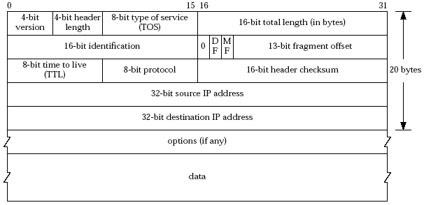
Network Layer: IPv4 Header
QoS/CoS
fragmentation / reassembling
error
detection
routing
Email
WWW
FTP
Telnet
Email
WWW
FTP
Telnet
SSL
SSL
TCP
UDP
TCP
UDP
IP
multiplexing
/demultiplexing
IP
Ethernet
Wireless
Cable/DSL
Ethernet
Wireless
Cable/DSL

Slide 51
Transport Layer: UDP
A connectionless service
Does not provide: connection setup, reliability, flow control, congestion control, timing, or bandwidth guarantee
why is there a UDP?
Email
WWW
FTP
Telnet
TCP
UDP
IP
Ethernet
Wireless
Cable/DSL

Slide 52
Transport Services and APIs
Multiple services and APIs proposed in history
XTI (X/Open Transport Interface), a slight modification of the Transport Layer Interface (TLI) developed by AT&T.
Commonly used transport-layer service model and API: Socket
sometimes called "Berkeley sockets" acknowledging their heritage from Berkeley Unix
a socket has a transport-layer local port number
e.g., email (SMTP) port number 25, web port number 80
Application can send data into socket, read data out of socket
an application process binds to a socket (-a all; -u udp; -n number)
%netstat -aun
Notes:
http://www.techrepublic.com/blog/security/list-open-ports-and-listening-services/
lsof –i -n

Slide 53
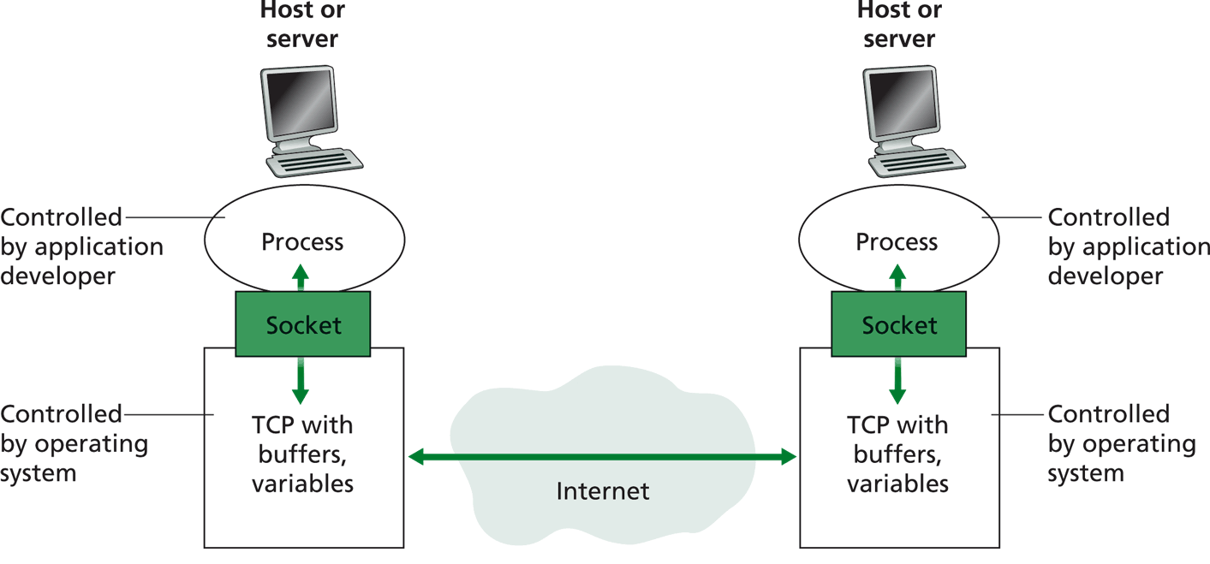
Socket Service Model and API
transport
protocol
buffers,
states
buffers,
states

Slide 54
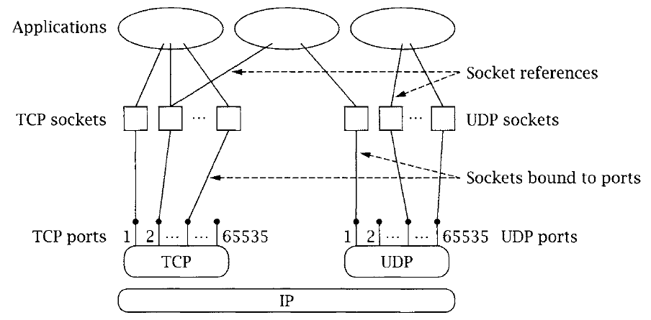
Multiplexing/Demultiplexing

Slide 55
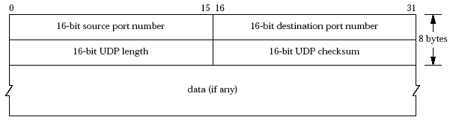
Transport Layer: UDP Header
multiplexing
/demultiplexing
error
detection
Email
WWW
FTP
Telnet
Email
WWW
FTP
Telnet
TCP
UDP
UDP
TCP
IP
IP
Ethernet
Wireless
FDDI
Ethernet
Wireless
Cable/DSL

Slide 56
Transport Layer: TCP
Services
multiplexing/demultiplexing
reliable transport
between sending and receiving processes
setup required between sender and receiver: a connection-oriented service
flow control: sender won’t overwhelm receiver
congestion control: throttle sender when network overloaded
error detection
does not provide timing, minimum bandwidth guarantees
Interface:
send a packet to a (app-layer) peer
Email
WWW
FTP
Telnet
TCP
UDP
IP
Ethernet
Wireless
FDDI

Slide 57
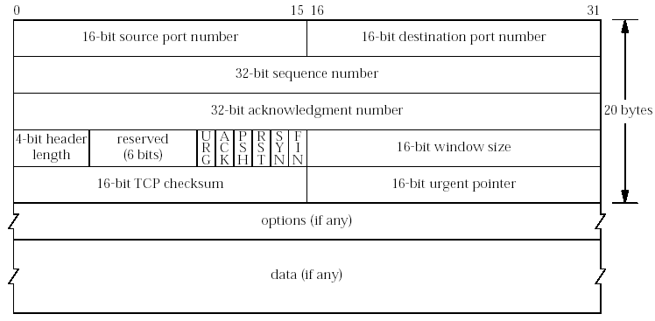
Transport Layer: TCP Header
multiplexing
/demultiplexing
Reliable
transport
congestion
control
flow control
error
detection
Email
WWW
FTP
Telnet
Email
WWW
FTP
Telnet
UDP
TCP
TCP
UDP
IP
IP
Ethernet
Wireless
FDDI
Ethernet
Wireless
Cable/DSL

Slide 58
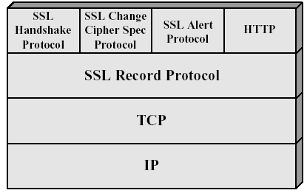
Secure Socket Layer Architecture
HTTP
POP3

Slide 59
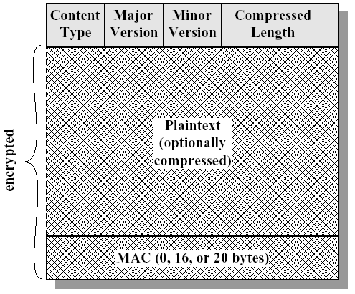
SSL Record-Layer Packet Format
20: change_cipher
21: alert
22: handshake
23: application

Slide 60
Summary: The Big Picture of the Internet
Hosts and routers:
~ 1 bil. hosts
autonomous systems organized roughly hierarchical
backbone links at 100 Gbps
Software:
datagram switching with virtual circuit support at backbone
layered network architecture
use end-to-end arguments to determine the services provided by each layer
the hourglass architecture of the Internet
Email
WWW
FTP
Telnet
SSL
TCP
UDP
IP4/6
Ethernet
Wireless
Cable/DSL

Slide 61
Protocol Formats

Slide 62
Outline
Admin. and recap
Layered network architecture
Application layer overview

Slide 63
Application Layer: Goals
Conceptual + implementation aspects of network application protocols
client server paradigm
peer to peer paradigm
network app. programming
Learn about applications by examining common applications
smtp/pop
dns
http (1, 1.1, /2)
content distribution
peer-to-peer

Slide 64
Network Applications vs. Application-layer Protocols
Network application: communicating, distributed processes
a process is a program that is running within a host
a user agent is a process serving as an interface to the user
web: browser
streaming audio/video: media player
processes communicate by an application-layer protocol
e.g., email, Web
Application-layer protocols
one “piece” of an app
define messages exchanged by apps and actions taken
implementing services by using the service provided by the lower layer, i.e., the transport layer
application
transport
network
data link
physical
application
transport
network
data link
physical

Slide 65
App. and Trans.: App. Protocols and their Transport Protocols
An application needs to choose the transport protocol
Application
layer protocol
smtp [RFC 821]
telnet [RFC 854]
http [RFC 2068]
ftp [RFC 959]
proprietary
(e.g., Vocaltec)
NFS
proprietary
Underlying
transport protocol
TCP/SSL
TCP
TCP/SSL
TCP
typically UDP
TCP or UDP
typically UDP but moving to http
Application
e-mail
remote terminal access
Web
file transfer
Internet telephony
remote file server
streaming multimedia

Slide 66
Client-Server Paradigm
Typical network app has two pieces: client and server
application
transport
network
data link
physical
Client (C):
initiates contact with server (“speaks first”)
typically requests service from server
for Web, client is implemented in browser; for e-mail, in mail reader
Server (S):
provides requested service to client
e.g., Web server sends requested Web page; mail server delivers e-mail
request
reply
application
transport
network
data link
physical

Slide 67
Client-Server Paradigm: Key Questions
application
transport
network
data link
physical
request
Key questions to ask about a C-S application
- Is the application extensible?
- Is the application scalable?
- How does the application handle server failures (being robust)?
- How does the application handle security?
reply
application
transport
network
data link
physical

Slide 68
Outline
Admin. and recap
Layered network architecture
Application layer overview
Network applications
Email

Slide 69
Electronic Mail
Still active
80B emails/day
3.9B active email boxes
A highly recommended reading: a history of Email development
linked on the Schedule page

Slide 70
Recall: SMTP
C: auth login
S: 334 VXNlcm5hbWU6
C: eG11Y25ucw==
S: 334 UGFzc3dvcmQ6
C: MzM0ZjU2MDVkZjE1MDRmOQ==
S: 235 OK Authenticated
C: mail from:xmucnns@sina.com
S: 250 ok
C: rcpt to:qiaoxiang@xmu.edu.cn
S: 250 ok
C: data
S: 354 End data with <CR><LF>.<CR><LF>
C: Date:2021-9-22 12:36
C: From:xmucnns@sina.com
C: To:qiaoxiang@xmu.edu.cn
C: Subject:test smtp
C:
C: Hello, Qiao.
C:
C: .
S: 250 ok queue id 11479549283321
C: quit
S: 221 smtp-97-27.smtpsmail.fmail.bx.sinanode.com
S: Connection closed by foreign host.

Slide 71
Electronic Mail: Components
outgoing
message queue
user mailbox
user
agent
Three major components:
User agents
Mail servers
Protocols
Mail transport protocol
SMTP
Mail access protocols
POP3: Post Office Protocol [RFC 1939]
IMAP: Internet Mail Access Protocol [RFC 1730]
mail
server
user
agent
SMTP
mail
server
user
agent
SMTP
mail
server
SMTP
user
agent
POP3 or
IMAP SMTP
user
agent
user
agent

Slide 72
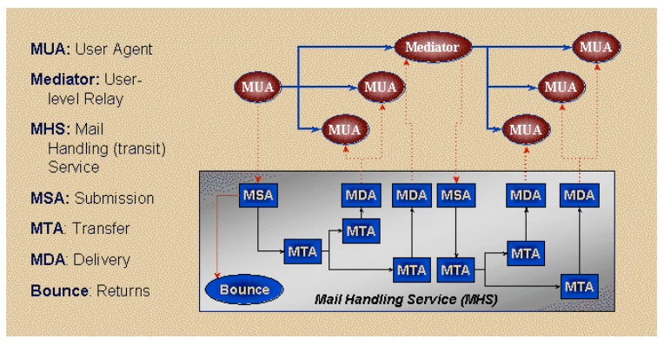
Email Transport Architecture
http://www.maawg.org/sites/maawg/files/news/MAAWG_Email_Authentication_Paper_2008-07.pdf

Slide 73
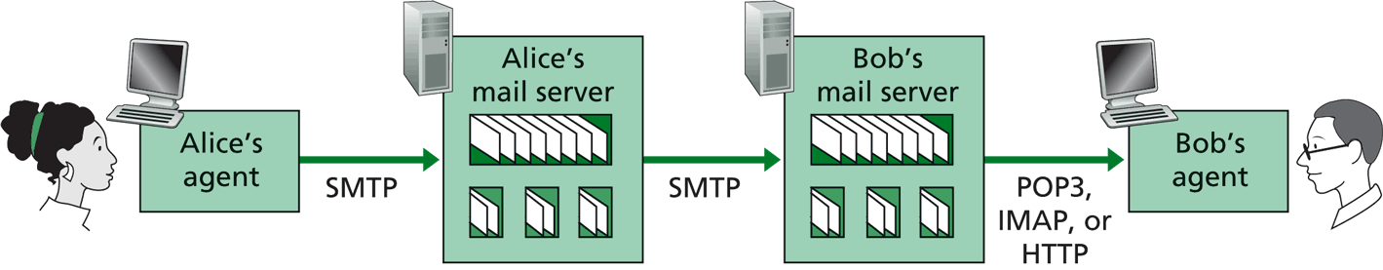
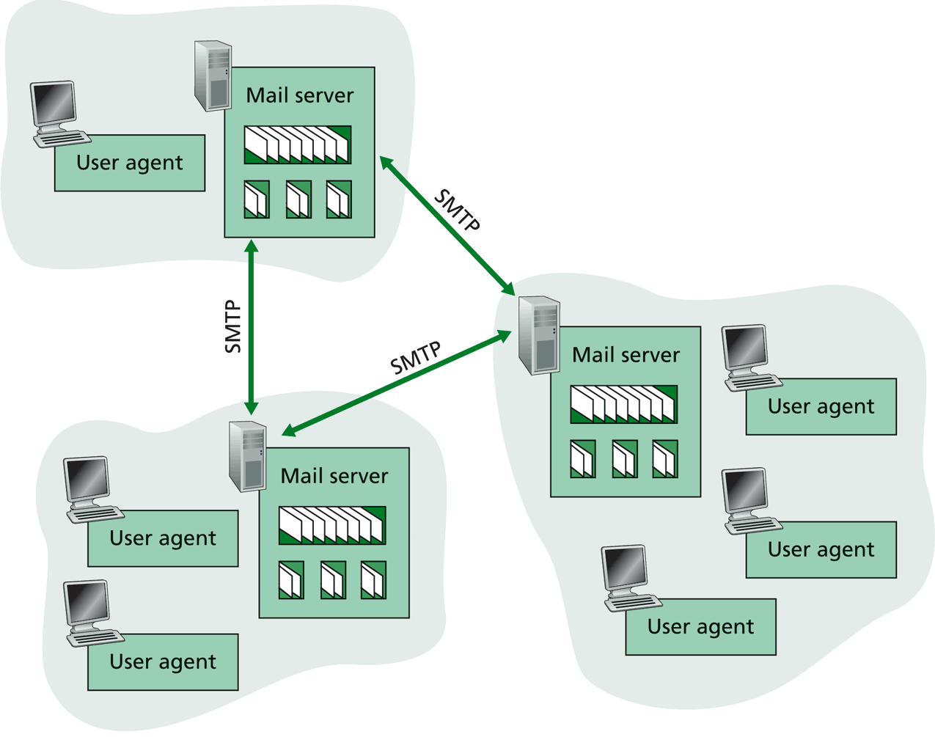
SMTP: Mail Transport Protocol Messages (Envelop Messages)
C: auth login
S: 334 VXNlcm5hbWU6
C: eG11Y25ucw==
S: 334 UGFzc3dvcmQ6
C: MzM0ZjU2MDVkZjE1MDRmOQ==
S: 235 OK Authenticated
C: mail from:xmucnns@sina.com
S: 250 ok
C: rcpt to:qiaoxiang@xmu.edu.cn
S: 250 ok
C: data
S: 354 End data with <CR><LF>.<CR><LF>
C: Date:2021-9-22 12:36
C: From:xmucnns@sina.com
C: To:qiaoxiang@xmu.edu.cn
C: Subject:test smtp
C:
C: Hello, Qiao.
C:
C: .
S: 250 ok queue id 11479549283321
C: quit
S: 221 smtp-97-27.smtpsmail.fmail.bx.sinanode.com
S: Connection closed by foreign host.
Email text different from SMTP protocol message
%telnet smtp.sina.com 25

Slide 74
Mail Message Data
SMTP: protocol for exchanging email msgs
RFC 822: standard for text message format:
Header lines, e.g.,
To:
From:
Subject:
Body
the “message”, ASCII characters only
header
blank
line
body
Benefit of separating protocol and msg: easier extensibility

Slide 75
Message Format: Multimedia Extensions
MIME: multimedia mail extension, RFC 2045, 2056
Additional lines in msg header declare MIME content type
From: xmucnns@sina.com
To: qiaoxiang@xmu.edu.cn
Subject: Network map.
MIME-Version: 1.0
Content-Type: image/jpeg Content-Transfer-Encoding: base64
base64 encoded data .....
.........................
......base64 encoded data
MIME version
multimedia data
type, subtype,
parameter declaration
method used
to encode data
encoded data
Benefit of MIME type: self describing data type, adding extensibility.

Slide 76
Multipart Type: How Attachment Works
From: xmucnns@sina.com
To: qiaoxiang@xmu.edu.cn
Subject: Network map.
MIME-Version: 1.0
Content-Type: multipart/mixed; boundary=98766789
--98766789
Content-Transfer-Encoding: quoted-printable
Content-Type: text/plain
Hi,
Attached is network topology map.
--98766789
Content-Transfer-Encoding: base64
Content-Type: image/jpeg
base64 encoded data .....
.........................
......base64 encoded data
--98766789--

Slide 77
POP3 Protocol: Mail Retrieval
Authorization phase
client commands:
user: declare username
pass: password
server responses
+OK
-ERR
Transaction phase, client:
list: list message numbers
retr: retrieve message by number
dele: delete
quit
S: +OK sina pop3 server ready
C: user xmucnns
S: +OK welcome to sina mail
C: pass 334f5605df1504f9
S: +OK 4 messages (32377 octets)
C: list
S: +OK 4 messages (32377 octets)
S: 1 10410
S: 2 10748
S: 3 7859
S: 4 3360
S: .
C: retr 4
S: +OK 3360 octets
C: dele 2
C: quit
S: +OK
user successfully logged in
POP3 server signing off
%telnet pop.sina.com 110
Notes:
http://www.electrictoolbox.com/article/networking/pop3-commands/

Slide 78
Exercise
Register an email address at sina.com
Send an email to the registered email address using smtp
Retrieve using pop

Slide 79
Evaluation of SMTP/POP/IMAP
user
agent
mail
server
user
agent
Key questions to ask about a C-S application
- extensible?
- scalable?
- robust?
- security?
SMTP
mail
server
user
agent
SMTP
SMTP
mail
server
user
agent
POP3 or
IMAP SMTP
user
agent
user
agent

Slide 80
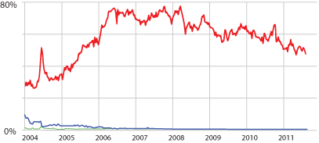
Email Security: Spam
Spam (Google)
Notes:
https://support.google.com/mail/answer/1366858?hl=en
http://www.securelist.com/en/analysis/204792282/Spam_in_January_2013
https://www.trustwave.com/support/labs/spam_statistics.asp
http://en.wikipedia.org/wiki/Bayesian_spam_filtering
http://www.pcworld.com/article/252206/google_explains_gmails_spam_filtering_process.html

Slide 81
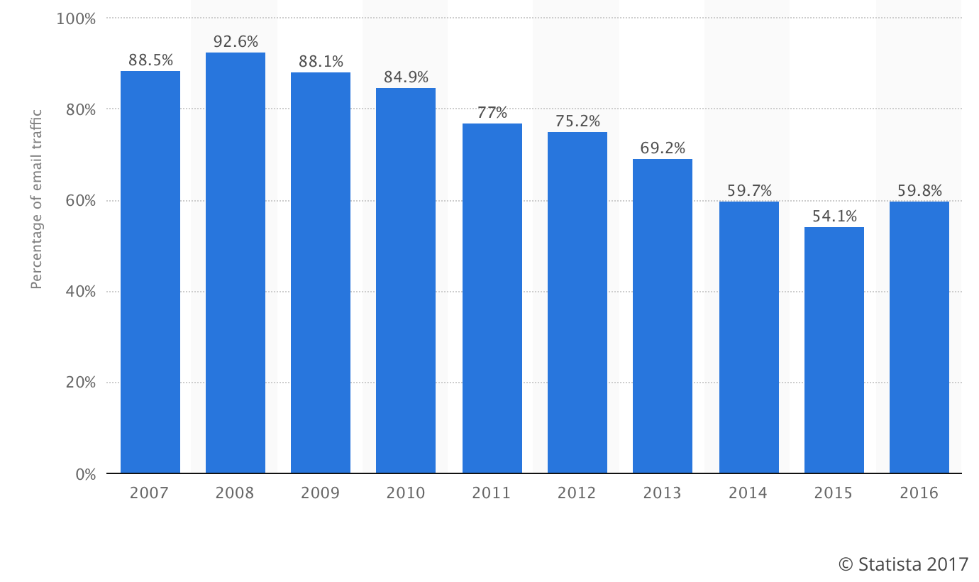
Email Security Issue: Spam
Source: https://www.statista.com/statistics/420400/spam-email-traffic-share-annual/

Slide 82
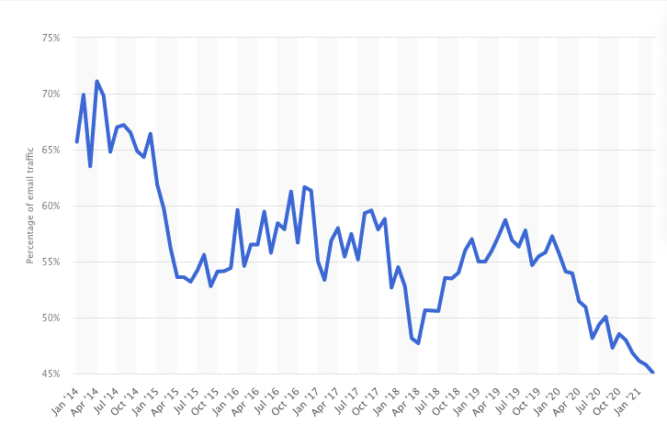
Email Security Issue: Spam
Source: https://www.statista.com/statistics/420391/spam-email-traffic-share/

Slide 83
Discussion: How May One Handle Email Spams?
Notes:
https://support.google.com/mail/answer/1366858?hl=en
http://support.simpledns.com/KB/a62/configuring-dns-records-for-domainkeys-dkim.aspx
http://www.slideshare.net/kka7/what-you-need-to-know-about-email-authentication

Slide 84
Detection Methods Used by GMail
Known phishing scams
Message from unconfirmed sender identity
Message you sent to Spam/similarity to suspicious messages
Administrator-set policies
https://support.google.com/mail/answer/1366858?hl=en
Notes:
https://support.google.com/mail/answer/1366858?hl=en
http://support.simpledns.com/KB/a62/configuring-dns-records-for-domainkeys-dkim.aspx

Slide 85
Backup Slides

Slide 86
The Design Philosophy of the DARPA Internet

Slide 87
Goals
. Connect different networks
Survivability in the face of failure
Support multiple types of services
Accommodate a variety of networks
Permit distributed management of resources
Be cost effective
Permit host attachment with a low level of effort
Be accountable

Slide 88
Survivability in the Face of Failure: Questions
What does the goal mean?
Why is the goal important?
How does the Internet achieve this goal?
Does the Internet achieve this goal (or in what degree does the Internet achieve this goal)?

Slide 89
Survivability in the Face of Failure
Continue to operate even in the presence of network failures (e.g., link and router failures)
as long as the network is not partitioned, two endpoints should be able to communicate…moreover, any other failure (excepting network partition) should be transparent to endpoints
Decision: maintain state only at end-points (fate-sharing)
eliminate the problem of handling state inconsistency and performing state restoration when router fails
Internet: stateless network architecture

Slide 90
Support Multiple Types of Service: Questions
What does this goal mean?
Why is the goal important?
How does the Internet achieve this goal?
Does the Internet achieve this goal (or in what degree does the Internet achieve this goal)?

Slide 91
Support Multiple Types of Service
Add UDP to TCP to better support other types of applications
e.g., “real-time” applications
This was arguably the main reason for separating TCP and IP
Provide datagram abstraction: lower common denominator on which other services can be built: everything over IP
service differentiation was considered (remember ToS?), but this has never happened on the large scale (Why?)

Slide 92
Support a Variety of Networks: Questions
What does the goal mean?
Why is this goal important?
How does the Internet achieve this goal?
Does the Internet achieve this goal (or in what degree does the Internet achieve this goal)?

Slide 93
Support a Variety of Networks
Very successful
because the minimalist service; it requires from underlying network only to deliver a packet with a “reasonable” probability of success
…does not require:
reliability
in-order delivery
The mantra: IP over everything
Then: ARPANET, X.25, DARPA satellite network..
Now: ATM, SONET, WDM…

Slide 94
Other Goals
Permit distributed management of resources
Be cost effective
Permit host attachment with a low level of effort
Be accountable

