Slide 1
Network Transport Layer: Transport Reliability: Sliding Windows; Connection Management; TCP
Qiao Xiang
https://qiaoxiang.me/courses/cnns-xmuf21/index.shtml
11/11/2021
This deck of slides are heavily based on CPSC 433/533 at Yale University, by courtesy of Dr. Y. Richard Yang.

Slide 2
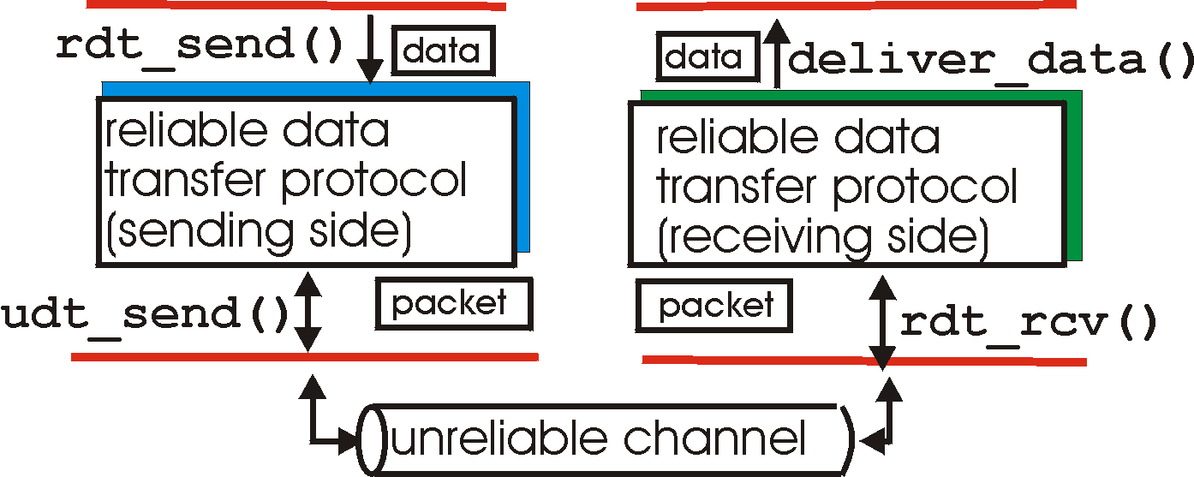
Recap: Reliable Data Transfer Context
rdt_send(): called from above, (e.g., by app.)
deliver_data(): called by rdt to deliver data to upper
send
side
receive
side
udt_send(): called by rdt,
to transfer packet over
unreliable channel to receiver
rdt_rcv(): called from below; when packet arrives on rcv-side of channel

Slide 3
Recap: rdt2.0: Reliability allowing only Data Msg Corruption
rdt_send(data)
snkpkt = make_pkt(data, checksum)
udt_send(sndpkt)
receiver
rdt_rcv(rcvpkt) &&
isNAK(rcvpkt)
Wait for data
Wait for ACK or NAK
rdt_rcv(rcvpkt) &&
corrupt(rcvpkt)
udt_send(sndpkt)
udt_send(NAK)
rdt_rcv(rcvpkt) && isACK(rcvpkt)
Λ
Wait for data
sender
rdt_rcv(rcvpkt) &&
notcorrupt(rcvpkt)
extract(rcvpkt,data)
deliver_data(data)
udt_send(ACK)
3

Slide 4
Recap: Rdt2.0 Analysis
sender
receiver
data (n)
Execution traces of rdt2.0: {data^ NACK}* data deliver ACK
waiting for N/ACK
NACK
data (n)
ACK
waiting for data
data (n+1)

Slide 5
Recap: rdt2.1b: Reliability allowing Data/Control Msg Corruption
Guess garbled feedback as NAK
sender
Fix wrong guess by checking seq#
receiver
5

Slide 6
Protocol Analysis using (Generic) Execution Traces Technique
Issue: how to systematically enumerate all potential execution traces to understand and verify correctness
A systematic approach to enumerating exec. traces is to compute joint sender/receiver/channels state machine
sender state: waiting for n
receiver state: waiting for n
snd->rcv channel state
rcv d_{n} _{del}
s_{n} r_{n+1} - ACK
…
rcv>snd channel state
w_{n} r_{n} - -
snd d_{n}
s_{n} r_{n} d_{n} -
rcv d^_{n}
s_{n} r_{n} - NAK
…
6
Notes:
{data(n)^ NACK|NACK^}* data(n) deliver
ACK^ data(n)
ACK^ data(n)^ XXXX

Slide 7
Recap: Protocol Analysis using (Generic) Execution Traces Technique
r d_{n}
deliv
s ACK
r ACK
s d_{n}
w_{n} r_{n} - -
s_{n} r_{n} d_{n} -
s_{n} r_{n+1} - ACK
W_{n+1} r_{n+1} - -
r NAK| r NAK^ s d_{n}
r d_{n}^ s NAK
r d_{n}
s ACK
r ACK^
s d_{n}
s_{n} r_{n} - NAK
s_{n} r_{n+1} d_{n} -
r NAK| r NAK^
s d_{n}
r d_{n}^
s NAK
s_{n} r_{n+1} - NAK
Execution traces of rdt2.1b are all that can be generated by the finite state machine above.
7
Notes:
{data(n)^ NACK|NACK^}* data(n) deliver
ACK^ data(n)
ACK^ data(n)^ XXXX

Slide 8
Recap: Protocol Analysis using State Invariants
first
time
rcvs
ack 0
W1: wait for data with seq. 1
S1: sending data with seq. 1
w0
s0
w1
s1
w2
s2
w3
sender
w0
w1
w2
w3
receiver
State invariant:
- When receiver’s state is waiting for seq #n, sender’s state can be sending either seq#n-1or seq#n, and only either #n or #n-1 packets can arrive
first
time
rcvs 0

Slide 9
rdt2.1c: Sender, Handles Garbled ACK/NAKs: Using 1 bit (Alternating-Bit Protocol)
rdt_send(data)
sndpkt = make_pkt(0, data, checksum)
udt_send(sndpkt)
rdt_rcv(rcvpkt) &&
( corrupt(rcvpkt) ||
isNAK(rcvpkt) )
Wait for call 0 from above
Wait for ACK or NAK
udt_send(sndpkt)
rdt_rcv(rcvpkt)
&& notcorrupt(rcvpkt)
&& isACK(rcvpkt)
rdt_rcv(rcvpkt)
&& notcorrupt(rcvpkt)
&& isACK(rcvpkt)
Λ
Λ
Wait for ACK or NAK 1
Wait for
call 1 from above
rdt_rcv(rcvpkt) &&
( corrupt(rcvpkt) ||
isNAK(rcvpkt) )
rdt_send(data)
udt_send(sndpkt)
sndpkt = make_pkt(1, data, checksum)
udt_send(sndpkt)

Slide 10
rdt2.1c: Receiver, Handles Garbled ACK/NAKs: Using 1 bit
rdt_rcv(rcvpkt) && notcorrupt(rcvpkt)
&& has_seq0(rcvpkt)
extract(rcvpkt,data)
deliver_data(data)
sndpkt = make_pkt(ACK, chksum)
udt_send(sndpkt)
rdt_rcv(rcvpkt) && (corrupt(rcvpkt)
rdt_rcv(rcvpkt) && (corrupt(rcvpkt)
sndpkt = make_pkt(NAK, chksum)
udt_send(sndpkt)
sndpkt = make_pkt(NAK, chksum)
udt_send(sndpkt)
Wait for
0 from below
Wait for
1 from below
rdt_rcv(rcvpkt) &&
not corrupt(rcvpkt) &&
has_seq1(rcvpkt)
rdt_rcv(rcvpkt) &&
not corrupt(rcvpkt) &&
has_seq0(rcvpkt)
sndpkt = make_pkt(ACK, chksum)
udt_send(sndpkt)
sndpkt = make_pkt(ACK, chksum)
udt_send(sndpkt)
rdt_rcv(rcvpkt) && notcorrupt(rcvpkt)
&& has_seq1(rcvpkt)
extract(rcvpkt,data)
deliver_data(data)
sndpkt = make_pkt(ACK, chksum)
udt_send(sndpkt)

Slide 11
rdt2.1c: Summary
Sender:
state must “remember” whether “current” pkt has 0 or 1 seq. #
Receiver:
must check if received packet is duplicate
state indicates whether 0 or 1 is expected pkt seq #

Slide 12
rdt2.2: a NAK-free protocol
Same functionality as rdt2.1c, using ACKs only
Instead of NAK, receiver sends ACK for last pkt received OK
receiver must explicitly include seq # of pkt being ACKed
Duplicate ACK at sender results in same action as NAK: retransmit current pkt

Slide 13
rdt2.2: Sender, Receiver Fragments
rdt_send(data)
sndpkt = make_pkt(0, data, checksum)
udt_send(sndpkt)
rdt_rcv(rcvpkt) &&
( corrupt(rcvpkt) ||
isACK(rcvpkt,1) )
Wait for call 0 from above
Wait for ACK 0
udt_send(sndpkt)
sender FSM
fragment
rdt_rcv(rcvpkt)
&& notcorrupt(rcvpkt)
&& isACK(rcvpkt,0)
rdt_rcv(rcvpkt) &&
(corrupt(rcvpkt) ||
has_seq1(rcvpkt))
Λ
Wait for
0 from below
receiver FSM
fragment
sndpkt= make_pkt(ACK,1, chksum)
udt_send(sndpkt)
rdt_rcv(rcvpkt) && notcorrupt(rcvpkt)
&& has_seq0(rcvpkt)
extract(rcvpkt,data)
deliver_data(data)
sndpkt = make_pkt(ACK,0, chksum)
udt_send(sndpkt)

Slide 14
Outline
Admin and review
Reliable data transfer
perfect channel
channel with bit errors
channel with bit errors and losses

Slide 15
rdt3.0: Channels with Errors and Loss
New assumption: underlying channel can also lose packets (data or ACKs)
checksum, seq. #, ACKs, retransmissions will be of help, but not enough
Q: Does rdt2.2 work under losses?
Approach: sender waits “reasonable” amount of time for ACK
requires countdown timer
retransmits if no ACK received in this time
if pkt (or ACK) just delayed (not lost):
retransmission will be duplicate, but use of seq. #’s already handles this
receiver must specify seq # of pkt being ACKed

Slide 16
rdt3.0 Sender
rdt_send(data)
rdt_rcv(rcvpkt) &&
( corrupt(rcvpkt) ||
isACK(rcvpkt,1) )
sndpkt = make_pkt(0, data, checksum)
udt_send(sndpkt)
start_timer
udt_send(sndpkt)
rdt_rcv(rcvpkt)
Λ
Λ
Wait for
call 0 from above
Wait for ACK0
timeout
udt_send(sndpkt)
start_timer
rdt_rcv(rcvpkt)
&& notcorrupt(rcvpkt)
&& isACK(rcvpkt,1)
rdt_rcv(rcvpkt)
&& notcorrupt(rcvpkt)
&& isACK(rcvpkt,0)
stop_timer
stop_timer
Wait for ACK1
Wait for
call 1 from above
timeout
udt_send(sndpkt)
start_timer
rdt_rcv(rcvpkt)
rdt_send(data)
Λ
rdt_rcv(rcvpkt) &&
( corrupt(rcvpkt) ||
isACK(rcvpkt,0) )
sndpkt = make_pkt(1, data, checksum)
udt_send(sndpkt)
start_timer
Λ

Slide 17
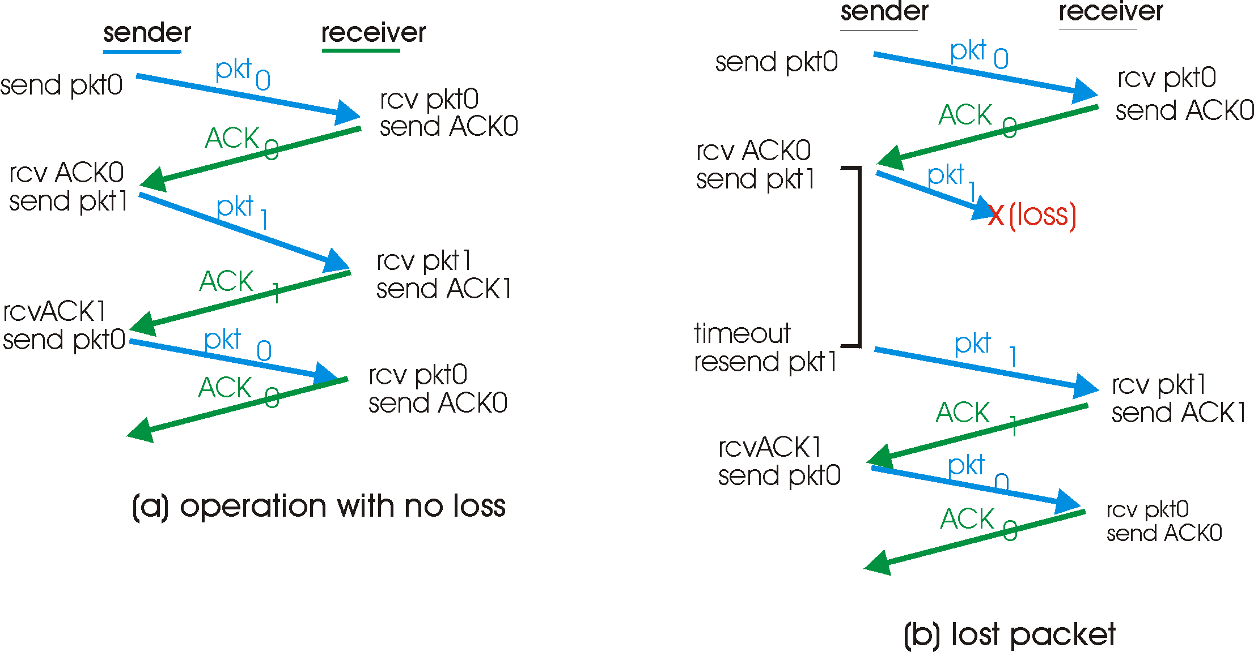
rdt3.0 in Action

Slide 18
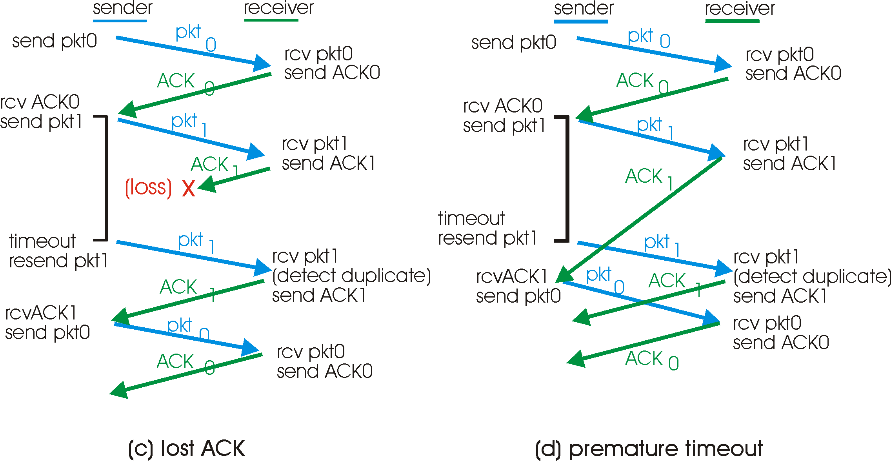
rdt3.0 in Action
Question to think about: How to determine a good timeout value?
Home exercise: What are execution traces of rdt3.0? What are some state invariants of rdt3.0?

Slide 19
rdt3.0: Protocol Analysis using State Invariants
sender
receiver
data 0 (n-1)
waiting for 0 (n-1)
State consistency:
When receiver’s state is waiting n, the state of the sender is either sending for n-1 or sending for n
When sender’s state is sending for n, receiver’s state is waiting for n or n + 1
ACK for 0 (n-1)
sending 0 (n-1)
data 0 (n-1)
waiting for 1
(n)
ACK for 0 (n-1)
data 1 (n)
sending 1 (n)
waiting for 0 (n+1)

Slide 20
rdt3.0: Stop-and-Wait Performance
sender
receiver
first packet bit transmitted, t = 0
last packet bit transmitted, t = L / R
first packet bit arrives
RTT
last packet bit arrives, send ACK
ACK arrives, send next
packet, t = RTT + L / R
What is U_{sender}: utilization – fraction of time link busy sending?
Assume: 1 Gbps link, 15 ms e-e prop. delay, 1KB packet
20

Slide 21
Performance of rdt3.0
rdt3.0 works, but performance stinks
Example: 1 Gbps link, 15 ms e-e prop. delay, 1KB packet:
T
=
L (packet length in bits)
8kb/pkt
transmit
=
= 8 microsec
R (transmission rate, bps)
10**9 b/sec
1KB pkt every 30 msec -> 33kB/sec thruput over 1 Gbps link
network protocol limits use of physical resources !

Slide 22
A Summary of Questions
How to improve the performance of rdt3.0?
What if there are reordering and duplication?
How to determine the “right” timeout value?
22

Slide 23
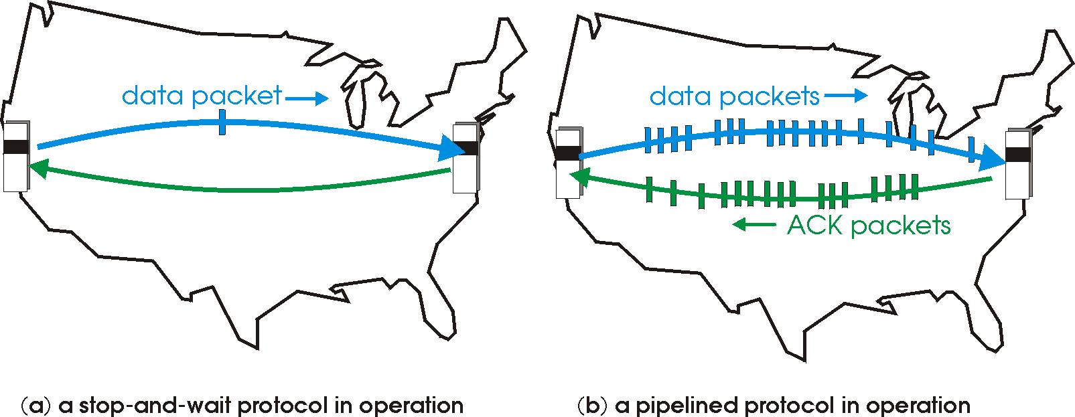
Sliding Window Protocols: Pipelining
Pipelining: sender allows multiple, “in-flight”, yet-to-be-acknowledged pkts
range of sequence numbers must be increased
buffering at sender and/or receiver
23
Notes:
Two generic forms of pipelined protocols: go-Back-N, selective repeat

Slide 24
Pipelining: Increased Utilization
sender
receiver
first packet bit transmitted, t = 0
last bit transmitted, t = L / R
first packet bit arrives
RTT
last packet bit arrives, send ACK
last bit of 2nd packet arrives, send ACK
last bit of 3rd packet arrives, send ACK
ACK arrives, send next
packet, t = RTT + L / R
increase utilization
by a factor of 3!
Question: a rule-of-thumb window size?
24

Slide 25
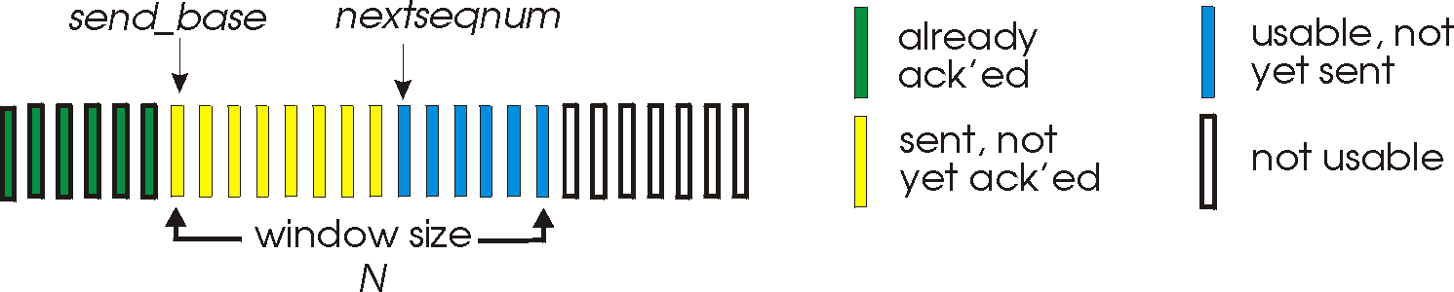
Realizing Sliding Window: Go-Back-n
Sender:
k-bit seq # in pkt header
“window” of up to W, consecutive unack’ed pkts allowed
W
ACK(n): ACKs all pkts up to, including seq # n - “cumulative ACK”
note: ACK(n) could mean two things: I have received upto and include n, or I am waiting for n
timer for the packet at base
timeout(n): retransmit pkt n and all higher seq # pkts in window
25

Slide 26
GBN: Sender FSM
rdt_send(data)
if (nextseqnum < base+W) {
sndpkt[nextseqnum] = make_pkt(nextseqnum,data,chksum)
udt_send(sndpkt[nextseqnum])
if (base == nextseqnum) start_timer
nextseqnum++
} else
block sender
Λ
base=1
nextseqnum=1
timeout
start_timer
udt_send(sndpkt[base])
udt_send(sndpkt[base+1])
…
udt_send(sndpkt[nextseqnum-1])
Wait
rdt_rcv(rcvpkt)
&& corrupt(rcvpkt)
rdt_rcv(rcvpkt) &&
notcorrupt(rcvpkt)
if (new packets ACKed) {
advance base;
if (more packets waiting) send more packets
}
if (base == nextseqnum)
stop_timer
else
start_timer for the packet at new base
26

Slide 27
GBN: Receiver FSM
default
udt_send(sndpkt)
rdt_rcv(rcvpkt)
&& notcurrupt(rcvpkt)
&& hasseqnum(rcvpkt,expectedseqnum)
Λ
Wait
extract(rcvpkt,data)
deliver_data(data)
sndpkt = make_pkt(expectedseqnum,ACK,chksum)
udt_send(sndpkt)
expectedseqnum++
expectedseqnum=1
sndpkt =
make_pkt(expectedseqnum,ACK,chksum)
Only state: expectedseqnum
out-of-order pkt:
discard (don’t buffer) -> no receiver buffering!
re-ACK pkt with highest in-order seq #
may generate duplicate ACKs
27

Slide 28
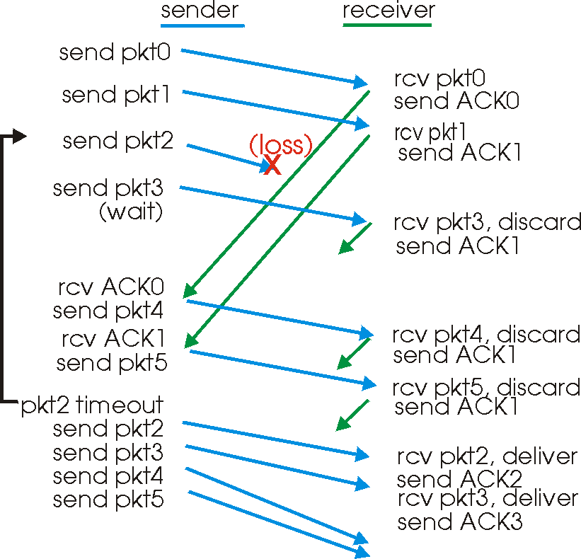
GBN in Action
window
size = 4
28

Slide 29
Analysis: Efficiency of Go-Back-n
Assume window size W
Assume each packet is lost with probability p
On average, how many packets do we send for each data packet received?
29

Slide 30
Selective Repeat
Sender window
Window size W: W consecutive unACKed seq #’s
Receiver individually acknowledges correctly received pkts
buffers out-of-order pkts, for eventual in-order delivery to upper layer
ACK(n) means received packet with seq# n only
buffer size at receiver: window size
Sender only resends pkts for which ACK not received
sender timer for each unACKed pkt
30

