Slide 1
Network Transport Layer: TCP
Qiao Xiang
https://qiaoxiang.me/courses/cnns-xmuf21/index.shtml
11/16/2021
This deck of slides are heavily based on CPSC 433/533 at Yale University, by courtesy of Dr. Y. Richard Yang.

Slide 2
Admin
Lab assignment 2 to be returned on Nov. 18
Class Project
15% of your final score
Please start ASAP
Talk to the instructor or TA to get feedback

Slide 3
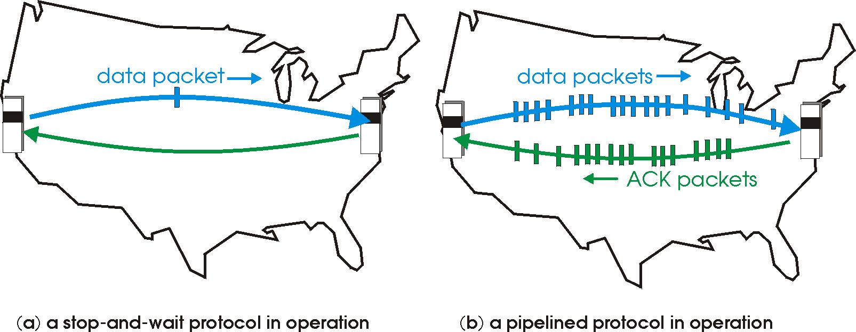
Recap: Reliable Transport
Basic structure: sliding window protocols
Realization: GBN or SR
General technique: pipelining.

Slide 4
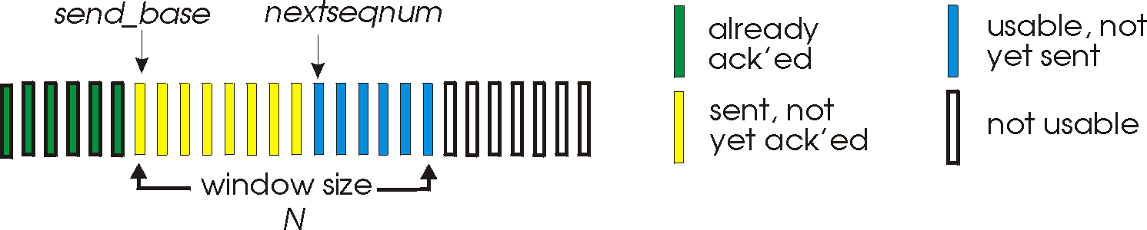
Recap: Go-Back-N
Sender:
k-bit seq # in pkt header
“window” of up to W, consecutive unack’ed pkts allowed
W
ACK(n): ACKs all pkts up to, including seq # n - “cumulative ACK”
note: ACK(n) could mean two things: I have received upto and include n, or I am waiting for n
timer for the packet at base
timeout(n): retransmit pkt n and all higher seq # pkts in window
4

Slide 5
Recap: Go-Back-N
default
udt_send(sndpkt)
rdt_rcv(rcvpkt)
&& notcurrupt(rcvpkt)
&& hasseqnum(rcvpkt,expectedseqnum)
Λ
Wait
extract(rcvpkt,data)
deliver_data(data)
sndpkt = make_pkt(expectedseqnum,ACK,chksum)
udt_send(sndpkt)
expectedseqnum++
expectedseqnum=1
sndpkt =
make_pkt(expectedseqnum,ACK,chksum)
Only state: expectedseqnum
out-of-order pkt:
discard (don’t buffer) -> no receiver buffering!
re-ACK pkt with highest in-order seq #
may generate duplicate ACKs
5

Slide 6
Selective Repeat
Sender window
Window size W: W consecutive unACKed seq #’s
Receiver individually acknowledges correctly received pkts
buffers out-of-order pkts, for eventual in-order delivery to upper layer
ACK(n) means received packet with seq# n only
buffer size at receiver: window size
Sender only resends pkts for which ACK not received
sender timer for each unACKed pkt
6

Slide 7
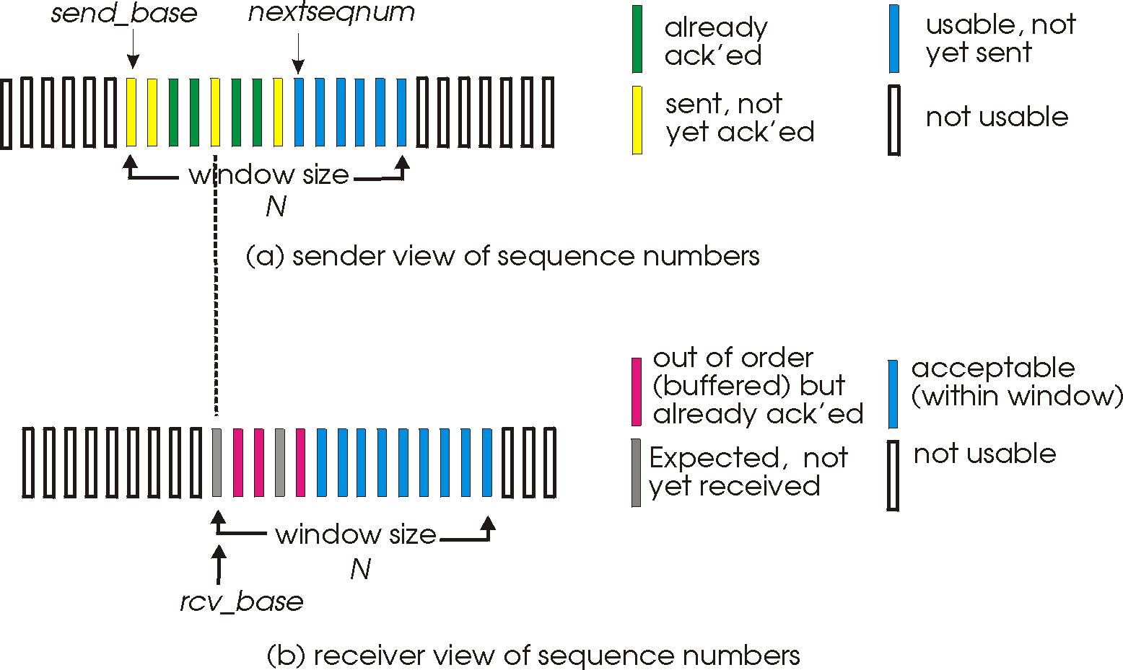
Selective Repeat: Sender, Receiver Windows
W
W
7

Slide 8
Selective Repeat
sender
receiver
data from above :
unACKed packets is less than window size W, send; otherwise block app.
timeout(n):
resend pkt n, restart timer
ACK(n) in [sendbase,sendbase+W-1]:
mark pkt n as received
update sendbase to the first packet unACKed
pkt n in [rcvbase, rcvbase+W-1]
send ACK(n)
if (out-of-order) mark and buffer pkt n else /*in-order*/
deliver any in-order packets
otherwise:
ignore
8

Slide 9
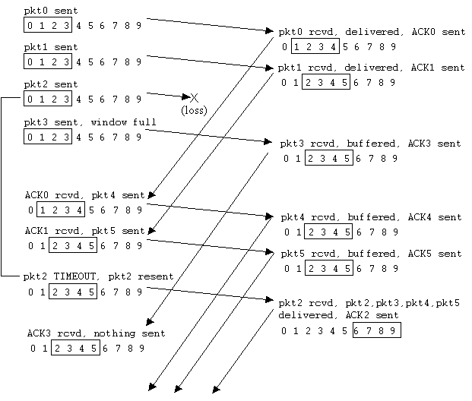
Selective Repeat in Action
9

Slide 10
Discussion: Efficiency of Selective Repeat
Assume window size W
Assume each packet is lost with probability p
On average, how many packets do we send for each data packet received?
10

Slide 11
Selective Repeat: Seq# Ambiguity
Example:
seq #’s: 0, 1, 2, 3
window size=3
Error: incorrectly passes duplicate data as new.
11

Slide 12
State Invariant: Window Location
Go-back-n (GBN)
Selective repeat (SR)
sender window
receiver window
sender window
receiver window
12

Slide 13
Q: what relationship between seq # size and window size?
Window Location
Go-back-n (GBN)
Selective repeat (SR)
sender window
receiver window
sender window
receiver window
13

Slide 14
Selective Repeat
sender
receiver
data from above :
unACKed packets is less than window size W, send; otherwise block app.
timeout(n):
resend pkt n, restart timer
ACK(n) in [sendbase,sendbase+W-1]:
mark pkt n as received
update sendbase to the first packet unACKed
pkt n in [rcvbase, rcvbase+W-1]
send ACK(n)
if (out-of-order) mark and buffer pkt n else /*in-order*/
deliver any in-order packets
pkt n in [rcvbase-W, rcvbase-1]
send ACK(n)
otherwise:
ignore
14

Slide 15
Sliding Window Protocols: Go-back-n and Selective Repeat
 | Go-back-n | Selective Repeat
data bandwidth: sender to receiver (avg. number of times a pkt is transmitted)
ACK bandwidth (receiver to sender)
Relationship between M (the number of seq#) and W (window size)
Buffer size at receiver
Complexity
Less efficient
More efficient
More efficient
Less efficient
M > W
M ≥ 2W
1
W
Simpler
More complex
p: the loss rate of a packet; M: number of seq# (e.g., 3 bit M = 8); W: window size
15

Slide 16
Outline
Admin and Recap
Reliable data transfer
perfect channel
channel with bit errors
channel with bit errors and losses
sliding window: reliability with throughput
TCP reliability

Slide 17
TCP: Overview RFCs: 793, 1122, 1323, 2018, 2581
Point-to-point reliability: one sender, one receiver
Flow controlled and congestion controlled

Slide 18
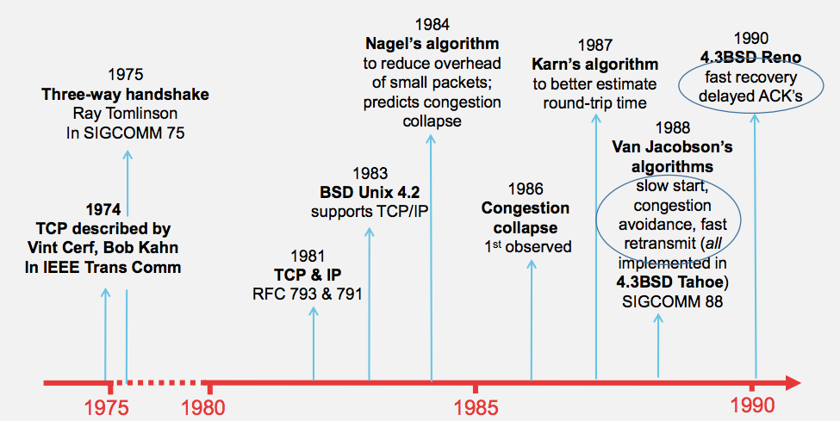
Evolution of TCP
Source: http://webcourse.cs.technion.ac.il/236341/Winter2015-2016/ho/WCFiles/Tutorial10.pdf

Slide 19
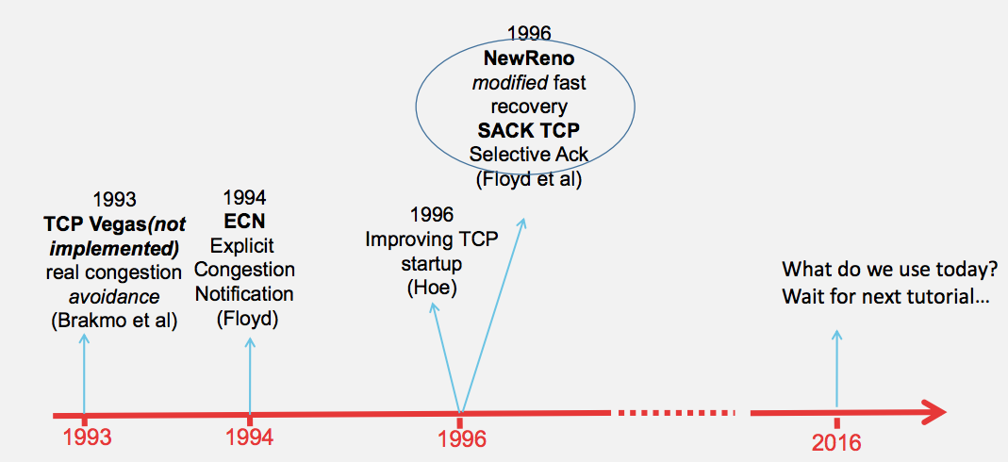
Evolution of TCP
multiple versions
Source: http://webcourse.cs.technion.ac.il/236341/Winter2015-2016/ho/WCFiles/Tutorial10.pdf

Slide 20
TCP Reliable Data Transfer
Connection-oriented:
connection management
setup (exchange of control msgs) init’s sender, receiver state before data exchange
close
Full duplex data:
bi-directional data flow in same connection
A sliding window protocol
a combination of go-back-n and selective repeat:
send & receive buffers
cumulative acks
TCP uses a single retransmission timer
do not retransmit all packets upon timeout

Slide 21
TCP Segment Structure
32 bits
URG: urgent data
(generally not used)
counting
by bytes
of data
(not segments!)
source port #
dest port #
sequence number
ACK: ACK #
valid
acknowledgement number
head
len
not
used
U
rcvr window size
A
P
R
S
PSH: push data now
(generally not used)
F
flow control
checksum
ptr urgent data
RST, SYN, FIN:
connection management
(reset, setup teardown
commands)
Options (variable length)
application
data
(variable length)
Also in UDP

Slide 22
Outline
Admin and Recap
Reliable data transfer
perfect channel
channel with bit errors
channel with bit errors and losses
sliding window: reliability with throughput
TCP reliability
data seq#, ack, buffering

Slide 23
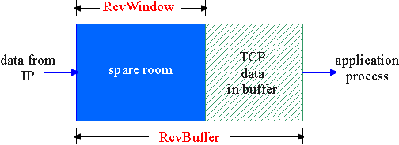
Flow Control
flow control
sender won’t overflow
receiver’s buffer by
transmitting too much,
too fast
receive side of a connection has a receive buffer:
speed-matching service: matching the send rate to the receiving app’s drain rate
app process may be slow at reading from buffer

Slide 24
TCP Flow Control: How it Works
source port #
dest port #
sequence number
acknowledgement number
head
len
not
used
U
A
rcvr window size
P
R
S
F
checksum
ptr urgent data
spare room in buffer
= RcvWindow
Options (variable length)
application
data
(variable length)

Slide 25
TCP Seq. #’s and ACKs
Seq. #’s:
byte stream “number” of first byte in segment’s data
ACKs:
seq # of next byte expected from other side
cumulative ACK in standard header
selective ACK in options
Host A
Host B
User
types
‘C’
Seq=42, ACK=79, data = ‘C’
host ACKs
receipt of
‘C’, echoes
back ‘C’
Seq=79, ACK=43, data = ‘C’
host ACKs
receipt
of echoed
‘C’
Seq=42, ACK=80
time
simple telnet scenario

Slide 26
TCP Send/Ack Optimizations
TCP includes many tune/optimizations, e.g.,
the “small-packet problem”: sender sends a lot of small packets (e.g., telnet one char at a time)
Nagle’s algorithm: do not send data if there is small amount of data in send buffer and there is an unack’d segment
the ”ack inefficiency” problem: receiver sends too many ACKs, no chance of combing ACK with data
Delayed ack to reduce # of ACKs/combine ACK with reply

Slide 27
TCP Receiver ACK Generation [RFC 1122, RFC 2581]
Event at Receiver
Arrival of in-order segment with
expected seq #. All data up to
expected seq # already ACKed
Arrival of in-order segment with
expected seq #. One other
segment has ACK pending
Arrival of out-of-order segment
higher-than-expect seq. # .
Gap detected
Arrival of segment that
partially or completely fills gap
TCP Receiver Action
Delayed ACK. Wait up to 500ms
for next segment. If no next segment,
send ACK
Immediately send single cumulative
ACK, ACKing both in-order segments
Immediately send duplicate ACK,
indicating seq. # of next expected byte
Immediate send ACK, provided that
segment starts at lower end of gap

Slide 28
Outline
Admin and Recap
Reliable data transfer
perfect channel
channel with bit errors
channel with bit errors and losses
sliding window: reliability with throughput
TCP reliability
data seq#, ack, buffering
timeout realization

Slide 29
TCP Reliable Data Transfer
Basic structure: sliding window protocol
Remaining issue: How to determine the “right” parameters?
timeout value?
sliding window size?

Slide 30
History
Key parameters for TCP in mid-1980s
fixed window size W
timeout value = 2 RTT
Network collapse in the mid-1980s
UCB ←→ LBL throughput dropped by 1000X !
The intuition was that the collapse was caused by wrong parameters…

Slide 31
Timeout: Cost of Timeout Param
Why is good timeout value important?
too short
premature timeout
unnecessary retransmissions; many duplicates
too long
slow reaction to segment loss
Q: Is it possible to set Timeout as a constant?
Q: Any problem w/ the early approach: Timeout = 2 RTT

Slide 32
Setting Timeout
Problem:
Ideally, we set timeout = RTT, but RTT is not a fixed value => using the average of RTT will generate many timeouts due to network variations
Possibility: using the average/median of RTT
Issue: this will generate many timeouts due to network variations
Solution:
Set Timeout RTO = avg + “safety margin” based on variation
freq.
RTT
TCP approach:
Timeout = EstRTT + 4 * DevRTT

Slide 33
Compute EstRTT and DevRTT
Exponential weighted moving average (EWMA)
influence of past sample decreases exponentially fast
EstRTT = (1-alpha)*EstRTT + alpha*SampleRTT
- SampleRTT: measured time from segment transmission until ACK receipt
- typical value: alpha = 0.125
DevRTT = (1-beta)*DevRTT + beta|SampleRTT-EstRTT|
(typically, beta = 0.25)

Slide 34
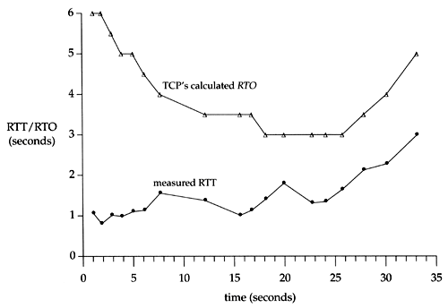
An Example TCP Session

Slide 35
Fast Retransmit
Issue: Timeout period often relatively long:
long delay before resending lost packet
Question: Can we detect loss faster than RTT?
Detect lost segments via duplicate ACKs
sender often sends many segments back-to-back
if segment is lost, there will likely be many duplicate ACKs
If sender receives 3 ACKs for the same data, it supposes that segment after ACKed data was lost:
resend segment before timer expires

Slide 36
Triple Duplicate Ack
Packets
1
2
3
4
5
6
7
Acknowledgements (waiting seq#)
2
3
4
4
4
4

Slide 37
Fast Retransmit:
event: ACK received, with ACK field value of y
if (y > SendBase) {
…
SendBase = y
if (there are currently not-yet-acknowledged segments)
start timer
…
}
else {
increment count of dup ACKs received for y
if (count of dup ACKs received for y = 3) {
resend segment with sequence number y
…
a duplicate ACK for
already ACKed segment
fast retransmit

Slide 38
TCP: reliable data transfer
00 sendbase = initial_sequence number agreed by TWH
01 nextseqnum = initial_sequence number by TWH
02 loop (forever) {
03 switch(event)
04 event: data received from application above
05 if (window allows send)
06 create TCP segment with sequence number nextseqnum
06 if (no timer) start timer
07 pass segment to IP
08 nextseqnum = nextseqnum + length(data) else put packet in buffer
09 event: timer timeout for sendbase
10 retransmit segment
11 compute new timeout interval
12 restart timer
13 event: ACK received, with ACK field value of y
14 if (y > sendbase) { /* cumulative ACK of all data up to y */
15 cancel the timer for sendbase
sendbase = y
if (no timer and packet pending) start timer for new sendbase
while (there are segments and window allow)
sent a segment;
18 }
19 else { /* y==sendbase, duplicate ACK for already ACKed segment */
20 increment number of duplicate ACKs received for y
21 if (number of duplicate ACKS received for y == 3) {
22 /* TCP fast retransmit */
23 resend segment with sequence number y
24 restart timer for segment y
25 }
26 } /* end of loop forever */
Simplified
TCP
sender

Slide 39
Outline
Admin and Recap
Reliable data transfer
perfect channel
channel with bit errors
channel with bit errors and losses
sliding window: reliability with throughput
TCP reliability
data seq#, ack, buffering
timeout realization
connection management

Slide 40
Why Connection Setup/When to Accept (Safely Deliver) First Packet?
sender
receiver
data 0
accept
ACK for 0
40

Slide 41
Why Connection Setup/When to Accept (Safely Deliver) First Packet?
sender
receiver
data 0 (transfer $1000 to B)
accept
ACK for 0 (n)
data 0 (transfer $1000 to B)
accept?
41
Notes:
a sender should not reuse a seq# before it is sure the packet has left the network

Slide 42
Transport “Safe-Setup” Principle
A general safety principle for a receiver R to accept a message from a sender S is the general “authentication” principle, which consists of two conditions:
Transport authentication principle:
[p1] Receiver can be sure that what Sender says is fresh
[p2] Receiver receives something that only Sender can say
We first assume a secure setting: no malicious attacks.
Exercise: Techniques to allow a receiver to check for freshness (e.g., add a time stamp)?

Slide 43
Generic Challenge-Response Structure Checking Freshness
sender
receiver
I have data to send
deliver
Challenge (nonce)
Demonstrate knowing nonce; data

Slide 44
Three Way Handshake (TWH) [Tomlinson 1975]
Host A
Host B
SYN(seq=x)
notify initial seq#. Accept?
ACK(seq=x), SYN(seq=y)
think of y as a challenge
ACK(seq=y)
accept data only after
verified y is bounced back
x is the init. seq
DATA(seq=x+1)
SYN: indicates connection setup
Notes:
Syn(seq=x) could be duplicate or malicious

Slide 45
Scenarios with Duplicate Request/SYN Attack
Host A
Host B
SYN(seq=x)
accept?
ACK(seq=x), SYN(seq=y)
no such request
REJECT(seq=y)
reject

Slide 46
Scenarios with Duplicate Request/SYN Attack
Host A
Host B
SYN(seq=x)
accept?
ACK(seq=x), SYN(seq=y)
no such request
ACK(seq=z)
reject
REJECT(seq=y)

Slide 47
Make “Challenge y” Robust
To avoid that “SYNC ACK y” comes from reordering and duplication
for each connection (sender-receiver pair), ensuring that two identically numbered packets are never outstanding at the same time
network bounds the life time of each packet
a sender will not reuse a seq# before it is sure that all packets with the seq# are purged from the network
seq. number space should be large enough to not limit transmission rate
Increasingly move to cryptographic challenge and response
Notes:
Add QUIC design: QUIC uses a cryptographic handshake
Servers
front-end servers, which collectively handle billions of requests a day from web browsers and mobile apps across a wide range of services.
On the client side, we have deployed QUIC in
Chrome,
our mobile video streaming YouTube app, and in the
Google Search app on Android
TCP connections commonly incur at least one round-trip delay of connection setup time before any application data can be sent, and TLS adds two round trips to this delay

Slide 48
Connection Close
Why connection close?
so that each side can release resource and remove state about the connection (do not want dangling socket)
client
server
init. close
release
resource?
I am done. Are you done too?
close
I am done too. Goodbye!
release
resource?
close
release
resource?

Slide 49
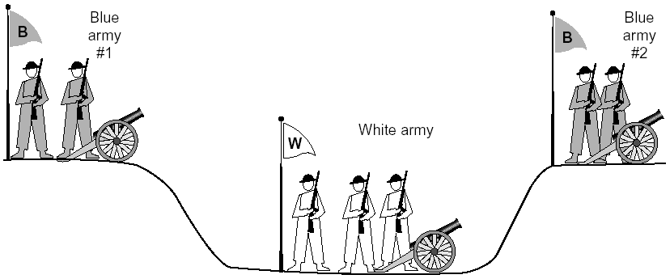
General Case: The Two-Army Problem
The gray (blue) armies need to agree on whether or not they will attack the white army. They achieve agreement by sending messengers to the other side. If they both agree, attack; otherwise, no. Note that a messenger can be captured!

Slide 50
Time_Wait
Generic technique: Timeout to “solve” infeasible problem
Instead of message-driven state transition, use a timeout based transition; use timeout to handle error cases
client
server
init. close
release
resource?
I am done. Are you done too?
Working
Closed
close
I am done too. Goodbye!
release
resource?
close
Working
Time_Waiit
Closed
release
resource?

Slide 51
Time_Wait Design Options
Design 1 (initiator time wait)
Design 2 (receiver time wait)
Host A
Host B
Host A
Host B
close
FIN
close
FIN
Time = n x timeout
Time to retry FIN after each timeout
Close after receive FIN
All states removed
ACK
Time to retransmit ACK
Close after first ACK
All states removed
ACK
All states removed
All states removed

Slide 52
TCP Four Way Teardown (For Bi-Directional Transport)
Host A
Host B
propose close A->B
close
FIN
A->B closed
ACK
close
propose close B->A
A->B closed
FIN
ACK
can retransmit the ACKif its ACK is lost
timed wait
closed
all states removed
closed
all states removed

Slide 53
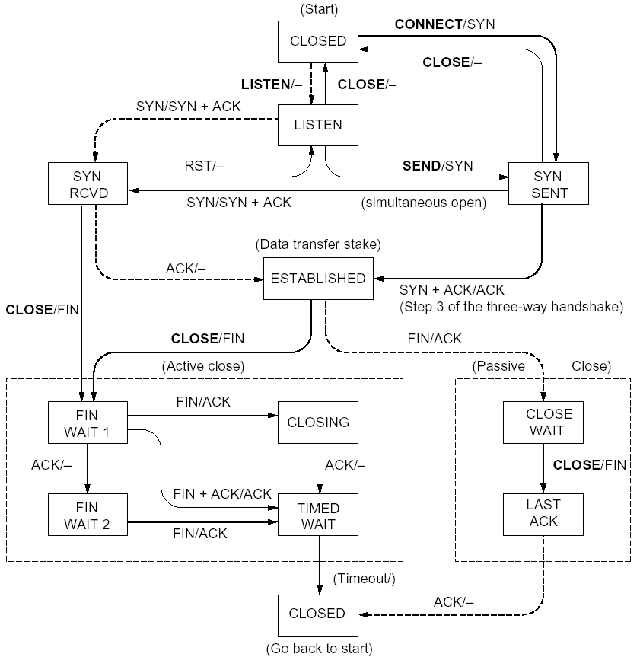
%netstat -t -a
CLOSED
SYN SENT
CLOSED
SYN
LISTEN
SYN RCVD
SYN/ACK
ESTABLSIHED
ACK
ESTABLSIHED
ESTABLSIHED
ESTABLSIHED
FIN WAIT 1
FIN
CLOSE WAIT
ACK
LAST ACK
FIN WAIT 2
FIN
TIME WAIT
ACK

Slide 54
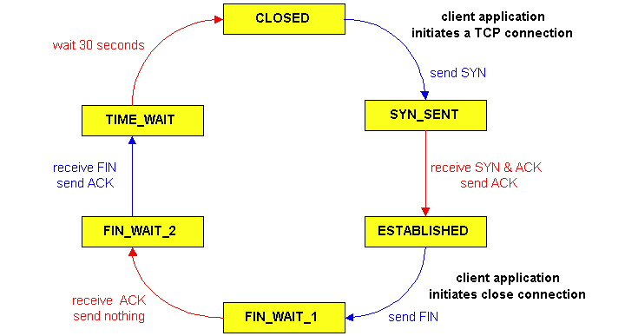
TCP Connection Management
CLOSED
SYN SENT
CLOSED
TCP lifecycle: init SYN/FIN
SYN
SYN RCVD
SYN/ACK
ESTABLSIHED
ACK
ESTABLSIHED
ESTABLSIHED
FIN WAIT 1
FIN
CLOSE WAIT
ACK
LAST ACK
FIN WAIT 2
FIN
TIME WAIT
ACK
http://dsd.lbl.gov/TCP-tuning/ip-sysctl-2.6.txt

Slide 55
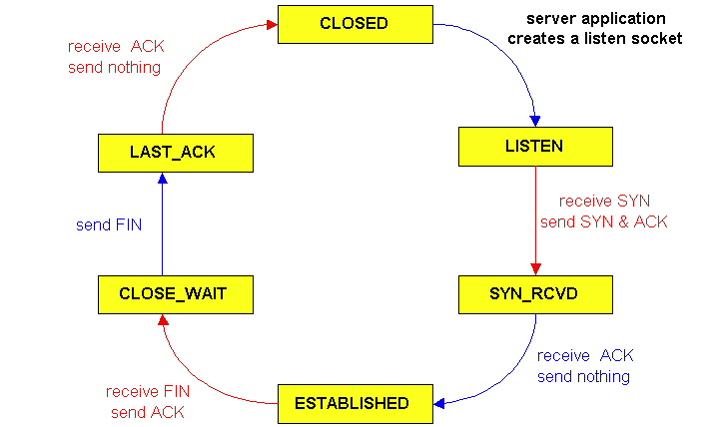
TCP Connection Management
CLOSED
SYN SENT
CLOSED
SYN
TCP lifecycle: wait for SYN/FIN
SYN RCVD
SYN/ACK
ESTABLSIHED
ACK
ESTABLSIHED
ESTABLSIHED
FIN WAIT 1
FIN
CLOSE WAIT
ACK
LAST ACK
FIN WAIT 2
FIN
TIME WAIT
ACK

Slide 56
A Summary of Questions
Basic structure: sliding window protocols
How to determine the “right” parameters?
timeout: mean + variation
sliding window size?

Slide 57
Sliding Window Size Function: Rate Control
Transmission rate determined by congestion window size, cwnd, over segments:
cwnd
cwnd segments, each with MSS bytes sent in one RTT:
cwnd * MSS
Rate =
Bytes/sec
RTT
Assume W is small enough. Ignore small details. MSS: Minimum Segment Size

Slide 58
Some General Questions
Big picture question:
How to determine a flow’s sending rate?
For better understanding, we need to look at a few basic questions:
What is congestion (cost of congestion)?
Why are desired properties of congestion control?

Slide 59
Roadmap
What is congestion
The basic CC alg
TCP/reno CC
TCP/Vegas
A unifying view of TCP/Reno and TCP/Vegas
Network wide resource allocation
Framework
Axiom derivation of network-wide objective function
Derive distributed algorithm

Slide 60
Outline
Admin and recap
Setting timeout
Transport congestion control
what is congestion (cost of congestion)

Slide 61
Cause/Cost of Congestion: Single Bottleneck
flow 1
20 Mbps
5 Mbps
10 Mbps
flow 2 (5 Mbps)
20 Mbps
20 Mbps
router 1
router 2
- Flow 2 has a fixed sending rate of 5 Mbps
- We vary the sending rate of flow 1 from 0 to 20 Mbps
- Assume
no retransmission; link from router 1 to router 2 has infinite buffer
throughput: e2e packets delivered in unit time
Delay?
throughput of flow 1 & 2 (Mbps)
delay at central link
delay due to
randomness
10
sending rate by flow 1 (Mbps)
sending rate by flow 1 (Mbps)
5
0
5
5
0

Slide 62
Cause/Cost of Congestion: Single Bottleneck
router 3
router 5
flow 1
20 Mbps
5 Mbps
10 Mbps
flow 2 (5 Mbps)
20 Mbps
20 Mbps
router 1
router 2
router 4
router 6
Assume
no retransmission
the link from router 1 to router 2 has finite buffer
throughput: e2e packets delivered in unit time
Zombie packet: a packet dropped at the link from router 2 to router 5; the upstream transmission from router 1 to router 2 used for that packet was wasted!
throughput of flow 1 & 2 (Mbps)
10
sending rate by flow 1 (Mbps)
5
x
0
5

Slide 63
Summary: The Cost of Congestion
When sources sending rate too high for the network to handle”:
Packet loss =>
wasted upstream bandwidth when a pkt is discarded at downstream
wasted bandwidth due to retransmission (a pkt goes through a link multiple times)
High delay
packet
loss
knee
cliff
Throughput
congestion
collapse
Load
Delay
Load

Slide 64
Outline
Admin and recap
Setting timeout
Transport congestion control
what is congestion (cost of congestion)
basic congestion control alg.

Slide 65
The Desired Properties of a Congestion Control Scheme
Efficiency: close to full utilization but low delay
fast convergence after disturbance
Fairness (resource sharing)
Distributedness (no central knowledge for scalability)

Slide 66
Derive CC: A Simple Model
User 1
x₁
d = sum x_{i} > X_{goal}?
sum xi
User 2
x₂
x_{n}
User n
Flows observe congestion signal d, and locally take actions to adjust rates.

Slide 67
Linear Control
Proposed by Chiu and Jain (1988)
The simplest control strategy
Discussion: values of the parameters?

Slide 68
State Space of Two Flows
fairness line: x1=x2
x₂
x(0)
overload
efficiency line: x1+x2=C
underload
x₁

Slide 69
congestion
x₀
x₀
efficiency
efficiency: distributed linear rule
x₀
x₀
fairness
intersection

Slide 70
Implication: Congestion (overload) Case
In order to get closer to efficiency and fairness after each update, decreasing of rate must be multiplicative decrease (MD)
a_{D} = 0
b_{D} < 1

Slide 71
no-congestion
x₀
x₀
efficiency
efficiency: distributed linear rule
x₀
x₀
fairness
convergence

Slide 72
Implication: No Congestion Case
In order to get closer to efficiency and fairness after each update, additive and multiplicative increasing (AMI), i.e.,
a_{I} > 0, b_{I} > 1
Simply additive increase gives better improvement in fairness (i.e., getting closer to the fairness line)
Multiplicative increase may grow faster

Slide 73
Intuition: State Trace Analysis of Four Special Cases
 | Additive Decrease | Multiplicative Decrease
Additive Increase | AIAD (b_{I}=b_{D}=1) | AIMD (b_{I}=1, a_{D}=0)
Multiplicative Increase | MIAD (a_{I}=0, b_{I}>1, b_{D}=1) | MIMD (a_{I}=a_{D}=0)
Discussion: state transition trace.

Slide 74
AIMD: State Transition Trace
x₂
fairness line: x1=x2
overload
x₀
efficiency line: x1+x2=C
underload
x₁

Slide 75
Intuition: Another Look
Consider the difference or ratio of the rates of two flows
AIAD
MIMD
MIAD
AIMD
Notes:
AIAD: difference does not change
MIMD: ratio does not change
MIAD: difference becomes bigger
AIMD: difference does not change

Slide 76
Mapping A(M)I-MD to Protocol
Question to look at: How do we apply the A(M)I-MD algorithm?
Notes:
Implement d(t): loss/delay
Adjust window size
b_D: exponential backoff timeout after window size is 1

Slide 77
Rate-based vs. Window-based
Rate-based:
Congestion control by explicitly controlling the sending rate of a flow, e.g., set sending rate to 128Kbps
Example: ATM
Window-based:
Congestion control by controlling the window size of a transport scheme, e.g., set window size to 64KBytes
Example: TCP
Discussion: rate-based vs. window-based

Slide 78
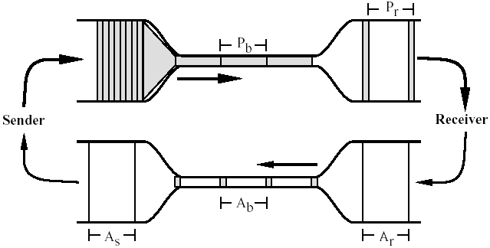
Window-based Congestion Control
Window-based congestion control is self-clocking: considers flow conservation, and adjusts to RTT variation automatically.
Hence, for better safety, more designs use window-based design.

Slide 79
Mapping A(M)I-MD to Protocol
Question to look at: How do we apply the A(M)I-MD algorithm?
Notes:
Implement d(t): loss/delay
Adjust window size
b_D: exponential backoff timeout after window size is 1

Slide 80
Outline
Admin and recap
Setting timeout
Transport congestion control
what is congestion (cost of congestion)
basic congestion control alg.
TCP/reno congestion control

Slide 81
TCP Congestion Control
Closed-loop, end-to-end, window-based congestion control
Designed by Van Jacobson in late 1980s, based on the AIMD alg. of Dah-Ming Chu and Raj Jain
Worked in a large range of bandwidth values: the bandwidth of the Internet has increased by more than 200,000 times
Many versions
TCP/Tahoe: this is a less optimized version
TCP/Reno: many OSs today implement Reno type congestion control
TCP/Vegas: not currently used
For more details: see TCP/IP illustrated; or read http://lxr.linux.no/source/net/ipv4/tcp_input.c for linux implementation

Slide 82
Basic Structure
Two “phases”
MI: slow-start
AIMD: congestion avoidance
Important variables:
cwnd: congestion window size
ssthresh: threshold between the slow-start phase and the congestion avoidance phase

Slide 83
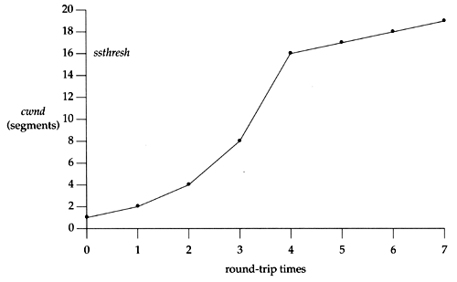
Visualization of the Two Phases

Slide 84
MI: Slow Start
Algorithm: MI
double cwnd every RTT until network congested
Goal: getting to equilibrium gradually but quickly, to get a rough estimate of the optimal of cwnd

Slide 85
MI: Slow-start
Initially:
cwnd = 1;
ssthresh = infinite (e.g., 64K);
For each newly ACKed segment:
if (cwnd < ssthresh)
/* MI: slow start*/
cwnd = cwnd + 1;
cwnd = 1
segment 1
ACK for segment 1
cwnd = 2
segment 2
segment 3
ACK for segments 2 + 3
cwnd = 4
segment 4
segment 5
segment 6
segment 7
cwnd = 6
cwnd = 8

Slide 86
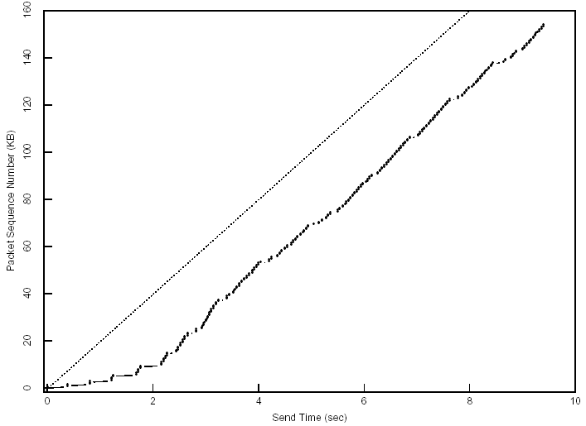
Startup Behavior with Slow-start
See [Jac89]

Slide 87
AIMD: Congestion Avoidance
Algorithm: AIMD
increases window by 1 per round-trip time (how?)
cuts window size
to half when detecting congestion by 3DUP
to 1 if timeout
if already timeout, doubles timeout
Goal: Maintains equilibrium and reacts around equilibrium

Slide 88
TCP/Reno Full Alg
Initially:
cwnd = 1;
ssthresh = infinite (e.g., 64K);
For each newly ACKed segment:
if (cwnd < ssthresh) // slow start: MI
cwnd = cwnd + 1;
else
// congestion avoidance; AI cwnd += 1/cwnd;
Triple-duplicate ACKs:
// MD
cwnd = ssthresh = cwnd/2;
Timeout:
ssthresh = cwnd/2; // reset
cwnd = 1;
(if already timed out, double timeout value; this is called exponential backoff)

